Slide 1
Geometry Cleanup on a Wheel Rim Geometry
COMSOL

Slide 2
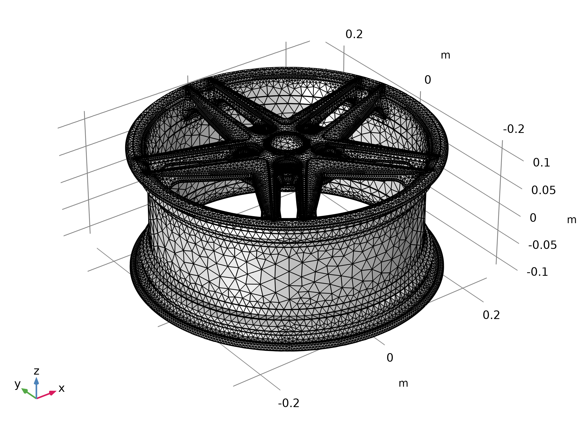
Model Definition
[[Placeholder presentation used for setting up the test suite.]]
Mesh 1

