Slide 1
Thin Layer Interfaces
COMSOL

Slide 2
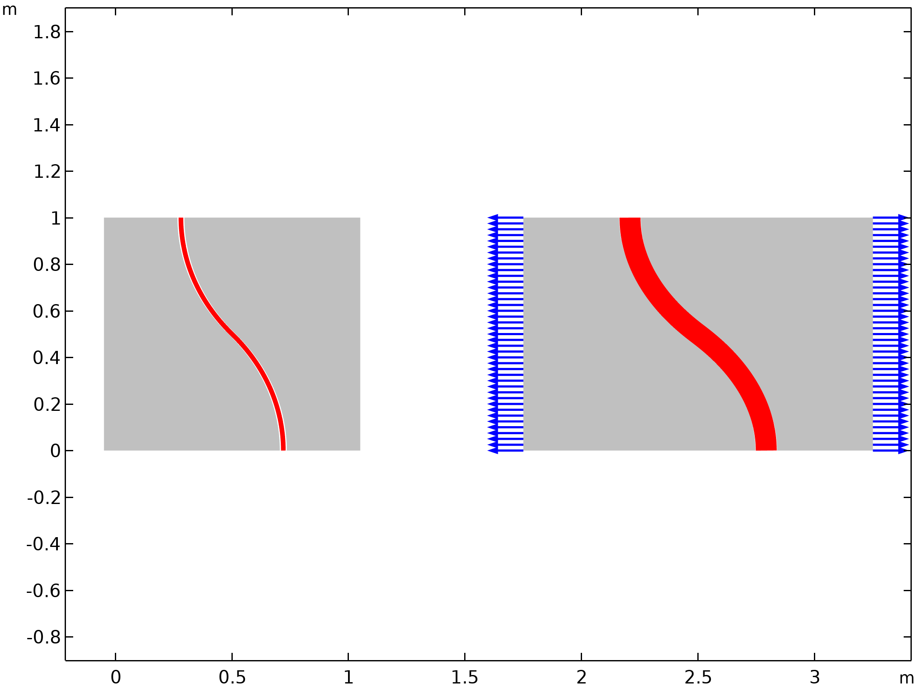
Background and Motivation
A layers is considered thin when its thickness is small compared to other dimensions of the structures
Difficult to produce a solid mesh of acceptable quality
Thin Layer feature can be used to avoid meshing
Alternative approximations are available: solid, membrane and spring
Continuity of the displacement and stress fields depends on the layer approximation and material properties

Slide 3
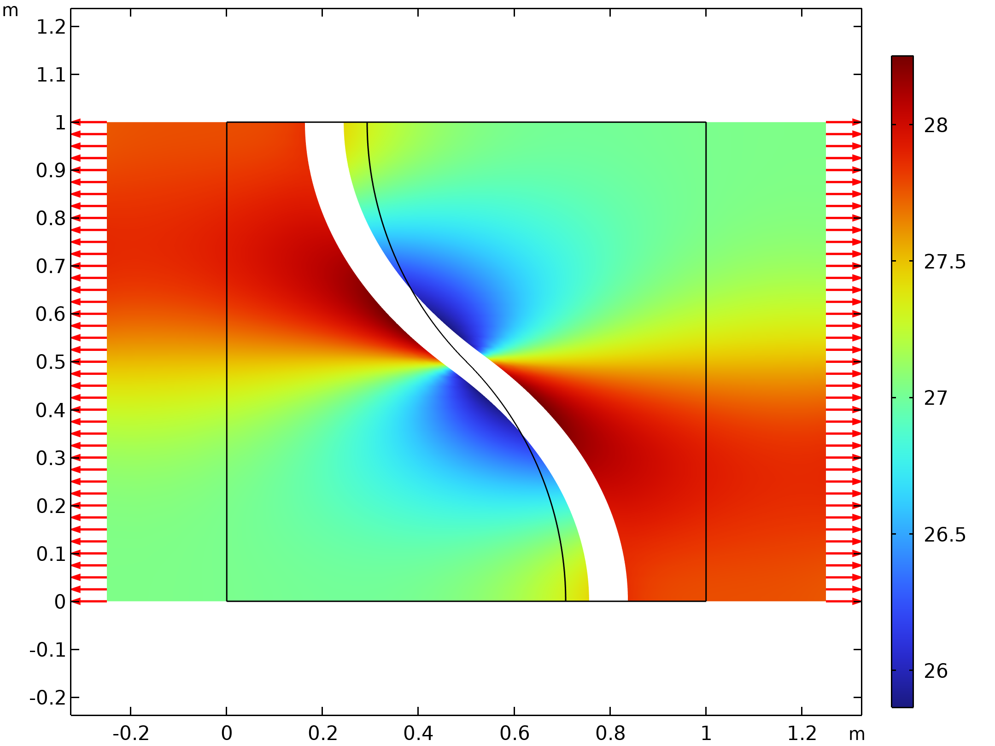

Solid approximation
Continuity of displacement is not enforced
Continuity of stress is not enforced
Solid approximation

Slide 4
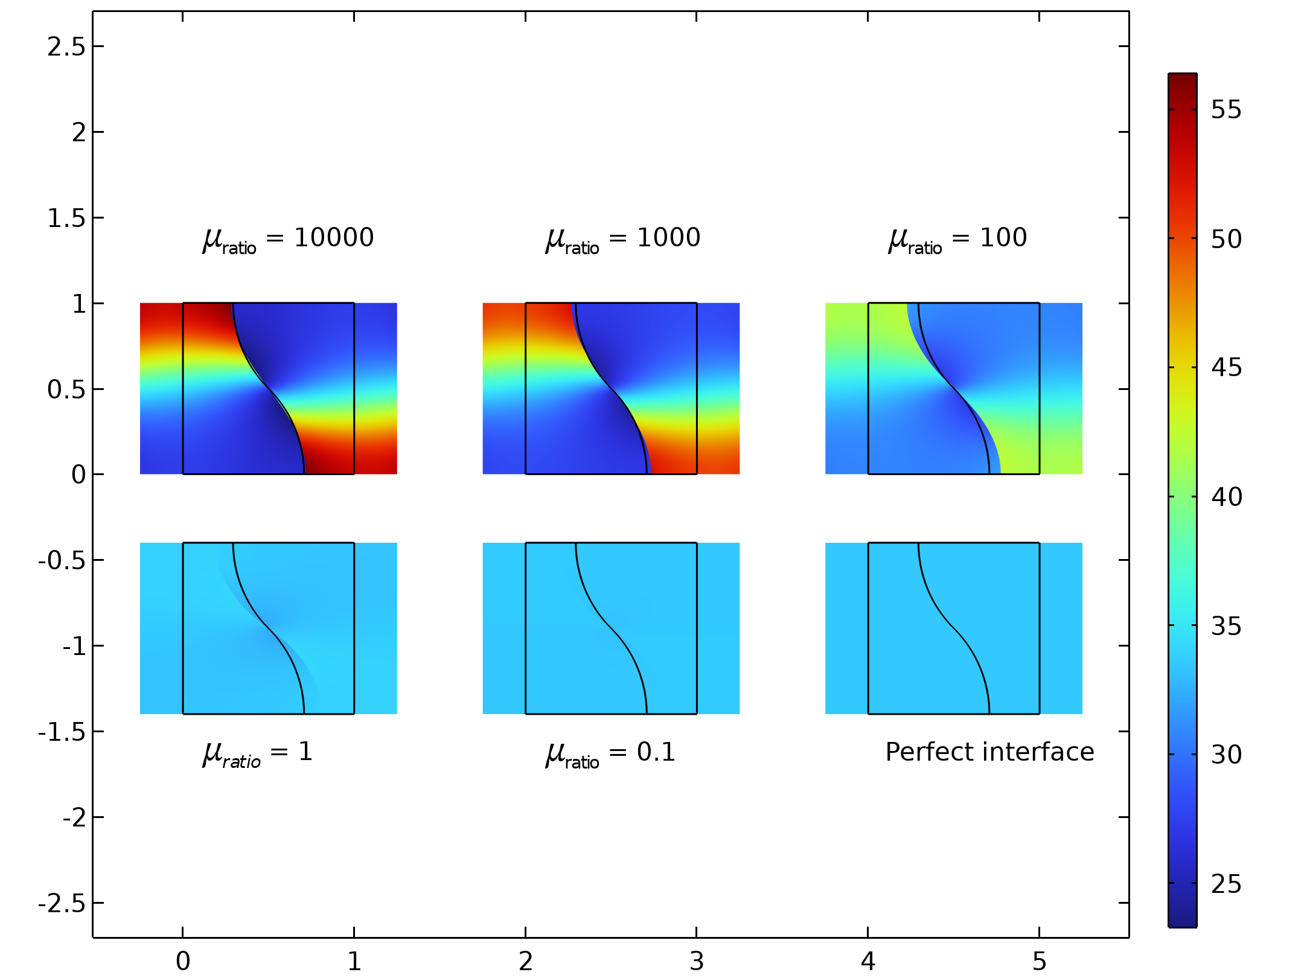
Membrane approximation
Continuity of displacement is enforced
Continuity of stress is not enforced
Converges to a perfect interface for low values of the interface shear modulus.
Transition from membrane approximation to perfect interface

Slide 5
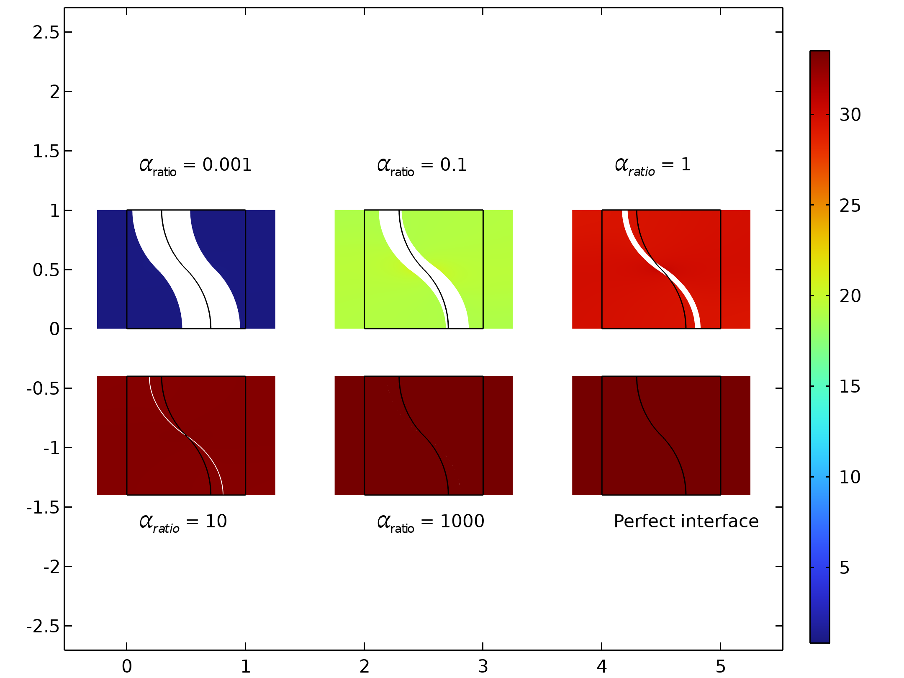

Spring approximation
Continuity of displacement is not enforced
Converges to a perfect interface for high values of spring stiffness
Transition from spring approximation to perfect interface

