Slide 1
Ion Range Benchmark
COMSOL

Slide 2
Introduction
When ions strike the surface of a solid material at extremely high energy, they may
penetrate a significant distance into the target material or even pass through it
The exchange of energy between the incident ions and atoms within the target material forms
the basis of a class of interactions known broadly as Single Event Effects (SEEs)
In harsh radiation environments, SEEs can cause a variety of undesirable phenomena in sensitive electronic equipment, ranging from soft errors such as bit flips to hard/ permanent problems such as single event latchup or burnout
For this reason, understanding of SEEs is vital when designing electronic devices for harsh radiation environments such as outer space

Slide 3
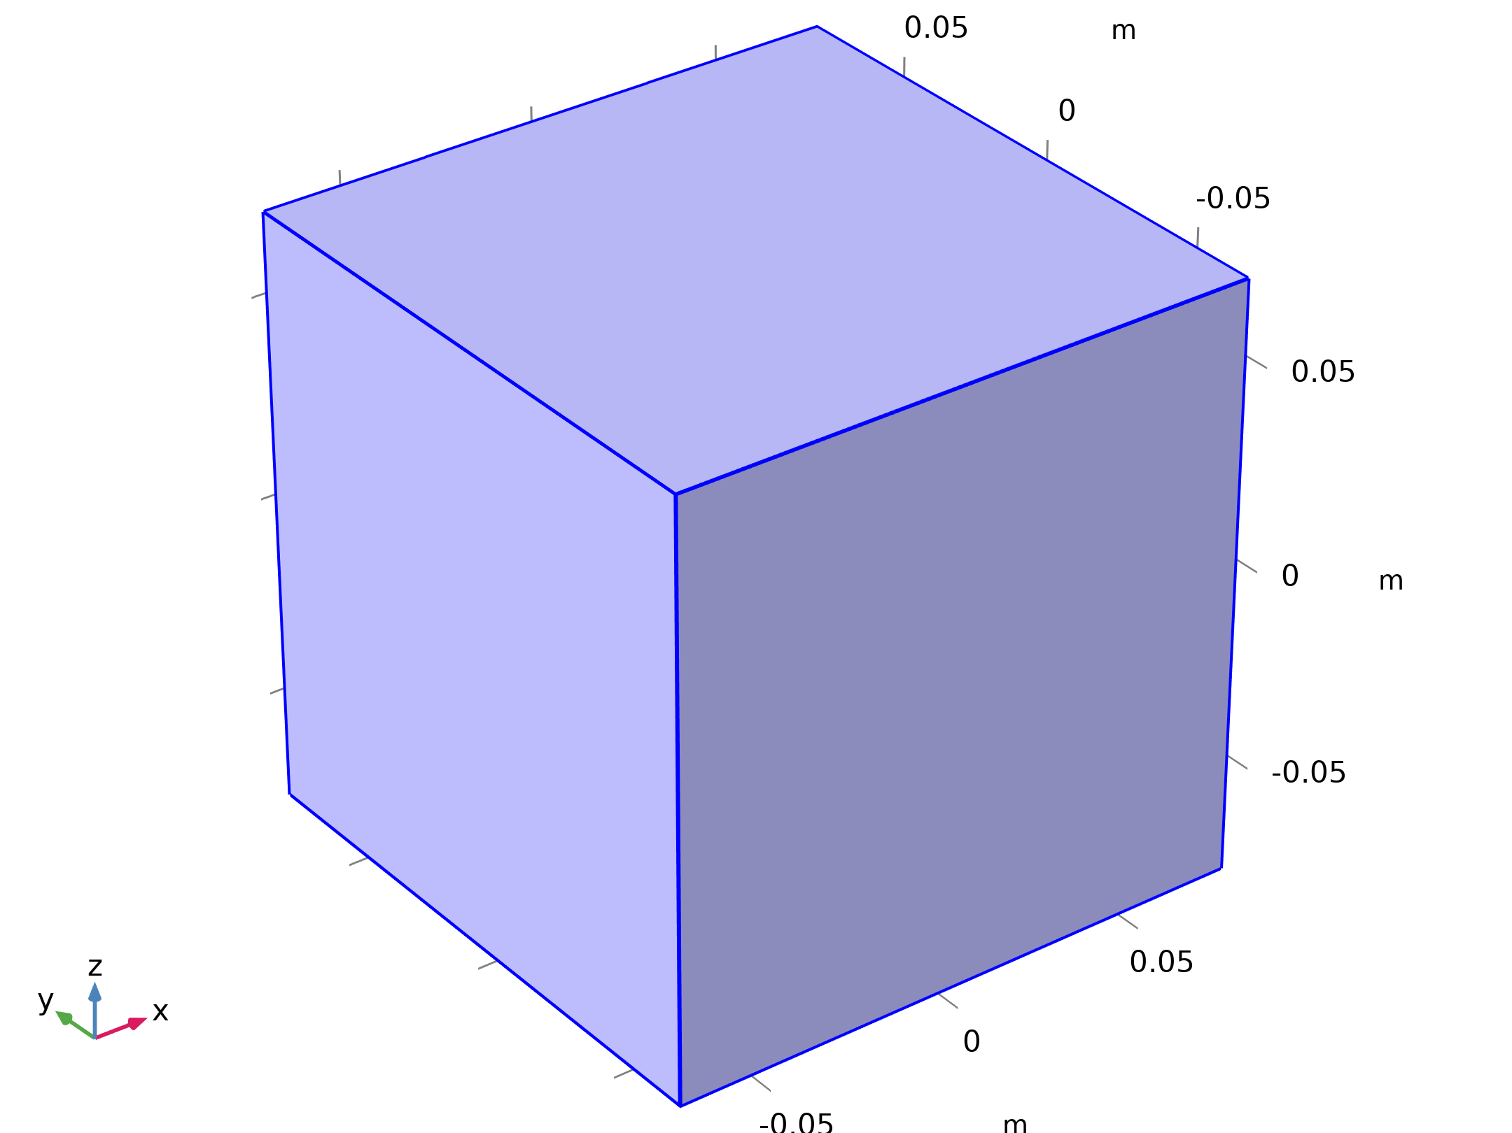
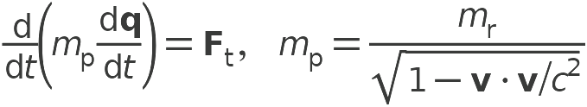
Model Definition
Charged Particle Tracing

Slide 4
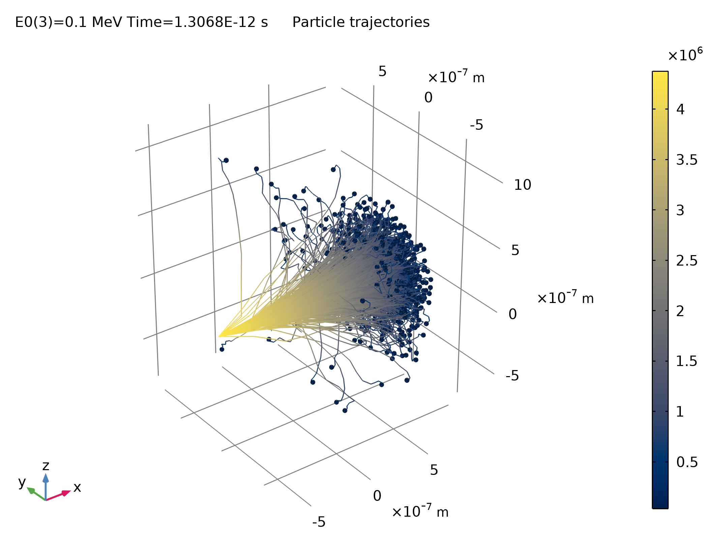
Results
The particle trajectories are computed for initial energy values ranging from 1 keV to 100 MeV
In general, as the energy increases, the particles move in more linear trajectories as their deceleration is dominated by ionization loss
At lower initial energy values, the ion trajectories are dominated by nuclear interactions and the ions tend to move in random directions
The figure shows a typical plot of the ion trajectories
Trajectories of 0.1 MeV protons in silicon. The changes in direction are due to collisions with target nuclei. The continuous decrease in energy is from ionization loss

Slide 5
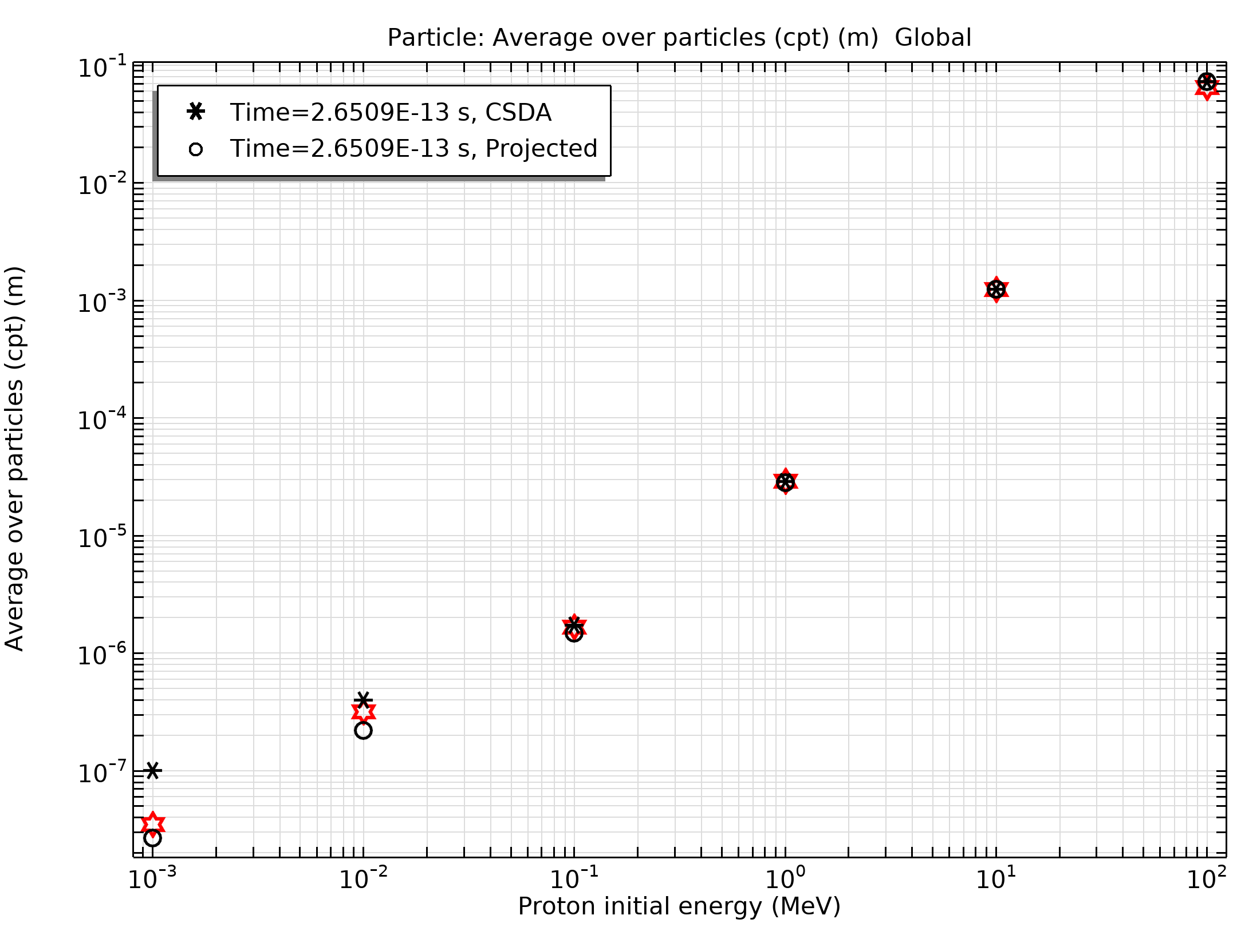
Results
The average ion range is reported in the figure
Both the CSDA range and the projected range are shown
As the initial ion energy increases, the agreement between the CSDA range and computed range improves because the decrease in ion energy is dominated by ionization losses, which cause the ions to decelerate continuously over time
Comparison of the average path length of the computed ion trajectories to the published values of the ion range. Both the CSDA range and projected range are reported

Slide 6
Results
The agreement between the CSDA range and the projected range improves as well because the ionization losses do not cause any change in the direction of ion propagation
Comparison of the average path length of the computed ion trajectories to the published values of the ion range. Both the CSDA range and projected range are reported

