Slide 1
Coupled Analysis of Flow and Stress in a Pipe
COMSOL

Slide 2
Introduction
In this tutorial model, the flow in a pipe with a bend is computed using the Pipe Flow interface
The computed fluid load is used as input to a stress analysis in the Pipe Mechanics interface
Gravity loads from the pipe and fluid are also taken into account

Slide 3
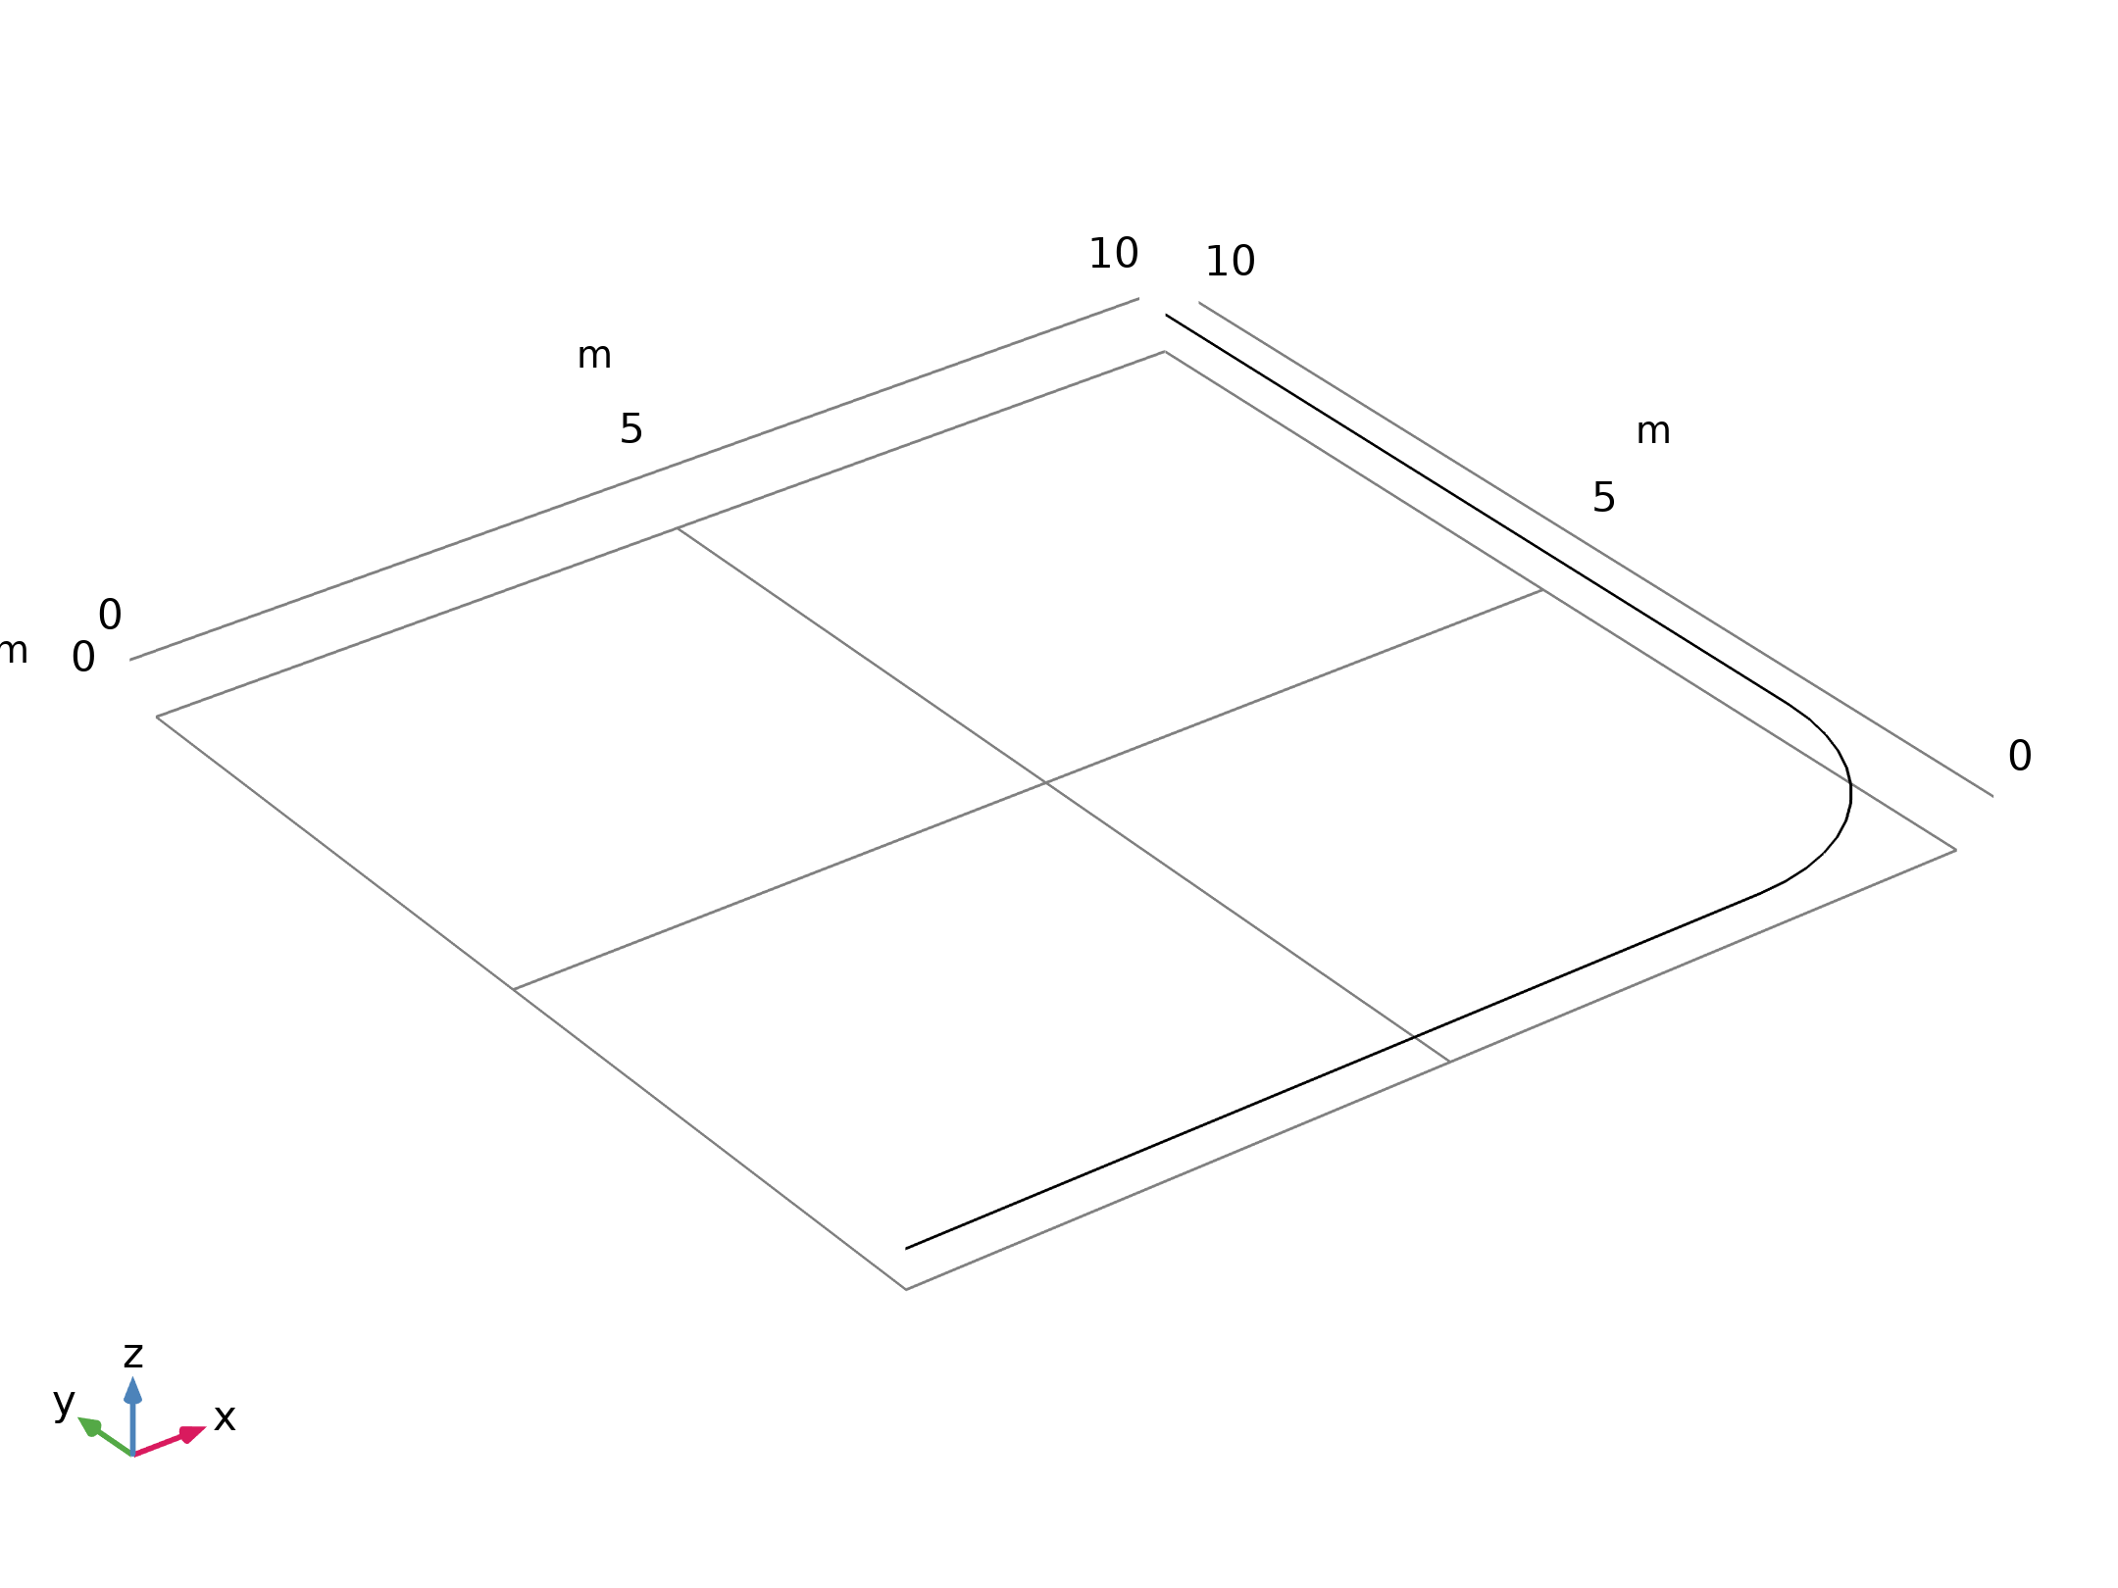
Model Definition
A circular pipe with outer diameter do = 10 cm consists of two straight 8 m long sections that are connected by a smooth 90 degree circular bend with a radius r_{b} = 2 m; see the figure
Geometry 1

Slide 4
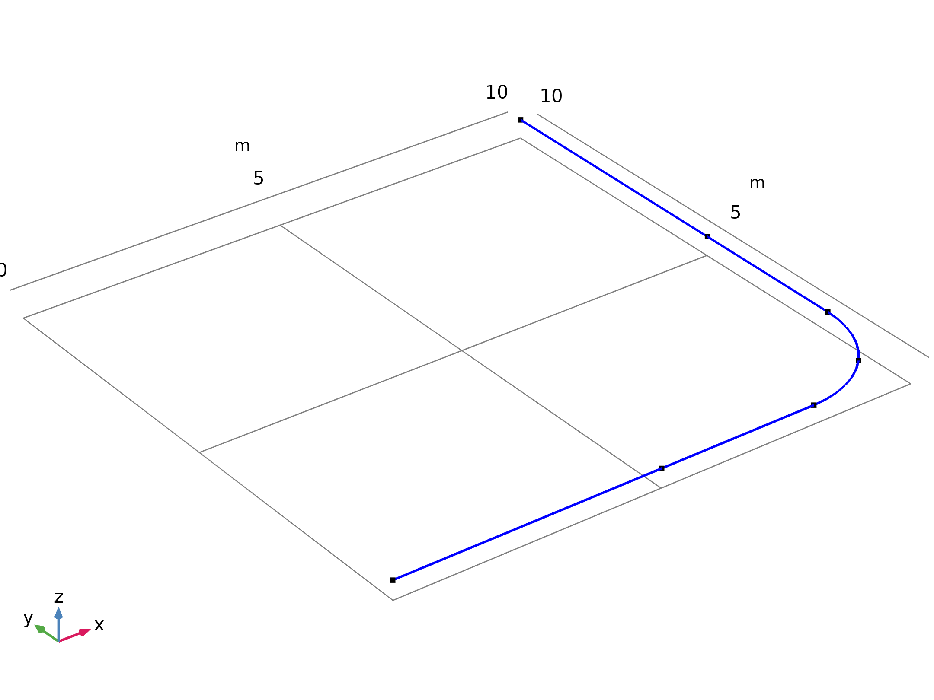
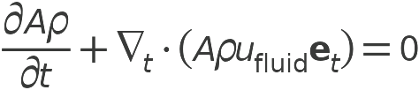
Model Definition
Pipe Flow

Slide 5

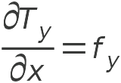
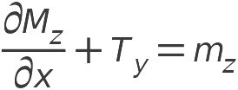
Model Definition
Pipe Mechanics

Slide 6
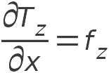
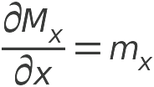
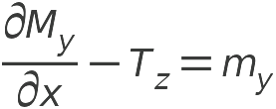
Model Definition
Pipe Mechanics

Slide 7

Model Definition
Pipe Mechanics

Slide 8
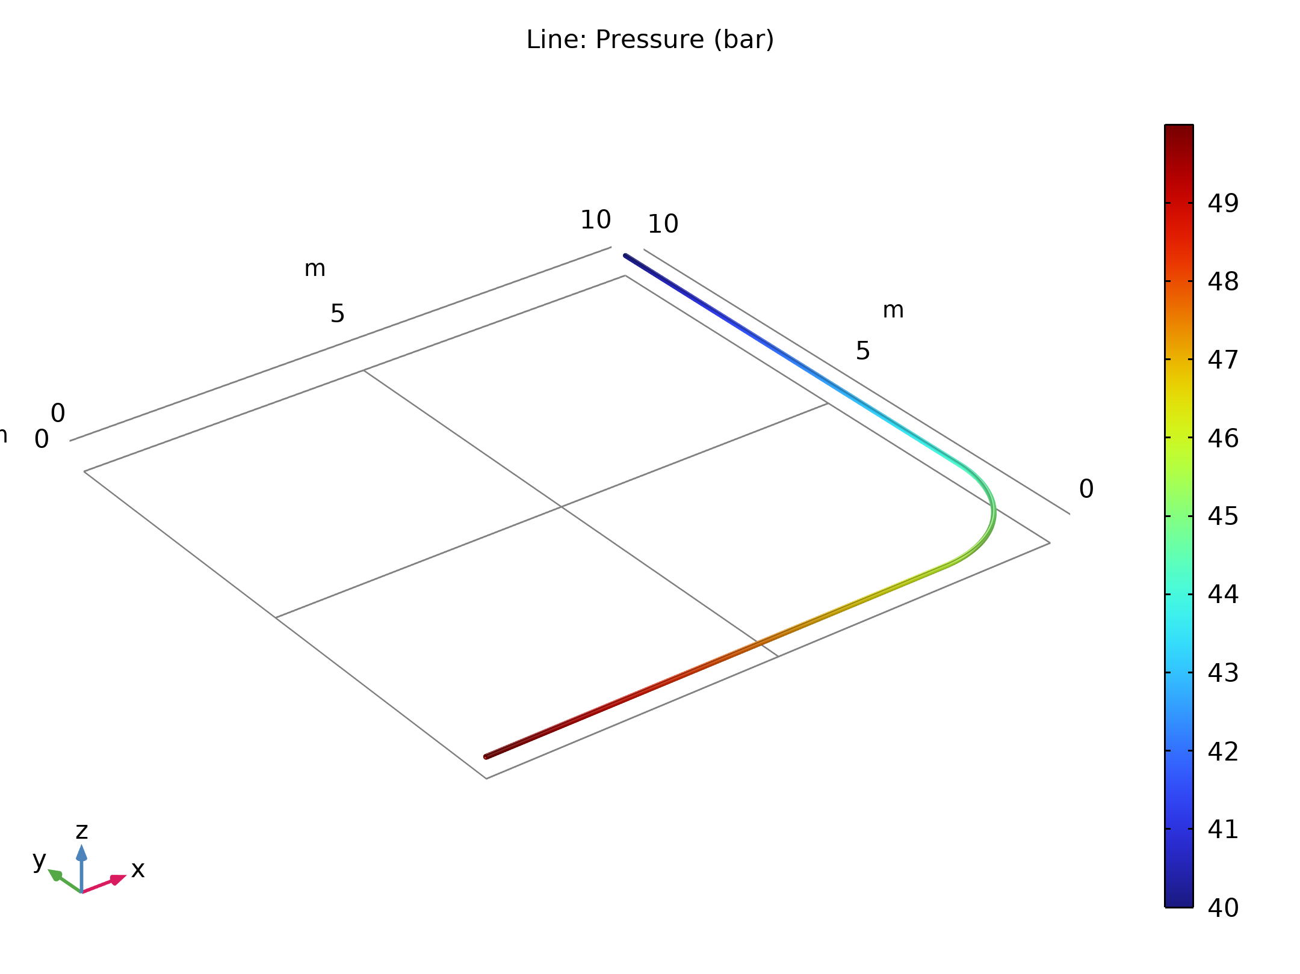
Results
The figure shows the pressure distribution inside the pipe
The flow has a uniform velocity around 23.8 m/s along the whole pipe, which corresponds to the Reynolds number Re = 2.2·10⁶ that indicates that the flow regime is highly turbulent
Pressure distribution

Slide 9
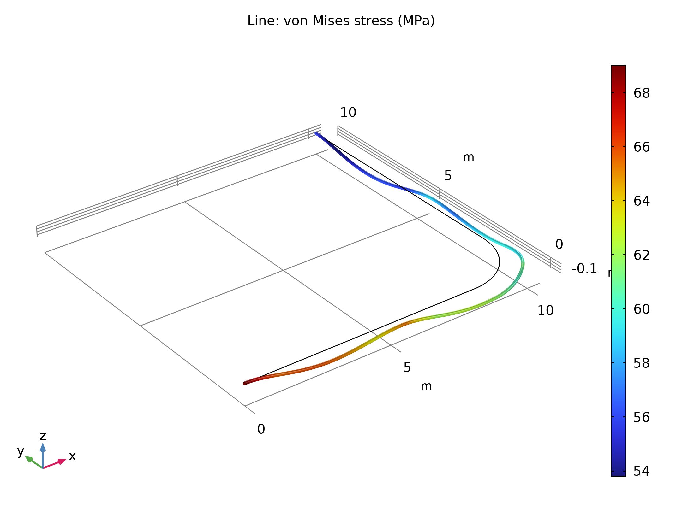
Results
The figure shows the stress distribution in the pipe walls
Due to the pressure drop in the fluid, the value is higher at the inlet than at the outlet
The pipe displacement
von Mises stress distribution along the deformed pipe.The deformation is scaled by approximately a factor of 150

Slide 10
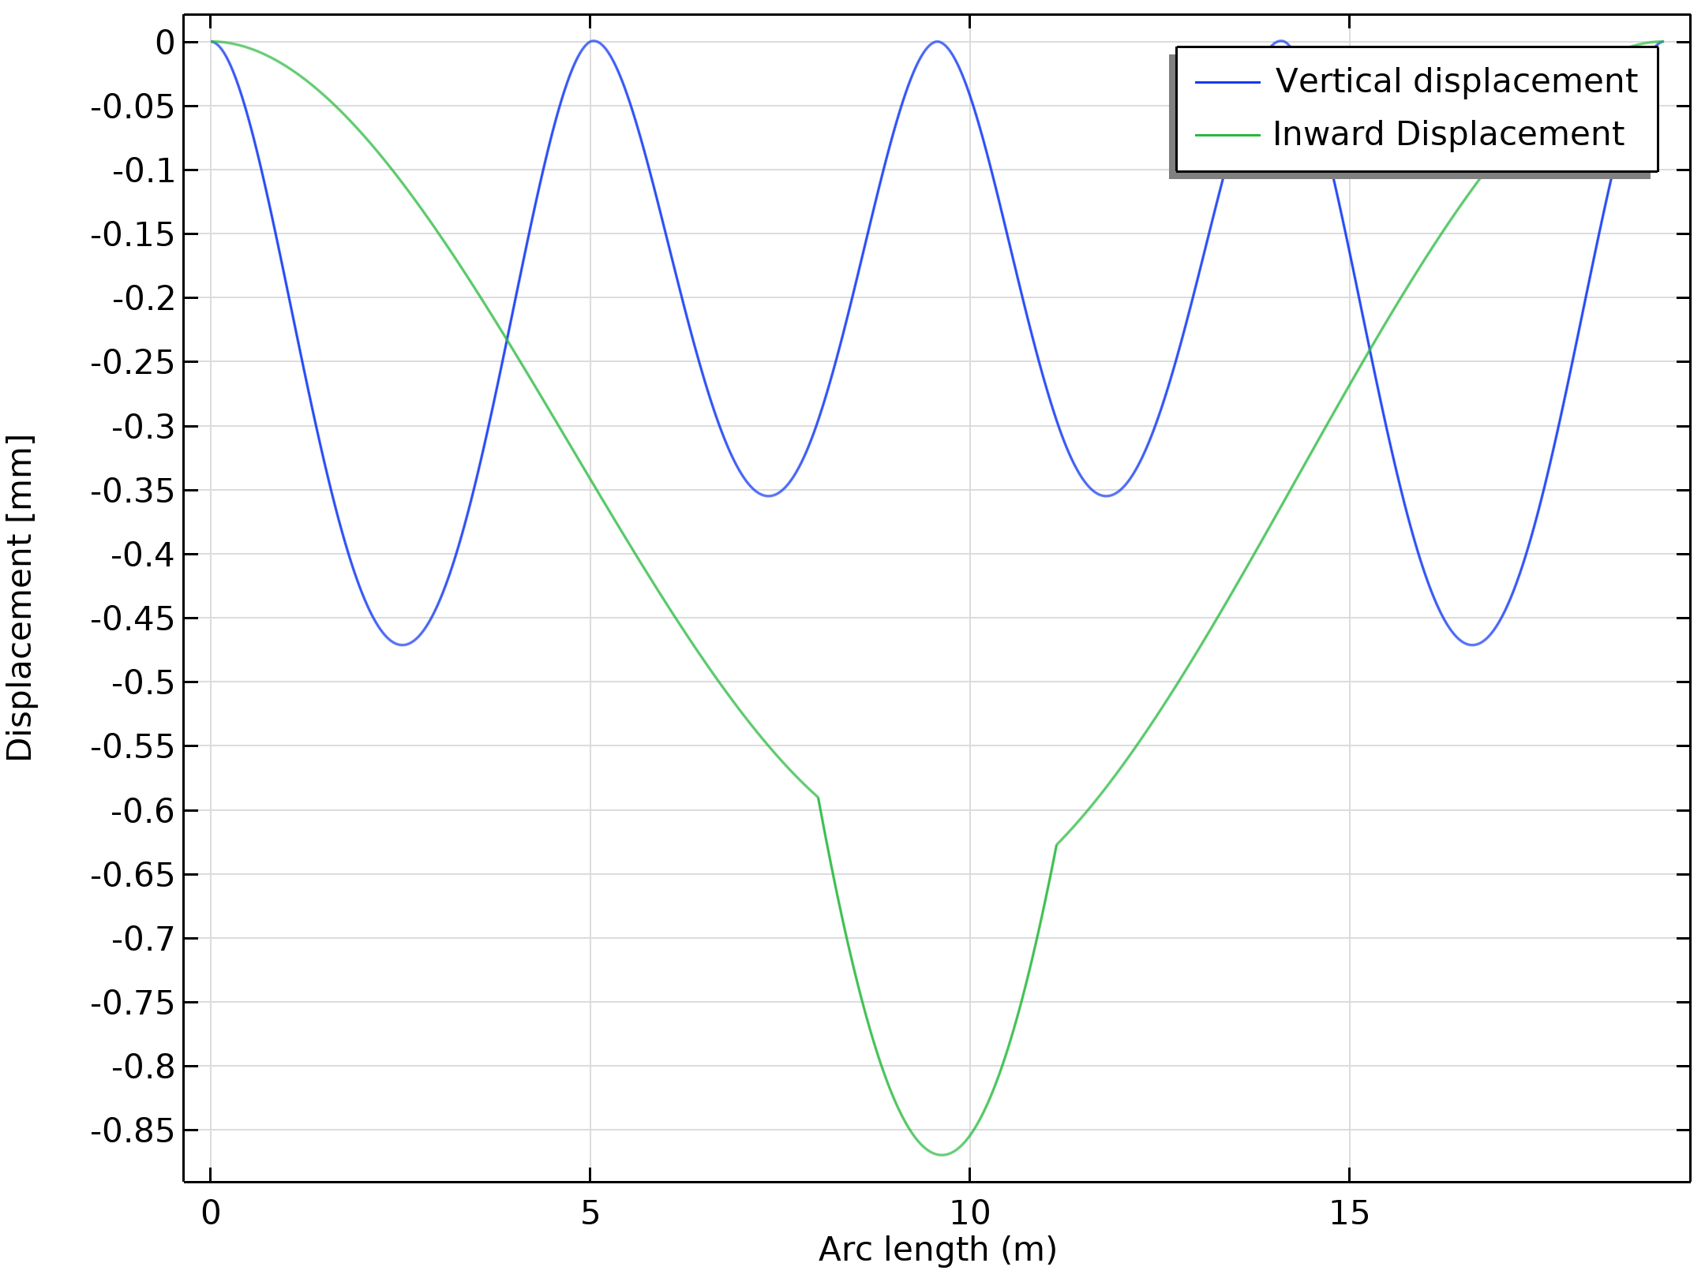
Results
The figure shows the pipe displacement components
The importance of the vertical supports is clearly visible
Pipe displacement

Slide 11
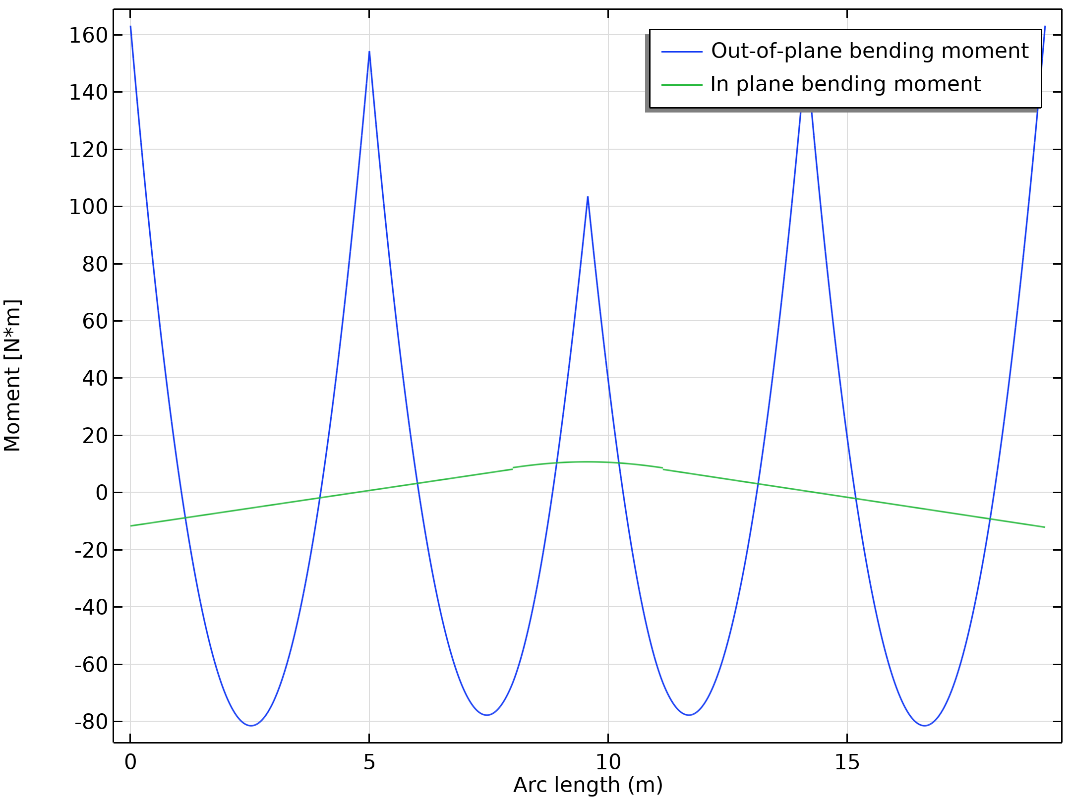
Results
The figure shows the bending moments along the pipe
Bending moment

Slide 12
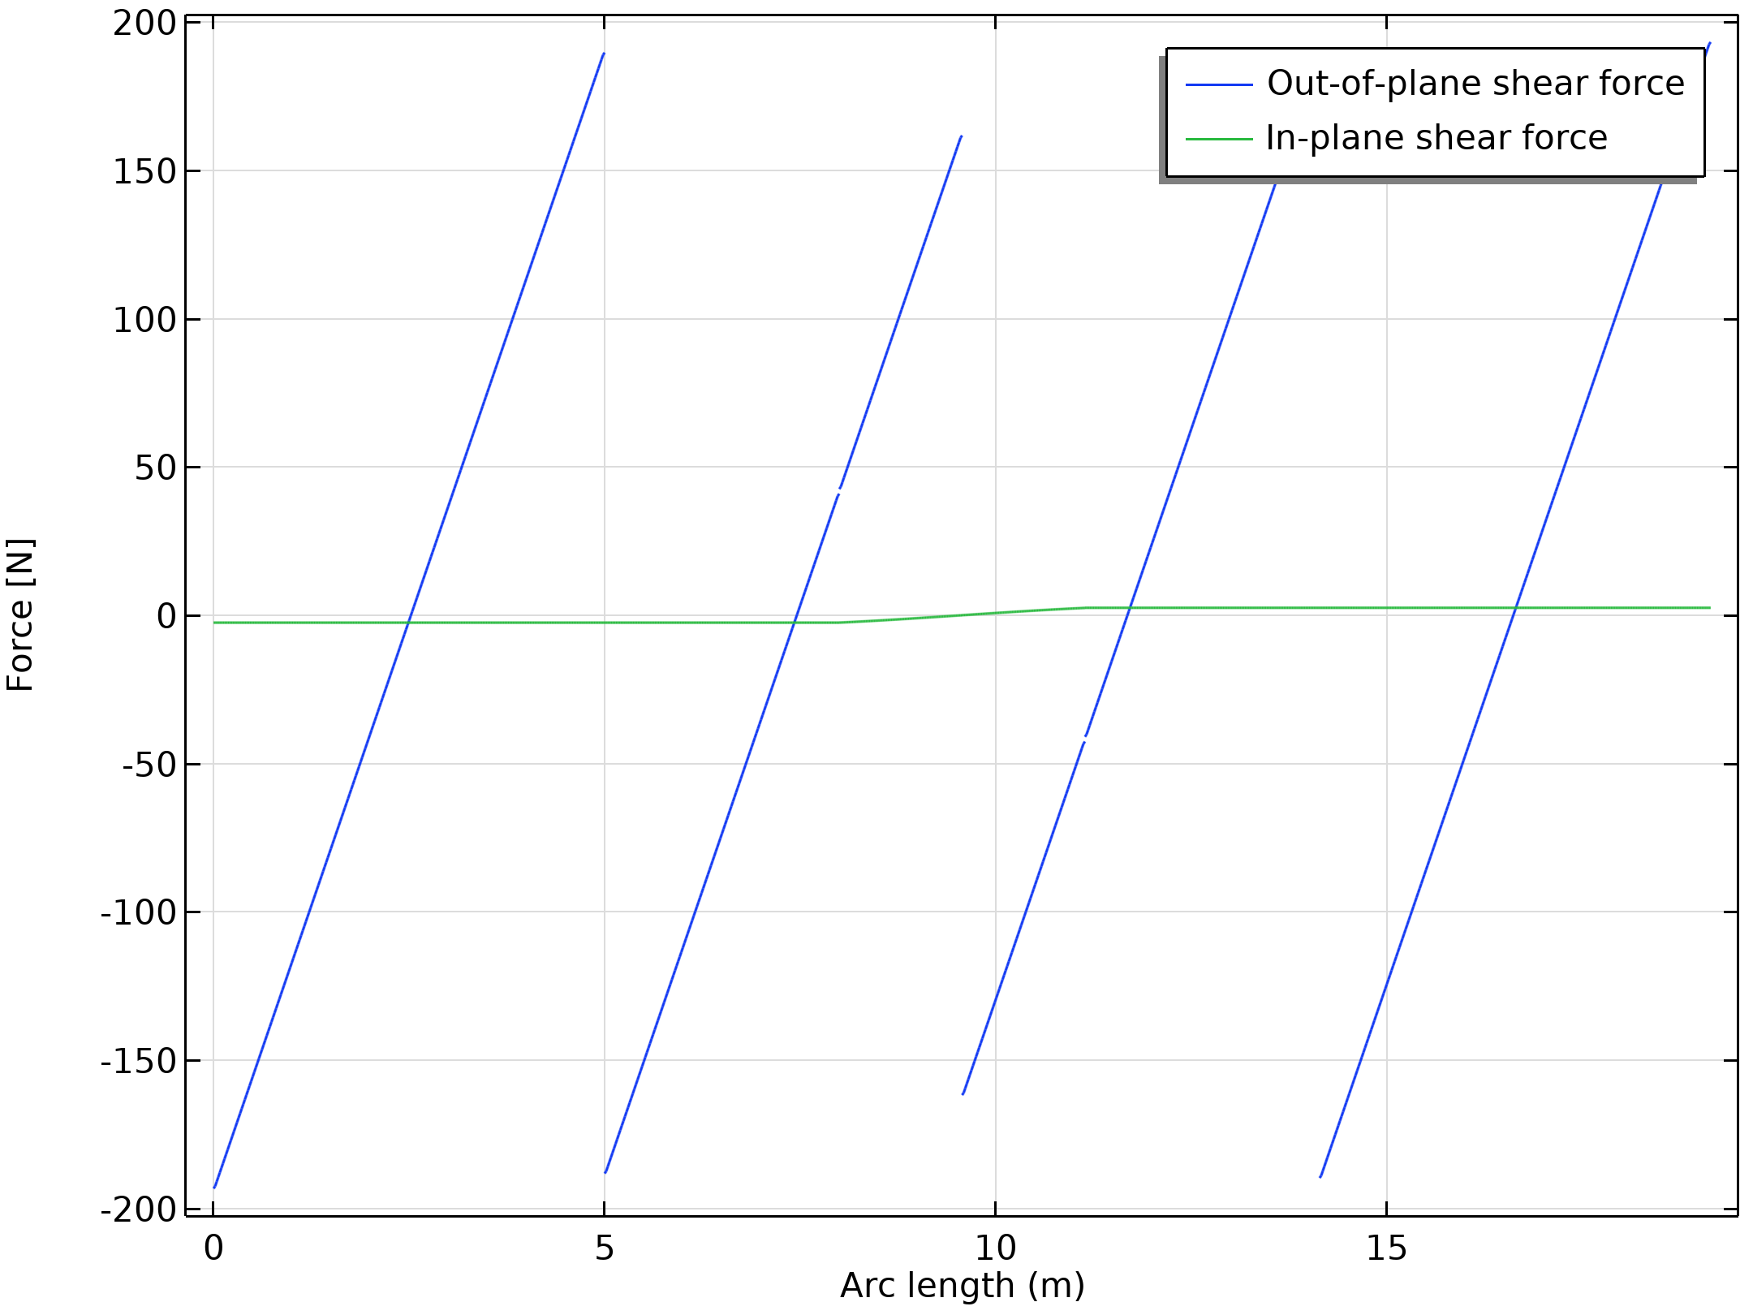
Results
The figure shows the shear forces along the pipe
Shear force

Slide 13
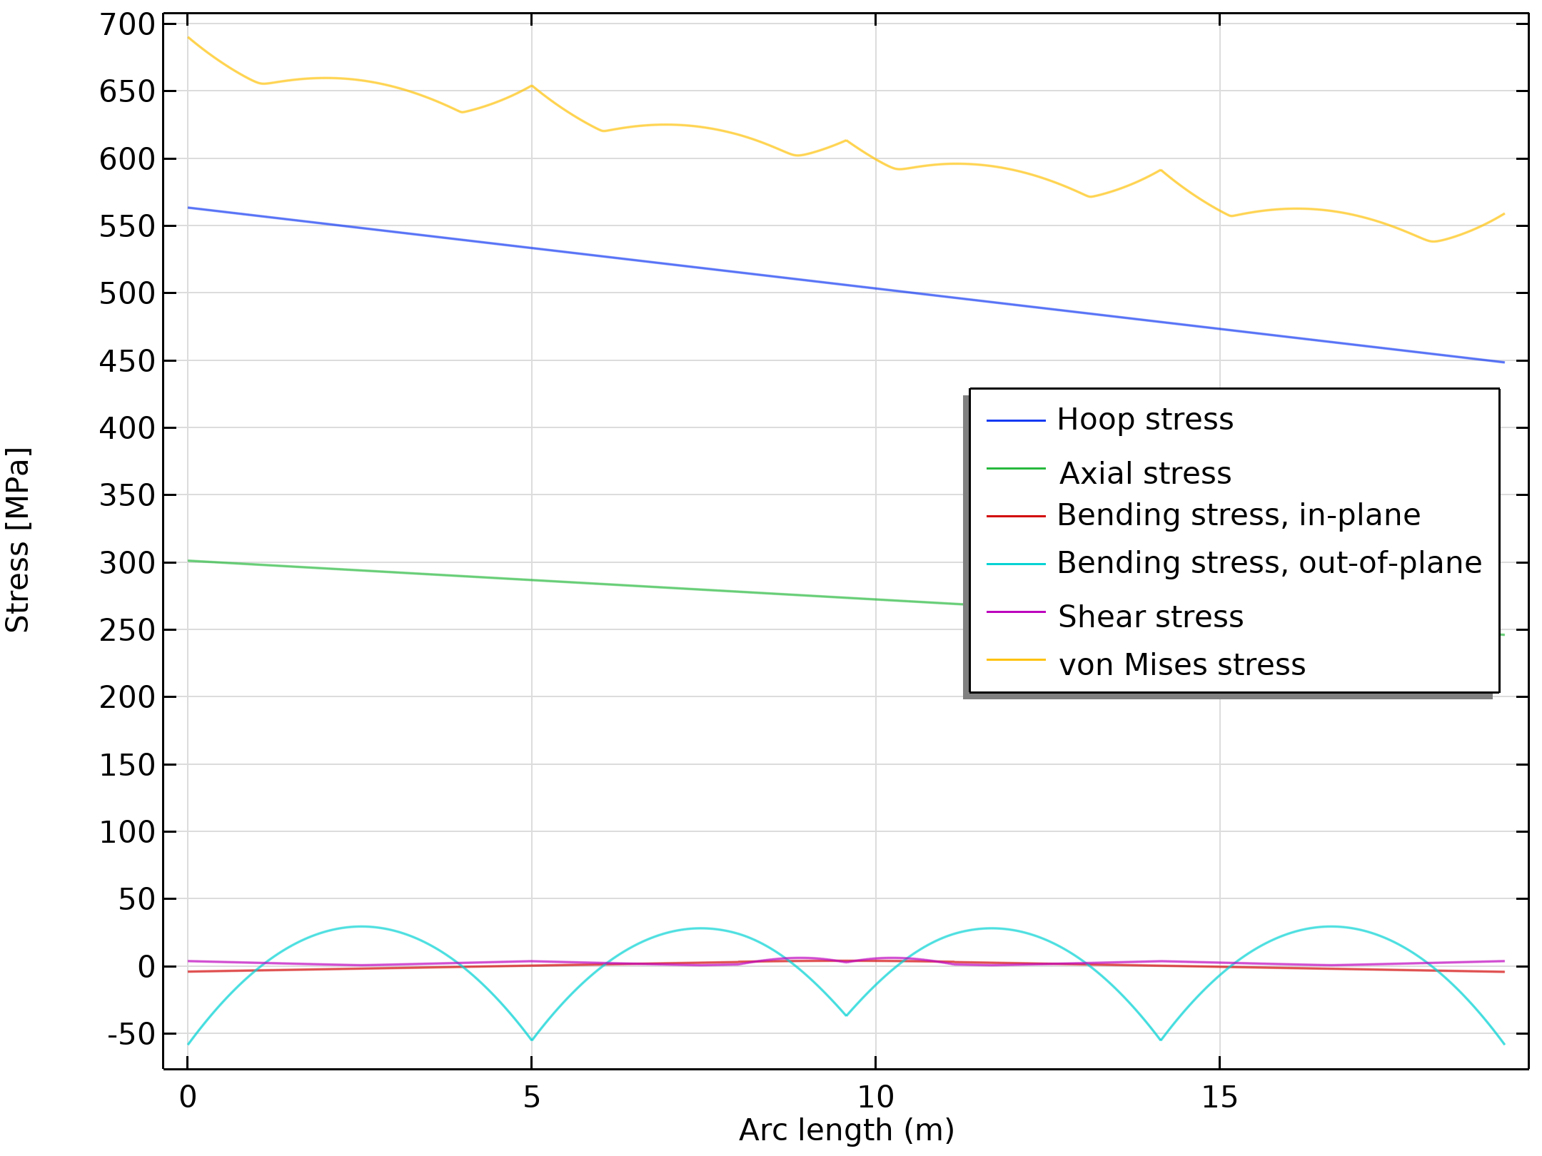
Results
The figure shows the different contributions to the total stress state
As is common in piping systems, the hoop stress caused by the internal pressure is dominant
Stress contributions

