Slide 1
Frozen Inclusion
COMSOL

Slide 2
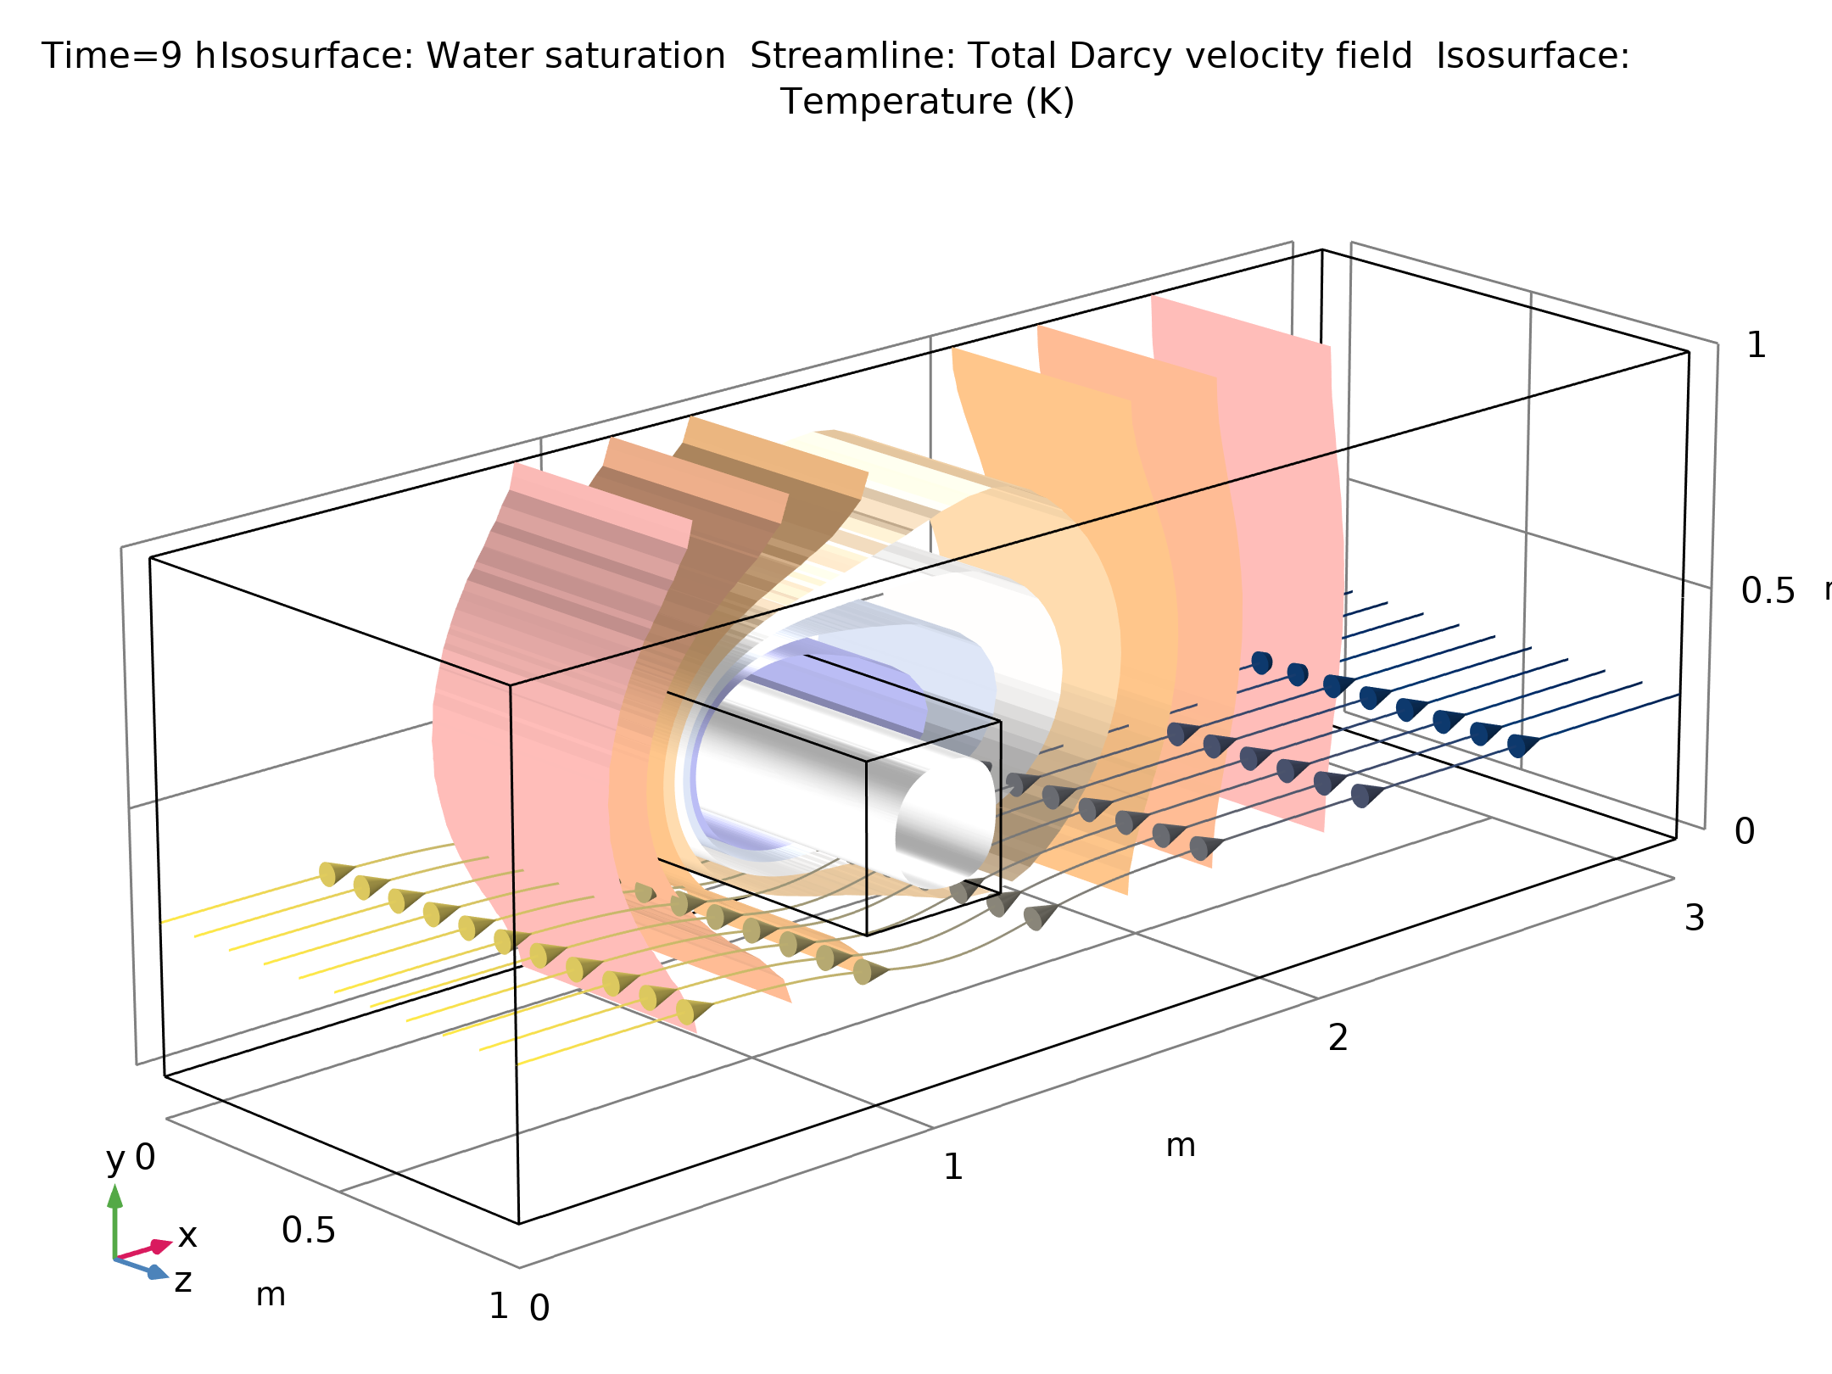
Introduction
This model represents a benchmark problem for simulating phase change in porous media which was one of the test cases within the INTERFROST project
The melting process of an ice inclusion within porous media is simulated
The model demonstrates how to couple Darcy's Law with the Heat Transfer in Porous Media interface
Reference: C. Grenier and others, “Groundwater flow and heat transport for systems undergoing freeze-thaw: Intercomparison of numerical simulators for 2D test cases“, Advances in Water Resources, vol. 114, pp.196-218, 2018.
3D figure of a frozen inclusion: The results show the ice block within the encompassing channel after 9h (white surface), the velocity streamlines (colors represent the hydraulic head), and the surrounding temperature (isosurfaces)

Slide 3
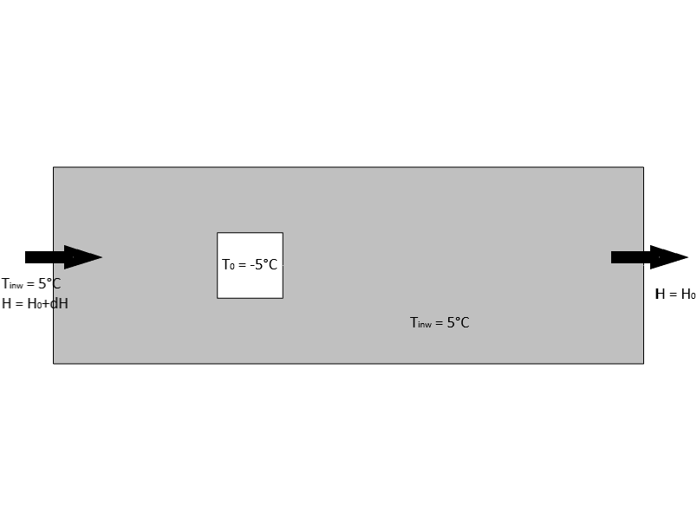
Model Setup
The flow channel is 3 meters long and 1 meter wide
The squared inclusion has a length of 33.3 cm and is centered at the coordinates x = 1 m and y = 0.5 m
The initial values and boundary conditions are illustrated in the figure
Model geometry, initial temperature distribution, and boundary conditions.

Slide 4
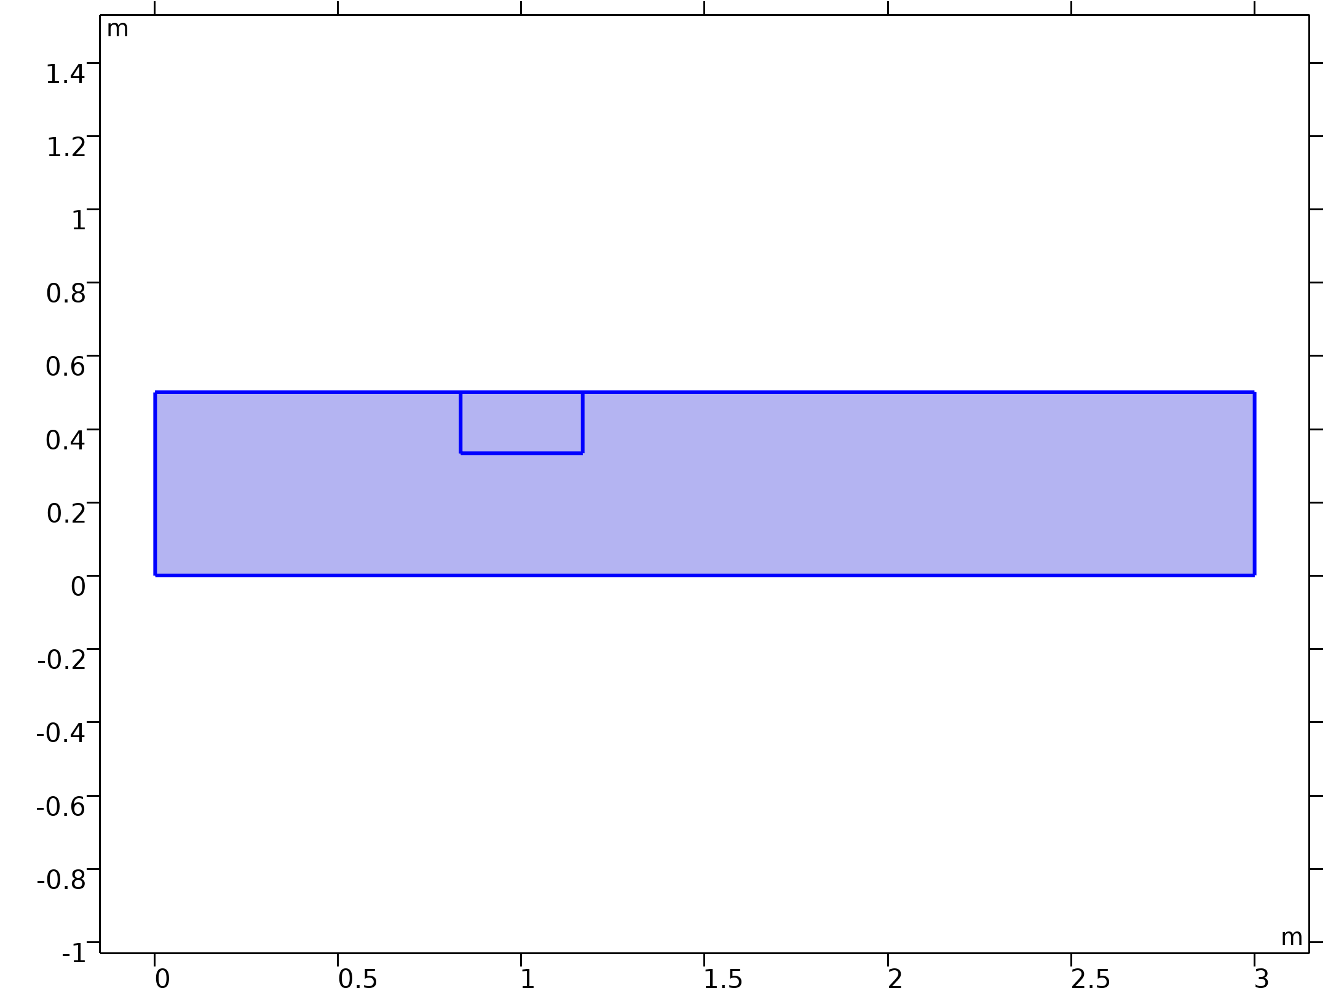


Model Equations
Darcy's Law
Darcy's Law

Slide 5

Model Equations
Heat Transfer Equations

Slide 6
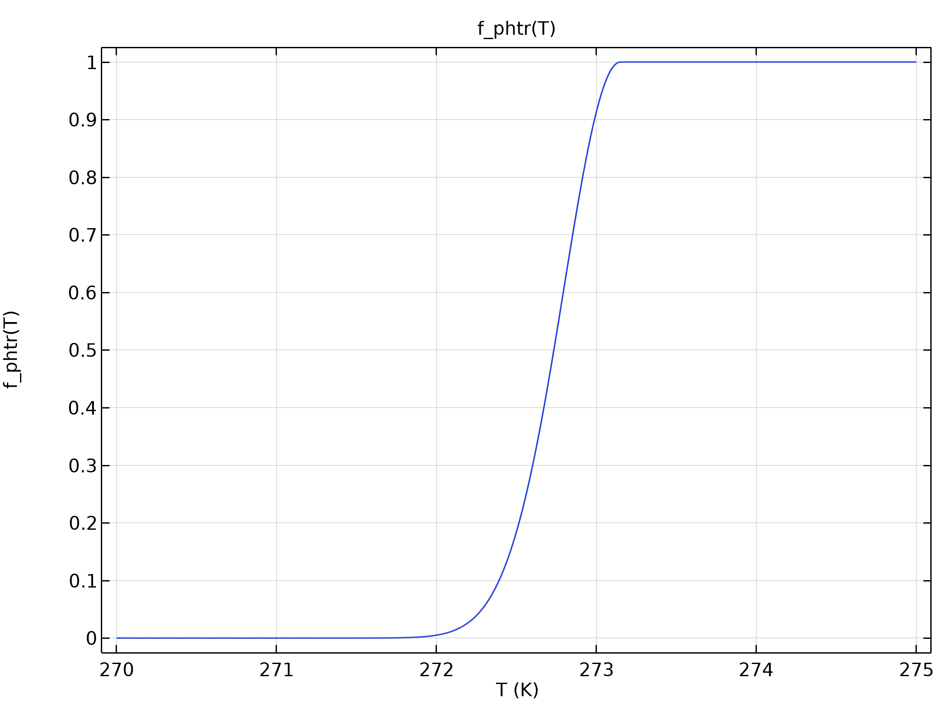
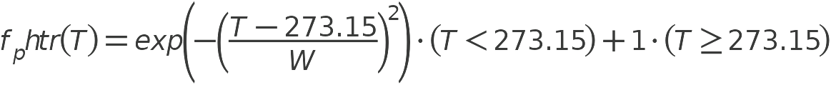
Phase Change
The user-defined phase transition function f_{phtr} (see adjacent figure) is used (with W = 0.5K)
Analytic 1

Slide 7
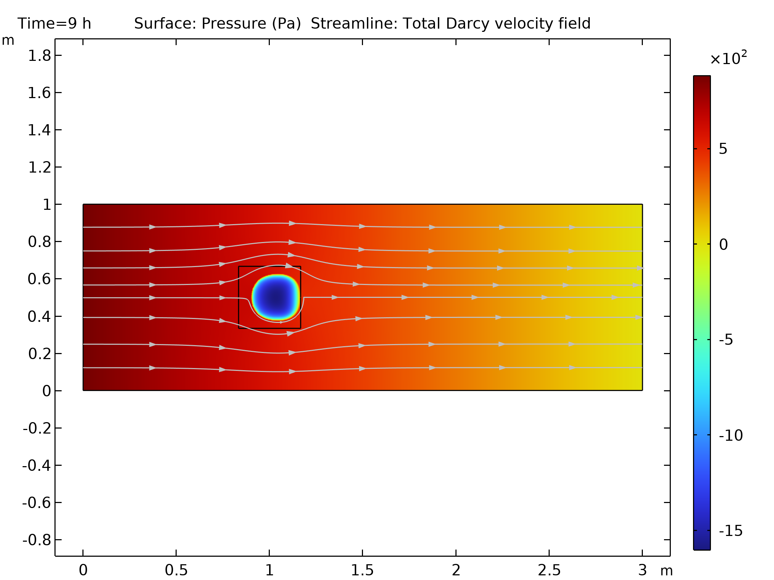
Results
Pressure and velocity field after 9 hours of simulated time
Pressure distribution (colored surface) after 9 hours when there is still some ice present in the model. The streamlines show the Darcy's velocity field.

Slide 8
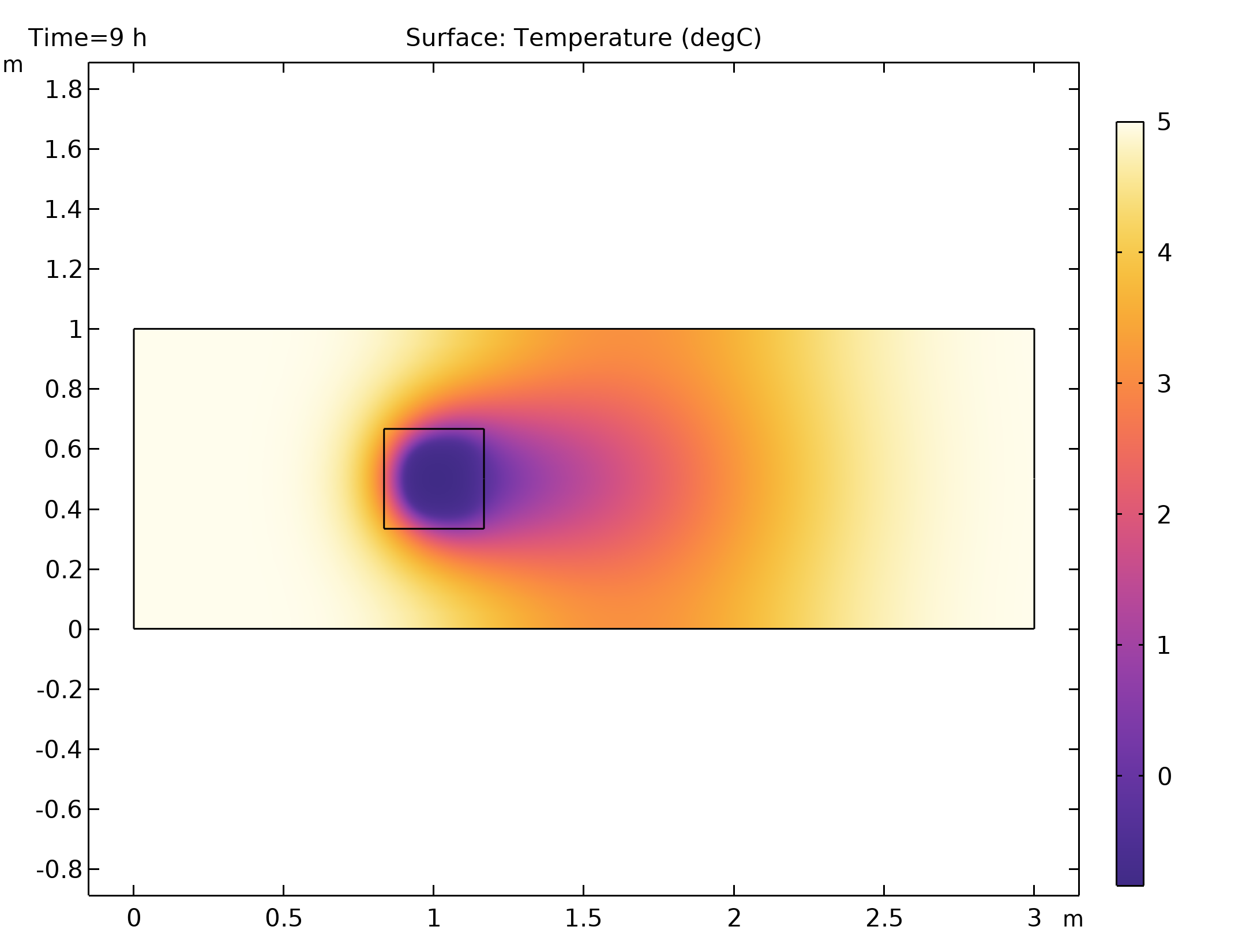
Results
Temperature distribution after 9 hours of simulated time
While the ice is melting, the cold air is advected further down the flow channel
Surface plot showing the temperature distribution after 9 hours

Slide 9
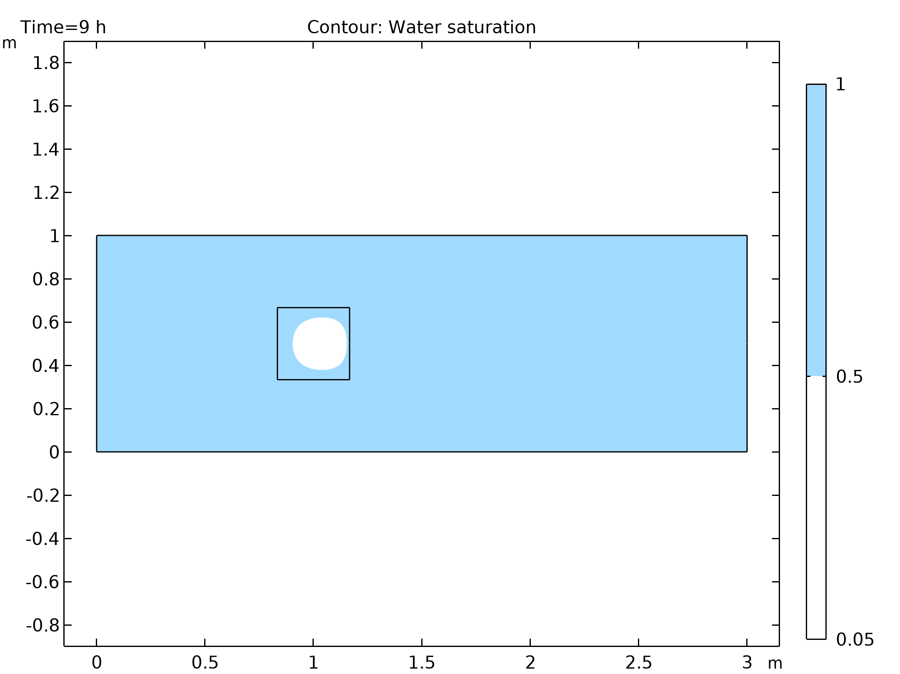
Results
The liquid water saturation after 9 hours of simulated time
The plot settings are chosen to show the areas of ice versus liquid water
Effectively, the areas with liquid water appear in blue whereas the areas of ice appear in white
The form of the remaining ice clearly shows the influence of the flow field
Surface plot showing the liquid water saturation after 9 hours.

Slide 10
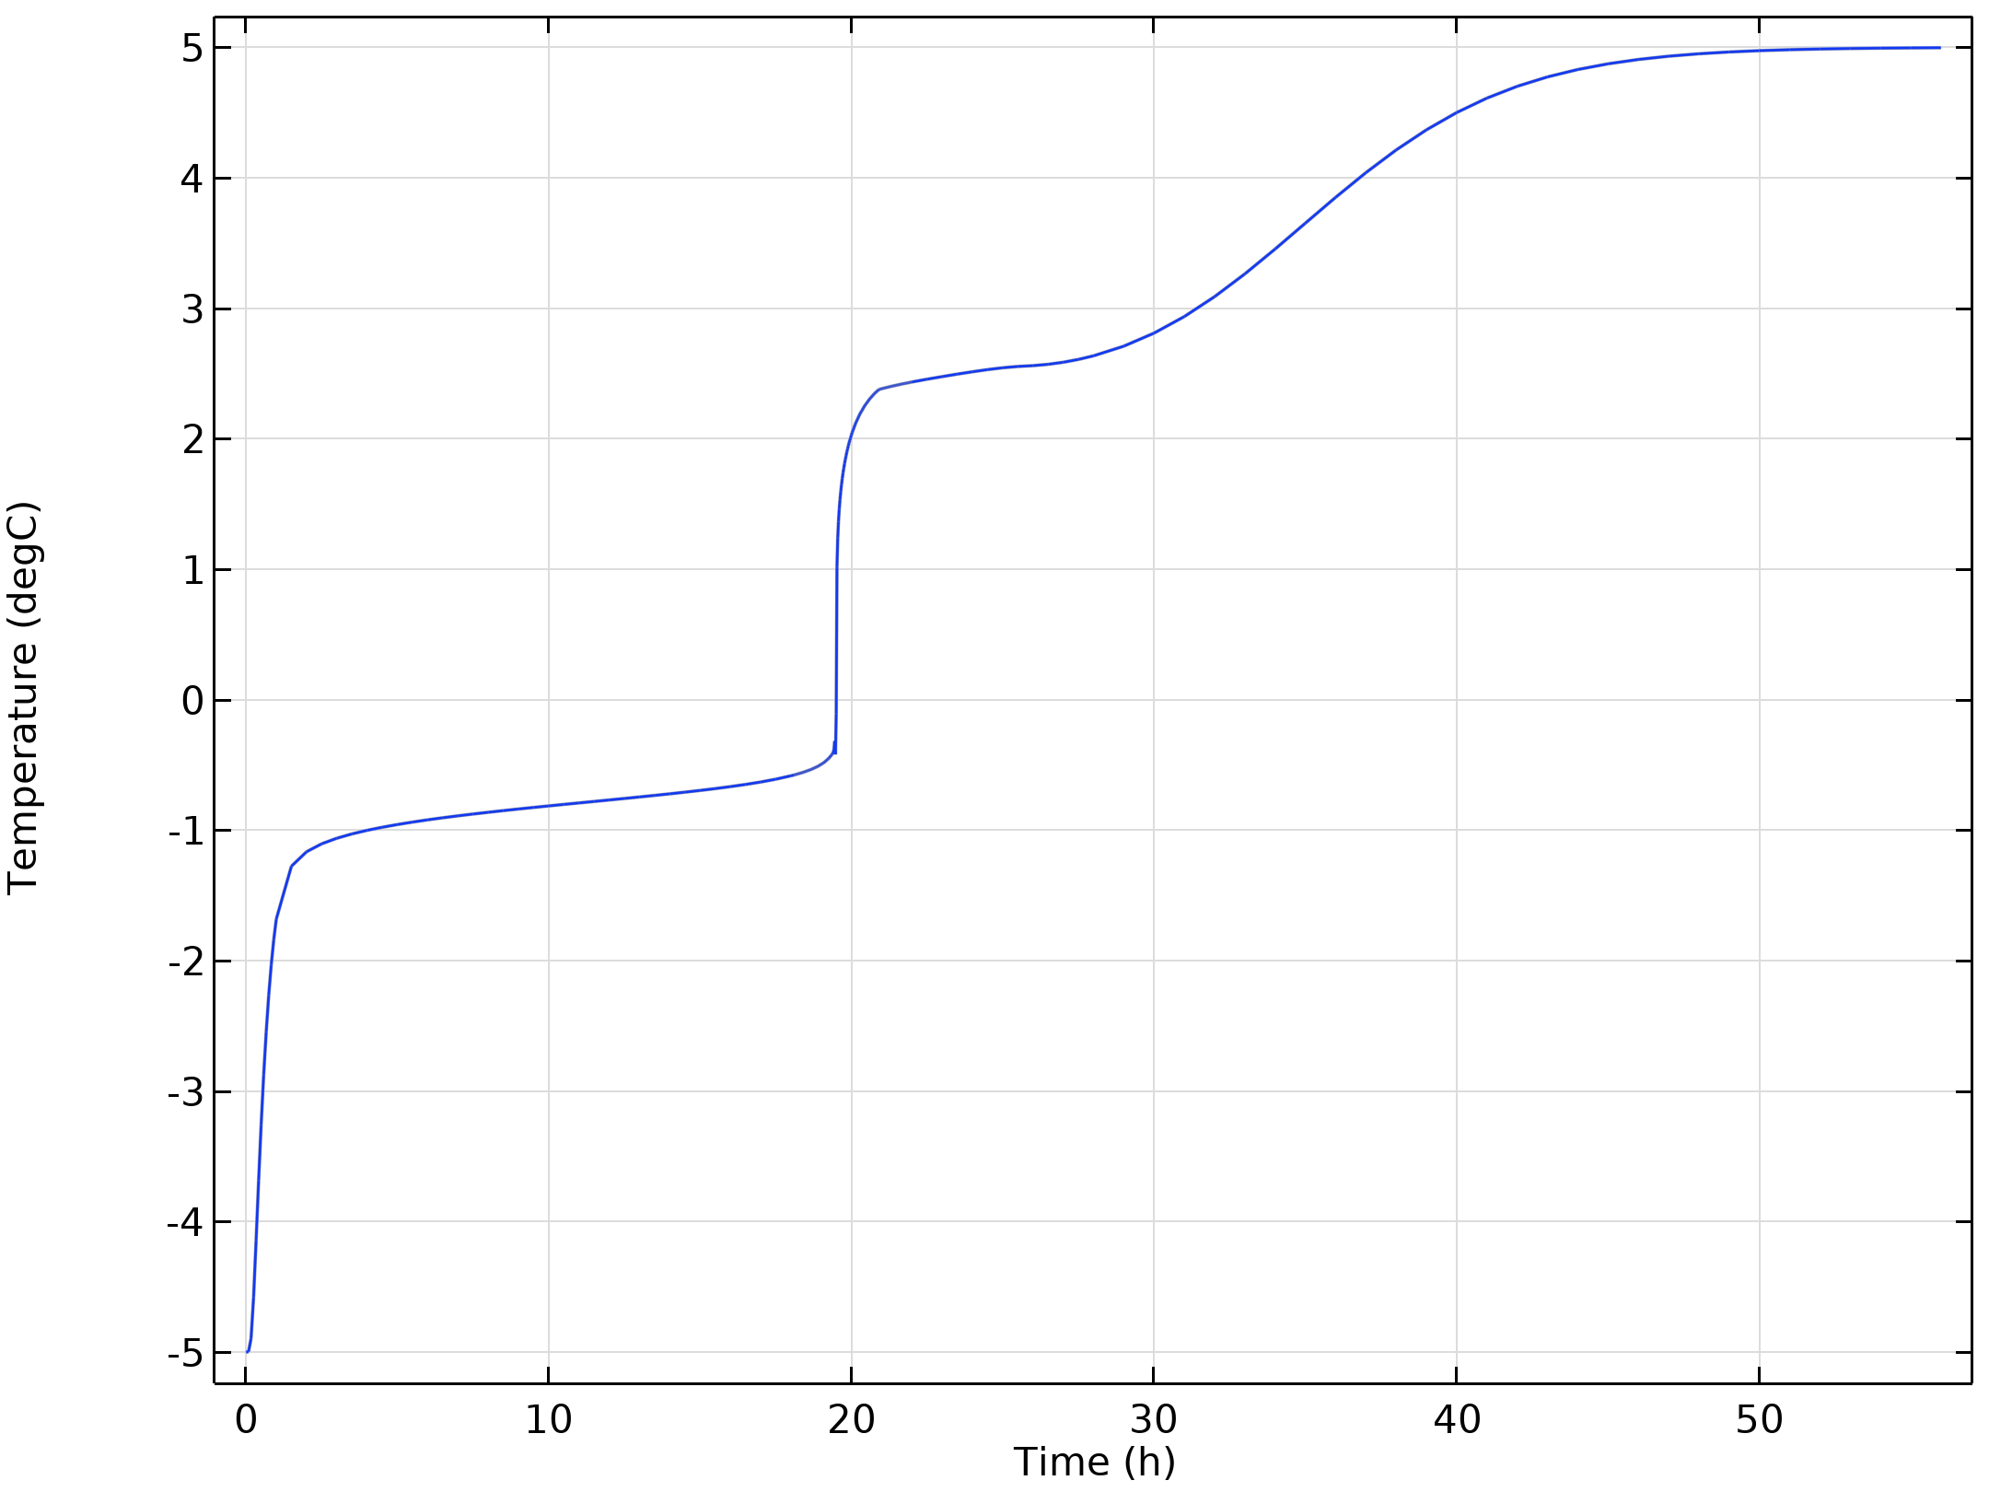
Results
In the first minutes, the frozen inclusion rapidly warms due to conductive heat loss to the surrounding water
Then, the temperature curve reaches a slowly evolving plateau between −1 and 0 °C due to the latent heat that is adsorbed during phase change
When the ice inclusion is totally molten, the temperature increase accelerates again
Finally, the flow field becomes uniform and the temperature increase slows down as the cold plume corresponding to the initial inclusion becomes mobile and moves downstream
The minimum temperature in the model domain as a function of time.

Slide 11
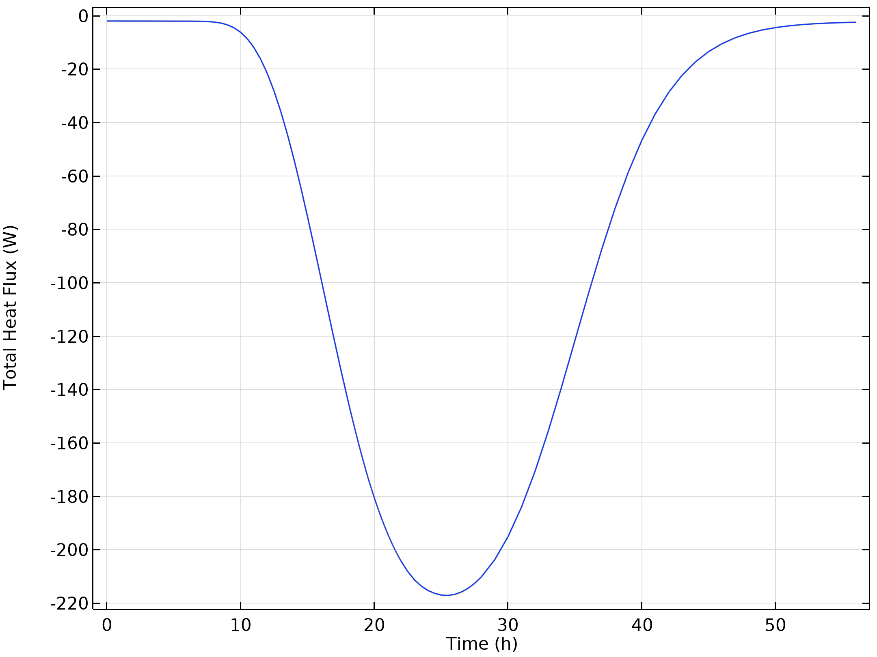
Results
The heat flux leaving the system exhibits a rapid increase as the cold plume reaches the outflow boundary
Therefore, the heat flux minium is reached after the frozen inclusion is totally thawed
Total heat flux exiting the system via the outflow boundary as a function of time.

Slide 12
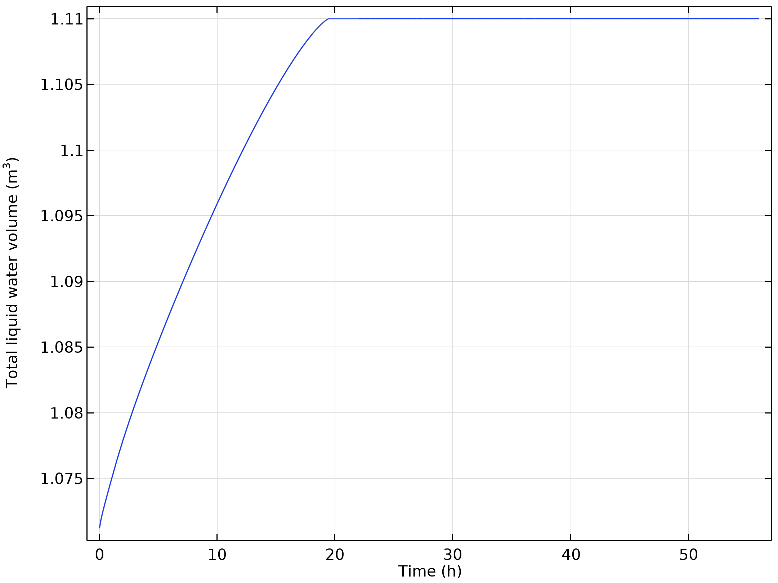
Results
The total liquid water volume in the system increases and finally reaches its maximum of 1.11 m³ when the minimum temperature of the system is above zero.
Total liquid water volume in the domain as a function of time.

