Slide 1
Microwave Oven
COMSOL

Slide 2
Introduction
This is a model of the heating process in a microwave oven
The distributed heat source is computed in a stationary, frequency-domain electromagnetic analysis followed by a transient heat transfer simulation showing how the heat redistributes in the food

Slide 3
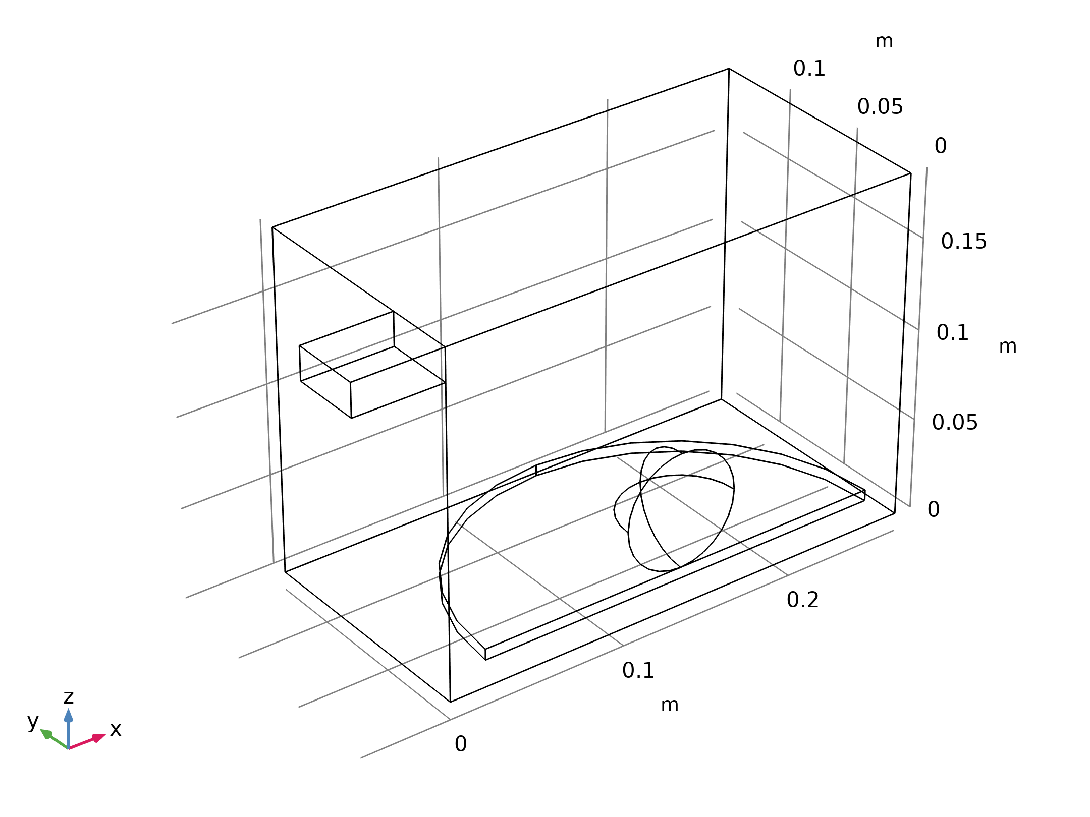
Model Definition
The microwave oven is a metallic box connected to a 2.45 GHz microwave source via a rectangular waveguide operating in the TE10 mode
Near the bottom of the oven there is a cylindrical glass plate with a spherical potato placed on top of it
The microwave operates at 1 kW, but when we use symmetry to reduce the model size by one half, we only input 500 W in simulation
Geometry 1

Slide 4
Model Definition
The symmetry cut is applied vertically through the oven, waveguide, potato, and plate
The figure shows both the full and reduced size geometry
Geometry 1

Slide 5
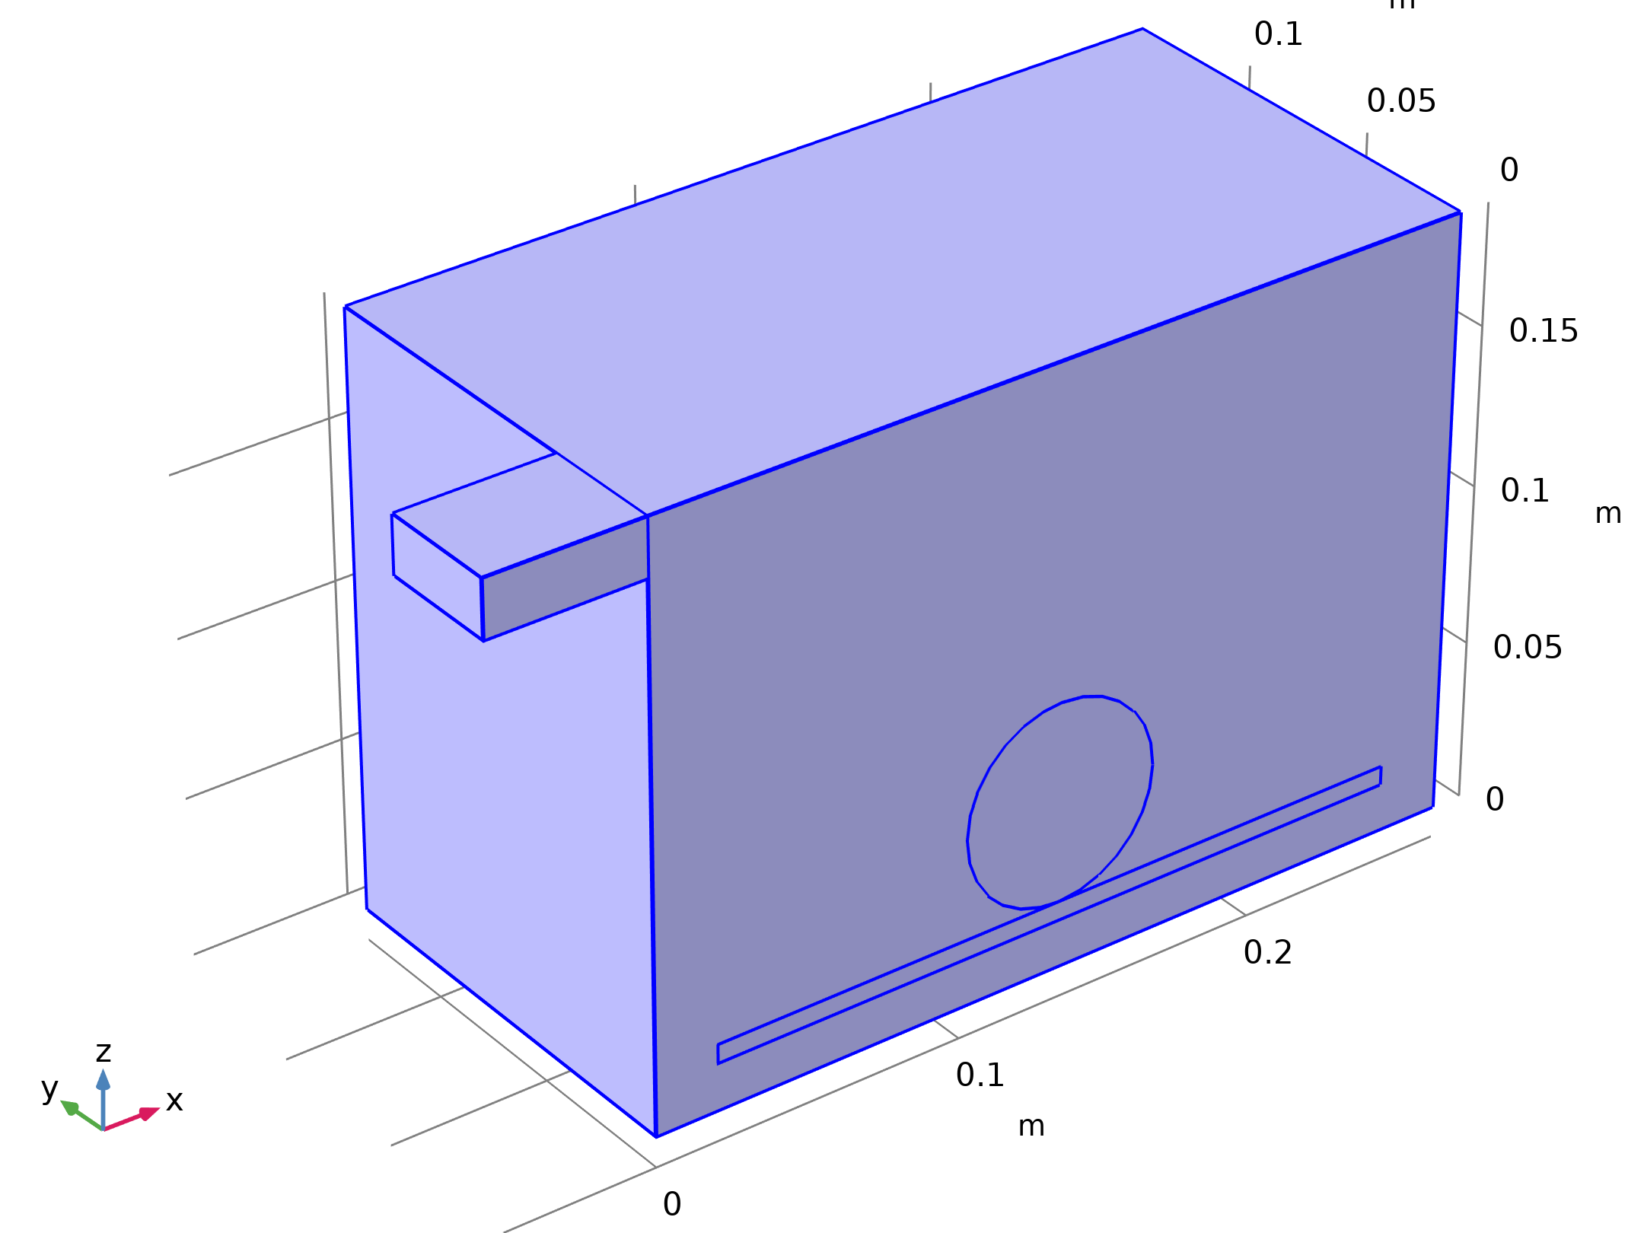
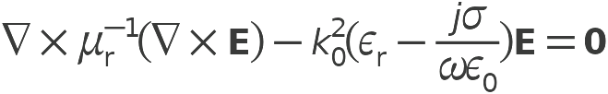
Model Definition
Electromagnetic Waves, Frequency Domain

Slide 6
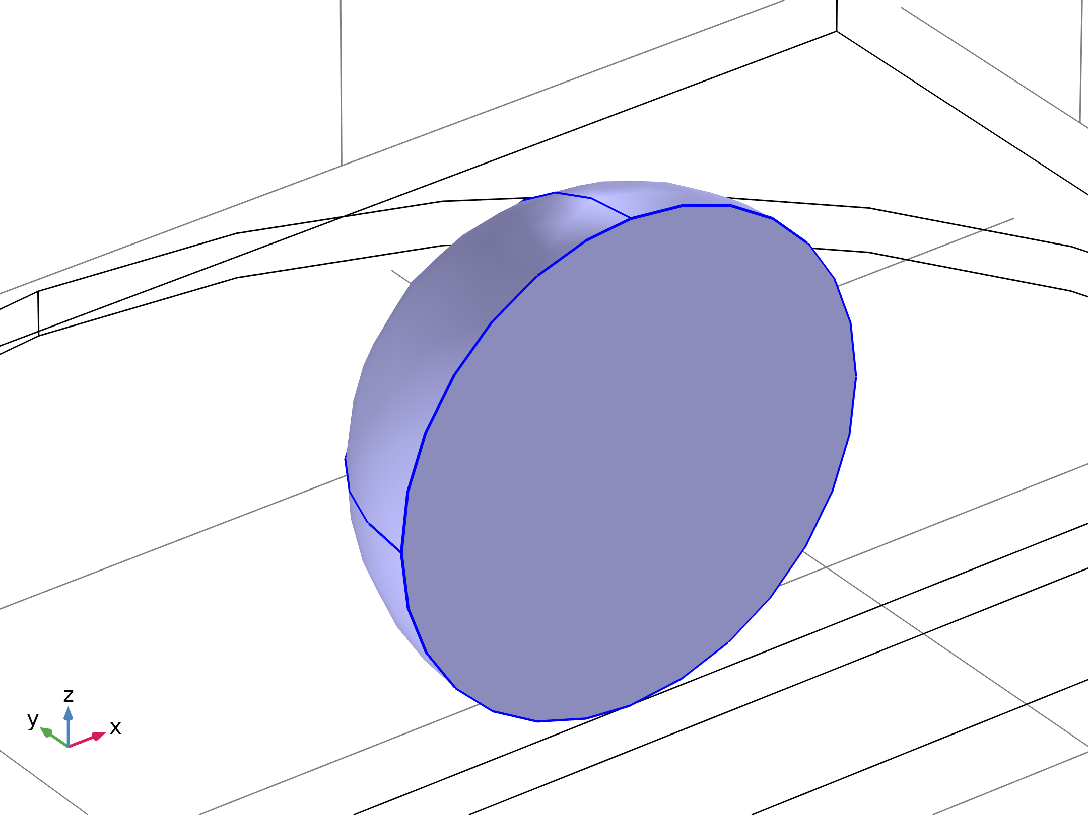


Model Definition
Heat Transfer in Solids

Slide 7
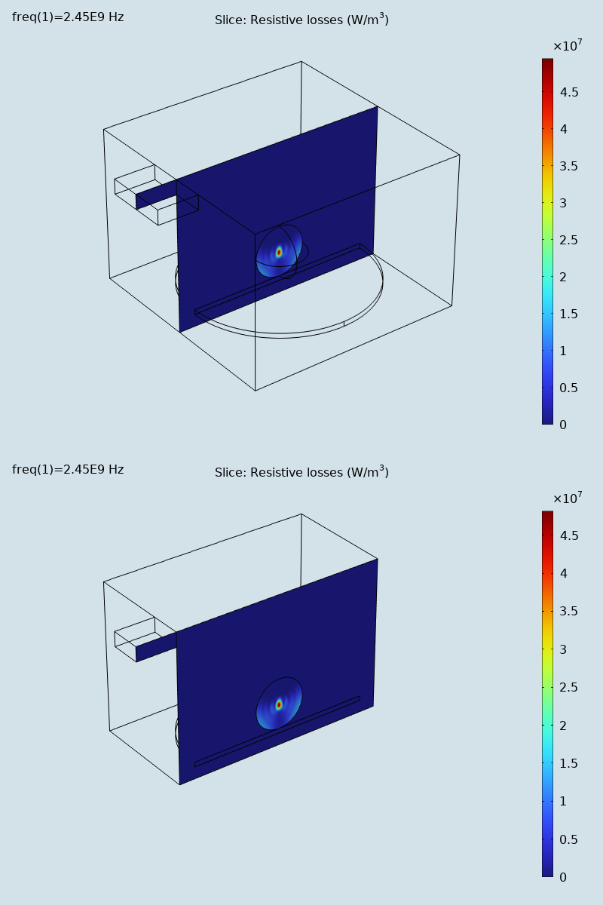
Results
The figure shows the distributed microwave heat source as a slice plot through the center of the potato
The rather complicated oscillating pattern, which has a strong peak in the center, shows that the potato acts as a resonant cavity for the microwave field
The power absorbed in the potato is evaluated and amounts to about 60% of the input microwave power
Most of the remaining power is reflected back through the port
Dissipated microwave power distribution (W/m3). Full size (top) and half size (bottom)

Slide 8
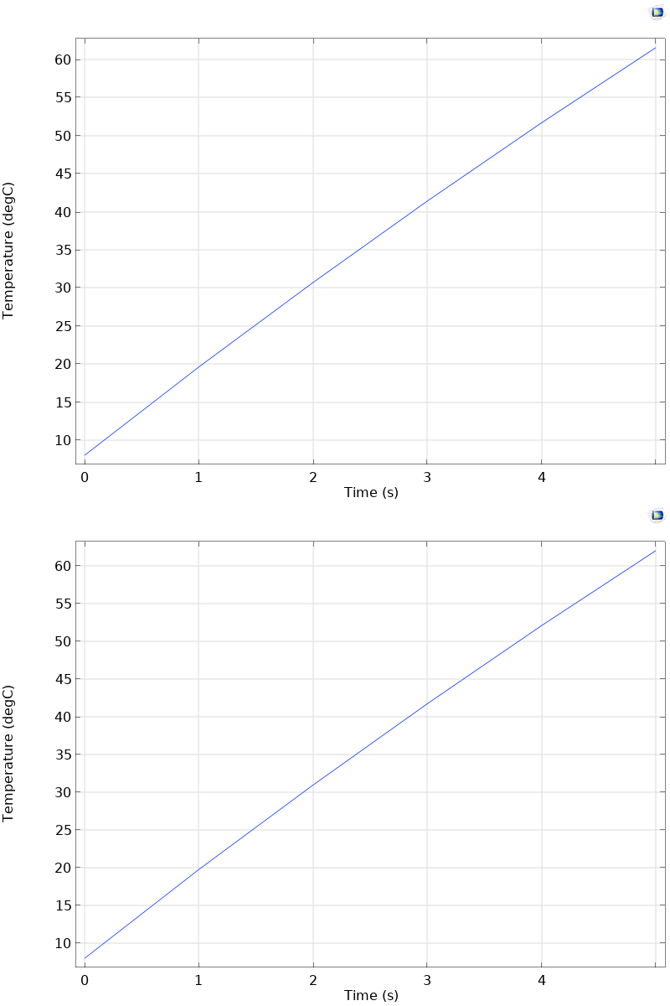
Results
The figure shows the temperature in the center of the potato as a function of time for the first 5 seconds
Temperature in the center of the potato during the first 5 seconds of heating. Full size (top) and half size (bottom)

Slide 9
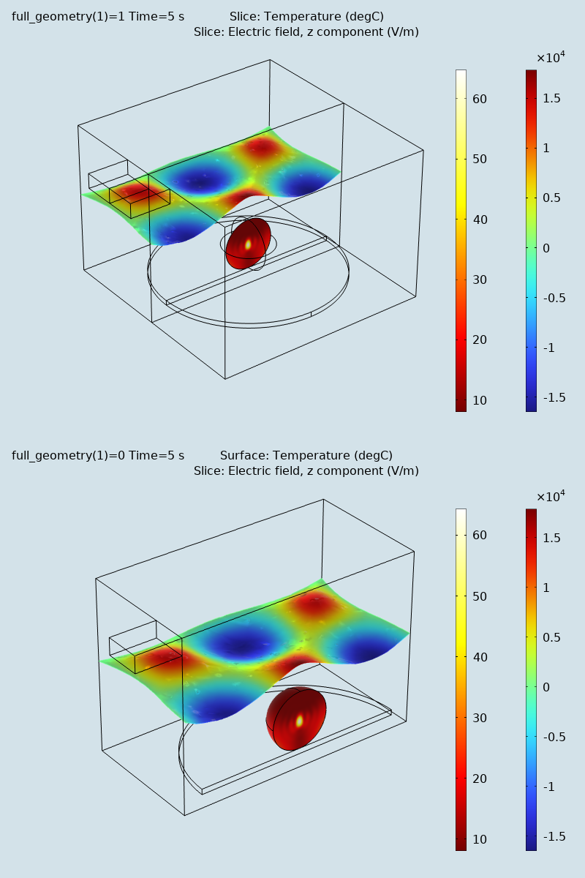
Results
Due to the low thermal conductivity of the potato, the heat distributes rather slowly, and the temperature profile after 5 seconds has a strong peak in the center (see the figure)
When heating the potato further, the temperature in the center eventually reaches 100°C and the water contents start boiling, drying out the center and transporting heat as steam to outer layers
Deformed electric field and Temperature distribution after 5 seconds of heating. Full size (top) and half size (bottom)

Slide 10
Results
This also affects the electromagnetic properties of the potato
The simple microwave absorption and heat conduction model used here does not capture these nonlinear effects
However, the model can serve as a starting point for a more advanced analysis
Deformed electric field and Temperature distribution after 5 seconds of heating. Full size (top) and half size (bottom)

