Slide 1
Earthquake Analysis of a Building
COMSOL

Slide 2
Introduction
This example shows how to perform an earthquake analysis of a structure using response-spectrum analysis
Earthquakes are, by their nature, not deterministic
If you were to check that a building can sustain an earthquake by time-domain analysis, you would have to run a large number of analyses with different representative prescribed acceleration histories for the supports
Such an approach would require large computational resources

Slide 3
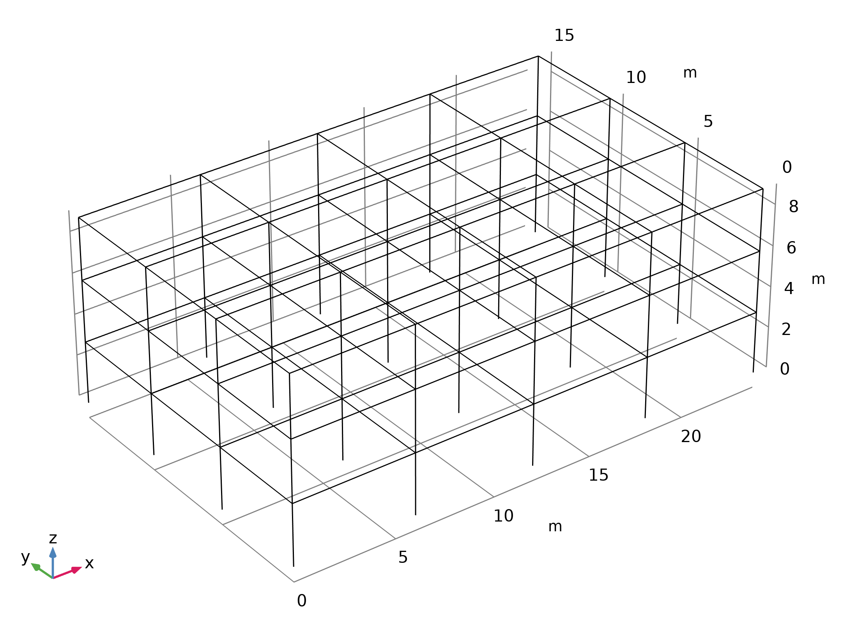
Model Definition
The structure is a regular beam framework
The geometry is parameterized so that it can have any number of columns in both horizontal directions and any number of floors
Also, the column spacing and floor height are parameters
The figure shows the geometry used in the analysis
Geometry 1

Slide 4
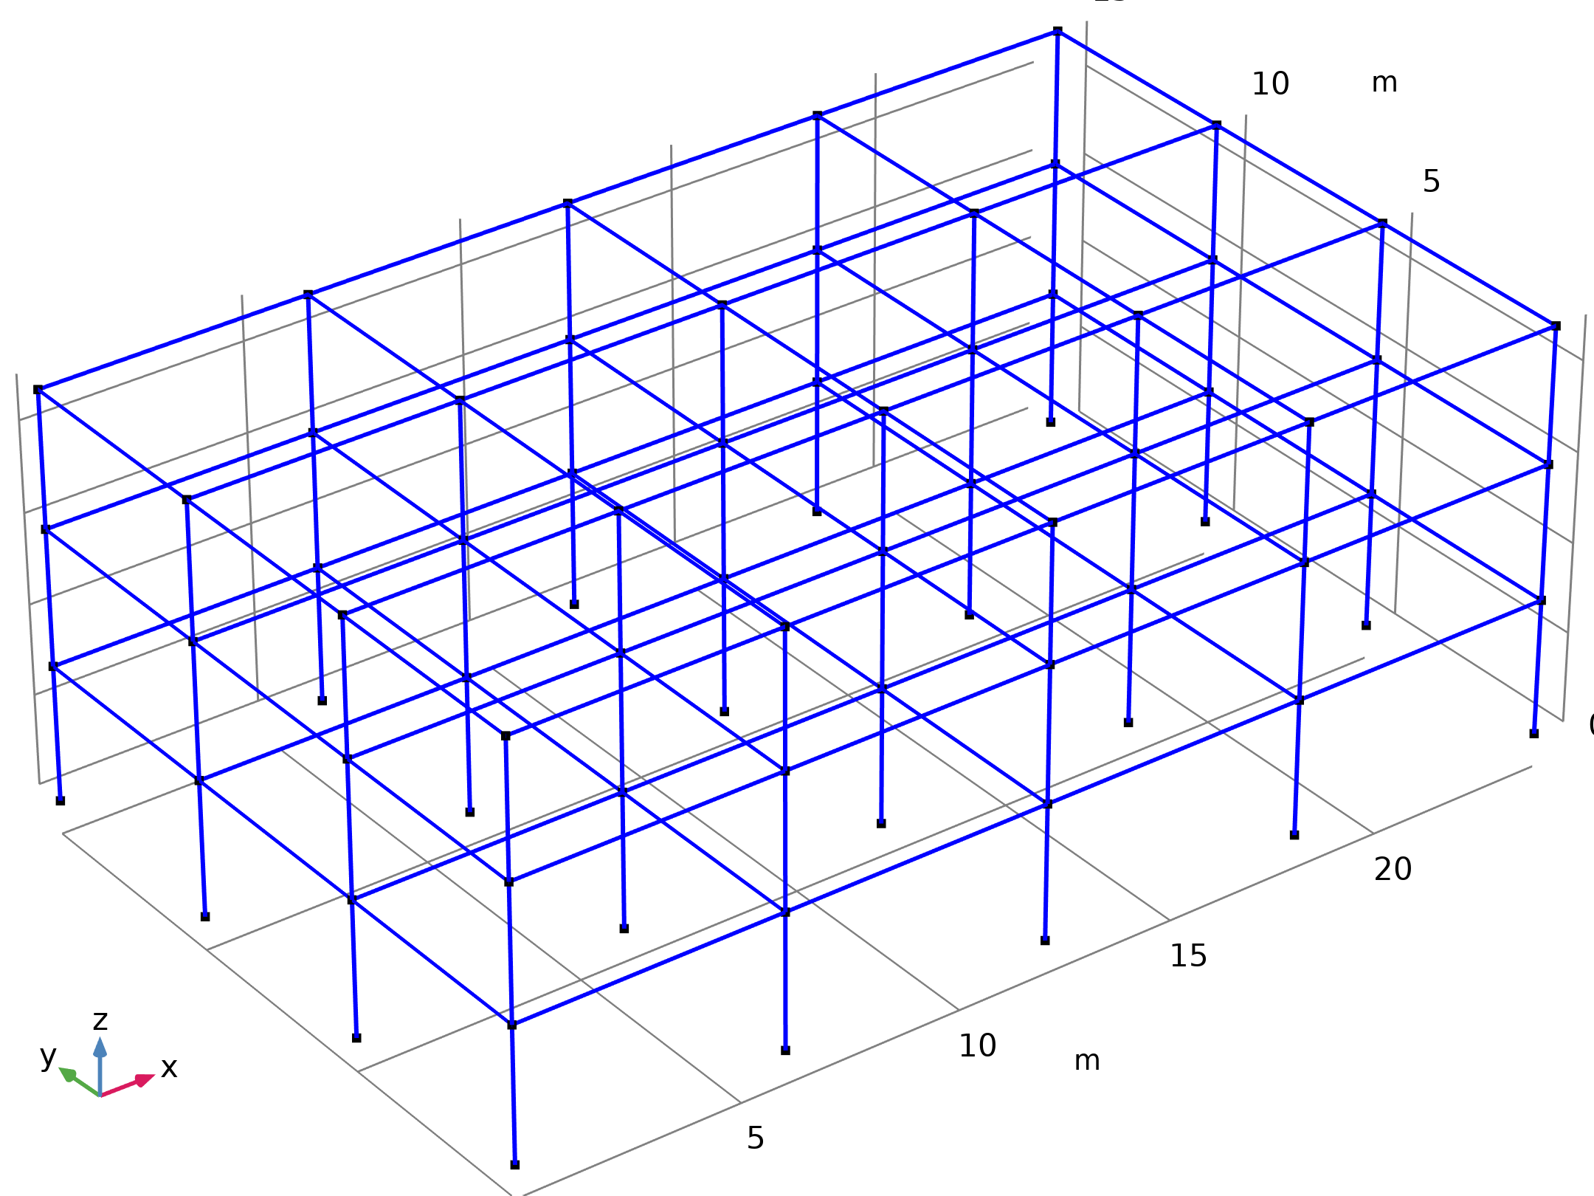

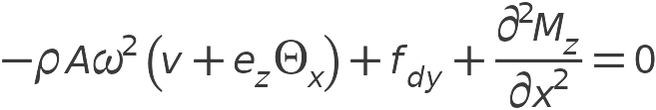
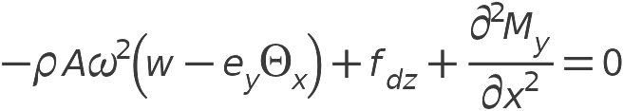
Model Definition
Beam

Slide 5
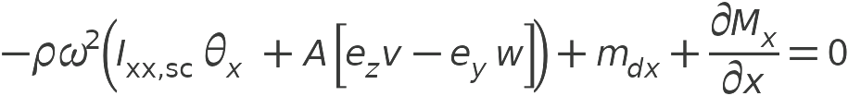

Model Definition
Beam

Slide 6
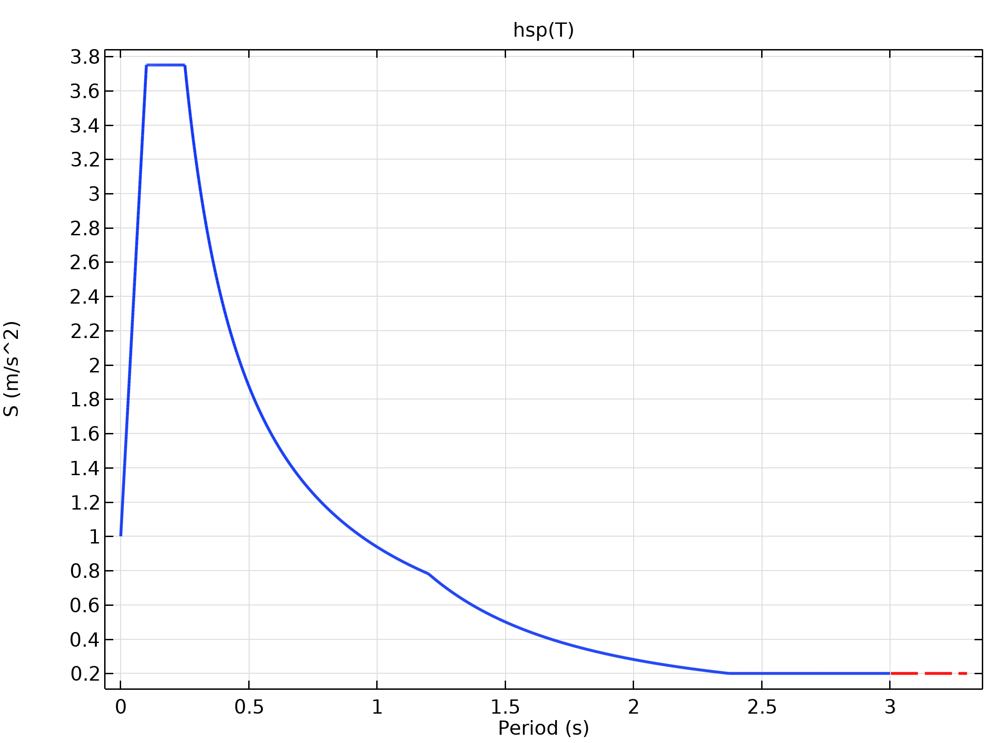
Results
For the response-spectrum evaluations, design response spectra inspired by Eurocode (EN1998-1) are used
The figure shows the horizontal pseudoacceleration spectrum
Horizontal design response spectrum

Slide 7
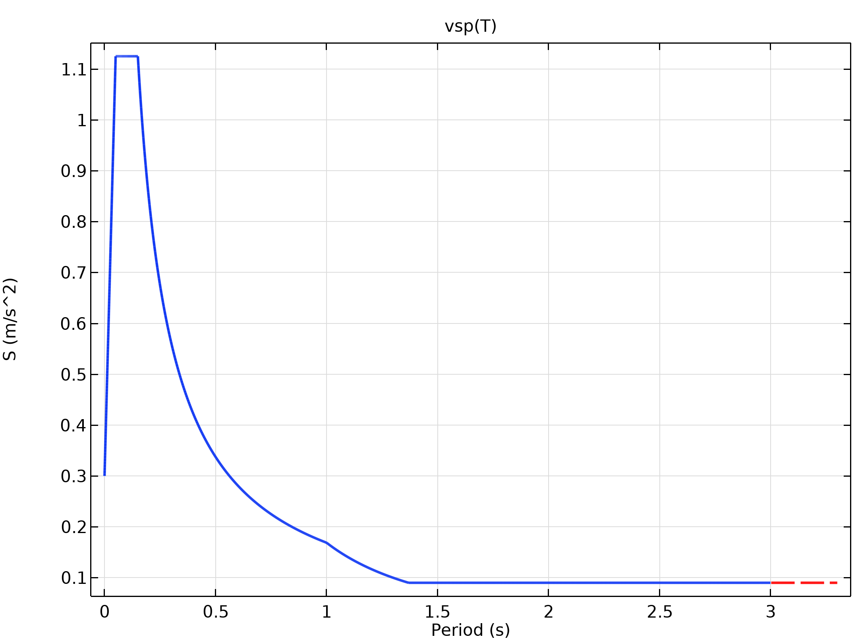
Results
The figure shows the vertical spectrum
The spectrum represents a rather mild earthquake
Vertical design response spectrum

Slide 8
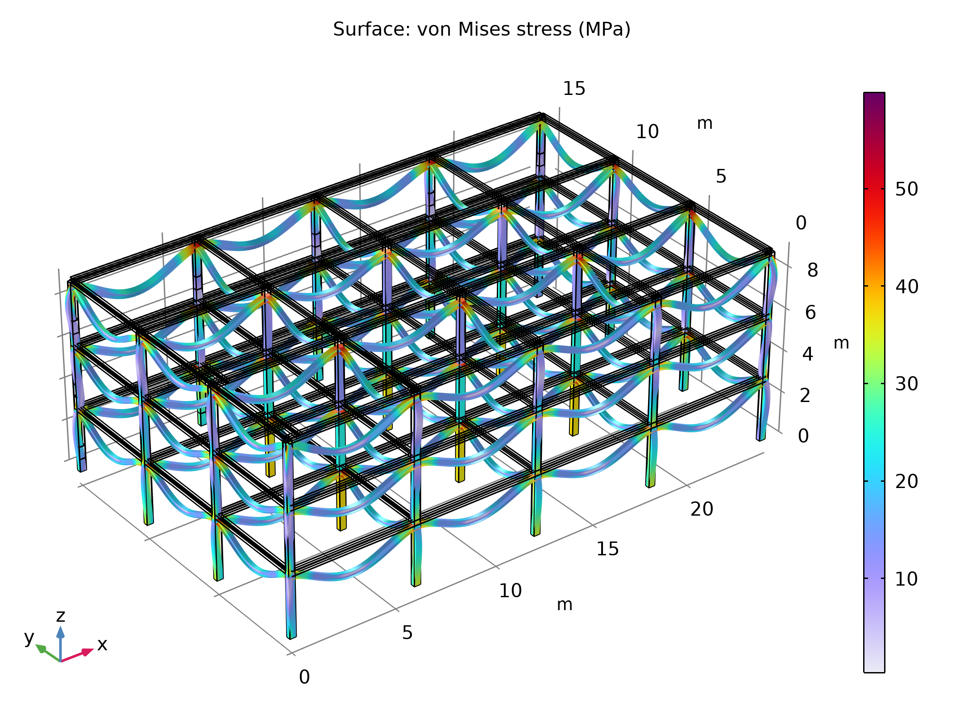
Results
In the first analysis, a pure gravity load is applied to the structure
The figure shows the stress distribution
The maximal stress — around 60 MPa — occurs at the top of the outermost columns
Stress distribution with only gravity load

Slide 9
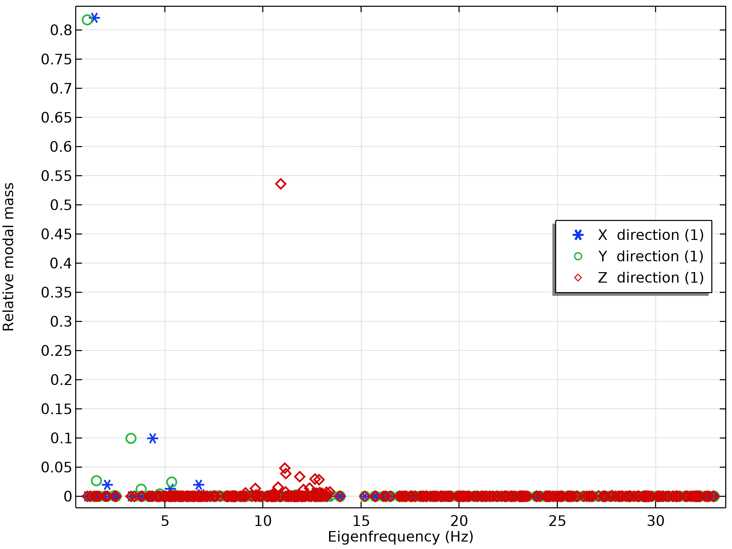
Results
An investigation of the mass associated with each eigenmode can give an indication of which modes are important
The figure shows the total mass for all computed eigenmodes on a linear scale
The relative modal mass as function of eigenfrequency; log scale

Slide 10
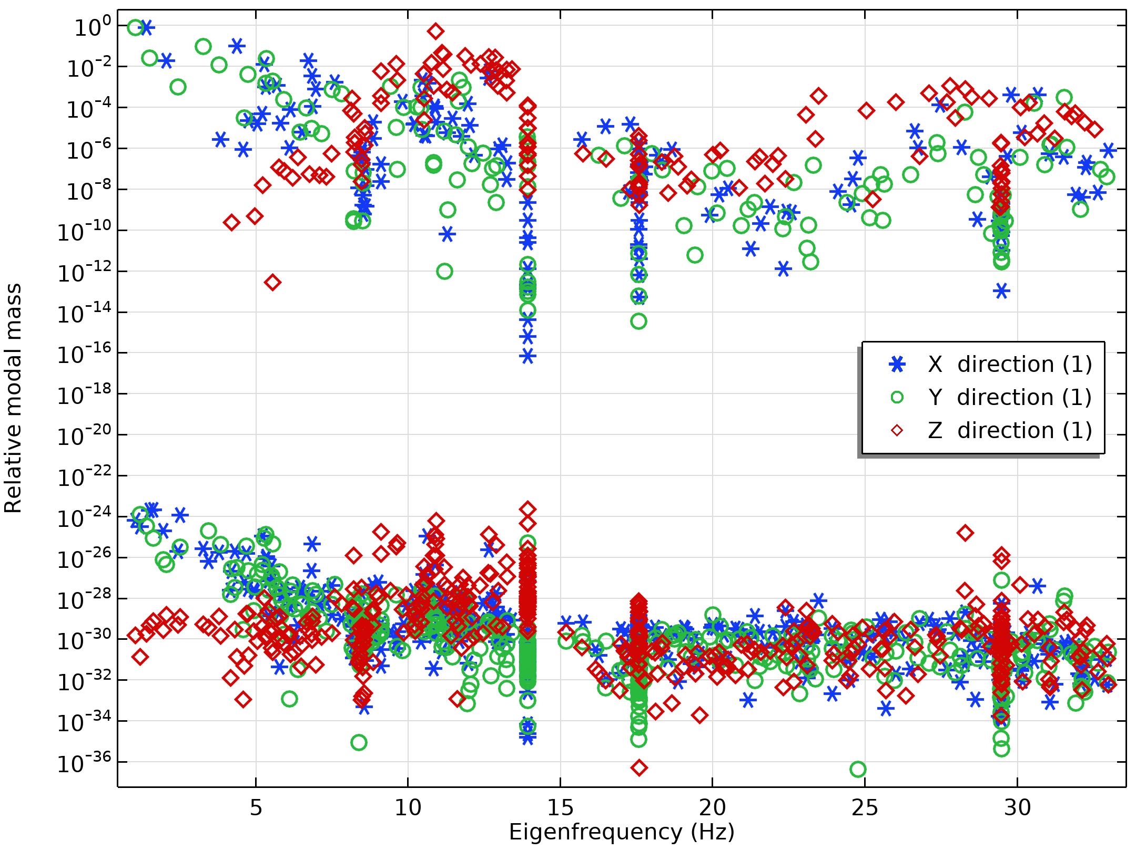
Results
An investigation of the mass associated with each eigenmode can give an indication of which modes are important
The figure shows the modal mass for all computed eigenmodes on a logarithmic scale
It can be seen that over 80% of the mass in both horizontal directions is represented already by the first two modes
The relative modal mass as function of eigenfrequency; log scale

Slide 11
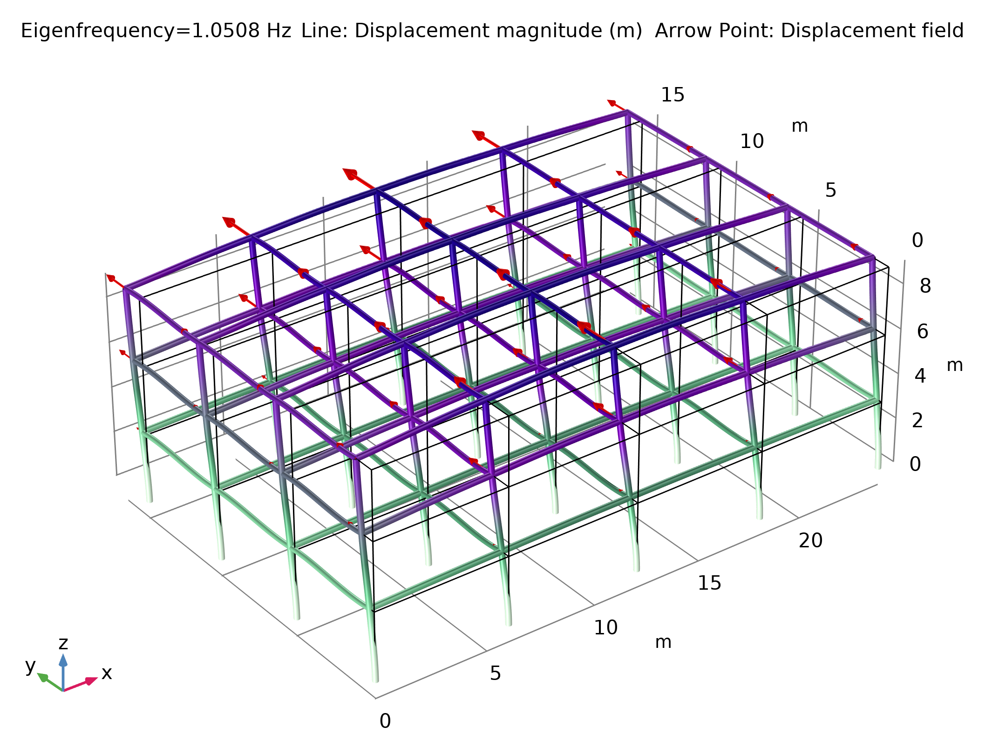
Results
The figure shows the most important modes for each direction
The first eigenmode; bending in the Y direction

Slide 12
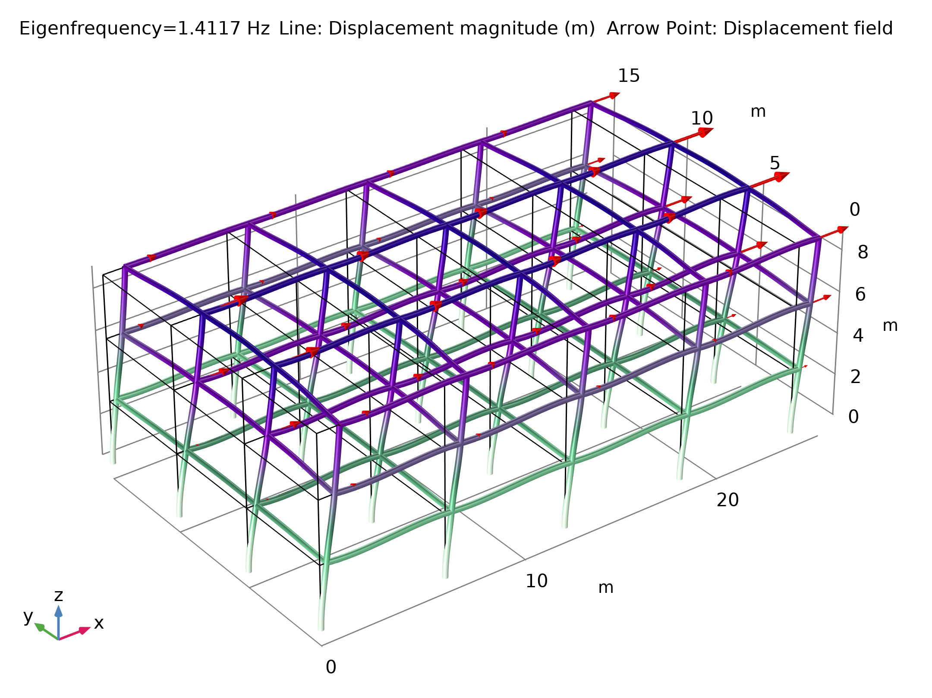
Results
The figure shows the most important modes for each direction
The second eigenmode; bending in the X direction

Slide 13
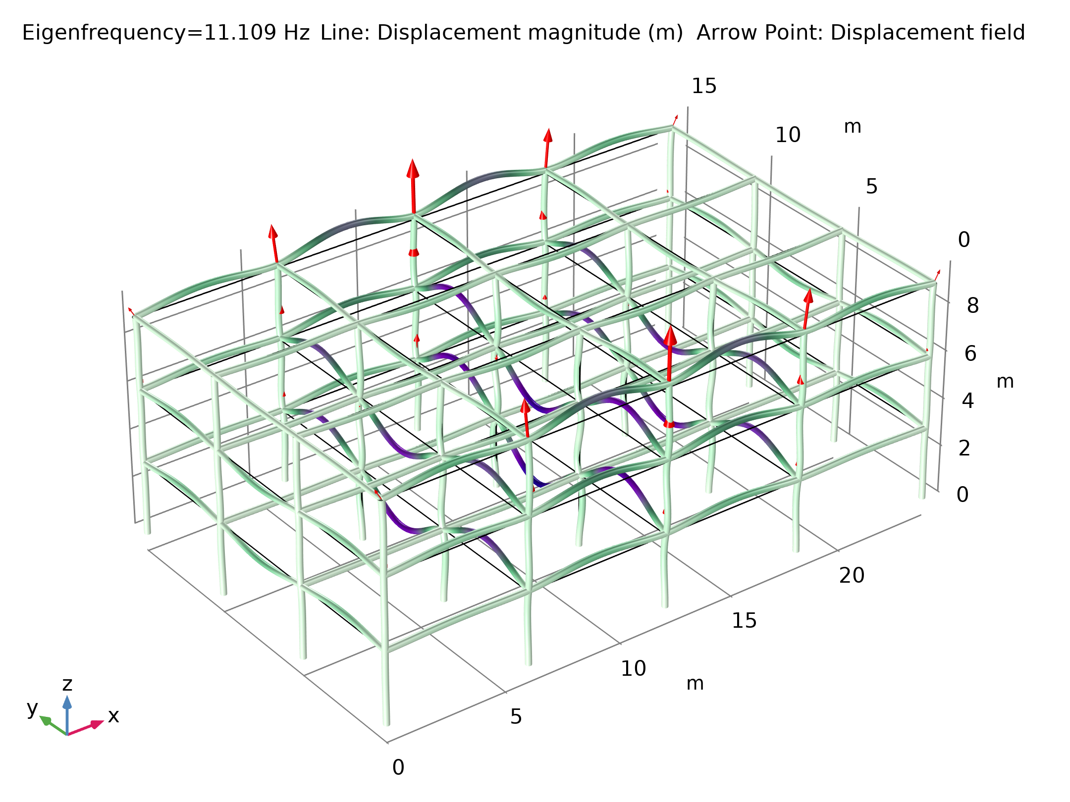
Results
The figure shows the most important modes for each direction
The first mode having a significant vertical displacement

Slide 14
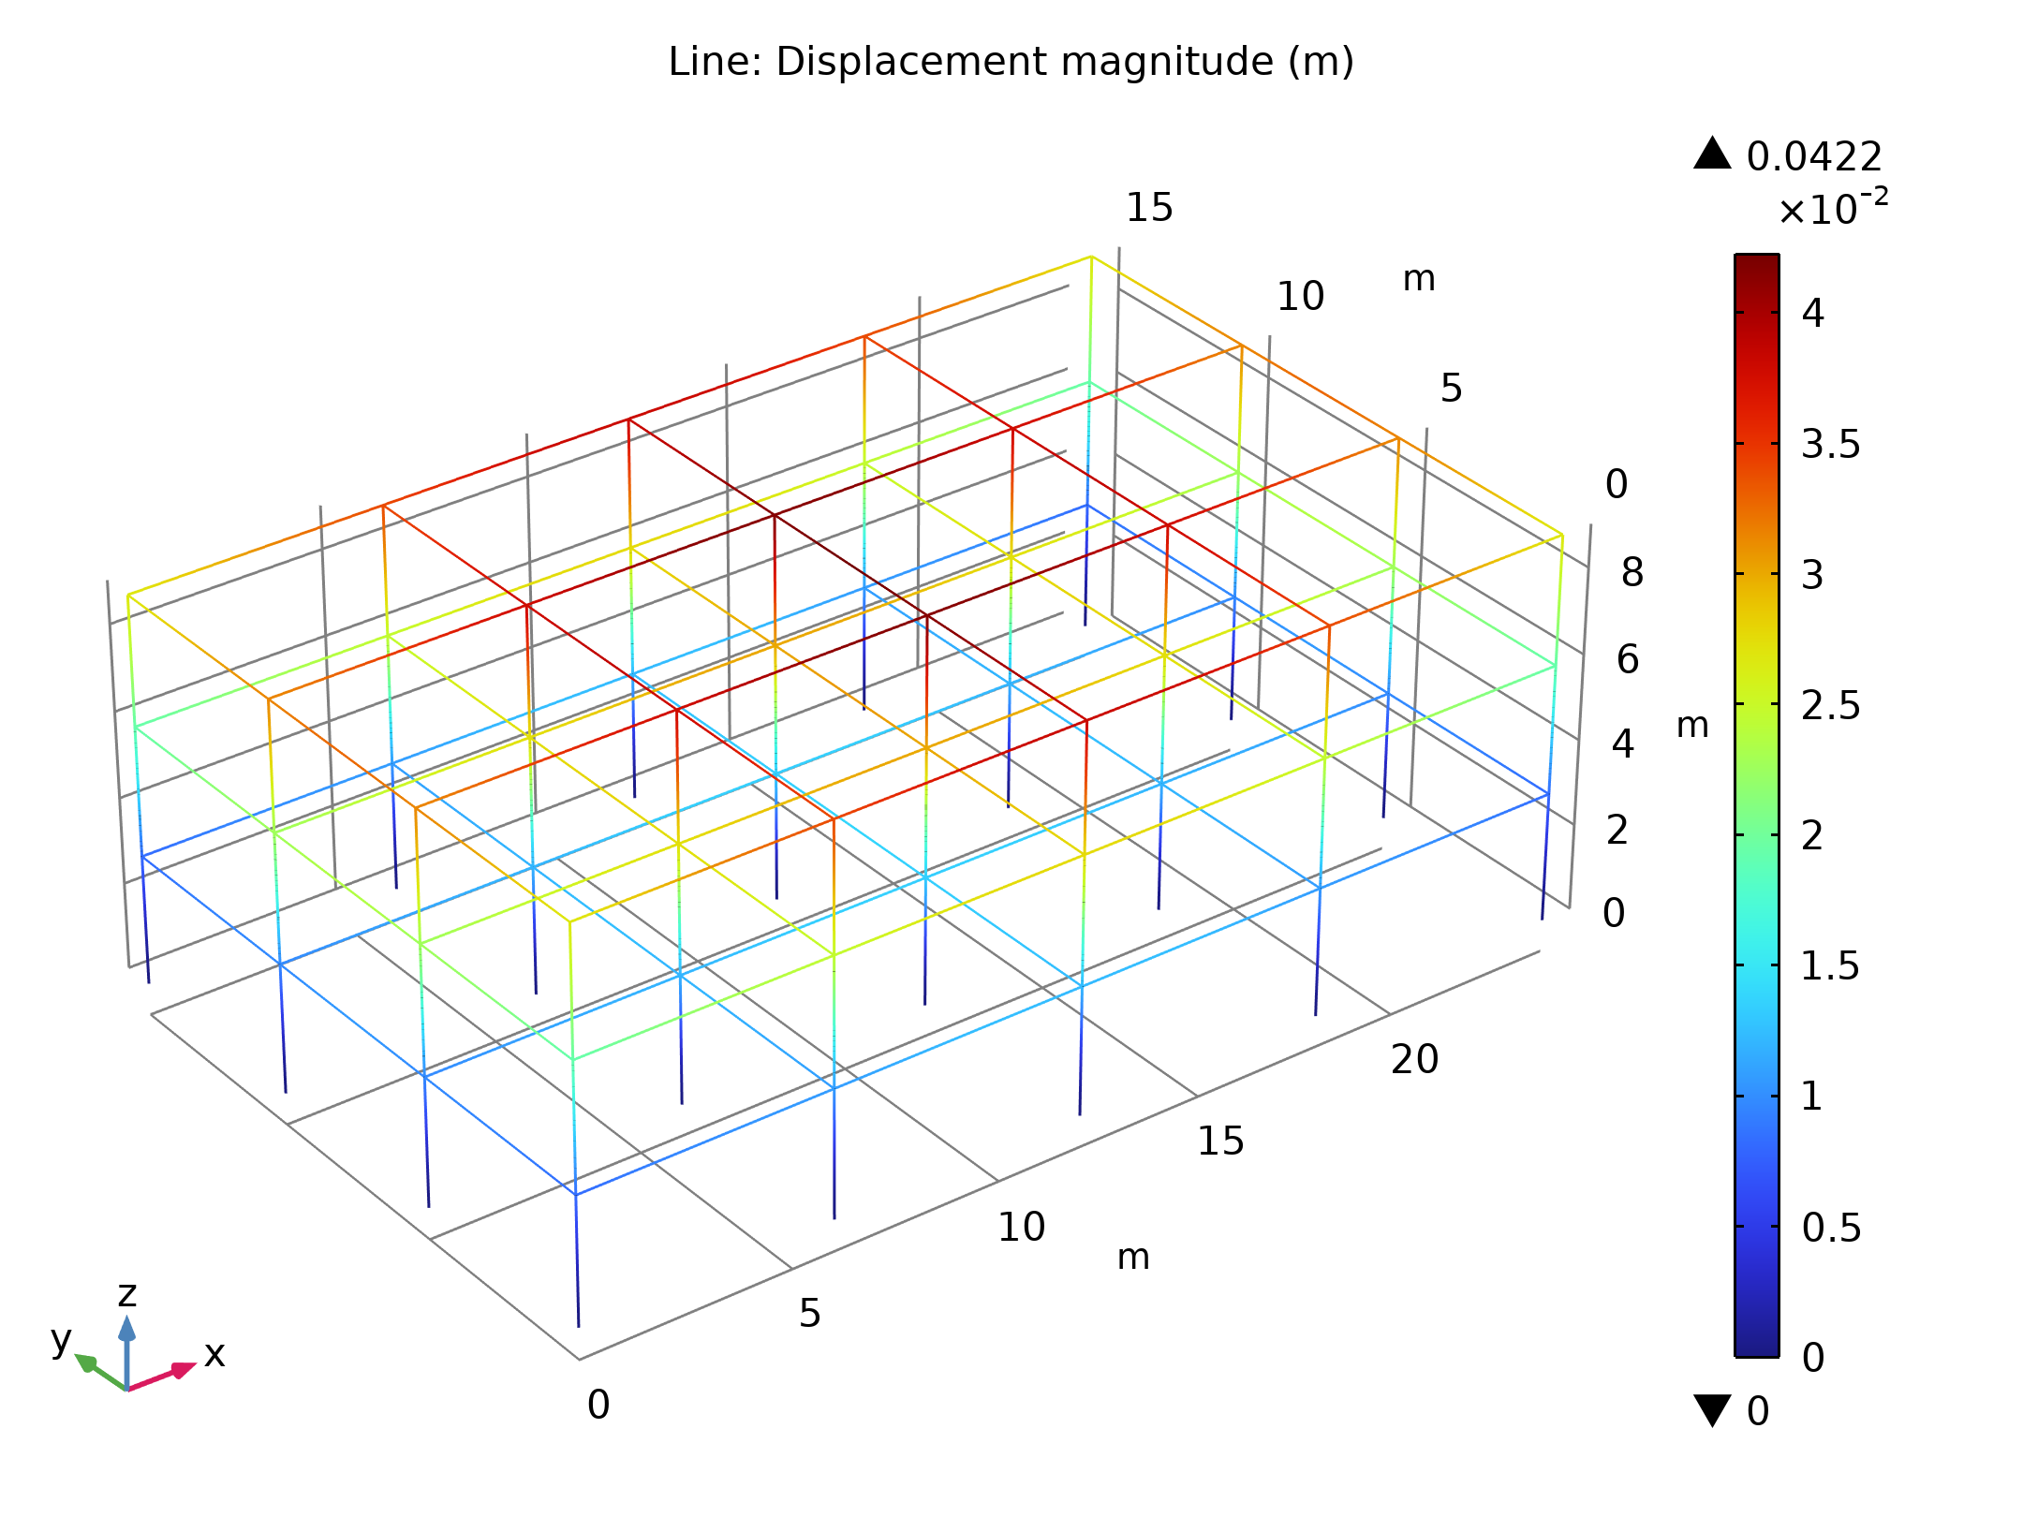
Results
First, a standard response-spectrum analysis is performed, for which all modes are considered to be fully periodic
The figure shows the stress and displacement results, respectively
Note that displacements in a response-spectrum analysis are relative to the fixed base, which is the ground in this case
von Mises stress with CQC solution

Slide 15
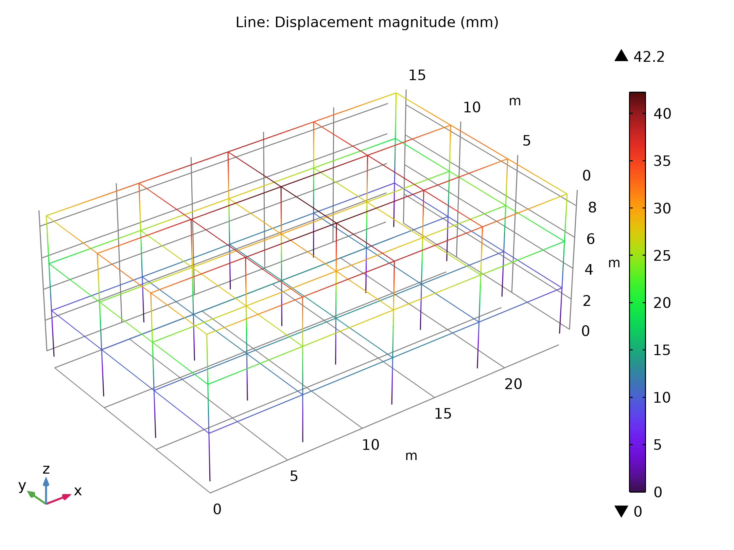
Results
The figure shows the stress and displacement results, respectively
Note that displacements in a response-spectrum analysis are relative to the fixed base which is the ground in this case
Total displacement with CQC solution

Slide 16

Results
The figure shows the stress results from such an evaluation
In this case, the deviation from the first evaluation is small; the largest stress is still 151 MPa
The reason is that, in this case, the response is dominated by the periodic modes
von Mises stress after including a missing mass correction

