Slide 1
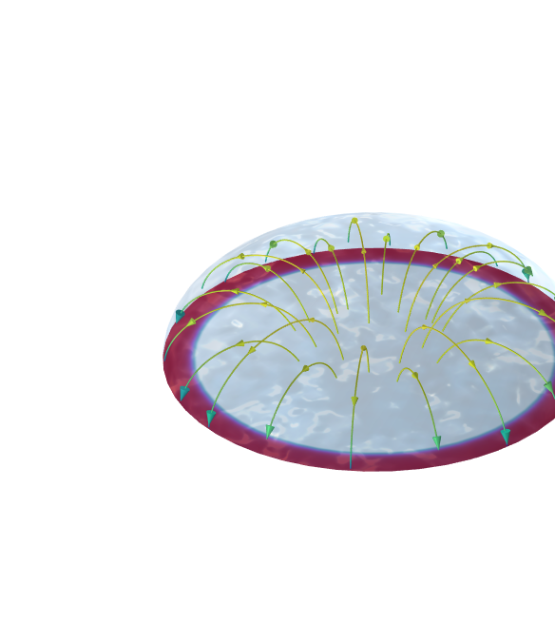
Corrosion Under An Evans Droplet

Slide 2
Overview
The century-old Evans droplet experiment demonstrates corrosion that is limited by oxygen transport.
This Evans droplet tutorial model defines the corrosion of an iron surface in contact with an aqueous sodium-chloride droplet in a surrounding atmosphere that contains both carbon dioxide and oxygen.
The model accounts for the charge and mass transport of a multitude of species as well as iron dissolution, oxygen reduction, carbonic acid equilibria, and corrosion-product formation.
Spatial gradients are displayed and are attributed to the complex interplay between the dissolved iron, corrosion products, and the atmospheric gases.
N₂, O₂, CO₂
H₂O
Fe

Slide 3
Model Definition
Geometry defined in 2D with axial symmetry: An electrolyte droplet covers the metal surface.
The modeled electrolyte species are:
  H⁺, OH⁻, H₂CO₃, HCO₃–, CO₃²⁻, Fe²⁺, FeOH⁺, FeCO₃(aq), Na⁺, Cl⁻, O₂(aq), CO₂(aq)
Homogeneous reactions in the electrolyte:
  H ⁺ + OH⁻ ⇔ H₂O
  CO₂(aq) + H₂O ⇔ H₂CO₃
  H₂CO₃ ⇔ HCO₃⁻ + H ⁺
  HCO₃⁻ ⇔ CO₃²⁻ + H ⁺
  Fe ²⁺ + H₂O ⇔ FeOH⁺ + H ⁺
  Fe ²⁺ + CO₃²⁻ ⇔ FeCO₃(aq)
Fixed concentrations are set for O₂ and CO₂ at the droplet surface boundary facing the atmosphere.
Symmetry
line, r = 0
Droplet surface
boundary
Model
domain
Fe electrode
surface boundary

Slide 4
Model Definition
There is an oxygen reduction reaction at the metal surface that is more dominant at the edge of the droplet:
  4H⁺ + 4e⁻ + O₂ → 2H₂O
Iron is oxidized to balance the reduction reaction:
  Fe(s) → Fe²⁺ + 2e⁻
Two precipitation reactions involving iron are accounted for at the metal surface:
  Fe²⁺ + 2OH⁻ → Fe(OH)₂(s)
  FeCO₃(aq) → FeCO₃(s)
CO₂ is dissolved at the droplet surface and is consumed inside the droplet in homogeneous reactions.
Symmetry
line, r = 0
Edge of
the droplet
7.155 mm

Slide 5
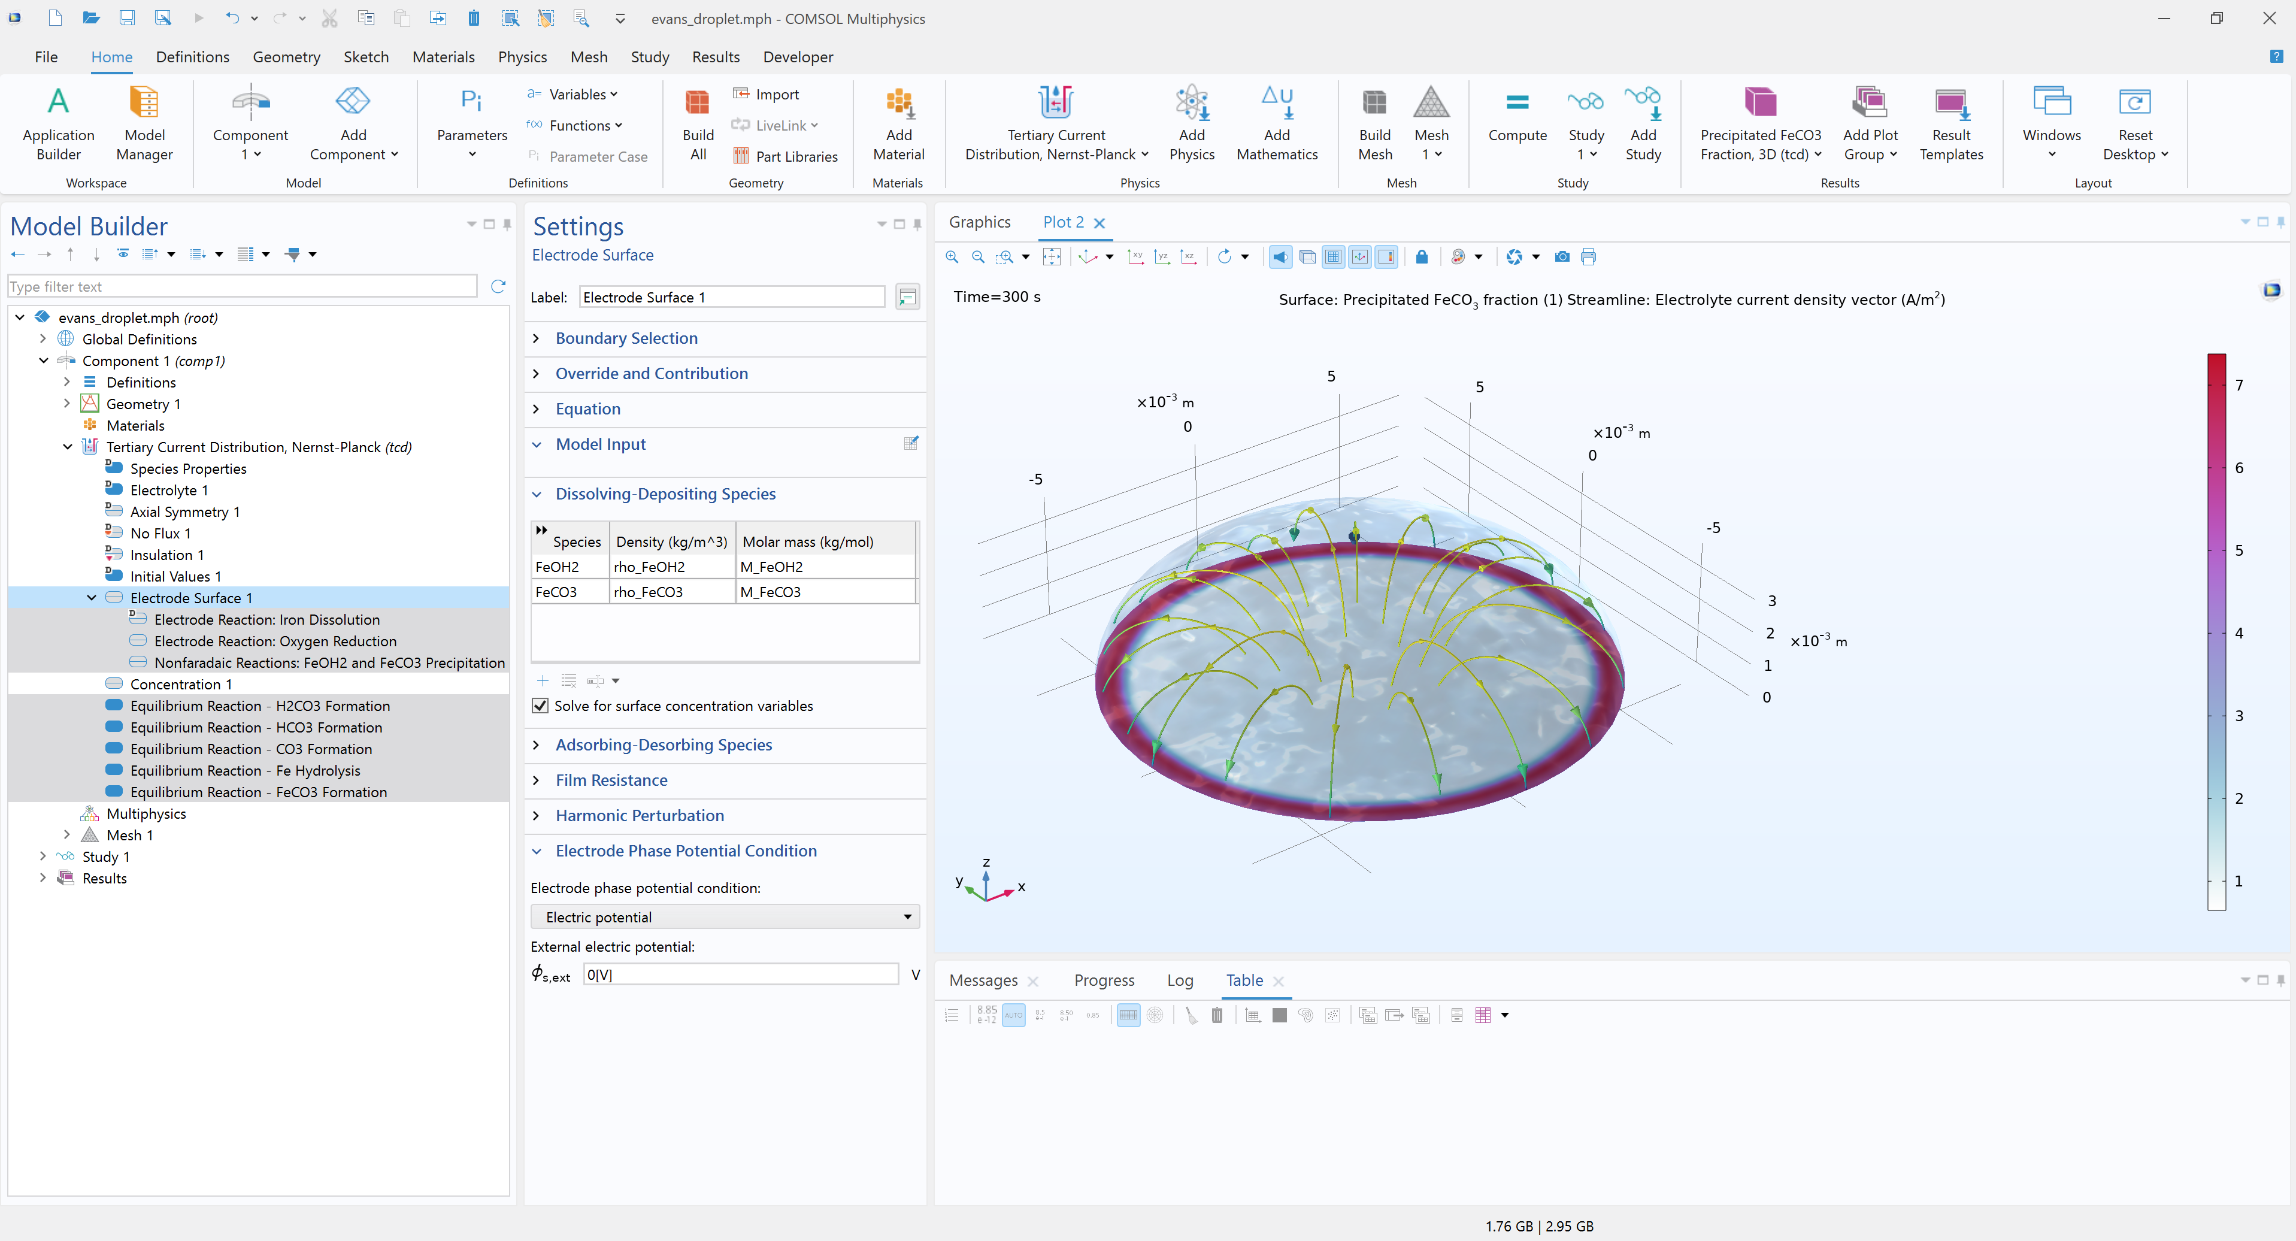
Tertiary Current Distribution, Nernst-Planck Interface Setup
Transport of Charged and Neutral Species
Reactions
The water-based model with an electroneutrality charge balance defines c_{H} and c_{OH} as built-in variables and defines the water autoprotolysis equilibrium automatically.
Electrochemical reactions are set using the Electrode Reaction node, precipitation reactions using the Non-Faradaic Reaction node, and homogeneous reactions using the Equilibrium Reaction nodes.

Slide 6
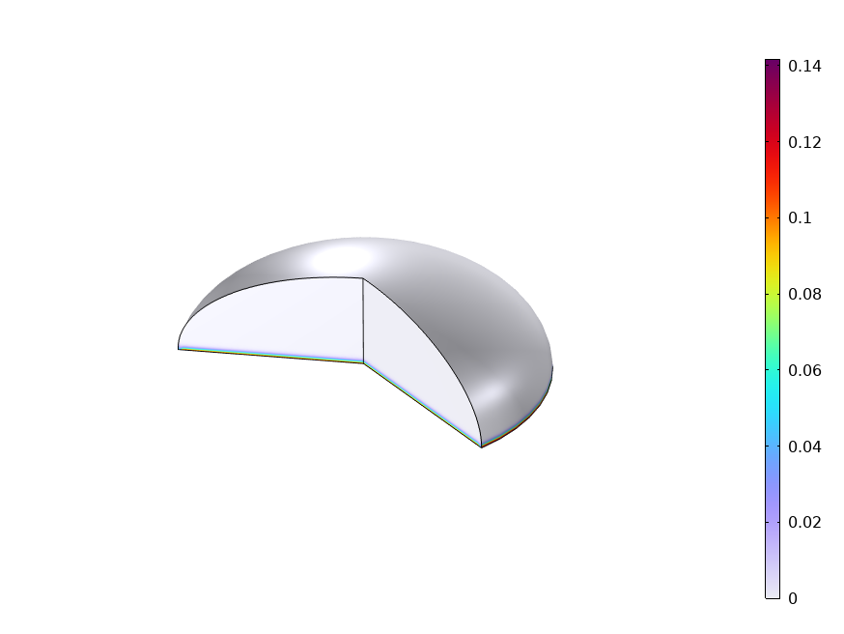
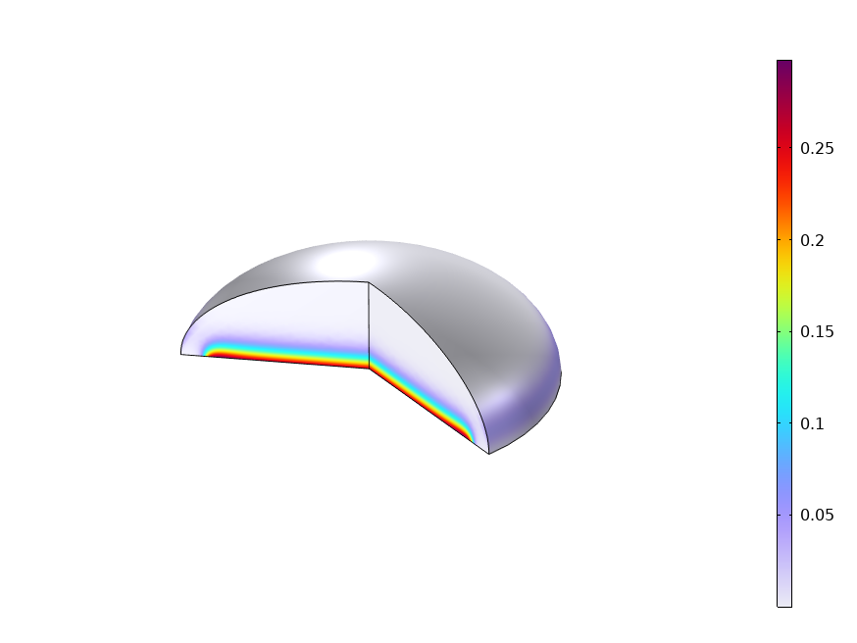
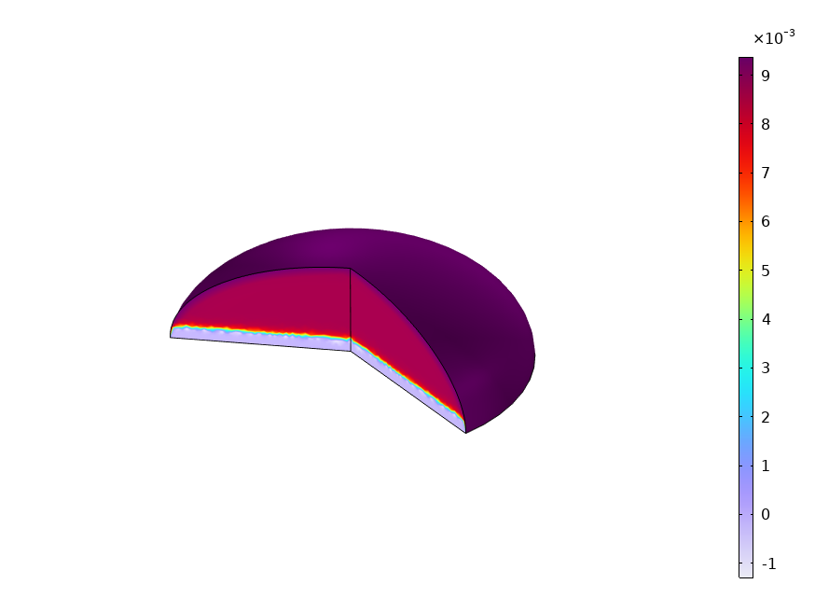
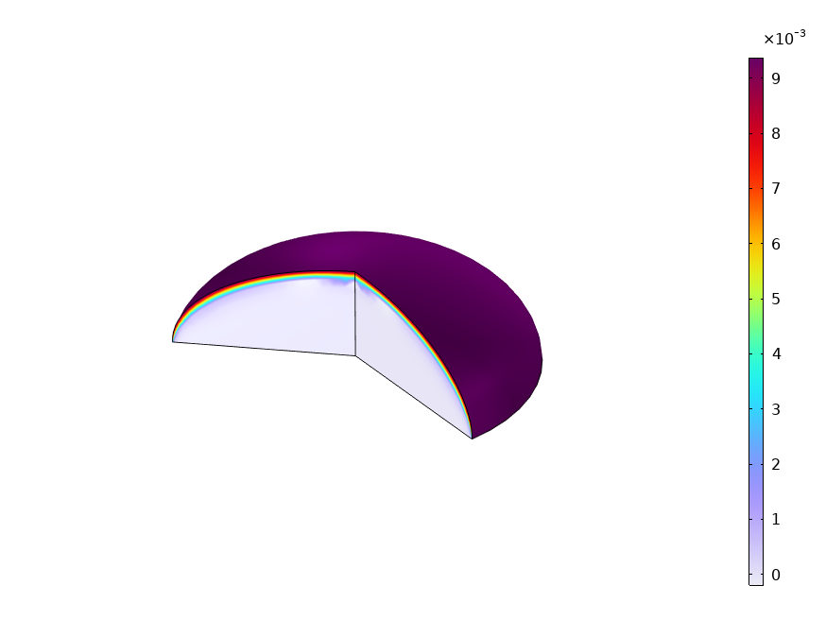
Results: Concentrations
Fe²⁺ at 10 s. Fast increase near the surface.
Fe²⁺ at 300 s. Iron can dissolve where the surface coverage is low.
CO₂(aq) at 10 s. CO₂ consumed in reactions within droplet.
CO₂(aq) at 300 s. CO₂ consumption continues during the exposure.

Slide 7
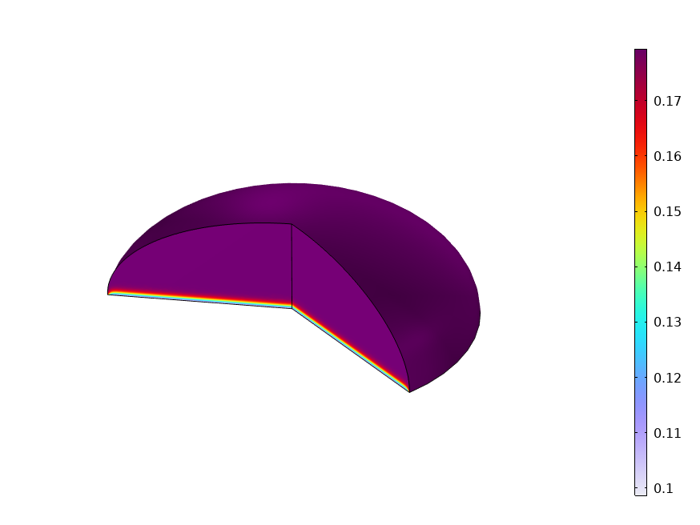
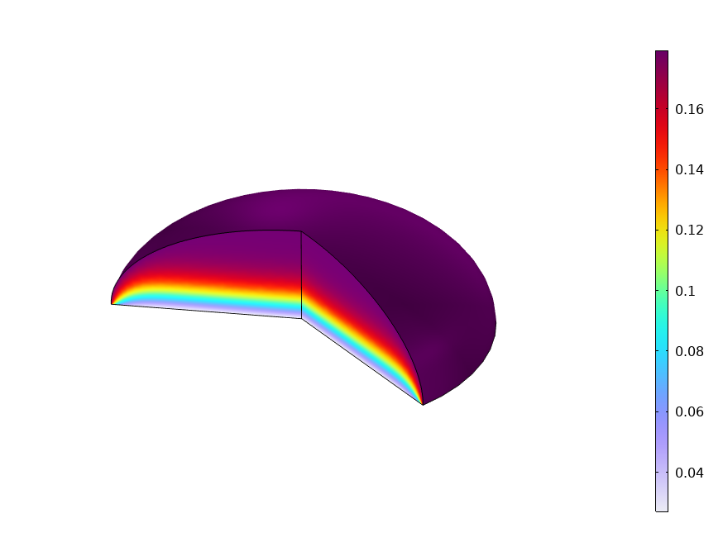
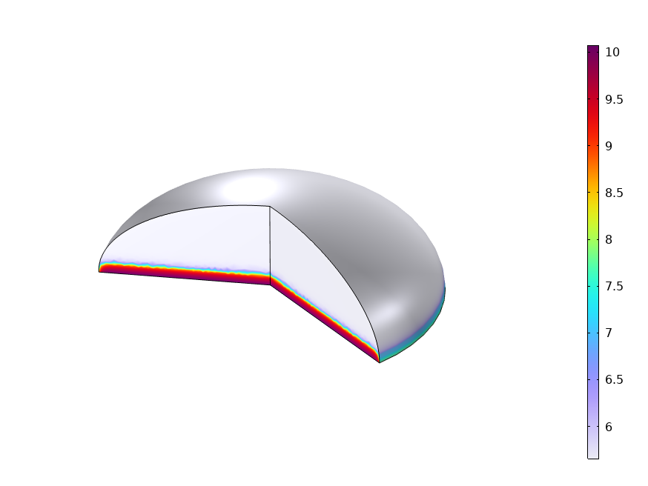
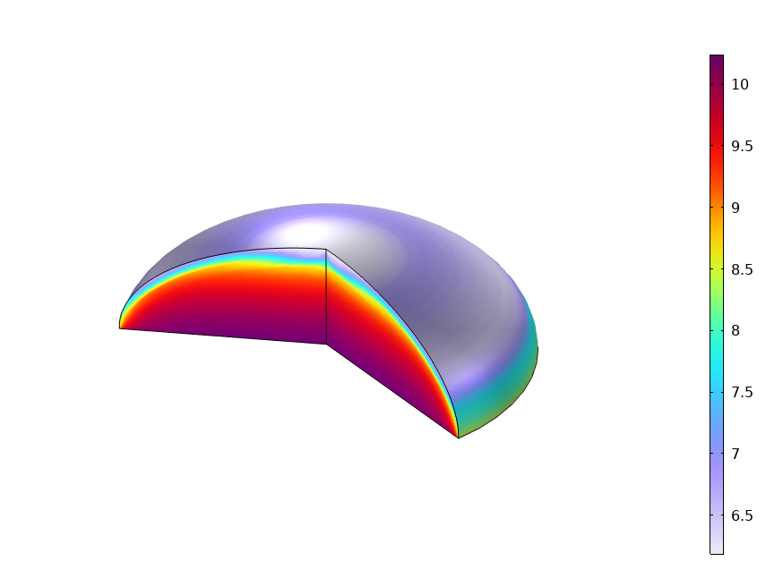
Results: Concentrations
O₂(aq) at 10 s. Oxygen is quickly consumed with oxygen reduction.
O₂(aq) at 300 s. Consumption has continued.
pH at 10 s. CO₂ dissolution lowers the pH at the droplet surface.
pH at 300 s. Reactions within droplet increase pH.

Slide 8
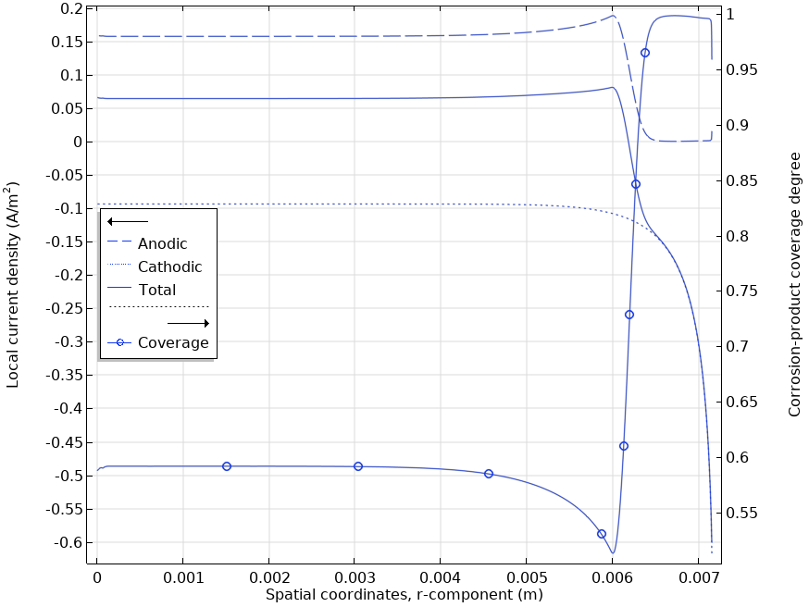
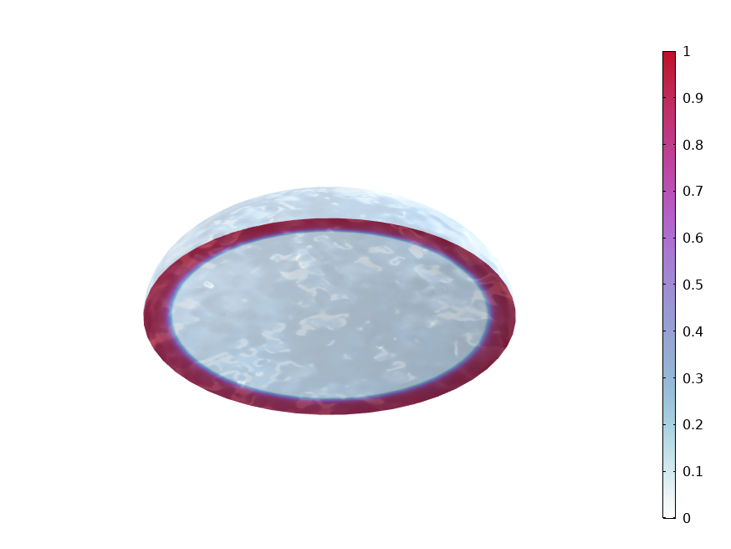
Results: Distribution At Metal Surface
Current Density and Coverage
Precipitated Ferrous Carbonate Fraction
At 300 s. Metal dissolution (anodic) is closely linked to the coverage of corrosion products and the oxygen reduction (cathodic) to the oxygen access.
At 300s. The fraction coincides with the coverage degree and indicates iron carbonate making up the coverage near the rim of the droplet.

Slide 9
References
B.G. Koushik, N. Van den Steen, M.H. Mamme, Y. Van Ingelgem, and H. Terryn, “Review on modelling of corrosion under droplet electrolyte for predicting atmospheric corrosion rate,” J. Mater. Sci. Technol., vol. 62, pp. 254–267, 2021.
M. Nordsveen, S. Nesic, R. Nyborg, and A. Stangeland, “A Mechanistic Model for Carbon Dioxide Corrosion of Mild Steel in the Presence of Protective Iron Carbonate Films-Part 1: Theory and Verification,” Corrosion, vol. 59, no. 5, pp. 443–456, 2003.
A. Kahyarian and S. Nesic, “On the mechanism of carbon dioxide corrosion of mild steel: Experimental investigation and mathematical modeling at elevated pressures and non-ideal solutions,” Corros. Sci., vol. 173, no. 108719, pp. 1–27, 2020.
F. J. Millero, W. Yao, and J. Aicher, “The speciation of Fe(II) and Fe(III) in natural waters,” Marine Chemistry, vol. 50, pp. 21–39, 1995.

