Slide 1
Anisotropic Hygroscopic Porous Medium

Slide 2
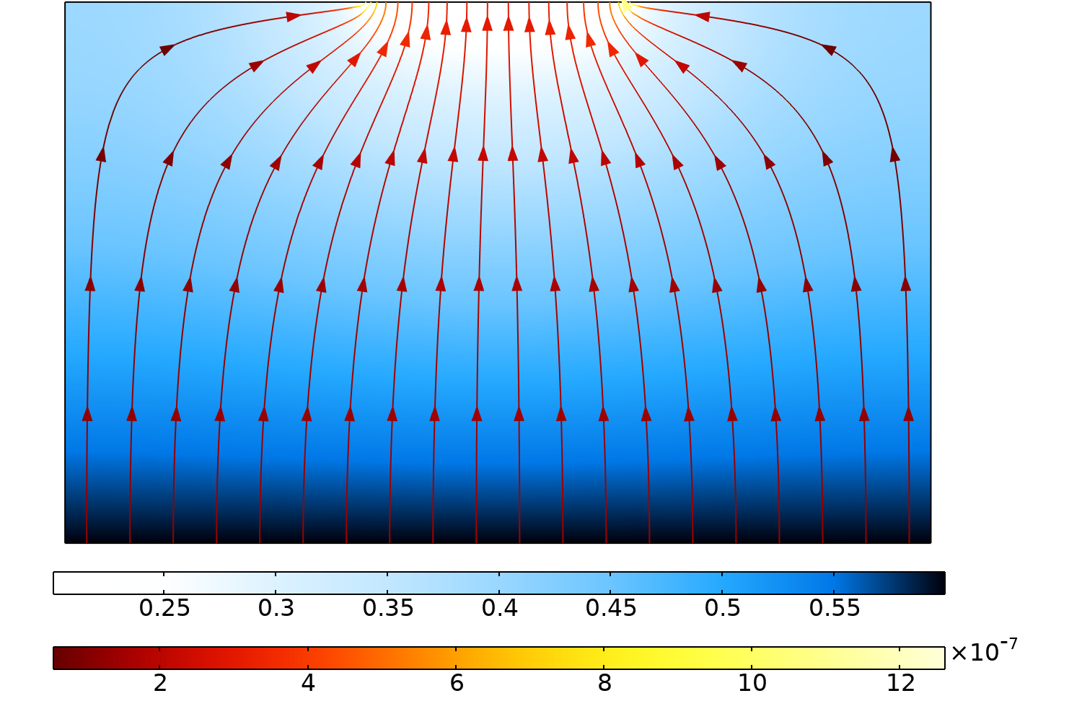
Introduction
This model describes moisture transport through an hygroscopic porous medium, with anisotropic moisture diffusivity coefficient
Two approaches are considered and compared
  A structural anisotropy model alternating layers of materials with different diffusivities
  An effective anisotropy model using a single material with an effective diffusivity
The results match for both approaches
Relative humidity distribution (surface plot) and moisture flux magnitude (streamlines).

Slide 3
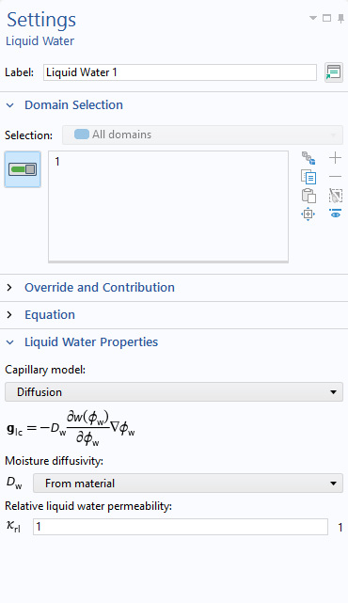
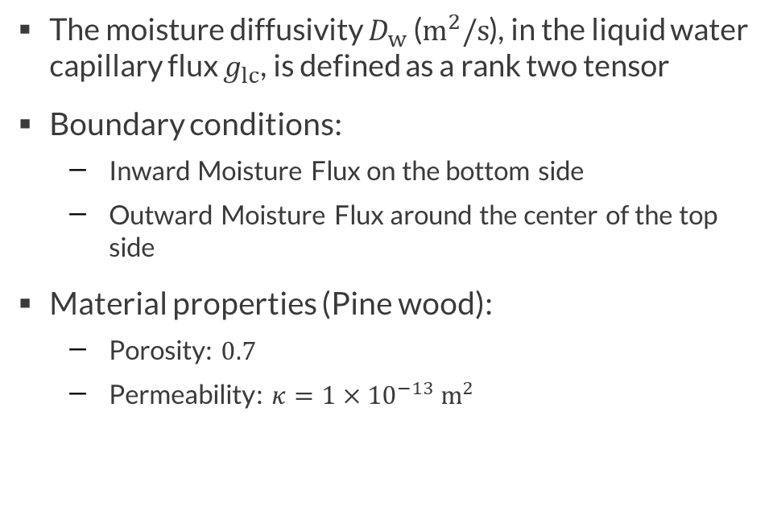
Model Definition
The moisture diffusivity $D_{w}$ ($m^{2}/s$), in the liquid water capillary flux $g_{lc}$, is defined as a rank two tensor
Boundary conditions:
  Inward Moisture Flux on the bottom side
  Outward Moisture Flux around the center of the top side
Material properties (Pine wood):
  Porosity: $0.7$
  Permeability: $κ=1×{10}^{−13} {\text{m}}^{2}$

Slide 4
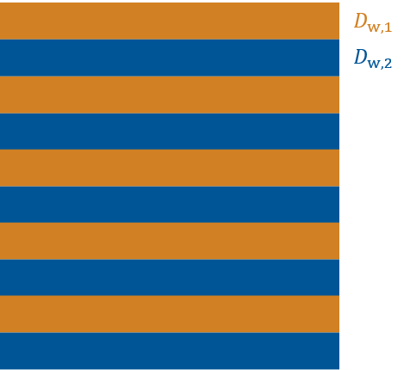
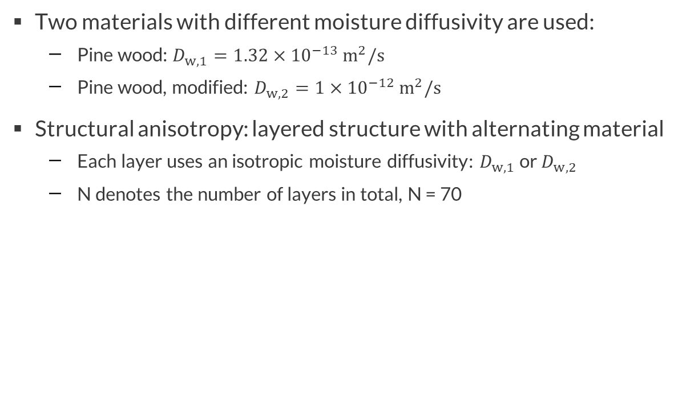
Model Definition
Structural Anisotropy
Two materials with different moisture diffusivity are used:
  Pine wood: $D_{w, 1}=1.32×{10}^{−13} m^{2}/s$
  Pine wood, modified: $D_{w, 2}=1×{10}^{−12} m^{2}/s$
Structural anisotropy: layered structure with alternating material
  Each layer uses an isotropic moisture diffusivity: $D_{w, 1}$ or $D_{w, 2}$
  N denotes the number of layers in total, N = 70
Material distribution in the porous medium.

Slide 5
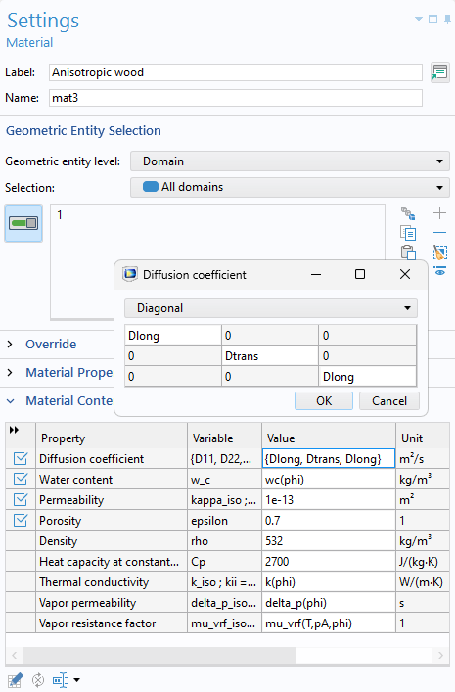
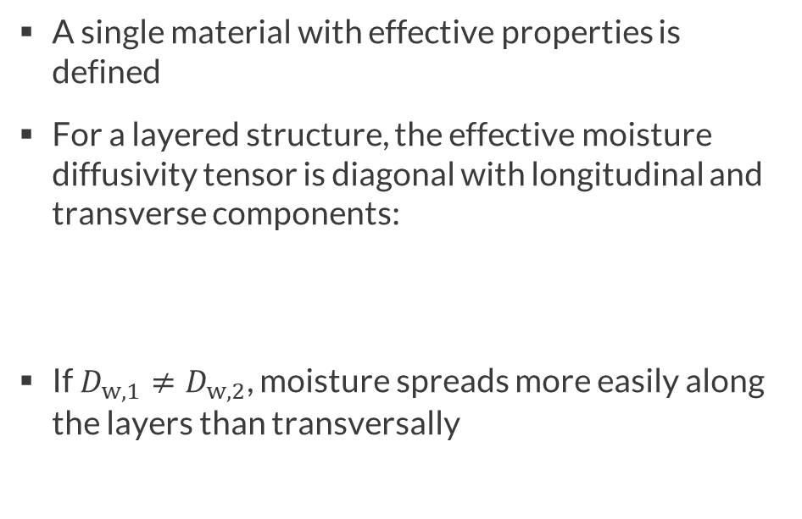
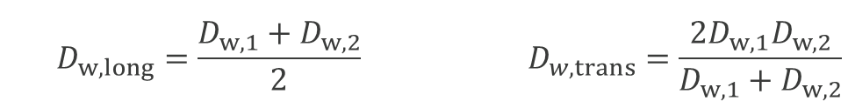
Model Definition
Effective Anisotropy
A single material with effective properties is defined
For a layered structure, the effective moisture diffusivity tensor is diagonal with longitudinal and transverse components:
If $D_{w, 1}≠D_{w, 2}$, moisture spreads more easily along the layers than transversally
  $$D_{w,long}=\frac{D_{w,1}+D_{w,2}}{2} D_{w,trans}=\frac{2D_{w,1}D_{w,2}}{D_{w,1}+D_{w,2}}$$

Slide 6
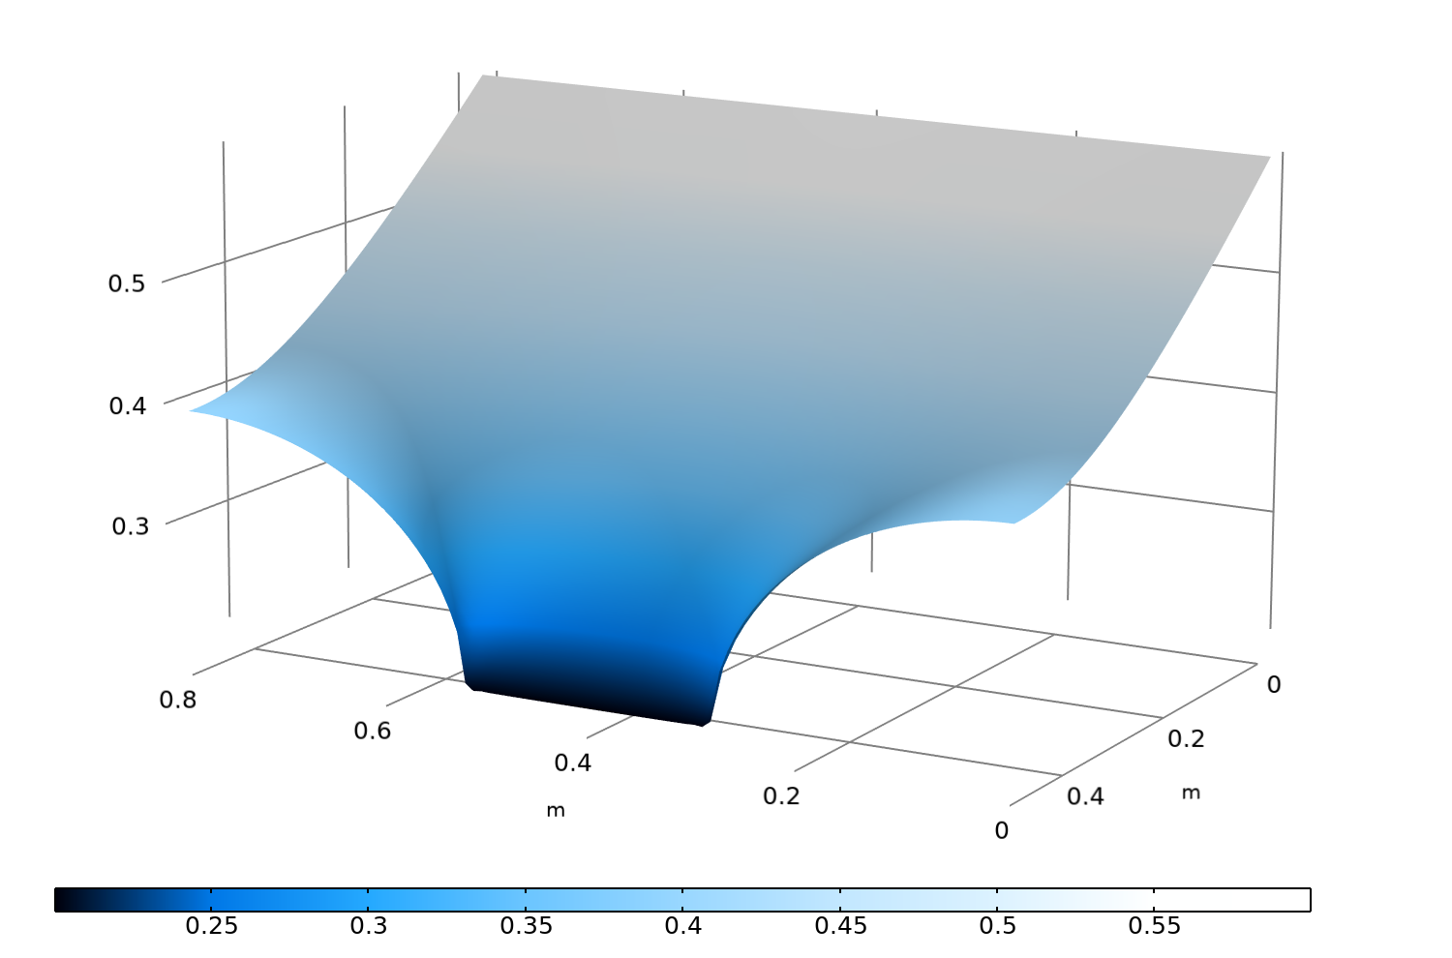
Relative Humidity Reference Solution
The plot shows the relative humidity distribution for the layered model
This solution is taken as a reference for further comparison with the effective properties model
Relative humidity distribution (height and surface plot) for the structural anisotropy model.

Slide 7
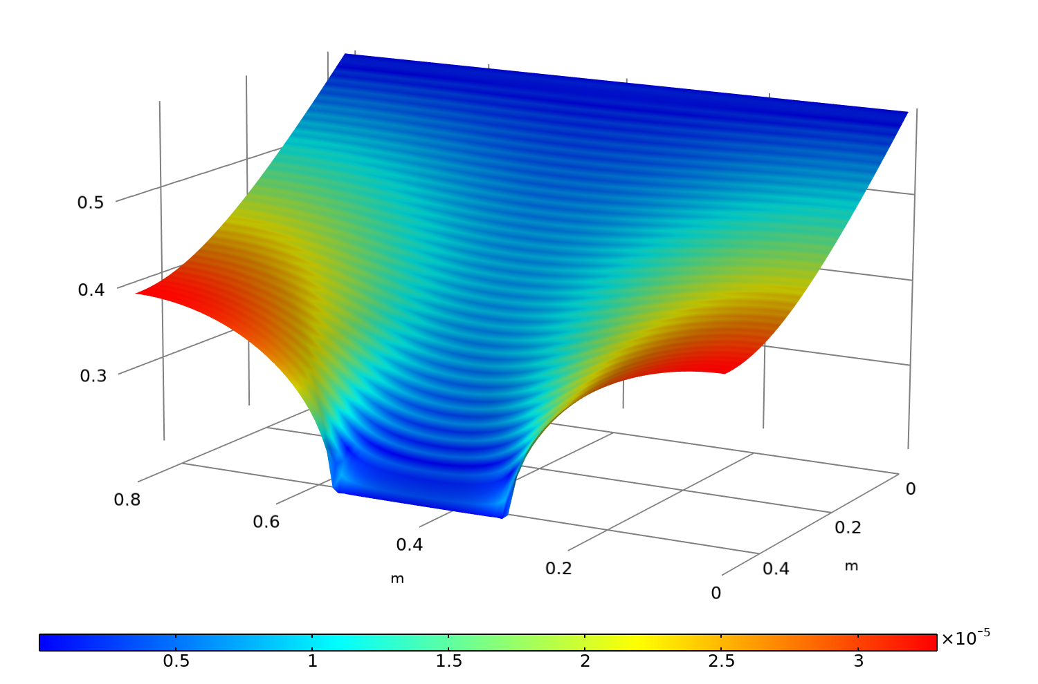
Relative Humidity Models Difference
The results obtained with the structural anisotropy model and the effective properties model are similar
The maximum relative difference in terms of relative humidity is inferior to 0.01%
The effective properties approach allows to specify the mesh with no concern for the layers
Relative humidity distribution (height) and relative difference between the two models (surface plot).

