Slide 1
Spot Weld Connection in a
Double Hat Beam

Slide 2
Introduction
This example demonstrates how to model spot welds in COMSOL Multiphysics.
The natural frequencies of a double hat beam are computed for two different set of spot welds location.
The beam is made of two steel sheets connected to each other using spot welds.
In COMSOL Multiphysics, the nugget definition is independent of the geometry/mesh. It is thus possible to modify the locations and diameters of the welds without having to regenerate the geometry or mesh.

Slide 3
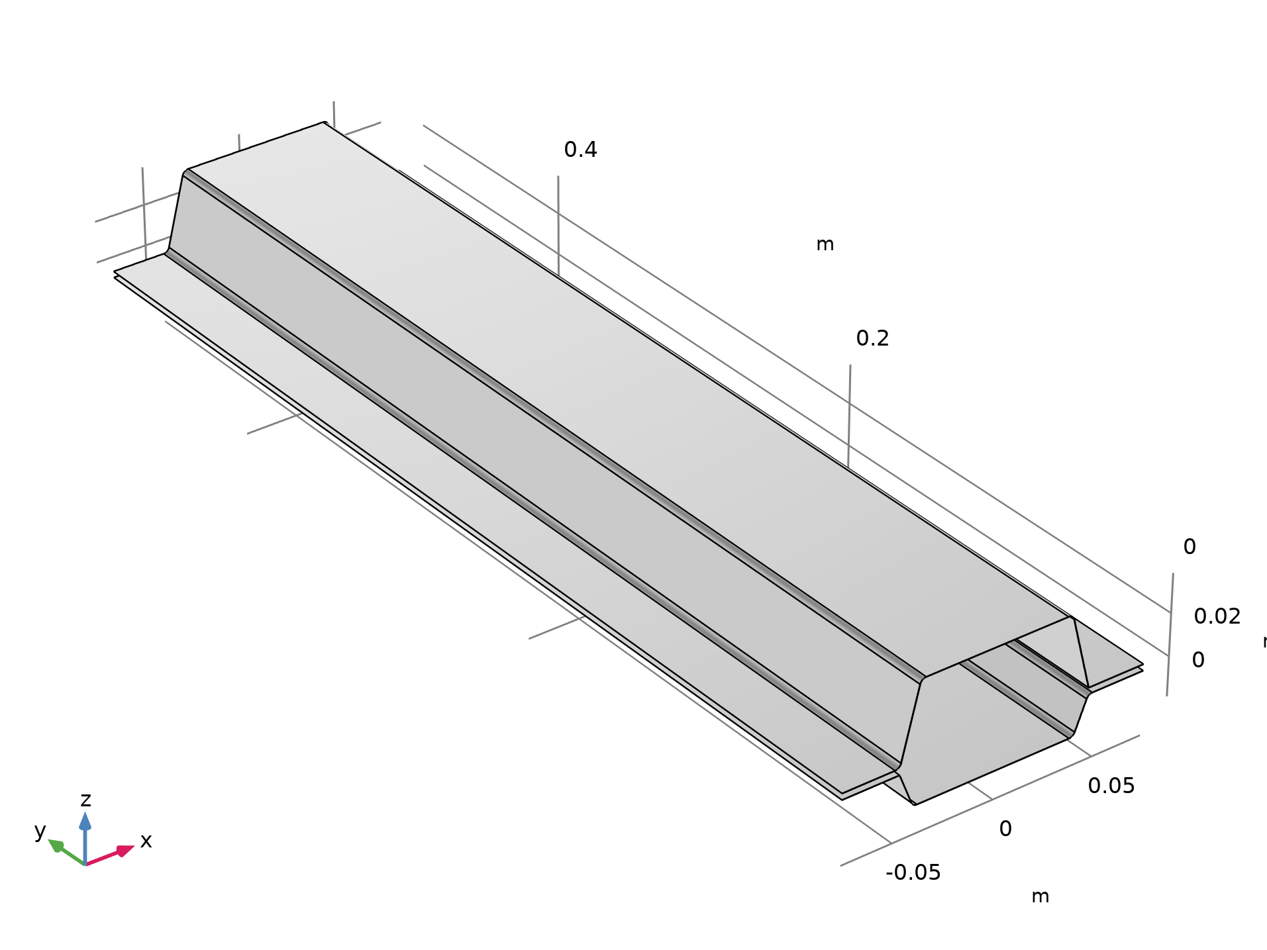
Model Definition
The model geometry consists in two faces representing a double hat beam.
The beam is 500 mm long, 150 mm wide and the flange width is about 28 mm.
The top hat height is 40 mm and the bottom hat height is 20 mm.
The plates are connected using 10 spot welds equally spaced on each flange. The nugget diameter is 6 mm.
The spot welds are not represented in the geometry.
Geometry

Slide 4
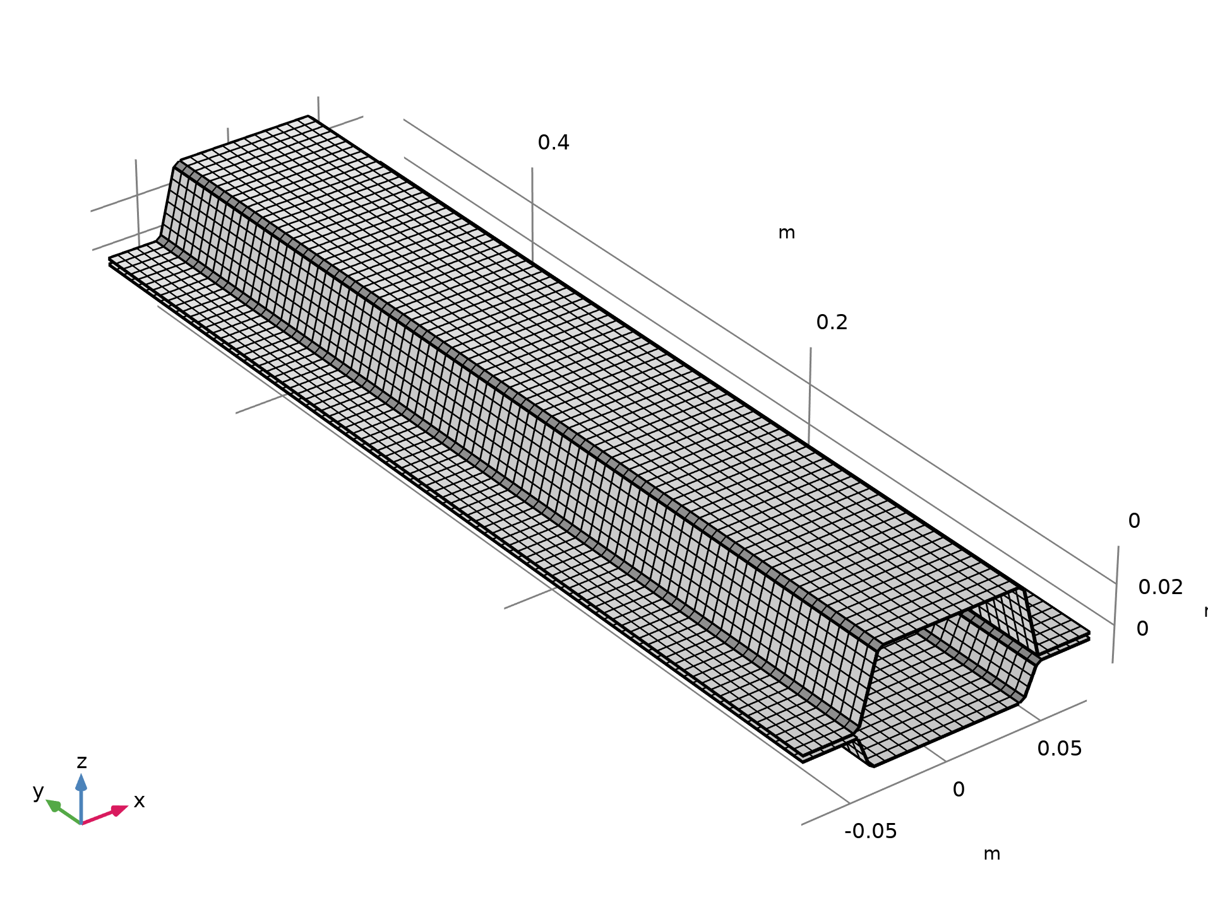
Mesh
The mesh consist of a mapped mesh with a maximum element size of 6 mm.
Mesh

Slide 5
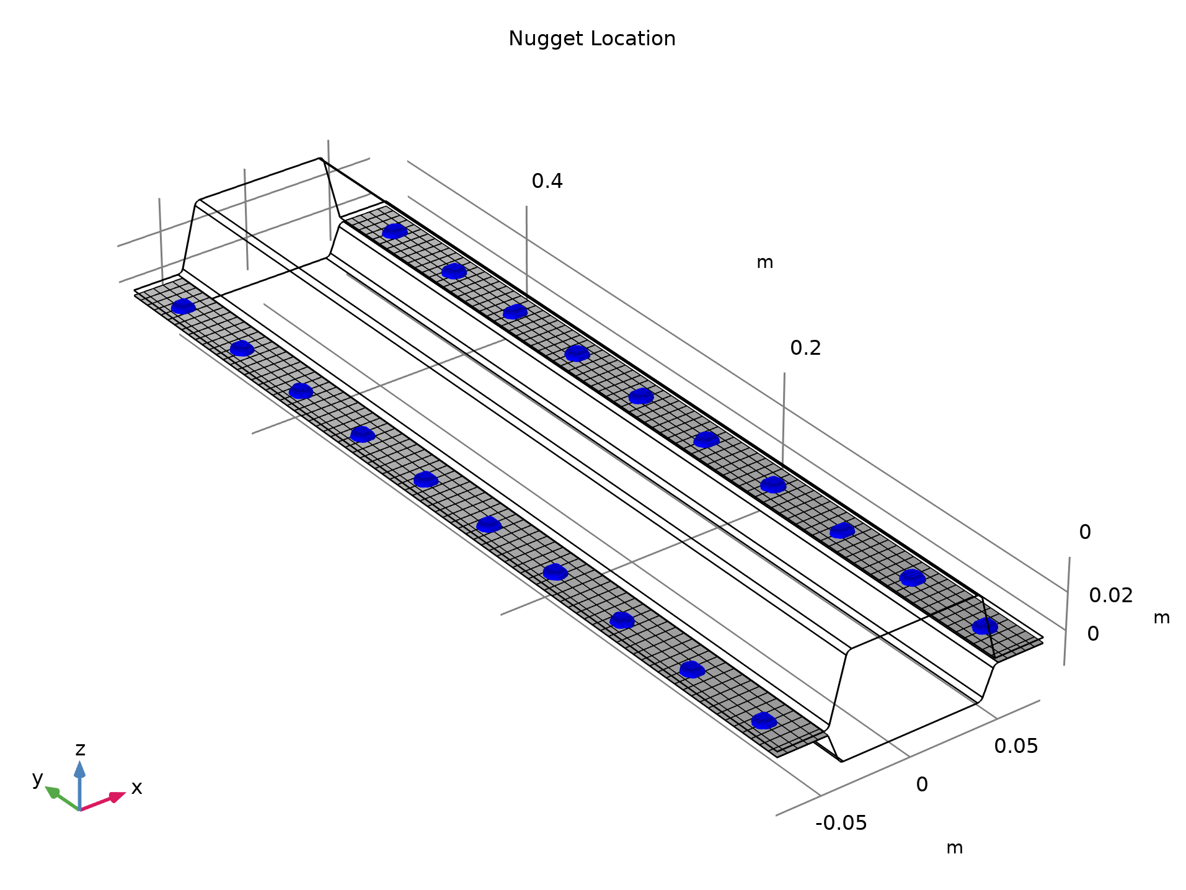
Spot Welds
The spot welds definition consist of
  Source and destination boundary selection
  Nugget coordinate locations,
  Nugget diameter
The coordinate locations can be stored in a text file and imported into the model.
The locations does not have to be exact as the coordinates are automatically projected to the destination boundary.
A cohesize thickness can be adjusted to fit the local stiffness.
Solid Mechanics

Slide 6
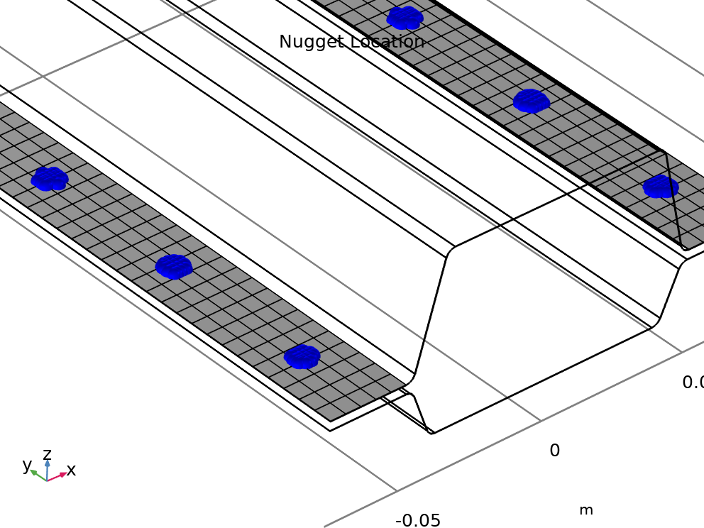
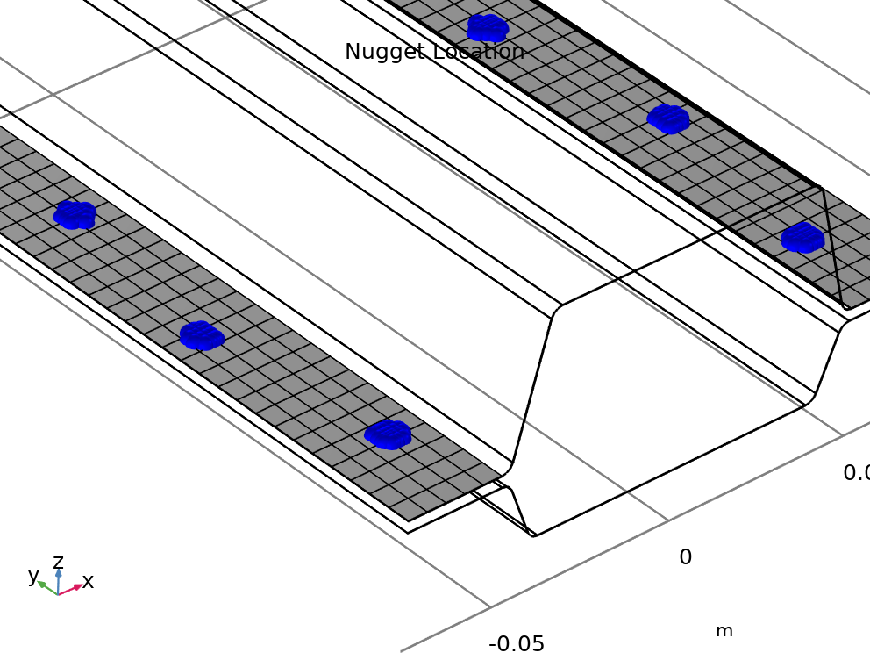
Spot Welds Location
Two sets of spot welds location are studied.
Case 1, the spot welds are aligned along the flange.
Case 2, the spot welds are misaligned (4mm in the x-direction).
Spot Welds location for case 1 (top) and case 2 (bottom)

Slide 7
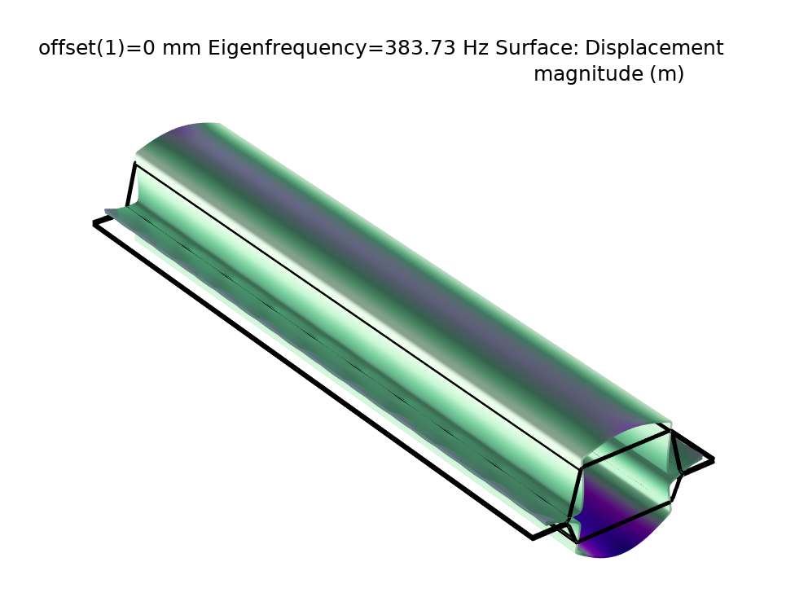
Results, Eigenfrequencies
Mode | Case 1 | Case 2
1 | 384 Hz | 410 Hz
2 | 391 Hz | 423 Hz
3 | 431 Hz | 433 Hz
4 | 456 Hz | 460 Hz
5 | 731 Hz | 738 Hz
6 | 876 Hz | 8t8 Hz
Displacement at the 1st Eigenmode

Slide 8
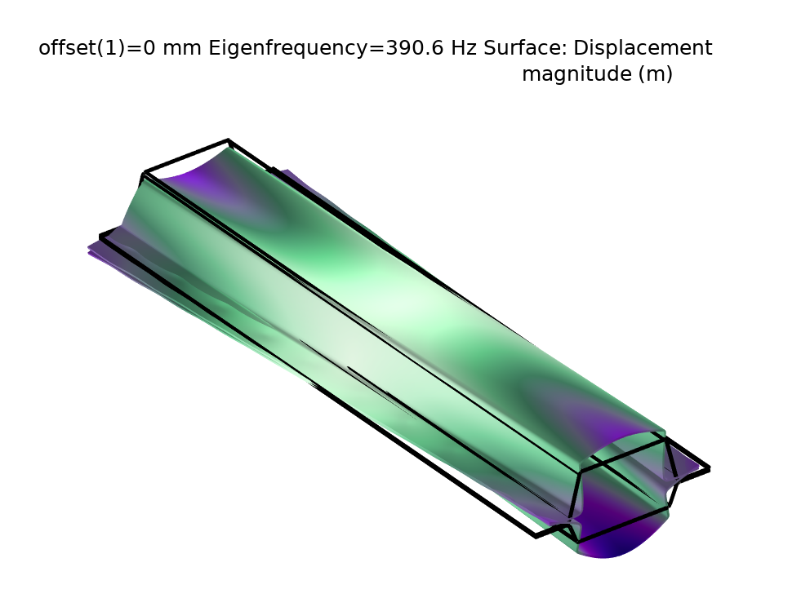
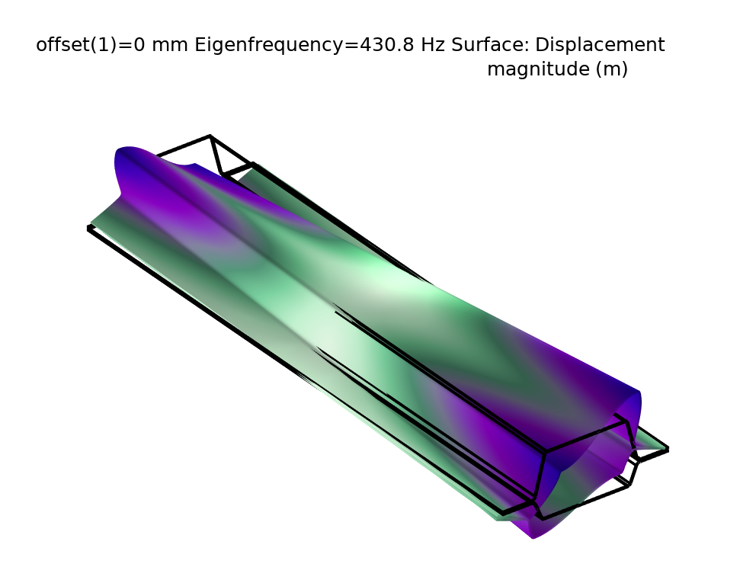
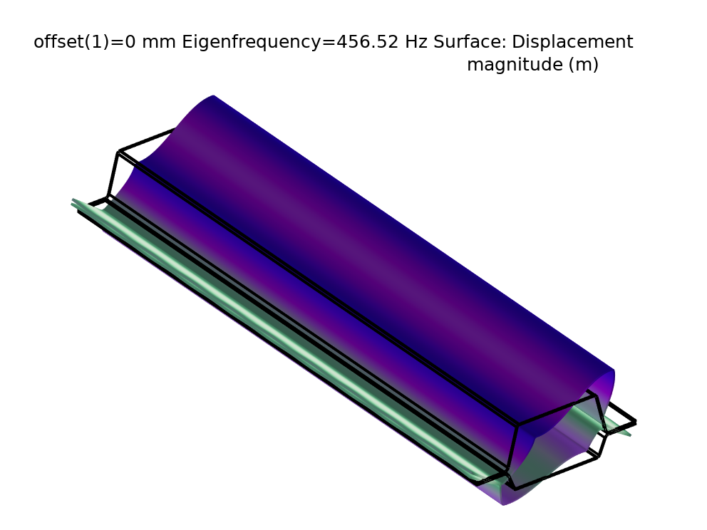
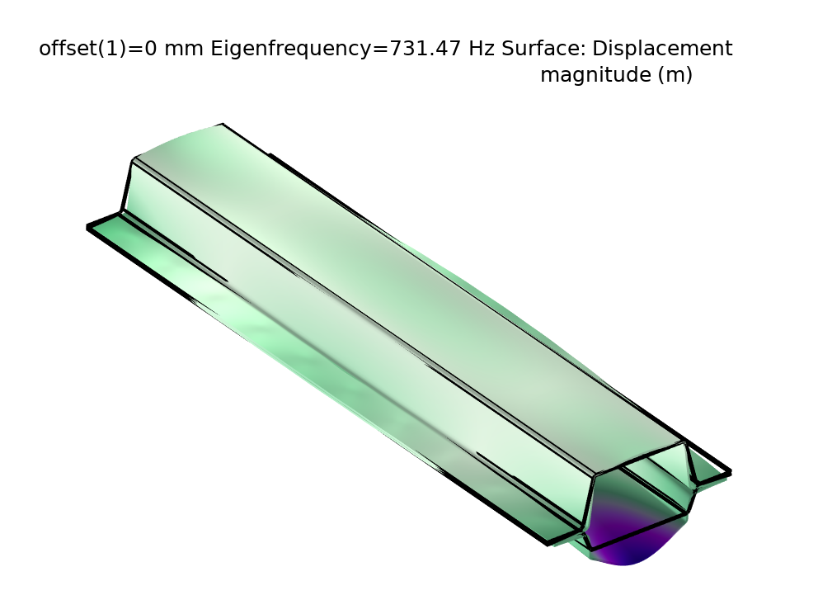
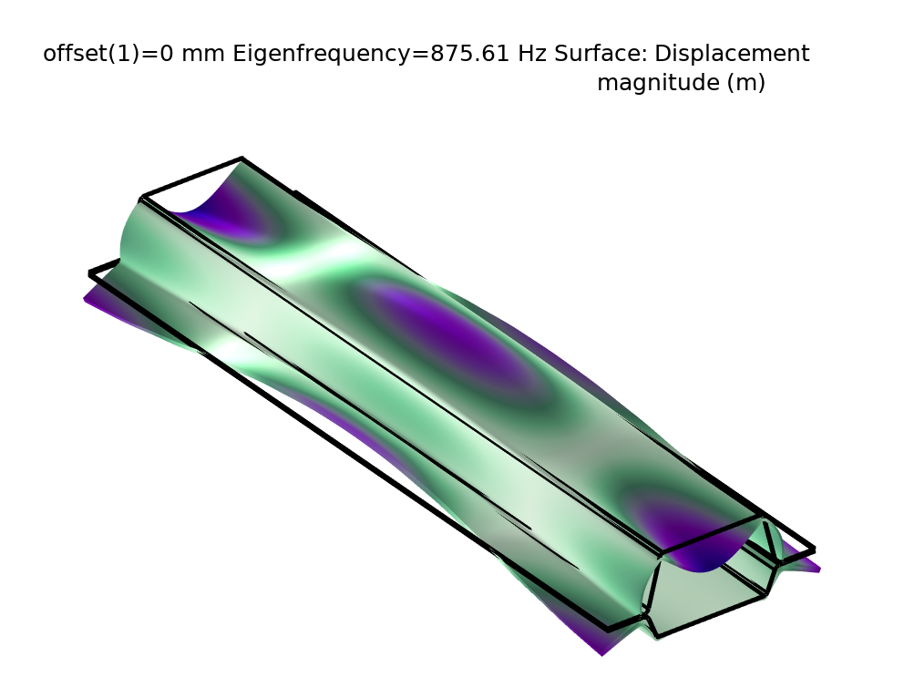
Results, Mode Shapes
The mode shapes for the first 6 eigenfrequencies (from left to right, top to bottom)

