Slide 1
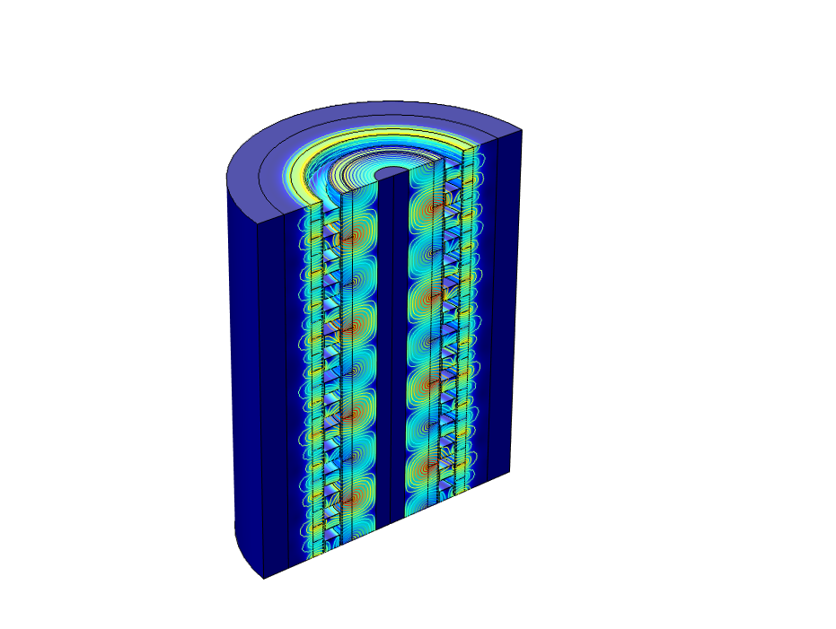
Linear Magnetic Gear in 2D Axisymmetry

Slide 2
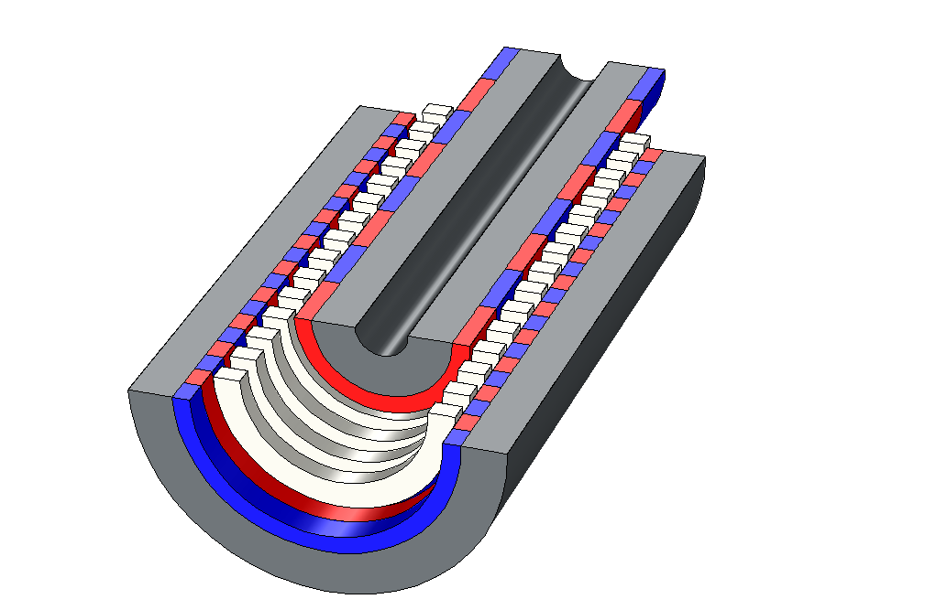
Construction
High speed armature
P_{i} = 2 pole pairs
Stationary steel poles
P_{s} = 15 pole pairs
V_{i}
Iron backing
Low speed armature
P_{o} = 11 pole pairs
V_{o}
Iron backing
Permanent magnets
(blue and red)

Slide 3
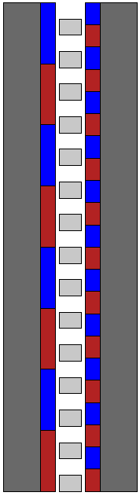
Construction
Iron Backing
Iron Backing
High Speed
Armature
Low Speed
Armature
Permanent Magnets
Stationary Steel Poles
r=0
Low speed rotor consists of Iron and 11-pole pair permanent magnets (22 pieces).
The stationary steel poles consists of 15 equally spaced steel pieces.
High speed rotor consists of Iron and 4-pole pair permanent magnets (8 pieces)

Slide 4
Construction (contd.)
The low speed armature (on the right) consist of 22 permanent magnets (PMs) pieces and a soft iron backing forming a 11-pole pair rotor.
The high speed armature (on the left) consists of 8 PMs pieces and soft iron backing forming a 4-pole pair rotor.
The middle stationary ring consists of 15 steel poles with equally spaced airgaps in between.
The number of pole pairs for all three section are selected such that the torque ripple is minimum.
The torque/speed relation is given in the next slide.

Slide 5




Gear Ratio and Torque Transmission
The relation between the speeds of the three rotors is:
ω$l=\frac{ph}{ph−ps}\text{ω}h+\frac{ps}{ps−ph}\text{ω}s$
ω_{l} = Speed of low speed rotor
ω_{h} = Speed of high speed rotor
ω_{s} = Speed of steel poles.
p_{l} = Number of pole pairs in low speed rotor = 11
p_{h} = Number of pole pairs in high speed rotor = 4
p_{s} = Number of pole pairs in steel pole rotor = 15
Keeping the steel poles stationary i.e. ω_{s} =0
ω$l=\frac{ph}{ph−ps}\text{ω}h$
Since, p_{h} - p_{s}= -p_{l}
ω$l=−\frac{ph}{pl}\text{ω}h=−$G₁₂$\text{ω}h$
Where, G₁₂ is called gear ratio.
These ripples are primarily due to the cogging torque created from the interaction of the PM motors and the stationary steel poles-pieces. The armature with less pole pairs usually has a higher cogging torque (armature on the left). The parameter that is used for minimizing these cogging torque is called a cogging factor given by:
C$f=\frac{ps 2ph}{LCM(2ph,ps)}$
Here, LCM is a “least common multiple”. The best configuration is obtained for C_{f} = 1.

Slide 6
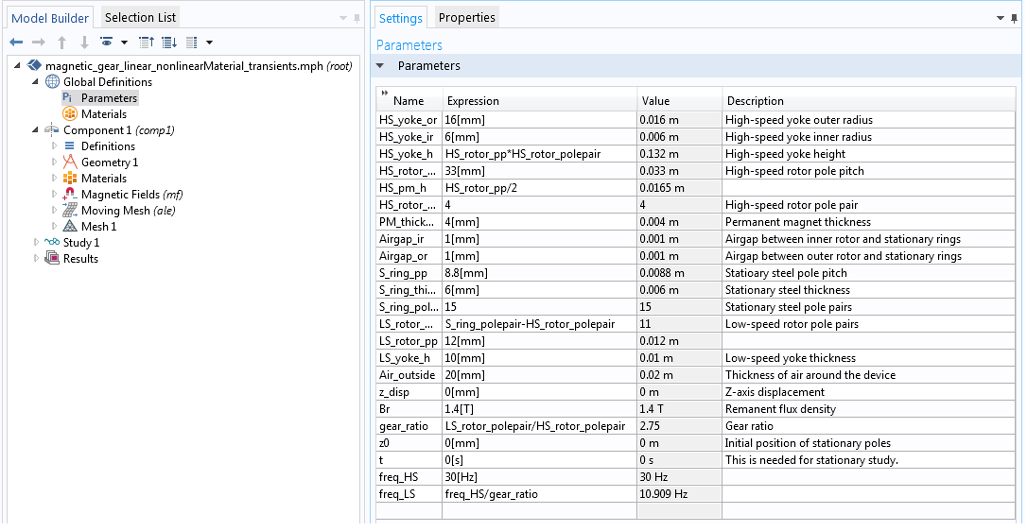
Parameters

Slide 7
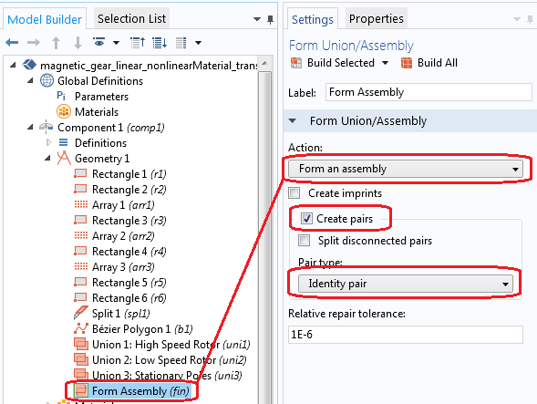
Geometry
Note 1: Form three Unions for high speed armature, low speed armature and stationary steel regions.
Note 2: The Form an Assembly option is needed here to create geometric discontinuity which is used later to allow the mesh around the rotor to slide against the mesh around the stator. Two separate Identity Pairs are created (as shown in next two slides).

Slide 8
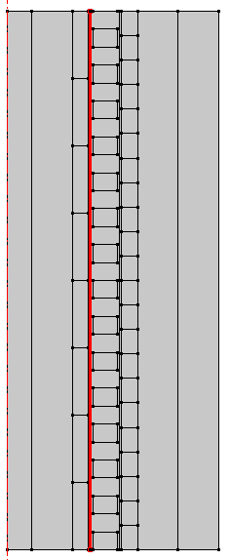
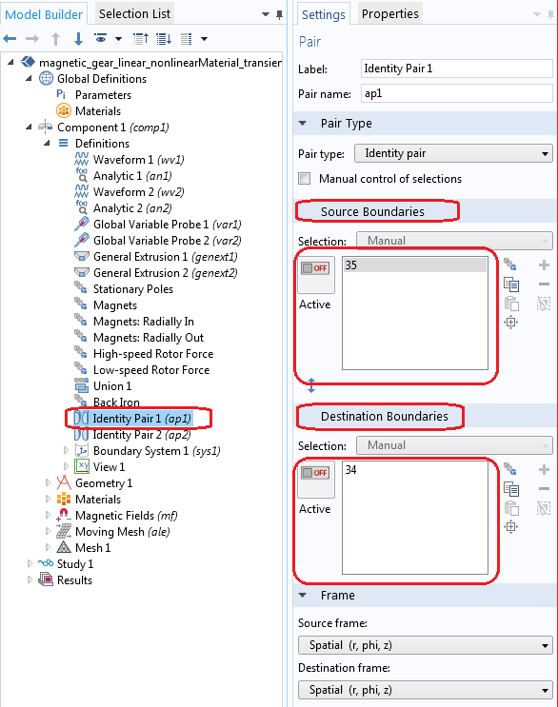
Identity Pair I

Slide 9
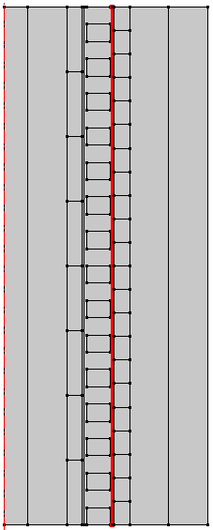
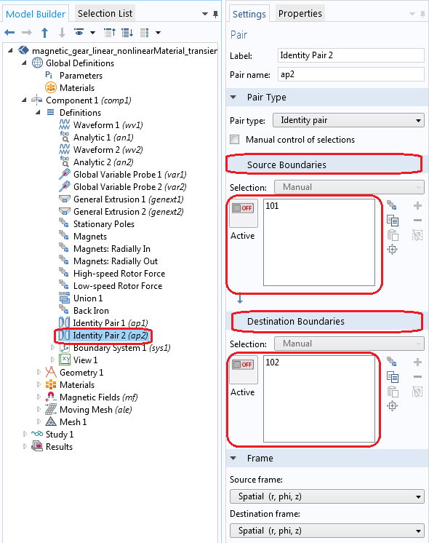
Identity Pair 2

Slide 10
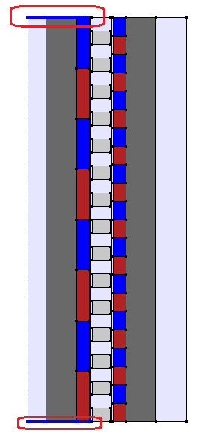
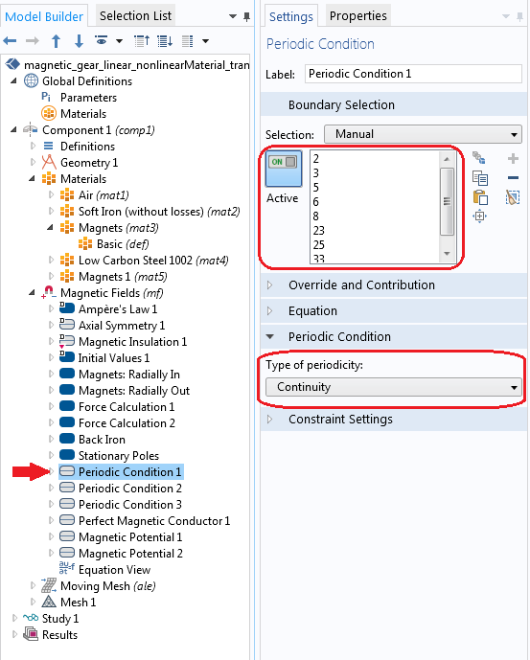
Periodic Condition 1
NOTE: The identical mesh should be used at the source and destination boundaries of the periodic boundary condition.

Slide 11
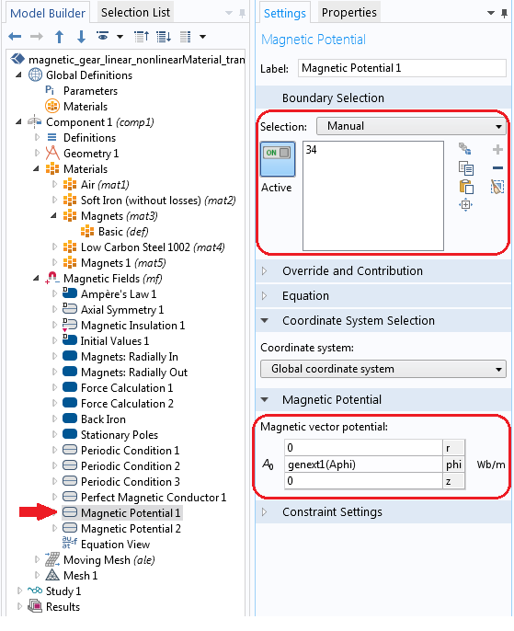
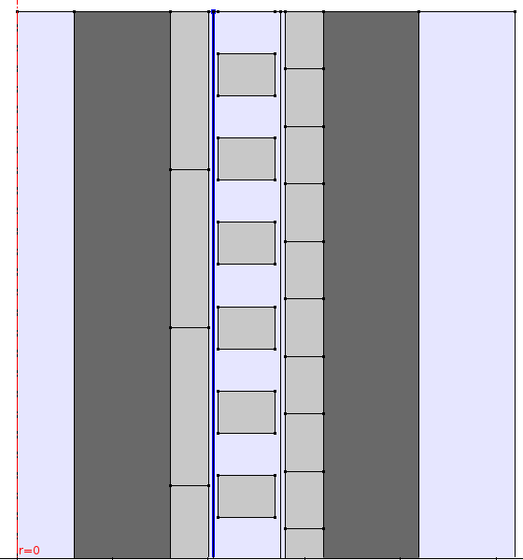
Magnetic Potential 1Using General Extrusion 1

Slide 12
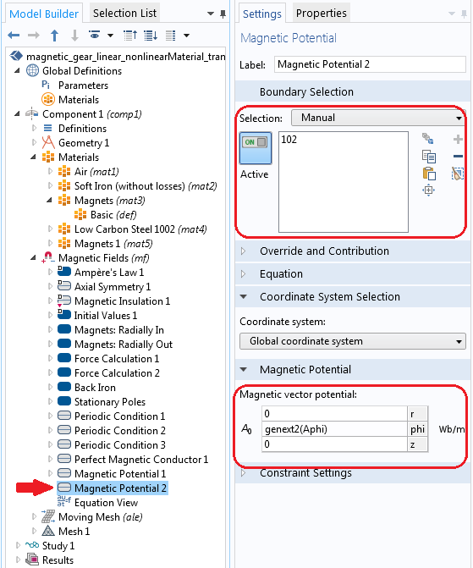
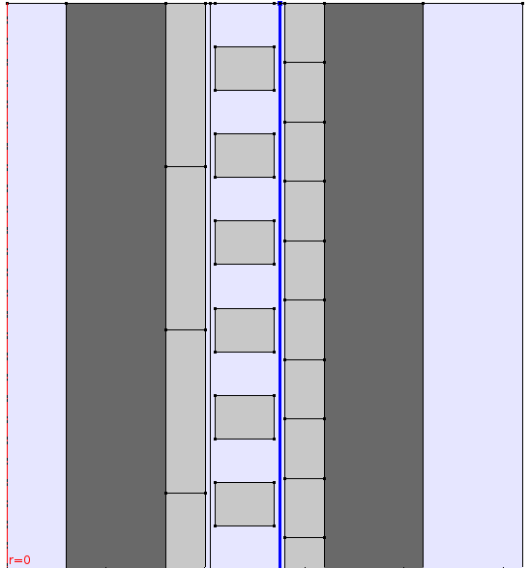
Magnetic Potential 2using General Extrusion 2

Slide 13
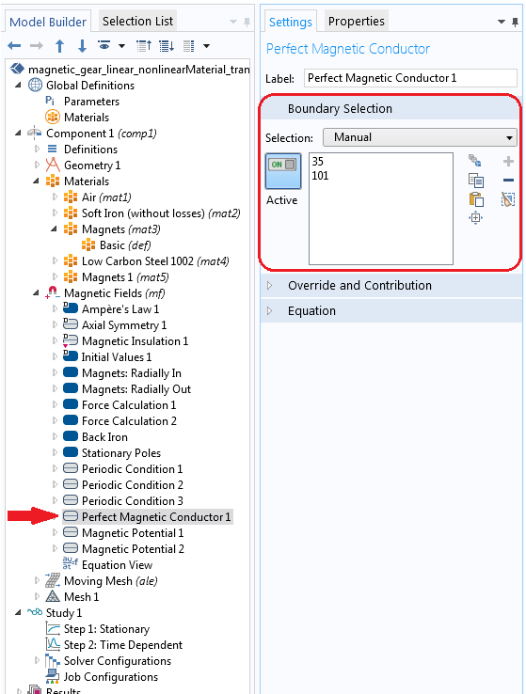
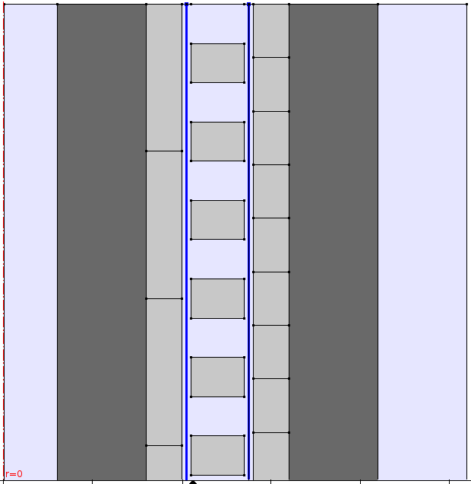
Perfect Magnetic Conductor

Slide 14
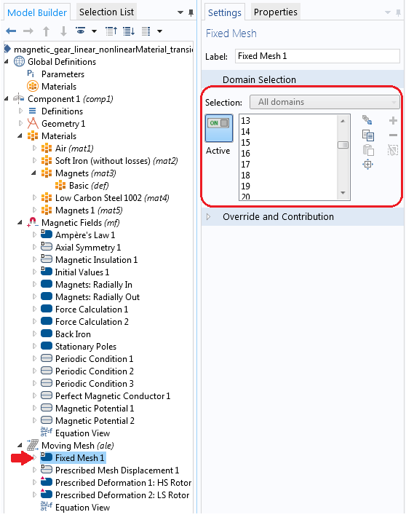
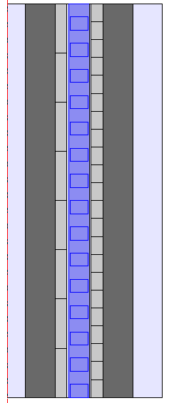
Moving Mesh: Fixed Mesh Part

Slide 15
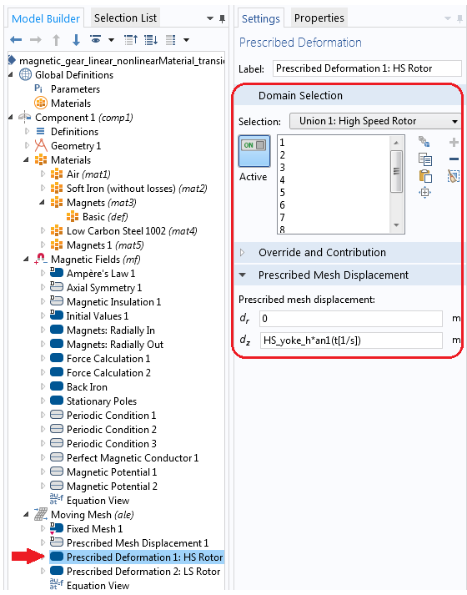
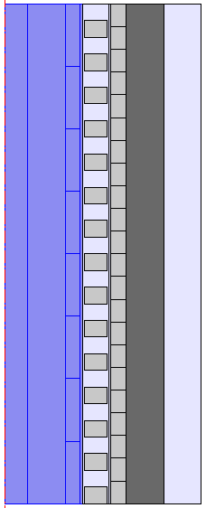
Moving Mesh: Prescribed Deformation High Speed Armature

Slide 16
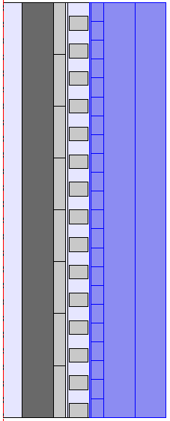
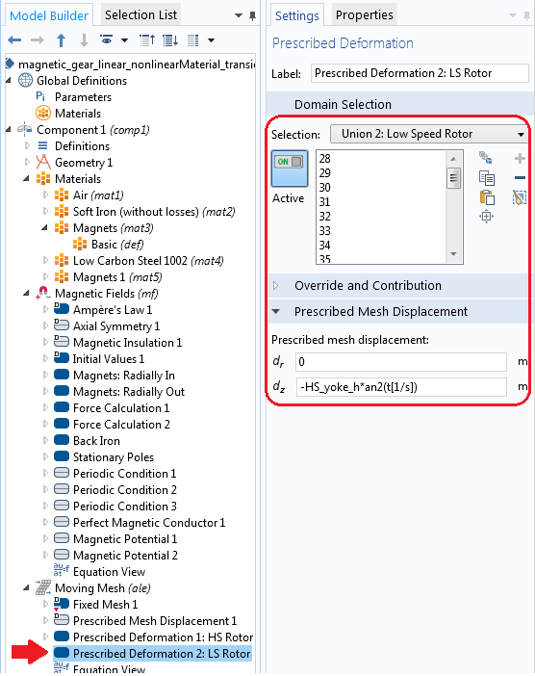
Moving Mesh: Prescribed Deformation Low Speed Armature

Slide 17
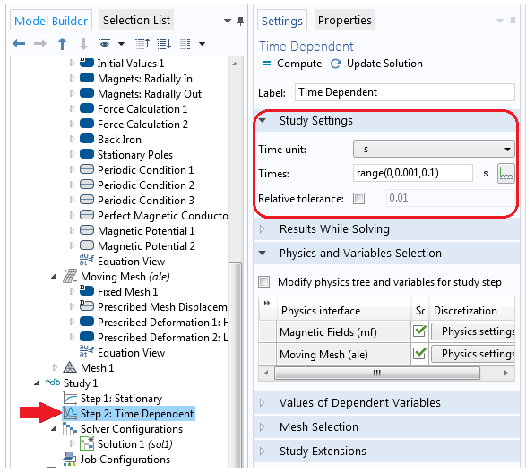
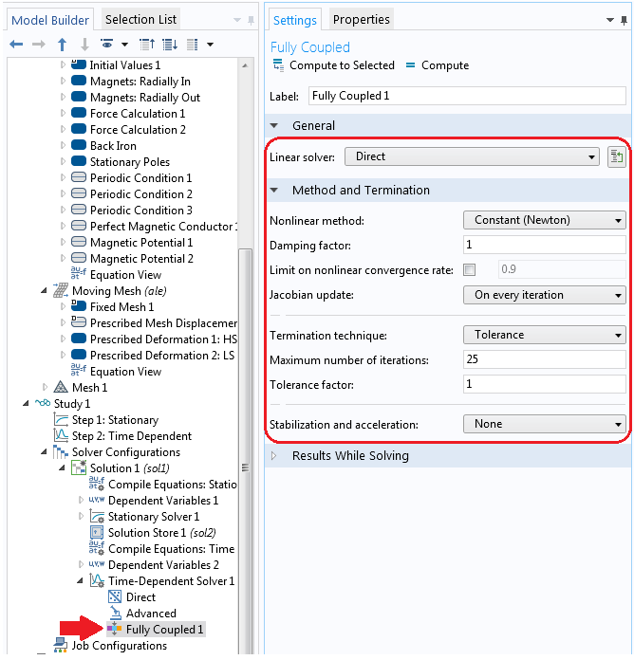
Solver Settings
# Add “Time Dependent” solver
# Right click “Study 1” -> “Show Default Solver”
NOTE: “Stationary” step is necessary to model the magnetic fields produced by the Permanent Magnets at t=0[s]. The results from the “Stationary” study will automatically be used as the initial condition for the “Time Dependent” study step. See the following Knowledge Based Entry for detail:
http://www.comsol.com/support/knowledgebase/1127/

Slide 18
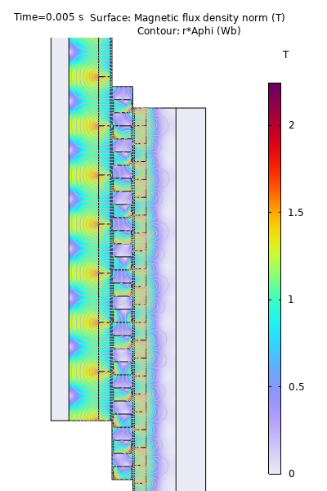
Results: Magnetic Flux Density
Notes:
The model was solved for a single pole, but the results are displayed for other two poles before and after the actual one that is solved.

Slide 19
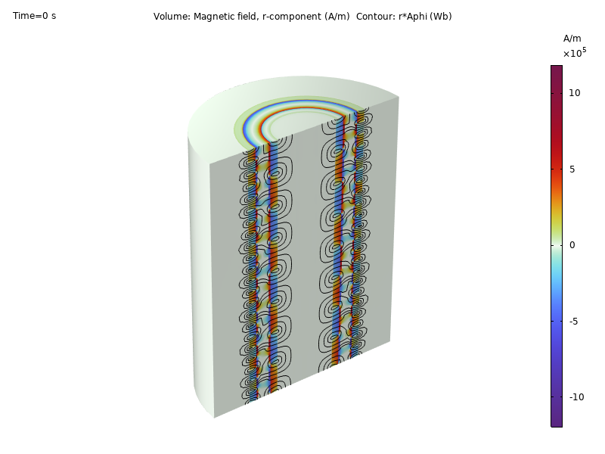
Results: Magnetic Field, Radial Component
Notes:
The model was solved for a single pole, but the results are displayed for other two poles before and after the actual one that is solved.

Slide 20
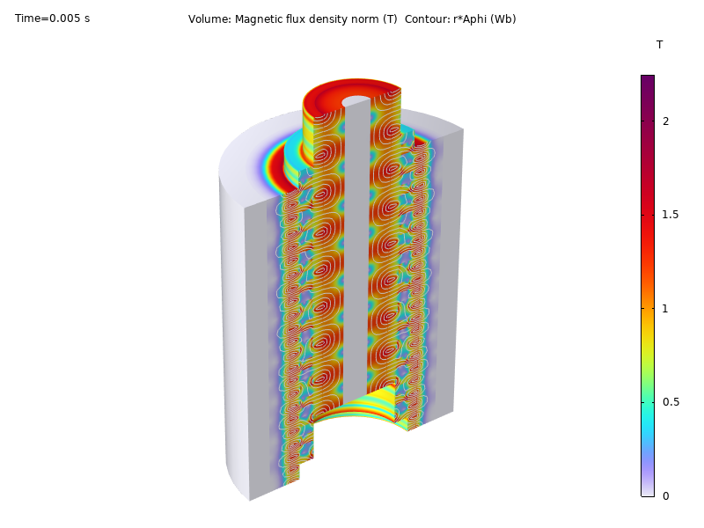
Results: Magnetic Flux Density
The volume plot for magnetic flux density norm and the contour plot for magnetic flux density radial component.

Slide 21
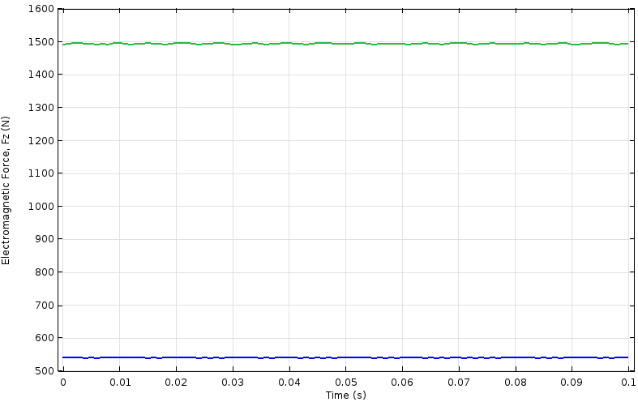
Result: Electromagnetic Forces on the High Speed and Low Speed Armatures
Low speed armature
High speed armature

Slide 22
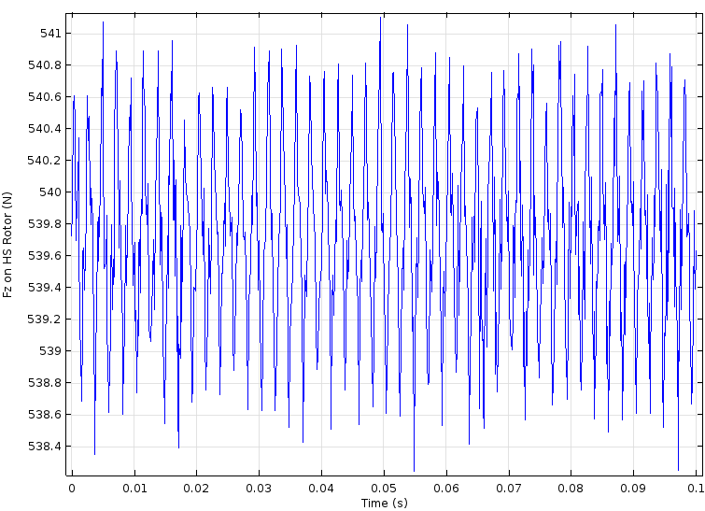
Result: Electromagnetic Force, F_{z} on the High Speed Armature

Slide 23
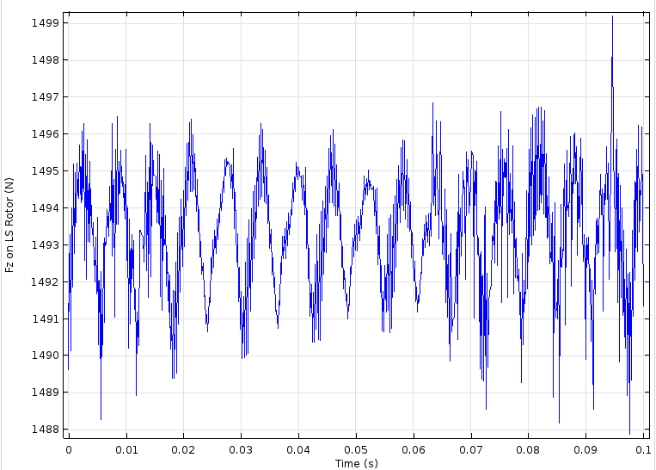
Result: Electromagnetic Force, F_{z} on the Low Speed Armature

Slide 24
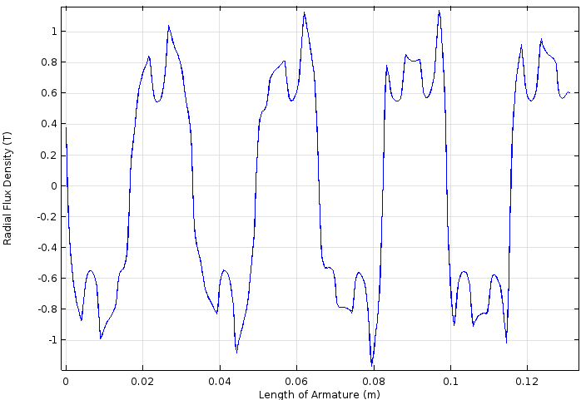
Results: Magnetic Flux Density in the Airgap adjacent to High Speed Armature
This is the plot for r-component of magnetic flux density in the airgap between the high speed rotor and steel poles along the length of the armature at time t=0s.

Slide 25
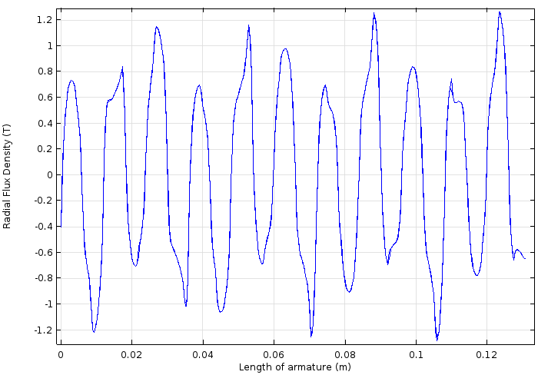
Results: Magnetic Flux Density in the Airgap adjacent to Low Speed Armature
This is the plot for r-component of magnetic flux density in the airgap between the low speed rotor and steel poles along the length of the armature at time t= 0s.

