Slide 1
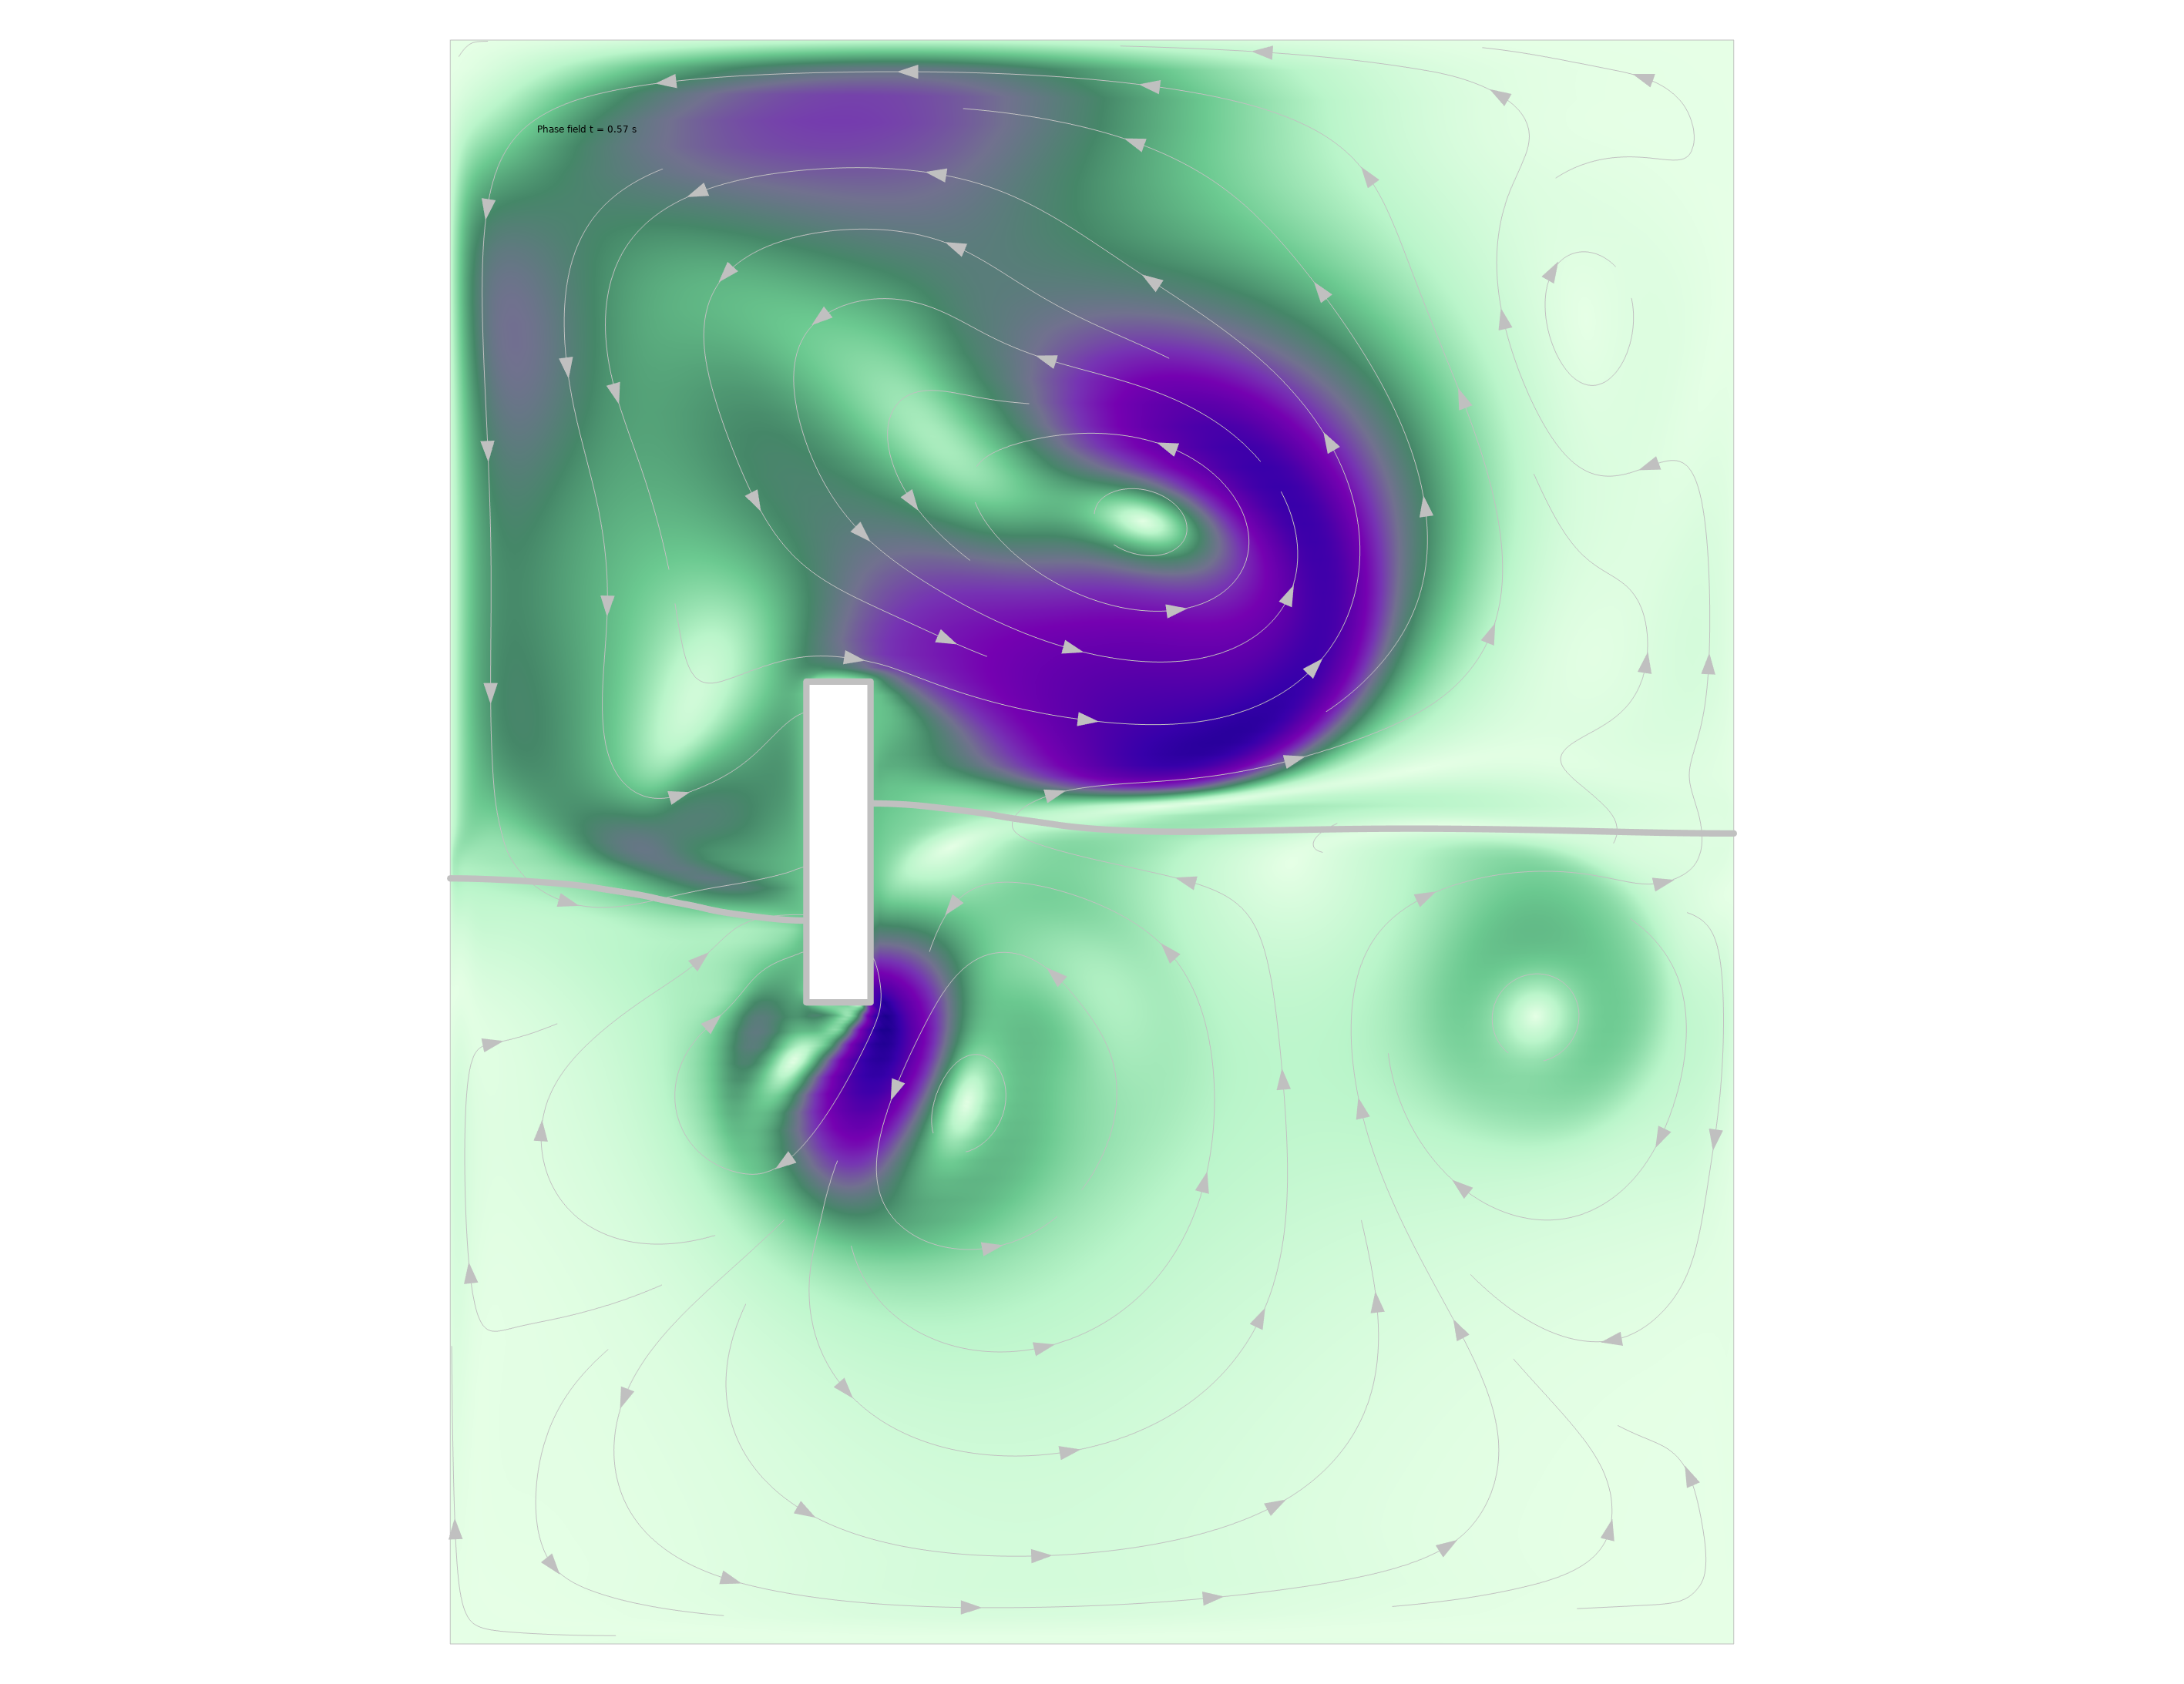
Modeling of Free Surfaces in
COMSOL Multiphysics®
A Comparison of Level Set, Phase Field, and Moving Mesh Methods

Slide 2
Free Liquid Surfaces
Three different approaches:
Level Set
Phase Field
Moving Mesh

Slide 3
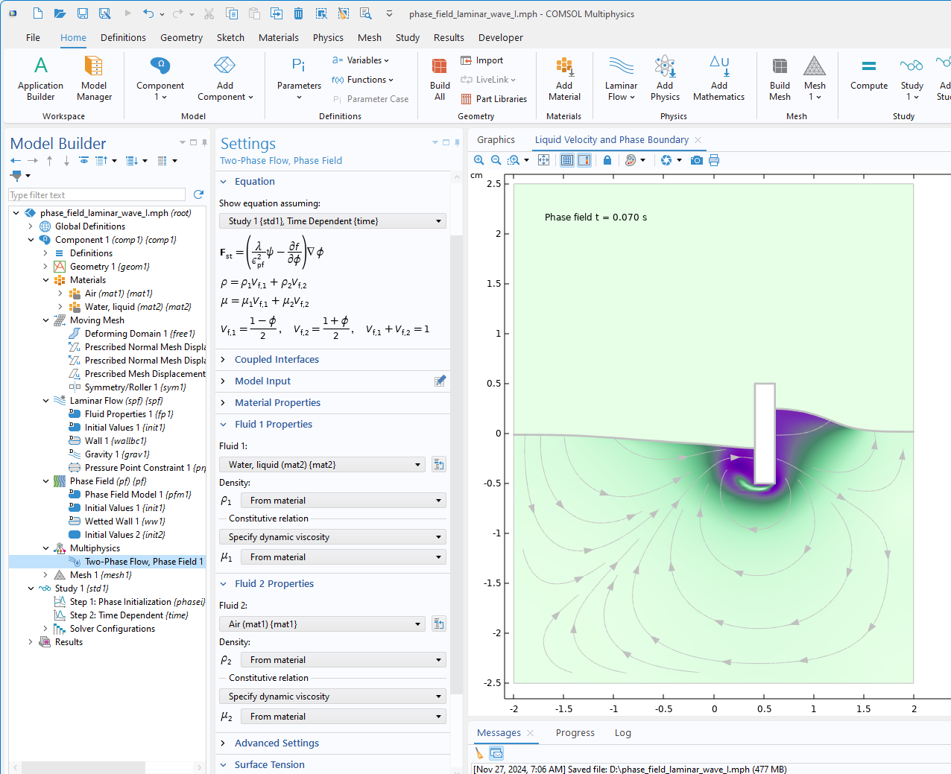
Level Set and Phase Field Methods
The free surface is an isosurface of either the level set or the phase field function, both denoted φ
The level set or phase field functions, φ, are advected by the fluids’ velocity vectors
The value of φ determines the properties of the fluids, e.g. if it is the liquid or the gas

Slide 4

Level Set and Phase Field Methods
The model equation (the nonconservative form):
  $$\frac{∂φ}{∂t}+u∙∇φ=F$$
The source term, F, differs in the two methods
The velocity vector The phase field or level set function A source term

Slide 5

Level Set and Phase Field Methods
Fluid Properties with volume averaging:
  $$ρ=ρ_{1}+\left(ρ_{2}−ρ_{1}\right)φ$$
  $$μ=μ_{1}+\left(μ_{2}−μ_{1}\right)φ$$
The example is for the level set function but the analogy is valid for the phase field function
Density Dynamic Viscosity

Slide 6
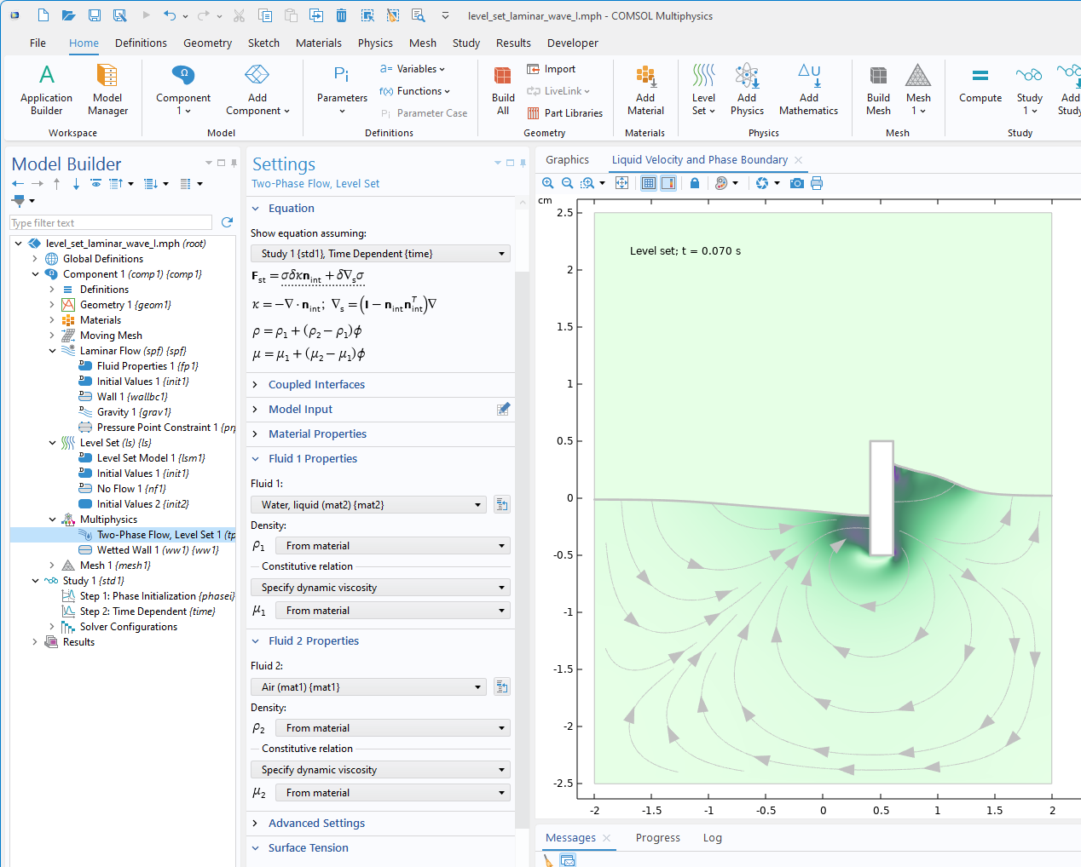
Level Set and Phase Field Methods
Surface tension introduced as a source term in the momentum equations:
Level set uses the curvature of the isosurface to compute the source
Phase field adds a force computed from the chemical potential close to the isosurface to account for surface tension

Slide 7
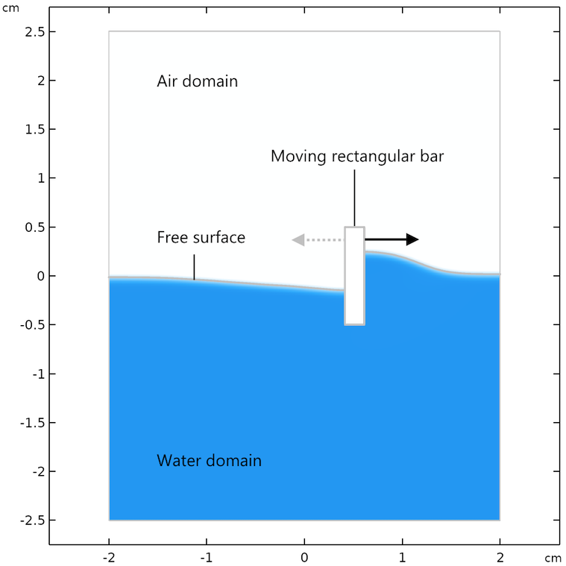
The Example Problem
Add gravity
Add reference point with a pressure point constraint
Use Navier slip condition for the walls

Slide 8
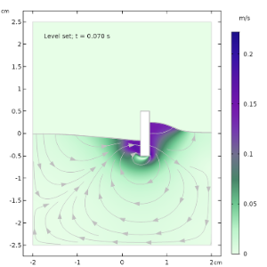
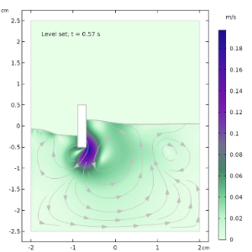
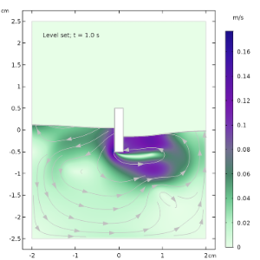
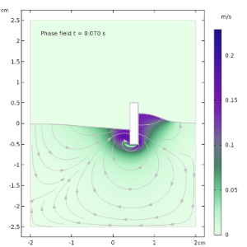
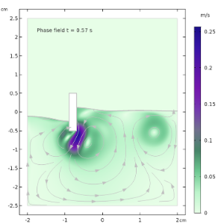
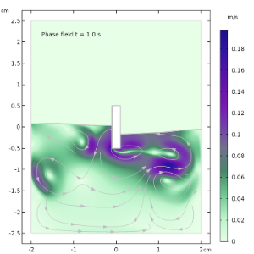
Results: Level Set vs Phase Field

Slide 9
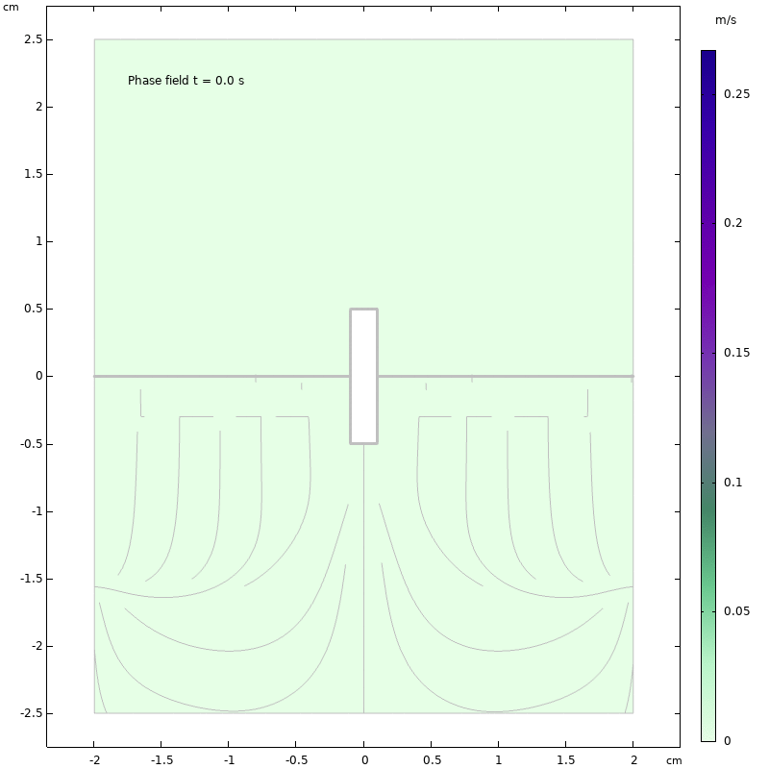
Phase Field

Slide 10
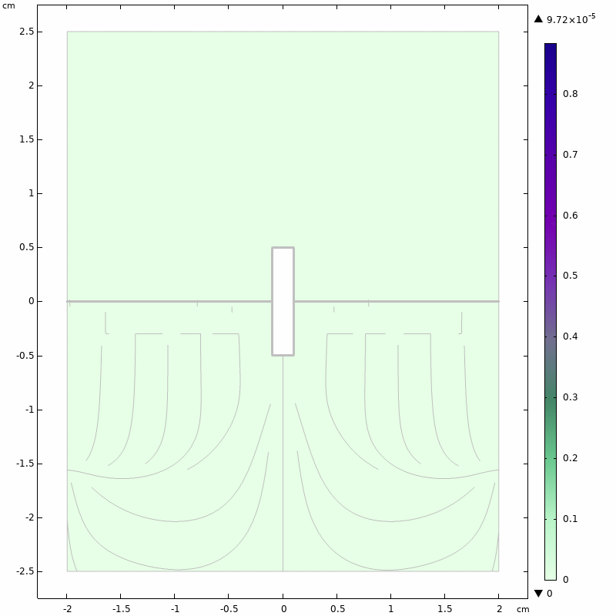
Phase Field with Topology Changes

Slide 11
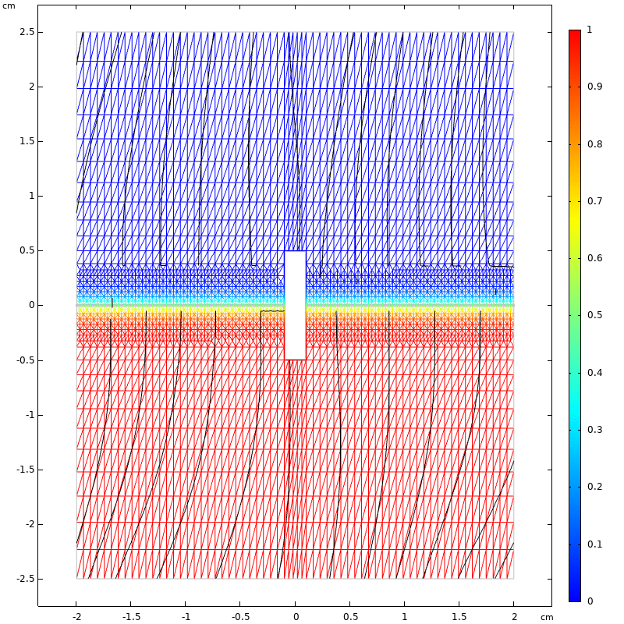
Adaptive Meshing

Slide 12
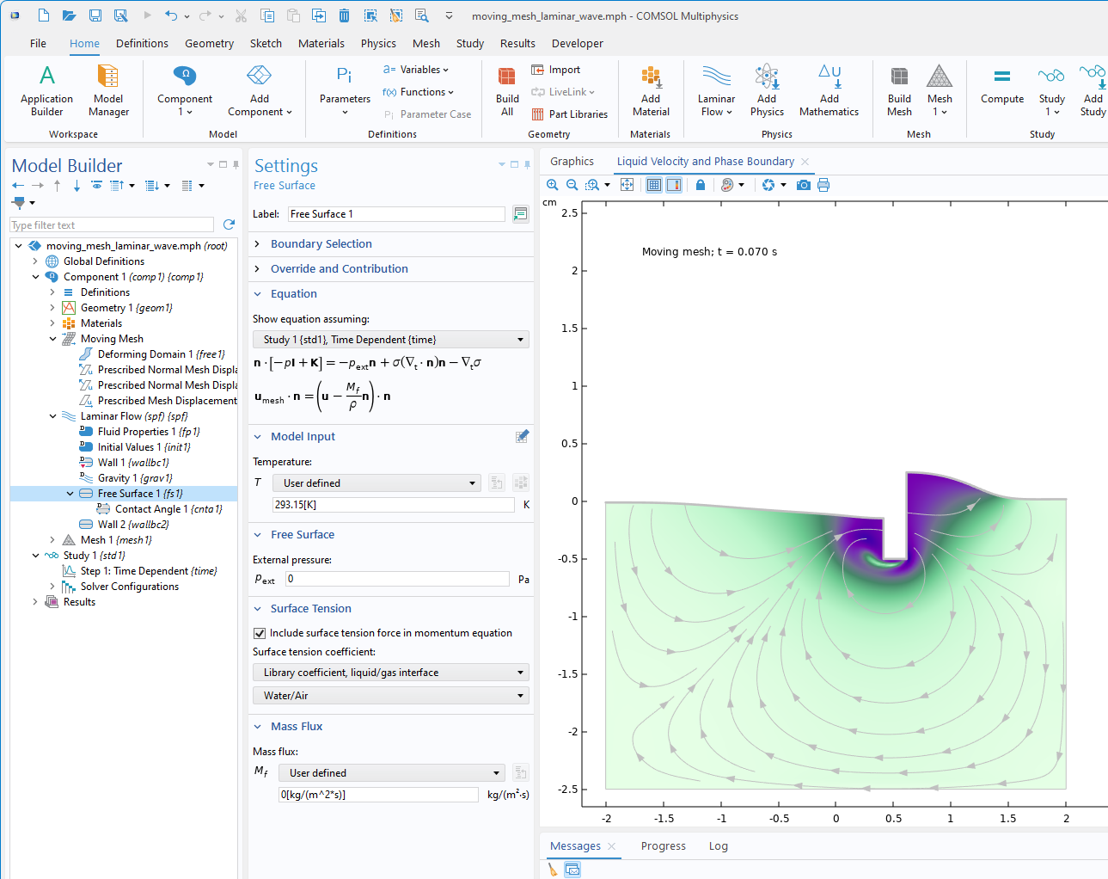
Free Surface with Moving Mesh
The displacement velocity of the free surface is obtained as the fluid’s velocity
The solution to the moving mesh equations smoothly displaces the mesh nodes at the surface and inside the bulk of the fluid
The Navier-Stokes equations are solved on a moving frame fully coupled to the mesh equations

Slide 13
Free Surface with Moving Mesh
Benefits:
  Forces on the surface, such as surface tension, can be added directly at the surface as boundary conditions
  Computationally efficient since there is the option to avoid computing the velocity and pressure fields in the gas phase
Downside:
  Cannot handle topology changes

Slide 14
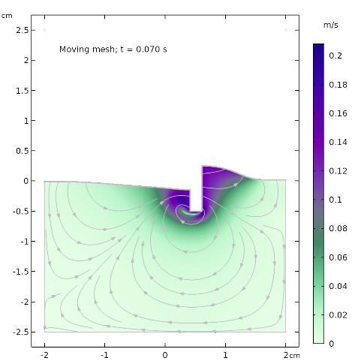
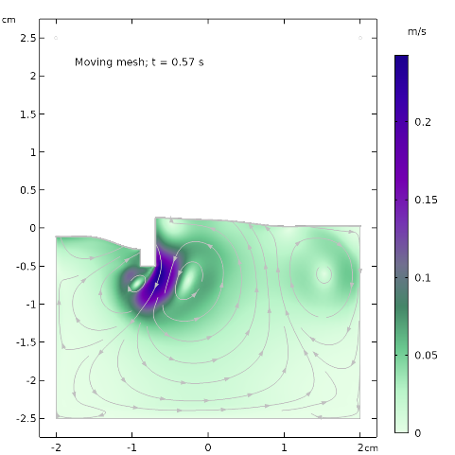
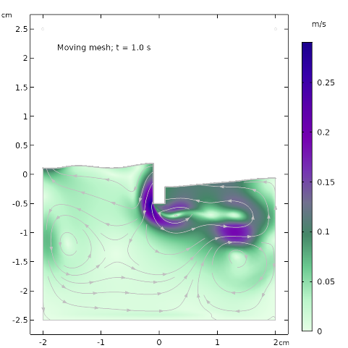
Moving Mesh vs Phase field

Slide 15
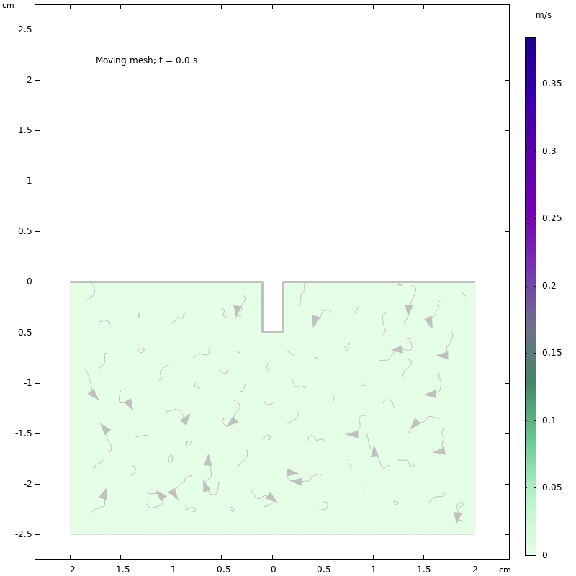
Moving Mesh vs Phase field

Slide 16
Conclusions for Modeling of Free Surfaces
Moving mesh is the best choice if there are no topology changes
Phase field is the best choice for modeling free surfaces with surface tension effects and where topology changes occur
Level set is the most computationally effective method when surface tension is less important

