Slide 1
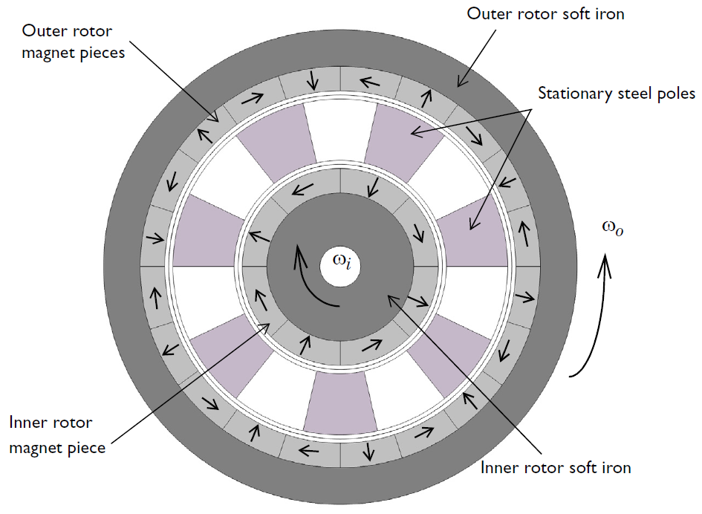
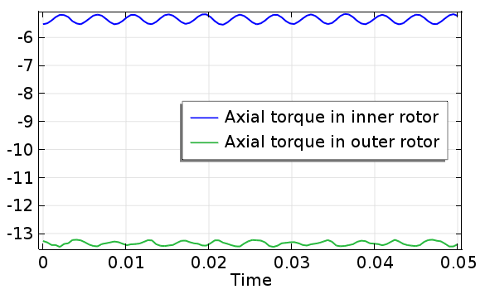
Magnetic Gear in 2D
The axial torque is calculated on inner and outer rotor using Rotating Machinery, Magnetic physics
A gear ratio of 5:2 is achieved using a 5 pole-pair outer rotor, a 2 pole-pair inner rotor and a 7 pole-pairs of stationary steel stator.
Geometry is parameterized
Magnetic flux at various locations are calculated
Top: diagram of the magnetic gear with the magnetic directions indicated by the arrows.
Bottom: The calculated axial torque in N*m.
http://www.comsol.com/showroom/gallery/14583/

Slide 2
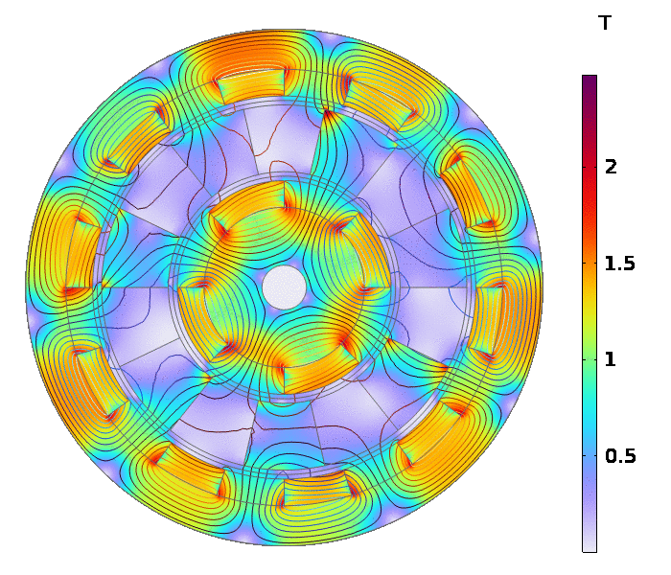
Magnetic Flux Density with Time

