Slide 1
Electromagnetic Plunger
COMSOL

Slide 2
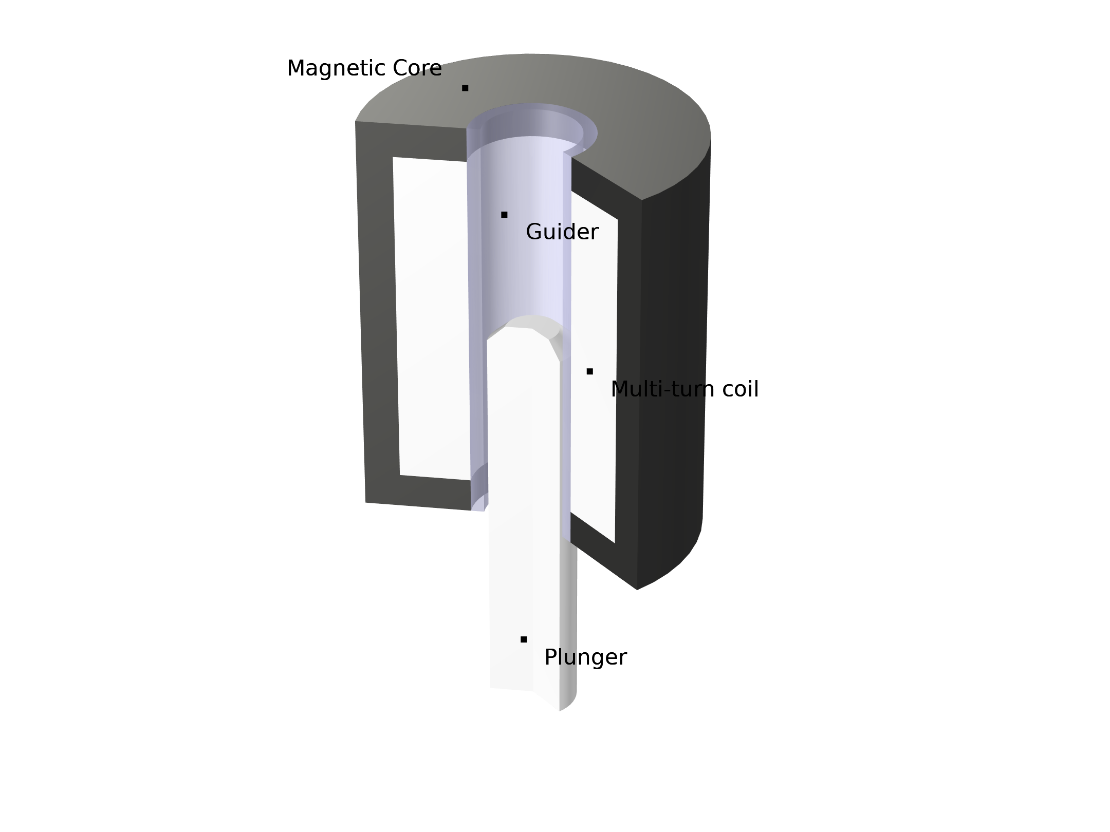
Introduction
Linear plungers/actuators are used for many applications such as in voice coils, electromagnetic relays and electromagnetic valves.
When a current is applied through the mutli-turn coil, the induced magnetic field applies a force to raise the plunger. The base of the plunger is attached to a spring and a damper (not pictured) that applies a restorative force to return the plunger to the lower position.

Slide 3
Introduction
This model investigates a single cycle of the current in the coil being toggled on and off. The resultant forces, velocity and position of the plunger are modeled for a selection of damping coefficients.
This model demonstrates both linear and nonlinear magnetization regimes as well as different damping coefficients.

Slide 4
Introduction
The model uses a moving mesh with the relevant equations of motion incorperated using Global state variables.
The applicable mesh and solver settings for this moving mesh case are also covered.

Slide 5
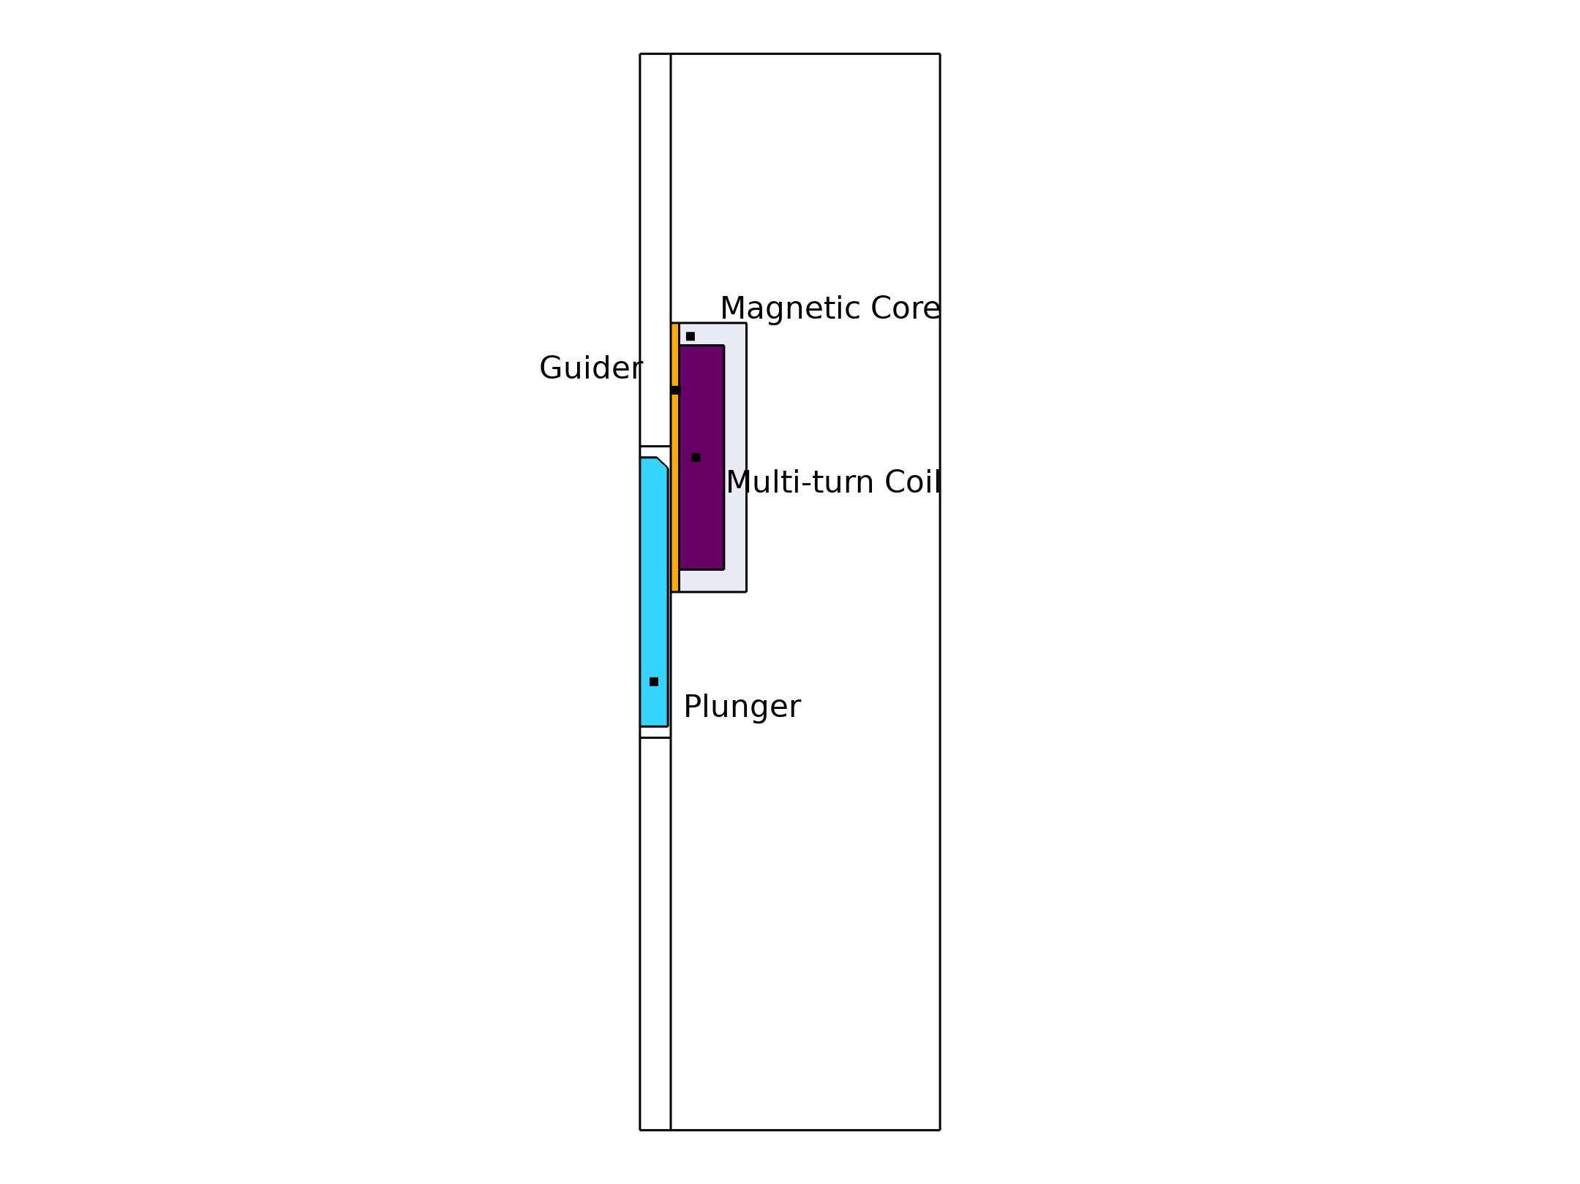
Model Definition
Geometry dimension: 2D-axisymmetry
Geometry finalized: using Form Assembly
Physics used:
  Magnetic Fields
  Moving Mesh
  Global ODEs and DAEs
Study type: Time Dependent
Results:
  Electromagnetic force on the plunger vs time
  Dynamic position of the plunger vs time
  Dynamic velocity of the plunger vs time

Slide 6
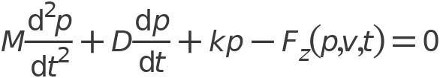


Governing Equations
Global ODEs and DAEs interface is used to solve the equation of motion
The above equation can be rewritten into two separate equations:

Slide 7
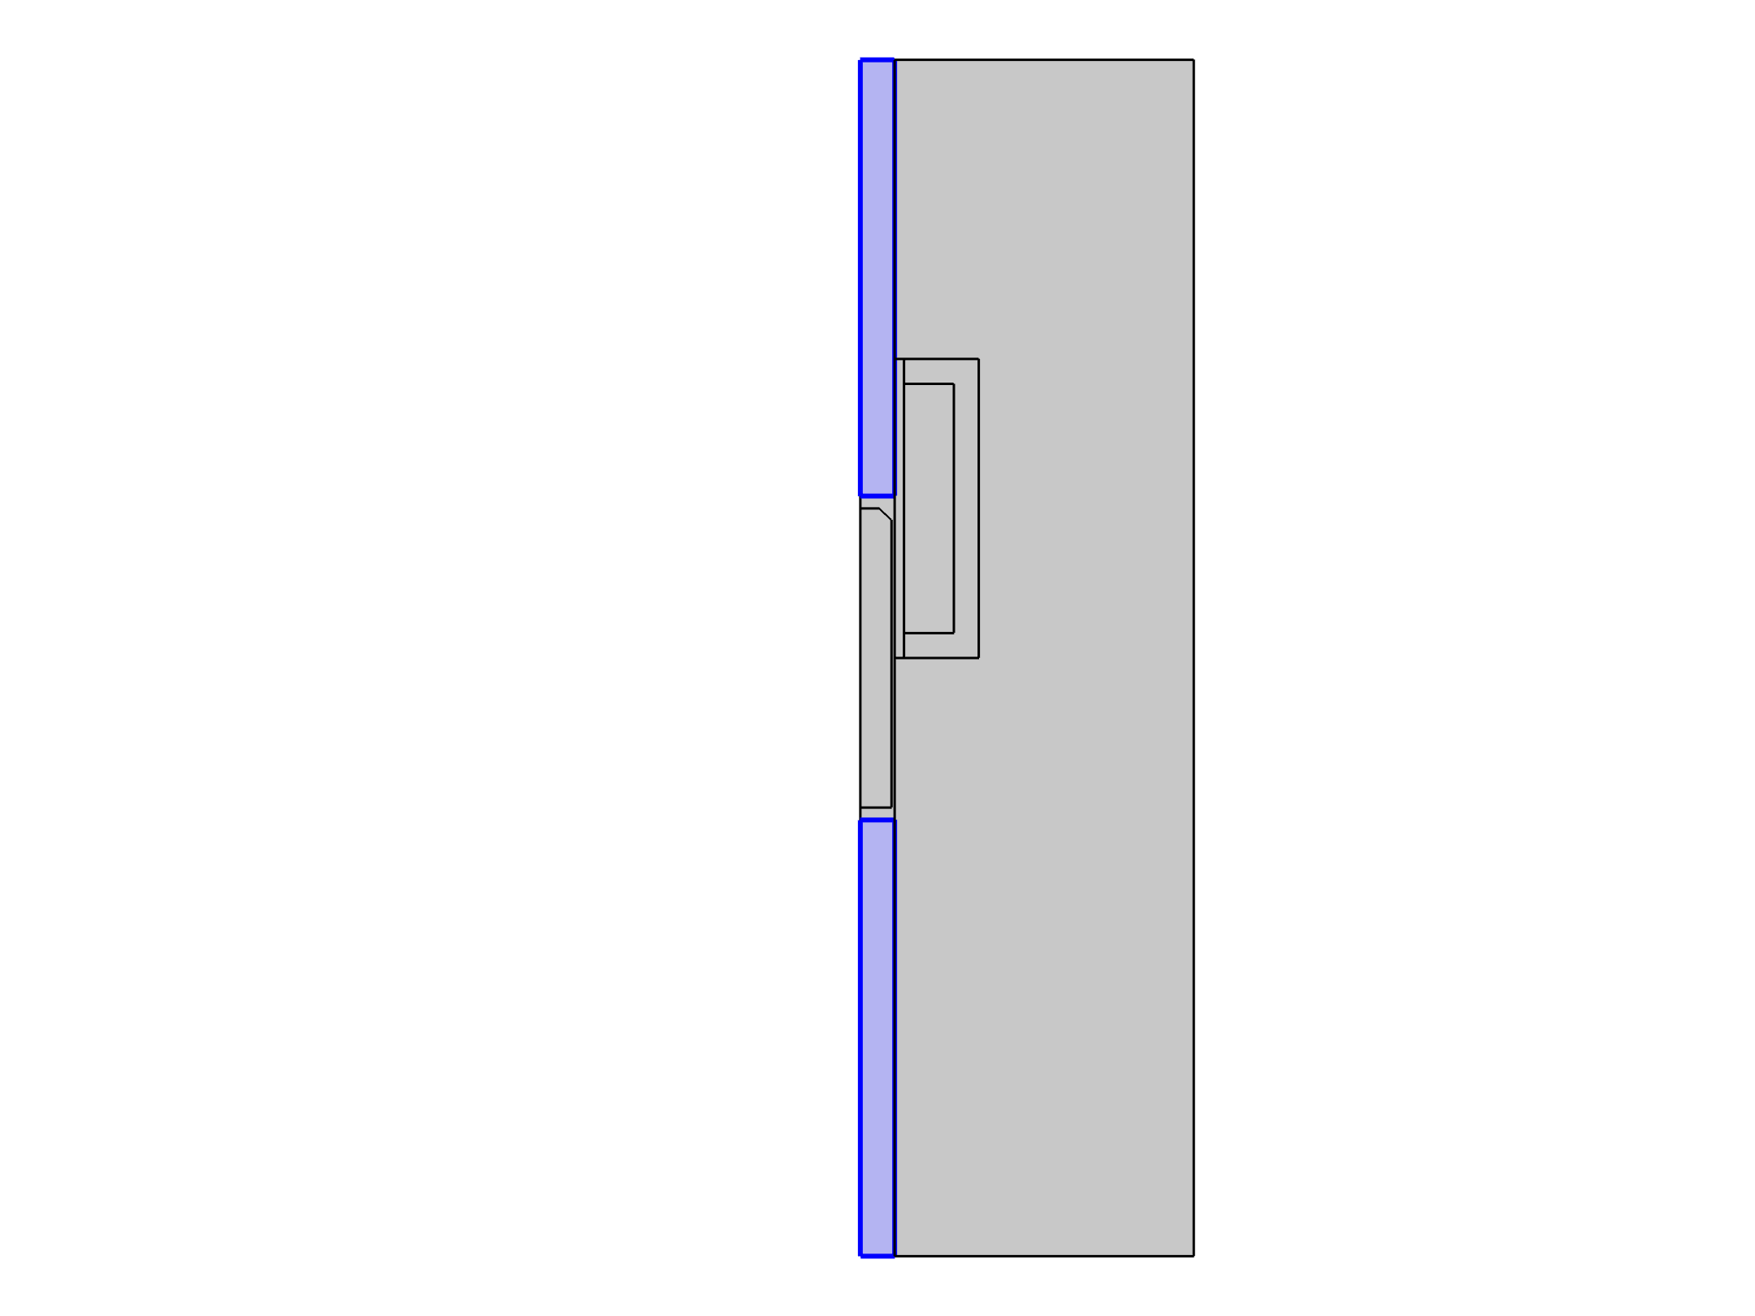
Mesh Settings
Tag | free1
Selection
Geometric entity level | Domain
Selection | Geometry geom1: Dimension 2: Domains 1, 4
Selection

Slide 8
Mesh Settings
Smoothing
Description | Value
Mesh smoothing type | Laplace
Initial deformation
Description | Value
Initial deformation | {0, 0, 0}
Selection

Slide 9
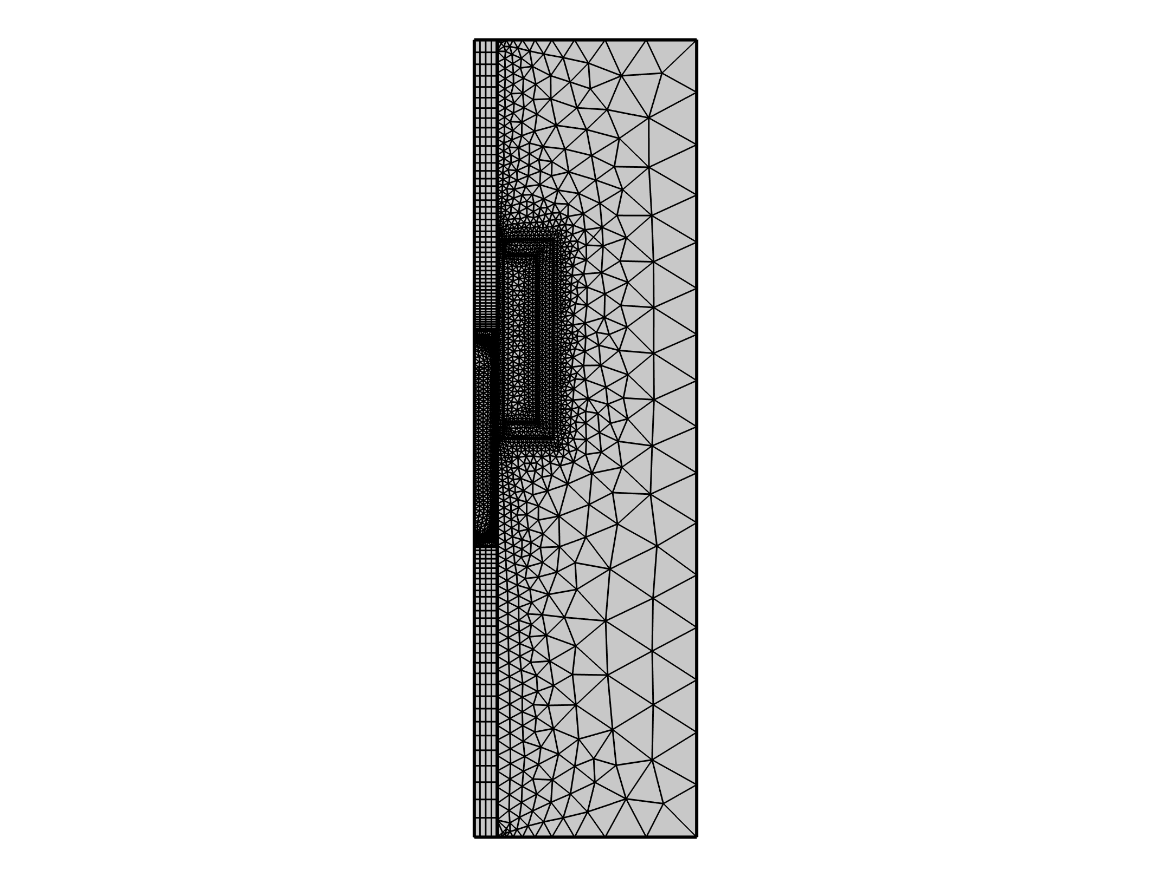
Mesh Settings
  The Destination boundary from the Identity pair should be finer than the Source boundary to properly map resolve the continuity between moving and stationary parts. This is implemented in the 'Maximum element size' setting.
  Mapped mesh is used in the moving domains (excluding Plunger).
  Boundary layers are defined on Plunger and Magnetic Core to properly resolve the induced eddy currents.
A very fine mesh is generated along the boundaries of the Plunger in order to accurately measure the forces using Maxwell’s Stress Tensor.

Slide 10
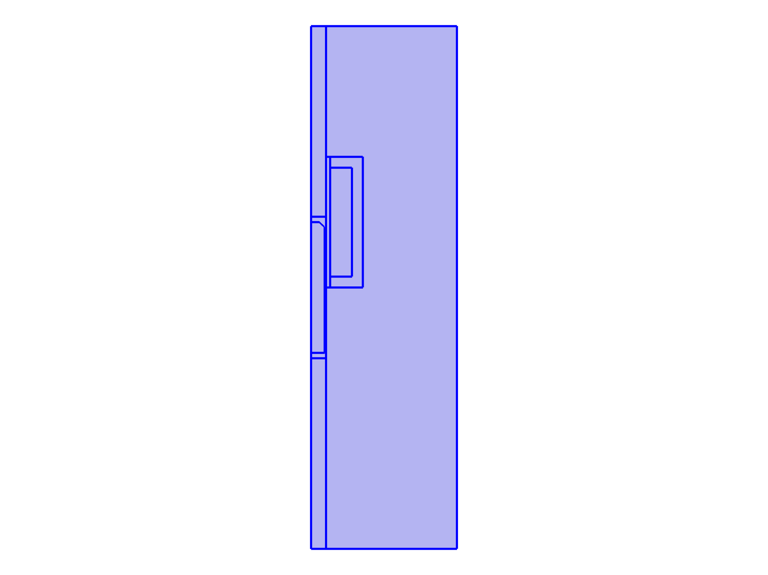
Changing Discretization
Settings
Description | Value
Magnetic vector potential | Linear
Settings
Description | Value
Equation form | Study controlled
Magnetic Fields

Slide 11
Changing Discretization
Settings
Description | Value
Field components solved for | Out - of - plane vector potential
Settings
Description | Value
Solve for | Full field
Magnetic Fields

Slide 12
Changing Discretization
Settings
Description | Value
Use manual port sweep | Off
For fast and robust computation, use linear elements by changing the Discretization to Linear. This is strongly recommended when having nonlinear materials (B-H curve). The reason being that the spatial transition from magnetically unsaturated to saturated regions is often not resolved by the mesh. That is handled better by linear elements whereas higher order elements can develop numerical instabilities.
Magnetic Fields

Slide 13
Solver Settings
For physics involving moving mesh, applying some manual solver tuning is recommended.
  Time-Dependent Solver
    Time stepping and Error estimation
  Fully Coupled
    Nonlinear Solver settings
  Direct Solver
    Pardiso is usually faster than MUMPS

Slide 14
Solver Settings
Time-Dependent Solver
    In the settings window for the time-dependent solver, theError Estimation is set to Exclude algebraic
    The Lagrange multipliers in weak constraints are algebraic and noisy. Other algebraic variables may arise in circuit couplings.
Fully Coupled
    In the fully coupled settings, 4 settings are changed from default:
  The Jacobian update is set to on every iteration as the moving parts changes the couplings.
  The termination technique is set to Tolerance
  The maximum number of iterations is set to 7
  (Optional) Set Stabilization and acceleration to Anderson acceleration
Direct Solver
    PARDISO is usually faster than MUMPS

Slide 15
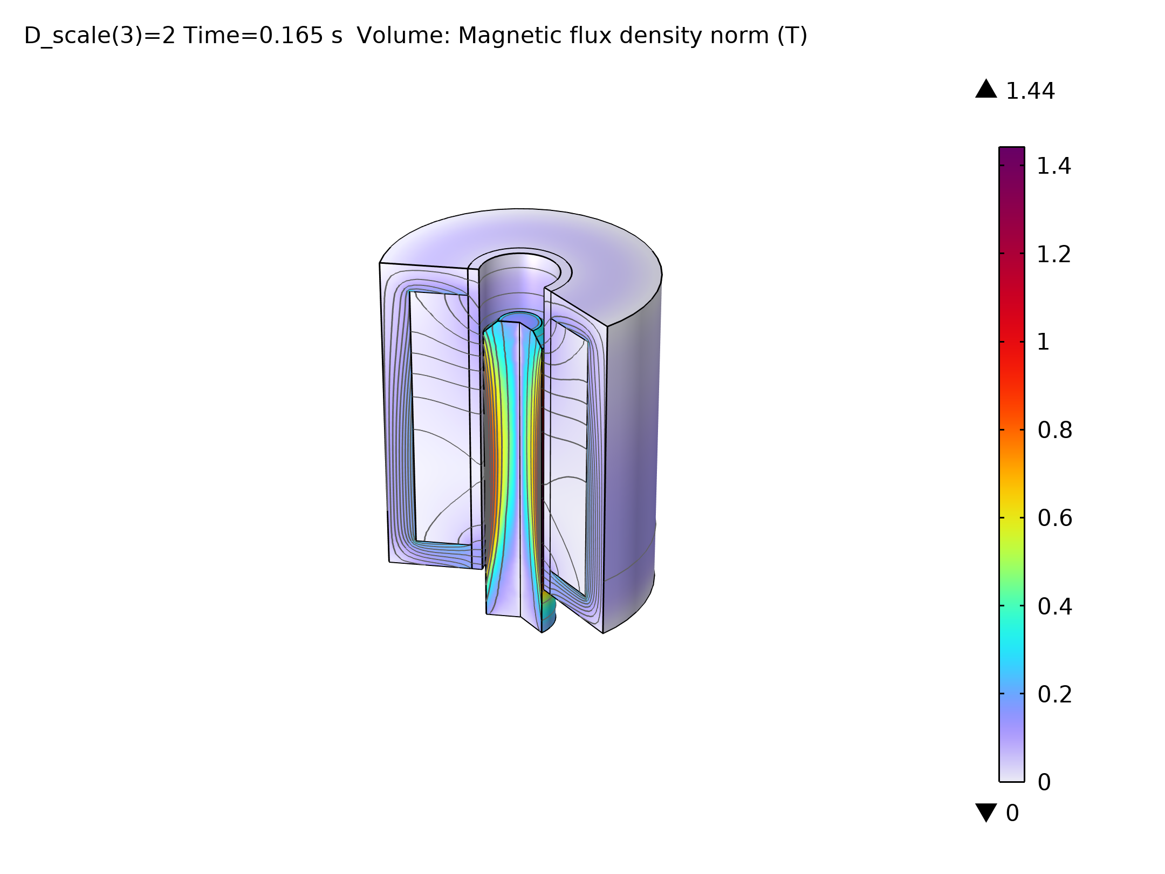
Results
Figure: Magnetic flux density in the plunger.

Slide 16
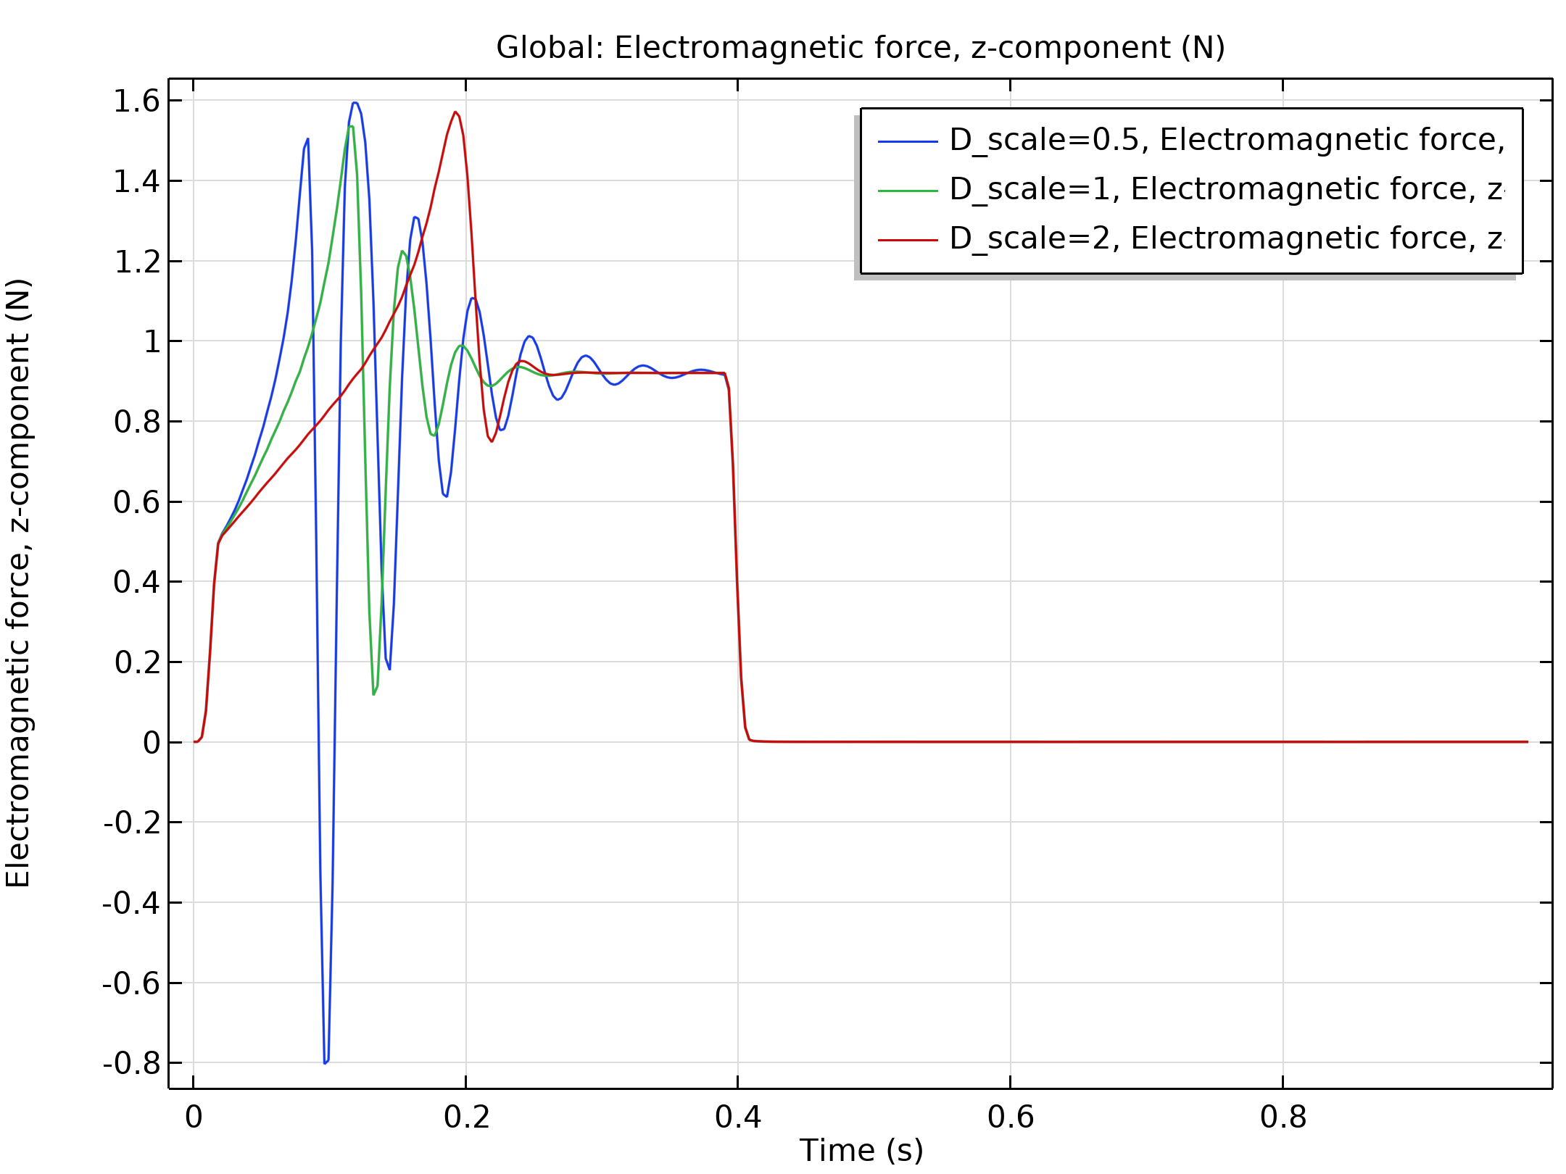
Results
Figure: The electromagnetic force acting on the plunger depending on the current in the coil for different ‘Damping Coefficients’.

Slide 17
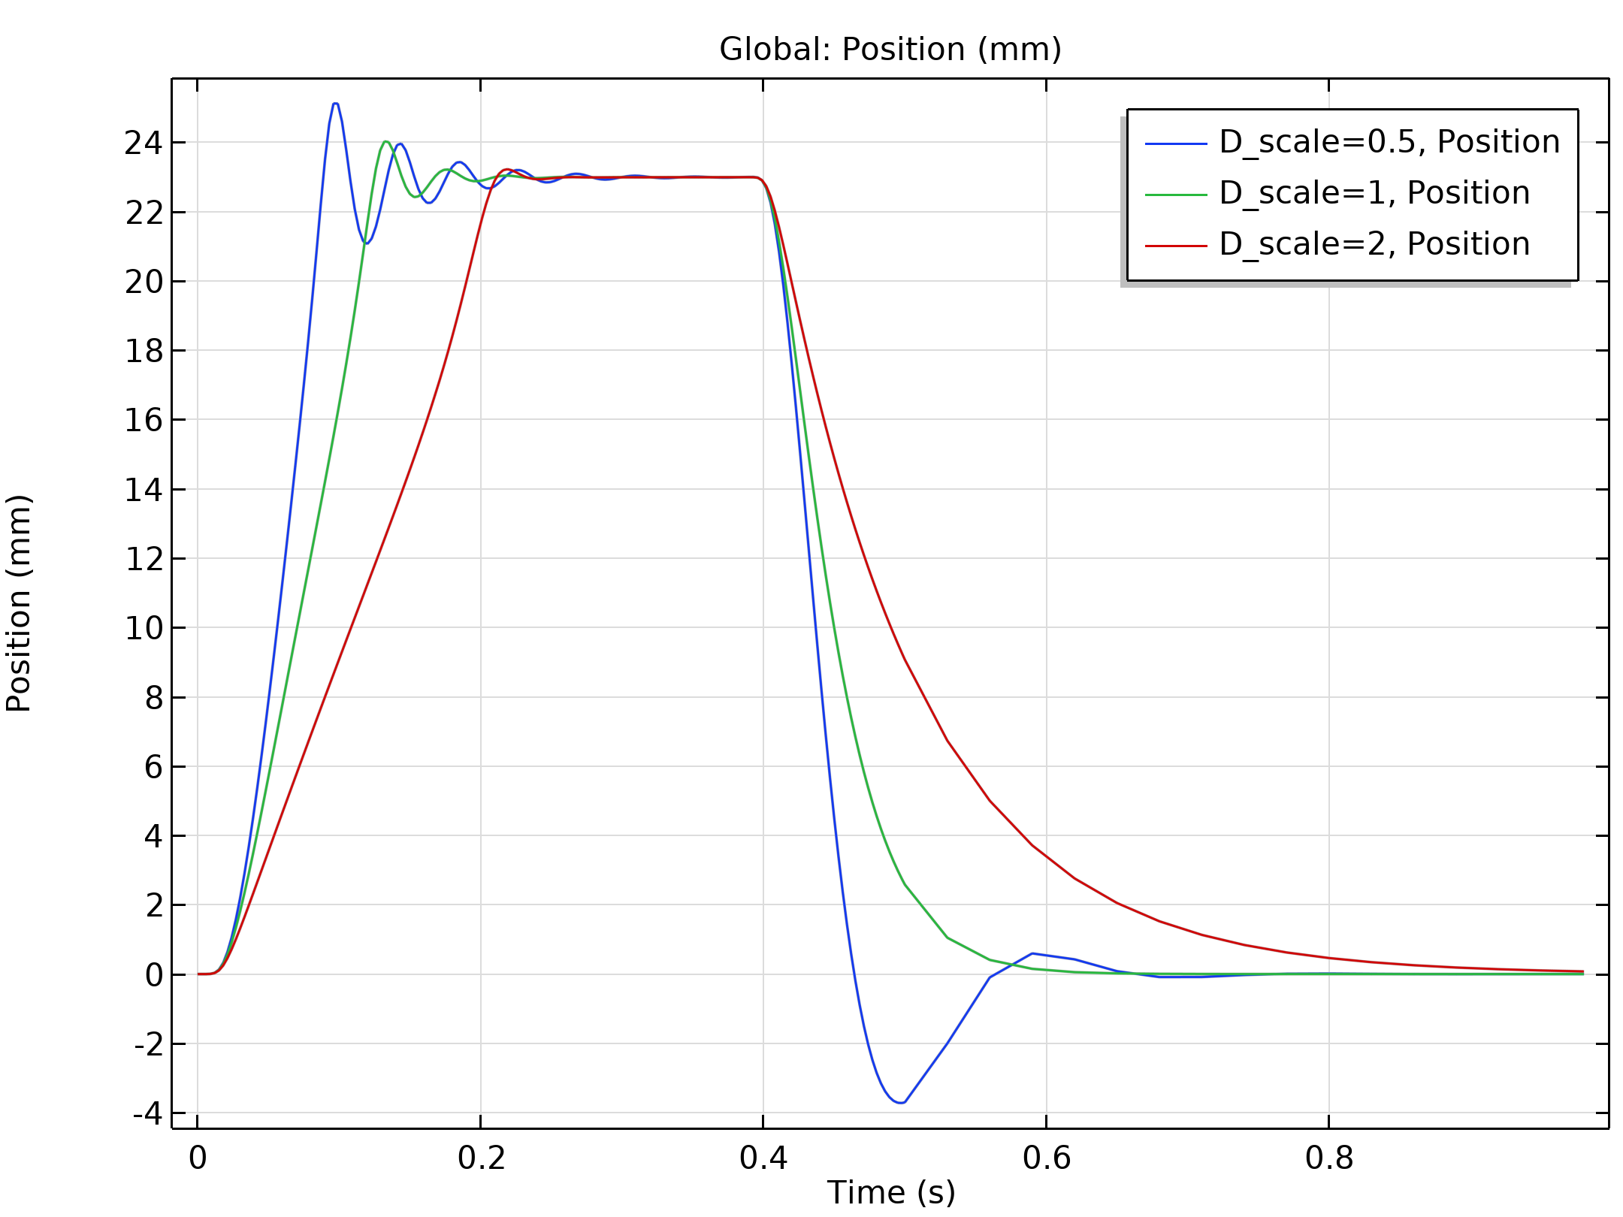
Results
Figure: The change in the position of the plunger as the current varies in the coil for different ‘Damping Coefficients’.

Slide 18
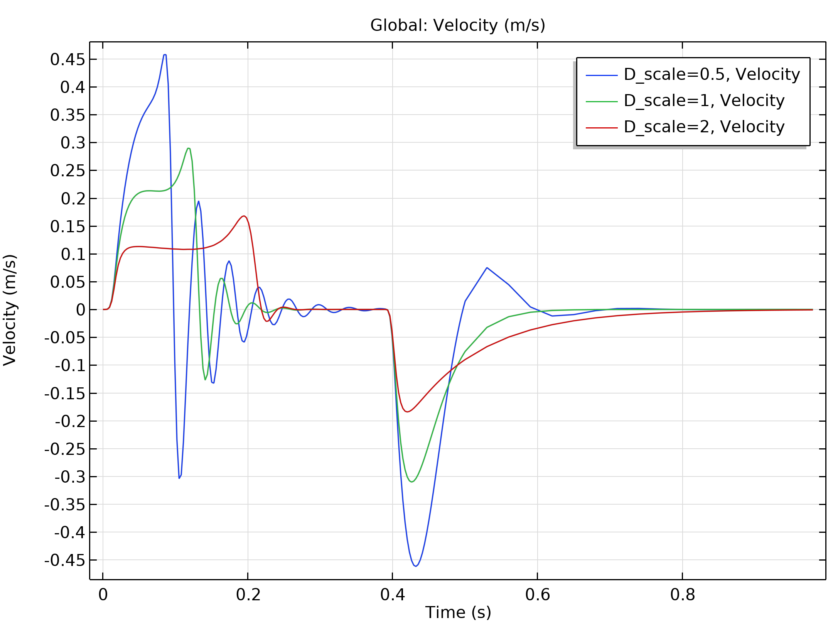
Results
Figure: The velocity profile of the plunger w.r.t time as the current varies in the coil for different ‘Damping Coefficients’.

Slide 19
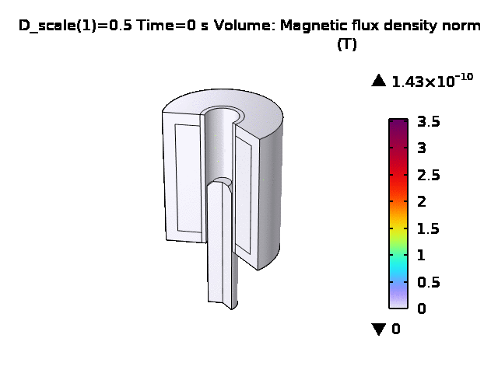
Results

