Slide 1
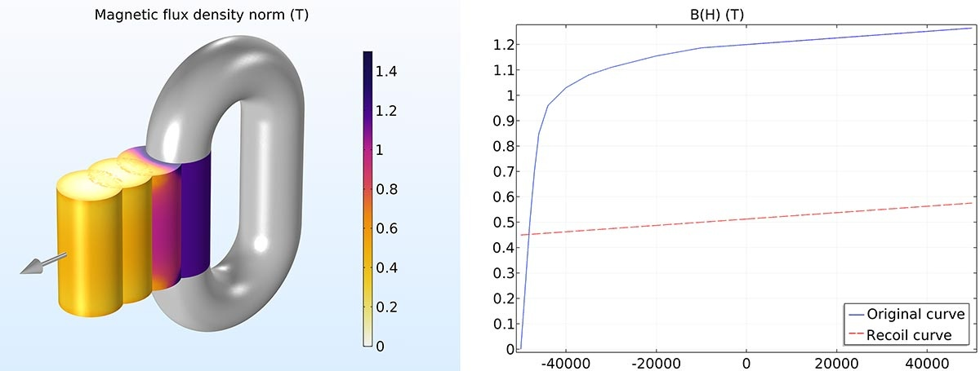
Self Demagnetization of a Cylindrical AlNiCo Magnet

Slide 2
Background and Motivation
Soft permanent magnets like AlNiCo are easily demagnetized if handled incorrectly
This model demonstrates the self demagnetization of a cylindrical AlNiCo magnet when moved out of its protective magnetic circuit
The modeling is performed in three solution steps
  The soft magnet protected by the magnetic circuit
  The self-demagnetization of the soft magnet when moved into free air
  The linear recoil model when moved back into the magnetic circuit

Slide 3
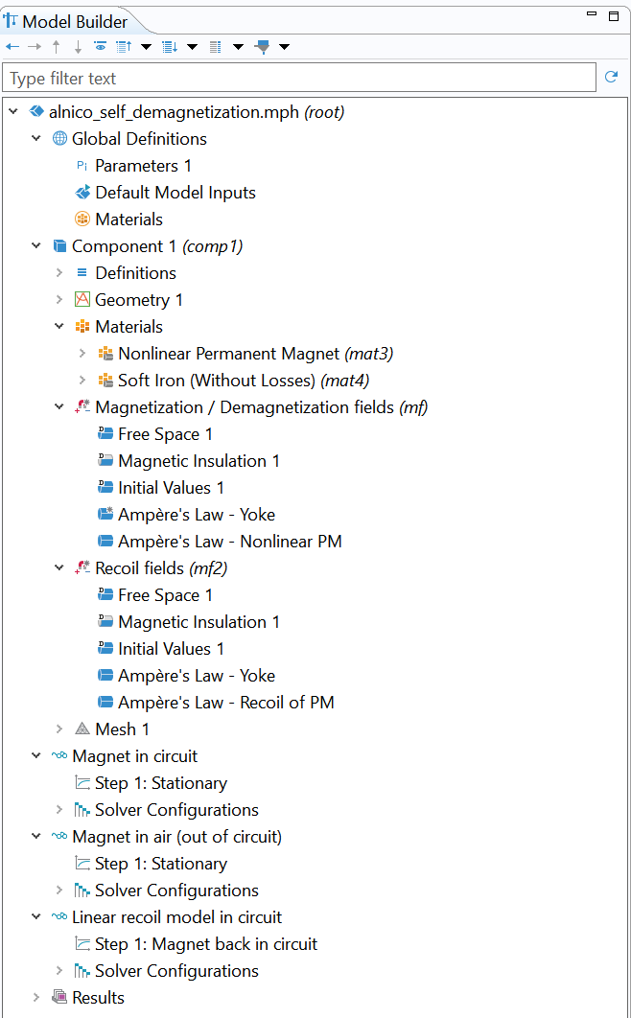
Modeling Interfaces
Two Magnetic Fields interfaces are used
The first physics interface determines the fields when the AlNiCo is magnetized in the circuit, or demagnetized in air. These are computed respectively in Study 1, and Study 2
The second physics interface takes care of the field when the AlNiCo is put back into the circuit. This is computed in Study 3. It uses the solution computed in Study 2

Slide 4
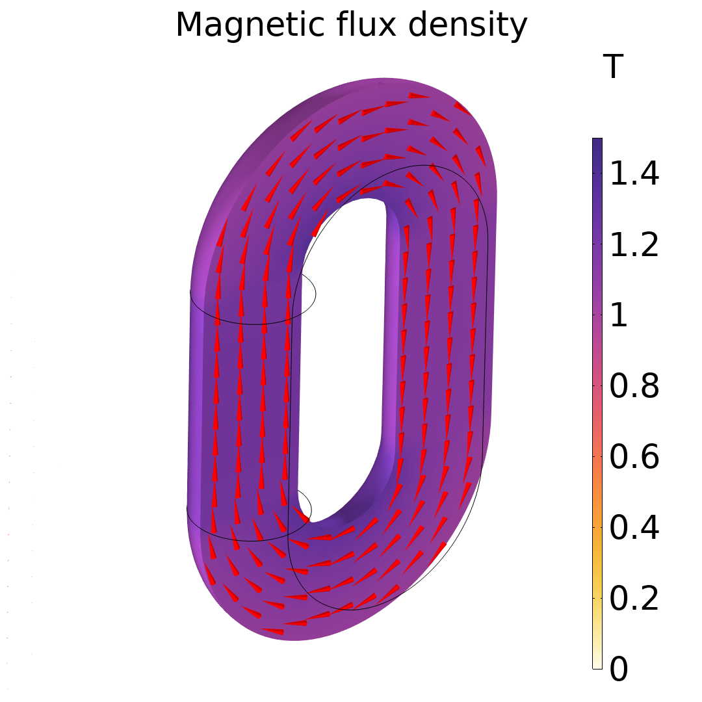
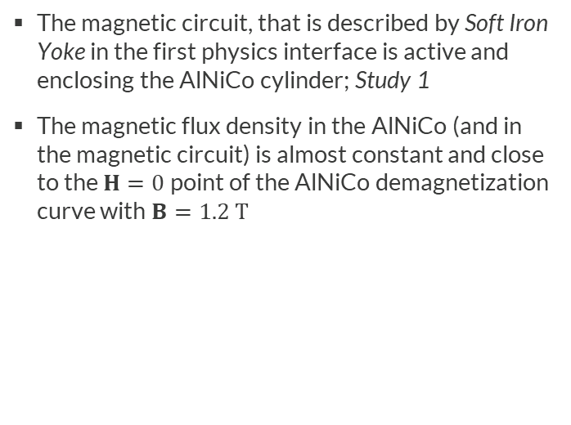
Magnet in Circuit
The magnetic circuit, that is described by Soft Iron Yoke in the first physics interface is active and enclosing the AlNiCo cylinder; Study 1
The magnetic flux density in the AlNiCo (and in the magnetic circuit) is almost constant and close to the $H=0$ point of the AlNiCo demagnetization curve with $B=1.2 T$

Slide 5
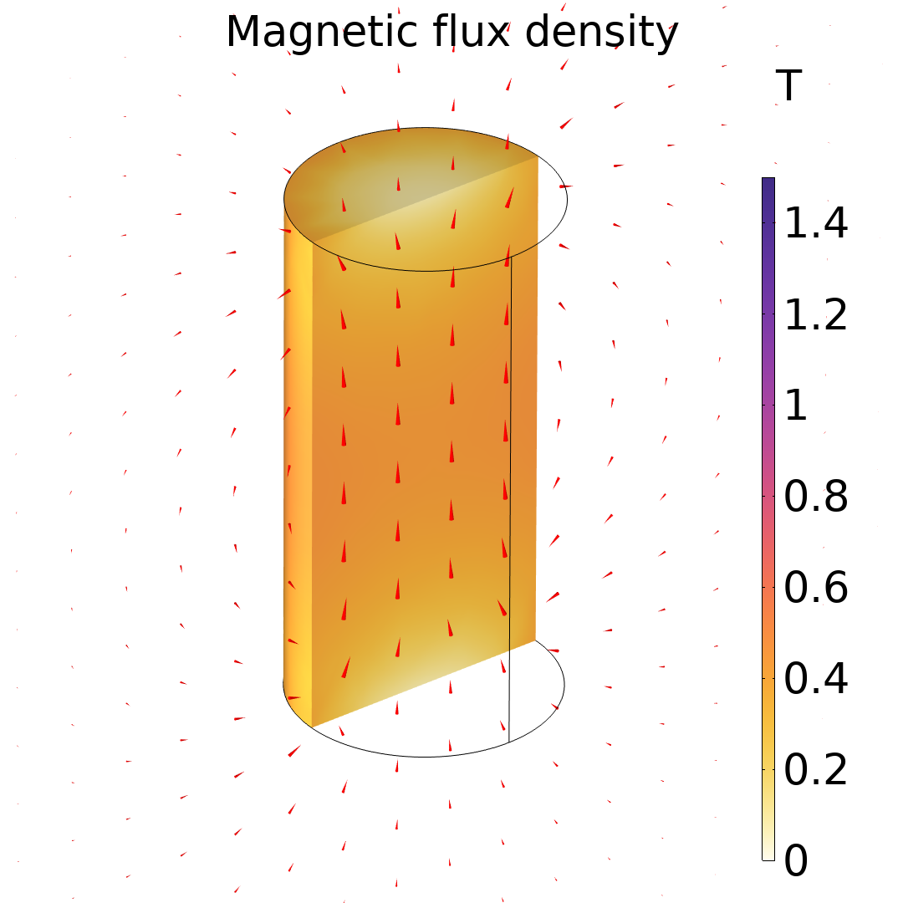
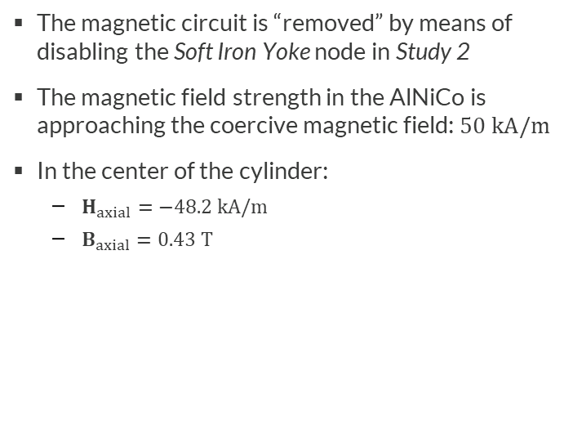
Magnet in Air
The magnetic circuit is “removed” by means of disabling the Soft Iron Yoke node in Study 2
The magnetic field strength in the AlNiCo is approaching the coercive magnetic field: $50 kA/m$
In the center of the cylinder:
  $H_{axial}=−48.2 kA/m$
  $B_{axial}=0.43 T$

Slide 6
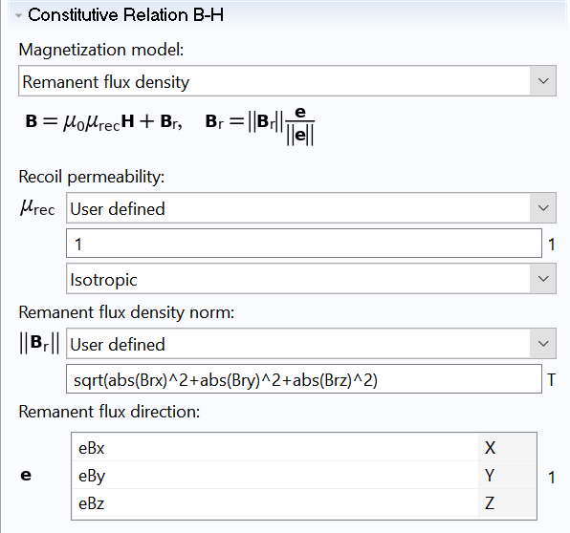
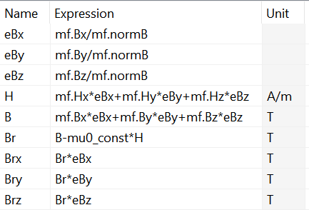
Linear Recoil Model
The linear recoil model (red dashed curve in plot “BH paths”) is implemented in a second Magnetic Fields physics interface, solved in Study 3. This physics contains the magnetic circuit and the settings below for the AlNiCo cylinder. Values for variables with prefix mf are taken from the solution for the magnet in air
Magnetization direction
B – H point definition
Remanent flux density modulus and components

Slide 7
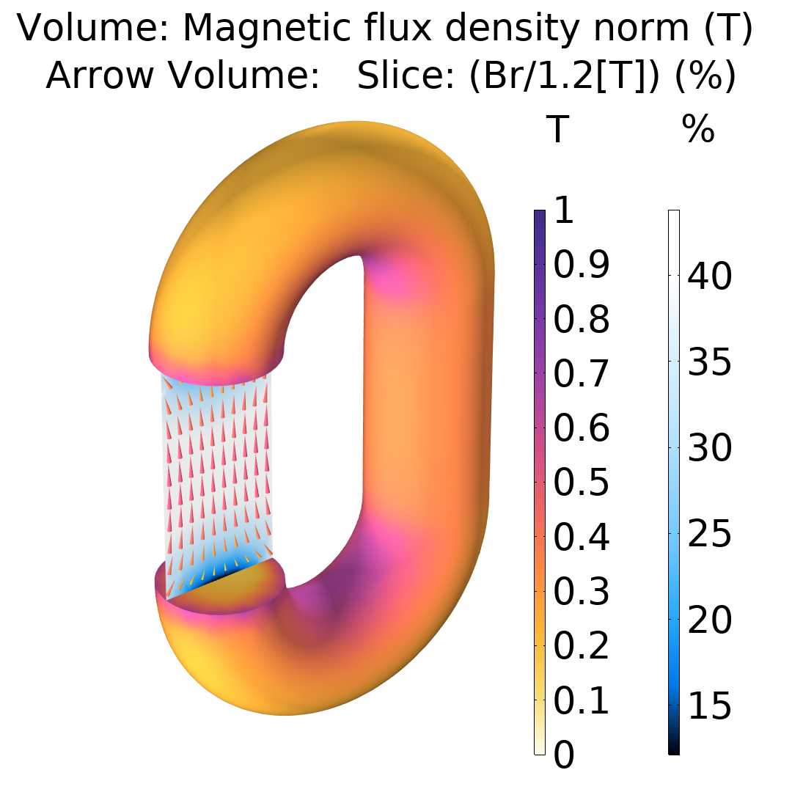
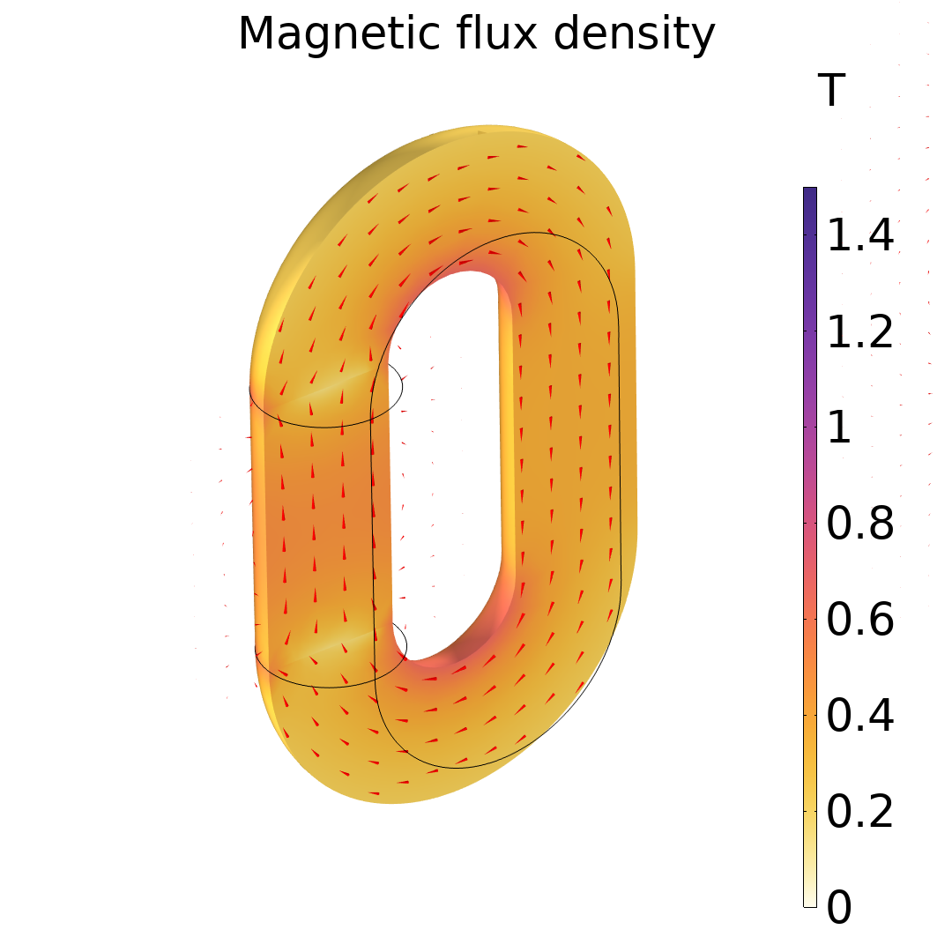
Magnet Back in Circuit
The magnetic flux density in the circuit is reduced to about 40% of the original value (before removing the magnet from the circuit and putting it back). The new remanence is also down to about 40% of the original 1.2T

