Slide 1
Modeling curing in automotive rubber
COMSOL

Slide 2
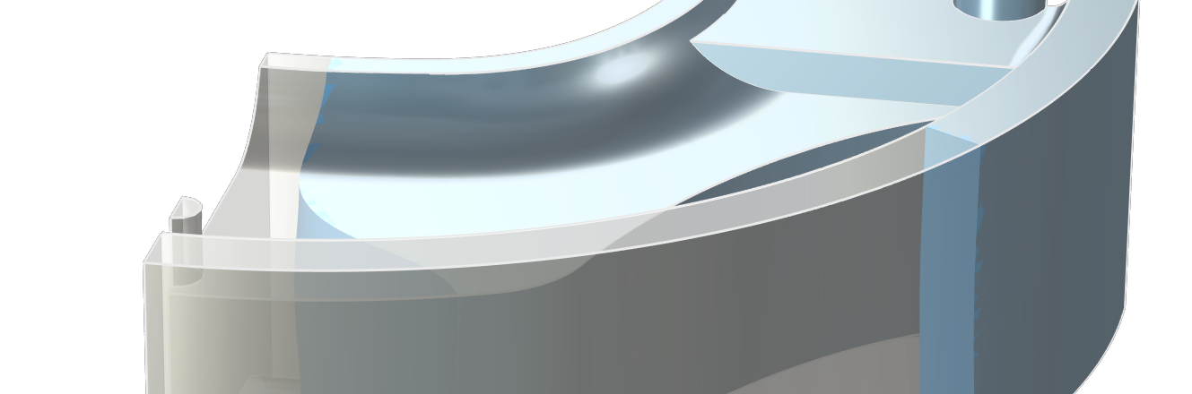
Background
Modeling curing is important in a wide variety of applications such as processing of polymer materials, rubber materials, plastics, and concrete.
Curing is usually an exothermic reaction.
In the current example, curing of butyl rubber is studied in a 3D mold for an automotive vibration damper.
The model uses the geometry from the “Rubber injection molding” model in the Polymer Flow Module.

Slide 3
Included Phenomena and Physics Interfaces
Heat transfer has to be accounted for when modeling curing processes, since the heat sources from the curing reactions impact the operating temperature and thus the rate of curing.
The Curing Reaction interface is added for modeling curing of polymers during heat treatment.
The Kamal-Sourour kinetic model is used for the curing reactions.
The Curing Reaction Heating multiphysics coupling is used to add the source term to account for reaction heating in the heat equation.

Slide 4
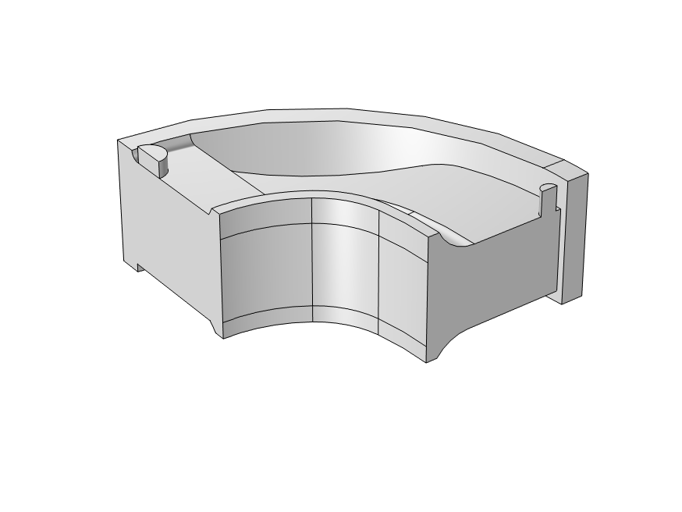
Model Definition
3D model with quarter symmetry filled with uncured butyl rubber.
Initial temperature: 122 °C
Heat transfer coefficient corresponding to natural convection at the external heated surface at 162 °C
Symmetry boundaries

Slide 5
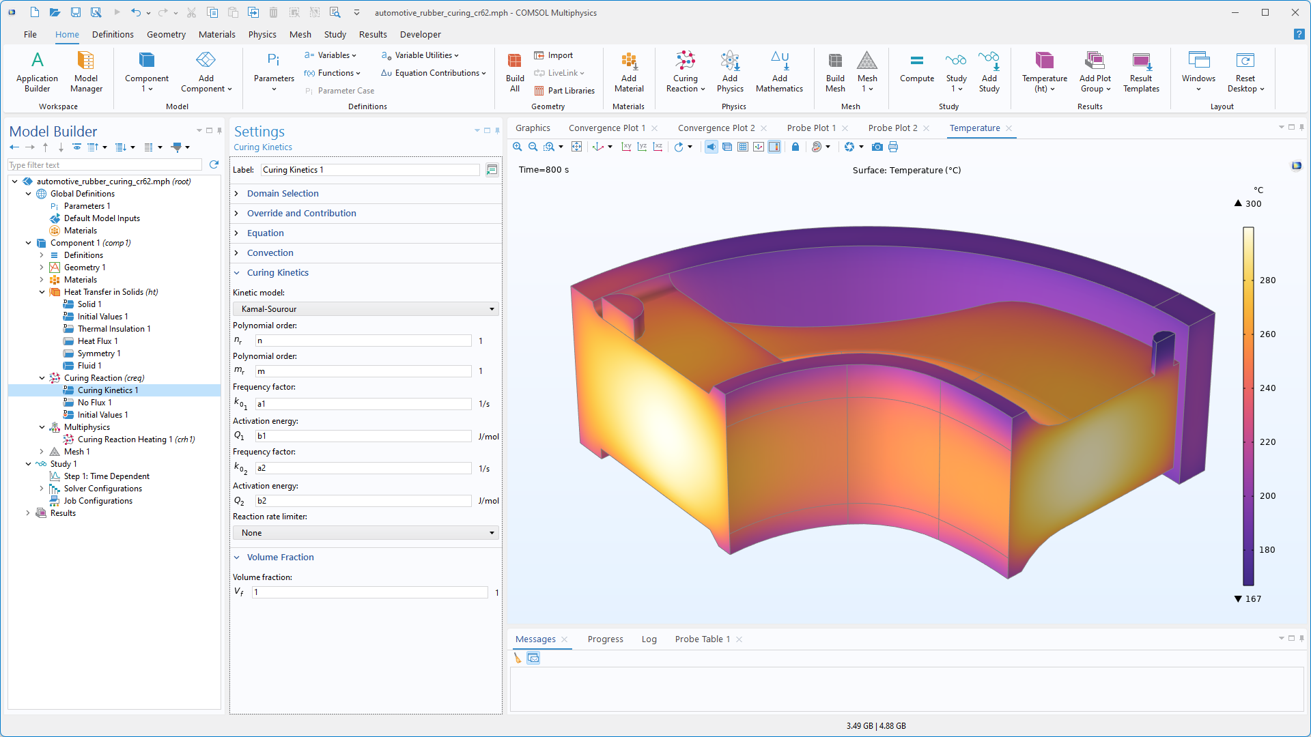
Curing Reaction
The Curing Kinetics feature defines the rate equation for the conversion.
The Kamal-Sourour kinetic model can be selected from the list of available models.

Slide 6
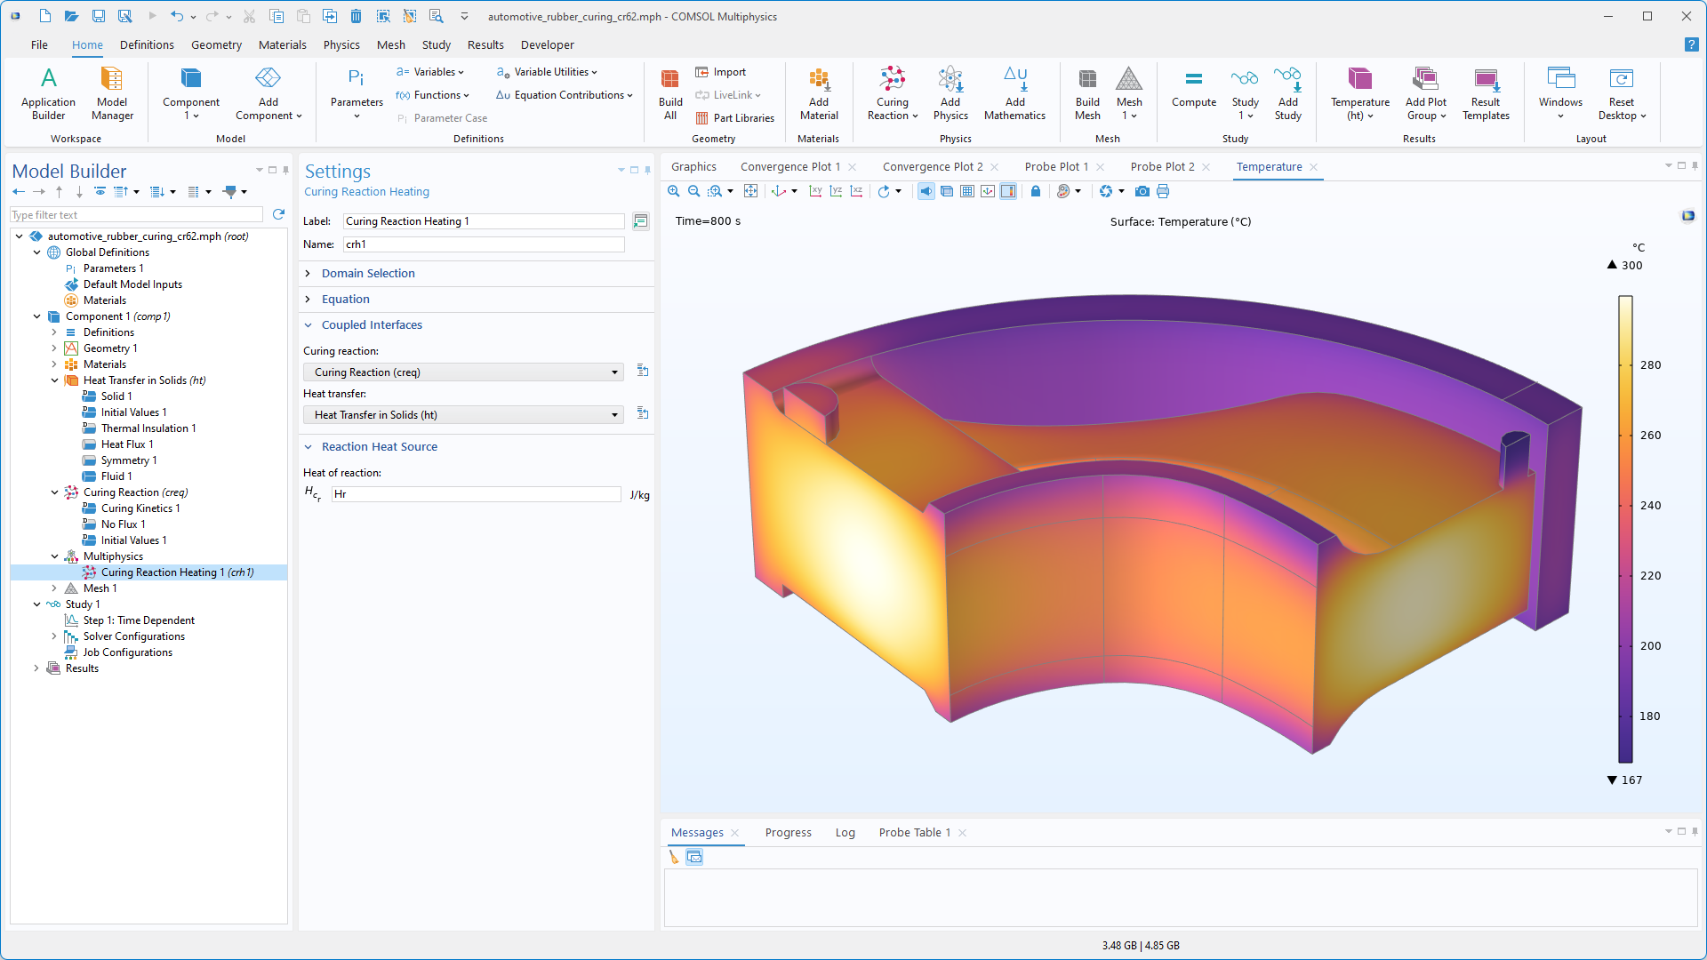
Curing Reaction Heating
A Curing Reaction Heating coupling is used to define the heat of reaction.

Slide 7
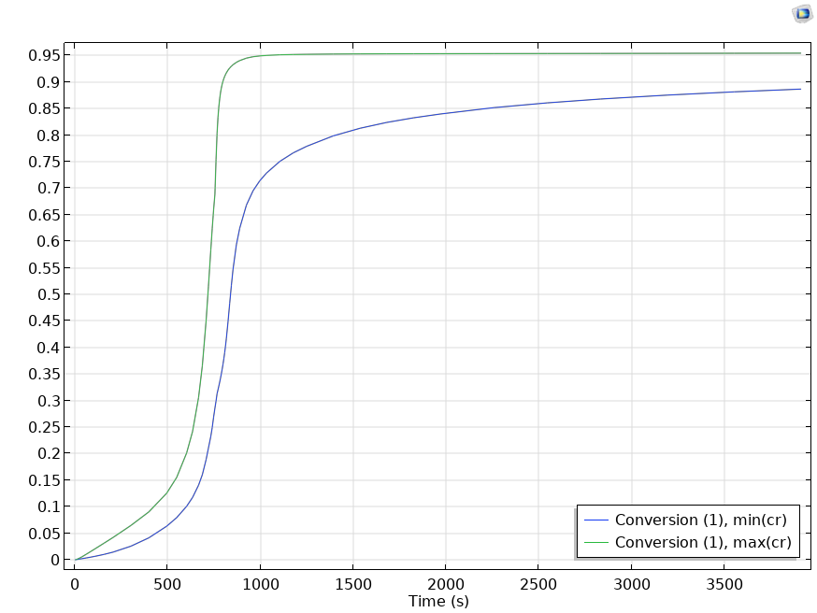
Results
Time-dependent maximum and minimum conversion in the domain.

Slide 8
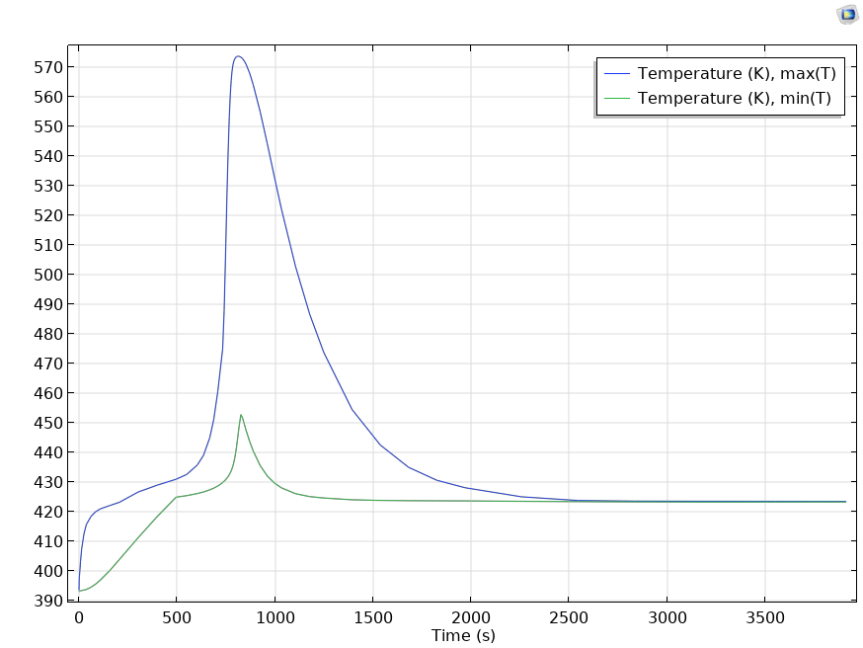
Results
Time-dependent maximum and minimum temperature in the domain.

Slide 9
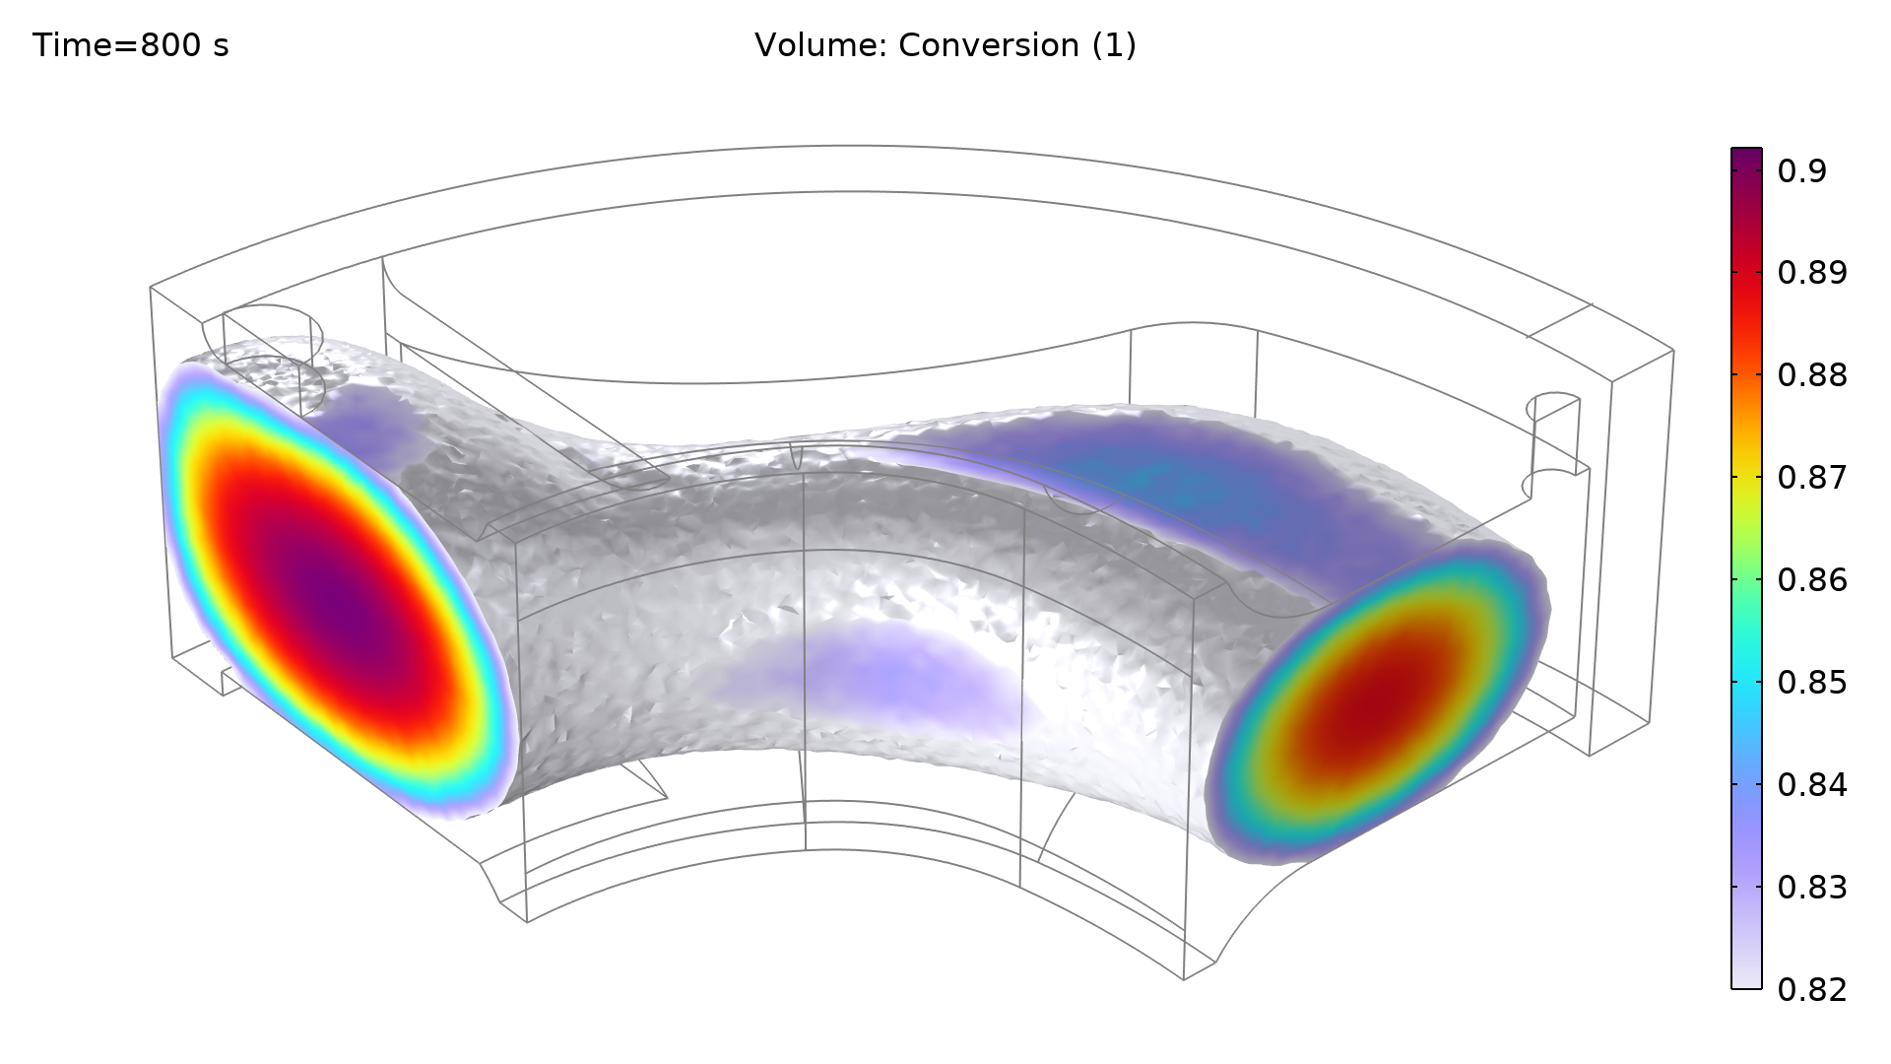
Results
The plots shows the volume of the sample that has achieved a curing conversion level of 82% or above after 800s.

Slide 10
Concluding Remarks
The model shows how to use the Curing Reaction interface with the Kamal-Sourour kinetic equation for curing of thermoset polymers.
The curing reaction acts as a significant heat source.

Slide 11
References
A three dimensional simulation of a rubber curing process considering variable order of reaction, M. Erfaninan et. al, Applied Mathematical Modelling Volume 40, Issues 19–20, October 2016, Pages 8592-8604

