Slide 1
Microstructured Optimized Rectangular-Shape Antireflective Coatings for Infrared Wavelengths
COMSOL

Slide 2
Objective
Bulk dielectric structures significantly reflect the infrared light
Fabricating microstructure over bulk dielectric structures can drastically improve the transmittance over a broad range of IR wavelengths
In this model, we showcase the approach of gradient-free optimization to tune the geometry of the dielectric microstructure to increase the transmittance of the structure
The work demonstrates broadband optimization of a rectangular silicon (Si) microstructure operating between 2.5 um and 4.5 um

Slide 3
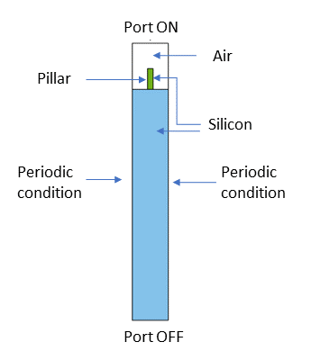
Assumptions
Pitch of the periodic structure is 780 nm
Optimize the following parameters:
  Width of the silicon pillar
  Height of the silicon pillar
Modeling assumption:
  Out of plane polarization is considered
  The ± 1 out of plane diffraction orders were added to the second Port to account for higher order diffraction wave propagation
  “Sum of objective” type of “Multiple Objectives” was selected to perform the broadband optimization between 2.5 um and 4.5 um
Single unit cell model.

Slide 4

The Optimization Study - Objective Function
where λ_{min} and λ_{max} are the minimum and maximum operating wavelengths, T_{e} = 100*realdot(ewfd.S21,ewfd.S21), and T_{t} = 100.

Slide 5
The Optimization Study - Control Parameters
The optimization control parameters have the following constraints:
Name | Description | Lower bound | Upper bound
w_pillar | Width of pillar | 50 nm | 300 nm
h_pillar | Height of pillar | 100 nm | 600 nm

Slide 6
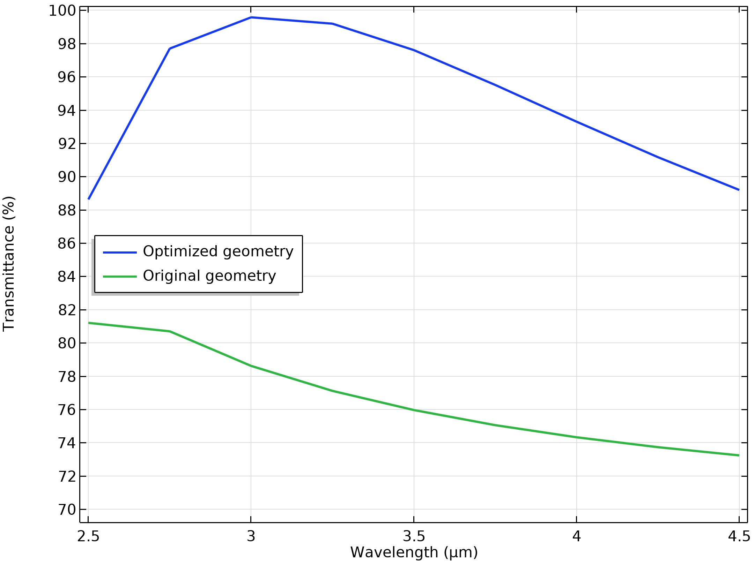
Results
Parameter | Original geometry | Optimized geometry
Width of pillar | 100 nm | 112 nm
Height of pillar | 200 nm | 451 nm
Transmittance spectra for the original and optimized Si pillars.

