Slide 1
Microstructured Optimized Pyramid-Shape Antireflective Coatings for Infrared Wavelengths
COMSOL

Slide 2
Objective
Bulk dielectric structures significantly reflect the infrared light
Fabricating microstructure over bulk dielectric structures can drastically improve the transmittance over a broad range of IR wavelengths
In this model, we showcase the approach of gradient-free optimization to tune the geometry of the dielectric microstructure to increase the transmittance of the structure
The work demonstrates broadband optimization of a pyramidal CZT microstructure operating between 7 um and 14 um

Slide 3
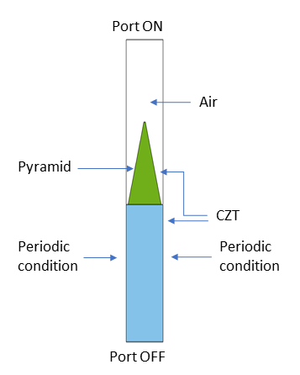
Assumptions
Pitch of the periodic structure is 2.4 um
Optimize the following parameters:
  Height of the CZT pyramid
  Bottom width of the CZT pyramid
  Top width of the CZT pyramid
Modeling assumption:
  Out of plane polarization is considered
  The ± 1 out of plane diffraction orders were added to the second Port to account for higher order diffraction wave propagation
Single unit cell model.

Slide 4
Assumptions
  “Sum of objective” type of “Multiple Objectives” was selected to perform the broadband optimization between 7 um and 14 um
Single unit cell model.

Slide 5
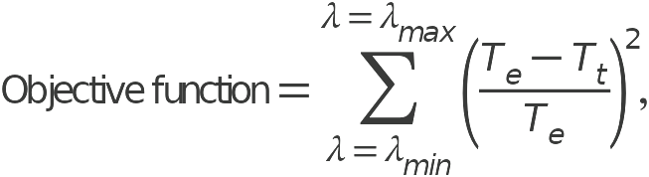
The Optimization Study - Objective Function
where λ_{min} and λ_{max} are the minimum and maximum operating wavelengths, T_{e} = 100*realdot(ewfd.S21,ewfd.S21), and T_{t} = 100.

Slide 6
The Optimization Study - Control Parameters
The optimization control parameters have the following constraints:
Name | Description | Lower bound | Upper Bound
w_bottom_pyramid | Bottom width of the pyramid | 0.5[um] | 2[um]
w_top_pyramid | Top width of the pyramid | 50[nm] | 300[nm]
h_pyramid | Height of the pyramid | 0.5[um] | 4[um]

Slide 7
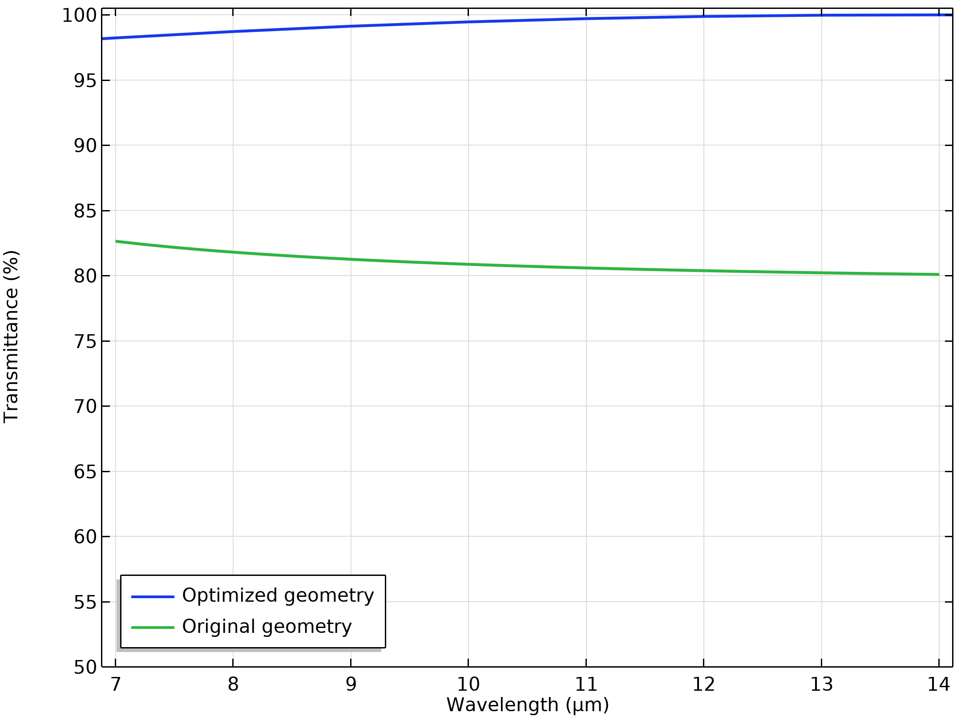
Results
Parameter | Original geometry | Optimized geometry
Top width of the pyramid | 50 nm | 50 nm
Bottom width of the pyramid | 0.5 um | 0.9 um
Height of the pyramid | 0.5 um | 2.25 um
Transmittance spectra for the original and optimized microstructured pyramids.

