Slide 1

Open Water Performance of the KP505 Propeller
COMSOL

Slide 2
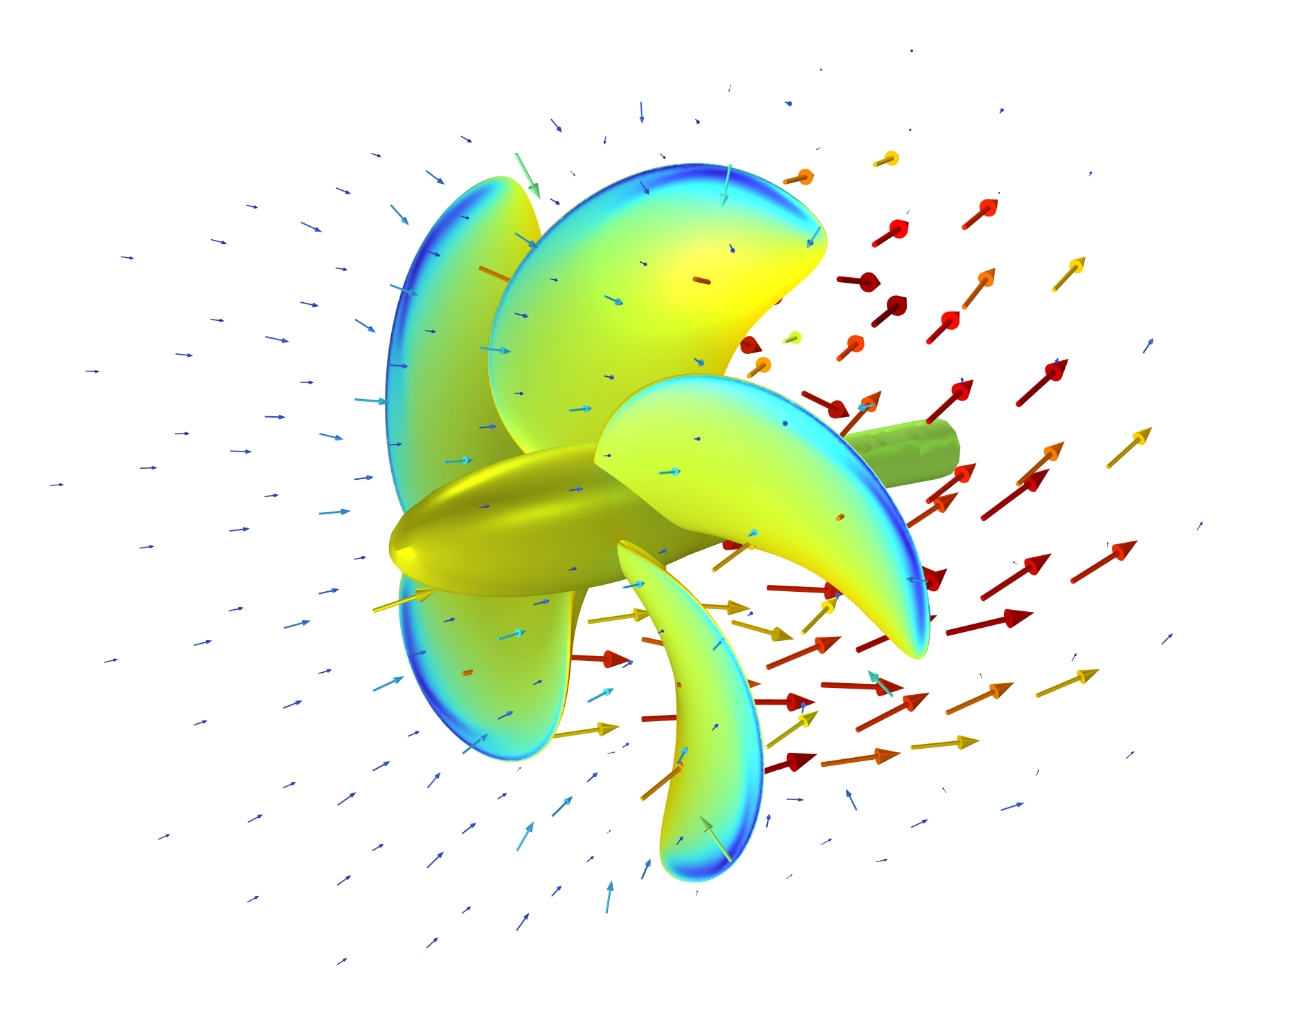
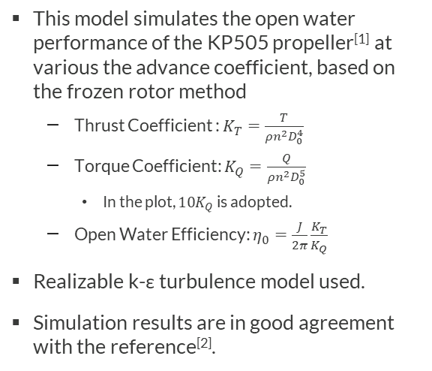
Overview
This model simulates the open water performance of the KP505 propeller^{[1]} at various the advance coefficient, based on the frozen rotor method
  Thrust Coefficient : $K_{T}=\frac{T}{ρn^{2}D_{0}^{4}}$
  Torque Coefficient: $K_{Q}=\frac{Q}{ρn^{2}D_{0}^{5}}$
    In the plot, ${10K}_{Q}$ is adopted.
  Open Water Efficiency: $η_{0}=\frac{J}{2π}\frac{K_{T}}{K_{Q}}$
Realizable k-ε turbulence model used.
Simulation results are in good agreement with the reference^{[2]}.
Surface pressure and surrounding velocity vector of the KP505 Propeller
[1] KP505 propeller geometry courtesy of Korea Research Institute of Ships & Ocean Engineering
[2] National Maritime Research Institute (NMRI) 2015 Tokyo 2015: A Workshop on CFD in Ship Hydrodynamics http://www.t2015.nmri.go.jp

Slide 3
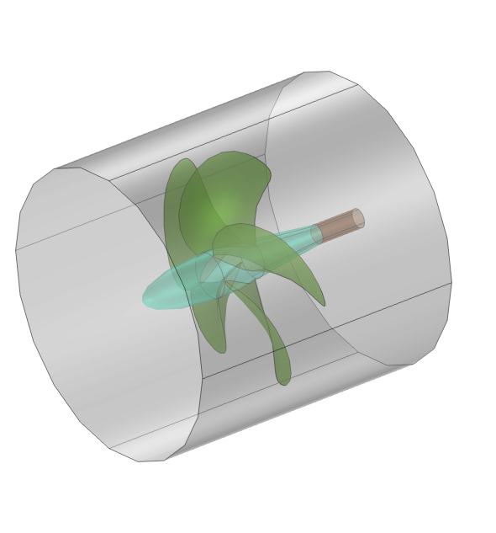
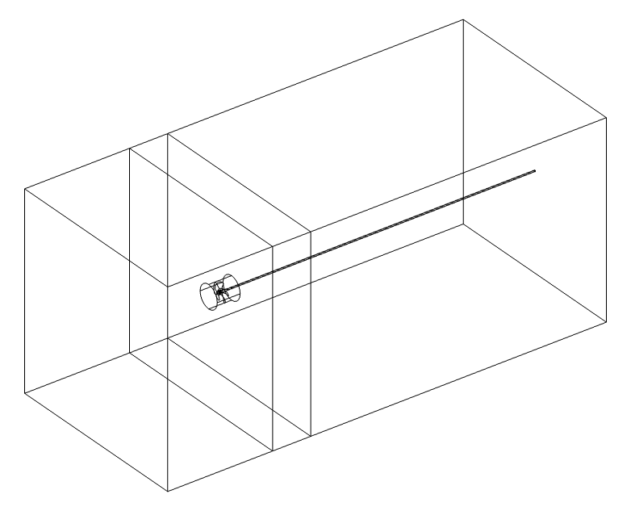
Geometry
Propeller blades
Rotating domain
Hub
screw
Rotating domain
Static domains
The KP505 propeller is a five-blade marine propeller.
  Propeller diameter D0=0.25m
The model includes the propeller blades, hub, and screw.
The computational domain is divided into rotating and static domains.
  The rotating region is used for the frozen rotor setup.
  The static region is used for setting the boundary conditions of the external flow field.

Slide 4
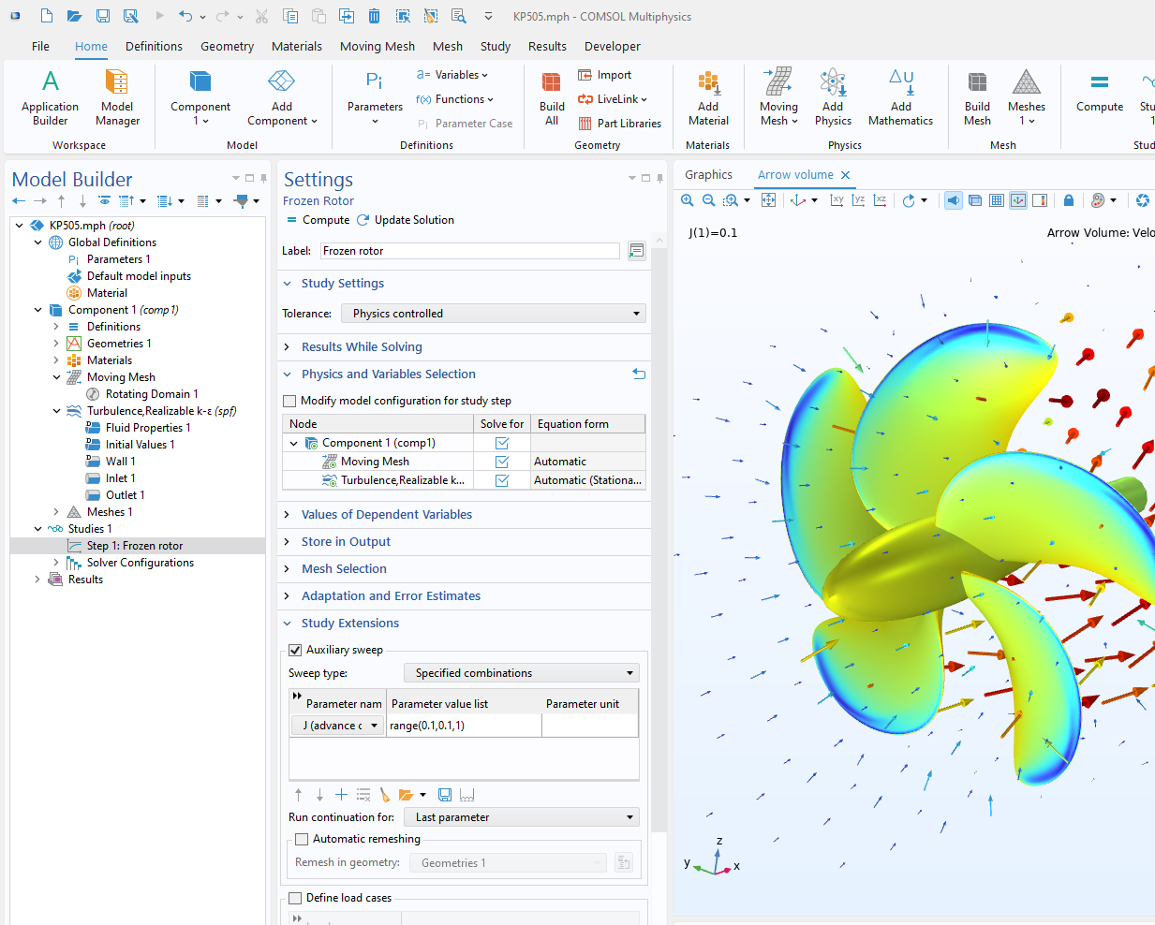
Implementation
Moving mesh:
Rotating Domain
Turbulent flow: Realizable k-ε Turbulence model

Slide 5
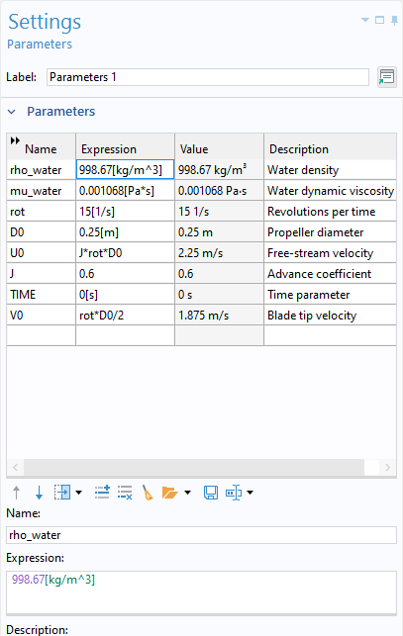
Parameter Settings
Rotating domain
  The rotational speed rot is 15 [1/s].
Free stream velocity
  Calculate U0=J*rot*D0 according to the advance coefficient
  Sweep the advance coefficient J over the range (0,0.1,1) to obtain different Free stream velocity U0

Slide 6
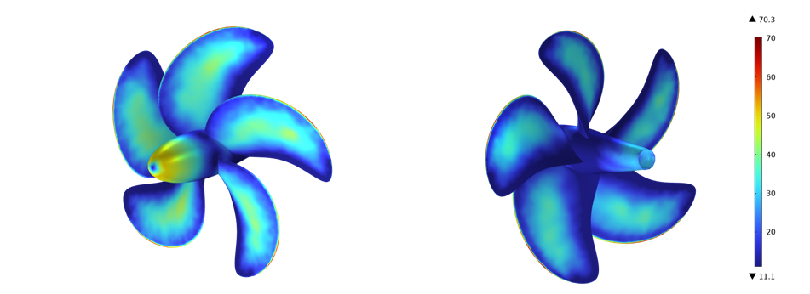
Wall Resolution in
Viscous Units
The non-dimensional wall resolution on the surfaces of the propeller and hub meets the requirements for wall function.

Slide 7
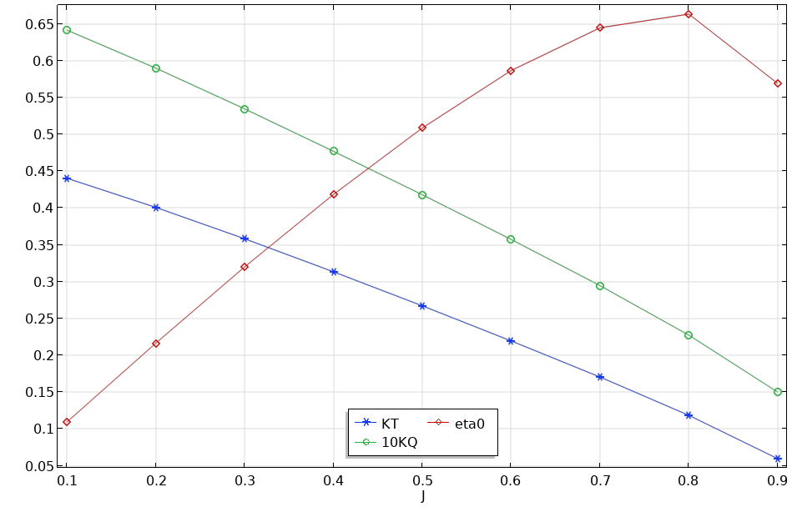
Results
The thrust coefficient and torque coefficient gradually decrease with the increase of advance coefficient .
The open water efficiency gradually increases with the increase of advance coefficient , reaches its peak at J=0.8, and then decreases.
KP505 Open Water Performance Curves

Slide 8
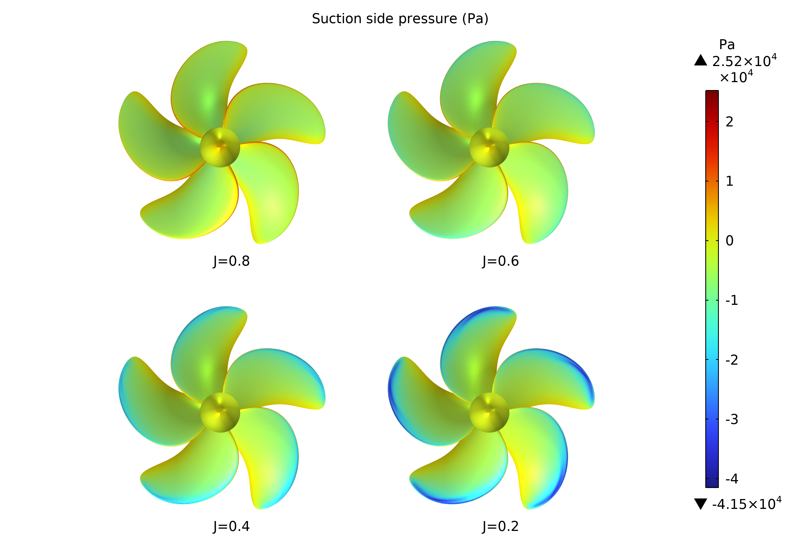
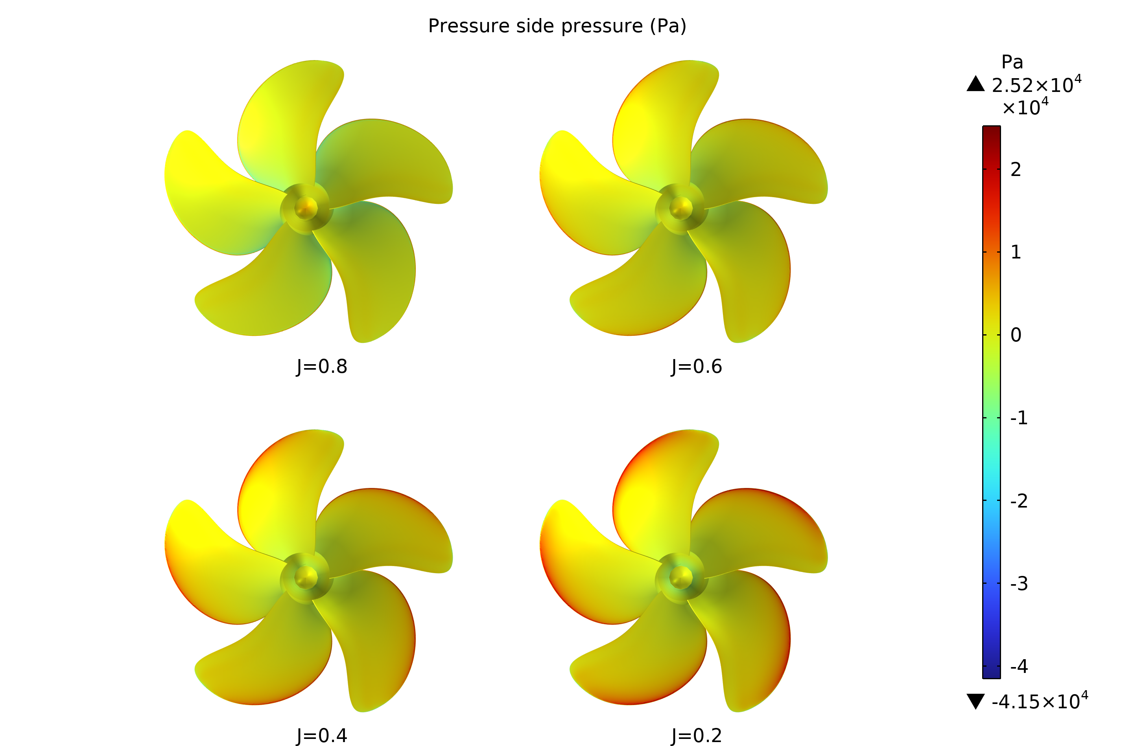
Pressure Distribution on the Blade Surface
The suction side is the surface facing the incoming flow, while the pressure side is the opposite side of the blades.
The relative pressure on the suction side is negative, and the relative pressure on the pressure side is positive. Under the action of pressure difference, the propeller generates thrust.
The pressure gradient is significant near leading edges of blades.
With the increase of the advance coefficient, the pressure distribution does not change much, but the absolute values of the pressure on both the suction and pressure sides gradually decrease, reflecting a reduction in the thrust coefficient.
The pressure distribution on the suction and pressure sides of the propeller blade.

Slide 9
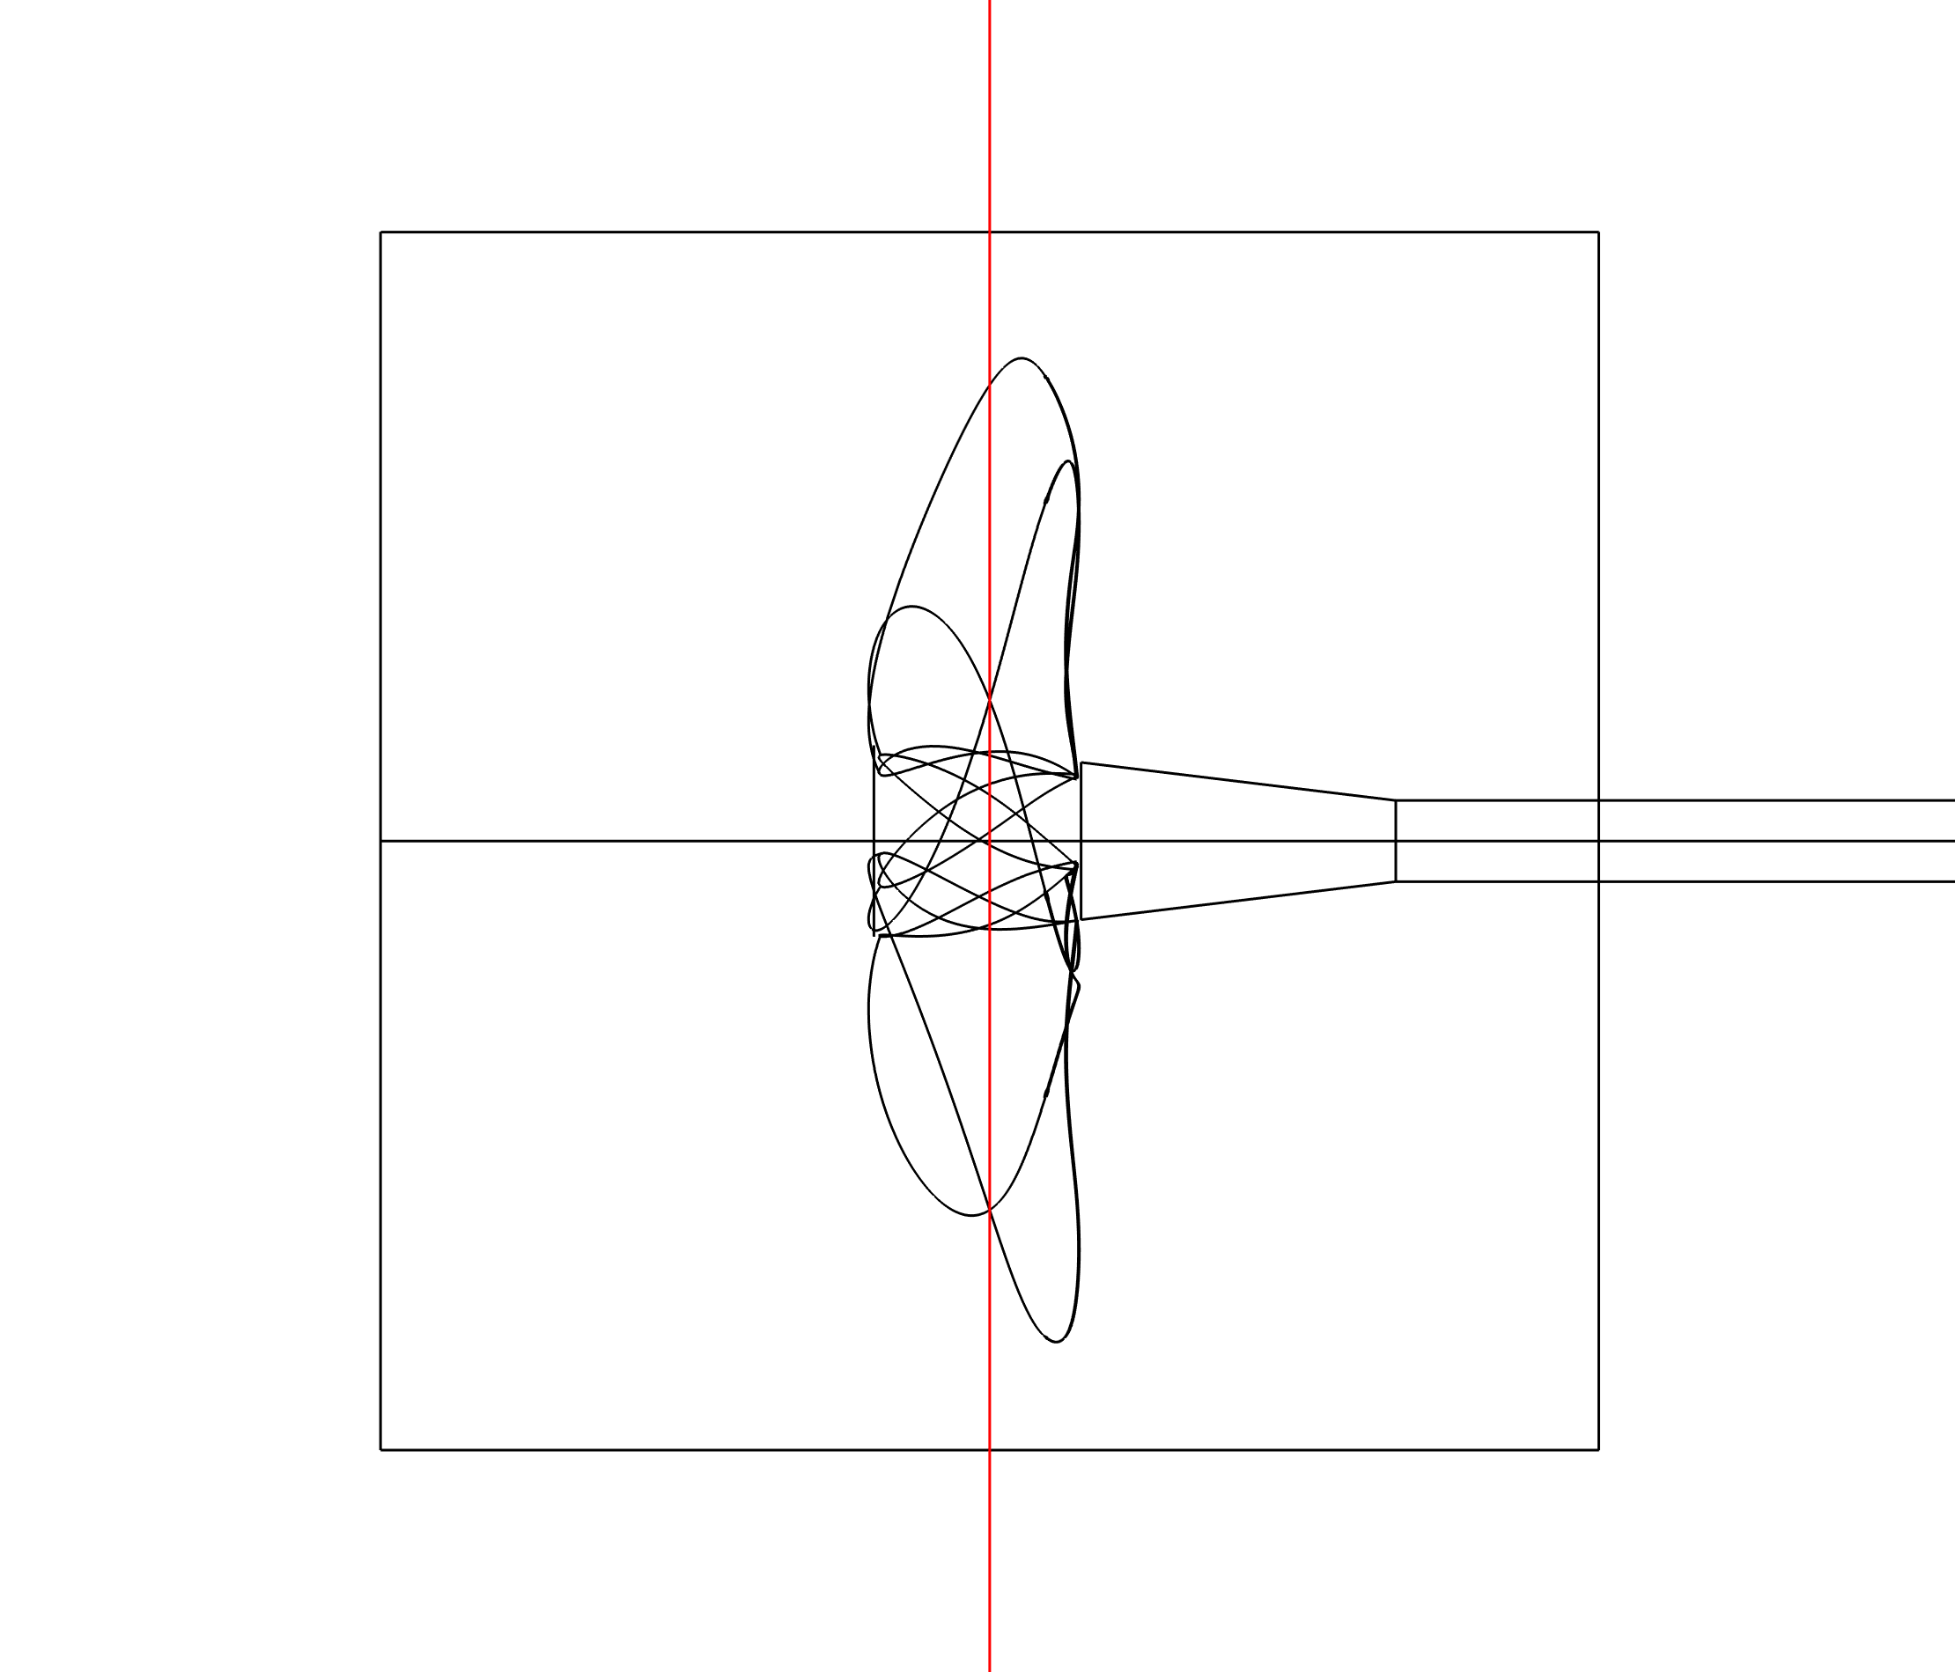
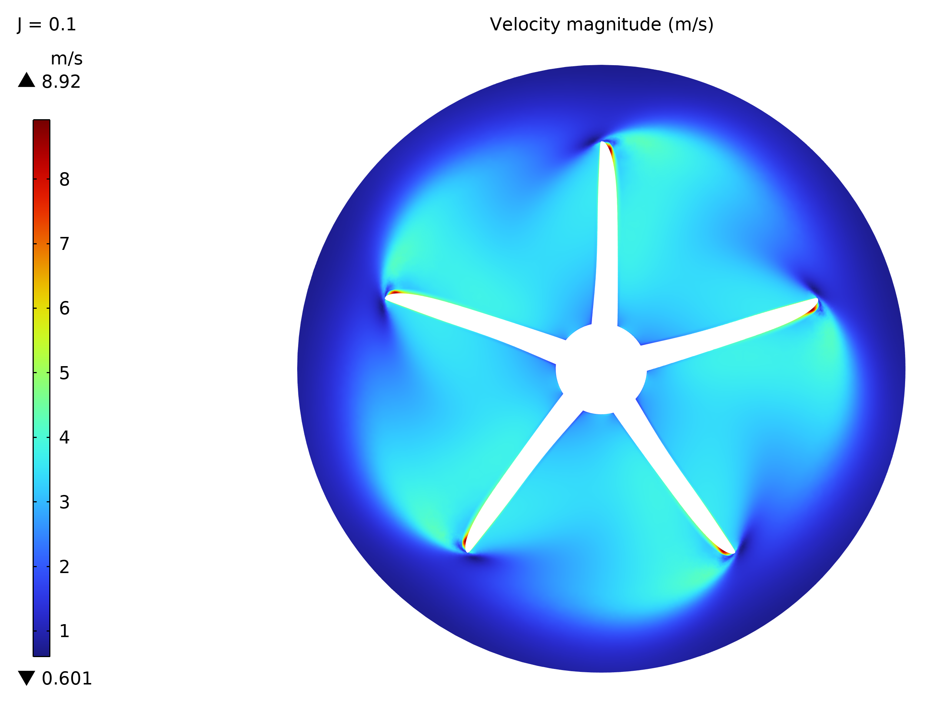
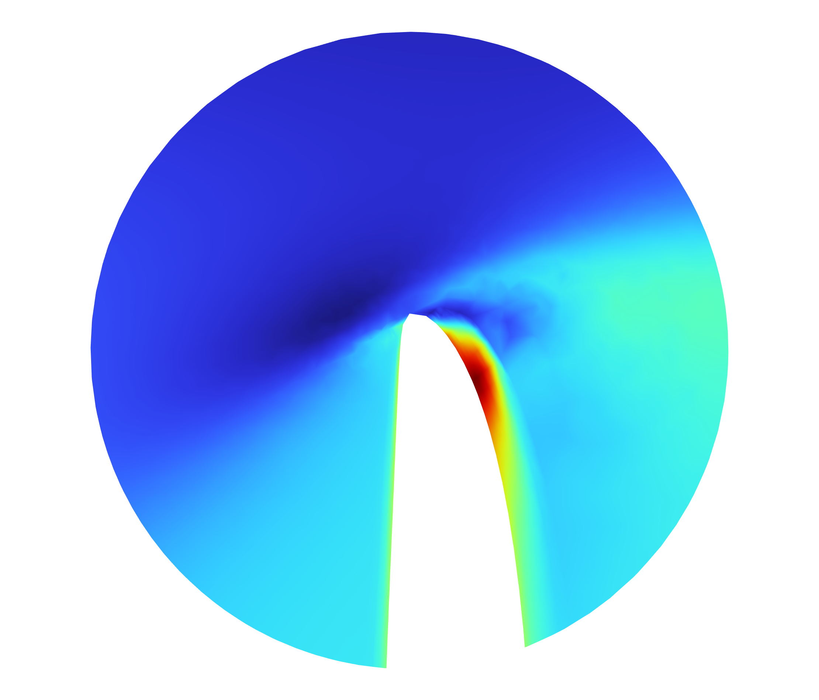
Propeller Cross-Sectional Velocity Distribution
There is a significant velocity gradient at the leading edge of the propeller blades.
x=0[m]

Slide 10
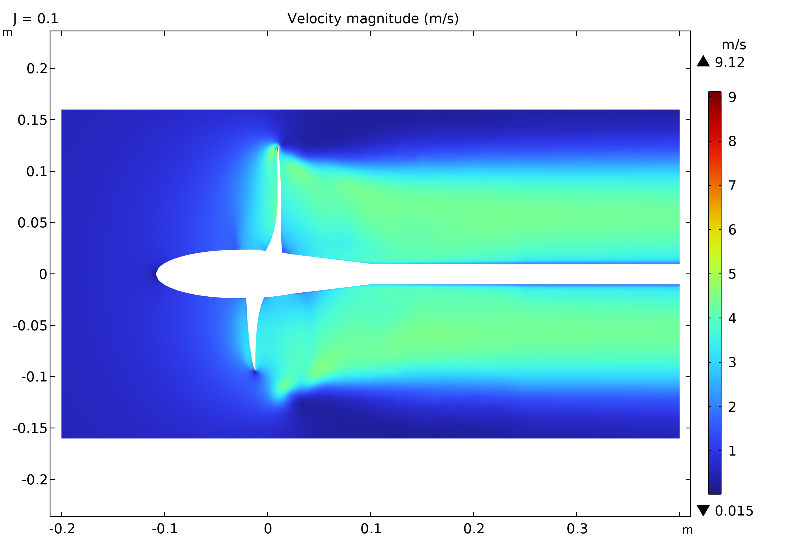
Velocity Distribution in the Flow Direction
The velocity is highest at the tip of the propeller blade.
A strong wake is formed behind the propeller and develops downstream.
The velocity distribution along the flow direction.

Slide 11
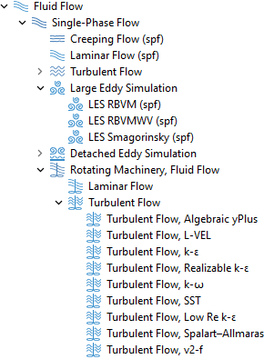
Summary
The propeller performance is calculated using the Realizable k - ε turbulence model with wall function.
SST (low Re) turbulence model can be considered to improve the solution accuracy.

