Slide 1
Heat and moisture transport in a wall with capillary active insulation

Slide 2
Model description
The model computes moisture distribution in a multilayer wall with capillary active interior insulation.
The wall consists of three layers: brick (365 mm), mortar (15 mm) and interior insulating material (40 mm). Material properties of layers are significantly different.
At the initial time step, there is a sudden change in temperature and vapor pressure at both interior and exterior sides. Duration of simulation is 60 days.
1D model is defined in HAMSTAD-WP2 Modeling, Benchmark 5:
  Project for the validation of numerical simulations for coupled heat and moisture transport in building materials
  Reference: Hagentoft, C.E.: HAMSTAD WP 2 Modeling – Final report: Methodology of HAM-modeling R-02:8. Gothenburg, Department of Building Physics, Chalmers University of Technology (2002).
Model is built with Heat and Moisture Transport in Building Materials predefined interface.

Slide 3

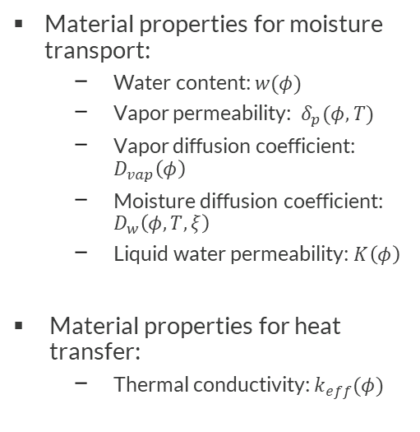

Geometry and Material properties
Load
Bearing (brick)
Interior insulation
Mortar
Material properties for moisture transport:
  Water content: $w(φ)$
  Vapor permeability: $δ_{p}(φ,T)$
  Vapor diffusion coefficient: $D_{vap}\left(φ\right)$
  Moisture diffusion coefficient: $D_{w}\left(φ,T,ξ\right)$
  Liquid water permeability: $K\left(φ\right)$
Material properties for heat transfer:
  Thermal conductivity: $k_{eff}(φ)$
Exterior,
$${p_{v}}_{e}, T_{e}$$
Interior,
$${p_{v}}_{i},T_{i}$$
365 mm
40 mm
420 mm

Slide 4





Model definition
Heat transfer in Building Materials interface:
$${\left(ρc_{p}\right)}_{eff}\frac{∂T}{∂t}+∇∙q=Q$$
$$q=−(k_{eff}∇T+L_{v}δ_{p}∇\left(φp_{sat}\left(T\right)\right)$$
Moisture transport in Building Materials interface:
$$ξ=\frac{∂w}{∂φ}$$
$ξ\frac{∂φ}{∂t}+∇∙g=G$,
$$g=−(ξD_{w}∇φ+δ_{p}∇\left(φp_{sat}\left(T\right)\right)$$
Liquid transport by capillary suction forces
Vapor diffusion
Boundary conditions at interior and exterior sides:
  Convective moisture flux: $g_{0}=β(φ_{ext}p_{sat,ext}−{φ p}_{sat})$
  Convective heat flux : $q_{0}=h(T_{ext}−T)$

Slide 5
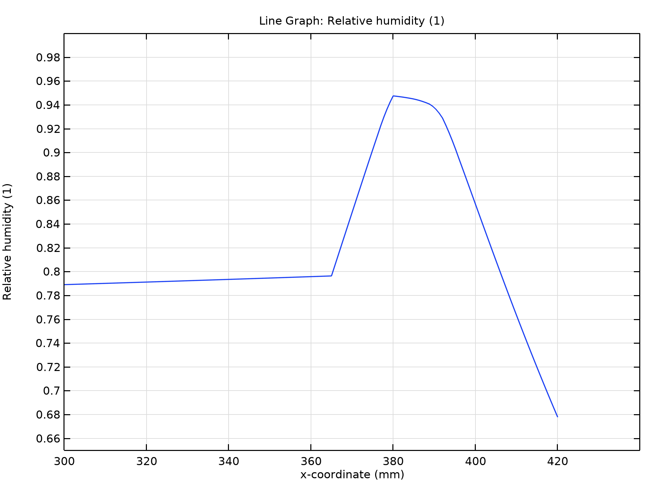
Relative humidity distribution
Brick
Mortar
Interior insulation
The relative humidity is continuous across the wall.
It is almost a constant in the brick, then increases sharply in mortar layer and decreases in the interior insulation.
The resulting distribution is in good agreement with the benchmark data.
Distribution of relative humidity across the wall after 60 hours.

Slide 6
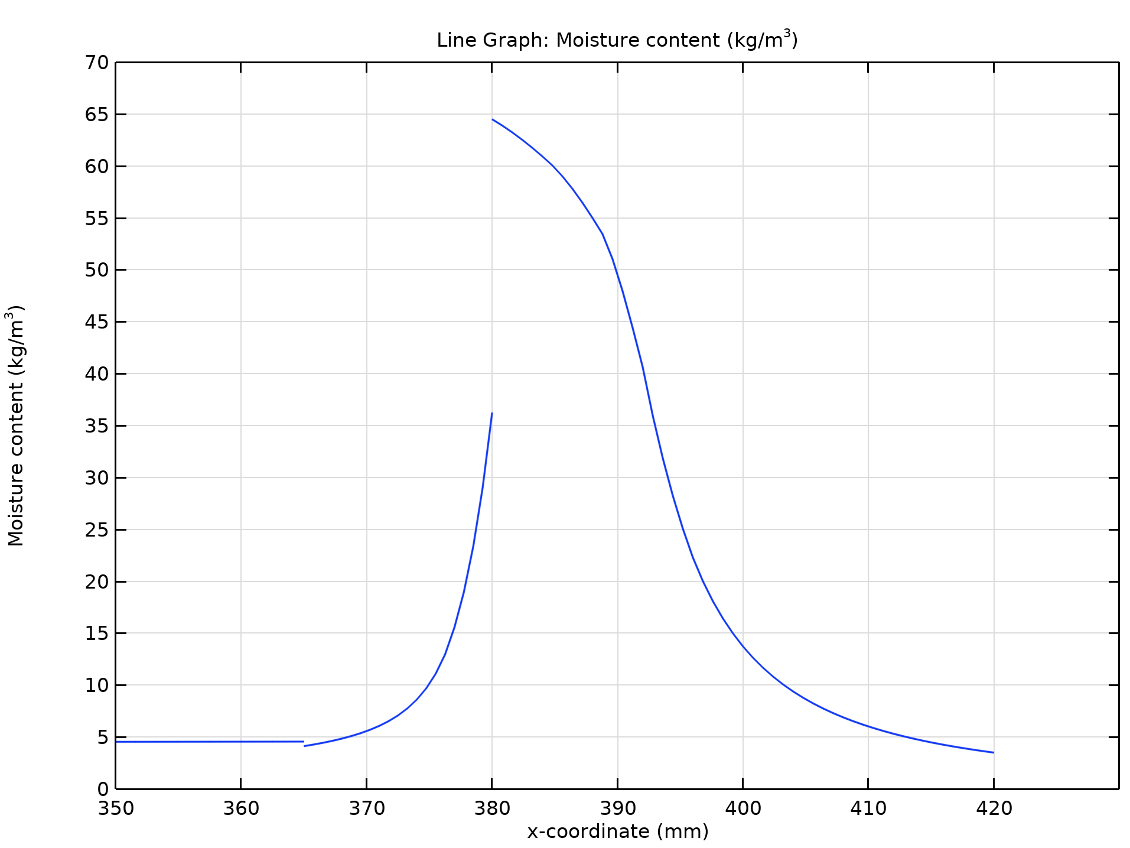
Relative humidity distribution
Brick
Mortar
Interior insulation
The distribution of moisture content exhibits discontinuities at the interfaces between different materials.
It is almost a constant in the brick layer and has strong variation in mortar and insulation layers.
The resulting distribution is in good agreement with the benchmark data.
Distribution of moisture content across the wall after 60 hours.

