Slide 1
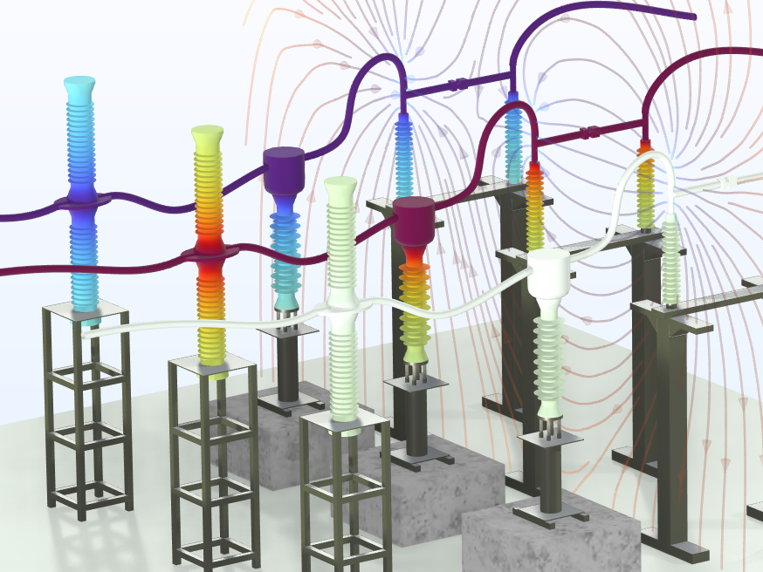
Surrogate Model of a 3-Phase
High-Voltage Switchgear
COMSOL

Slide 2
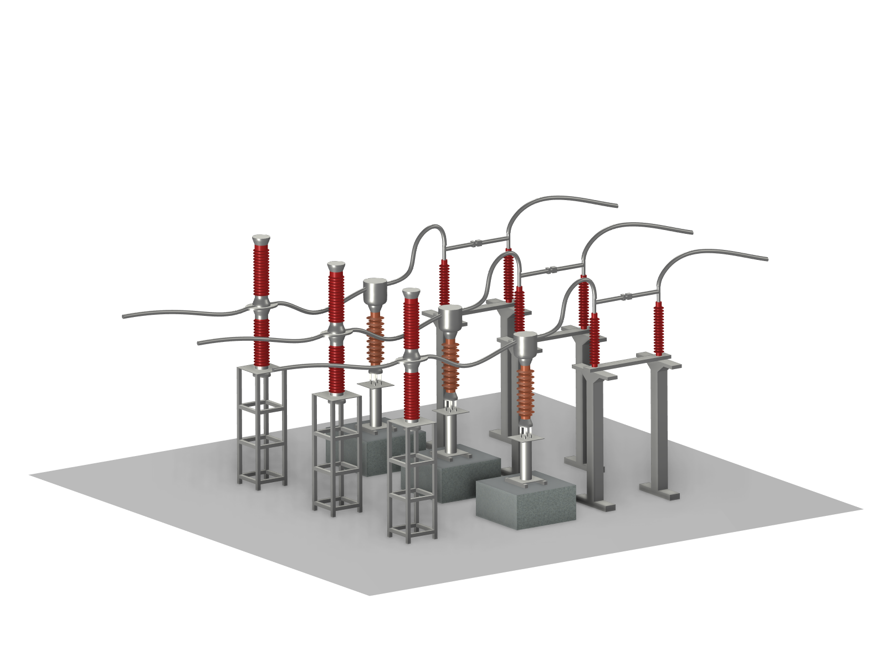
Background
110kV high-voltage switchgears include circuit-breakers, current transformers, disconnectors, conductors and other devices, which are widely used in AC substations in power systems.
At AC 50Hz, the Electrostatics Interface is used to simulate the distribution of electric potential and electric field. The results can be used for the design of insulation to avoid a nonuniform electric field that may cause corona or discharge.
For fast app execution, for example as a part of a digital twin, a surrogate model is created using a deep neural network (DNN) function approximation.

Slide 3
Model Definition
Breaker
Phase C
Phase B
The 110kV 3-phase breaker and disconnector system:
  Circuit breakers
  Current transformers(CT)
  Disconnectors
  Conductors
  Insulators
  Others
At AC 50Hz, V_{in}=110kV as rated operation voltage
Conductors
Phase A
Disconnector
Insulator
Current Transformer

Slide 4
Model Definition
Phase C
Phase B
Terminal voltage
  Phase A conductors:
  V_{A}=V_{in}*1.414
  Phase B conductors: V_{B}=V_{in}*1.414*exp(i*2*pi/3)
  Phase C conductors: V_{C}=V_{in}*1.414*exp(-i*2*pi/3)
Floating potential
  Current transformers(CT)
Ground
Phase A

Slide 5
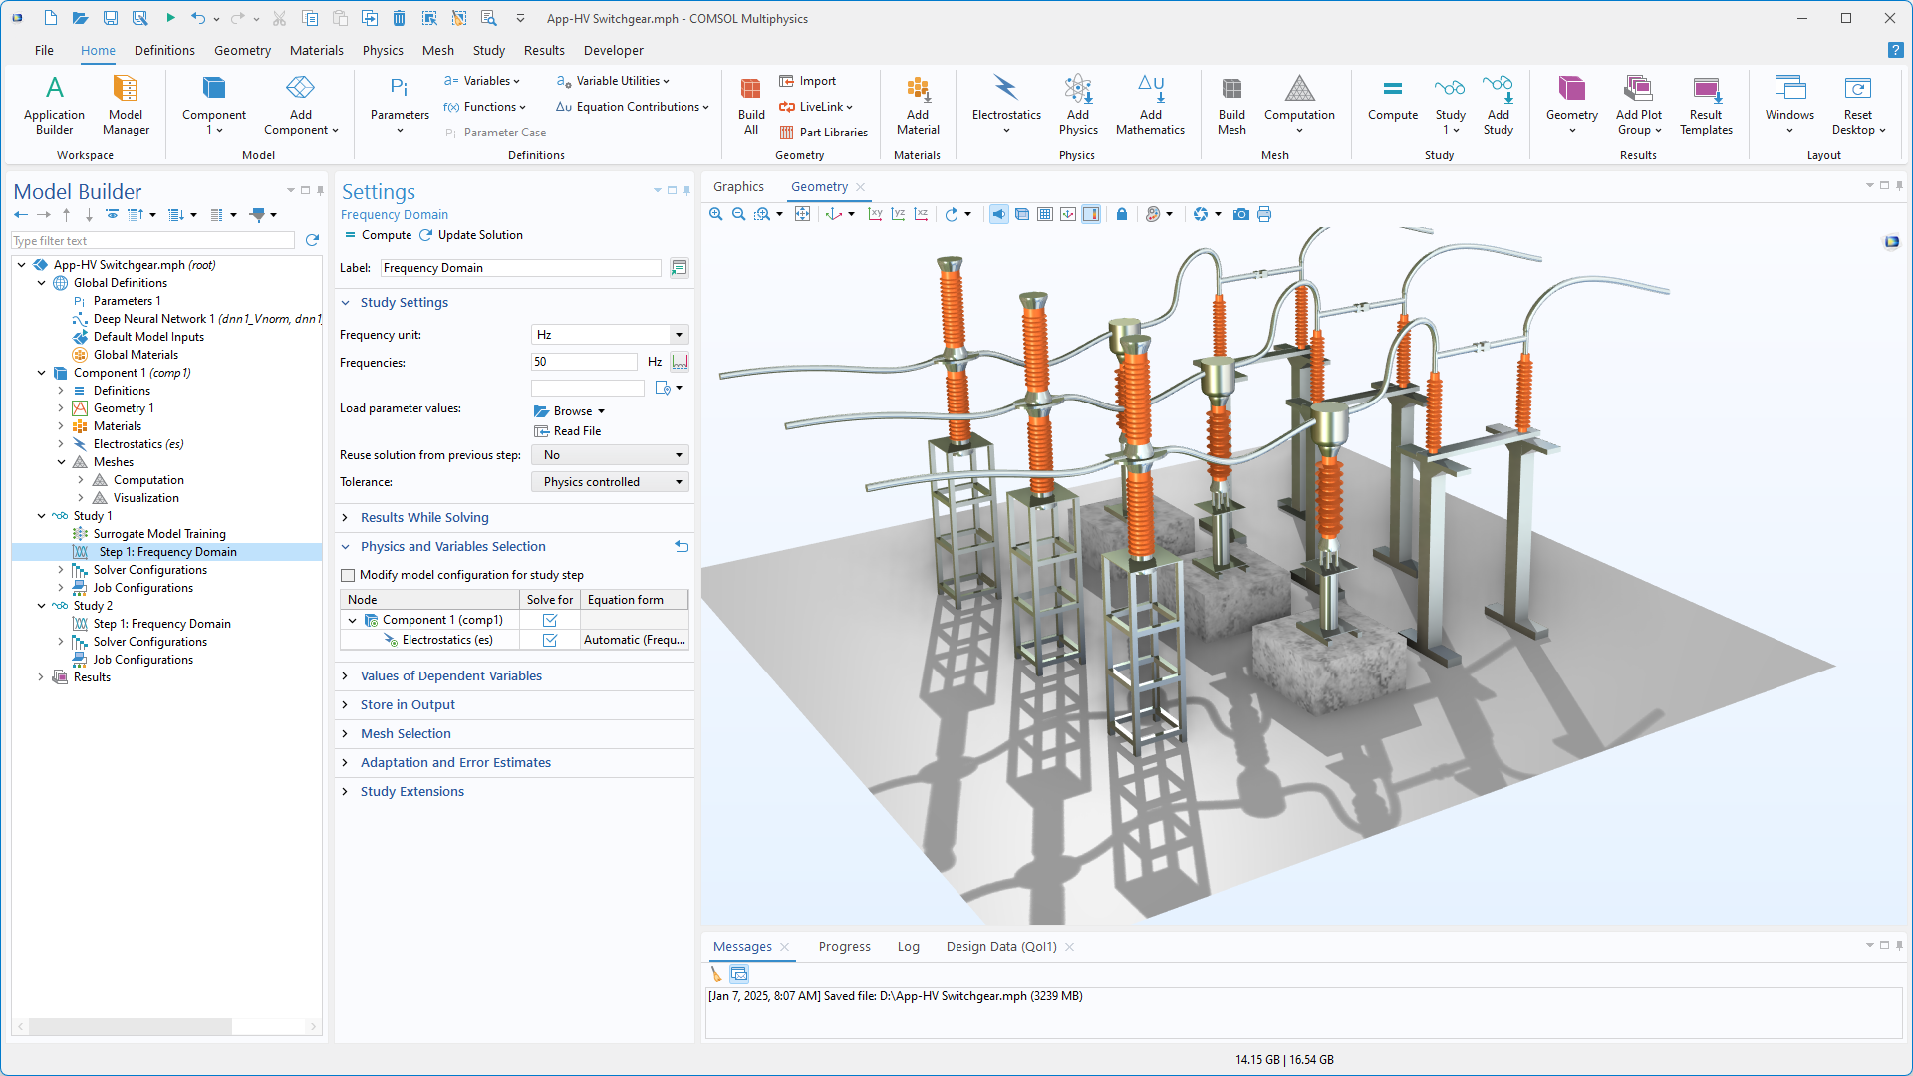
Study
Frequency Domain Study at 50Hz

Slide 6
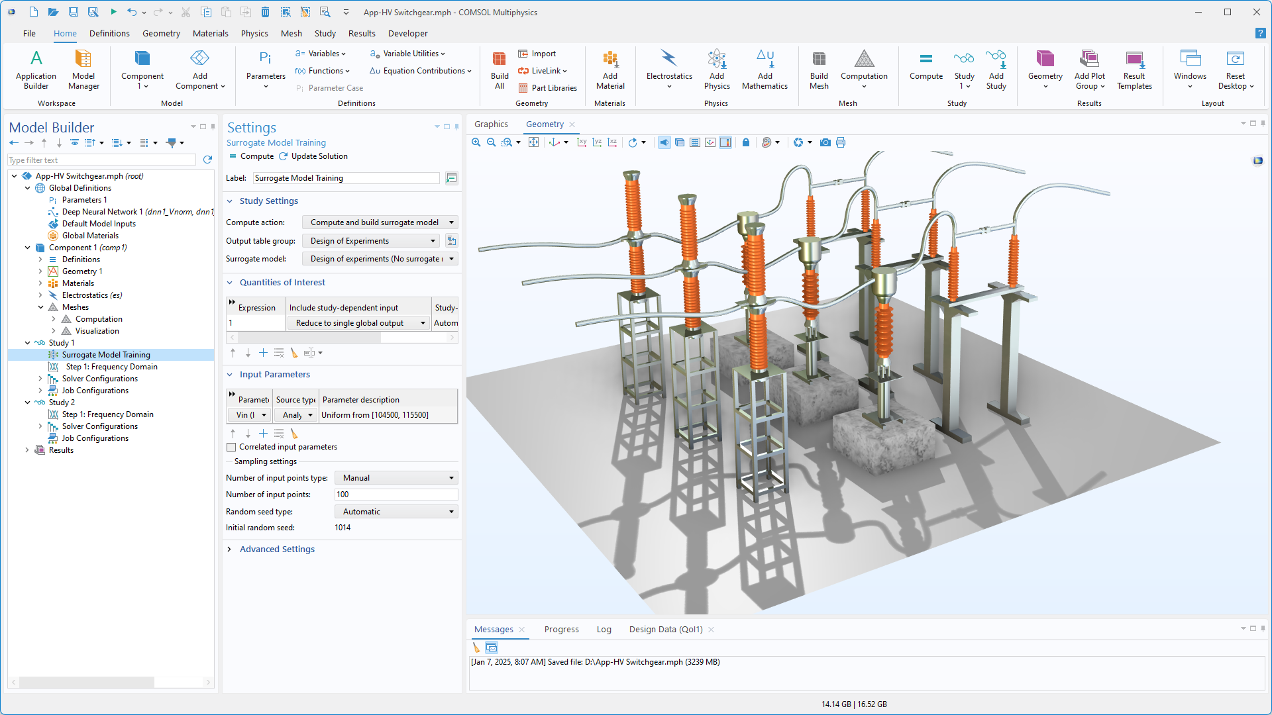
Study
Surrogate Model Training: Design of experiments (DoE) is used for making the parametric sweep and sampling more efficiently.
For more details of efficient sampling method, see the application.

Slide 7
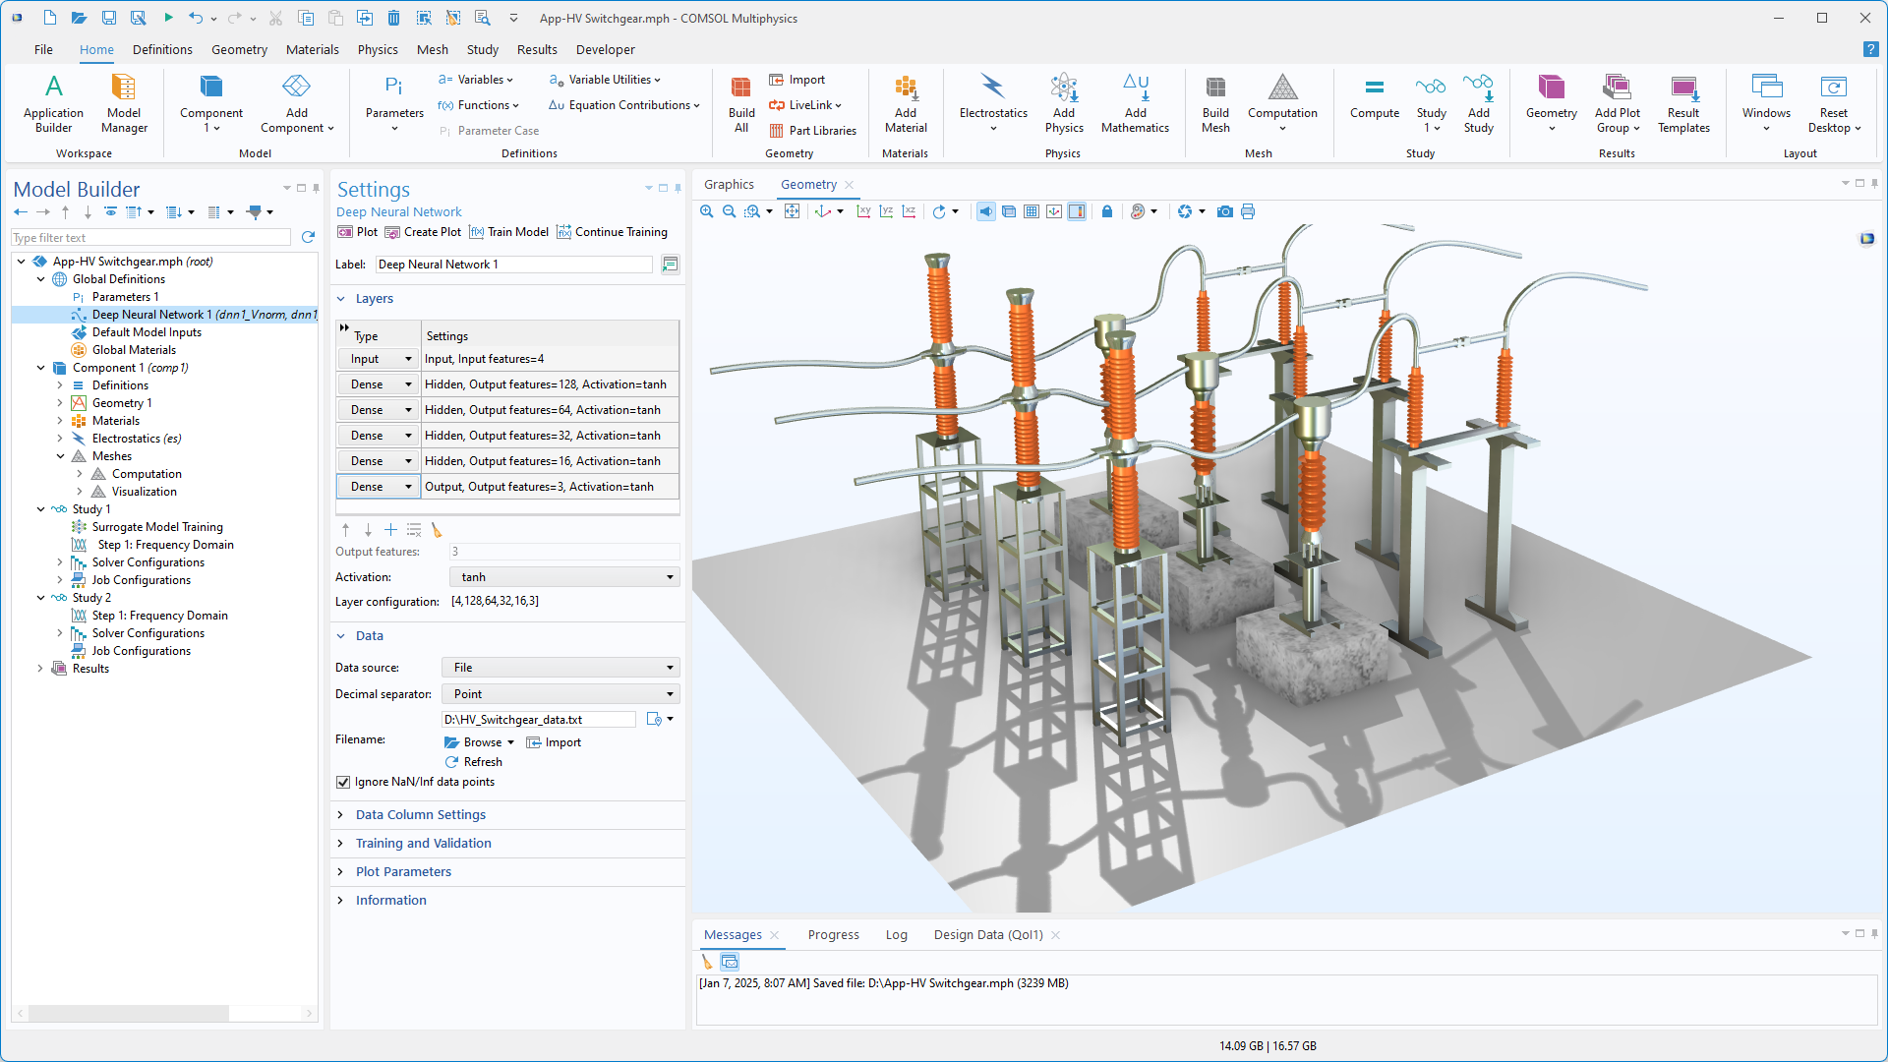
Study
Surrogate Model Training:
Deep neural network function uses the sampling data of DoE as training input data.

Slide 8
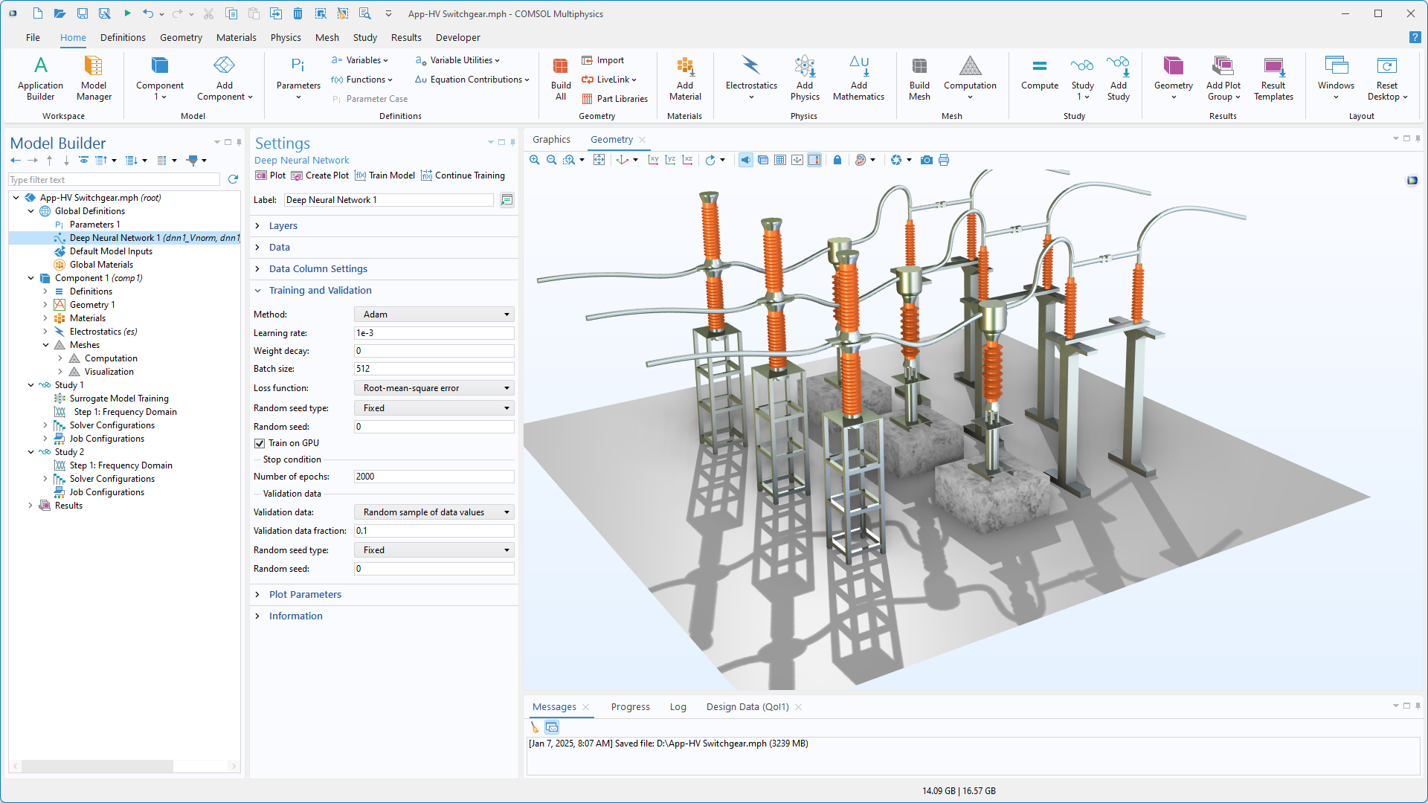
App Builder
The trained deep neural network functions dnn1_Vnorm, dnn1_Vreal, dnn1_Vimag are used for computing the results.

Slide 9
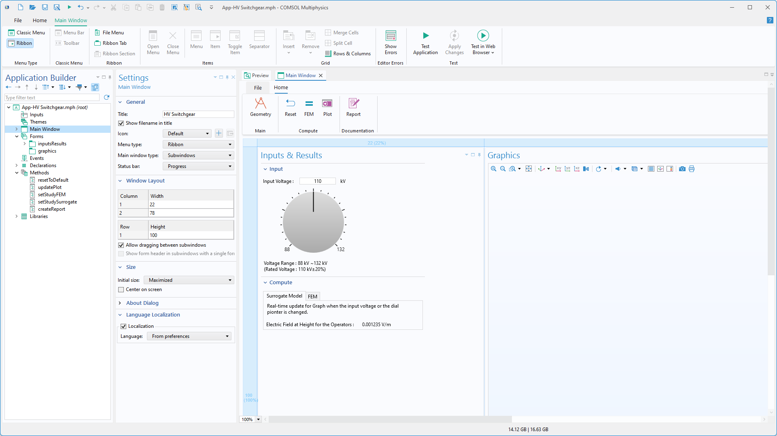
App Builder
A Timer event is used to trigger a command sequence that updates the input voltage V_{in} (±20% of fluctuation) automatically every second.

Slide 10
Results
At AC 50Hz, 3-phase results are shown, including the electric field (E_{norm}) and electric potential distribution.
Electric field streamlines and
Electric potential distribution

Slide 11
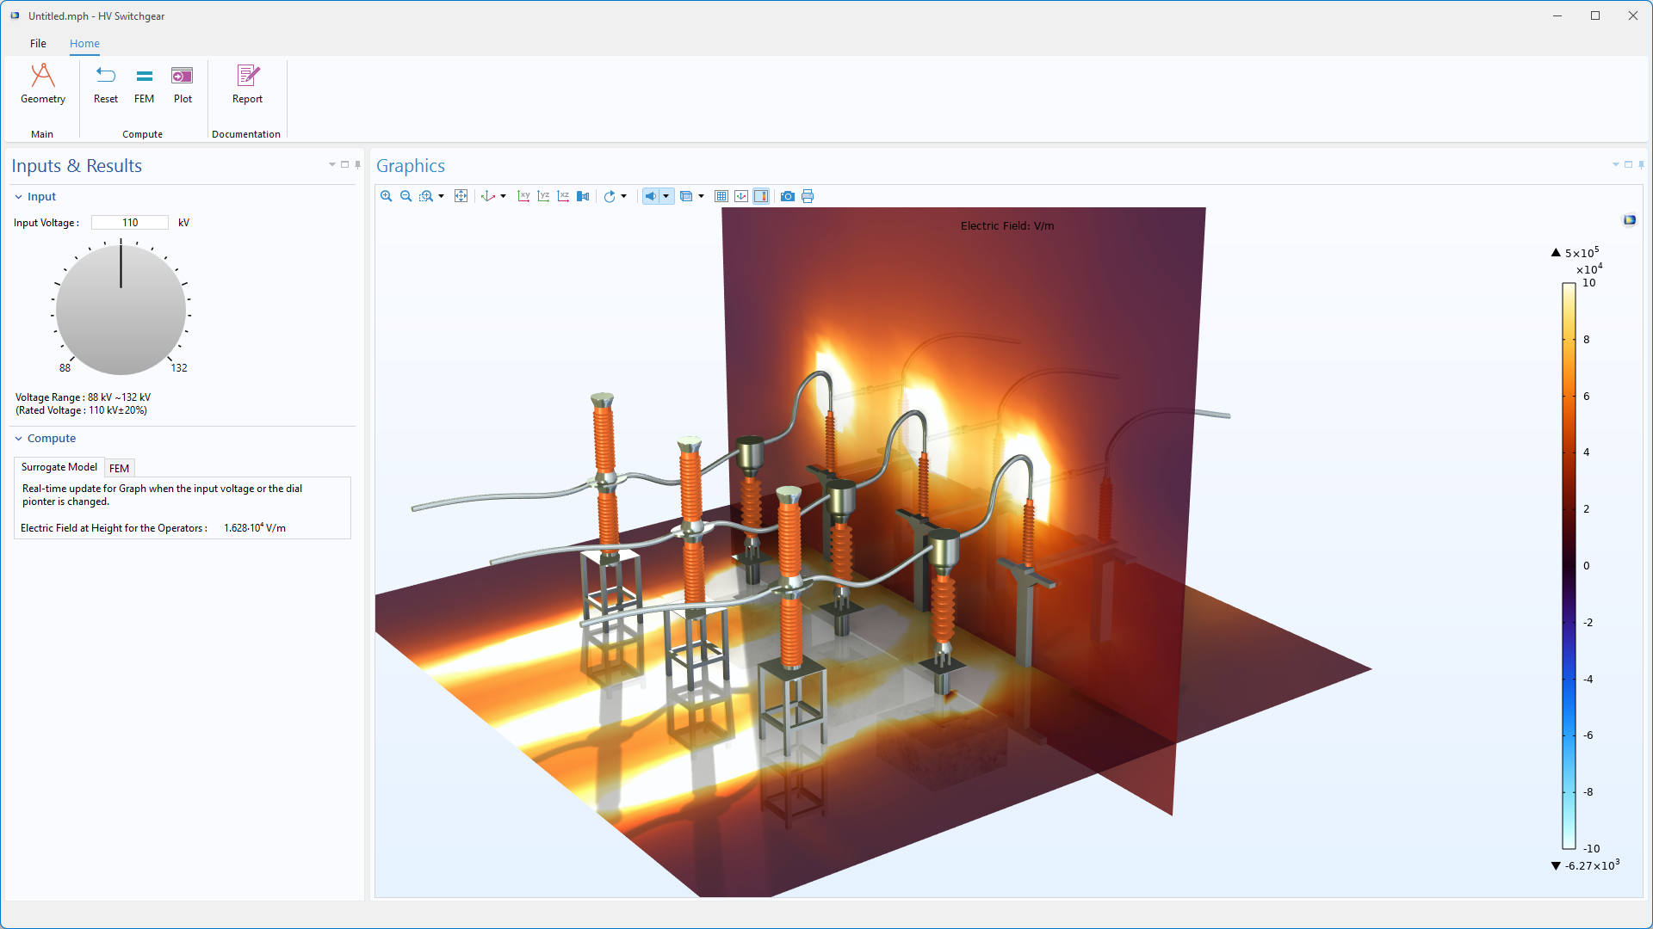
Surrogate Model
Using the app, we can see how the distribution of the electric potential varies with the input voltage V_{in}. Once trained, the surrogate model gives instantaneous results.

Slide 12
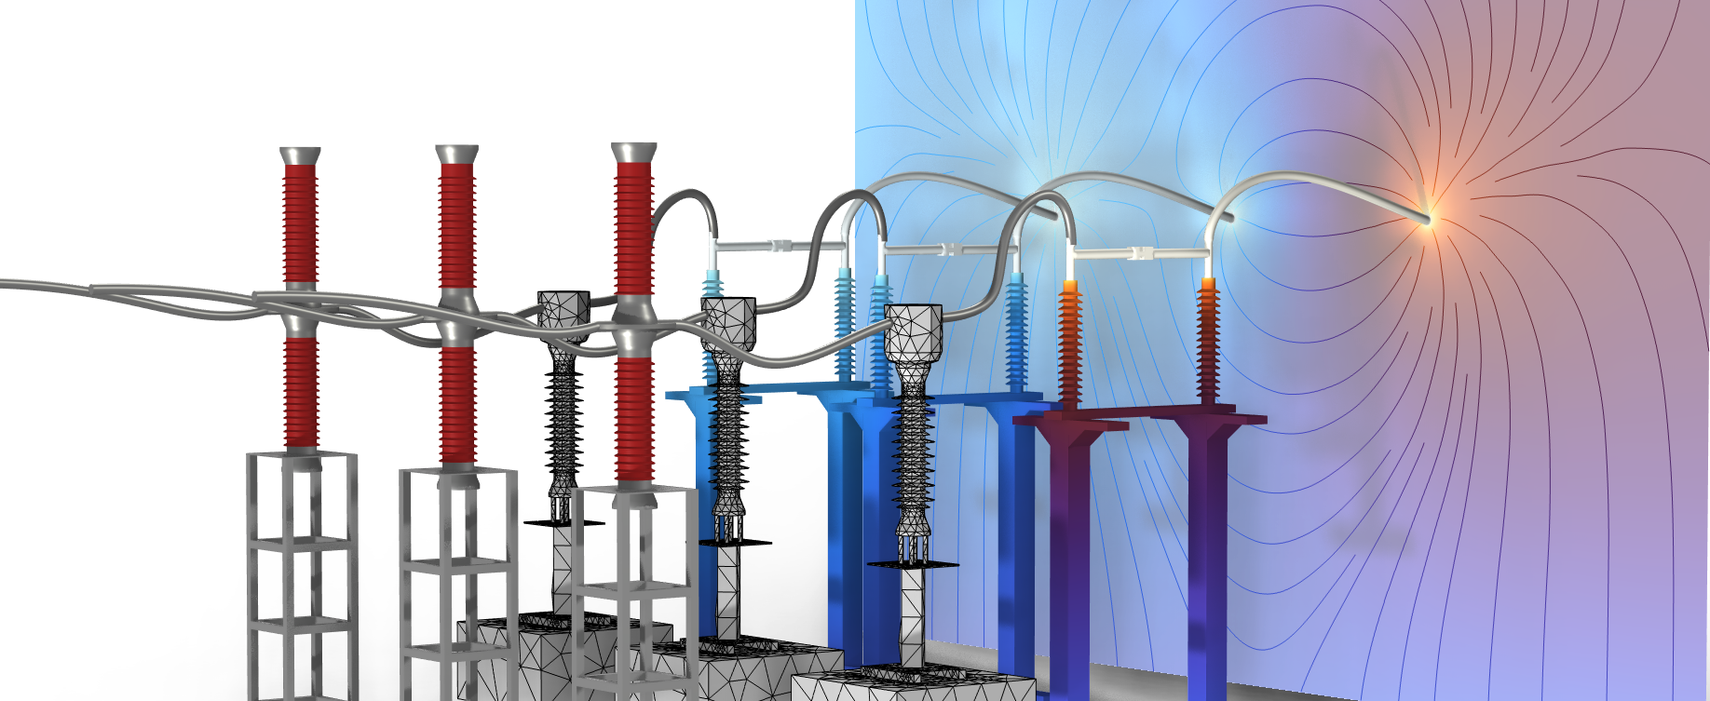
CONCLUDING REMARKS
High-Voltage Switchgears
The electric potential and electric field distribution is computed and the surrogate model (DNN) is so fast that it can easily be used as a part of a digital twin.

