Slide 1
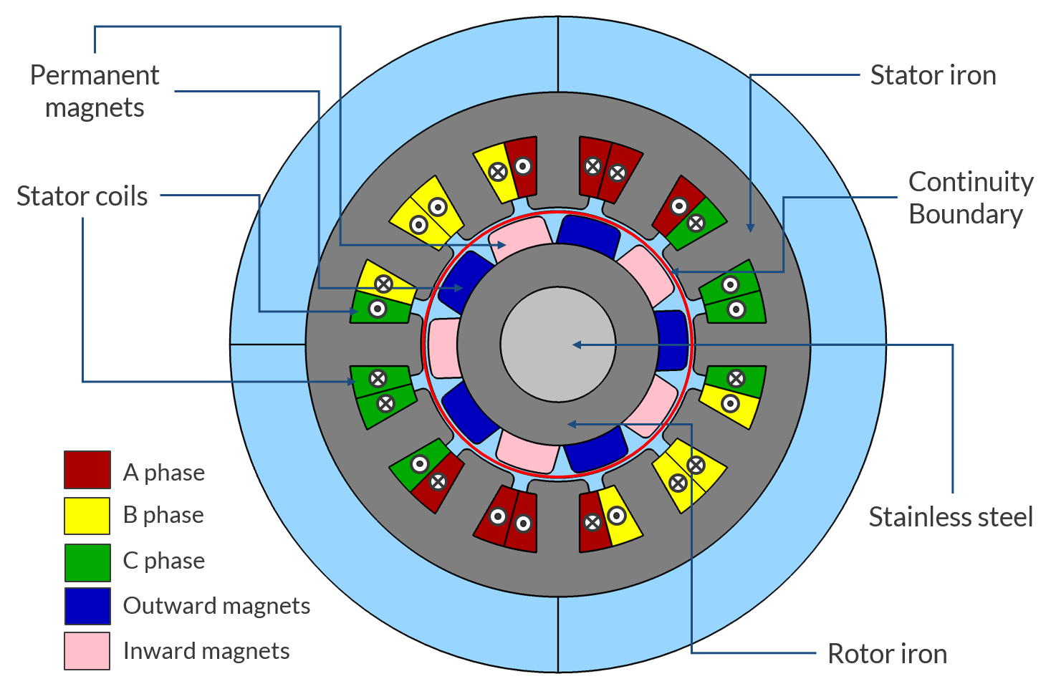
Analyzing electric motor and generator designs

Slide 2
Objective
Setup a lean but still general model of a rotating synchronous machine
As an example, a Permanent Magnet (PM) motor is analyzed
Inputs:
  Geometry
  Materials
  Current excitation
Outputs:
  Magnetic field distribution for different excitations
  Air gap magnetic flux density
  Torque
  Losses
More details and more stories from
Modeling Electric Motor and Generator Designs in COMSOL®

Slide 3
Electric motor geometry
Internal rotor
  External diameter: 35 mm
  Rotor diameter: 18 mm
  Transverse length: 80 mm
Use two geometry parts:
  12 slots stator
  10 poles surface mounted permanent magnets rotor
Embedded geometry parts allow easy extension to different number of poles/slot and size

Slide 4
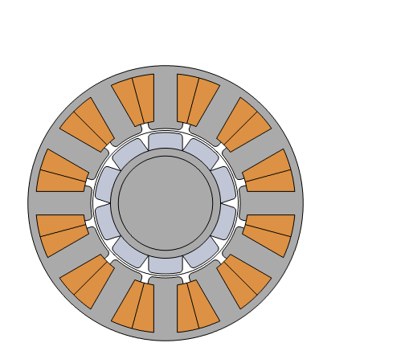
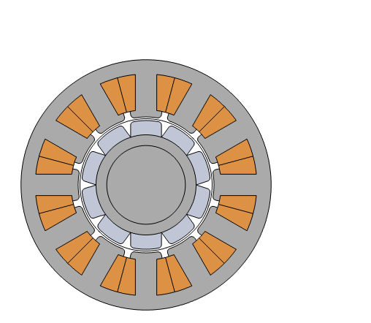
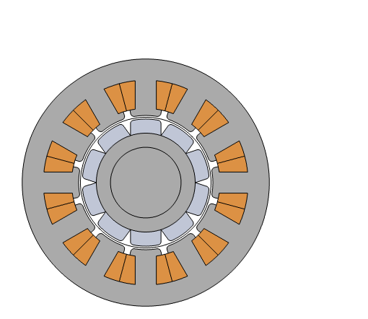
The three compared geometries
A common parameter “iron_th” modifies both stator back-iron and rotor iron thickness
iron_th= 3 mm
iron_th= 2 mm
iron_th= 3 mm

Slide 5
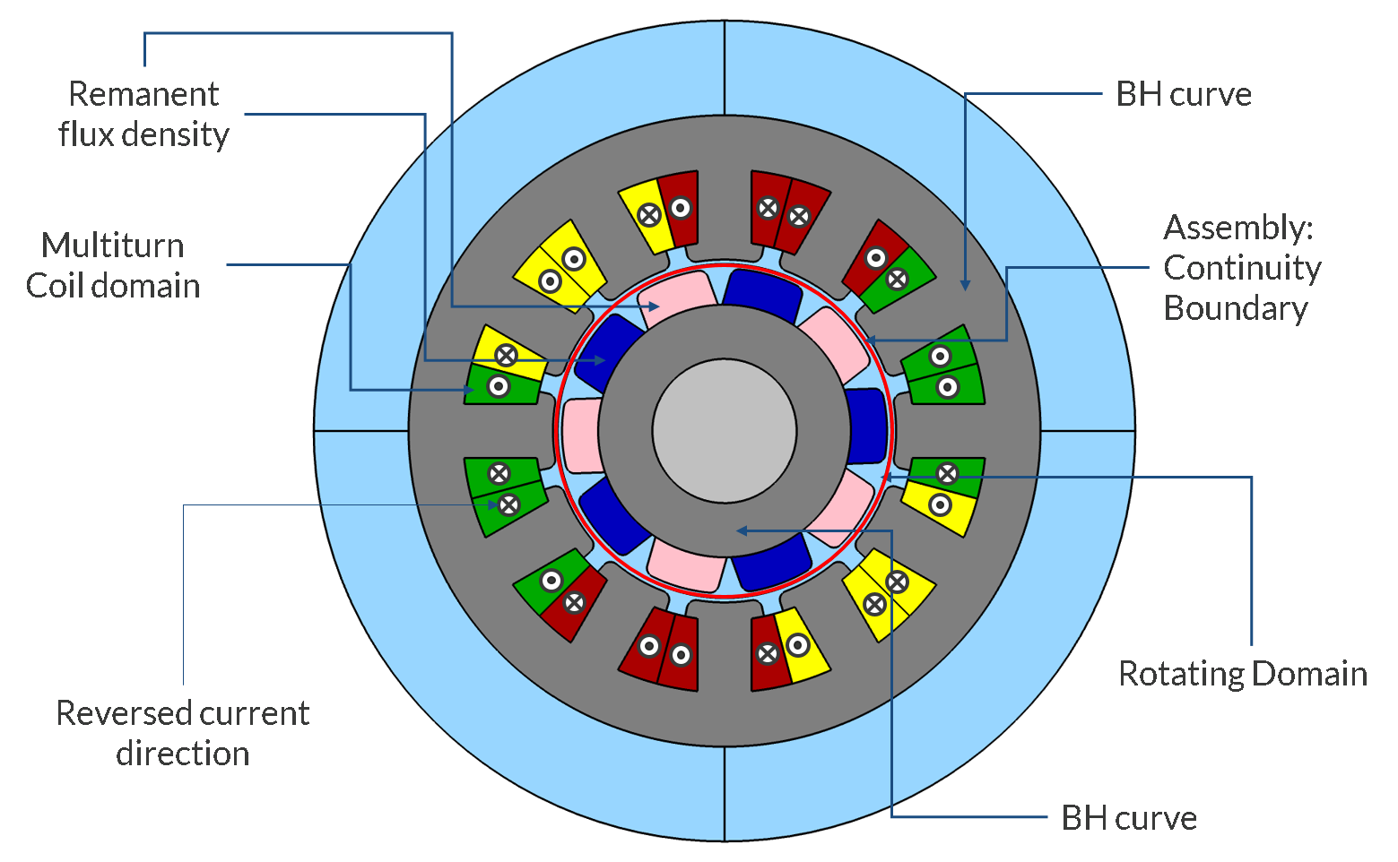
Materials and constitutive relations
Material from AC/DC Module Material Library or built-in
Stator and Rotor Iron
  Soft Iron
  B-H curve
Rotor magnets
  N54 (Sintered NdFeB)
  Remanent flux density (1.47[T])
Shaft: Iron from built-in materials
Slots wires
  Copper, 10 turns, 80% filling factor
  Described by three “Coil” features, one per phase as in the image

Slide 6
Modeling approach
Rotating Machinery Magnetic (RMM) interface
  Sliding mesh approach (2D)
  Continuity enforced over automatically generated assembly continuity pair
  Linear elements
Triangular mesh with a size that allows about 3 elements in all “gaps”
Torque
  Use automatic “Arkkio Torque Calculation”

Slide 7
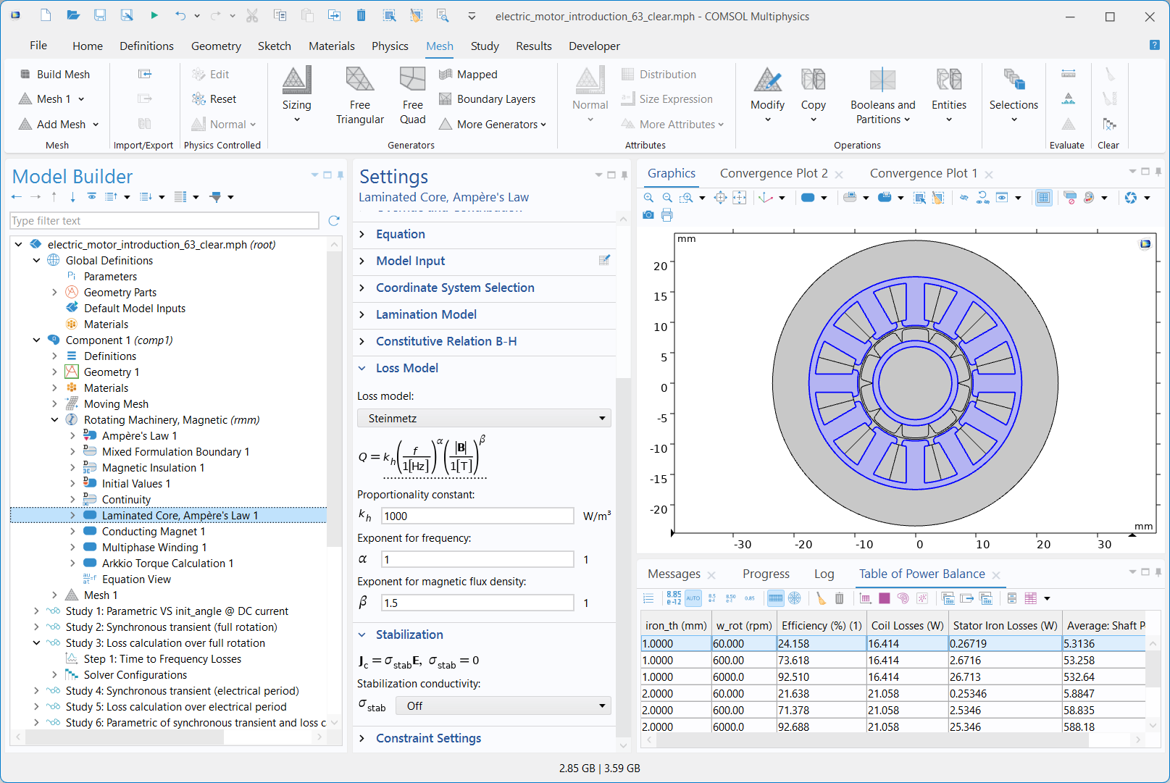
Setup of loss calculations
Losses in iron regions computed using built-in features:
  Steinmetz loss model
  Time to frequency losses study
Default resistive losses added to slots with Multiphase Winding
Losses can be used for computing efficiency or directly as heat source term in heat transfer analyses

Slide 8
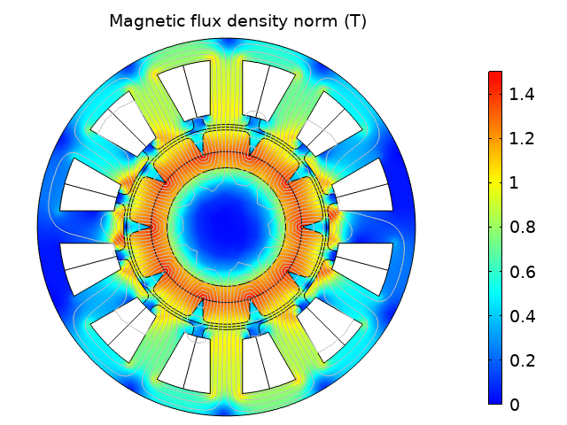
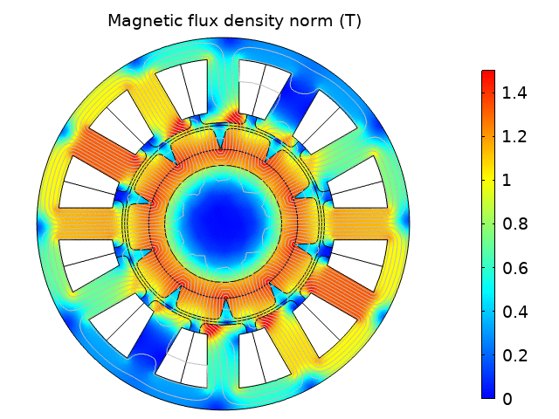
Animation of magnetic fields for different excitations
Parametric over angle @ 10[A] DC current
Synchronous rotation (current is phase locked with mechanical angle)

Slide 9
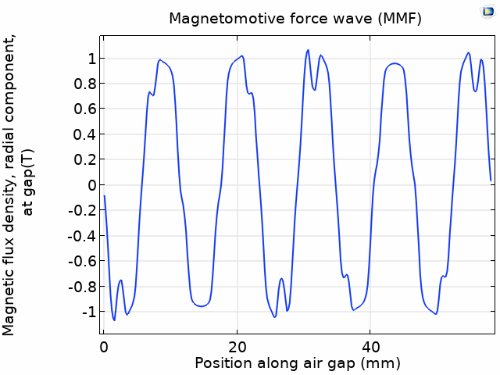
Air gap magnetic flux density
Vector Transform of magnetic flux density B from cartesian to cylindrical coordinates is added under “Definitions”
Radial component of B along airgap angle (at 10[A] DC current) is animated for the rotation
This illustrates what is called a magnetomotive force (MMF) wave
Non-sinusoidal MMF wave imply higher-order induced harmonics
FFT can be readily added

Slide 10
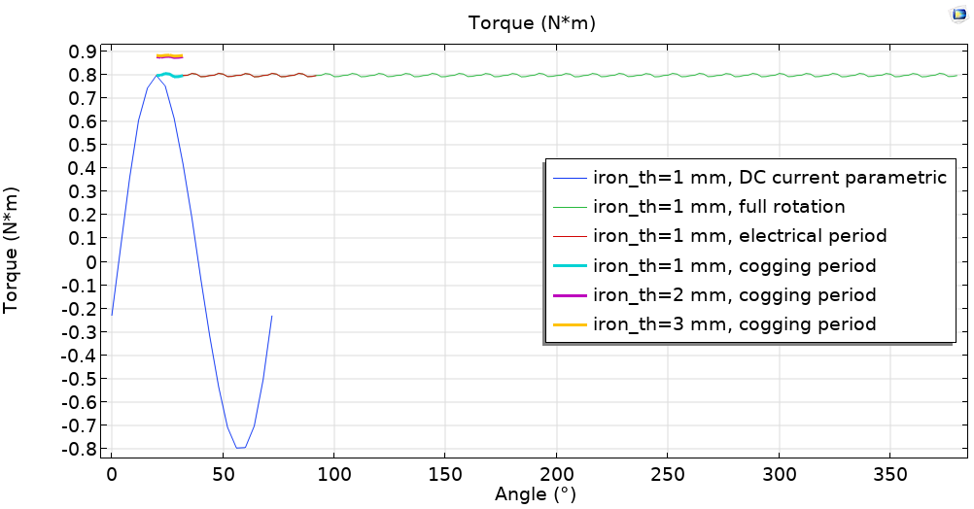
Torque, comparison of three geometries

Slide 11
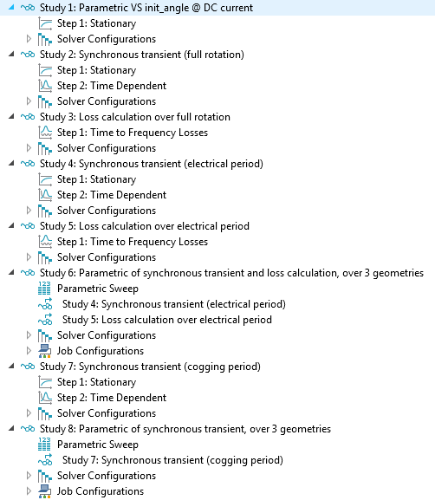
More details on model studies
Eight studies are present in the model as to investigate different time scales
  Study 1 solve for a single stationary parametric over angle
  All the others consider a transient synchronous excitation at 60[rpm]
Studies 2, and 3 consider a full rotation which is the real mechanical period
  This is necessary for general study including rotor iron losses rigorously; in this motor the losses in stator iron are however negligible
  Study 2 is the actual transient; study 3 is for loss calculation
Losses are essentially only in the stator, hence
  stator experiments employs a shorter period (by a factor Np/2)
  studies 4 and 5 reproduce in quicker way the same solution of study 2 and 3
Study 6 runs automatically for three values of “iron_th”, studies 4, and 5
  this allows to save time, still having the losses and easy comparison of geometries
The torque is nearly constant with a ripple that occurs on a period that is 1/6 of the electrical period
  study 7 runs a transient simulation for this period
  period of torque fluctuation (cogging) is not sufficient for proper loss calculation, but it is sufficient for mechanical considerations
  study 8 runs study 7 for three values of “iron_th”
All studies are set so that they can be run independently

Slide 12
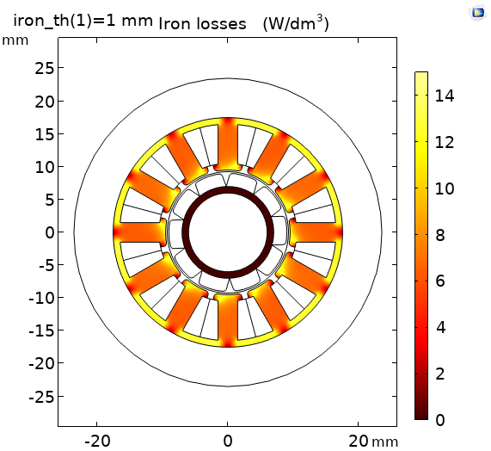
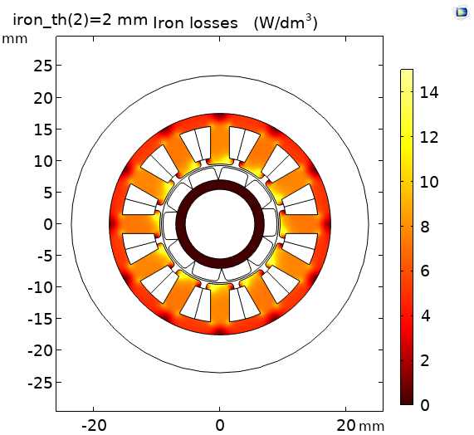
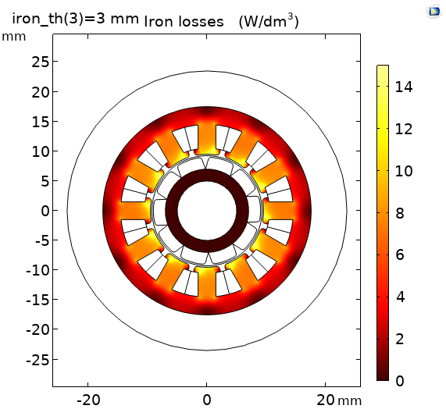
Losses (at 60[rpm] synchronous speed)
Integral 0.27 W
Integral 0.25 W
Integral 0.22 W
Iron losses in this model scale linearly with speed (see * in next slide)
Under current settings, coils losses are frequency independent and, for 10A, result
  iron_th =1 mm : 16.4W
  iron_th =2 mm : 21.1W
  iron_th =3 mm : 28.3W

Slide 13
Table of power balance at peak current (10 A)
Motor Model | w_rot (rpm) | Efficiency (%) (1) | Coil Losses (W) | Stator Iron Losses* (W) | Average: Shaft Power (W)
iron_th = 1 mm | 60 | 24.2 | 16.4 | 0.267 | 5.31
 | 600 | 73.6 | 16.4 | 2.67 | 53.3
 | 6000 | 92.5 | 16.4 | 26.7 | 533
iron_th = 2 mm | 60 | 21.6 | 21.1 | 0.253 | 5.88
 | 600 | 71.4 | 21.1 | 2.53 | 58.8
 | 6000 | 92.7 | 21.1 | 25.3 | 588
iron_th = 3 mm | 60 | 17.2 | 28.3 | 0.219 | 5.93
 | 600 | 66.0 | 28.3 | 2.19 | 59.2
 | 6000 | 92.2 | 28.3 | 21.9 | 592
* as to identify more clearly the origin of the quantities and simplify algebra of this tutorial, settings make iron losses scale exactly linearly with frequency. More complete analysis is possible, eventually including also terms that are here neglected as losses in magnets or increased losses in coils at higher frequencies or temperatures. Many of these aspects are described in other models.

Slide 14
Conclusion
A tutorial on a electric motor based on a lean modeling approach is presented
Parametrized electric motor geometries are shown
It has been shown how to extract a number of quantities
  Torque (average and ripple)
  Losses (in iron and in conductors)
  Comparing their balance with respect to different geometries and working conditions
Other contributions deal with more advanced topics and multiphysics aspects as
  Temperature increase
  Effect of forces on vibration and noise
  Motor optimization
More details and more stories from
Modeling Electric Motor and Generator Designs in COMSOL®

