Slide 1
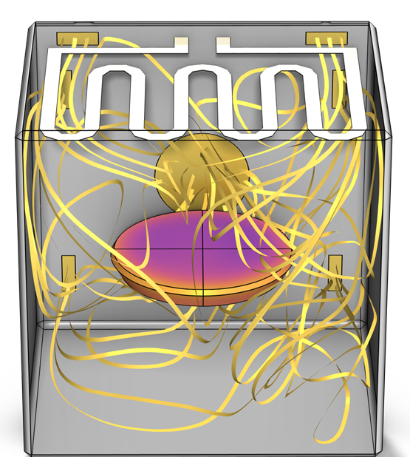
Domestic Oven

Slide 2
Motivation
This example describes the heating process of a pie in a domestic oven, considering conduction, convection and radiation.
Two approaches are considered:
  A one-way nonisothermal flow (one-way NITF) approach which solves for a stationary fluid flow, and then for heat transfer. The flow is considered incompressible.
  A fully coupled nonisothermal flow (NITF) approach which solves all physics together. The flow is considered weakly compressible.
The two approaches are compared in terms of computational times and results.

Slide 3
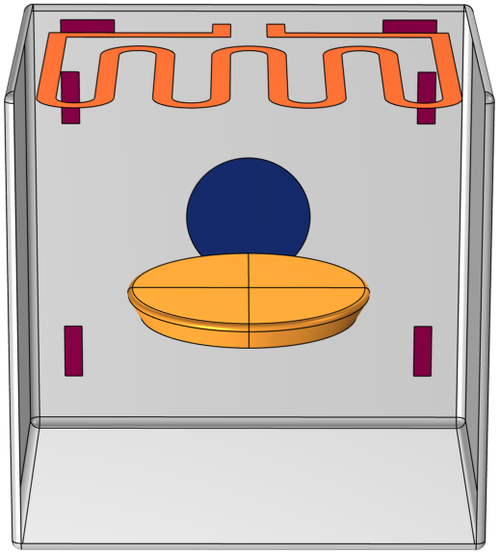
Model Definition
Heater (top resistance)
The top resistance, which can deliver up to 1000 W, is modeled as a shell.
At the back of the oven, between the outlet and the inlets, air is heated by a 1500 W resistance (not represented in the model).
A temperature probe is set on the outlet to control the power supply to both the top and back resistances.
A pie is placed in the middle of the oven.
The radiative heat transfer is considered in the oven.
Oven walls
Outlet
Pie
Inlet
Model geometry

Slide 4
Model Definition
P = 1000 W
Air is blown at about 5.5 m/s through the inlets.
The oven walls are thermally insulated.
A low Reynolds k-ε turbulence model is used as the Reynolds number is about 10,000.
The mesh size is defined to get a good resolution near the walls.
Thermal insulation
Outlet
Inlet (T_{in})
Model boundary conditions

Slide 5
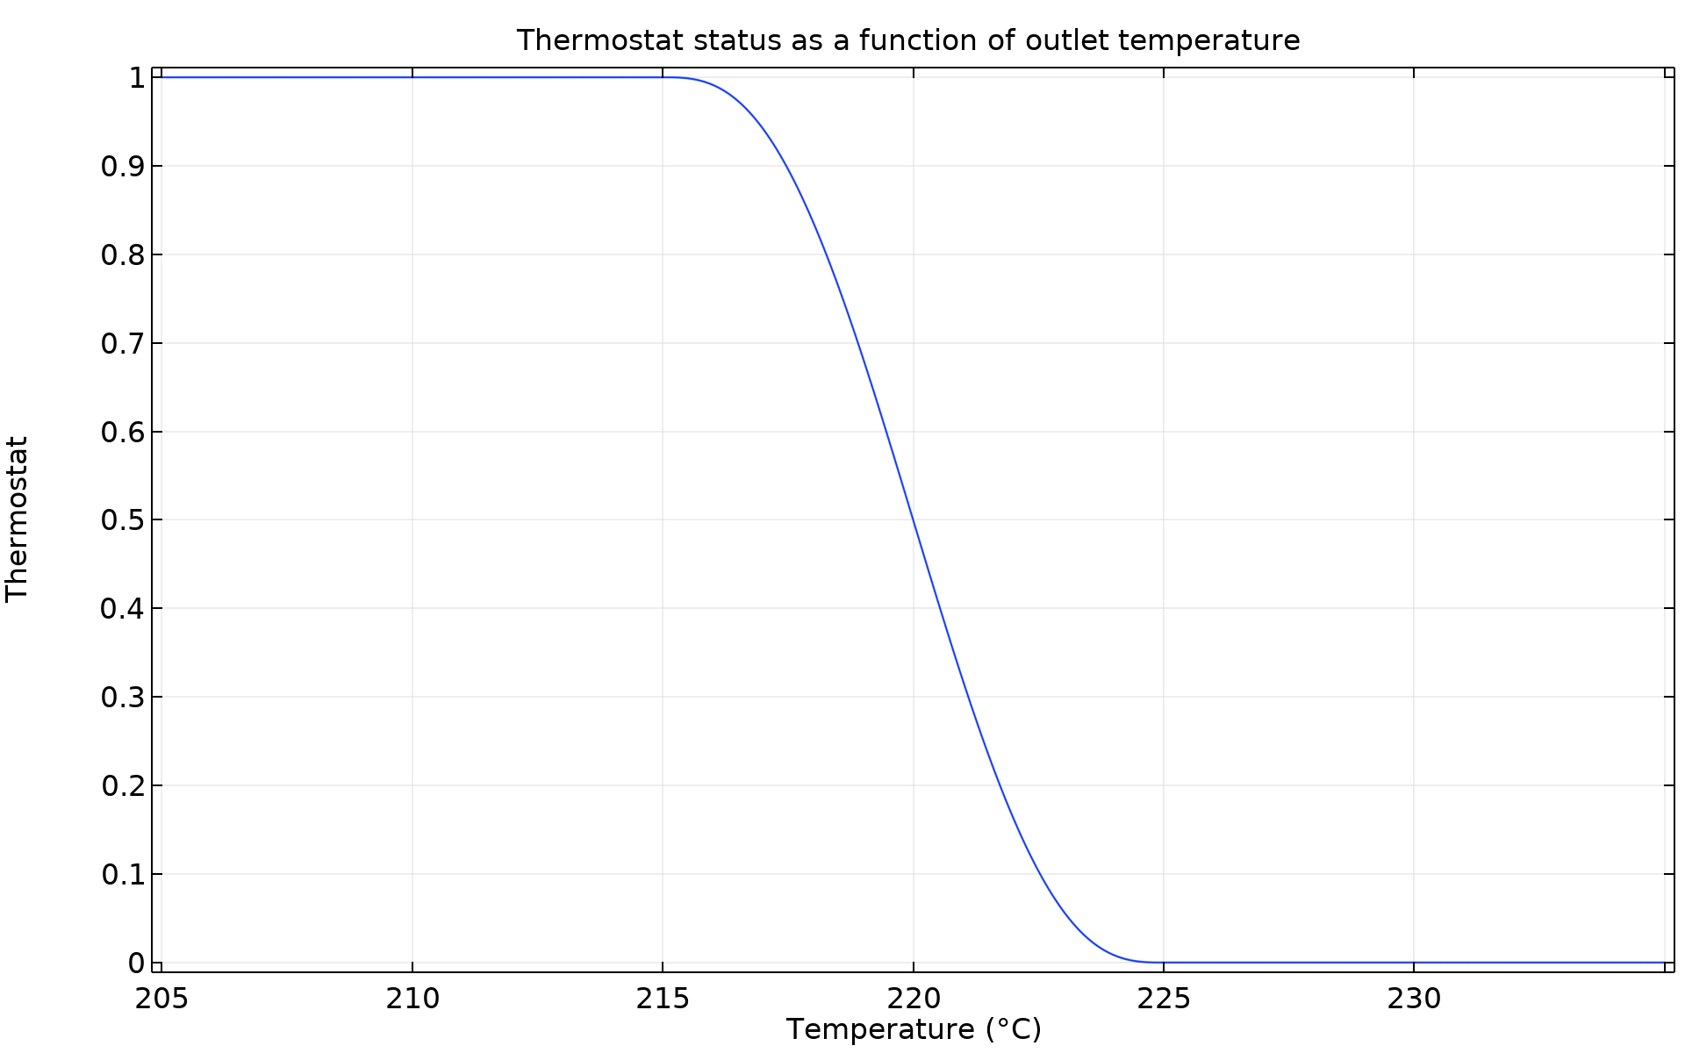
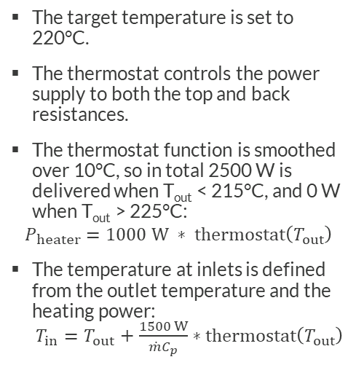
Model Definition
The target temperature is set to 220°C.
The thermostat controls the power supply to both the top and back resistances.
The thermostat function is smoothed over 10°C, so in total 2500 W is delivered when T_{out} < 215°C, and 0 W when T_{out} > 225°C:
$$P_{heater}=1000 W ∗ thermostat\left(T_{out}\right)$$
The temperature at inlets is defined from the outlet temperature and the heating power:
$T_{in}=T_{out}+\frac{1500 W}{{\dot{m}C}_{p}}∗thermostat\left(T_{out}\right)$
Thermostat function controlling power supply in the oven

Slide 6
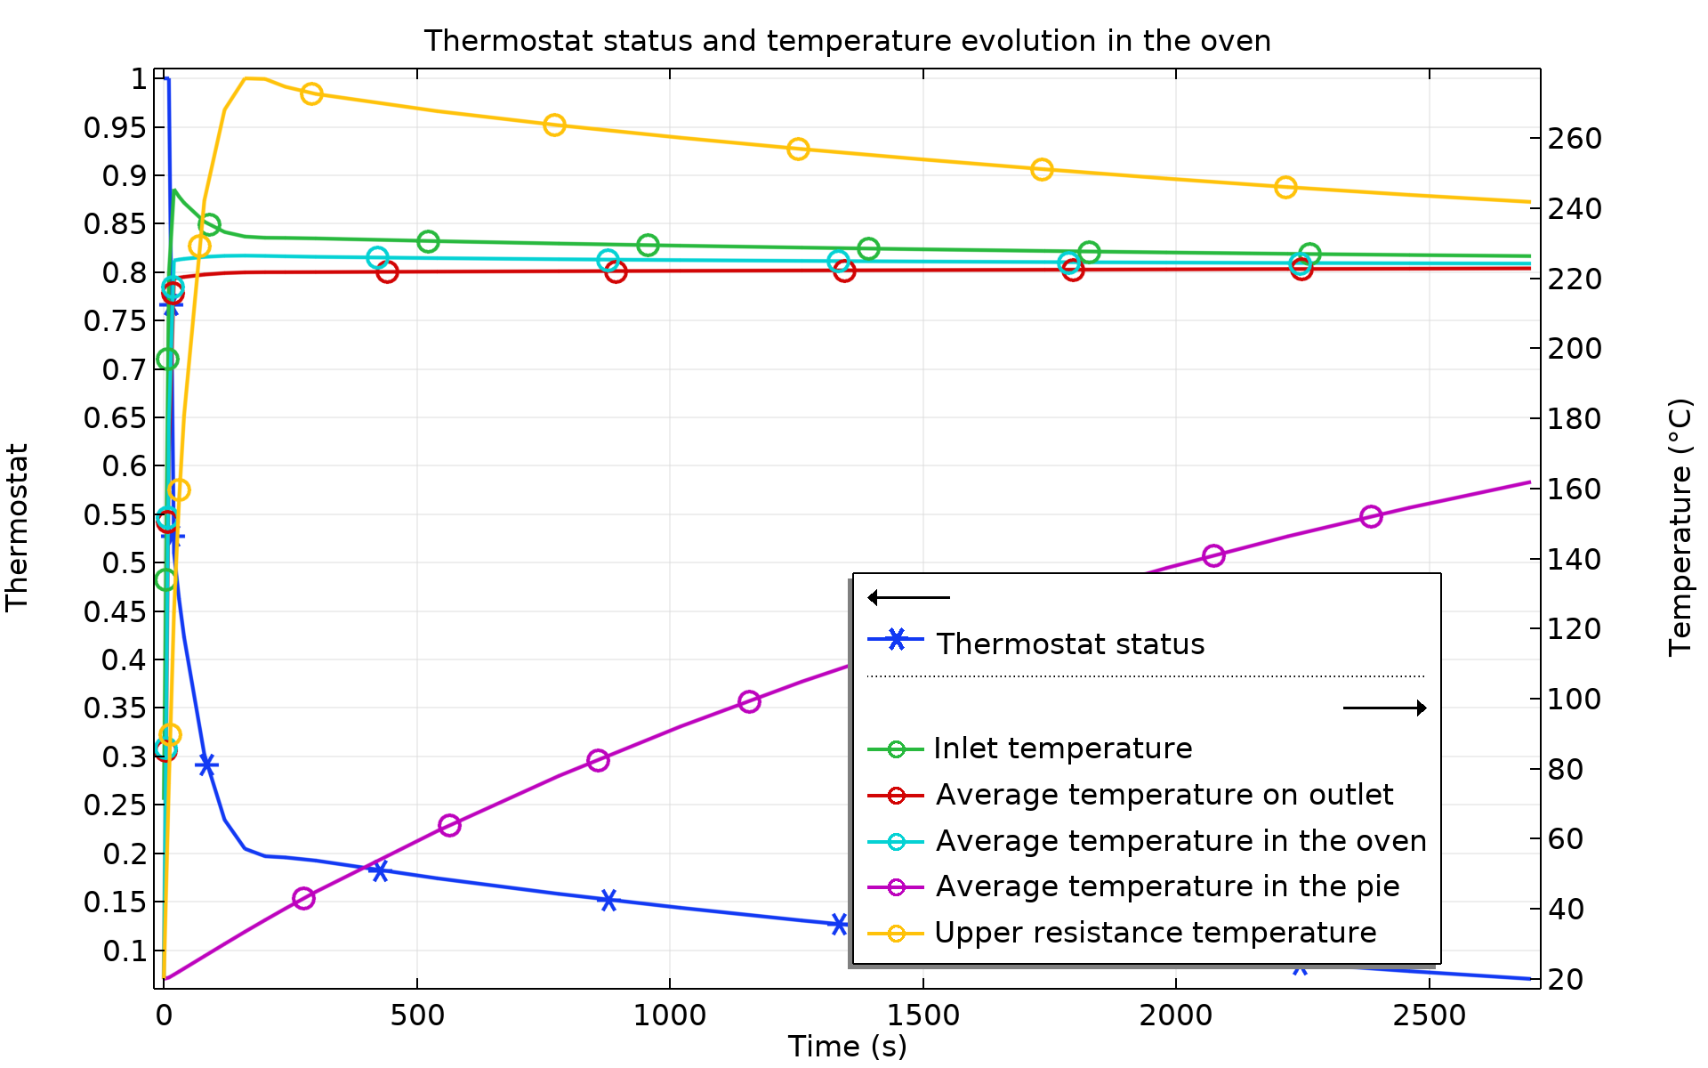
Results
The one-way NITF and NITF results are very similar. The results shown are from the one-way NITF approach.
The temperature in the oven quickly reaches 220°C, while the pie is heated slowly.
The top resistance has the highest temperature in the oven, reaching about 280°C at the end of the simulation.
After 45 minutes, the thermostat is close to 0.07, which means that about 7% of the oven power is still used.
Temperature in the oven over time (one-way NITF)

Slide 7
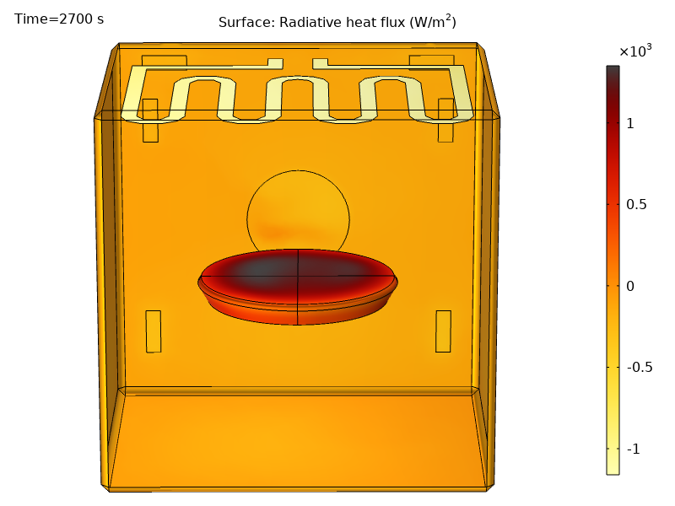
Results
As the temperature of the pie is lower than the rest of the oven parts, it receives radiative heat transfer.
The main radiative source is the top resistance which has the highest temperature.
The bottom oven wall delivers a small radiative heat flux as it faces the pie. On the other hand, the top wall of the oven (not shown) receives radiative heat flux has it faces the hot resistance.
Radiative heat flux in the oven at t=45 min (one-way NITF)

Slide 8
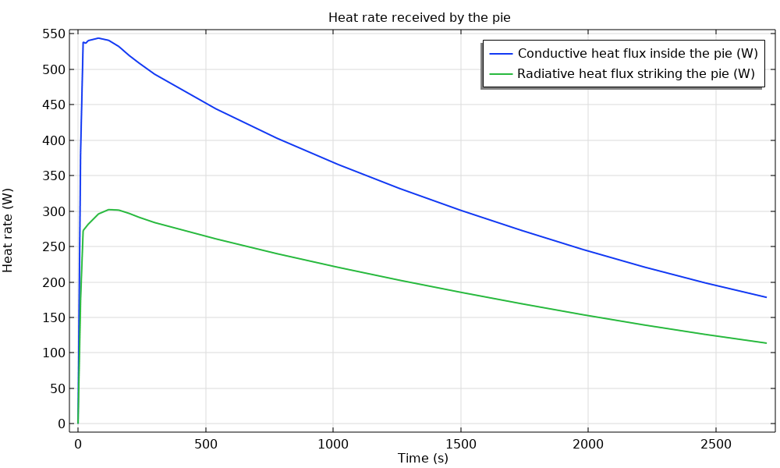
Results
The total heat flux in the pie corresponds to conduction with the surrounding fluid and radiation from the oven parts.
Radiation is responsible for more than half of the total heat flux, and is thus not negligible.
Heat rate received by the pie over time (one-way NITF)

Slide 9
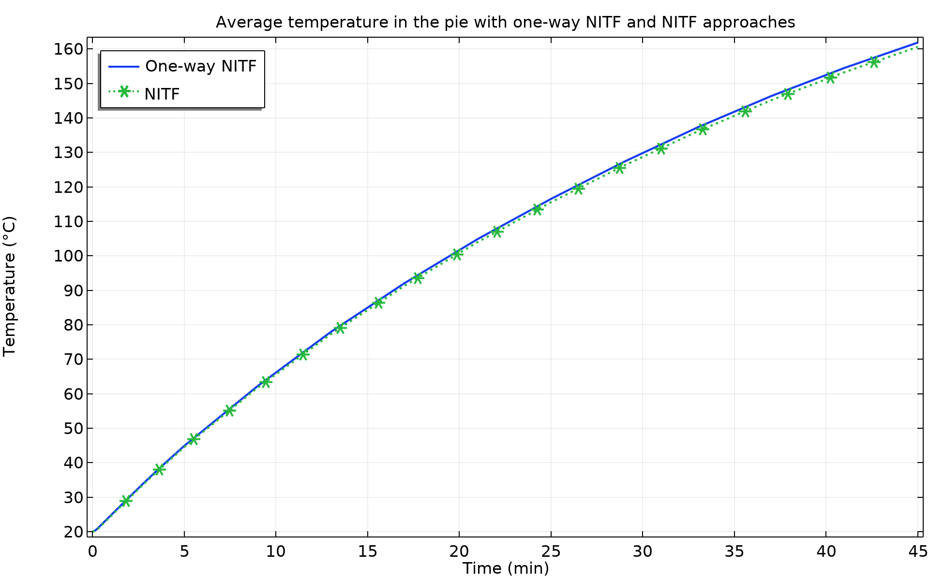
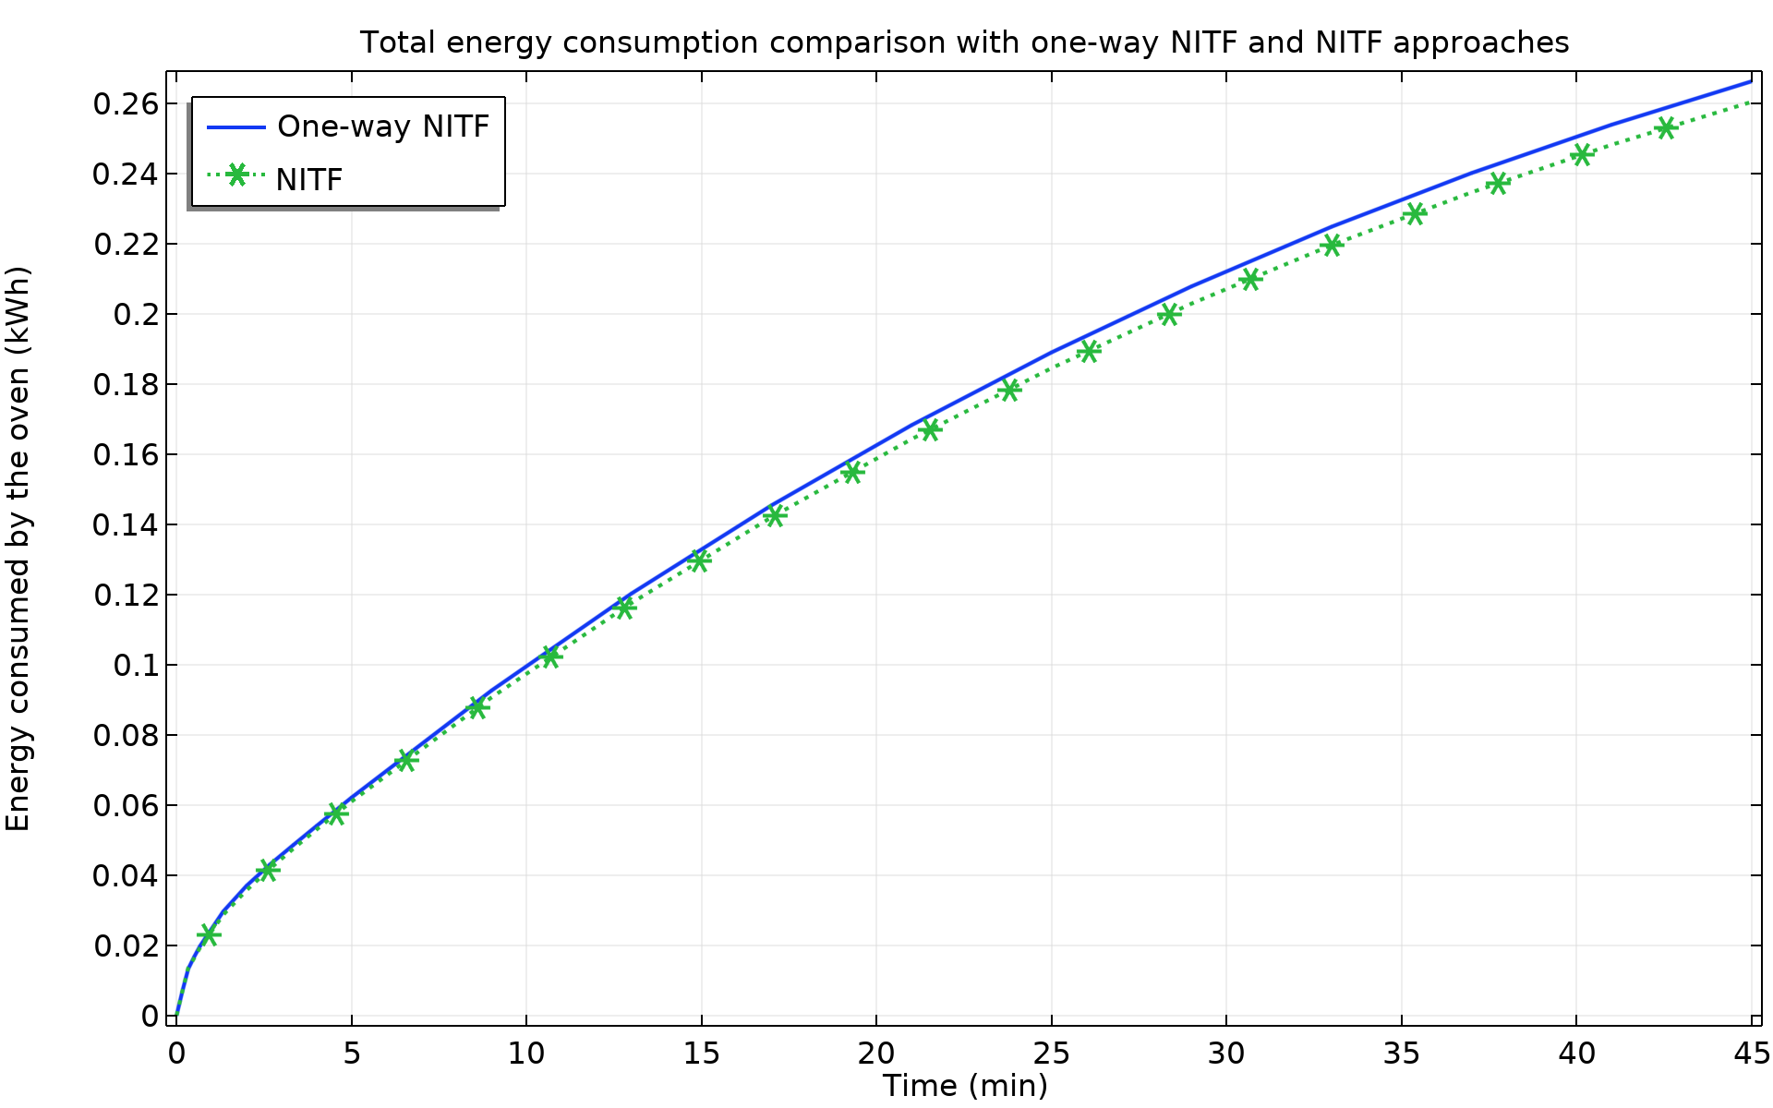
Results – Comparison
Both approaches are in very good agreement in terms of temperature of the pie and the estimated energy consumed by the oven.
Understanding the phenomena involved allows to take hypotheses to simplify the model. The one-way NITF is much less expensive in terms of computational time (about 4 times on our test computer) and memory usage. On the other hand, the NITF approach is less dependent on model parameters, and thus easier to set up in first place.
Temperature in the pie over time
Energy consumed by the oven over time

