Slide 1
Traveling Wave Thermoacoustic Engine

Slide 2

How the Engine Works
The engine consists of a loop and a heat exchanger
Pressure waves in the loop are amplified by the temperature gradient
A portion of the energy can be extracted to use it externally
Heat exchanger
Heat
Acoustic
energy
Energy
extraction

Slide 3
Fluid Motion and Temperature Change
High pressure wave
Low pressure wave
COLD
HOT
Consider the motion of fluid parcels on a plate with the temperature gradient
When a high pressure wave comes from the left, each parcel moves to the right and will be heated
  The pressure is increased due to the thermal expansion
Conversely, the temperature gradient decreases the pressure of a low pressure wave
  The cycle amplifies the acoustic waves
Hot & Higher pressure
Cold & Lower pressure
Time
Time

Slide 4
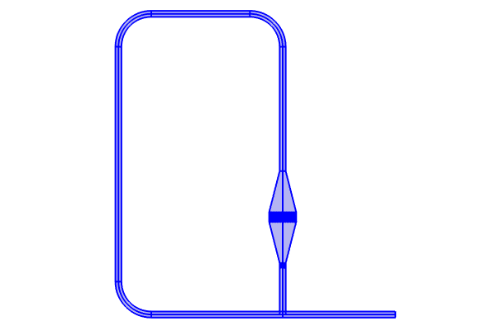
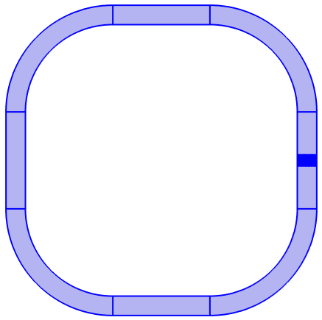
Geometry
* M. McGaughy, C. Wang, E. Boessneck, T. Salem, and J. Wagner,
“A Traveling Wave Thermoacoustic Engine — Design and Test,”
ASME Lett. Dyn. Syst. Control, vol. 31, no. 031006, 2021.
Model A – Simple Loop
Model B – Loop with a Stub
Model A – Simple Loop
  Quick computation (~ 0.5-1 min)
  Easy to understand
Model B – Loop with a Stub
  Comparison with the reference*
  Takes ~40 min to finish
  The geometry of the heat exchanger is simplified
  (The stack is modelled as
  parallel plate passages of the hydraulic radius 50 μm)

Slide 5
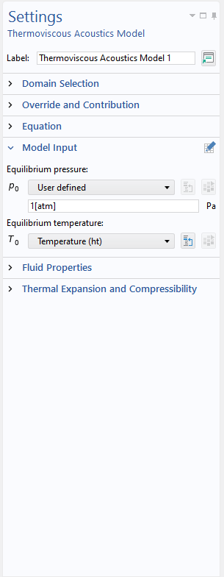
Study Steps
Step 1: Stationary
  Solve for the equilibrium temperature field
  Heat Transfer in Fluids
Step 2: Time Dependent
  Solve for the pressure amplification
  Thermoviscous Acoustics, Transient
  State Variables for post processing
  (in Model B)
The equilibrium temperature is
given by Step 1

Slide 6
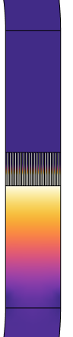
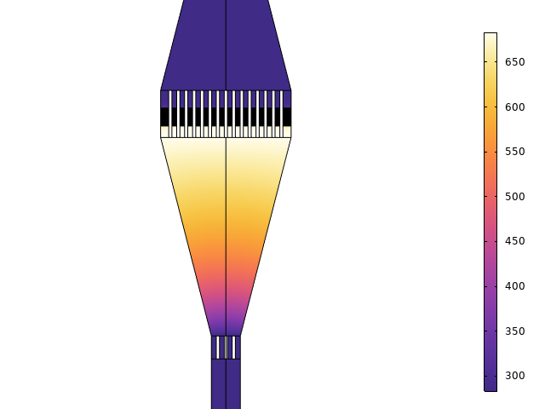
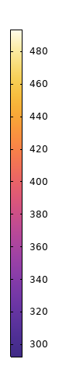
Model A&B
Equilibrium Temperature
Model A – Simple Loop
Model B – Loop with a Stub
In the stationary step, the equilibrium temperature is simulated
Each model has an array of thin plates with steep temperature gradients to amplify the acoustic waves
A cooler is placed in the downstream region to limit the area of high temperature
Cold
Amplify
Hot
Amplify
Cold
Hot
Cold
Cold

Slide 7


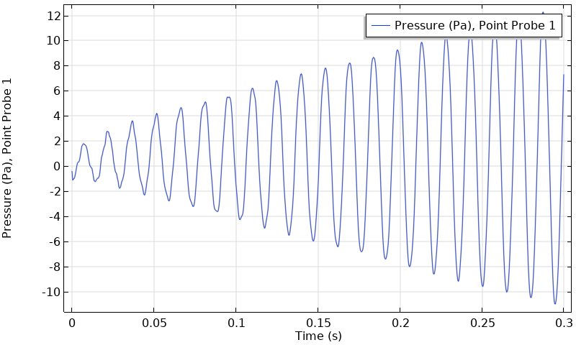
Model A
Amplification of Pressure Wave in the Loop
Pressure
Temperature
Pressure gradient is given at t = 0 to trigger the oscillation inside the loop
The temperature gradient in the heat exchanger excites the traveling wave in a clockwise direction

Slide 8


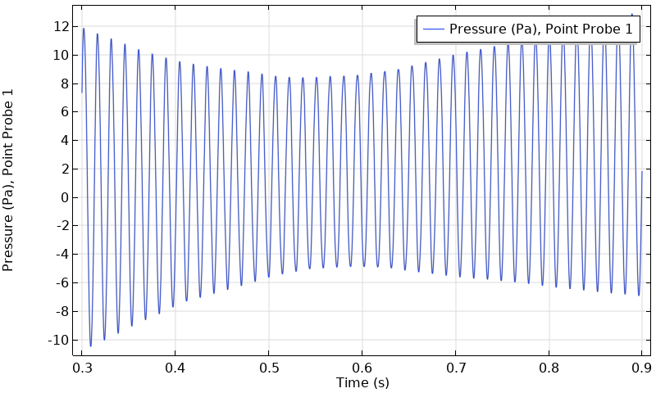
Model A
Impact of Reversed Temperature Gradient
Pressure
Temperature
At t = 0.3 s, the direction of the temperature gradient is reversed upside-down
The clockwise wave attenuates as the reversed temperature gradient can not feed the energy to the wave anymore. The counterclockwise wave becomes visible instead

Slide 9
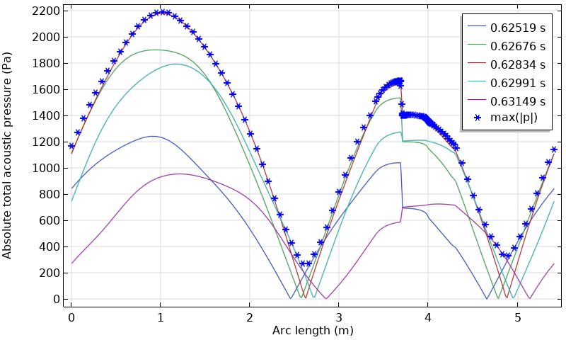
Model B
Pressure Distribution in the Loop
The pressure amplitude keeps growing as the simulation continues, since the thermal energy can be supplied into the system infinitely though the temperature boundary and there is no nonlinear effect
State variable MaxP is defined to track the maximum absolute value of the pressure at each position
As shown by MaxP, pressure amplitude depends on position. The profile agrees well with the experimental results of Fig. 10 in the reference*
Arc length
Stack
* M. McGaughy, C. Wang, E. Boessneck, T. Salem, and J. Wagner,
“A Traveling Wave Thermoacoustic Engine — Design and Test,”
ASME Lett. Dyn. Syst. Control, vol. 31, no. 031006, 2021.

Slide 10
comsol.com/contact

