Slide 1
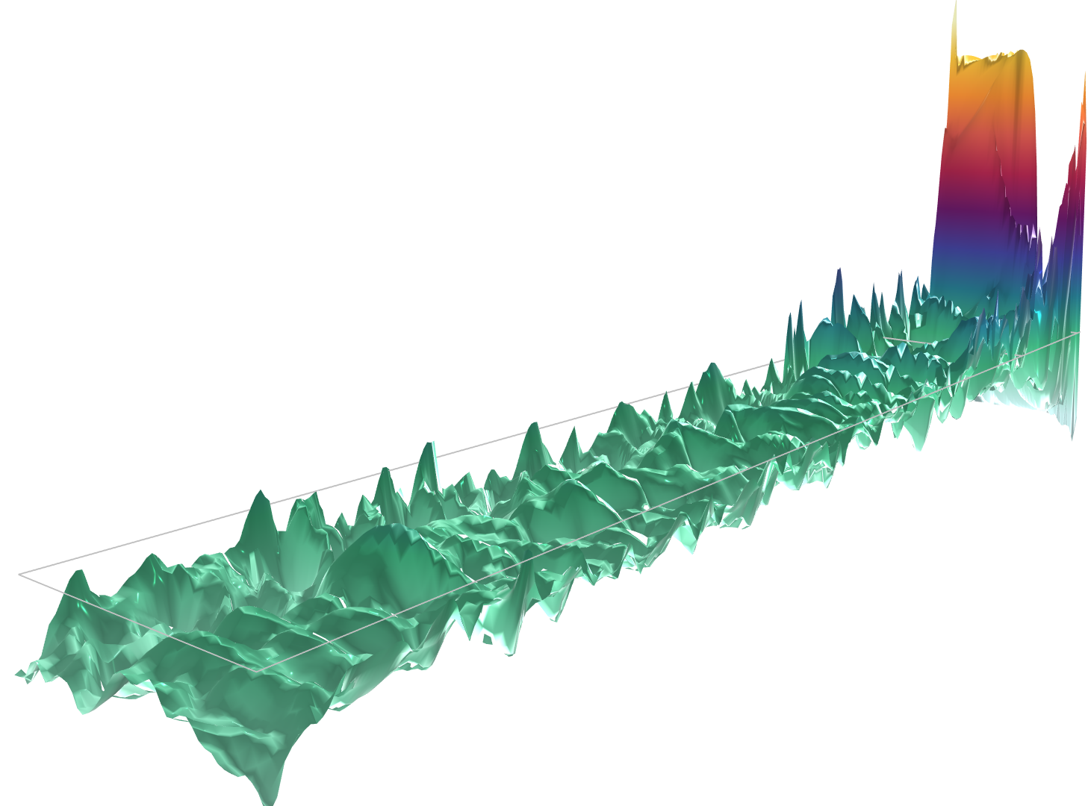
Circulating Fluidized Bed

Slide 2
Introduction
Gas
outlets
Recirculation
of particles
This model simulates the operation of a circulating fluidized bed. The dispersed phase, which consists of solid spherical particles, is fluidized by a gas and transported through a vertical riser.
Upon exiting the outlet, the dispersed phase is reintroduced near the gas inlet at the bottom of the bed.
To study the flow in the fluidized bed, the model employs the Euler–Euler approach. The setup follows the methodology described in [1].
Gas inlet
[1] N. Yang et al., “CFD simulation of concurrent-up gas–solid flow in circulating fluidized beds with structure-dependent drag coefficient,” J. Chem. Eng., vol. 96, pp. 71–80, 2003.

Slide 3
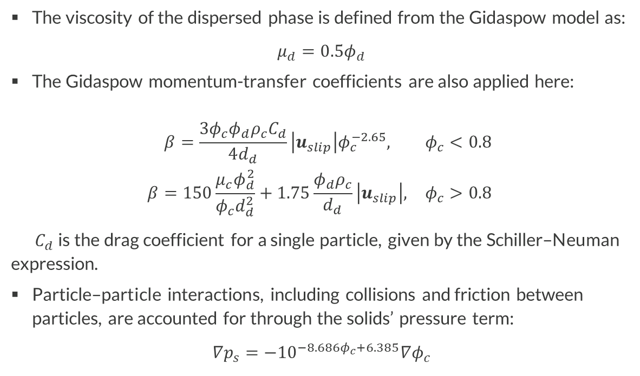
Problem Definition
Gas
outlets
Recirculation
of particles
The viscosity of the dispersed phase is defined from the Gidaspow model as:
$$μ_{d}=0.5φ_{d}$$
The Gidaspow momentum-transfer coefficients are also applied here:
$$\begin{matrix}\begin{matrix}β=\frac{3φ_{c}φ_{d}ρ_{c}C_{d}}{4d_{d}}\left|u_{slip}\right|φ_{c}^{−2.65}, & φ_{c}<0.8 \\ β=150\frac{μ_{c}φ_{d}^{2}}{φ_{c}d_{d}^{2}}+1.75\frac{φ_{d}ρ_{c}}{d_{d}}\left|u_{slip}\right|, & φ_{c}>0.8\end{matrix} \\ \end{matrix}$$
$C_{d}$is the drag coefficient for a single particle, given by the Schiller–Neuman expression.
Particle–particle interactions, including collisions and friction between particles, are accounted for through the solids’ pressure term:
$$∇p_{s}=−{10}^{−8.686φ_{c}+6.385}∇φ_{c}$$
Gas inlet

Slide 4
Boundary Conditions
Gas
outlets
Recirculation
of particles
To fluidize the bed, gas is injected vertically at the bottom of the riser, with the dispersed-phase flux set to zero at the gas inlet.
A pressure condition (normal flow) is applied to both phases at the outlet. To prevent the dispersed phase from falling back into the bed at the outflow boundary, the gravitational volume force is gradually removed in a region upstream of the outlet using a smoothly varying step function.
At a short distance from the bottom of the riser, the dispersed mass flux exiting at the top is reinjected horizontally through two inlets on the side walls, with a velocity equal to the gas inlet velocity.
Along the riser walls, a no-slip condition is applied to the continuous phase, while a slip condition is applied to the dispersed phase.
Gas inlet

Slide 5
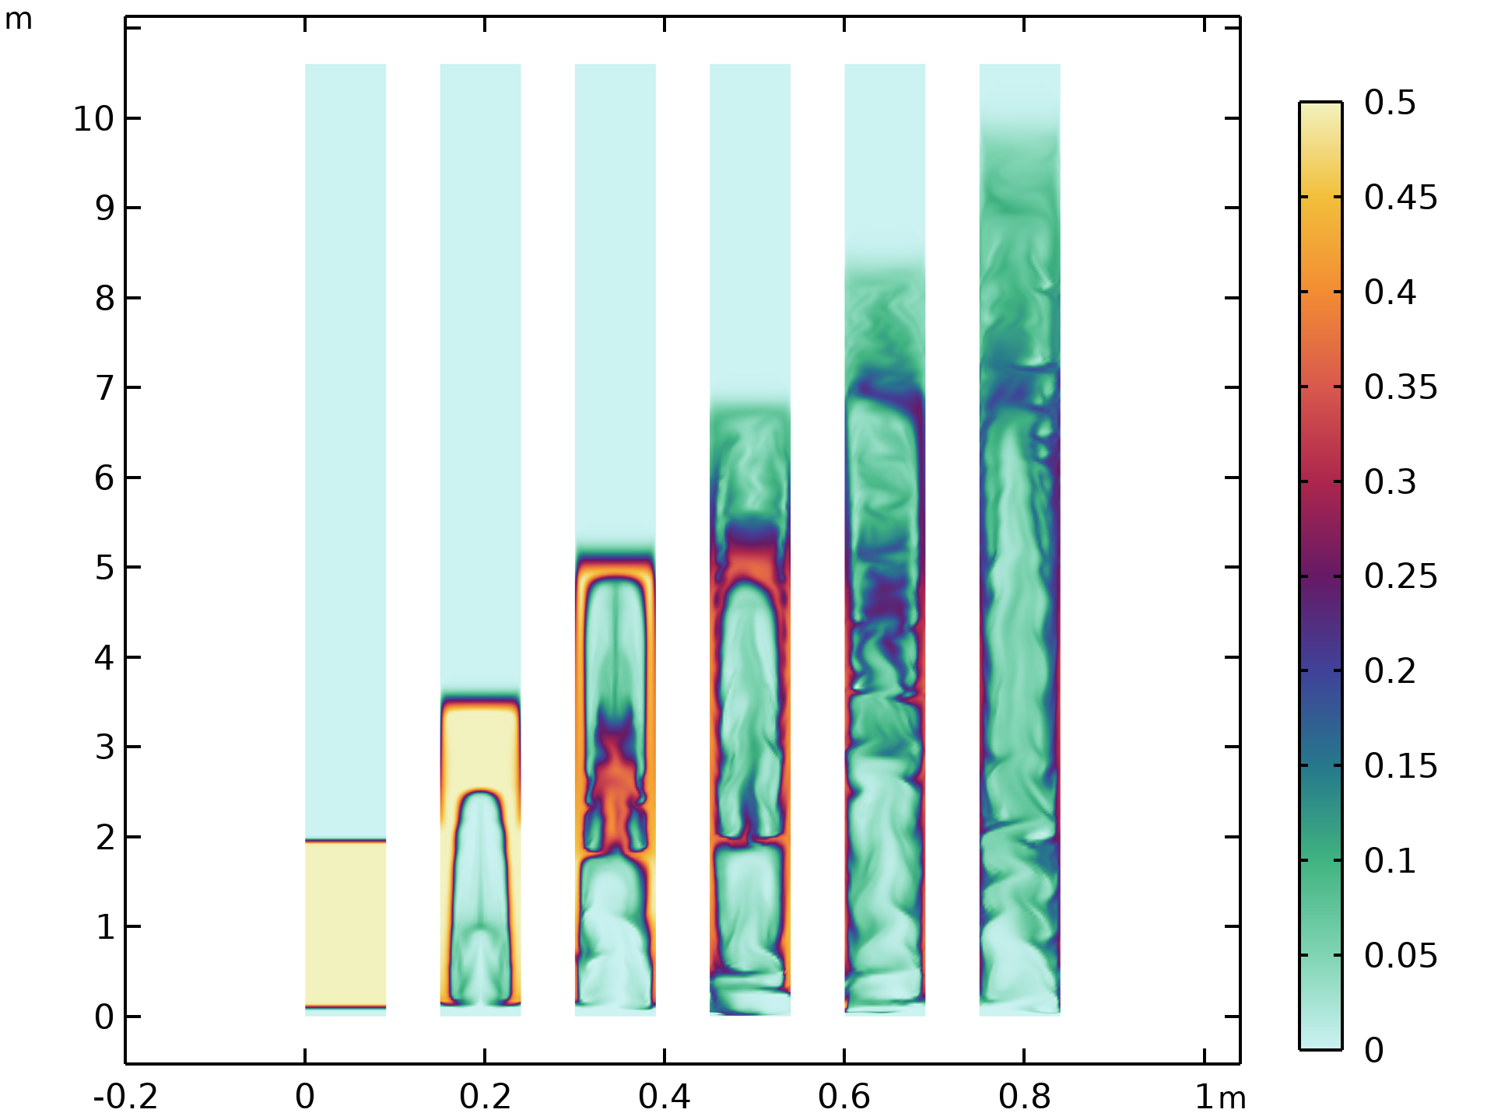
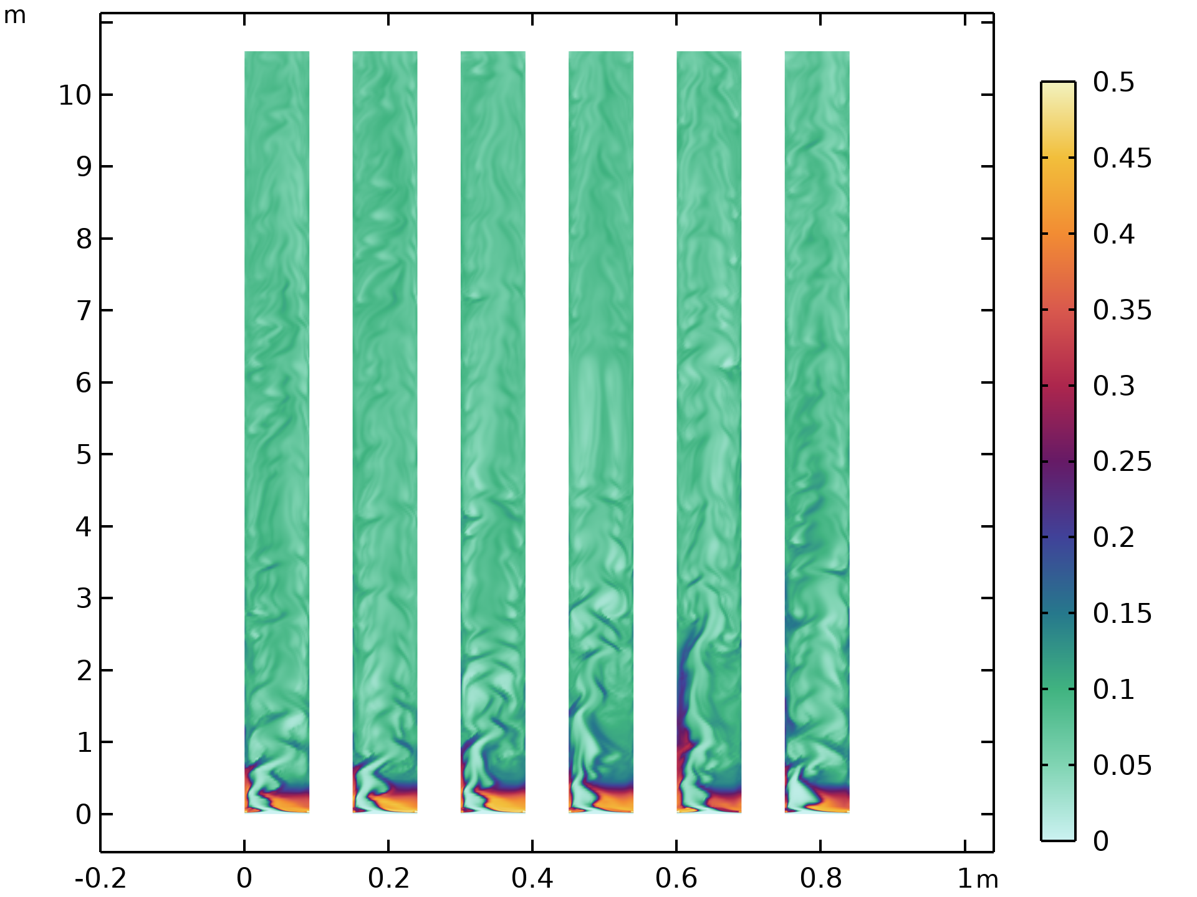
Visualization
The current model features a slender geometry with an aspect ratio of approximately 100. As a result, when plotting and inspecting the solution over the entire modeling domain, it is difficult to distinguish finer details. To enhance visibility in the figures below, the view has been stretched tenfold in the x-direction.

Slide 6
Start-Up Phase
The figure illustrates the startup of the fluidized bed simulation.
The dispersed phase volume fraction is shown at the initial state and during the first five seconds of the simulation.
The packed bed section is pushed upward by the gas, primarily in the center of the bed. Due to the lower gas velocity close to the walls, the heavy solid phase is able to accumulate and fall down along the walls, creating pockets with high concentrations of solids.

Slide 7
Steady Operation
This figure shows snapshots of the dispersed phase volume fraction during steady operation.
Black indicates high-volume fraction. The bed width has been scaled by a factor of 10.

Slide 8
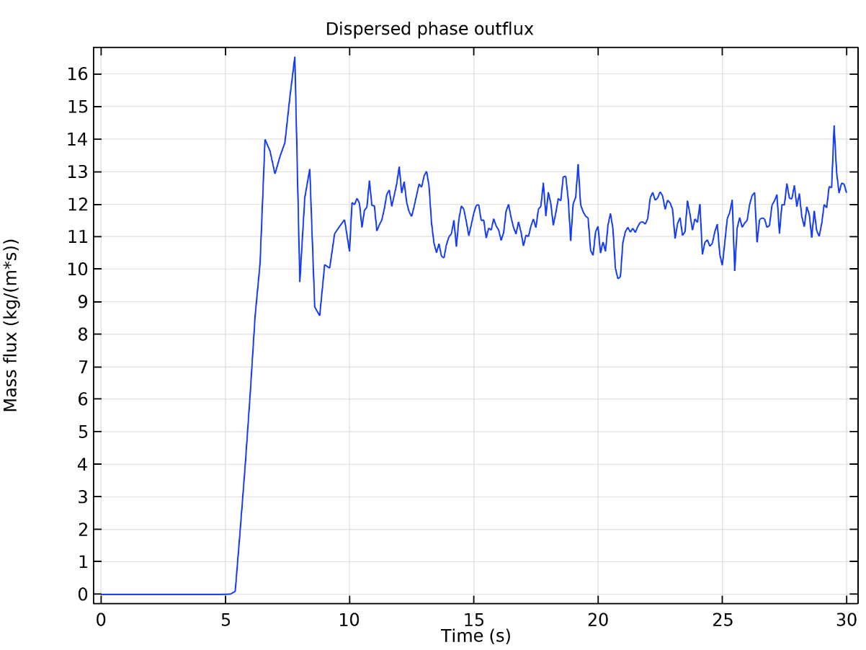
Dispersed Phase Outflux

Slide 9
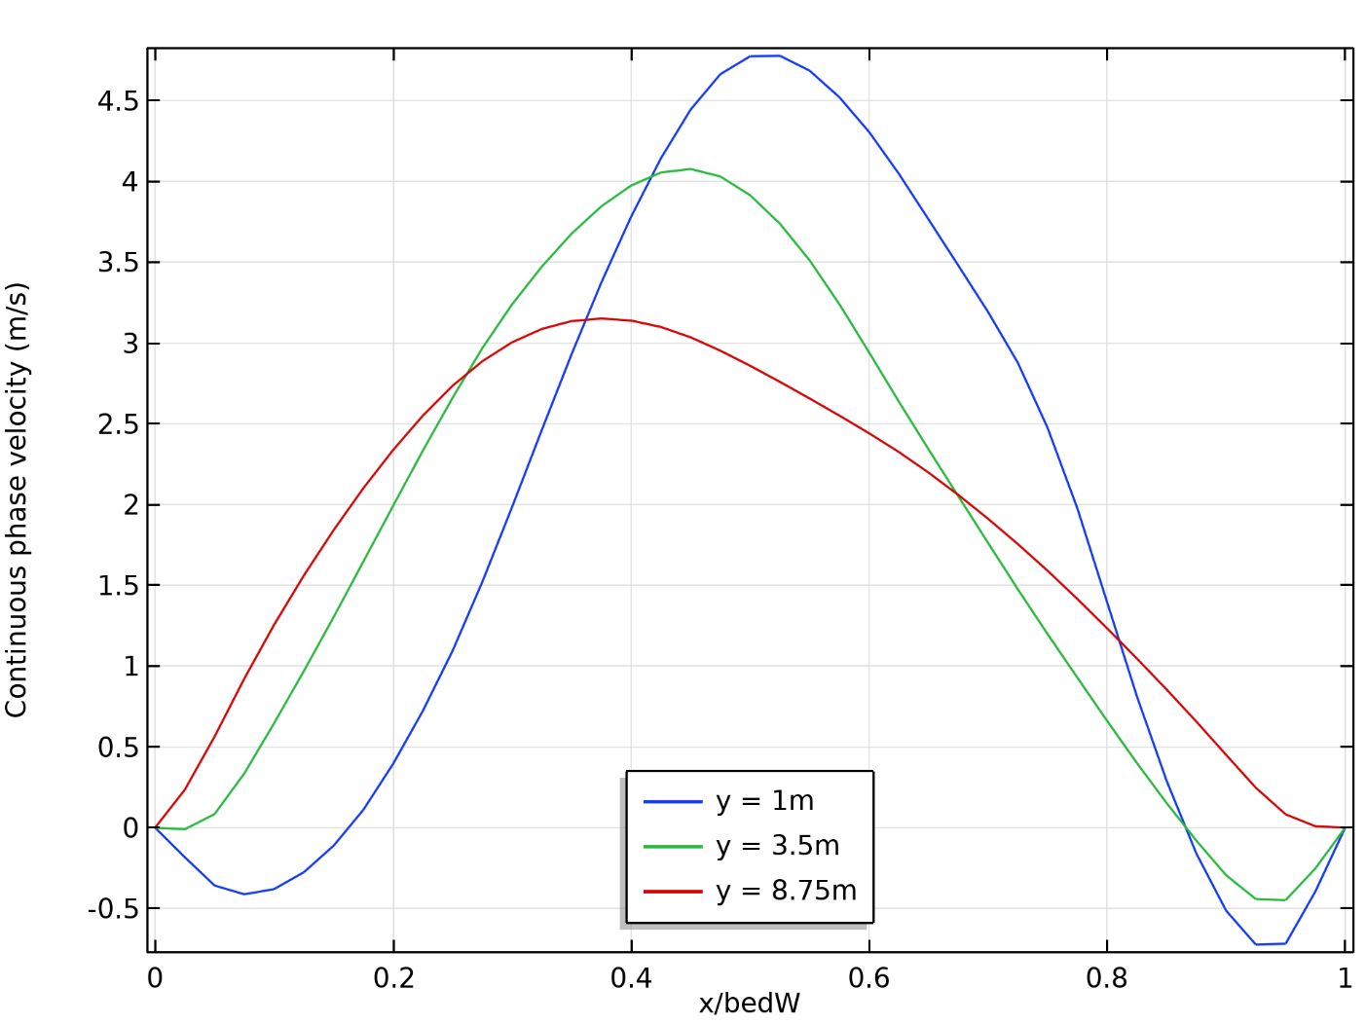
Averaged Streamwise Gas-Phase Velocity
Profiles of the averaged streamwise gas-phase velocity at three different vertical positions.

Slide 10
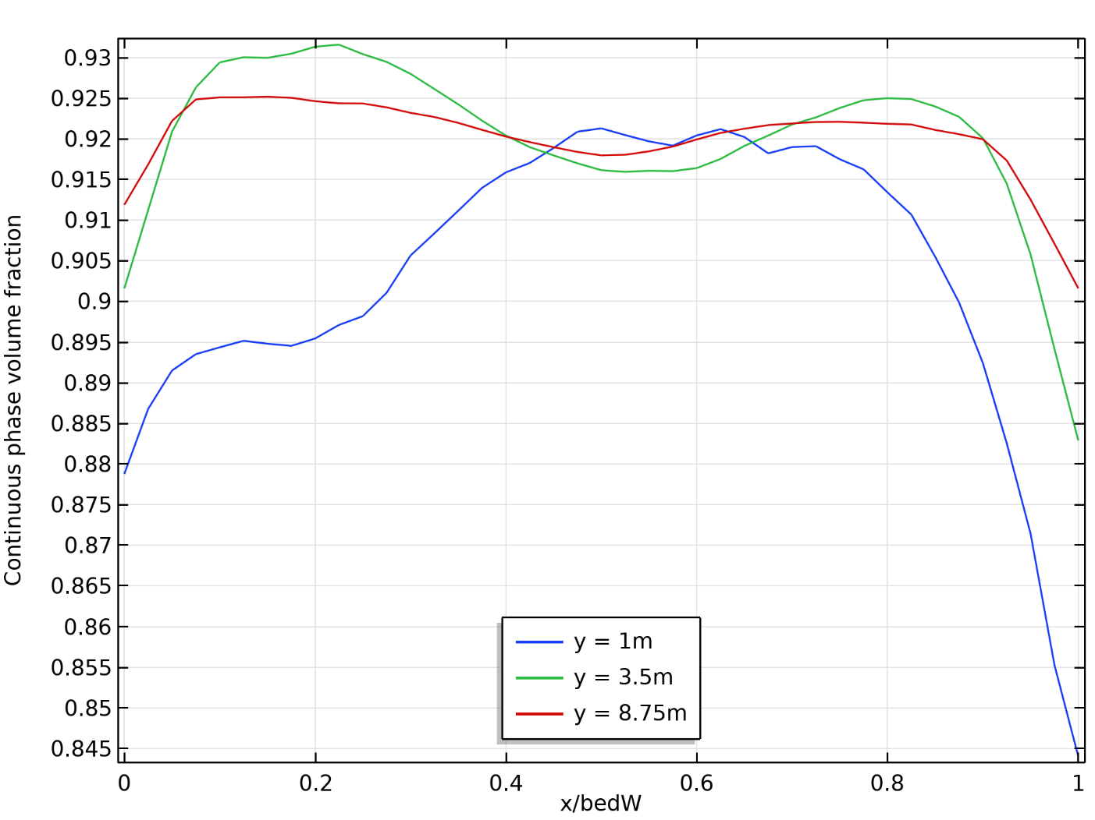
Averaged Gas-Phase Volume Fraction
The gas-phase volume fraction profiles at the corresponding positions (see previous slide).

Slide 11
info@comsol.com

