Slide 1
Working of the Pantograph Mechanism

Slide 2
Background and Motivation
This is a demo model to show how to model connections in a mechanical system using the Multibody Dynamics interface.
The purpose of this mechanism is to produce an identical, either enlarged or miniaturized, copy of an existing drawing.

Slide 3
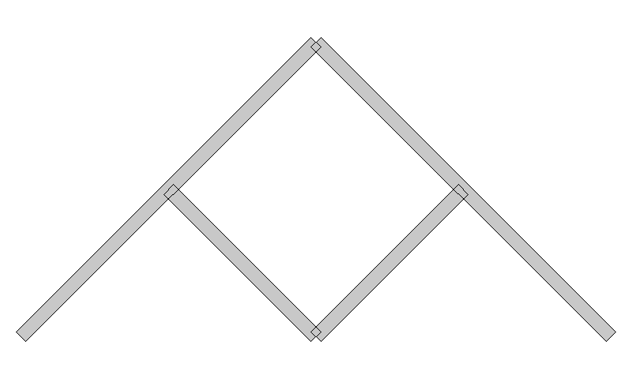
Geometry and Operating Conditions
All links are assumed rigid.
up = sin(t)*(exp(cos(t))-2*cos(4*t)-(sin(t/12))^5)
Vp = cos(t)*(exp(cos(t))-2*cos(4*t)-(sin(t/12))^5)
Hinge Joints
Hinge Joint
(with ground)
Input motion
(prescribed)
Output motion

Slide 4
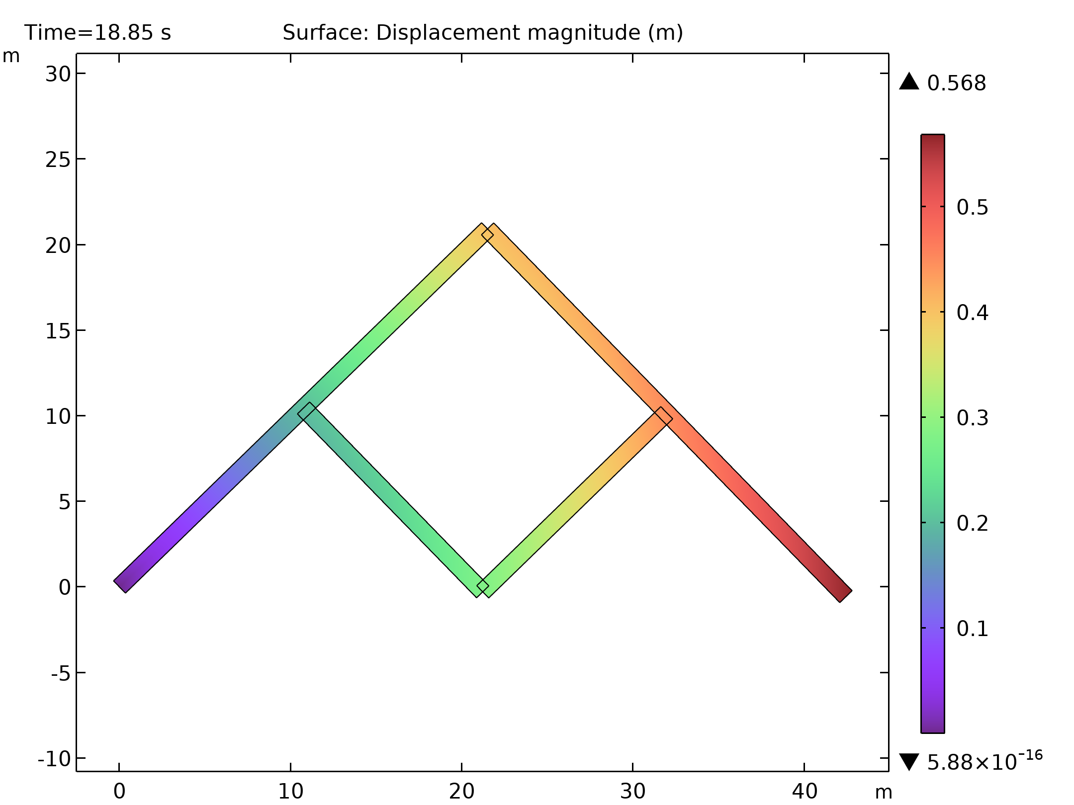
Results: Motion of Different Components

Slide 5
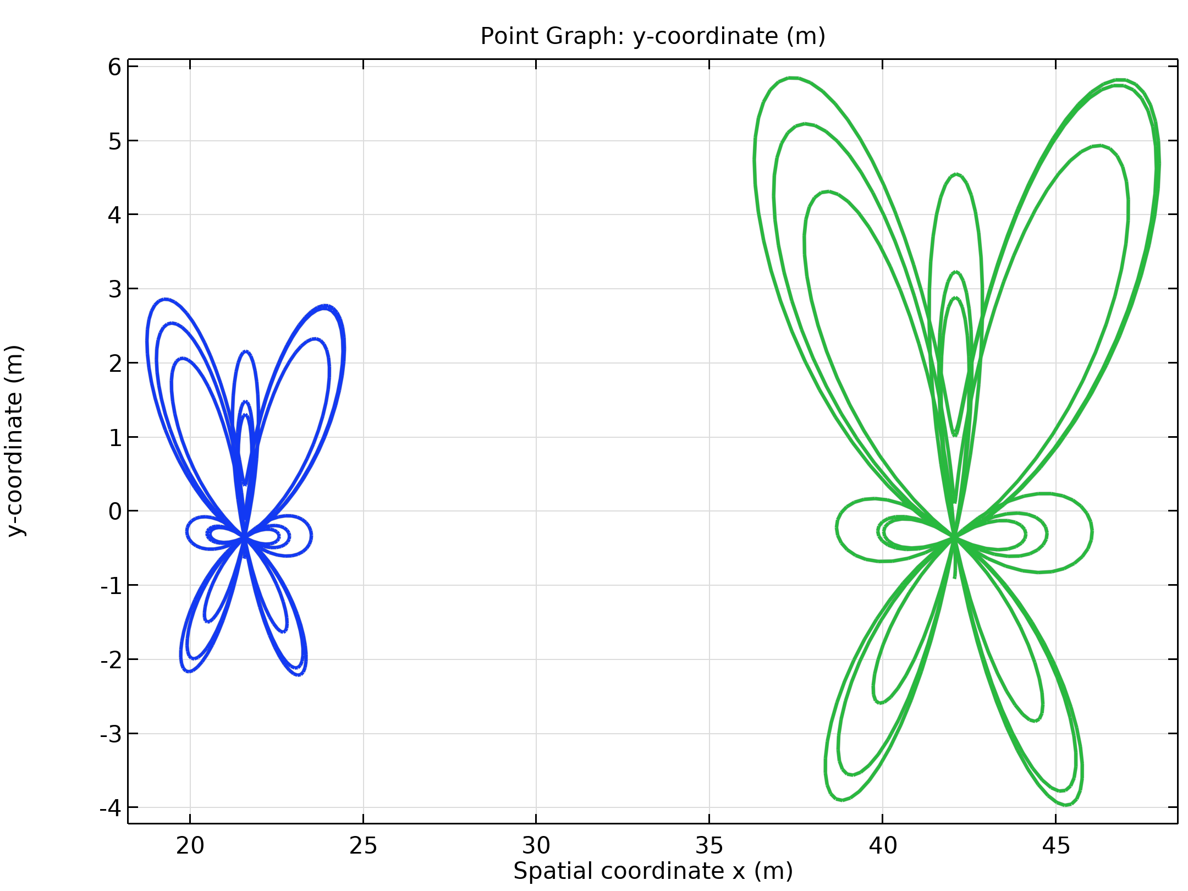
Results: The “Butterfly” Curve Traced

