Slide 1
Deposition of Al₂O₃ on U-Shaped Groove Surfaces Using the ALD Processing
COMSOL

Slide 2
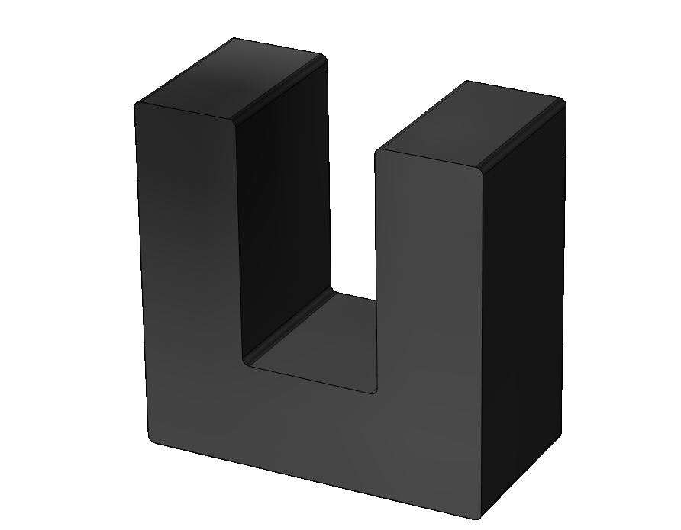
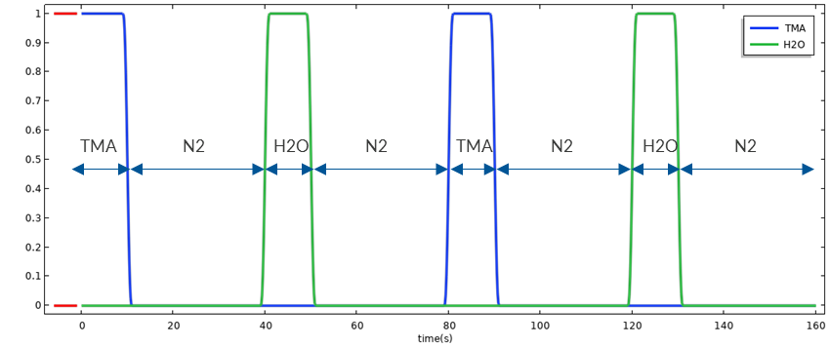
Overview
The model couples the analysis of fluid flow, species transport, and surface reactions in the reaction chamber to simulate the deposition process on the surfaces of a U-shaped microstructure.
Reference: Greer J. Preliminary rate equations for Al2O3 film growth[J]. Deliverable D6, 2003, 1.

Slide 3
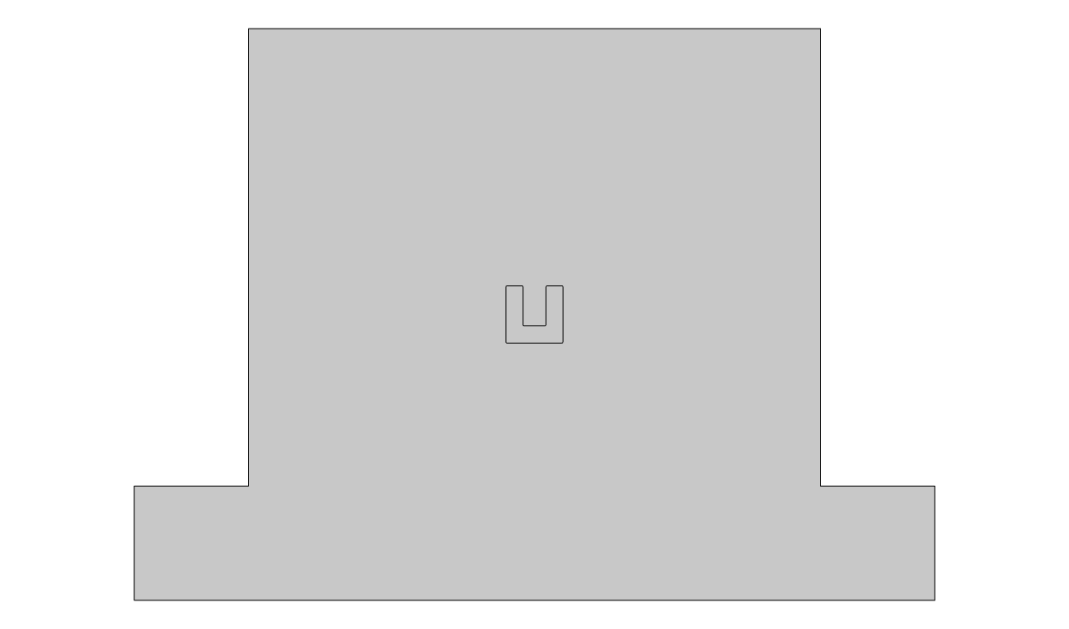
Model Definition
Inlet
U-shaped groove
  Width: 4mm
  Depth: 7mm
Surface hydroxylation completed
  Hydroxyl number density: 9.4e14[1/cm^2]
Reaction gases
  Trimethylaluminum (TMA, Al(CH₃)₃)
  H₂O
Purge gas
  N₂
Outlet
Outlet

Slide 4
Gas Introduction During the Deposition Process

Slide 5
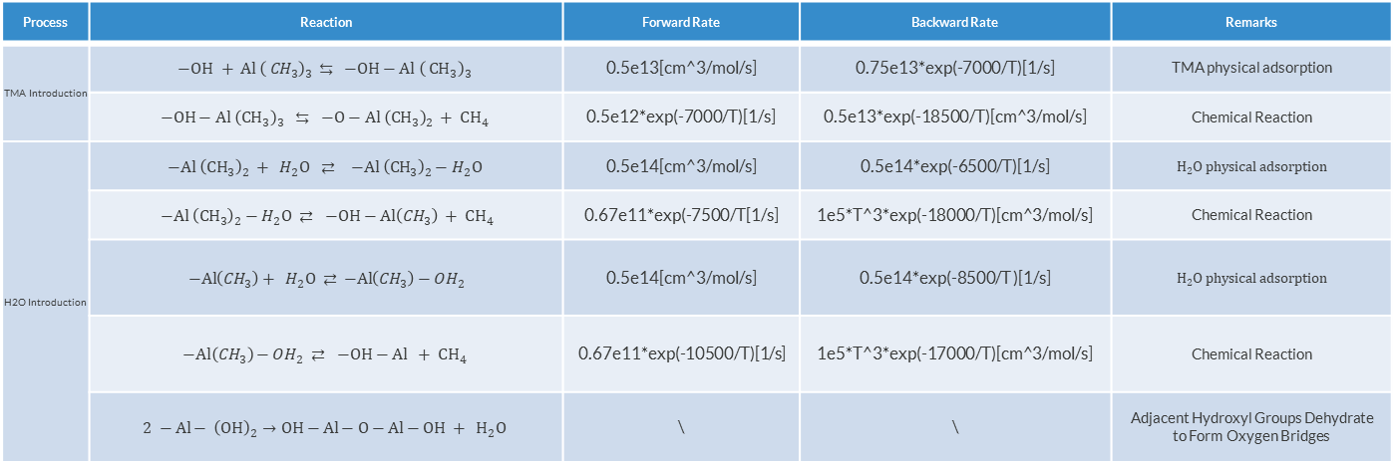
Surface Chemical Reactions
*Greer J. Preliminary rate equations for Al2O3 film growth[J]. Deliverable D6, 2003, 1.
Reaction Mechanism*
Due to the extremely fast dehydration rate of hydroxyl groups, the stoichiometric coefficient does not affect the film growth rate calculation. The last reaction forming oxygen bridges is not considered in this model.
Process | Reaction | Forward Rate | Backward Rate | Remarks
TMA Introduction | $$−\text{OH} + { Al \left( {CH}_{3}\right)}_{3 } ⇆ −OH−Al {\left( {CH}_{3}\right)}_{3}$$ | 0.5e13[cm^3/mol/s] | 0.75e13*exp(-7000/T)[1/s] | TMA physical adsorption
 | $$−OH−Al {\left({CH}_{3}\right)}_{3} ⇆ −O−Al {\left({CH}_{3}\right)}_{2} + {CH}_{4}$$ | 0.5e12*exp(-7000/T)[1/s] | 0.5e13*exp(-18500/T)[cm^3/mol/s] | Chemical Reaction
H2O Introduction | $$−Al {\left({CH}_{3}\right)}_{2} + H_{2}O ⇄ −Al {\left({CH}_{3}\right)}_{2}−H_{2}O$$ | 0.5e14[cm^3/mol/s] | 0.5e14*exp(-6500/T)[1/s] | $$H2O physical adsorption$$
 | $−Al {\left({CH}_{3}\right)}_{2}−H_{2}O ⇄ −OH−Al\left({CH}_{3}\right) + {CH}_{4}$ | 0.67e11*exp(-7500/T[1/s] | 1e5*T^3*exp(-18000/T)[cm^3/mol/s] | Chemical Reaction
 | $−Al\left({CH}_{3}\right)+ H_{2}O ⇄$ $−Al\left({CH}_{3}\right)−OH_{2}$ | 0.5e14[cm^3/mol/s] | 0.5e14*exp(-8500/T )[1/s] | $$H2O physical adsorption$$
 | $$−Al\left({CH}_{3}\right)−OH_{2} ⇄ −OH−Al + {CH}_{4}$$ | 0.67e11*exp(-10500/T)[1/s] | 1e5*T^3*exp(-17000/T)[cm^3/mol/s] | Chemical Reaction
 | $$2 −Al− {\left(OH\right)}_{2}→OH−Al−O−Al−OH + H_{2}O$$ | \ | \ | Adjacent Hydroxyl Groups Dehydrate to Form Oxygen Bridges

Slide 6




Implementation in COMSOL Multiphysics®
Fluid Flow
Species transport
Surface Reactions
Gas Flow in Reaction Chamber
Gas Flow around the microstructure
Chemical reactions
Convection and Diffusion of Species
Self-limiting reactions
Deposition thickness on Surfaces

Slide 7
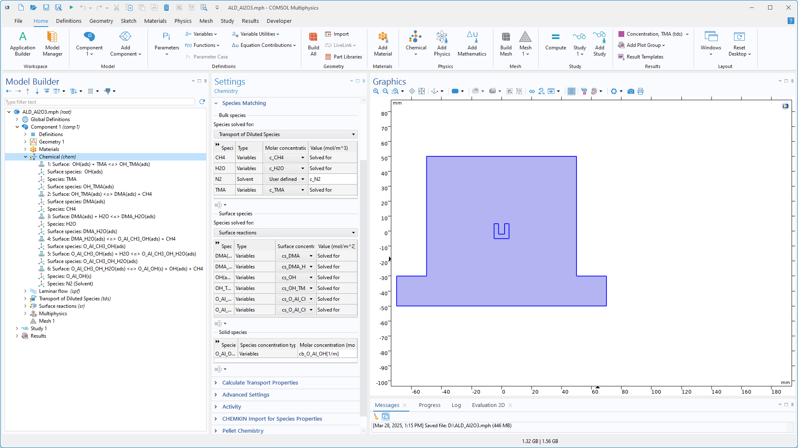
Chemistry
TMA and DMA represent trimethylaluminum and dimethylaluminum, respectively.
The last reaction explicitly includes a hydroxyl group to maintain the reaction cycle.
Gas-phase species are computed using the Transport of Diluted Species interface.
Surface and solid-phase species are computed using the Surface Reaction interface.

Slide 8
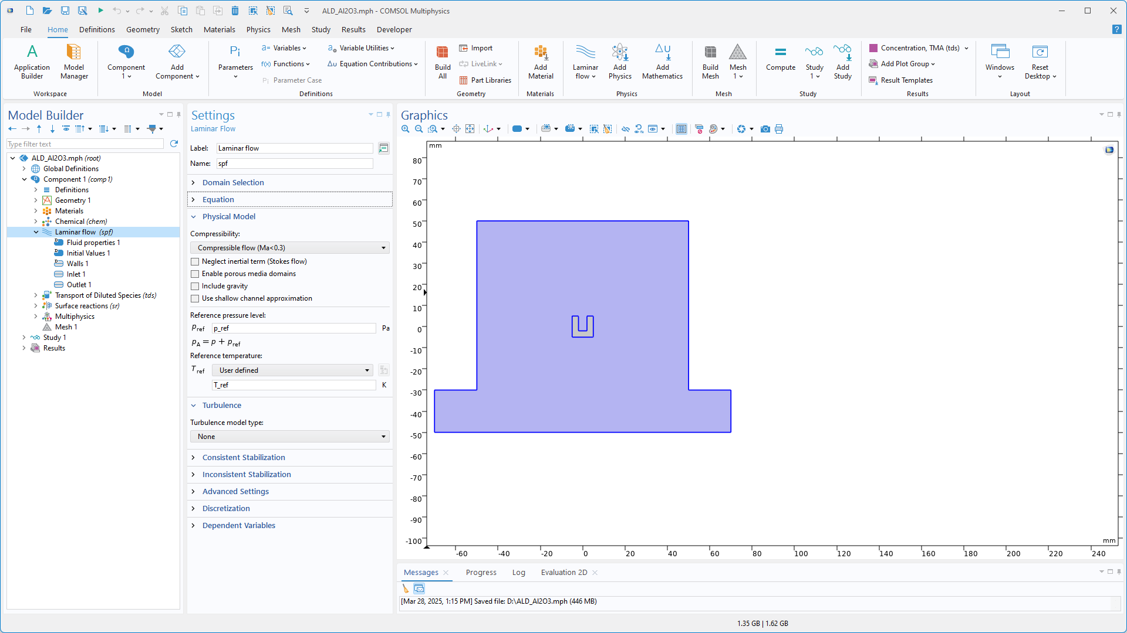
Fluid Flow
Laminar Flow Interface
Reference Pressure: 4000 Pa
Reference Temperature: 450 [K]
Inlet Velocity
  Fully developed flow
  0.5 [m/s]

Slide 9
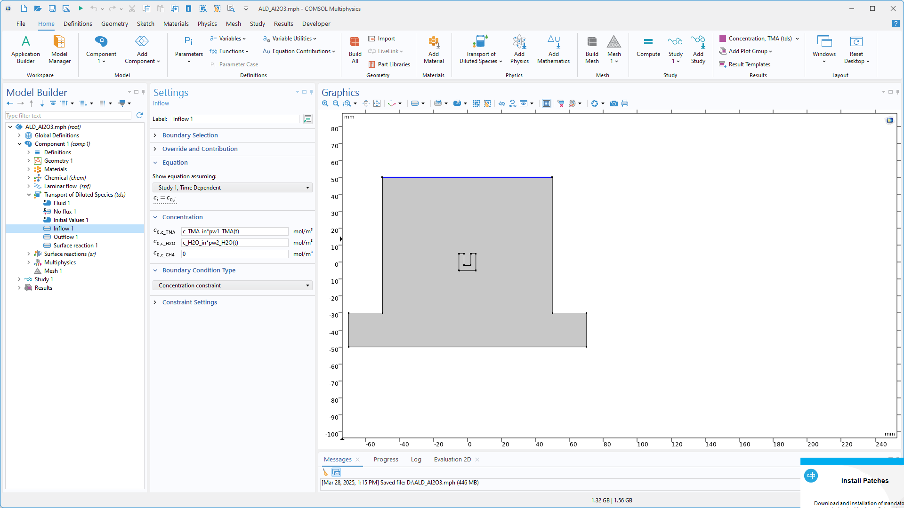
Species Transport
Transport of Diluted Species interface
Inlet Concentration: Defined using piecewise functions to alternate TMA, N₂ and H₂O
Surface Reaction feature defines TMA and H₂O consumption and CH₄ generation

Slide 10
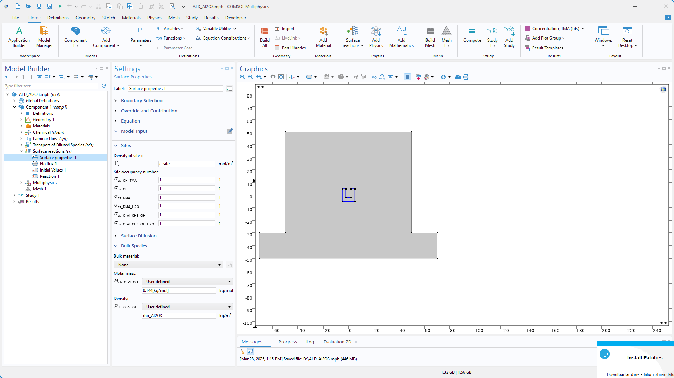
Surface Reactions
Number Density of sites
  9.4e14 [1/cm^2]
Sites are used to characterize surface hydroxyl groups
  This parameter is primarily employed to observe surface coverage during the evaluation of results and is independent of surface reaction kinetics.
  In some ALD reactions, in-situ sites represent surface dislocations, which require manual correlation with reaction rates, since dislocations are not actual species

Slide 11
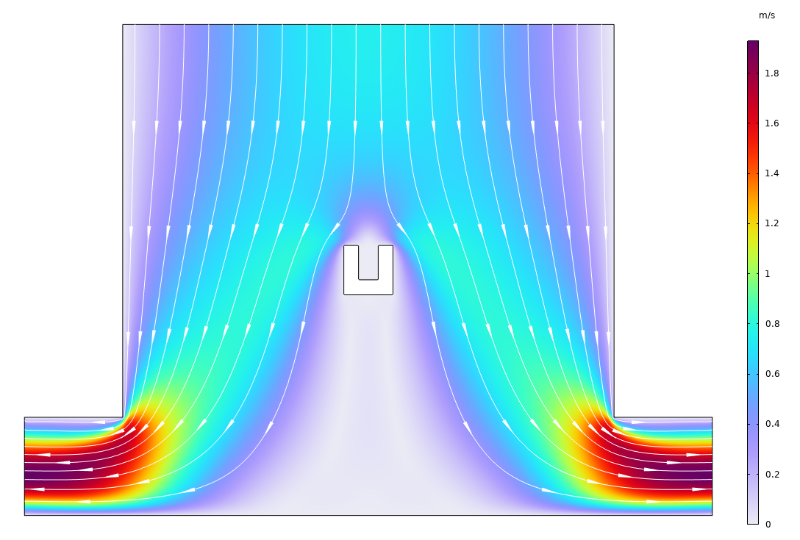
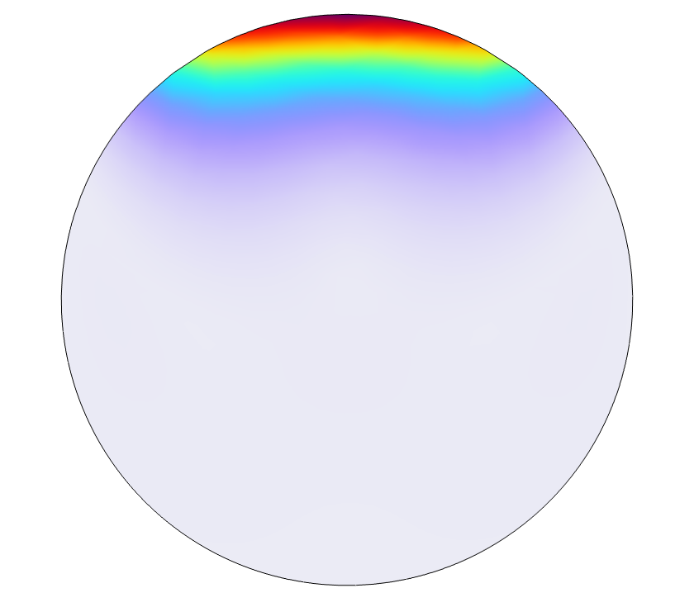
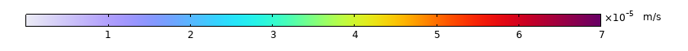
Flow Field
Negligible flow inside the U-shaped groove

Slide 12

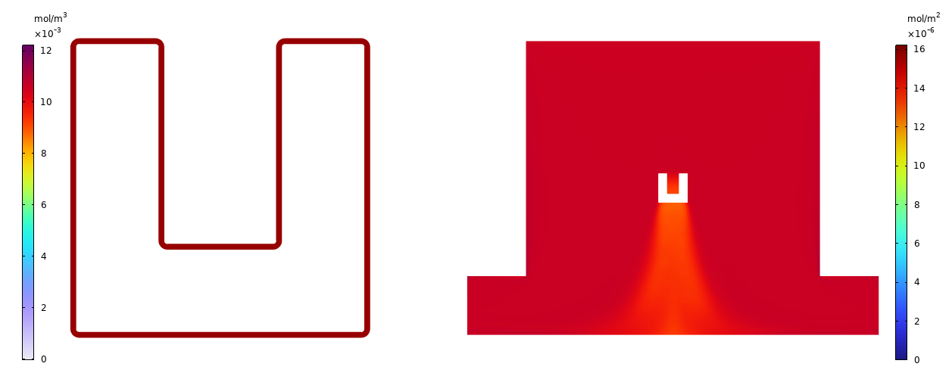
Concentration: First Introduction of TMA
As TMA is introduced, it gradually reacts with surface –OH, forming the intermediate product DMA.
The surface concentration of the intermediate product first saturates at the top, while in the groove, due to the low flow rate, saturation is reached last.
DMA Surface Concentration
TMA Concentration

Slide 13

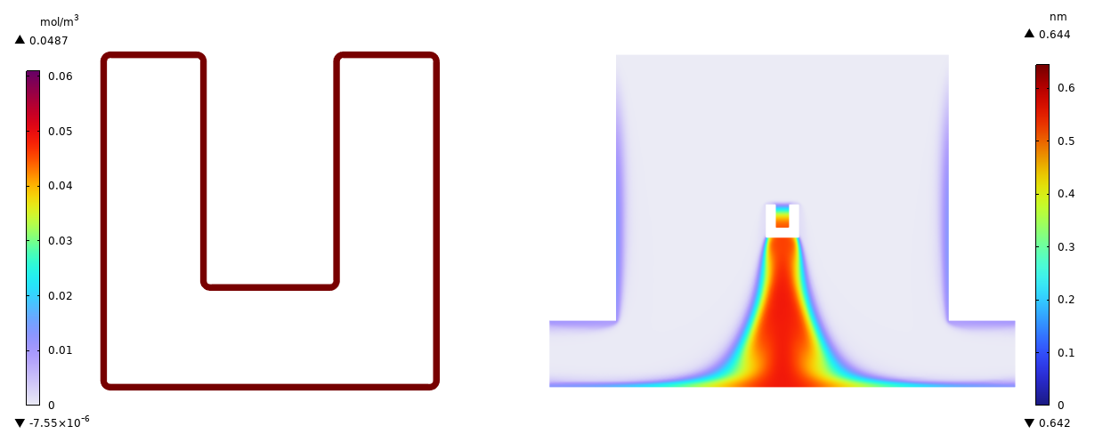
Concentration: First Introduction of H₂O
Upon introducing H₂O, the second reaction step is activated, and the Al₂O₃ film begins to grow gradually.
The film growth process is similar to that of the intermediate product, with a growth rate of approximately 0.3 [nm/s].
After the intermediate product is completely consumed, H₂O continues to be introduced, but the film thickness remains unchanged at 0.64 nm with high uniformity.
Film Thickness
H₂O Concentration

Slide 14

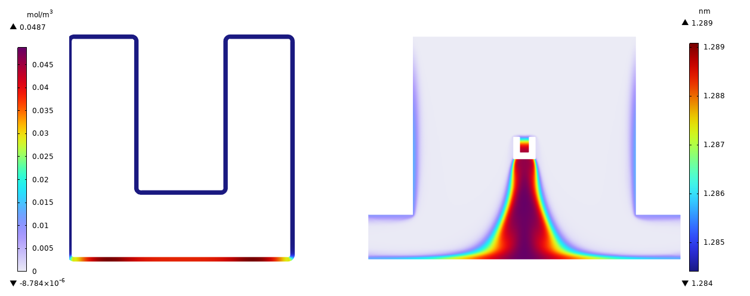
Concentration: Second Introduction of H₂O
With the second introduction of H₂O, the film thickness doubles to approximately 1.29 nm, following the exact same growth process as in the first cycle.
The results of these two cycles confirm the repeatability and consistency of this process.
Film Thickness
H₂O Concentration

Slide 15
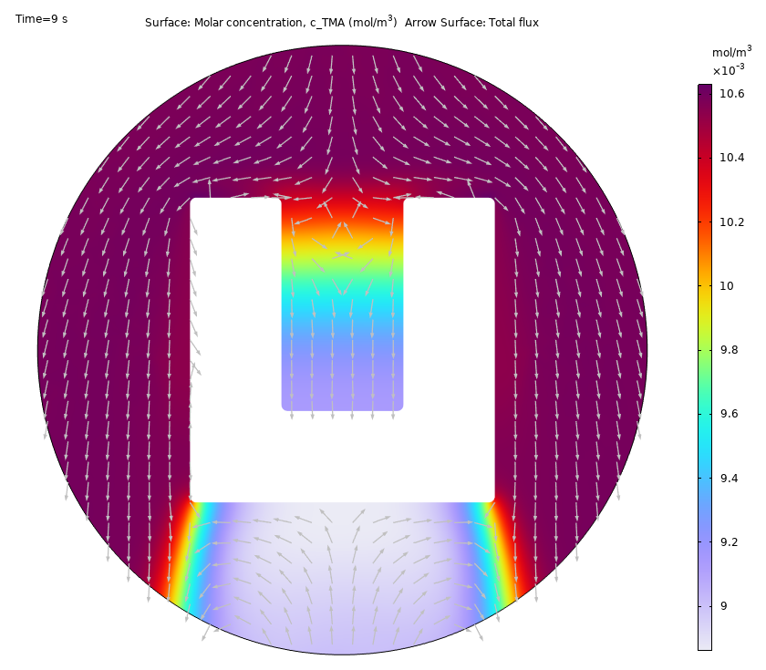
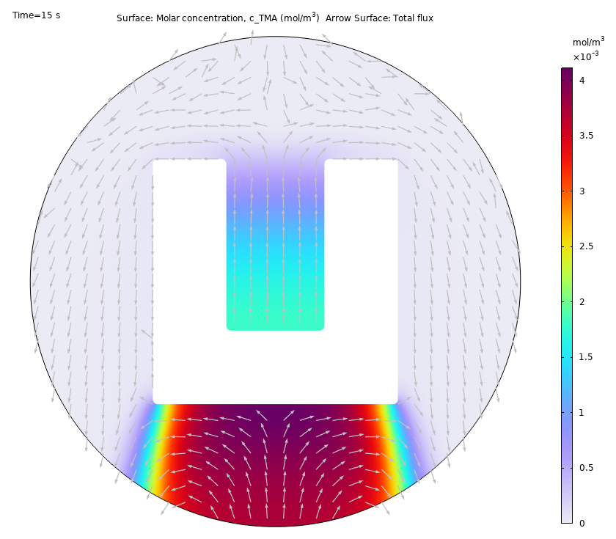
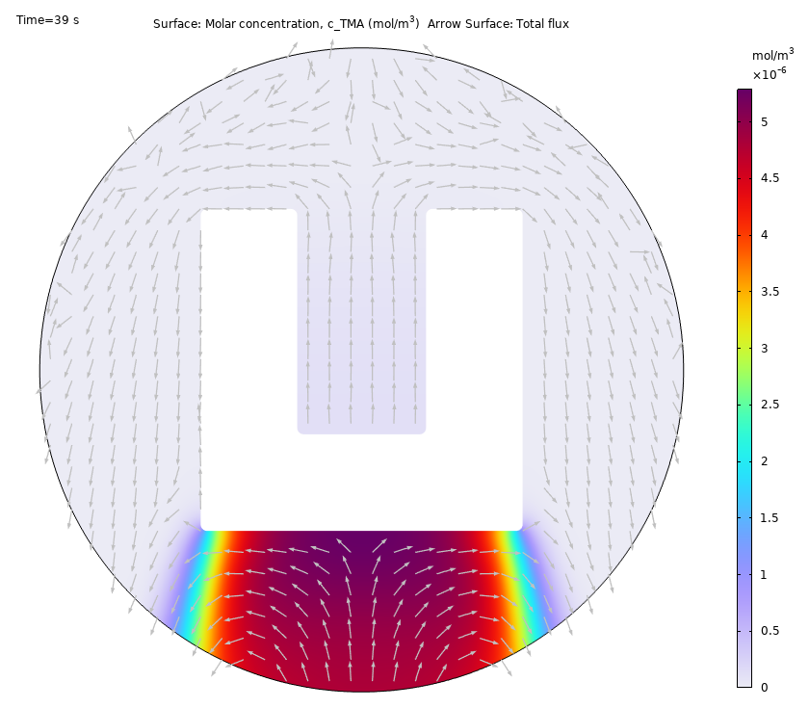
Introduction of Purge Gas
At the start of the purging process, external TMA is removed first, while a relatively high concentration remains inside the groove.
After an extended purging period, the TMA inside the groove is gradually diluted due to diffusion.

Slide 16

Deposition sequence at different locations
1
The boundaries of the U-shaped groove are numbered as follows:
  1: Top
  2: Outer wall
  3: Bottom
  4: Groove side wall
  5: Groove bottom
Deposition order:
  1->2->3->4->5
4
2
5
3

Slide 17
Summary
The deposition process of metal oxides on various surfaces of a U-shaped groove is modeled in this example.
Simulation results can be used to
  Understand the surface chemical reaction mechanisms in the ALD process
  Identify the deposition sequence
  Optimize the gas introduction strategies
  Optimize the design of the ALD chamber
Possible extensions include:
  Incorporating temperature field simulations to account for the impact of temperature non-uniformity on reaction rates
  Specifying active sites for surface chemical reactions based on actual surface conditions, such as substrate defects, dangling bonds, and the distribution of specific chemical groups.

Slide 18


Conclusion
ALD Deposition of Al₂O₃ on U-Shaped Structures
A coupled simulation of fluid flow, mass transfer, and chemical reactions was performed. The analysis results can be used to understand and optimize process parameters.
First Cycle
Second Cycle

