Slide 1
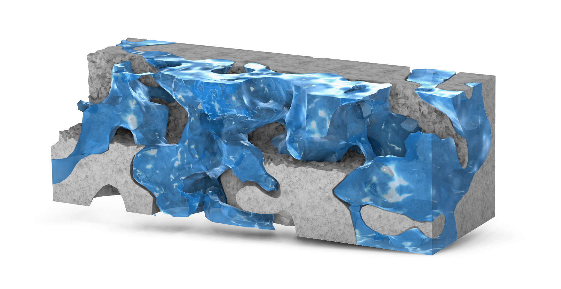
Digital rock morphology analysis
COMSOL

Slide 2
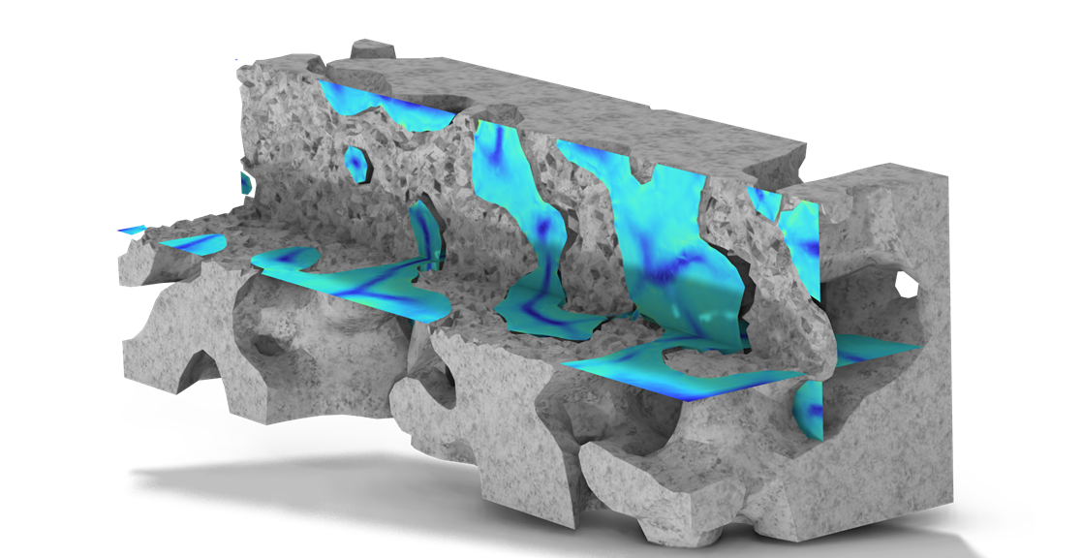
Background and purpose
Digital Rock Analysis employs high-resolution imaging techniques (2D slices and 3D CT reconstructions) of actual rock cores to quantitatively analyze rock pore structures at the pore scale.
This model with App GUI demonstrates how to use COMSOL to import digital rock geometry, analyze pore structures and connectivity, and visualize results interactively.
Main applications
  Characterize pore structure and connectivity of porous media
  Identify preferential flow paths, water channeling, and profile control
  Analyze pore throats (bottlenecks) and residual oil zones

Slide 3
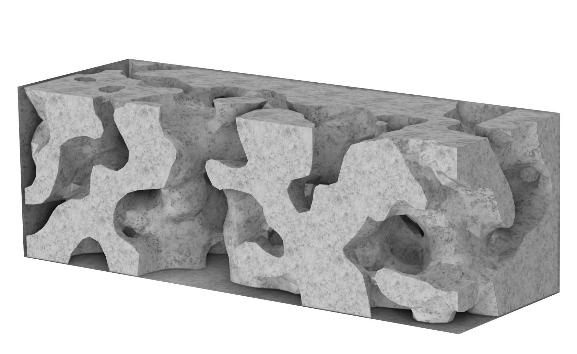
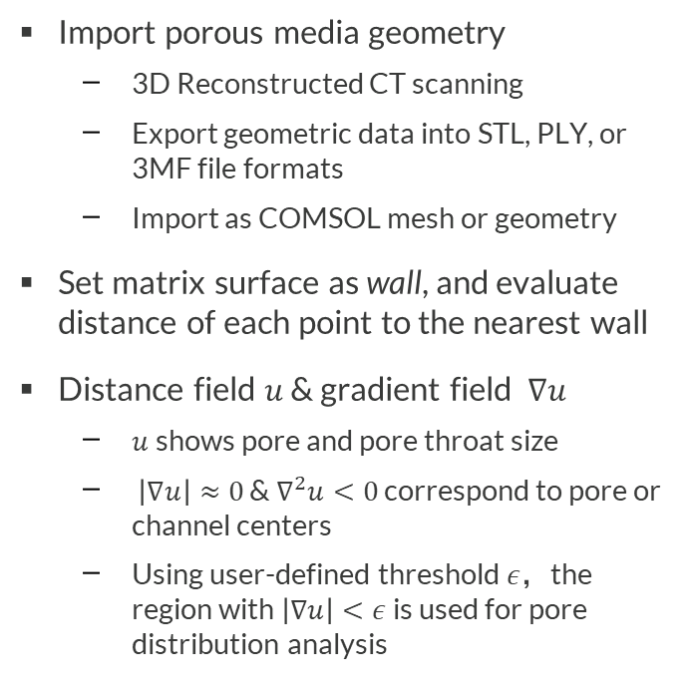
Model Definition – 3D
Import porous media geometry
  3D Reconstructed CT scanning
  Export geometric data into STL, PLY, or 3MF file formats
  Import as COMSOL mesh or geometry
Set matrix surface as wall, and evaluate distance of each point to the nearest wall
Distance field $u$ & gradient field $∇u$
  $u$shows pore and pore throat size
  $\left|∇u\right|≈0$ & $∇^{2}u<0$ correspond to pore or channel centers
  Using user-defined threshold $ε$，the region with $\left|∇u\right|<ε$ is used for pore distribution analysis
Matrix
Wall

Slide 4
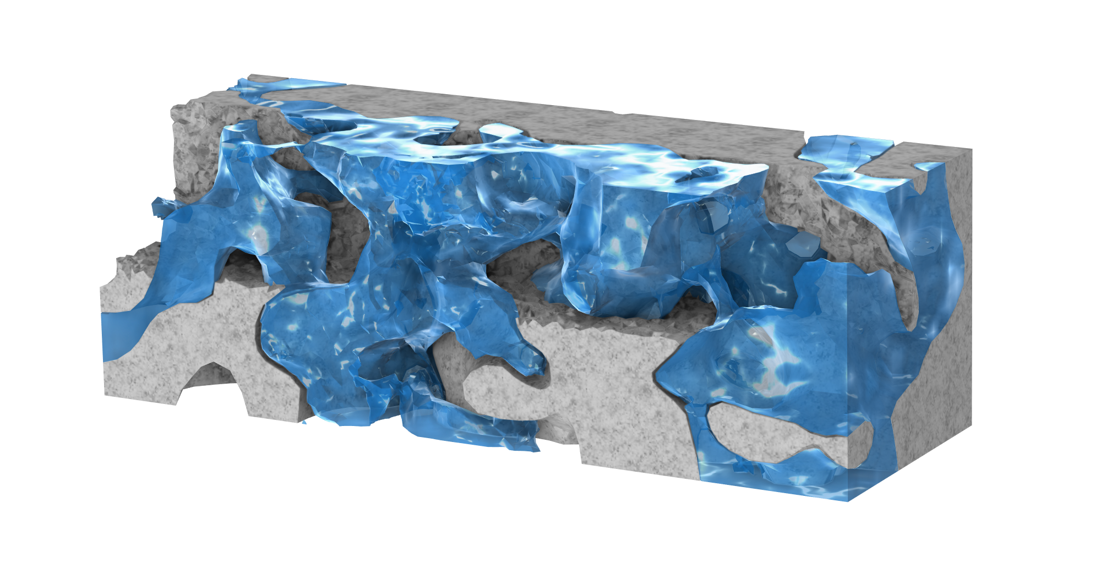
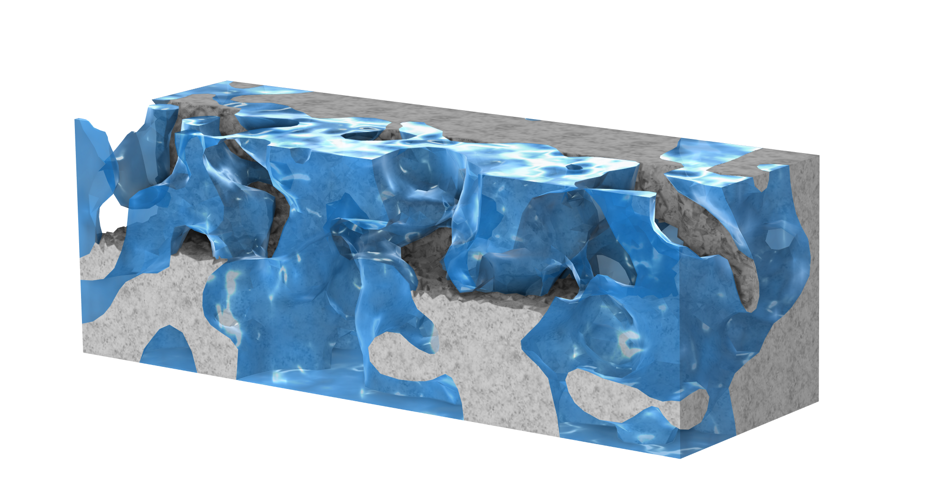
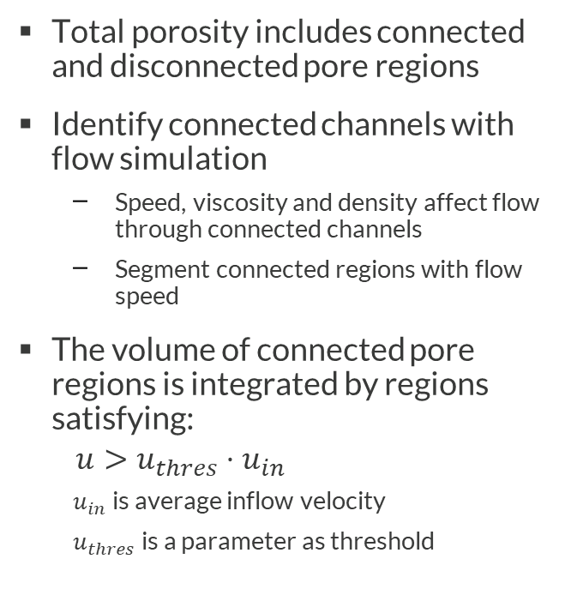
Model Definition – 3D
Total porosity includes connected and disconnected pore regions
Identify connected channels with flow simulation
  Speed, viscosity and density affect flow through connected channels
  Segment connected regions with flow speed
The volume of connected pore regions is integrated by regions satisfying:
$$u>u_{thres}⋅u_{in}$$
  $u_{in}$ is average inflow velocity
  $u_{thres}$ is a parameter as threshold
Outlet
Connected Region
Isolated Region
Inlet
Total porosity

Slide 5
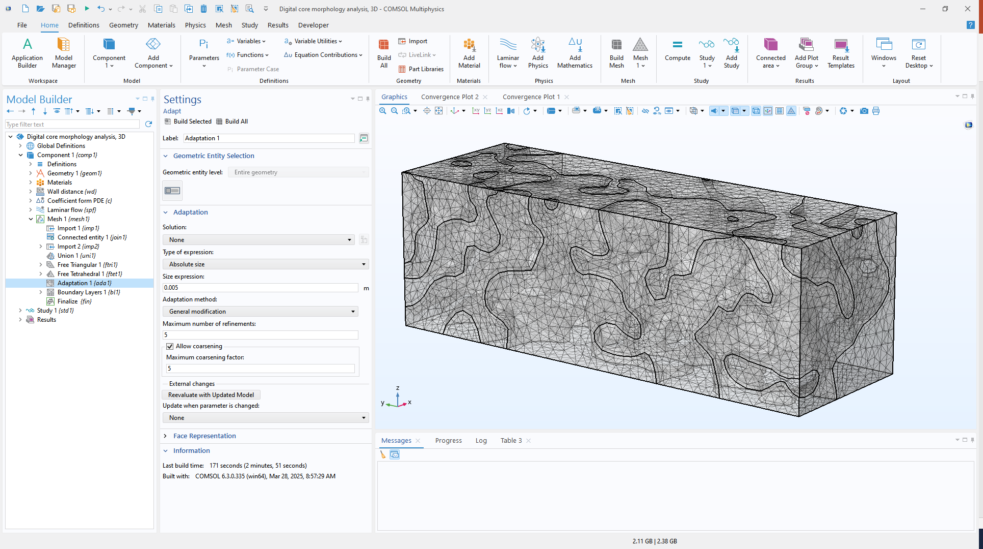
Mesh Import
Import 3D geometry
Use Union to define Matrix and Pore domains
Apply Adapt for mesh size control
Boundary Layers build mesh for flow simulation

Slide 6
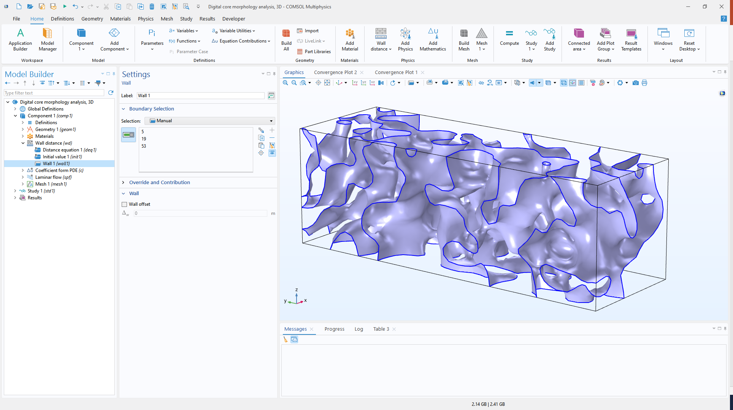
Wall Distance Setting
Select pore regions for Wall Distance interface
Select matrix surfaces as Wall boundary condition

Slide 7
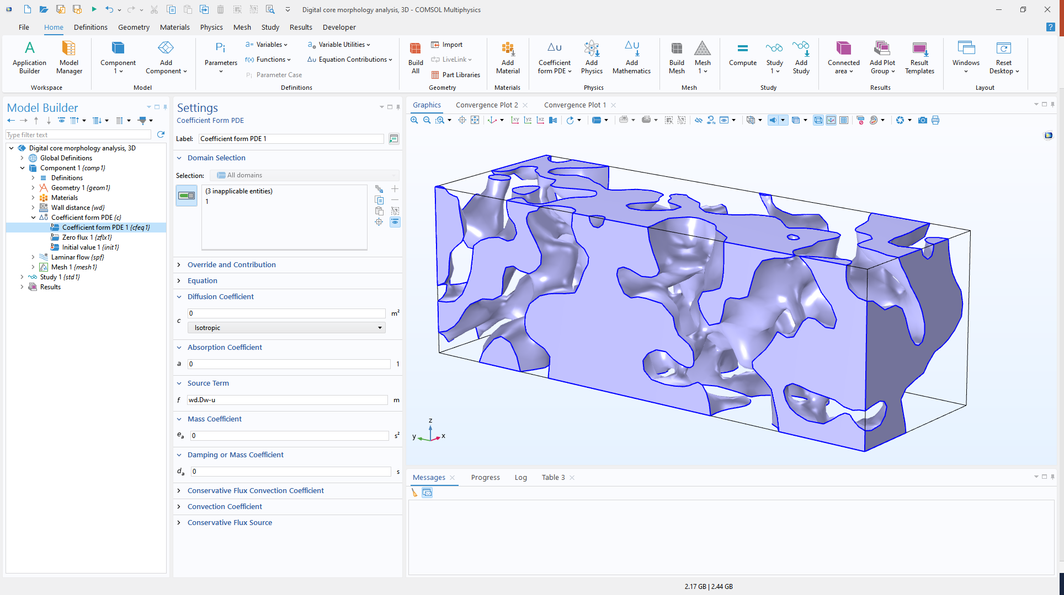
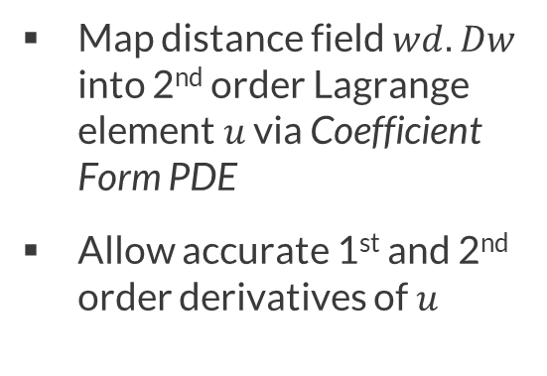
Distance and Gradient Field
Map distance field $wd.Dw$ into 2nd order Lagrange element $u$ via Coefficient Form PDE
Allow accurate 1st and 2nd order derivatives of $u$
+
+

Slide 8
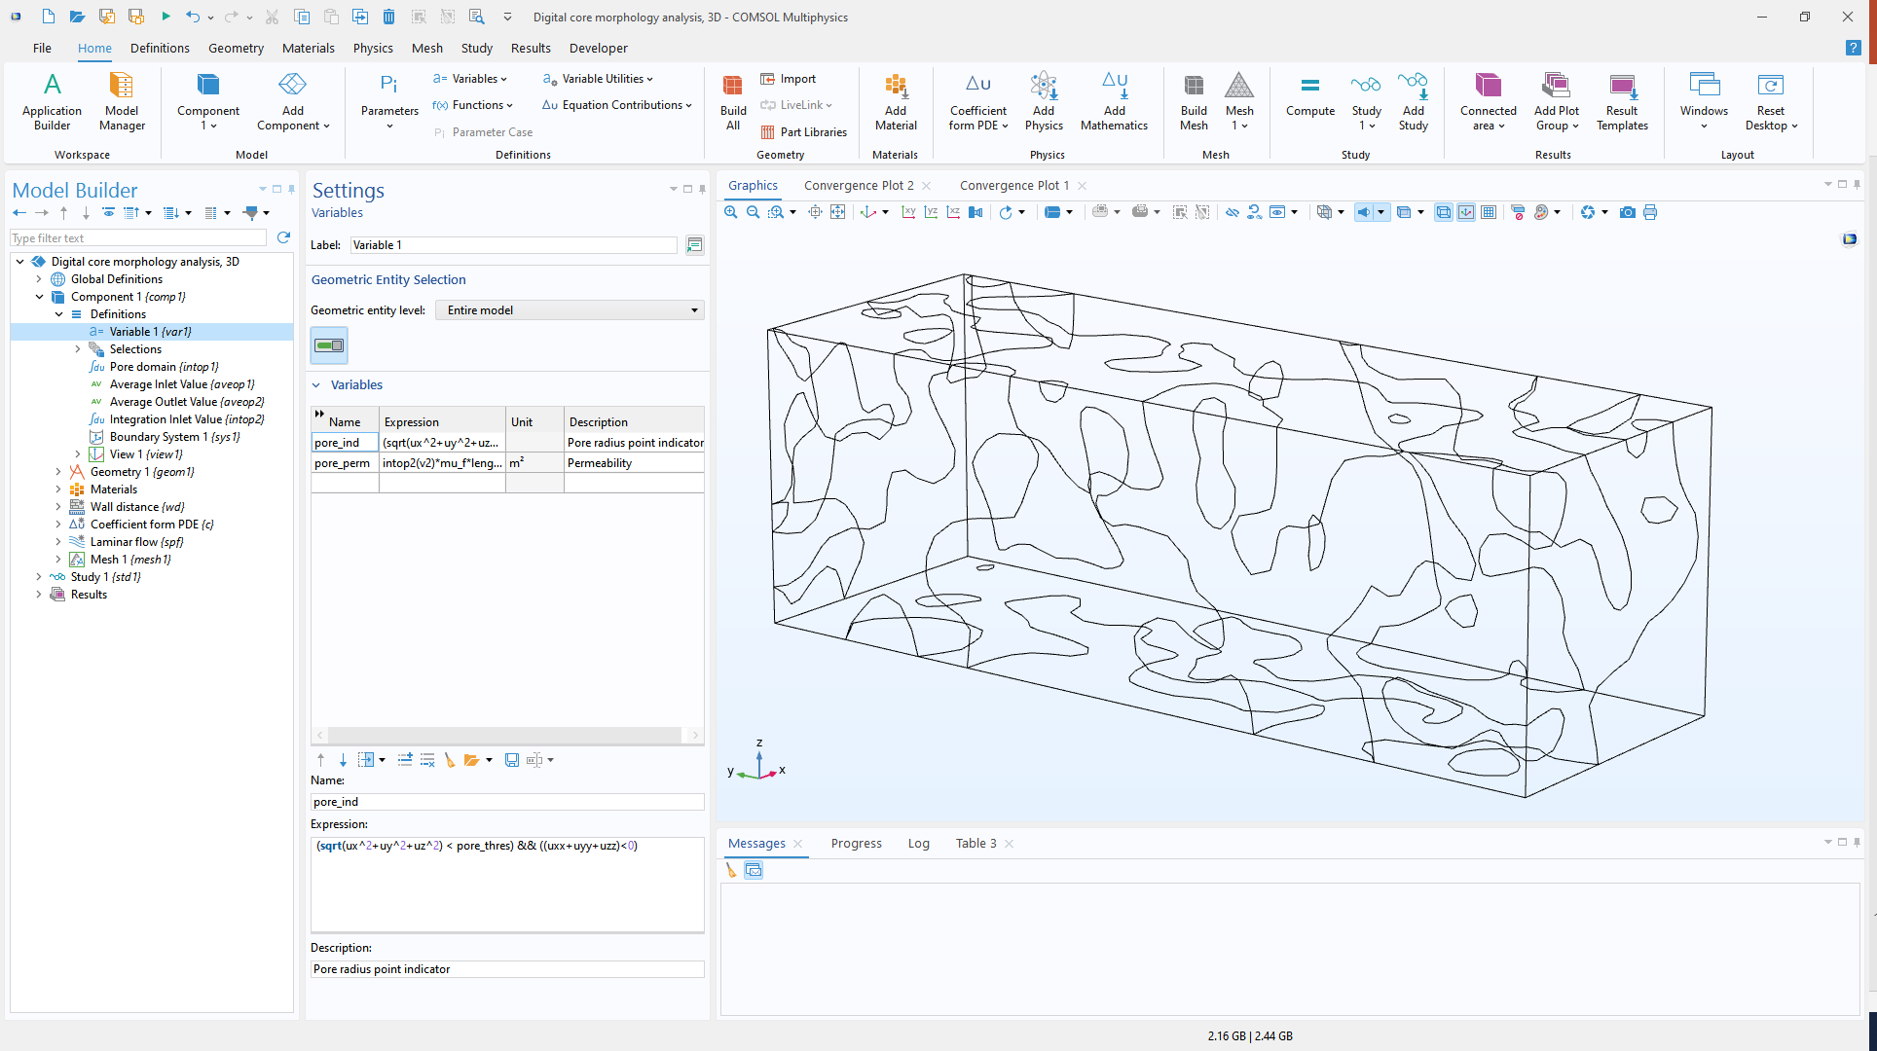
Local Maximum of Distance Field
+
The variable pore_ind indicates potential pore and channel locations
The threshold parameter pore_thres to refine detection criteria
+
+
+

Slide 9
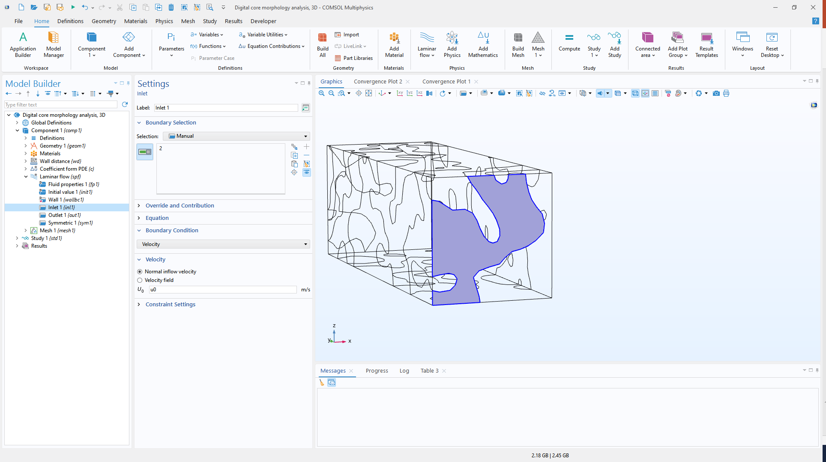
Flow in pores
Laminar Flow interface to compute flow in pore regions.
Inlet for average velocity

Slide 10
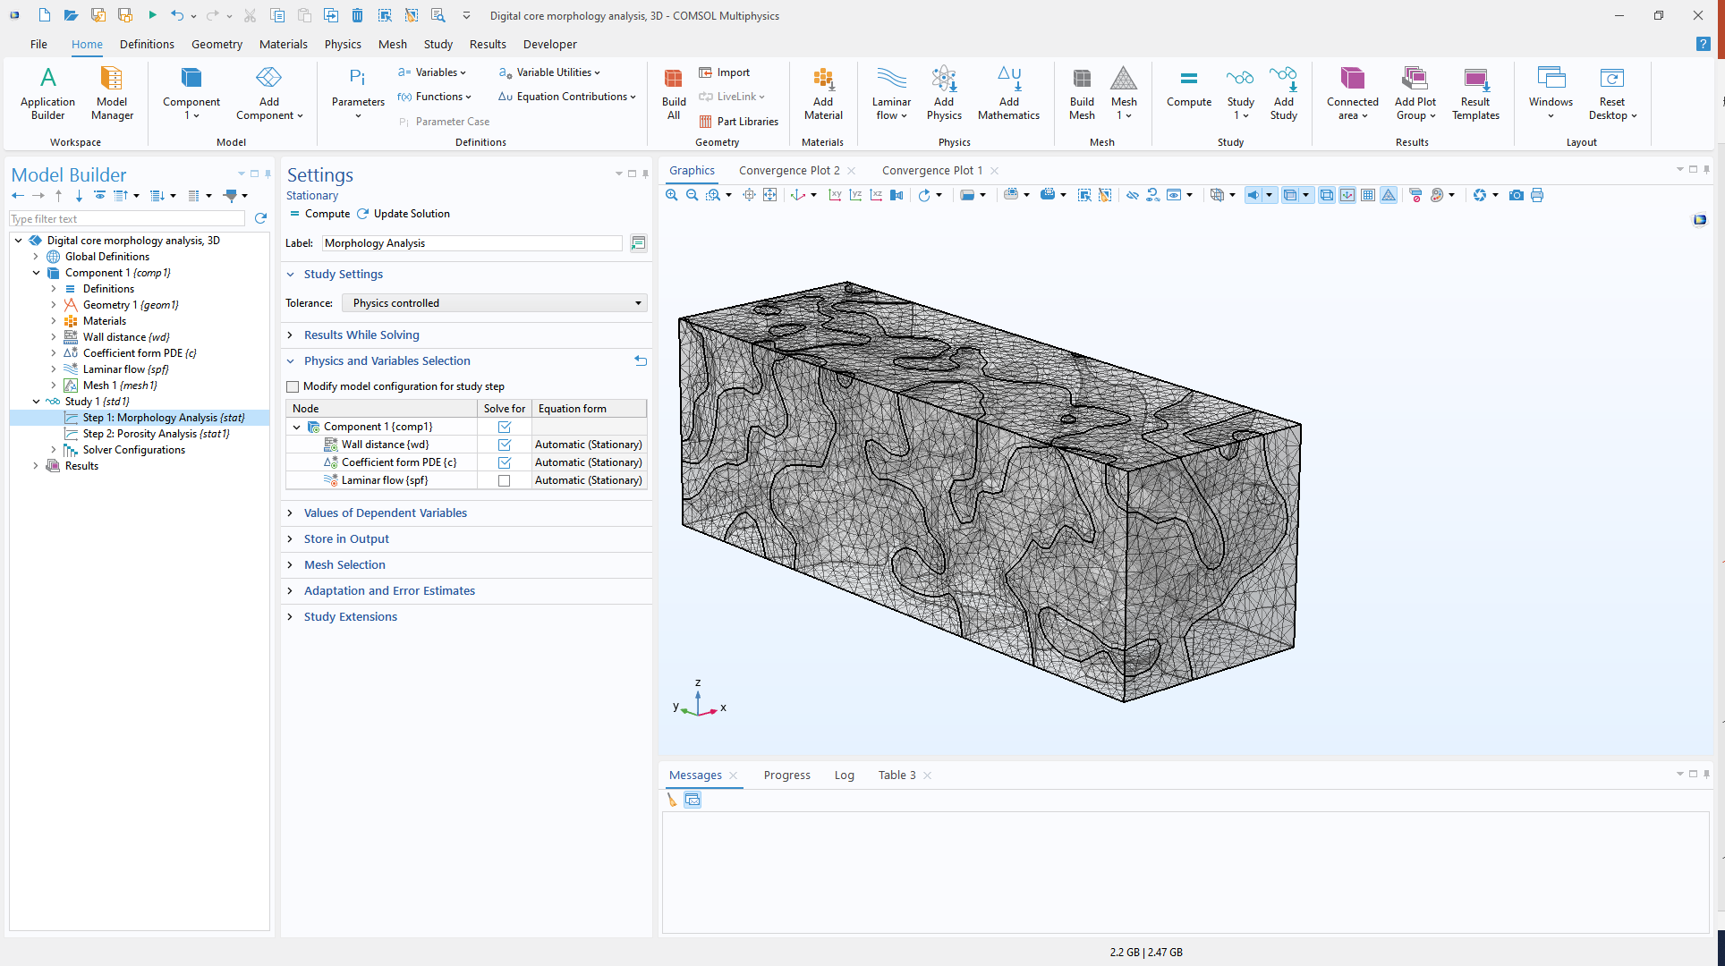
Study setting
Solve Wall Distance and Coefficient Form PDE together
Solve Laminar Flow separately

Slide 11
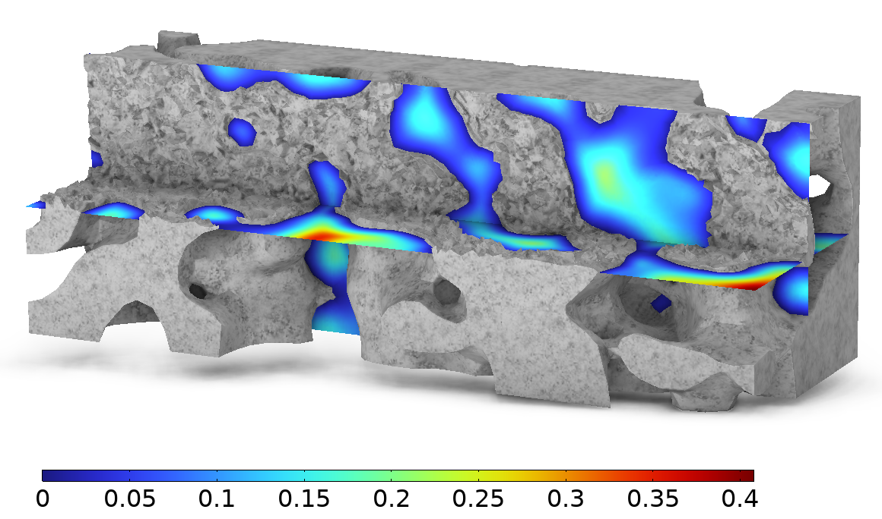
Wall Distance Field
Wall distance distribution provides the distance to the nearest wall at each point in the pore space
Largest wall distances occur at pore centers
Maximum pore radius in this 3D example: 0.4 mm*
Note: The distance estimate may be lower or higher due to mesh resolution and smoothing.

Slide 12
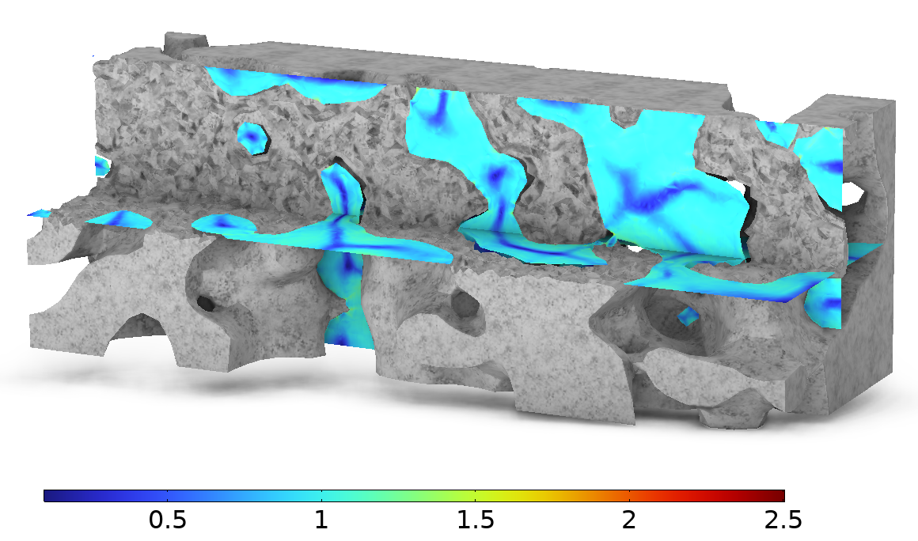
Wall Distance Gradient Field
Locations where the gradient magnitude approaches zero indicate pore or channel centers
Ridge structures reflect network connectivity
Extract distance values at pore and channel centers for pore radius distribution analysis

Slide 13
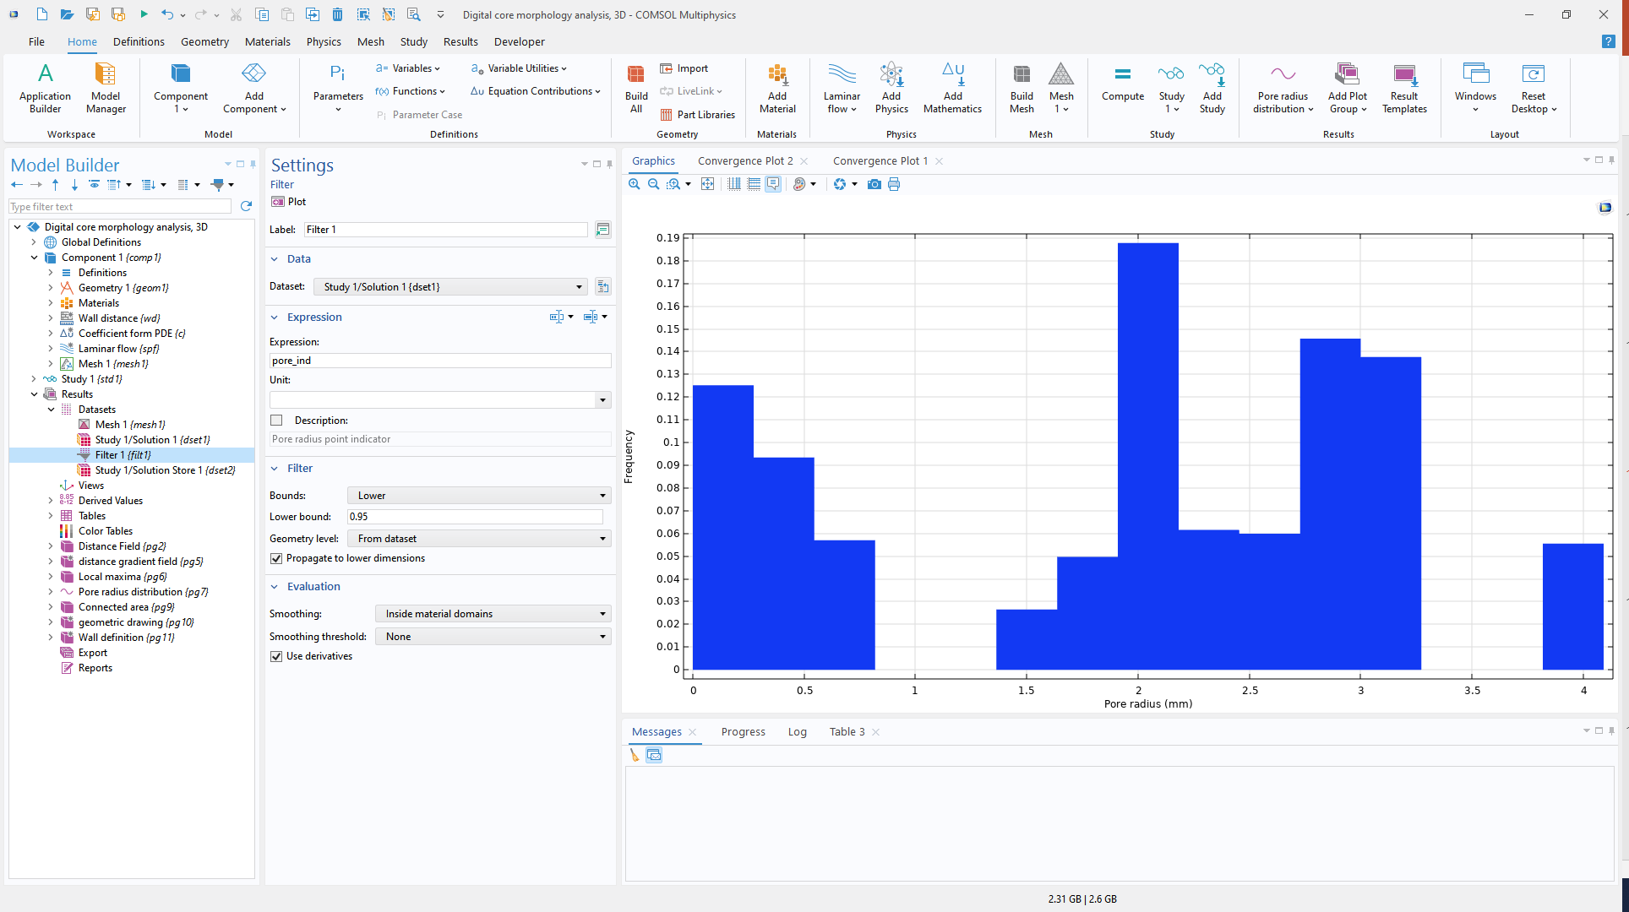
Pore Radius Distribution
Use pore_ind to filter data points located in pore and pore-channel regions
Dataset Filter select this subset, and plot with Histogram

Slide 14
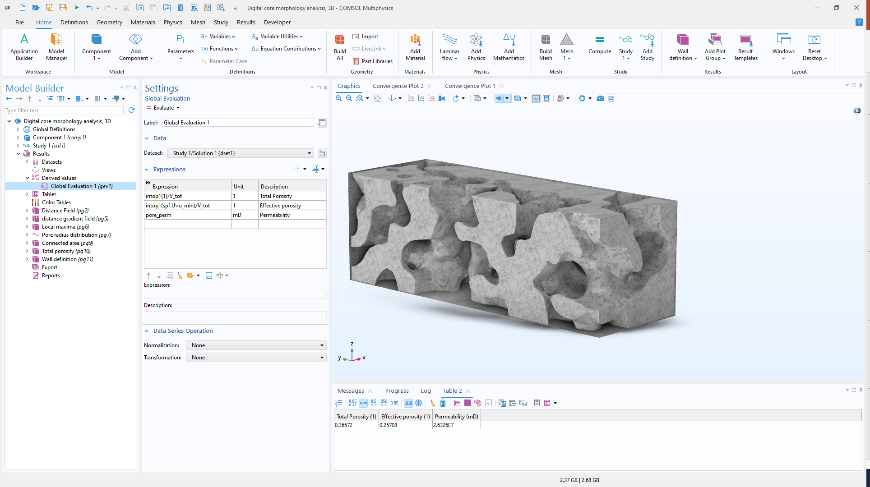
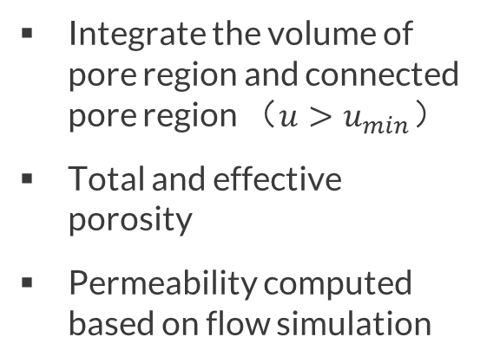
Porosity & Permeability
+
Integrate the volume of pore region and connected pore region （$u>u_{min}$）
Total and effective porosity
Permeability computed based on flow simulation
+

Slide 15
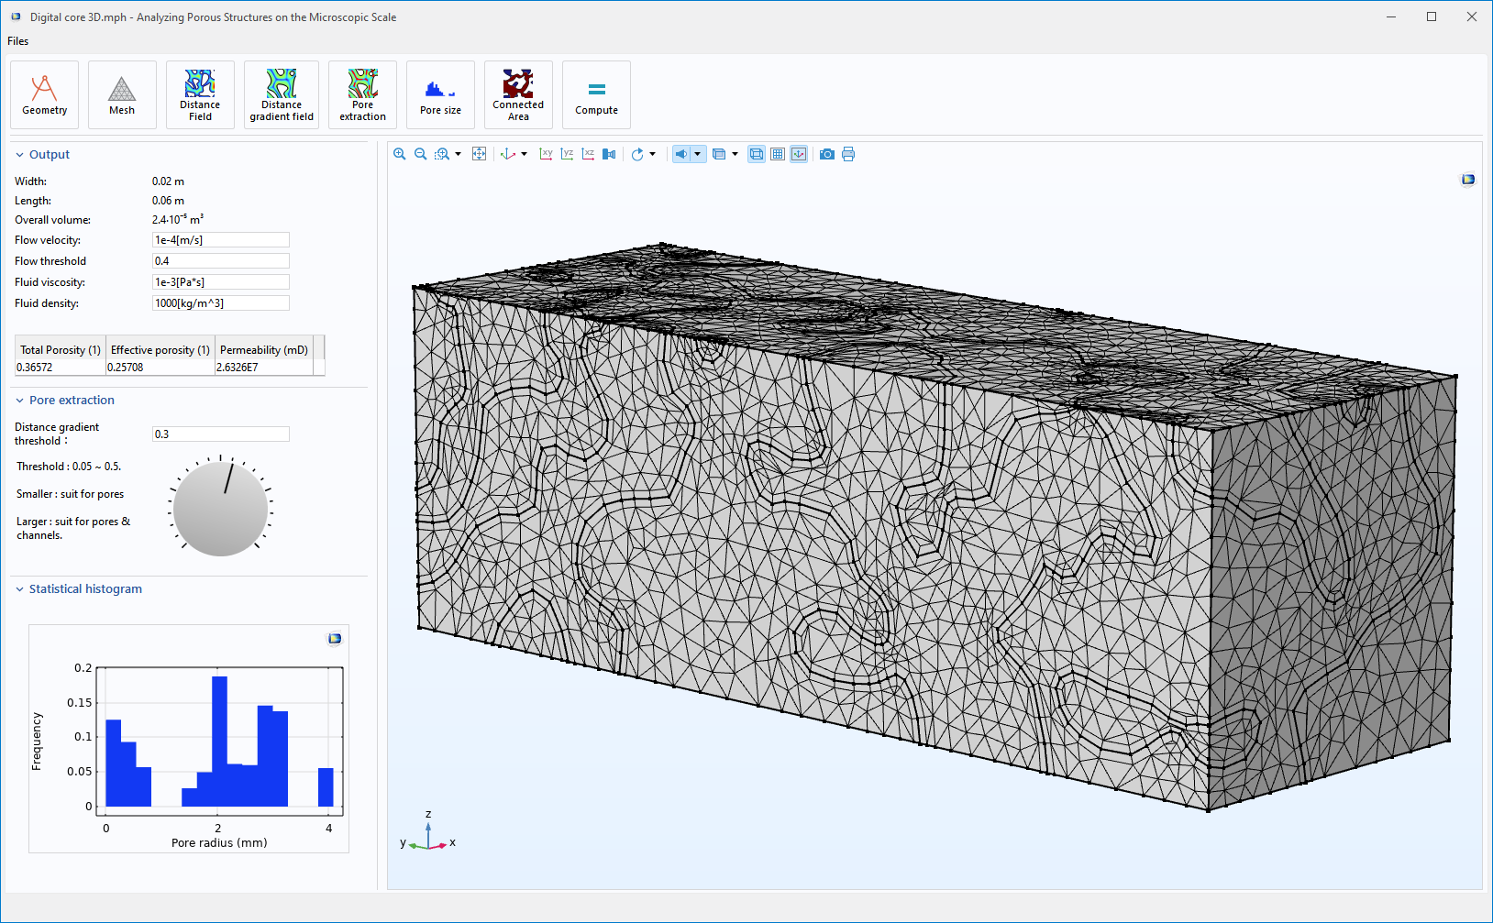
3D Digital Rock Morphology Analysis App

Slide 16
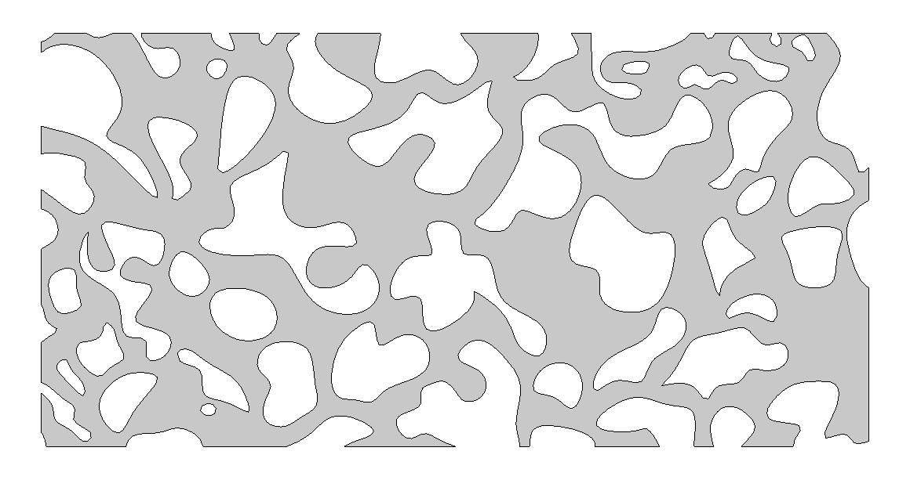
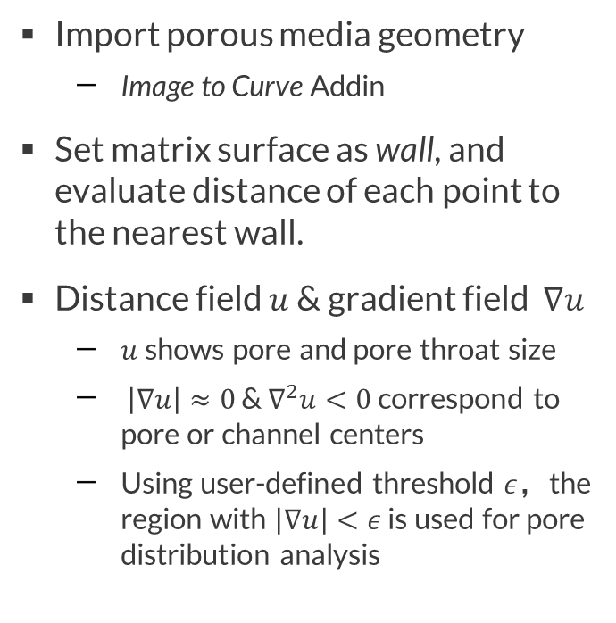
Model Definition – 2D
Import porous media geometry
  Image to Curve Addin
Set matrix surface as wall, and evaluate distance of each point to the nearest wall.
Distance field $u$ & gradient field $∇u$
  $u$shows pore and pore throat size
  $\left|∇u\right|≈0$ & $∇^{2}u<0$ correspond to pore or channel centers
  Using user-defined threshold $ε$，the region with $\left|∇u\right|<ε$ is used for pore distribution analysis
Matrix
Wall

Slide 17
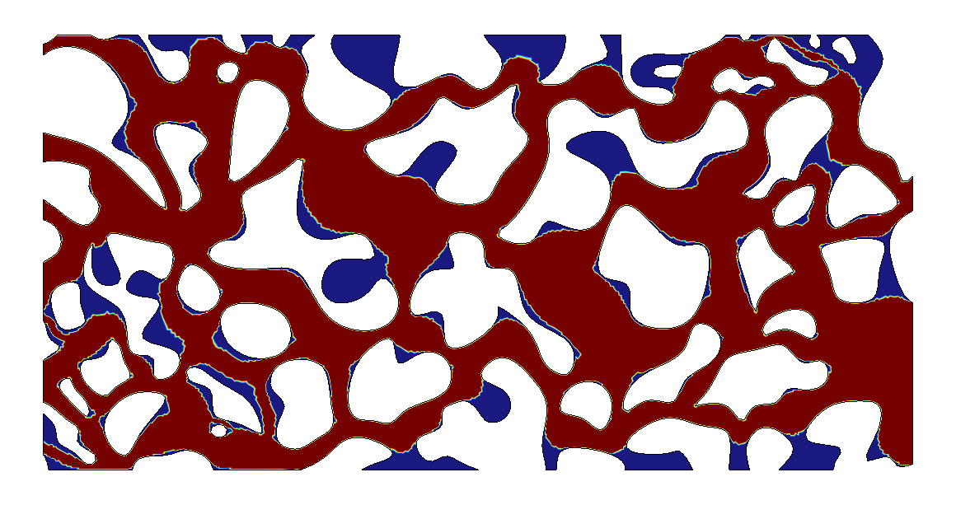
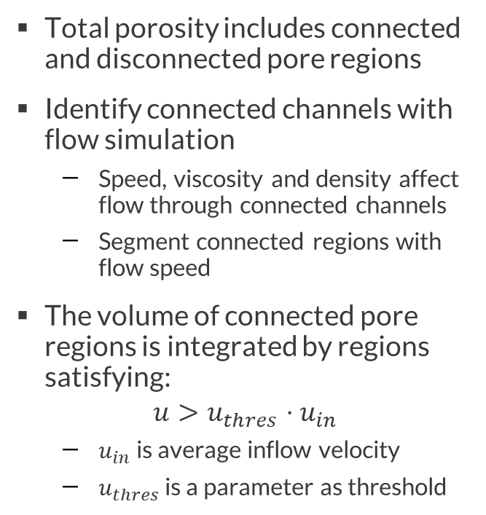
Model Definition – 2D
Total porosity includes connected and disconnected pore regions
Identify connected channels with flow simulation
  Speed, viscosity and density affect flow through connected channels
  Segment connected regions with flow speed
The volume of connected pore regions is integrated by regions satisfying:
$$u>u_{thres}⋅u_{in}$$
  $u_{in}$ is average inflow velocity
  $u_{thres}$ is a parameter as threshold
Outlet
Connected Region
Isolated
Region
Inlet

Slide 18
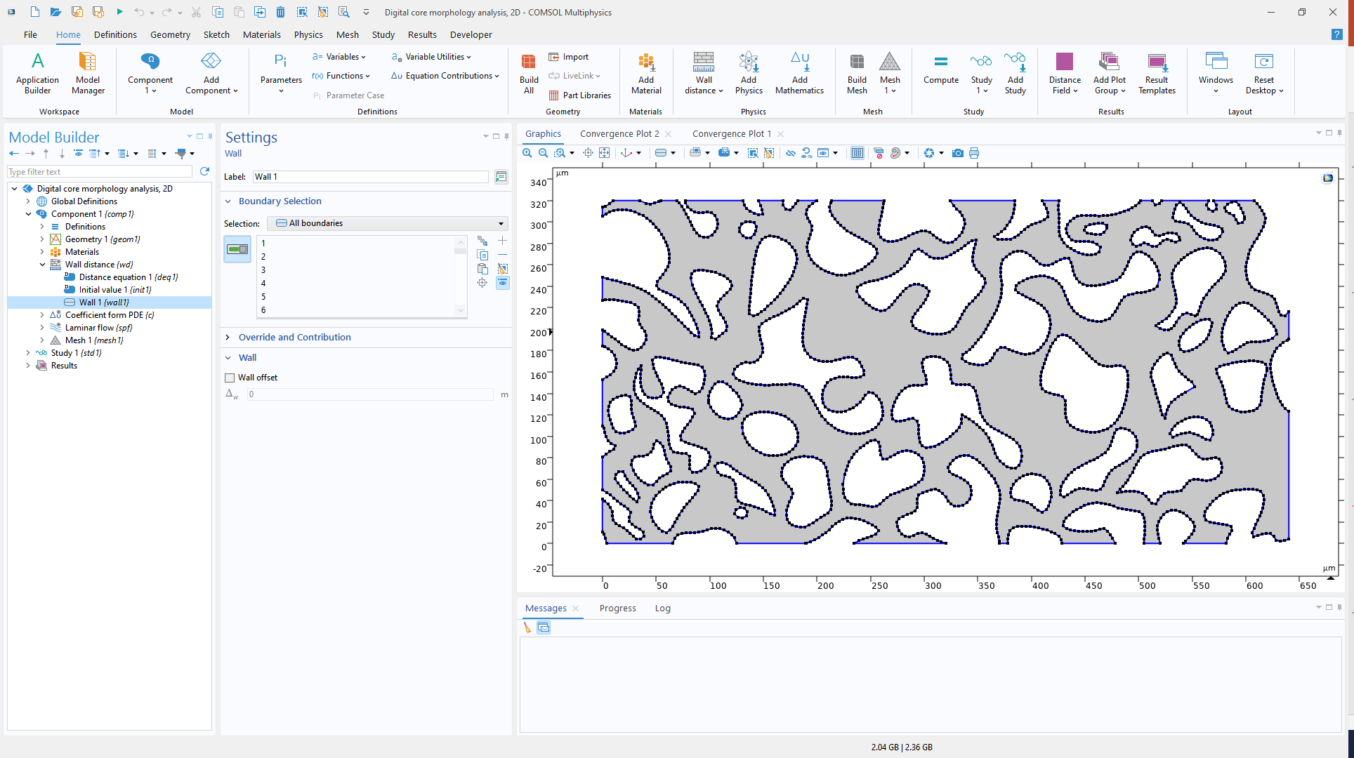
Wall Distance Setting
Select pore regions for Wall Distance interface
Select matrix surfaces as Wall boundary condition

Slide 19
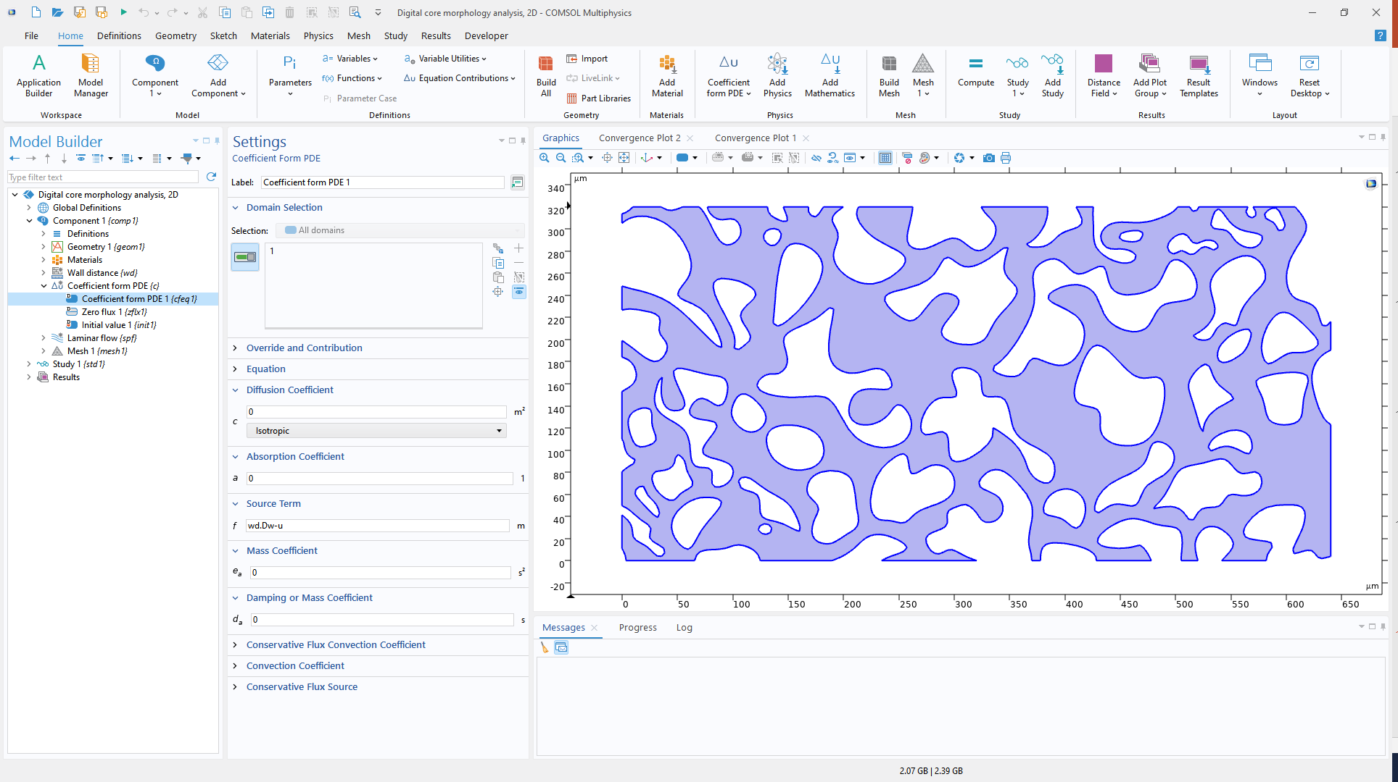
Distance and Gradient Field
Map distance field $wd.Dw$ into 2nd order Lagrange element $u$ via Coefficient Form PDE
Allow accurate 1st and 2nd order derivatives of $u$
+
+

Slide 20
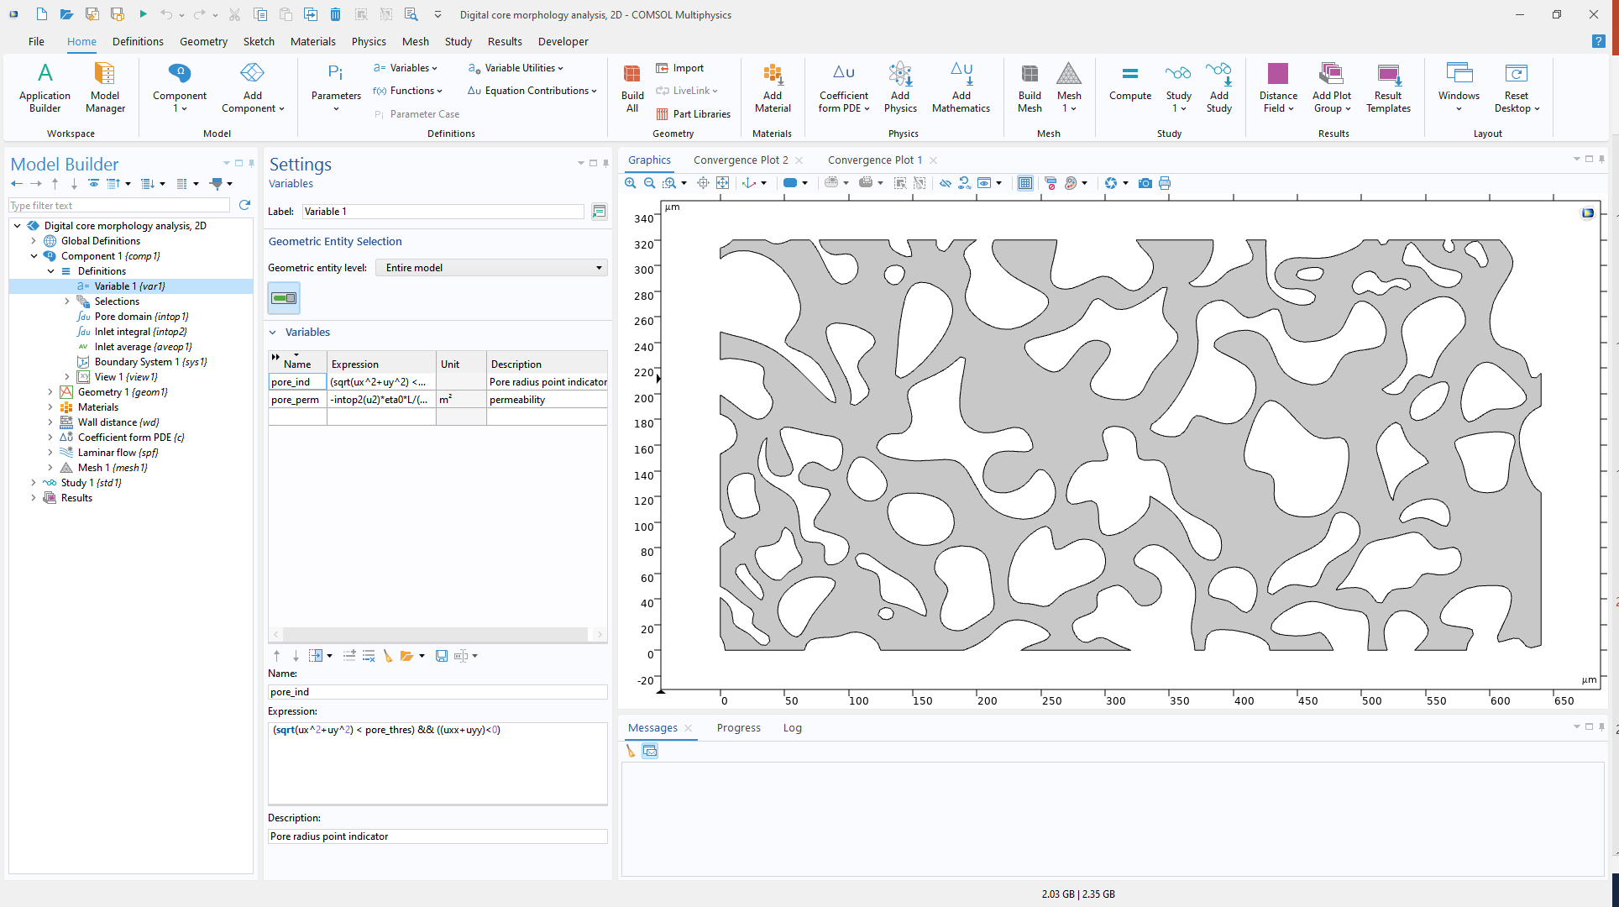
Local Maximum of Distance Field
+
The variable pore_ind indicates potential pore and channel locations
The threshold parameter pore_thres to refine detection criteria
+
+
+

Slide 21
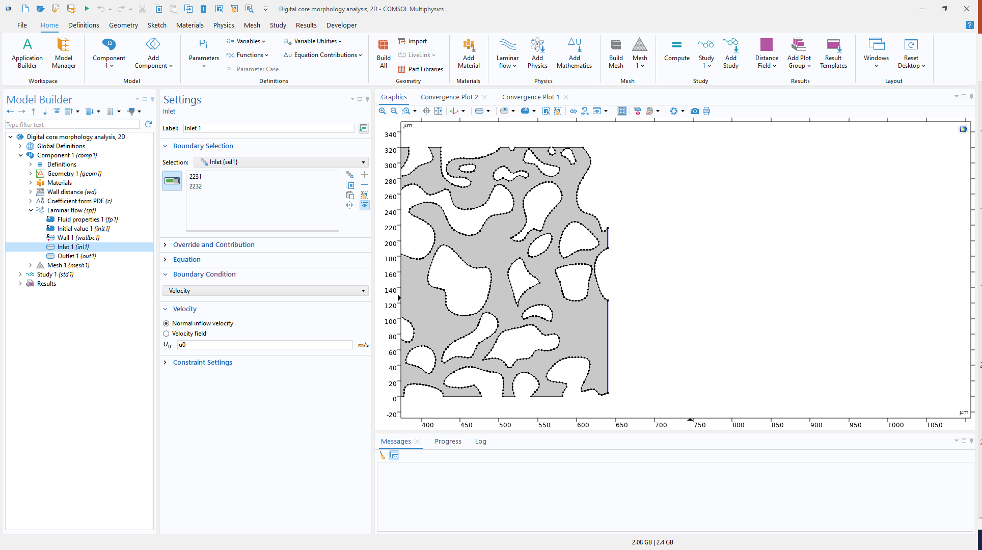
Flow in pores
Laminar Flow interface to compute flow in pore regions.
Inlet for average velocity

Slide 22
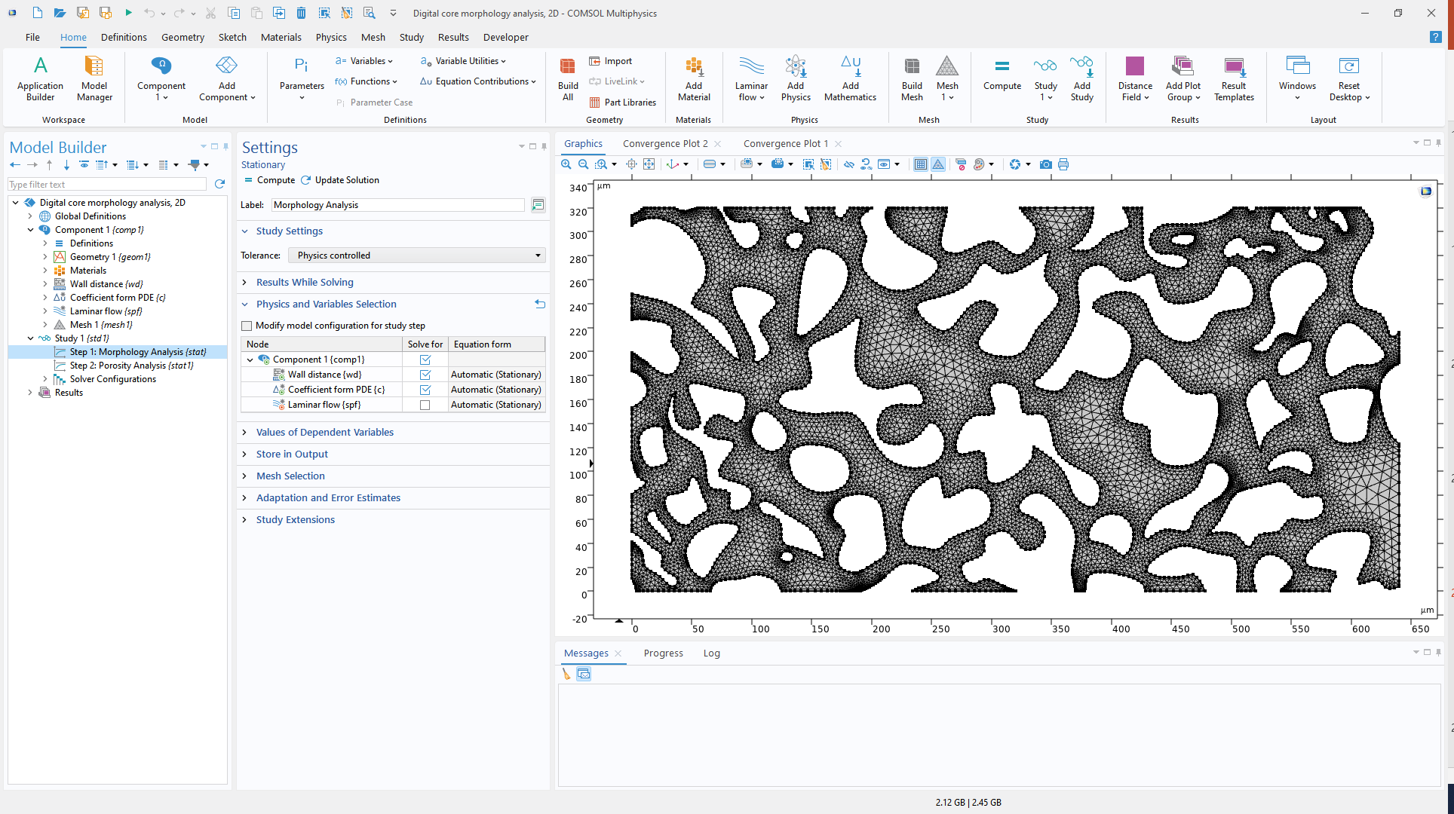
Study setting
Solve Wall Distance and Coefficient Form PDE together
Solve Laminar Flow separately

Slide 23
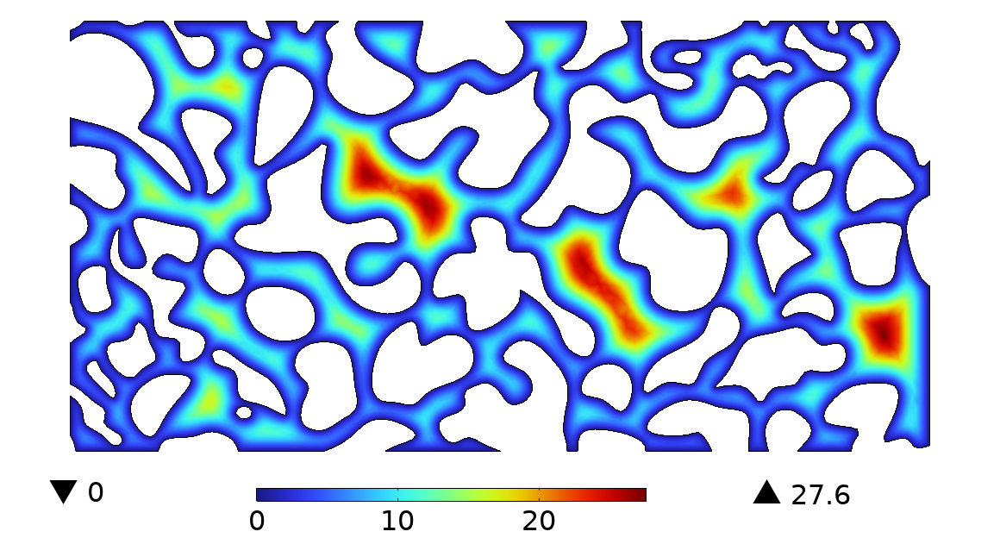
Wall Distance Field
Wall distance distribution provides the distance to the nearest wall at each point in the pore space
Largest wall distances occur at pore centers
Maximum pore radius in this 3D example: 27.6 um*
Note: The distance estimate may be lower or higher due to mesh resolution and smoothing.

Slide 24
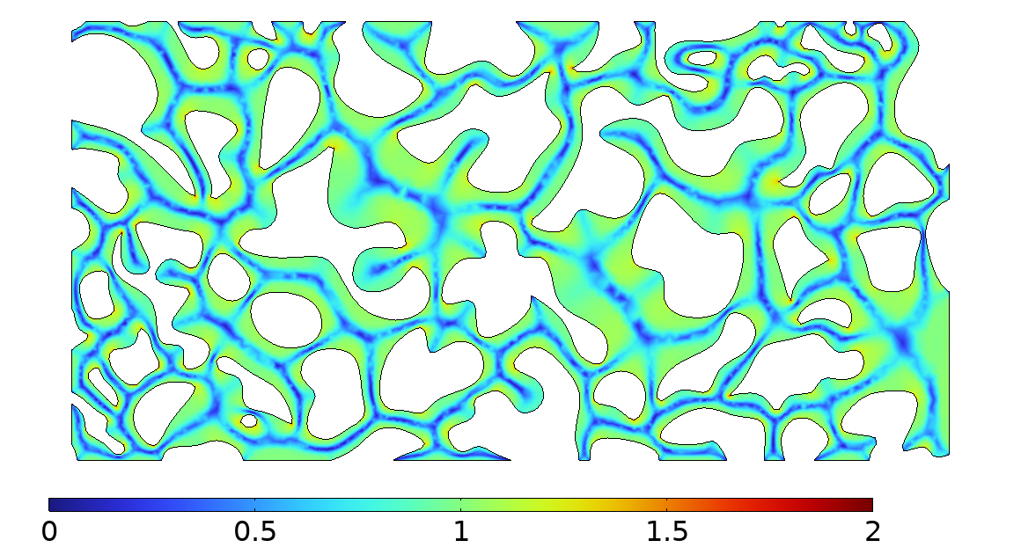
Wall Distance Gradient Field
Locations where the gradient magnitude approaches zero indicate pore or channel centers
Ridge structures reflect network connectivity

Slide 25
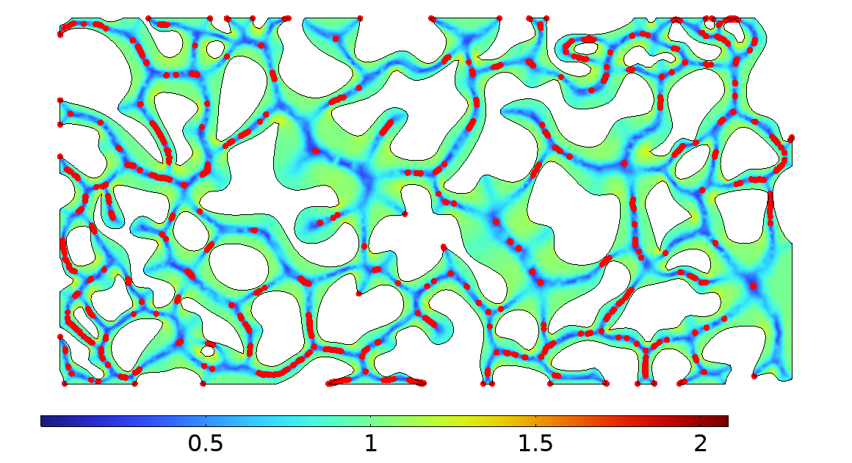
Wall Distance Gradient Field
Locations where the gradient magnitude approaches zero indicate pore or channel centers
Ridge structures reflect network connectivity
Extract distance values at pore and channel centers for pore radius distribution analysis

Slide 26
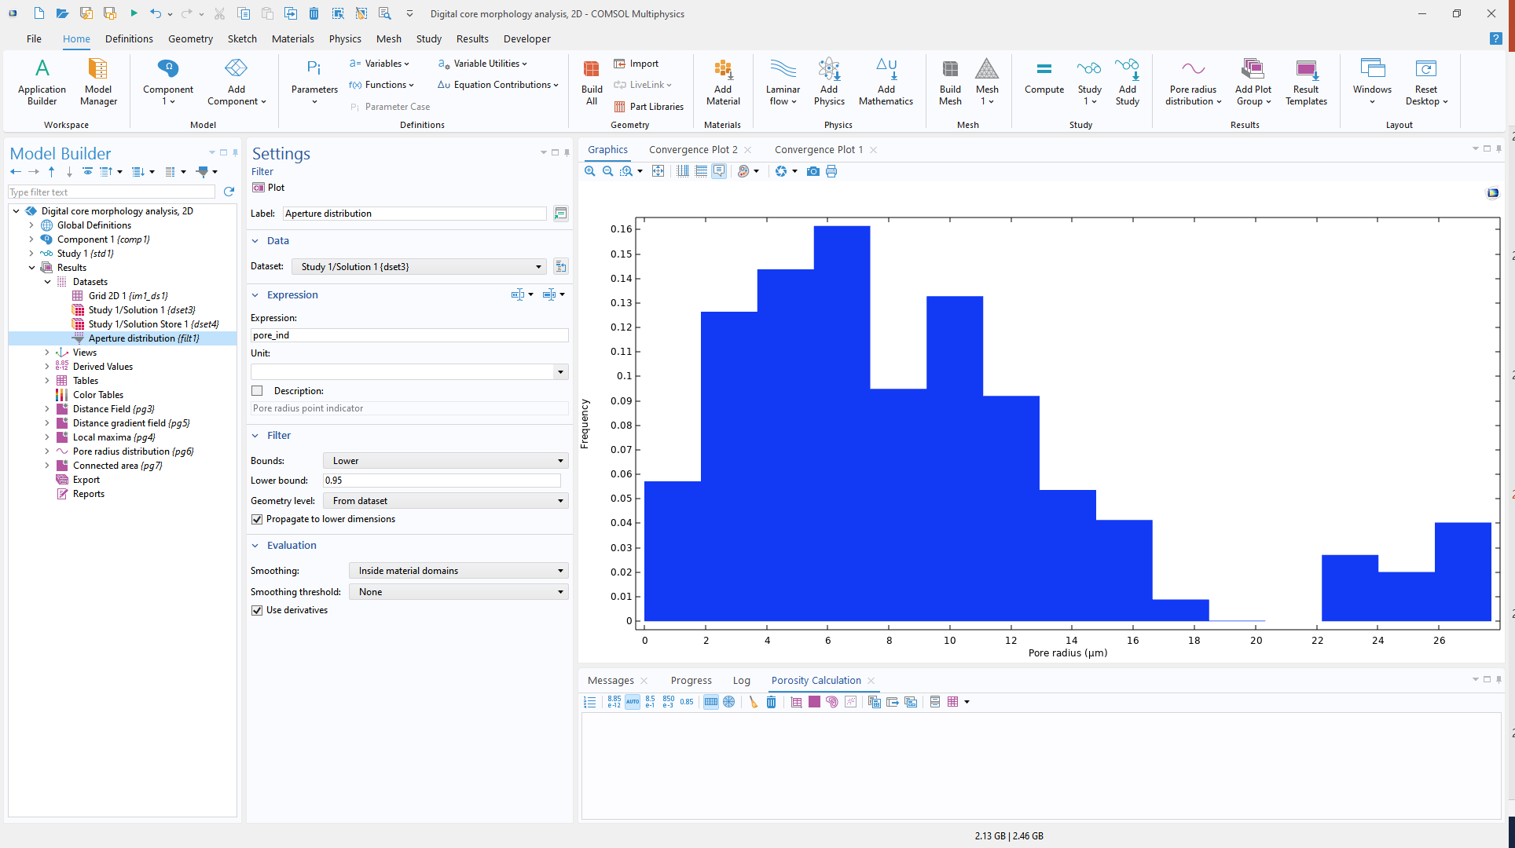
Pore Radius Distribution
Use pore_ind to filter data points located in pore and pore-channel regions
Dataset Filter select this subset, and plot with Histogram

Slide 27
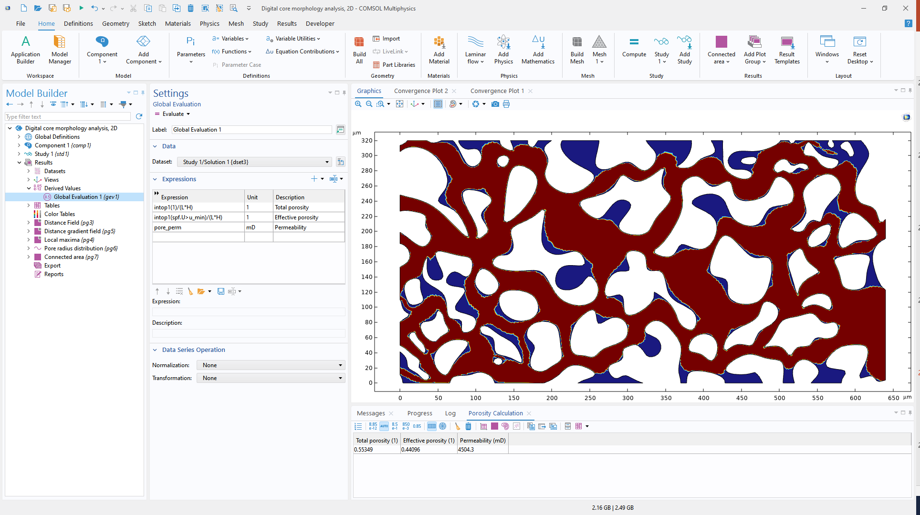
Porosity & Permeability
+
Integrate the volume of pore region and connected pore region （$u>u_{min}$）
Total and effective porosity
Permeability computed based on flow simulation
+

Slide 28
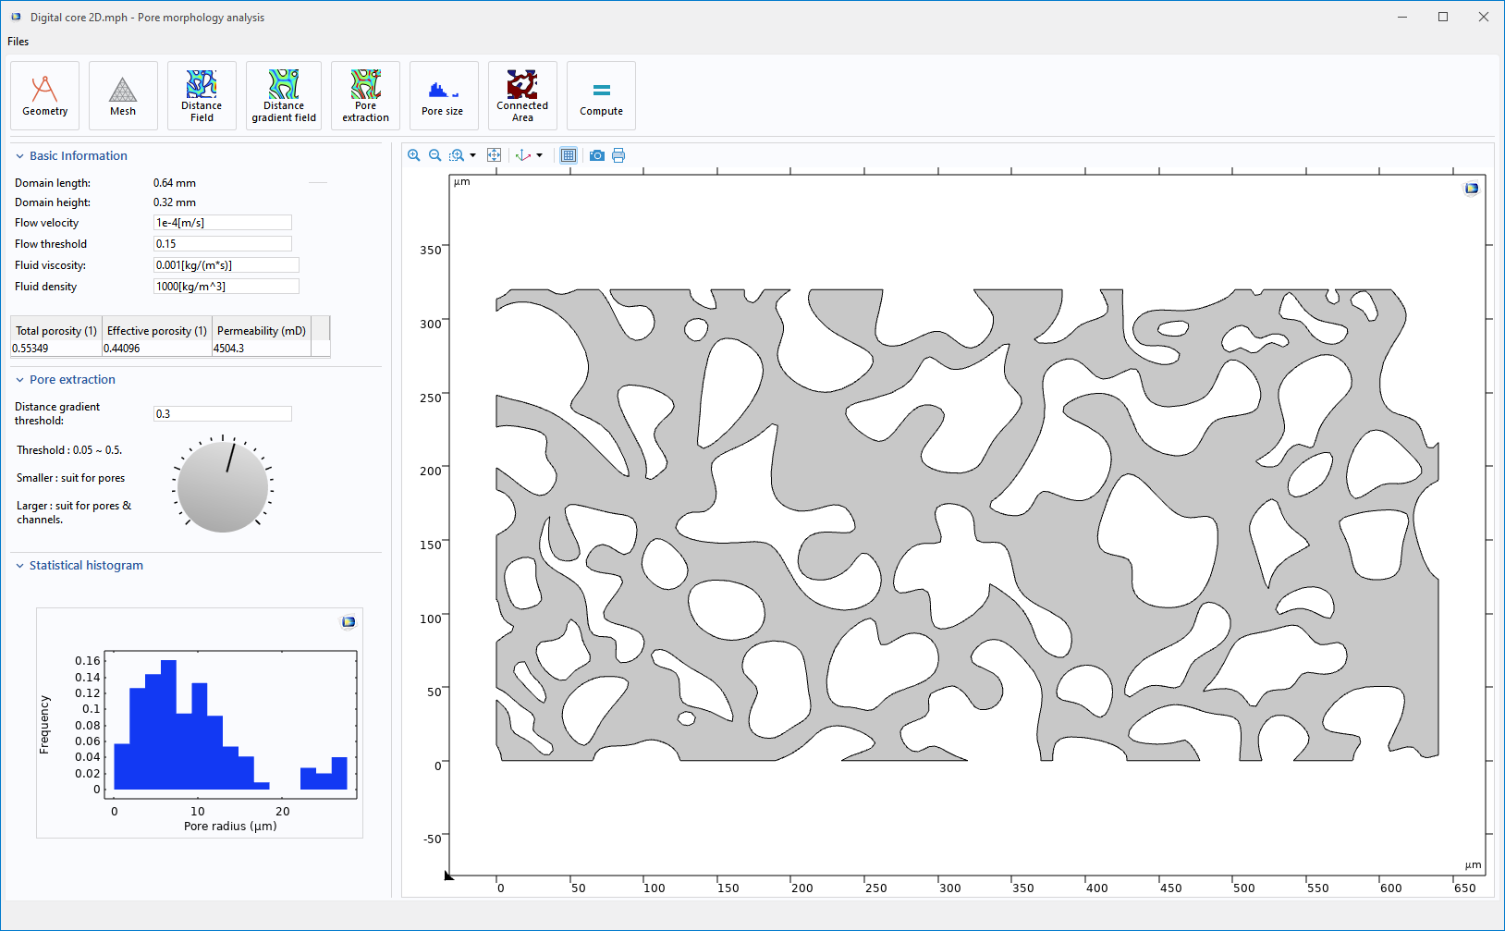
2D Digital Rock Morphology Analysis App

Slide 29
Discussion & possible extensions
Current models and Apps focus on 2D slices and 3D morphology analysis
Extension 1: Two-phase flow, absolute & relative permeability
  Use pore size distribution to refine initial values of pressure
  Optimize mesh size in different regions
  Simulate only connected pores to speed up
Extension 2: Hydraulic fracturing & fracture–pore coupling
  Simulate flow with various artificial fracture types
  The fracture opening-up and flow paths reconfiguration
  Analyze effects of fracture density and length

Slide 30
Conclusion
Digital rock morphology analysis
This model shows an integrated digital rock workflow, from geometry to morphology analysis and result evaluation. With Apps, results can be easily shared, distributed, and extended to multiphysics coupled analysis.

