Slide 1
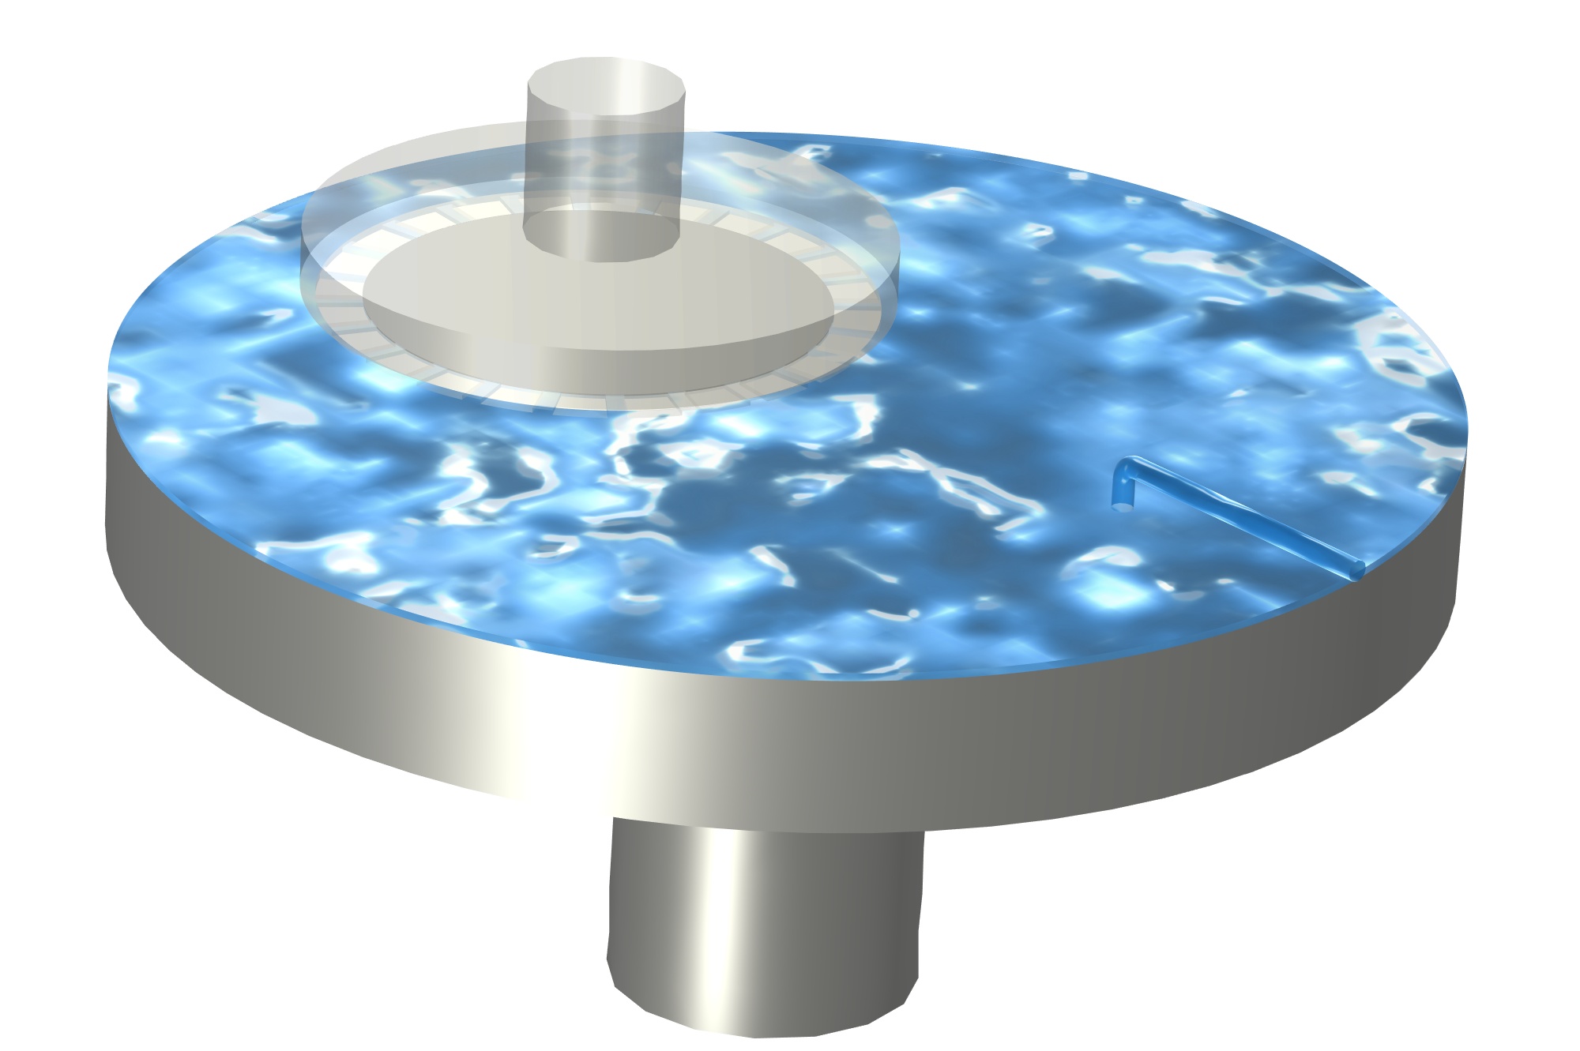
Simulation of the Flow Field and Abrasive Particles in Chemical Mechanical Polishing (CMP) Equipment
COMSOL

Slide 2
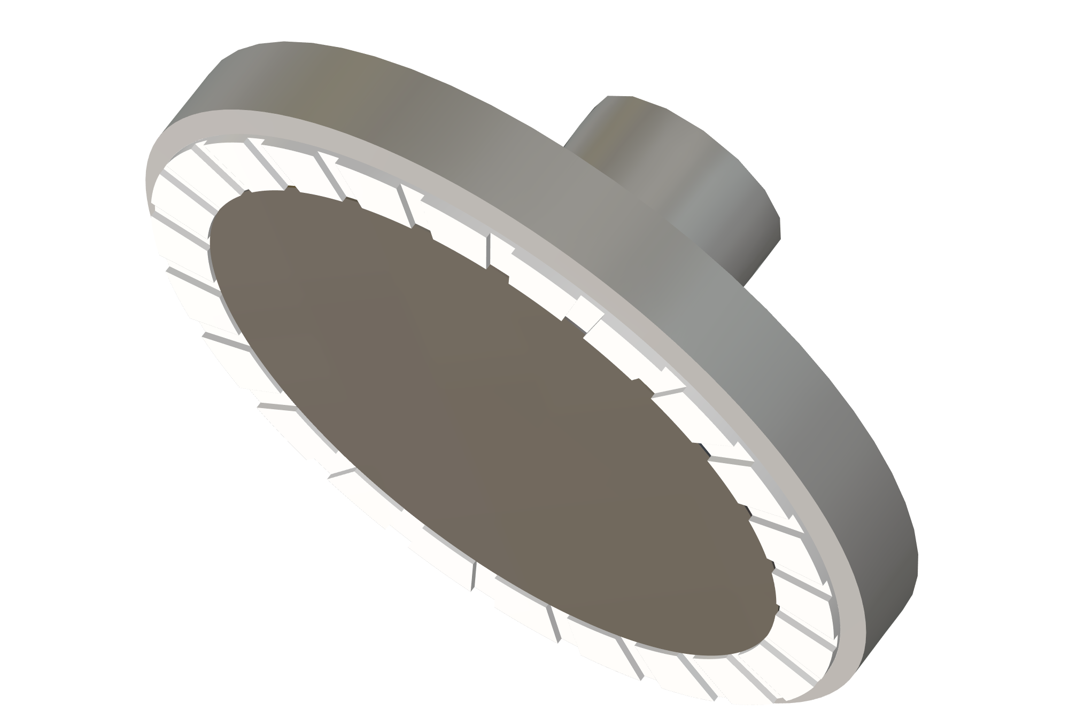
Model Introduction
Polishing head
Retaining ring
Retaining ring
Polishing pad
Inlet
Polishing disc
Wafer
Chemical Mechanical Polishing (CMP) Equipment
Polishing Head Structure
In CMP equipment, the wafer is held in place by the retaining ring, positioned beneath the polishing head and rotating with it.
The retaining ring has channels that allow fluid and particles to pass through.
Polishing fluid flows from the inlet and forms a liquid film on the polishing pad, which rotates under the drive of the polishing disc.
This model primarily studies the flow of polishing fluid within the retaining ring and the motion of abrasive particles within it.

Slide 3
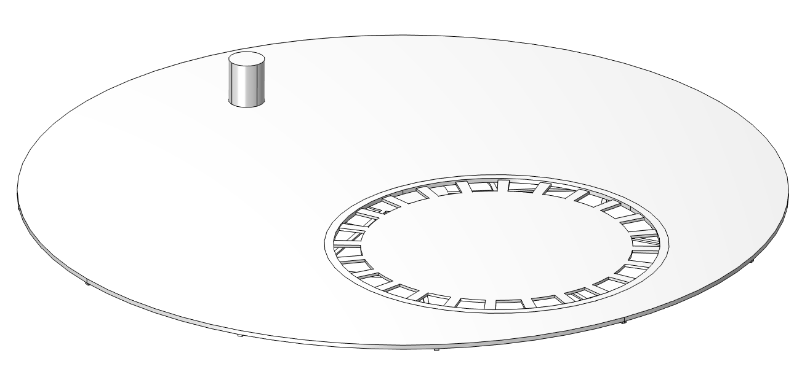
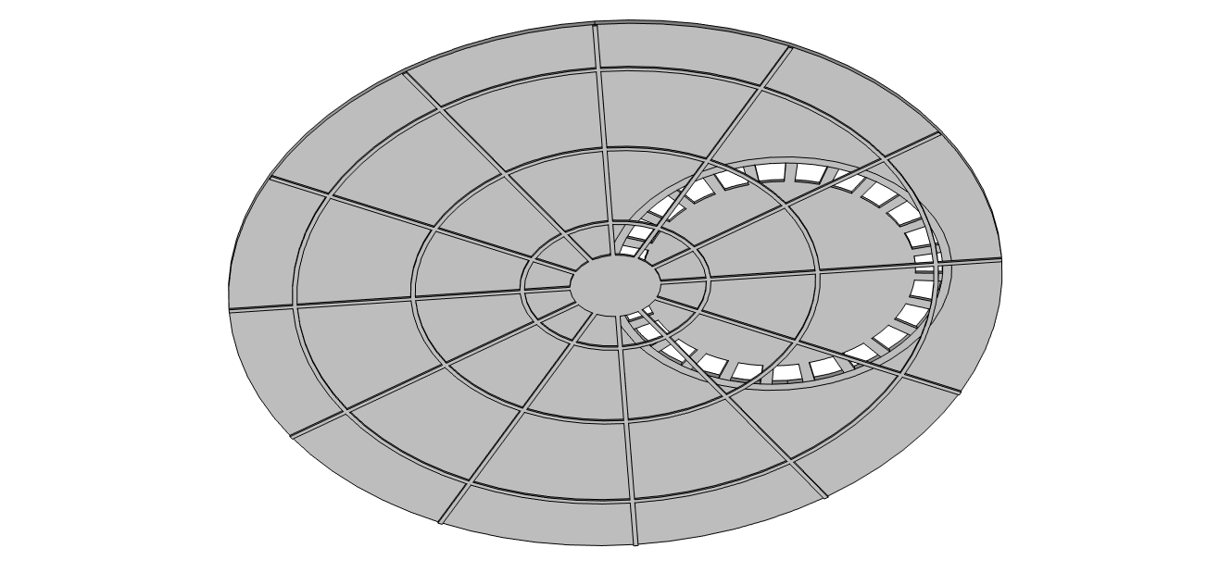
Model Setup
Inlet
Model simplifications
  Outside the polishing head on the polishing pad, a uniform liquid film is assumed with same thickness as the liquid inside the retaining ring.
  Modeling of the air-liquid interface outside the retaining ring is not considered.
Polishing fluid flow rate: 300[ml/min]
Polishing disc and retaining ring rotation speed:
  Auxiliary sweep: 5, 10, 50, 100, 120[rpm]
The grooves at the bottom of the polishing pad are radial.
Grooves at the bottom of the polishing pad

Slide 4
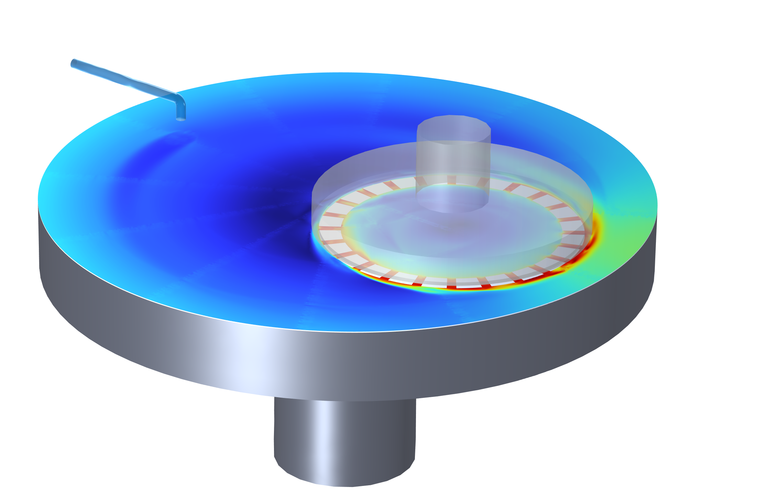
Settings in COMSOL Multiphysics®
Turbulent flow
Particle Tracing for Fluid Flow
CFD for the polishing fluid: The rotating retaining ring is modeled using the frozen rotor method.
The trajectories of the particles carried by the fluid flow are calculated.

Slide 5
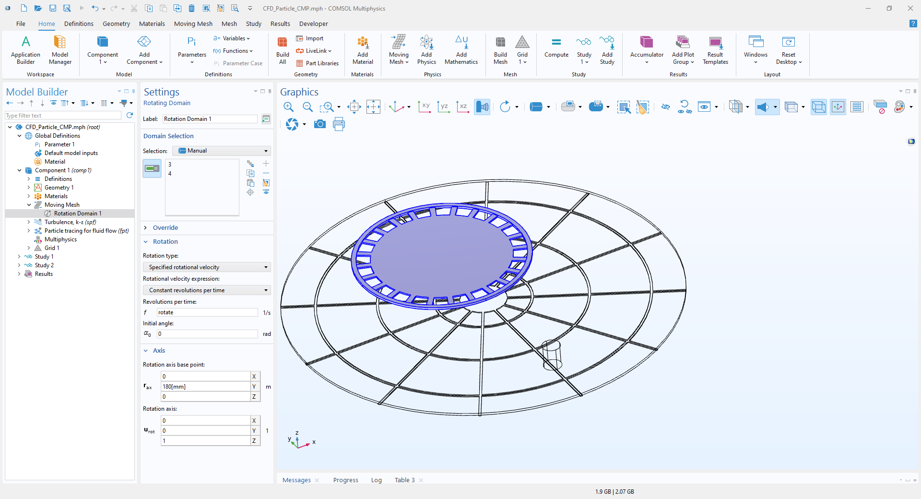
Fluid Rotating Domain Settings
Rotational velocity sweep: 5, 10, 50, 100, 120[rpm]

Slide 6
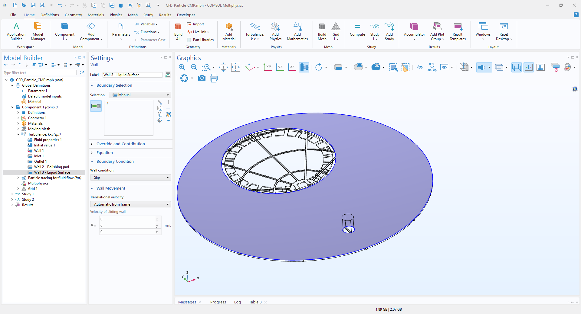
Liquid Surface Settings
The actual liquid surface is the interface between the polishing fluid and air, simplified here as a slip wall.

Slide 7
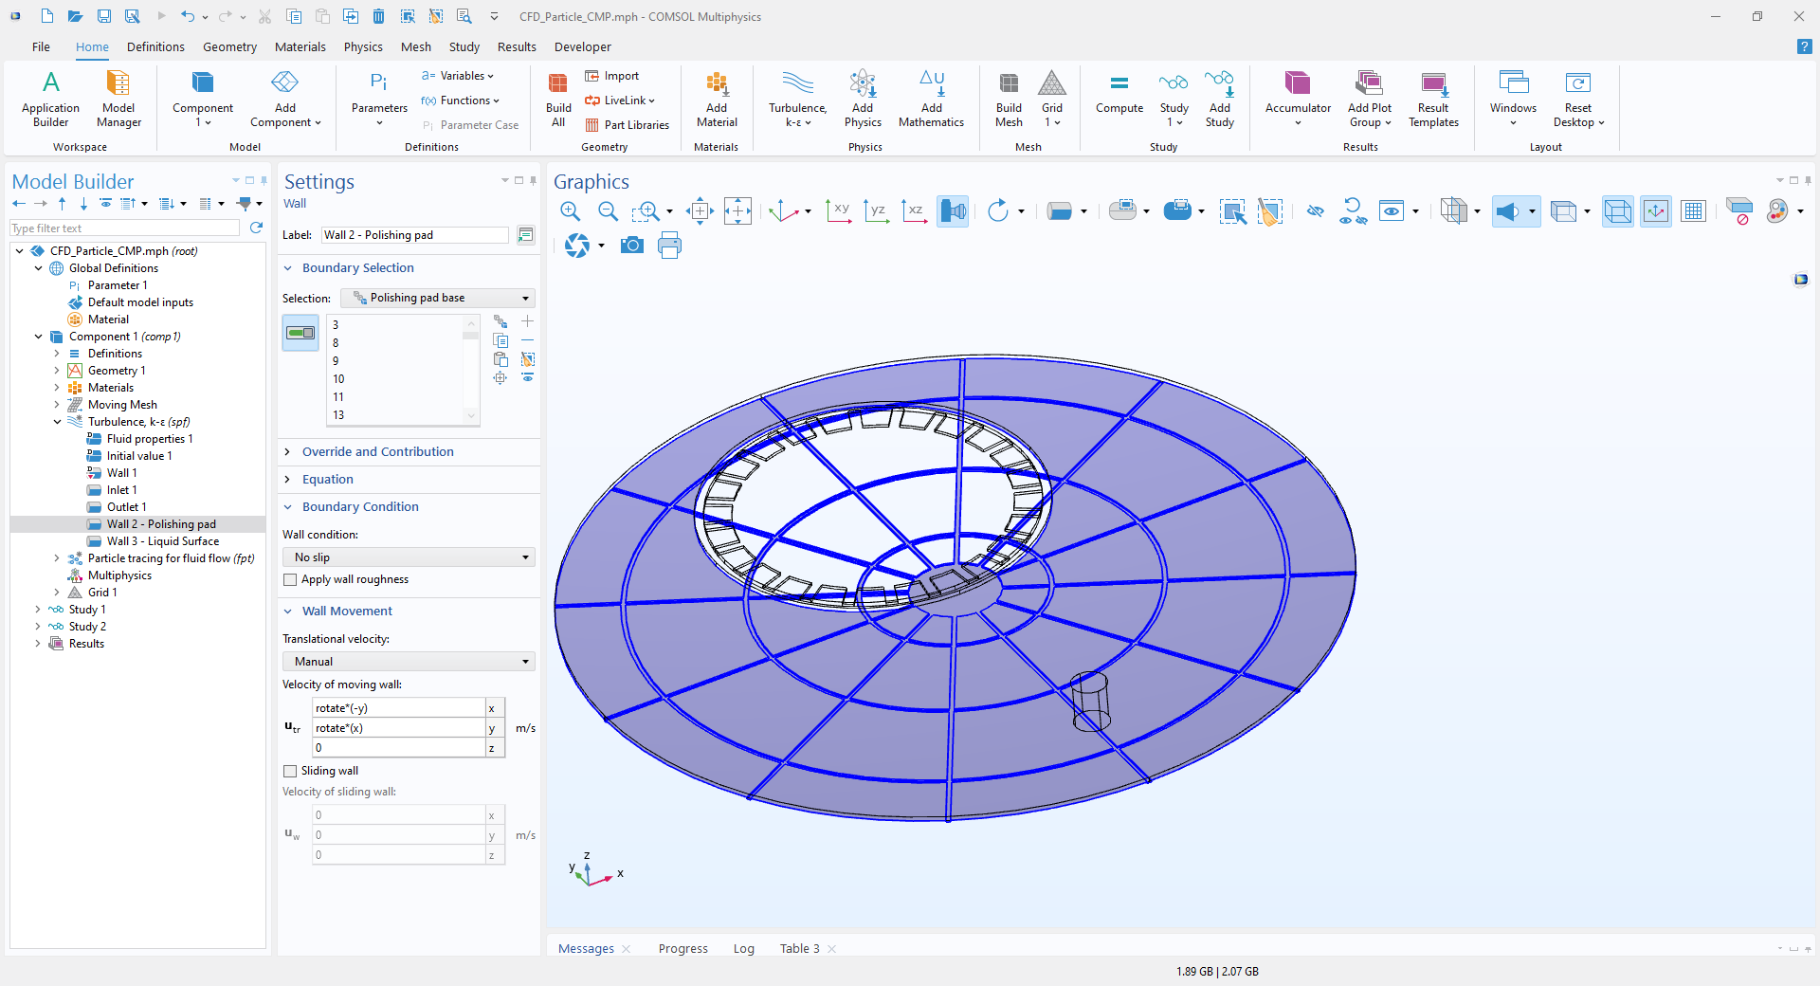
Polishing Pad Wall Settings
The polishing pad’s rotation speed is defined using wall movement.

Slide 8
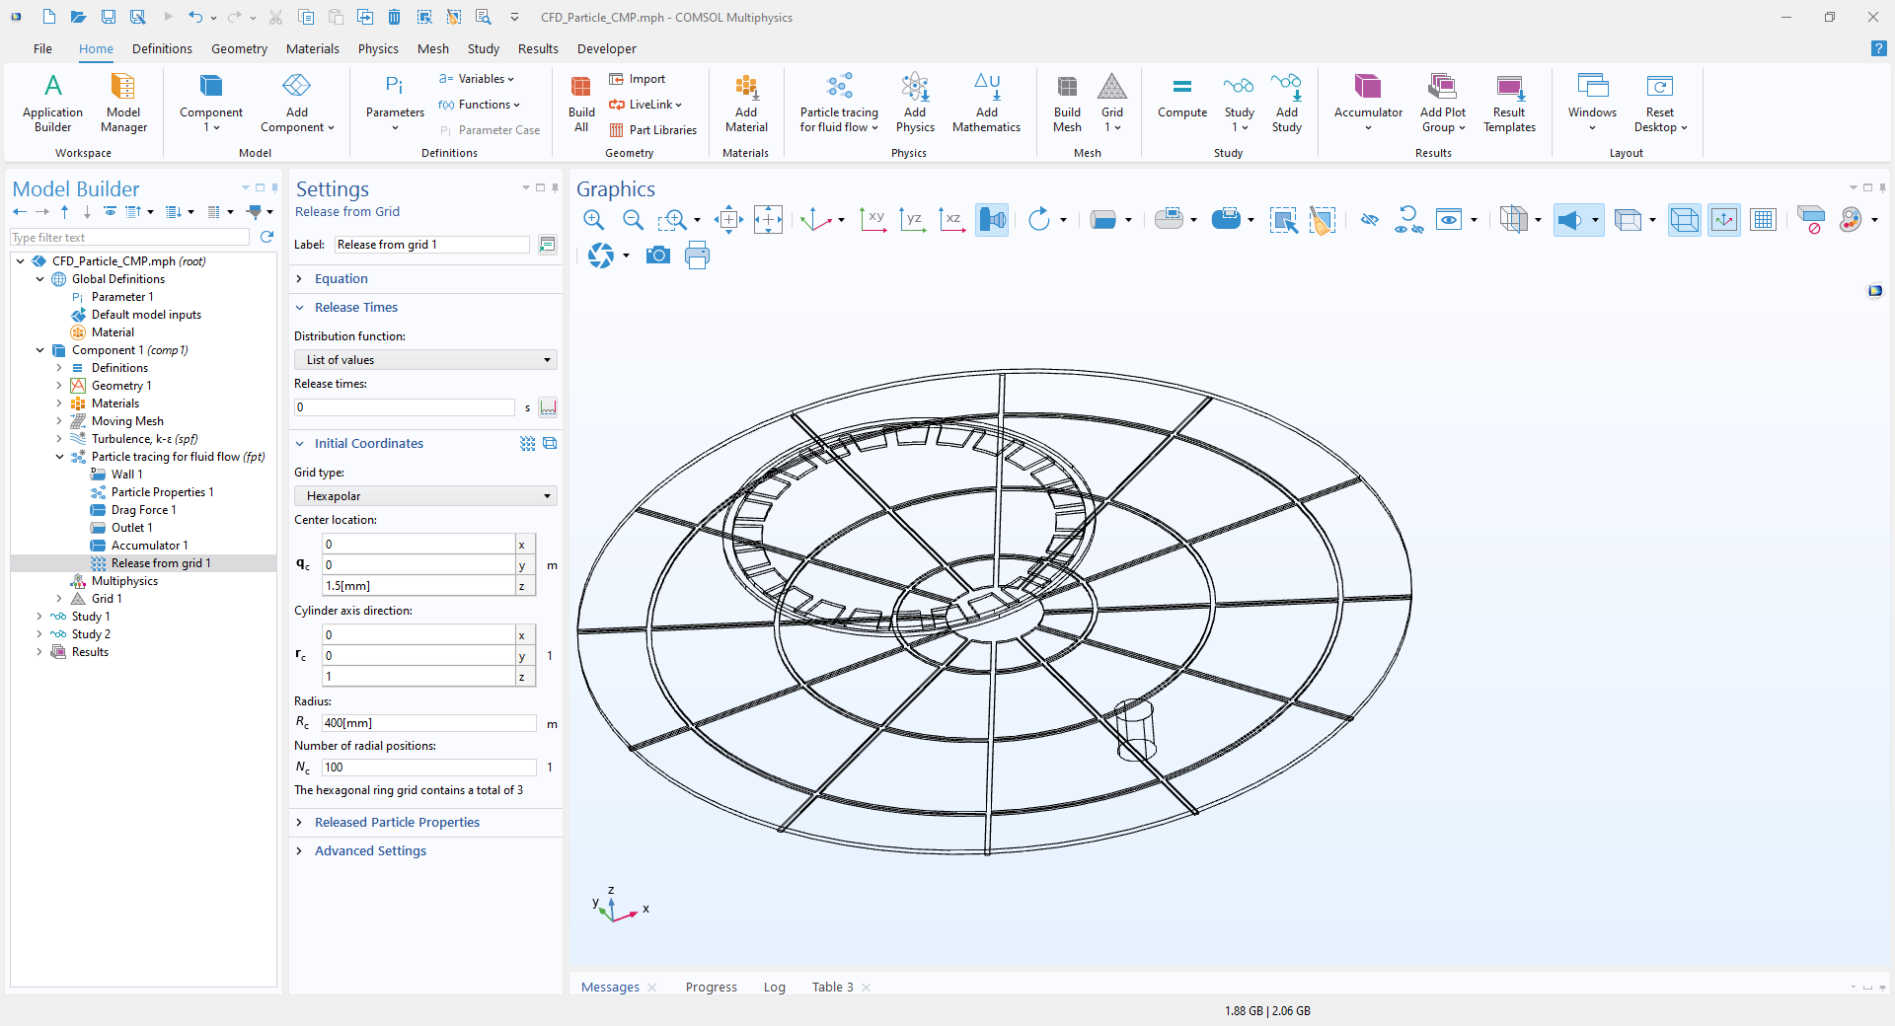
Particle Tracking Settings
Particle Size: 100[nm]
A uniform release of 30 000 particles is used, tracking the change in particle positions.

Slide 9
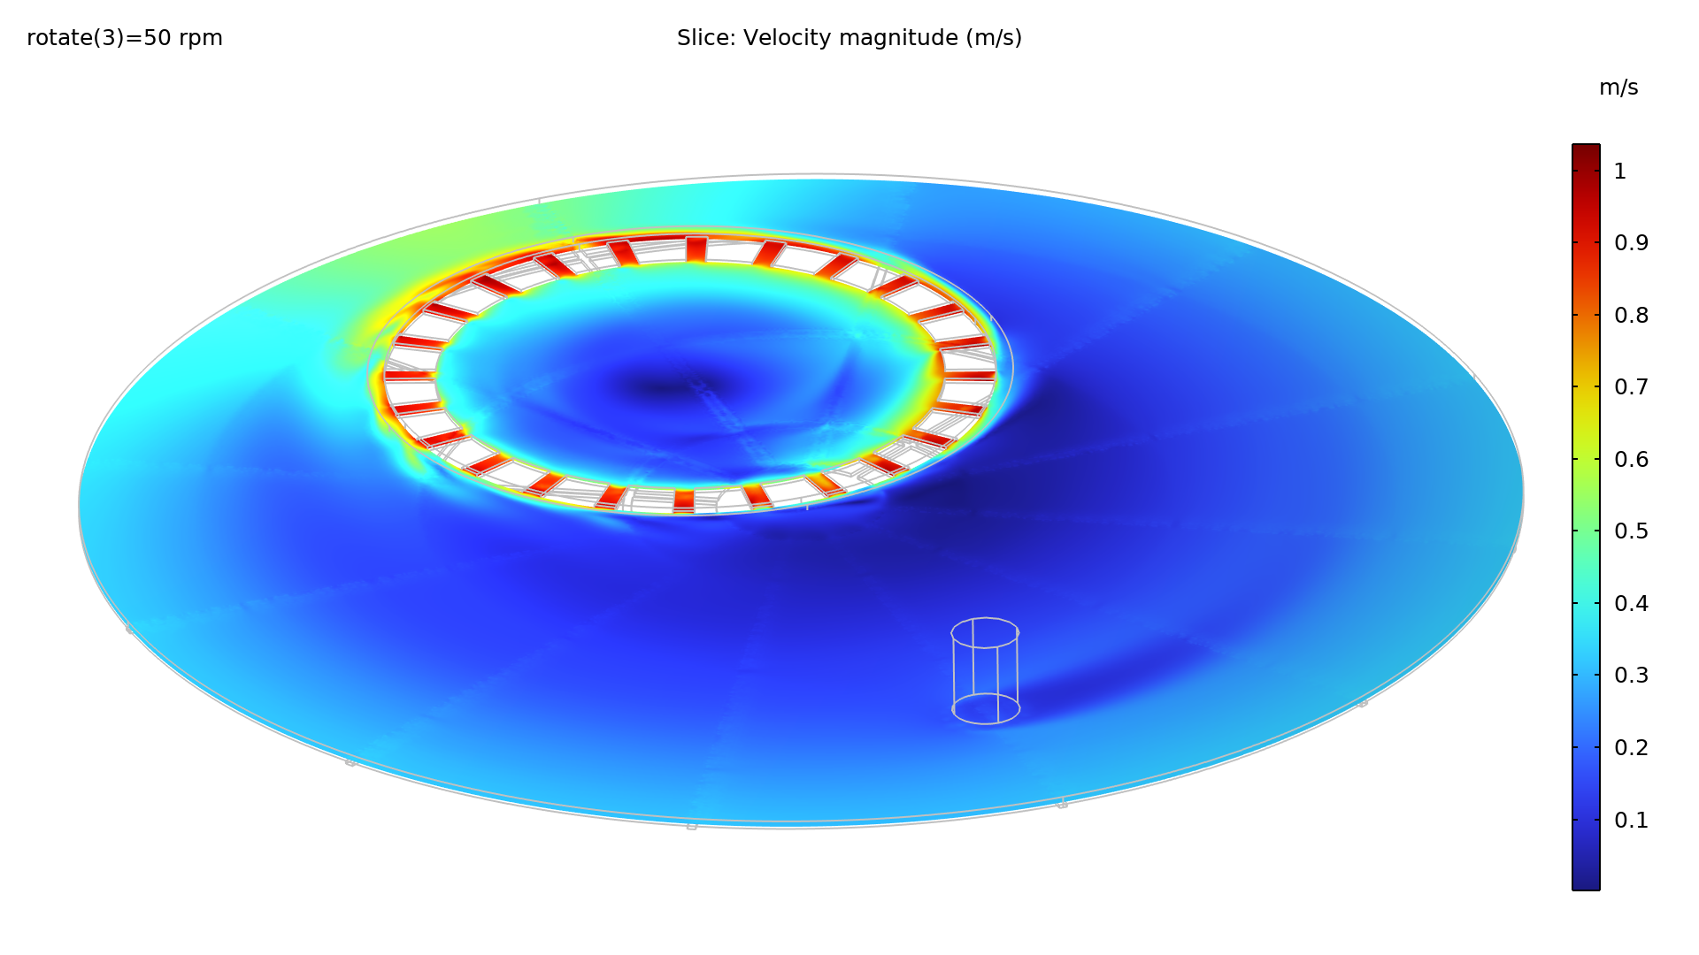
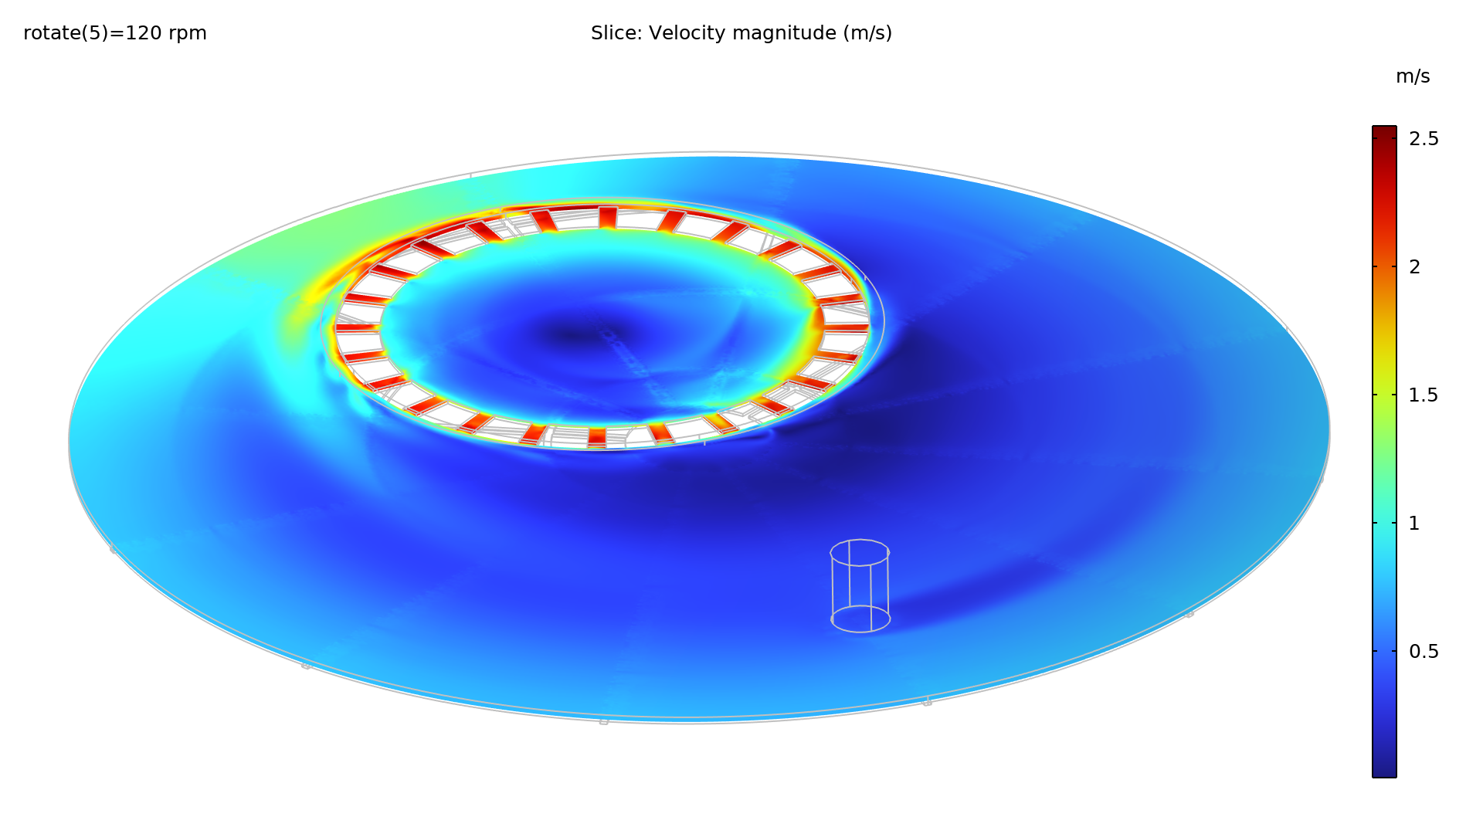
Flow Field Distribution
Flow near the opening of the retaining ring is complex.
Flow inside the retaining ring is more stable, with noticeable velocities within the grooves, facilitating inward transport of material and particles.

Slide 10
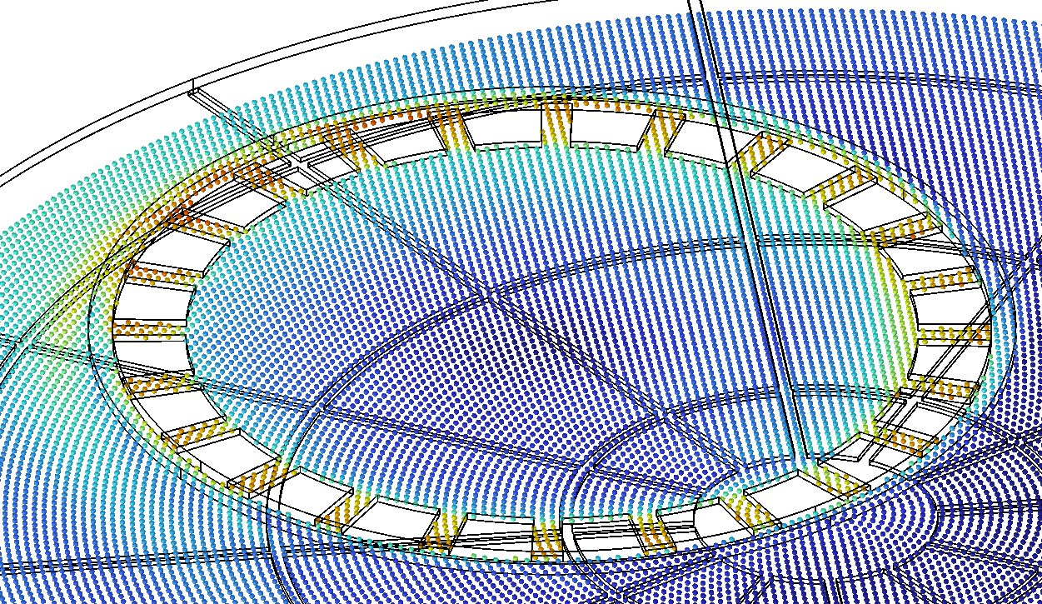
Particle Trajectories
Particles gradually concentrate towards the center.
External particles primarily enter the retaining ring at the center of the polishing pad.

Slide 11
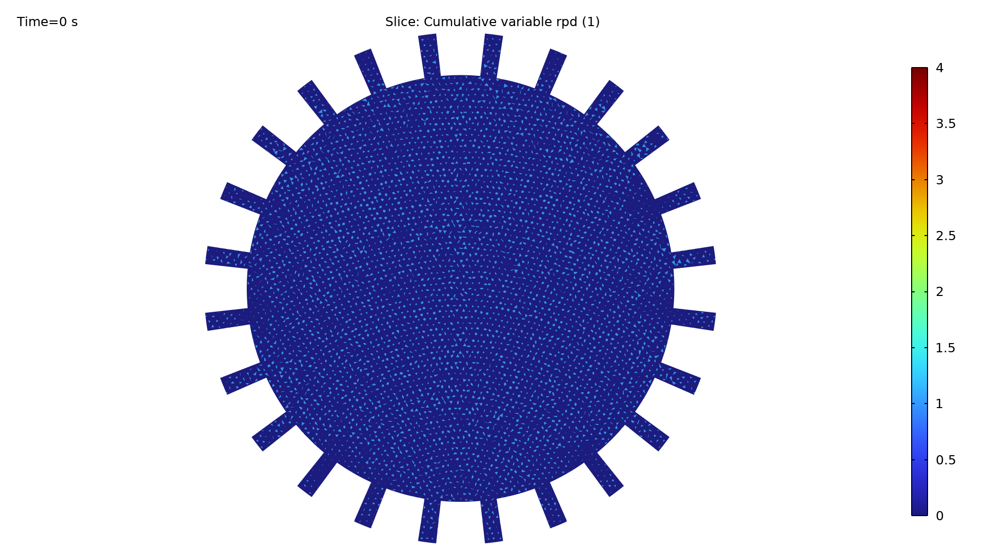
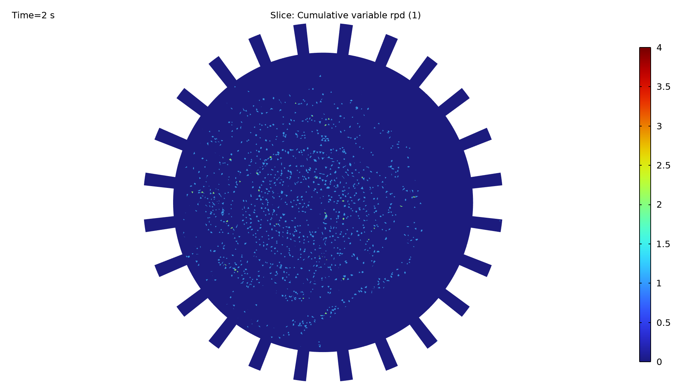
Particle Statistics
Grid colors represent the real-time particle count within each grid.
There is a clear trend of particles concentrating inward.

Slide 12
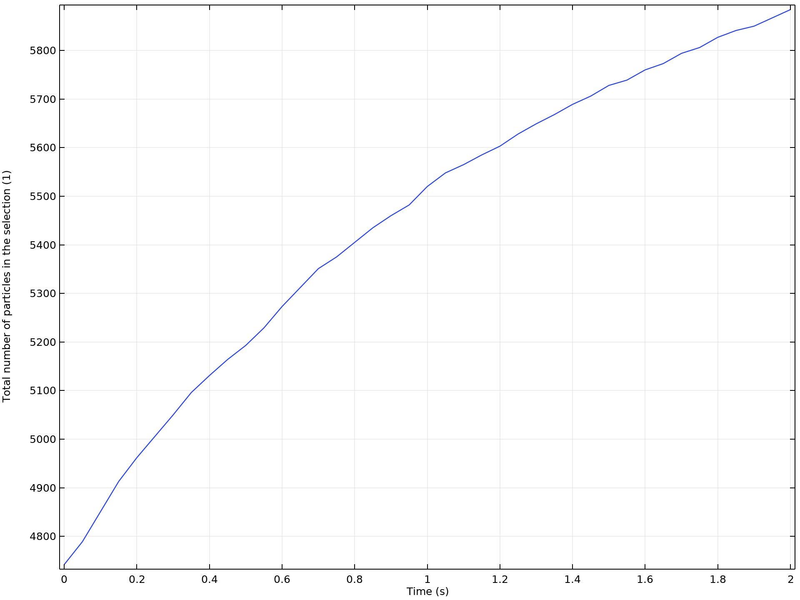
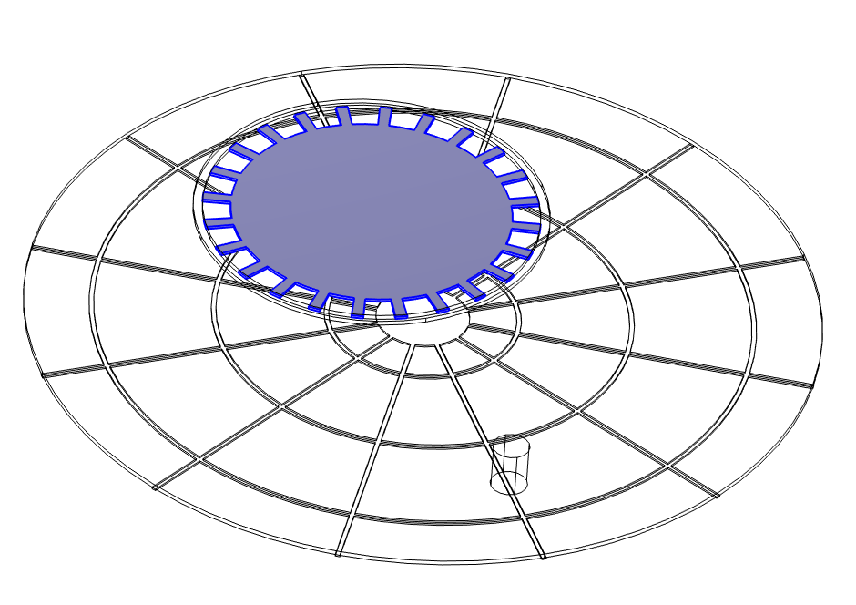
Particle Statistics
The total number of particles inside the retaining ring continuously increases.

Slide 13
CONCLUDING REMARKS
Flow Field and Flow Fluid Flow and Abrasive Particles in CMP Equipment
This model provides a reference for modeling CMP flow fields and particle analysis.

