Slide 1
Acoustic Streaming in a Microchannel with Inhomogeneous Fluids

Slide 2

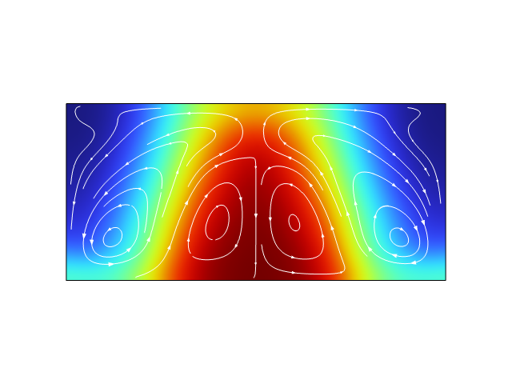
Acoustic Streaming in Inhomogeneous Fluids
An aqueous solution of iodixanol is modeled with an inhomogeneous initial concentration profile
The concentration profile can be manipulated by an acoustic field
The model uses the Frequency-Transient study
J. T. Karlsen, P. Augustsson, and H. Bruus, “Acoustic force density acting on inhomogeneous fluids in acoustic fields”, Phys. Rev. Lett. 117, 114504 1-6 (2016).
Top: Acoustic pressure. Bottom: Concentration profile with streamlines from the fluid flow.

Slide 3
comsol.com/contact

