Slide 1
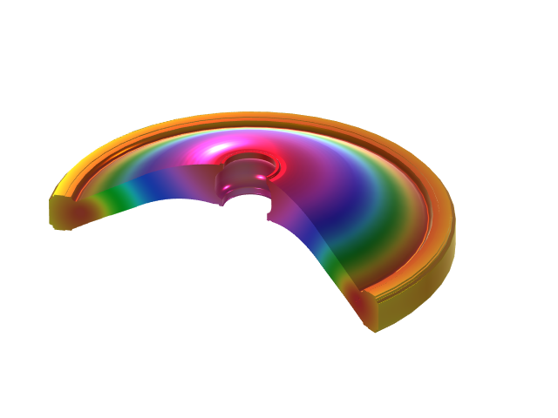
Simulation of Epoxy Resin Curing Process for Basin-Type Insulators
COMSOL

Slide 2
Model Introduction
Heat Transfer
Curing Reactions
Structural Mechanics
During the manufacturing process, residual stresses generated from epoxy resin curing may lead to crack formation in insulators during long-term operation, potentially causing partial discharge that compromises the safe operation of GIS equipment by impairing its electrical insulation performance.
This model couples heat transfer and structural analysis with consideration of the curing reaction heat to analyze the residual stress.
Thermal stress
Curing Heat
Curing Kinetics
Material Properties Depends on the Curing Degree
The model couples the curing reaction, heat transfer, and structural mechanics.

Slide 3
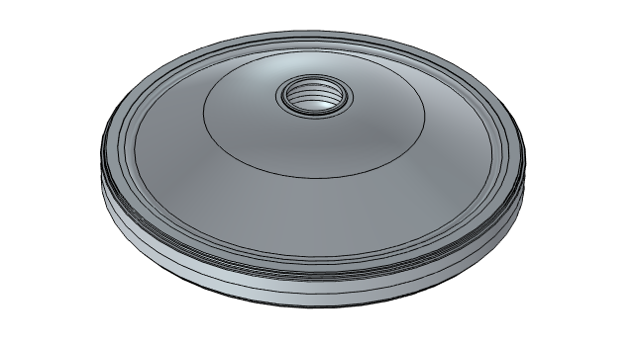
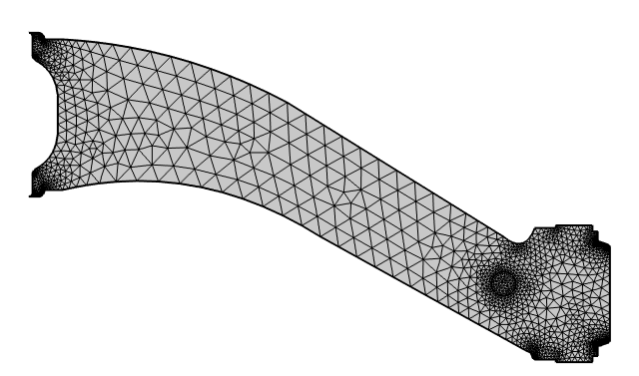
Geometry & Mesh
Geometry
Mesh
A two-dimensional axisymmetric simplification is used, including the epoxy resin components and metal shielding rings.
Physics-controlled mesh: Finer

Slide 4
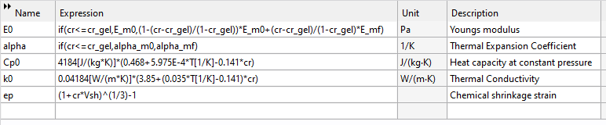

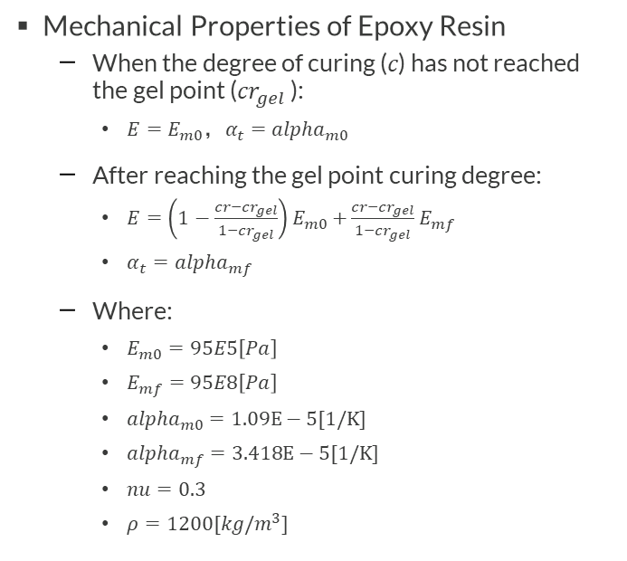
Material Properties
Mechanical Properties of Epoxy Resin
  When the degree of curing (𝑐) has not reached the gel point (${cr}_{gel}$ ):
    $E=E_{m0}\text{，}α_{t}={alpha}_{m0}$
  After reaching the gel point curing degree:
    $E=\left(1−\frac{cr−{cr}_{gel}}{1−{cr}_{gel}}\right)E_{m0}+$ $\frac{cr−{cr}_{gel}}{1−{cr}_{gel}}$ $E_{mf}$
    $α_{t}={alpha}_{mf}$
  Where:
    $E_{m0}=95E5\left[Pa\right]$
    $E_{mf}=95E8\left[Pa\right]$
    ${alpha}_{m0}=1.09E−5[1/K]$
    ${alpha}_{mf}=3.418E−5[1/K]$
    $nu=0.3$
    $ρ=1200[kg/m^{3}]$
Thermal Properties of Epoxy Resin
  $C_{p}=4184×\left(0.468+5.975E−4×T−0.141×cr\right)$
  $k=0.04184×\left(3.85+\left(0.035×T−0.141\right)×cr\right)$
Metal Shielding Ring
  Built-in Material: Alumina

Slide 5
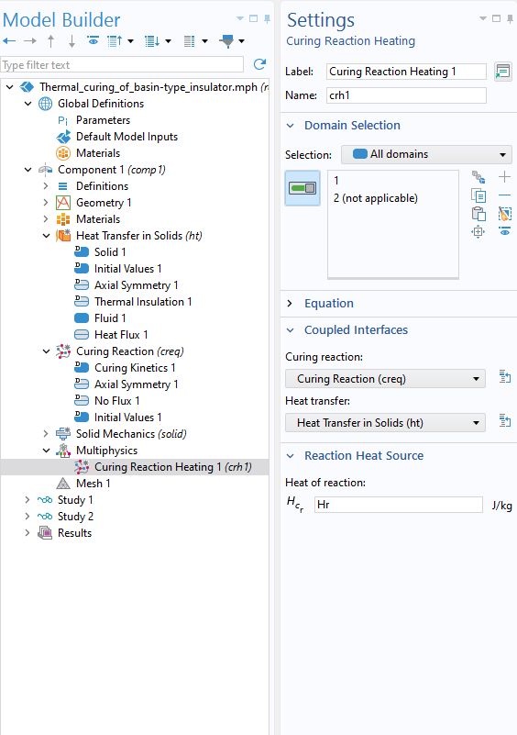
Curing Reaction Heating
Heat Transfer in Solids interface
  For simplicity, epoxy resin is modeled as a fluid with zero velocity.
  External heat flux
Curing reaction
  Kamal-Sourour curing kinetics model
Multiphysics couplings
  Temperature affects curing rate
  Curing reaction heat release affects temperature

Slide 6
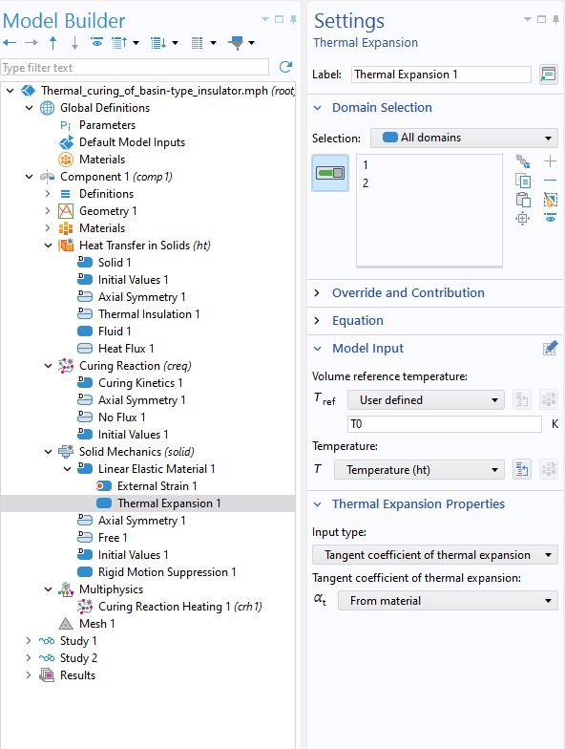
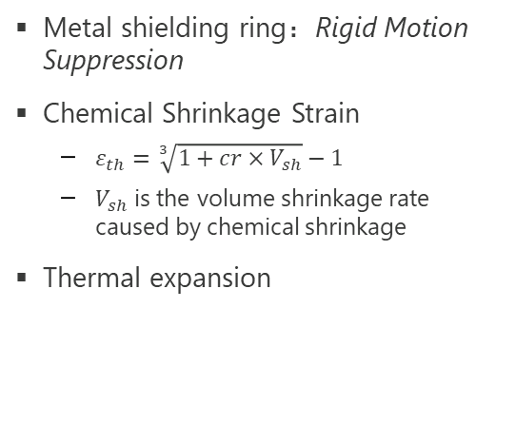
Solid Mechanics
Metal shielding ring：Rigid Motion Suppression
Chemical Shrinkage Strain
  $ε_{th}=\sqrt[3]{1+cr×V_{sh}}−1$
  $V_{sh}$ is the volume shrinkage rate caused by chemical shrinkage
Thermal expansion

Slide 7
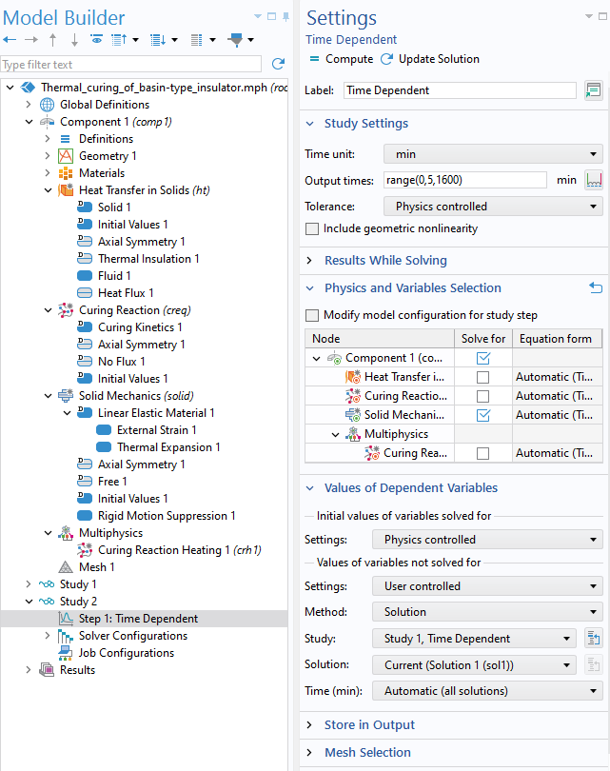
Study
Study 1: Transient
  Calculate curing reaction heating
Study 2: Transient
  Calculate Solid Mechanics
    Inherit temperature from Study 1

Slide 8
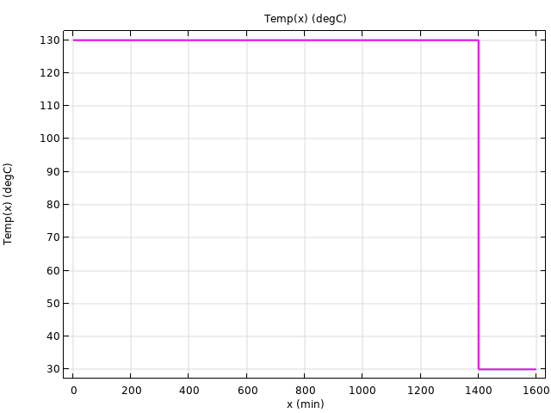
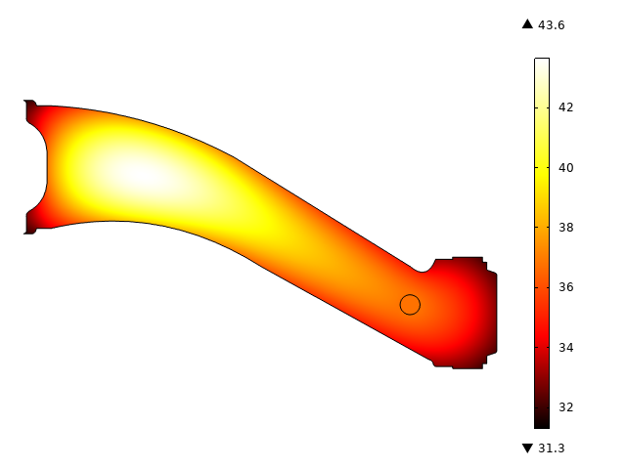
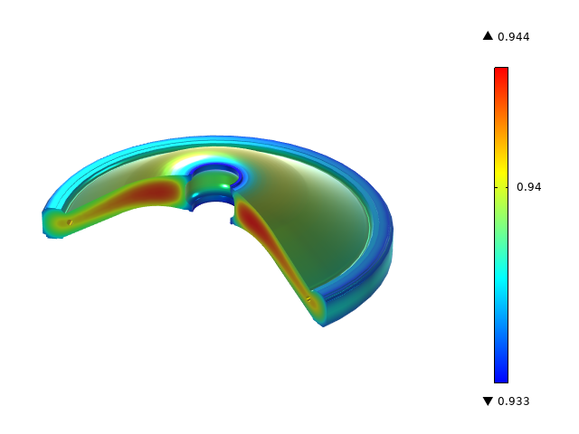
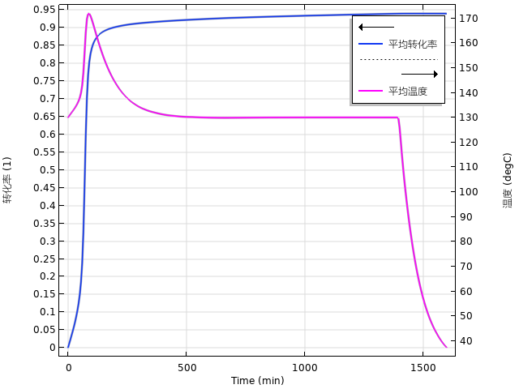
Results: Temperature and Conversion
Curing Temperature
Temperature
Conversion
Temperature and Conversion
At the start of the reaction, heating triggers a vigorous reaction. The reaction then slows down, and the curing degree reaches about 0.94.
The curing reaction releases heat, causing the temperature to rise during 0 to 85 minutes, then decrease to the curing temperature, and finally return to room temperature after 1400 minutes.

Slide 9
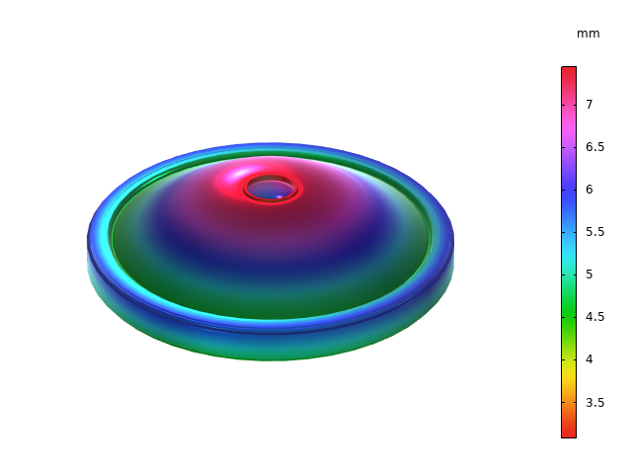
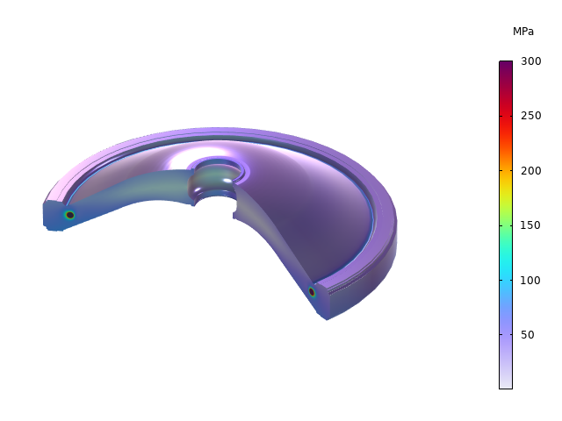
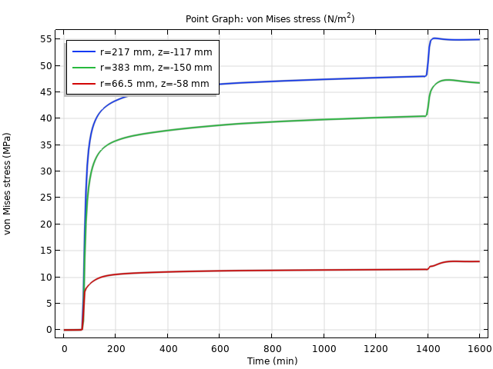
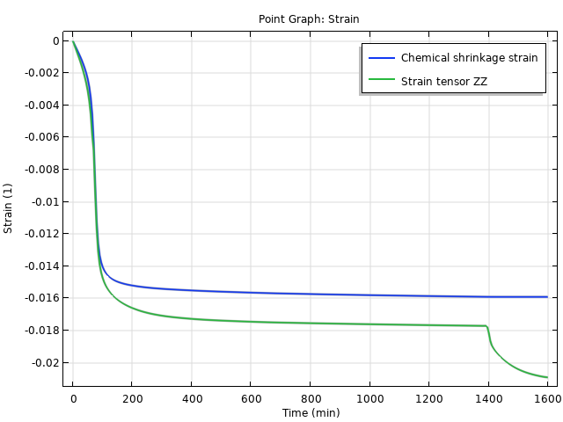
Results: Displacement and Stress
Displacement
Stress
Stress Curve
Strain Curve
The stress near the metal shielding ring is higher than in other areas.
0~70 min: Before the gel point, shrinkage stress and thermal stress are negligible.
70~1395 min: High-temperature curing phase, with little change in thermal stress and slow increase in shrinkage stress.
1395~1600 min: Cooling phase, with minimal change in shrinkage stress and rapid increase in thermal stress.

