Slide 1
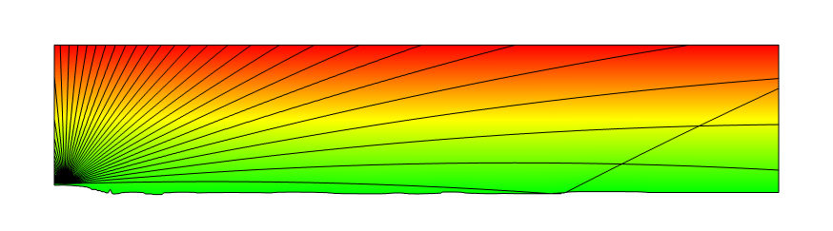
Acoustics Ray Refraction in Atmosphere

Slide 2
COMSOL’s Ray Tracing method
Capability for inhomogeneous medium
E.g., outdoor with temperature gradient
Modeling famous phenomenon | Why sound travels further at night
Sound echo from the school building 500 m away

Slide 3
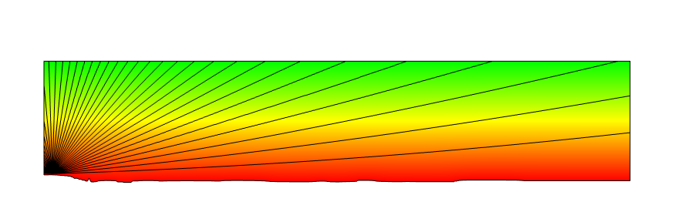
Ray Trajectory of outdoor sound at day and night
Day
Night
Example of sound ray propagation at day (above) and night (below), where black lines are the sound rays and background color represents the temperature field with temperature rising from green to red.

Slide 4
Simulation procedure
Step 1 | Calculate temperature field with Heat Transfer Parametric Sweep for temperature on the ground
Step 2 | Calculate radiation directivity of bell with Pressure Acoustics using temperature field obtained by Step 1
Step 3 | Calculate sound travel in outdoor with Ray Acoustics using temperature field obtained by Step 1 and source directivity obtained by Step 2
Output | Visualization of ray paths and auralized audio

Slide 5
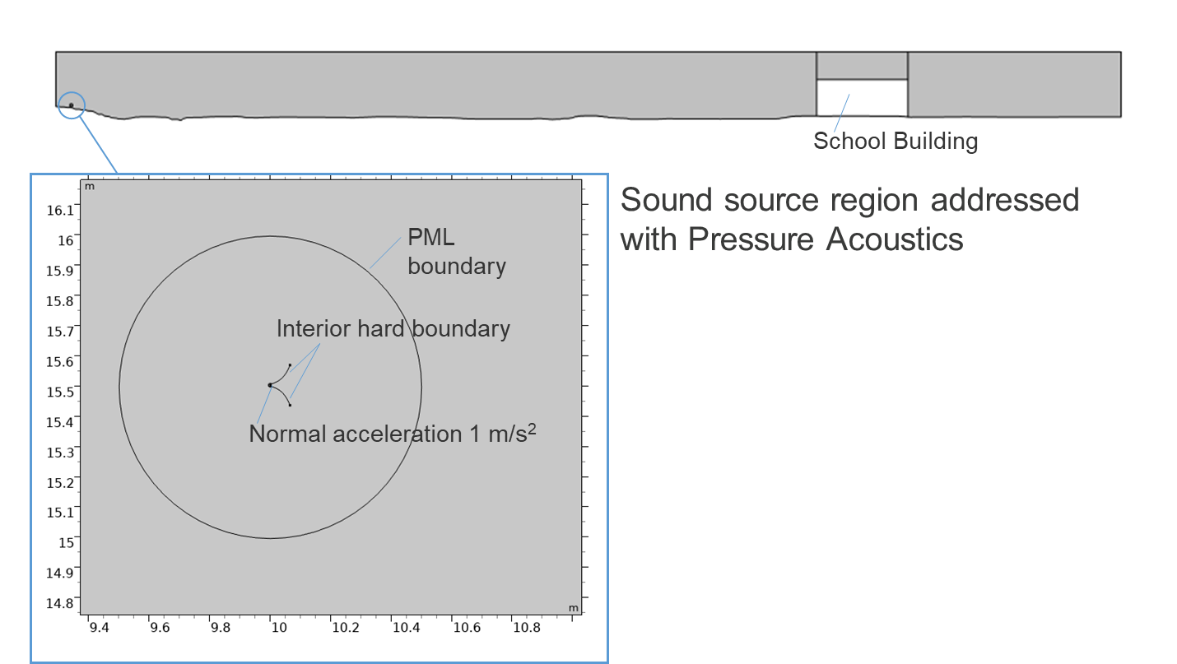
Model description
The geometry of the ground was created with the topographic map data published by the Geospatial Information Authority of Japan (https://www.gsi.go.jp/ENGLISH/index.html)

Slide 6
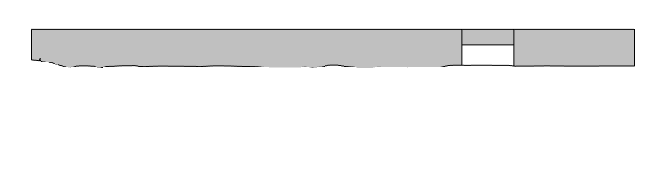
Step 1 — Calculate temperature field
Temperature boundary :19[degC]
Temperature boundary : 25[degC] or 9 [degC]
Lower and upper boundaries were set to temperature boundary
Other boundaries are thermal insulation

Slide 7
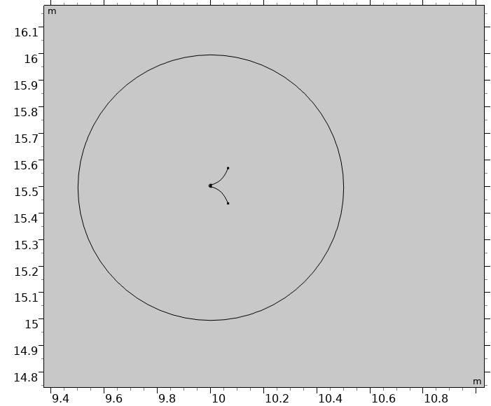
Step 2 — Calculate bell’s near-field directivity
Solving inner of the circle
Only effect of bell shape was considered
Calculation domain was truncated with PML boundary
Normal acceleration boundary was used as an excitation
PML boundary
Interior hard boundary
Normal acceleration 1 m/s²

Slide 8
Step 3 — Calculate temperature field
Wall: Disappear
Wall:Mixed diffuse and specular reflection
Sound absorption property of porous material was assigned to the ground (well used in the outdoor sound problems)
Bell directivity was considered with Release from Boundary

Slide 9
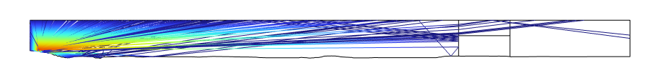
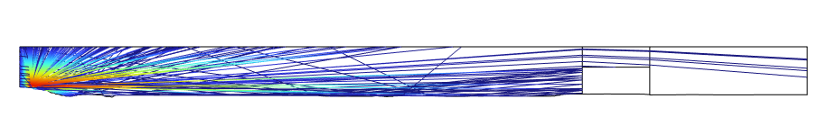
Results: Ray Trajectories
Day
Night
Day : few rays hit the building and almost all rays disappear into the sky
Night : many rays hit the building and returned to the player’s location
Notes:
Here, you can see the result for day. As expected, the ray refracts to upper direction and the ray does not hit the school buildings.

Slide 10
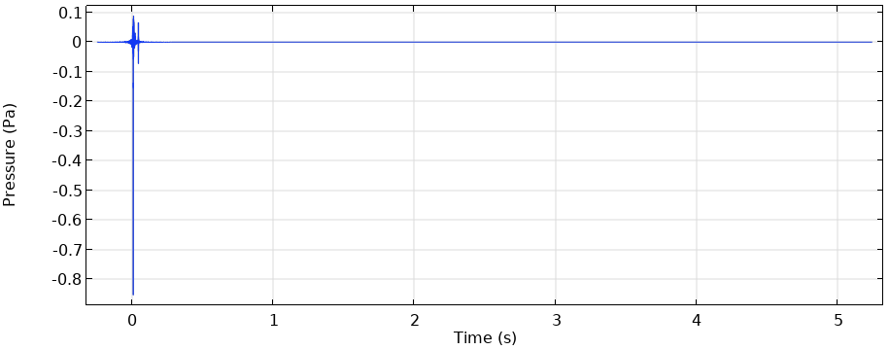
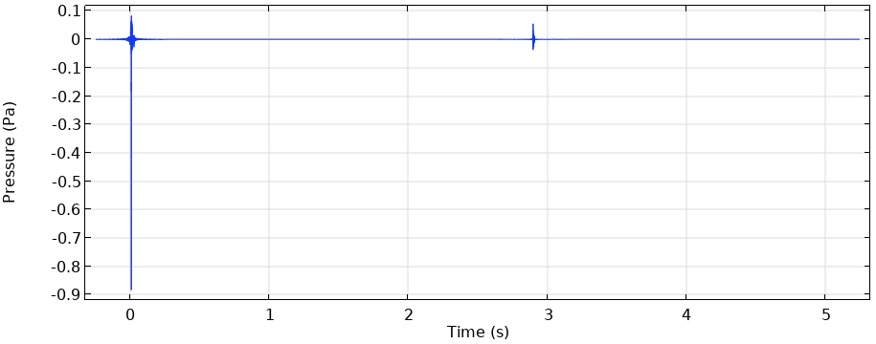
Results: Impulse response
The echo from the school building was captured only at night
Day
Echo from the building
Night

Slide 11
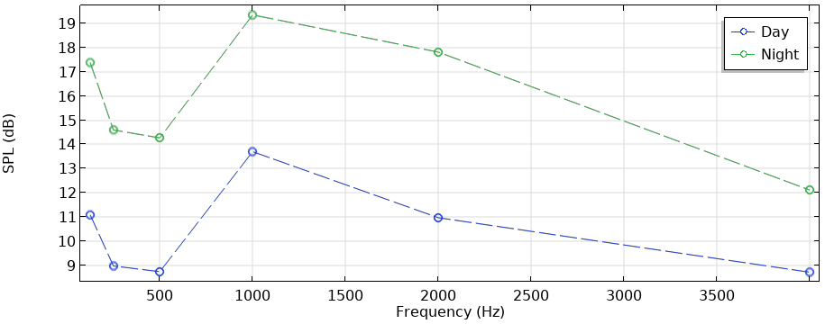
Results: Averaged SPL on the school building surface
At night the building surface receives louder sound of more than 5.5 dB except 4 kHz in comparison to day

Slide 12
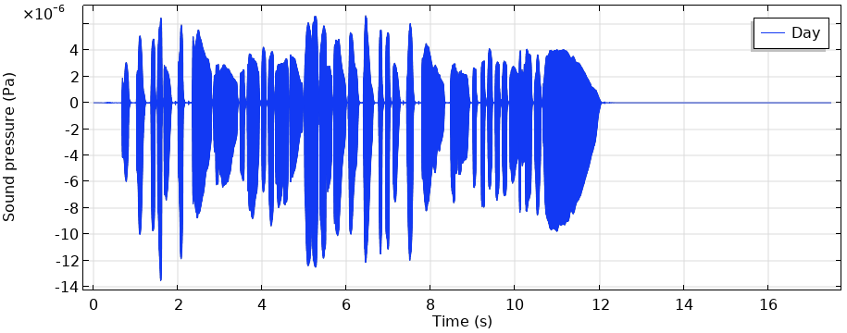
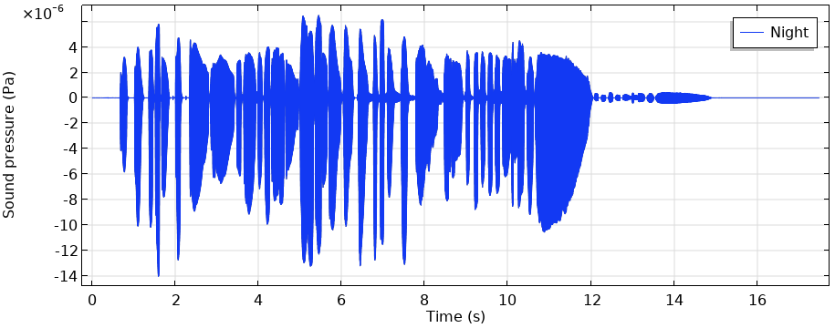

Auralization
You can compare sounds at the player’s position auditorily between the day and the night conditions, and hear the echo for the night condition
Day
Night
The anechoic sound is provided by The Open AIR Library (https://www.openair.hosted.york.ac.uk/) under CC BY 4.0 (https://creativecommons.org/licenses/by/4.0/).

