Slide 1
Squeeze-Film Flow with
Free Boundary

Slide 2
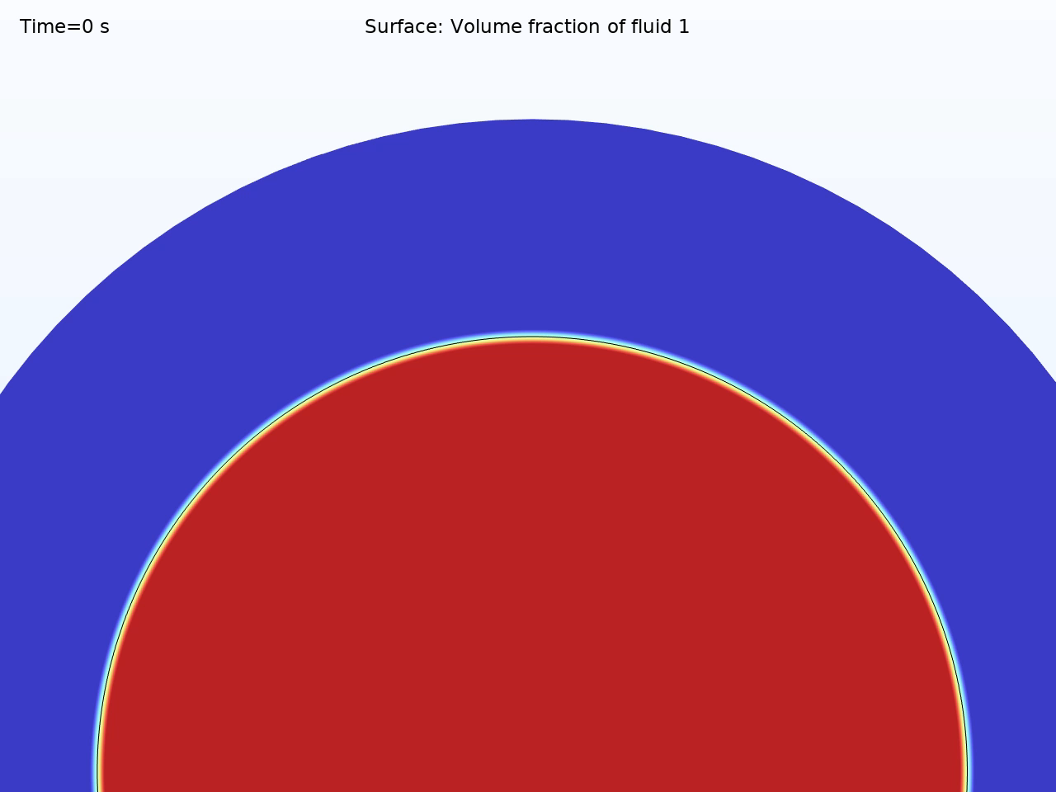
Introduction
Free-Boundary Lubrication
A thin lubricant film is squeezed between two parallel plates.
The top plate moves downward at a constant velocity, increasing the area of the film.
Purpose
Visualize the pressure distribution and radial film growth
Compare results to analytical models

Slide 3
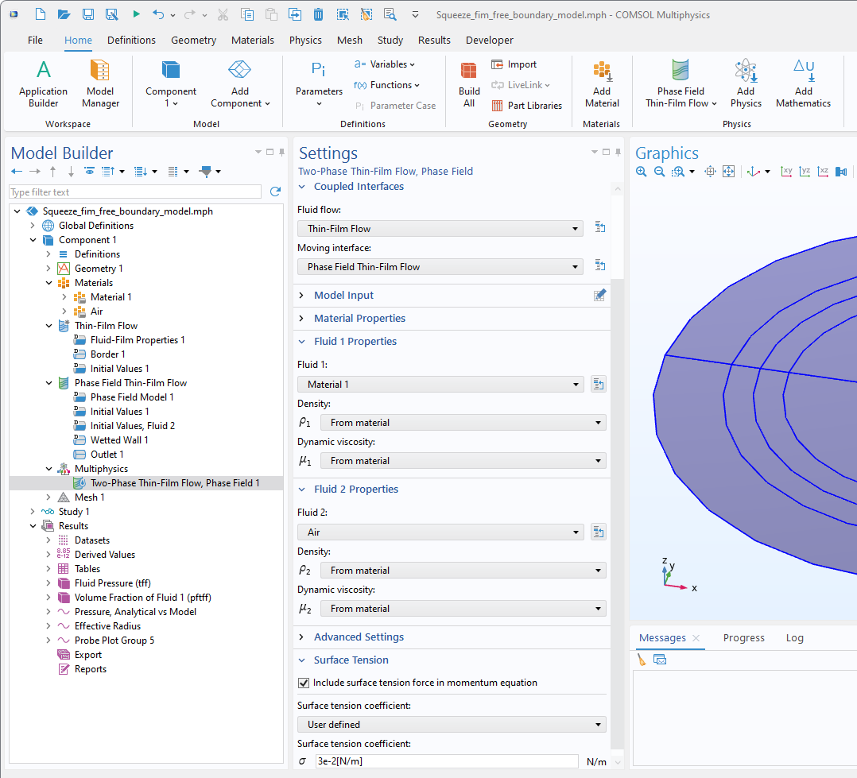
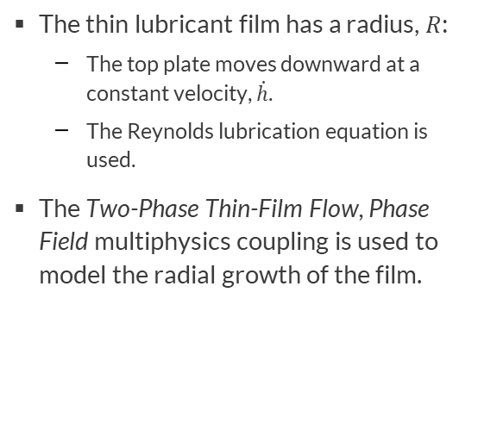
Model Setup
The thin lubricant film has a radius, $R$:
  The top plate moves downward at a constant velocity, $\dot{h}$.
  The Reynolds lubrication equation is used.
The Two-Phase Thin-Film Flow, Phase Field multiphysics coupling is used to model the radial growth of the film.

Slide 4
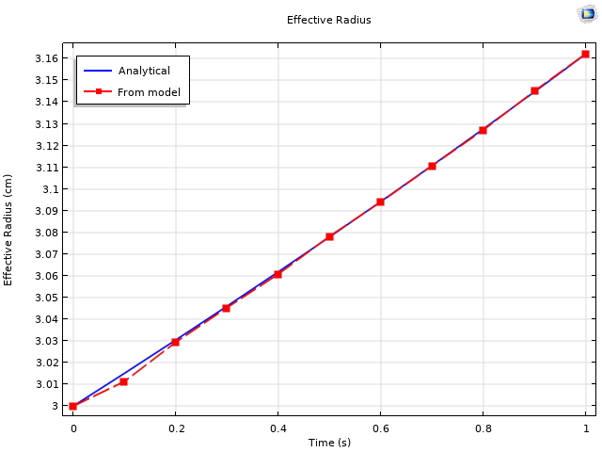
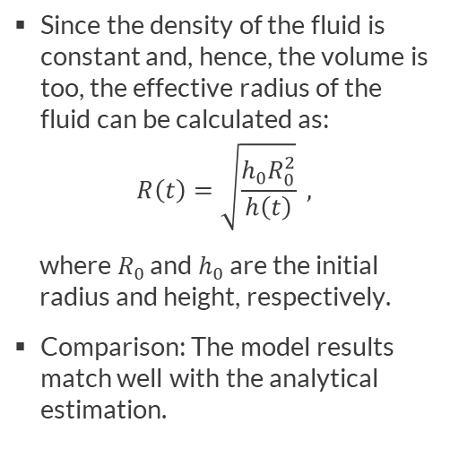
Evolution of Fluid Radius
Since the density of the fluid is constant and, hence, the volume is too, the effective radius of the fluid can be calculated as:
$$R\left(t\right)=\sqrt{\frac{h_{0}R_{0}^{2}}{h\left(t\right)}} ,$$
where $R_{0}$ and $h_{0}$ are the initial radius and height, respectively.
Comparison: The model results match well with the analytical estimation.

Slide 5
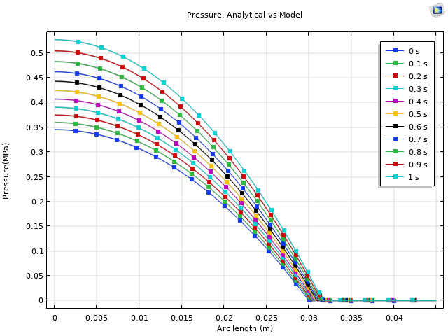
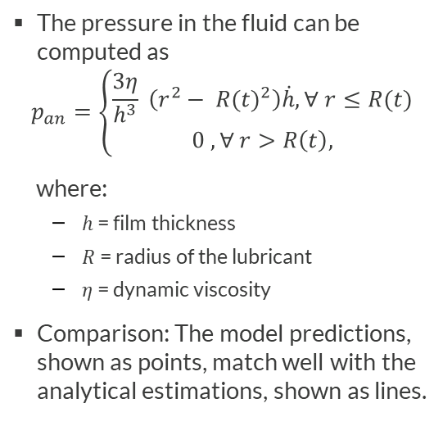
Pressure Developed
The pressure in the fluid can be computed as
$$p_{an}=\left\{\begin{aligned}\frac{3η}{h^{3}} \left(r^{2}− {R(t)}^{2}\right)\dot{h},∀ r≤R(t) \\ 0 ,∀ r>R\left(t\right),\end{aligned}\right.$$
where:
  $h$ = film thickness
  = radius of the lubricant
  $η$ = dynamic viscosity
Comparison: The model predictions, shown as points, match well with the analytical estimations, shown as lines.

