Slide 1
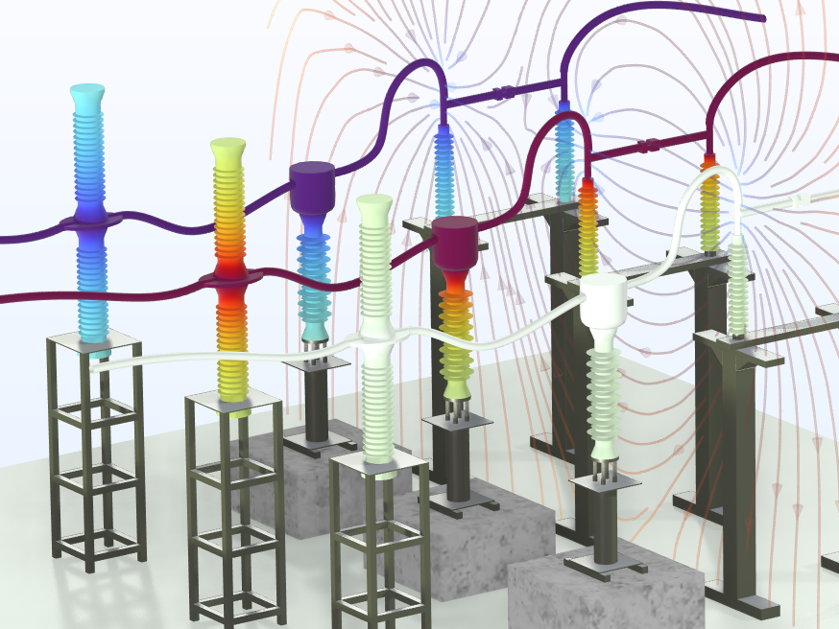
Surrogate Model of a 3-Phase
High-Voltage Switchgear
COMSOL

Slide 2
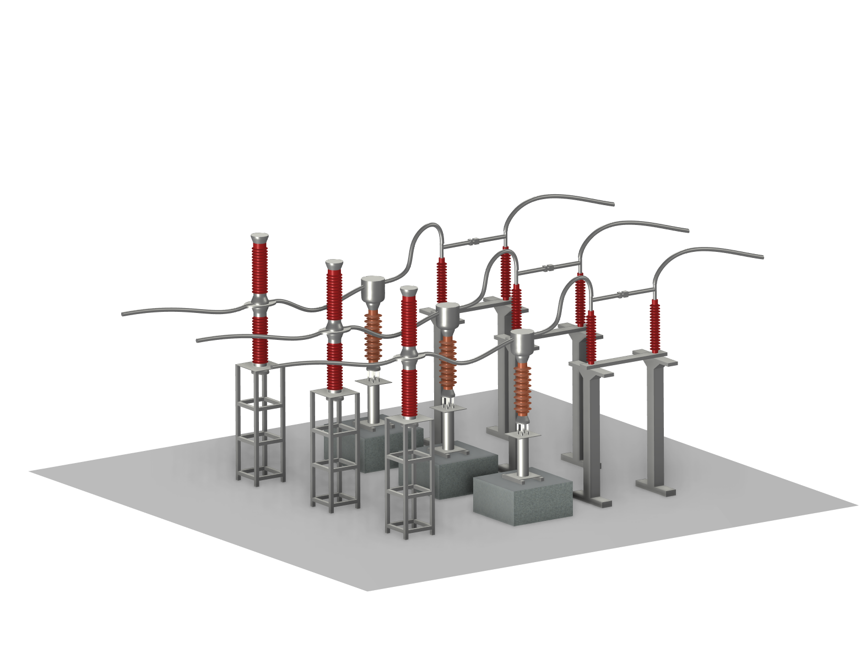
Background
110 kV high-voltage switchgear includes circuit-breakers, current transformers, disconnectors, conductors, and other devices that are widely used in AC substations in power systems.
At AC 50 Hz, the Electrostatics interface is used to simulate the distribution of electric potential and the electric field. The results can be used for the design of the insulation to avoid a nonuniform electric field that may cause corona or discharge.
For fast app execution, for example, as a part of a digital twin, a surrogate model is created using a deep neural network (DNN) function approximation.

Slide 3
Model Definition
Breaker
Phase C
Phase B
The 110 kV 3-phase breaker and disconnector system:
  Circuit breakers
  Current transformers (CT)
  Disconnectors
  Conductors
  Insulators
  Others
At AC 50 Hz, V_{in} = 110 kV as rated operation voltage
Conductor
Phase A
Disconnector
Insulator
Current transformer

Slide 4
Model Definition
Phase C
Phase B
Terminal voltage
  Phase A conductors:
  V_{A} = V_{in}*1.414
  Phase B conductors:
  V_{B} = V_{in}*1.414*exp(i*2*pi/3)
  Phase C conductors:
  V_{C} = V_{in}*1.414*exp(-i*2*pi/3)
Floating potential
  Current transformers (CT)
Ground
Phase A

Slide 5
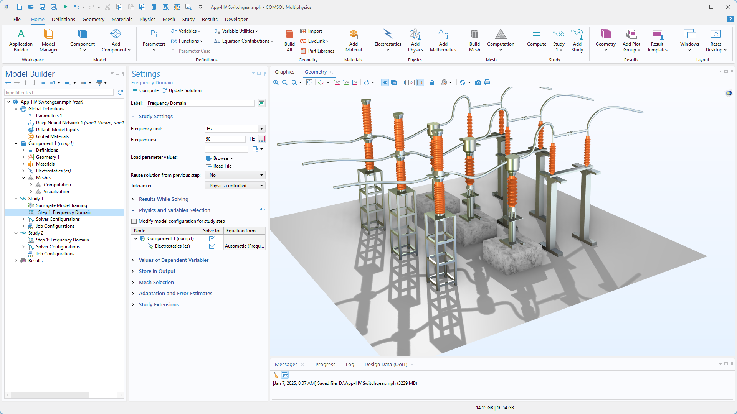
Study
Frequency Domain study at 50 Hz

Slide 6
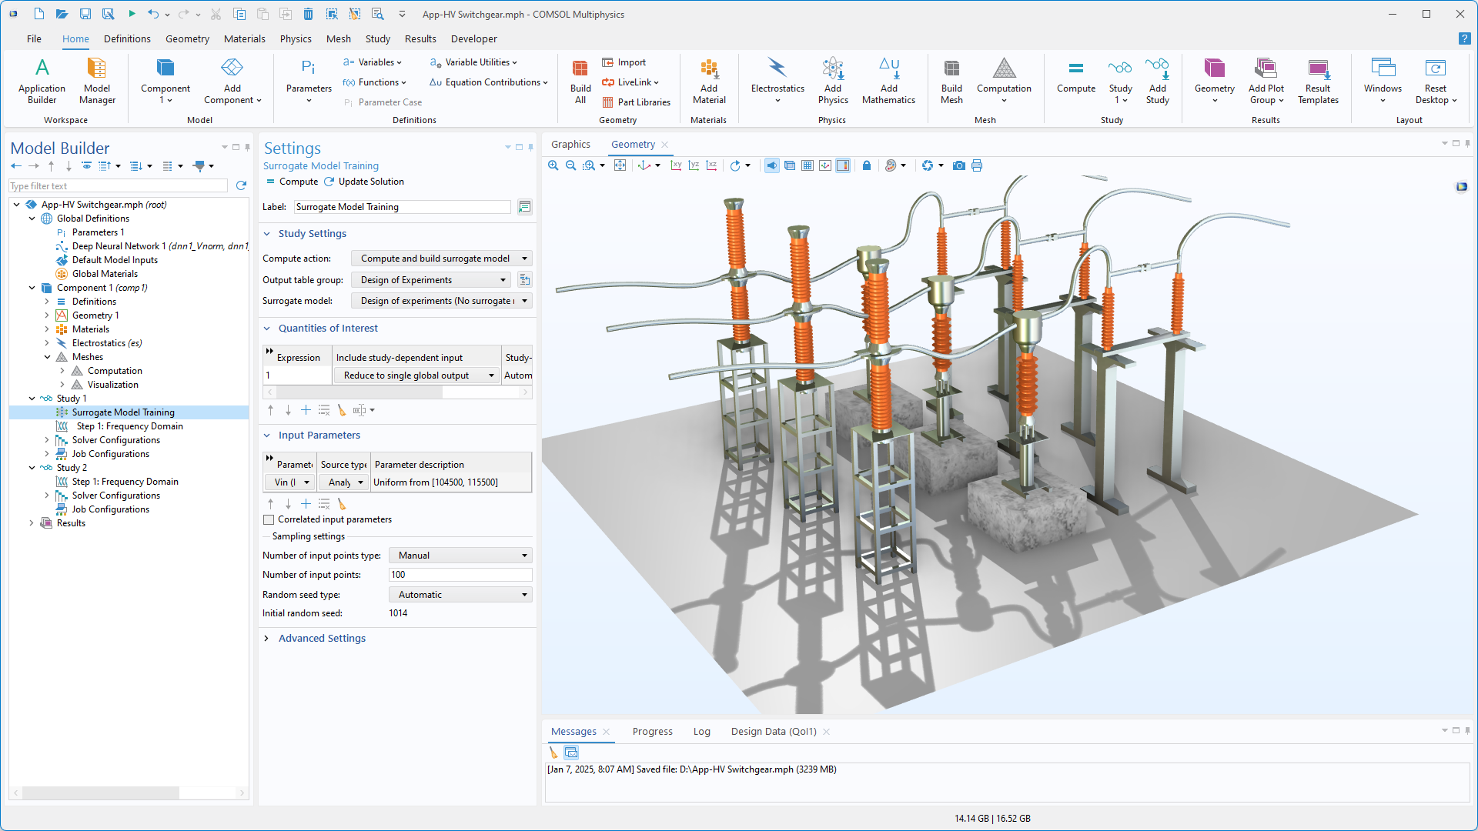
Study
Surrogate Model Training study: Design of experiments (DOE) is used to efficiently make the parametric sweep and sampling.
For more details of this efficient sampling method, see this application.

Slide 7
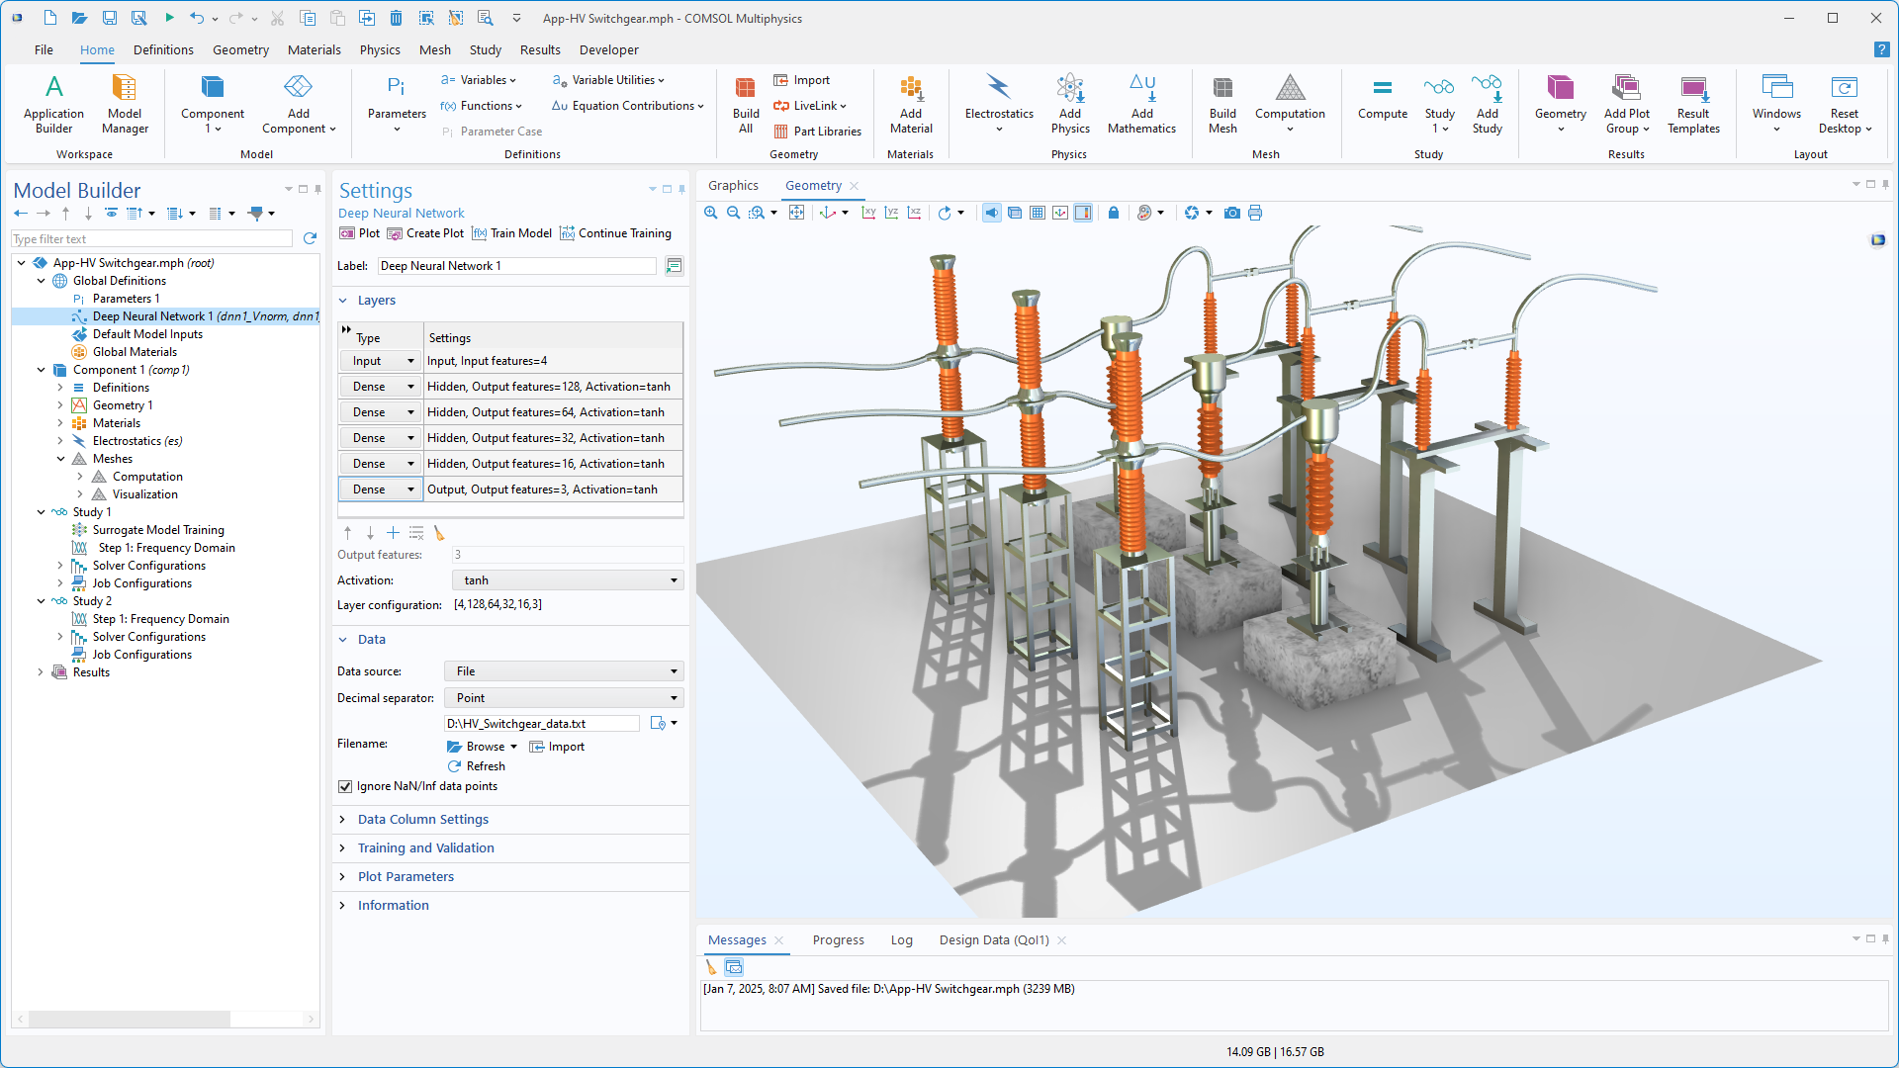
Study
Surrogate Model Training study:
The Deep Neural Network function uses the sampling data of DOE as training input data.

Slide 8
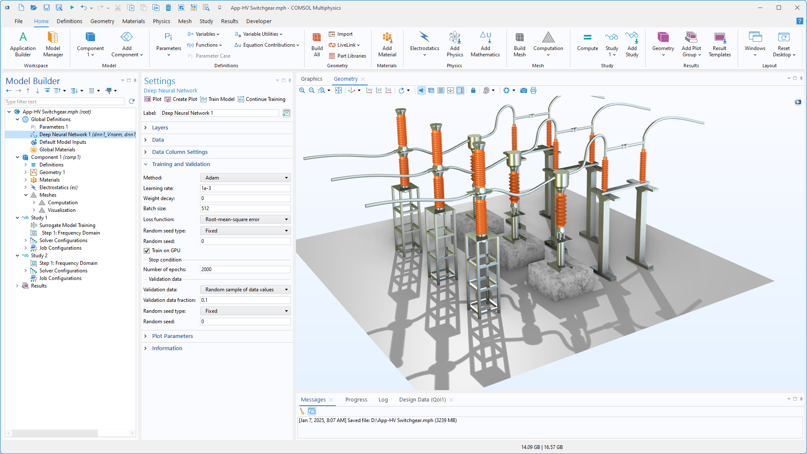
App Builder
The following trained Deep Neural Network functions are used for computing the results:
dnn1_Vnorm
dnn1_Vreal
dnn1_Vimag

Slide 9
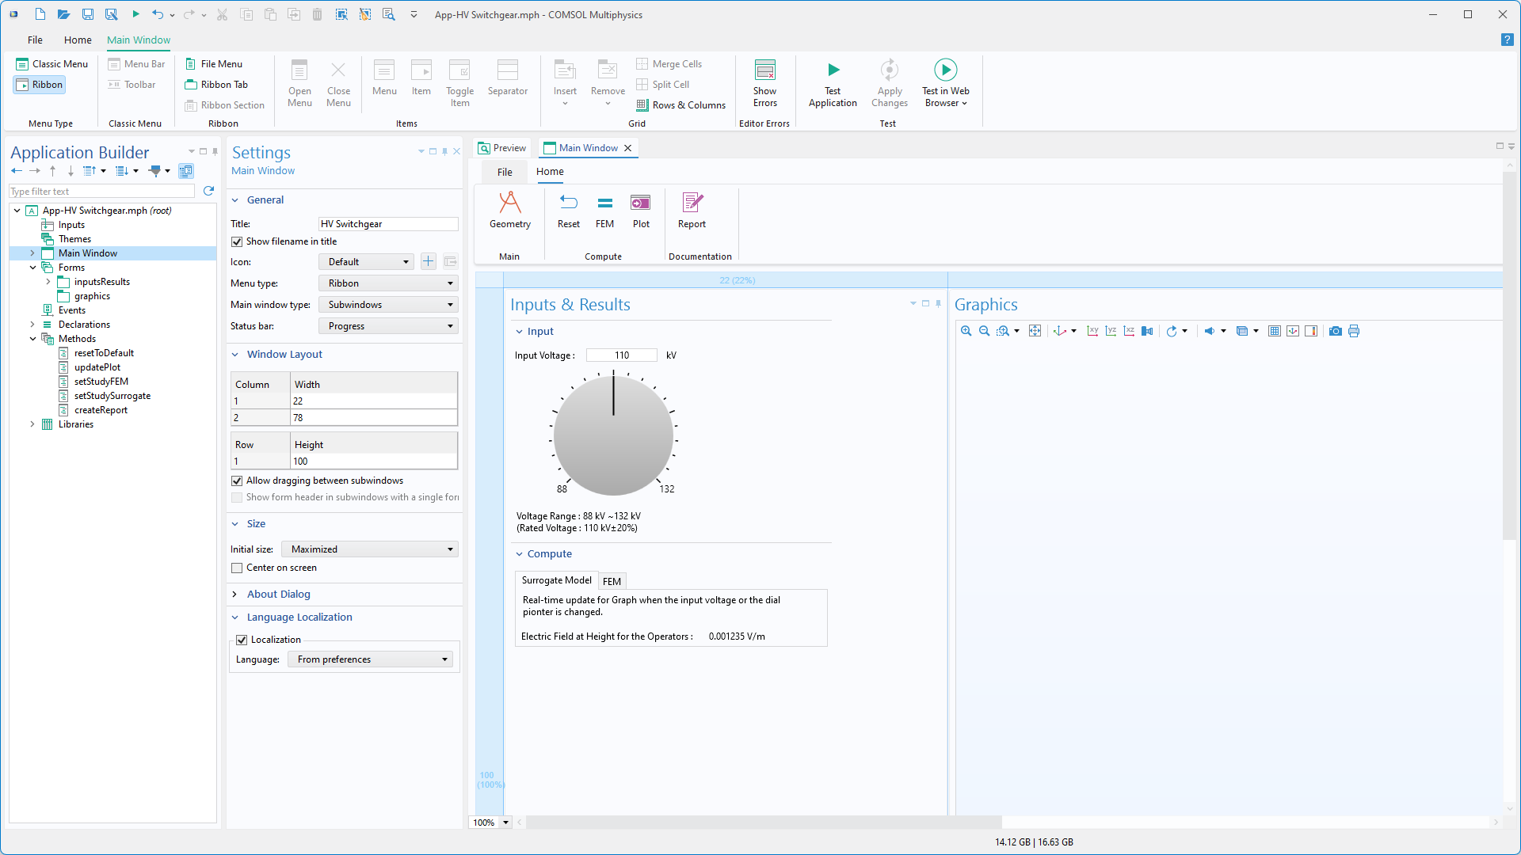
App Builder
A Timer events node is used to trigger a command sequence that automatically updates the input voltage V_{in} (± 20% of fluctuation) every second.

Slide 10
Results
At AC 50 Hz, 3-phase results are shown, including the electric field (E_{norm}) and electric potential distribution.
Electric field streamlines and
electric potential distribution.

Slide 11
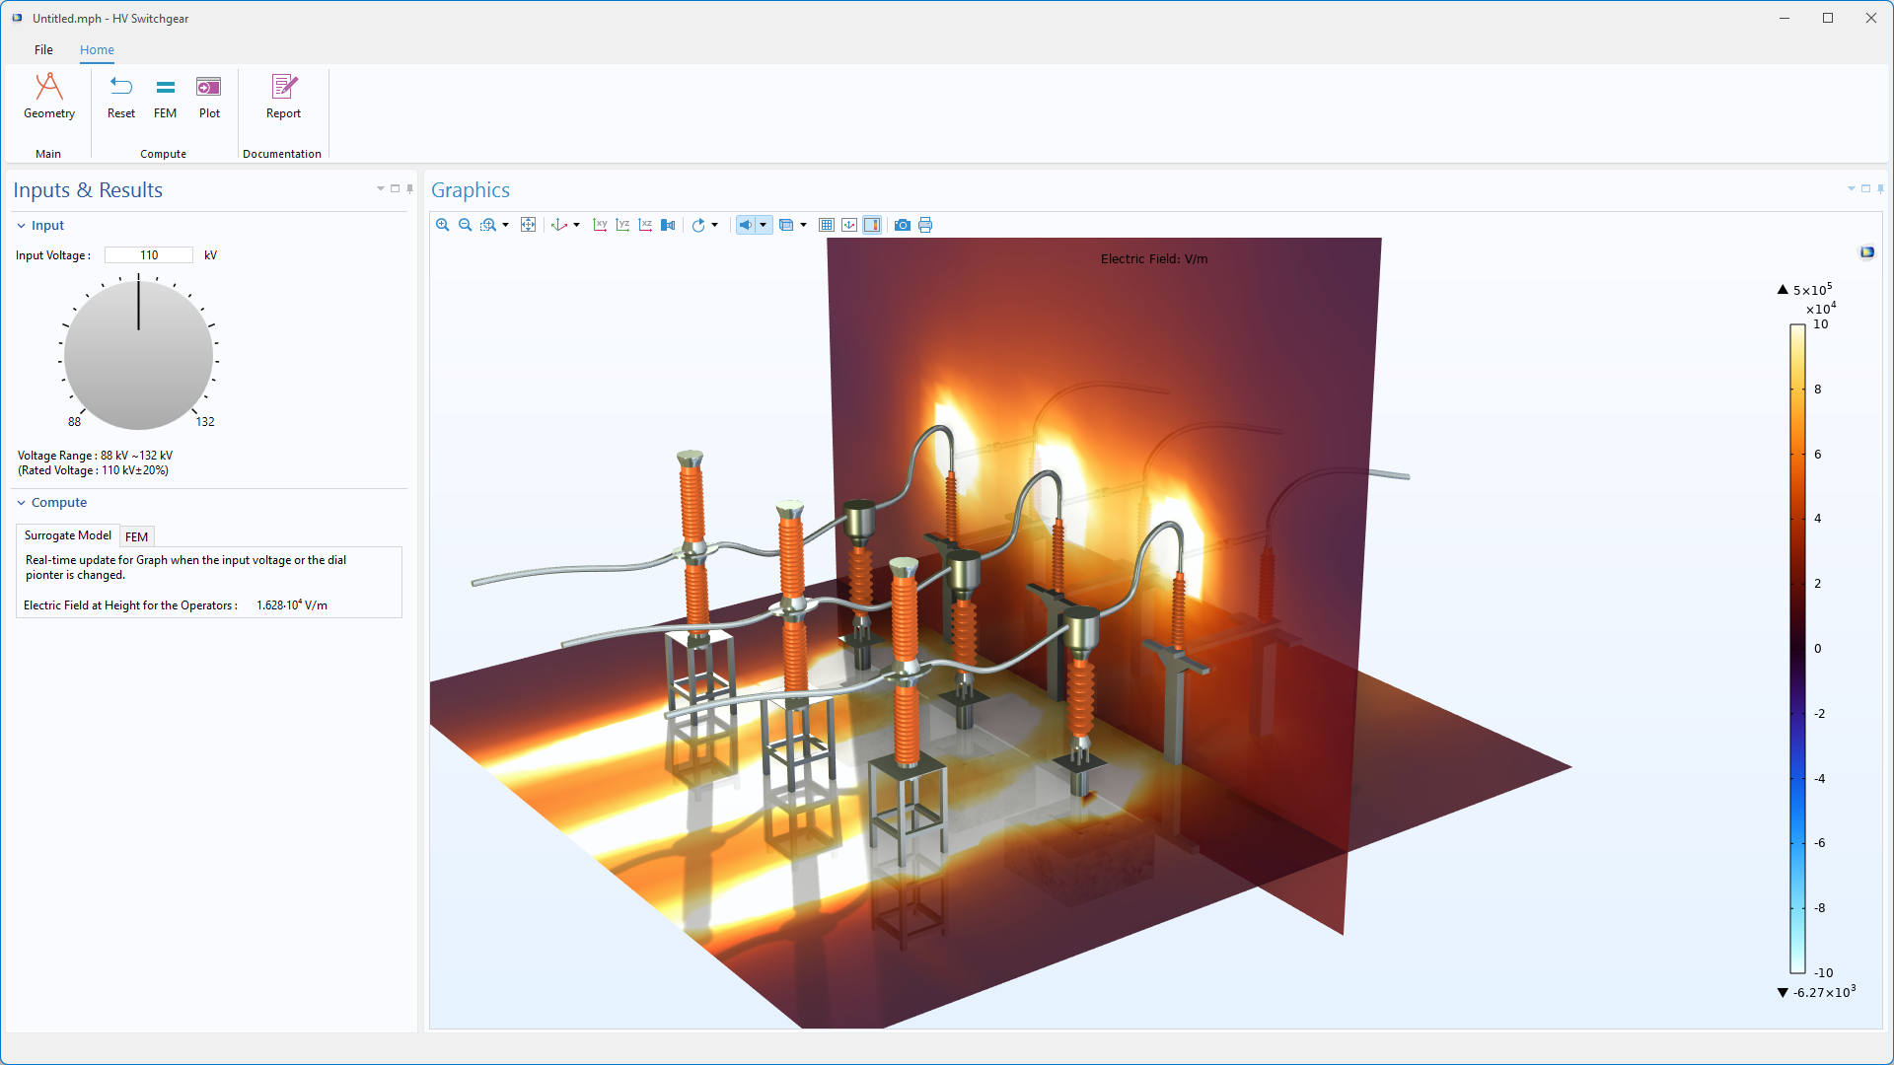
Surrogate Model
Using the app, we can see how the distribution of the electric potential varies with the input voltage V_{in}. Once trained, the surrogate model gives instantaneous results.

Slide 12
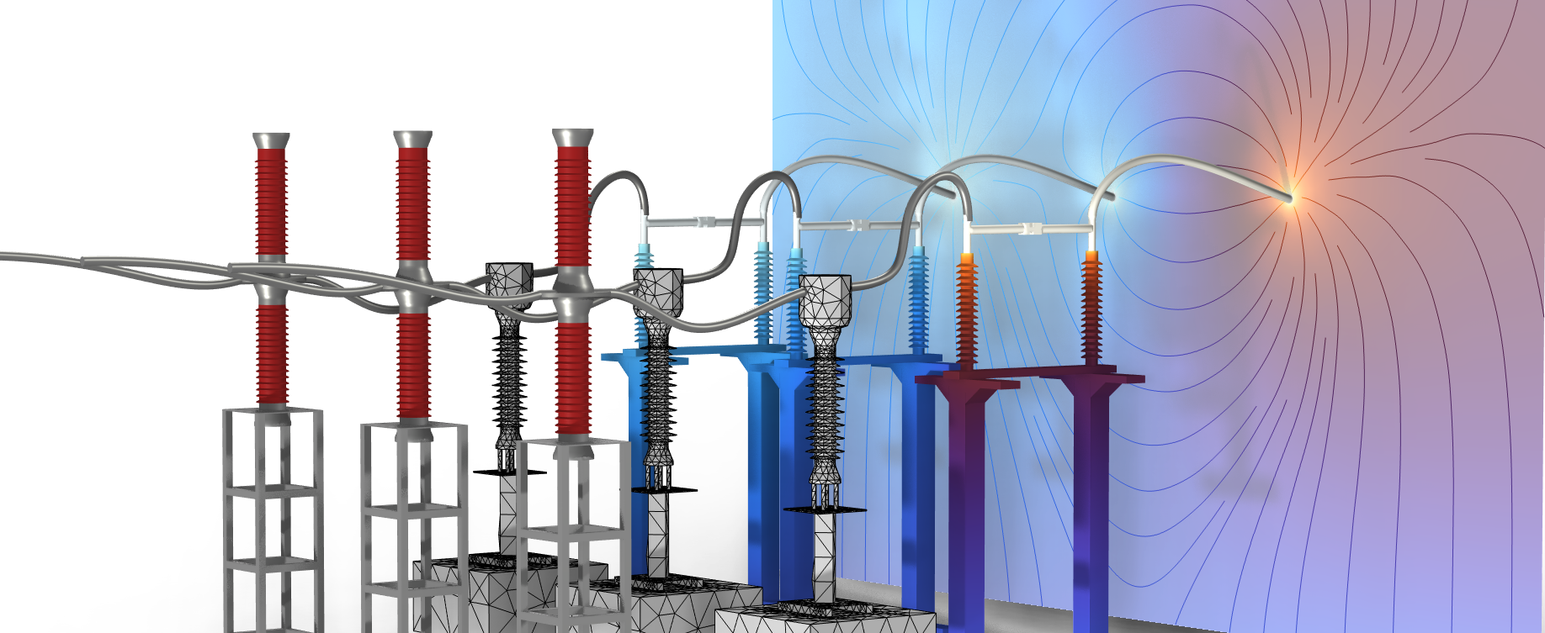
CONCLUDING REMARKS
High-Voltage Switchgear
The electric potential and electric field distribution are computed, and the fast execution of the surrogate model (DNN) means that it can easily be used as a part of a digital twin.

