Slide 1
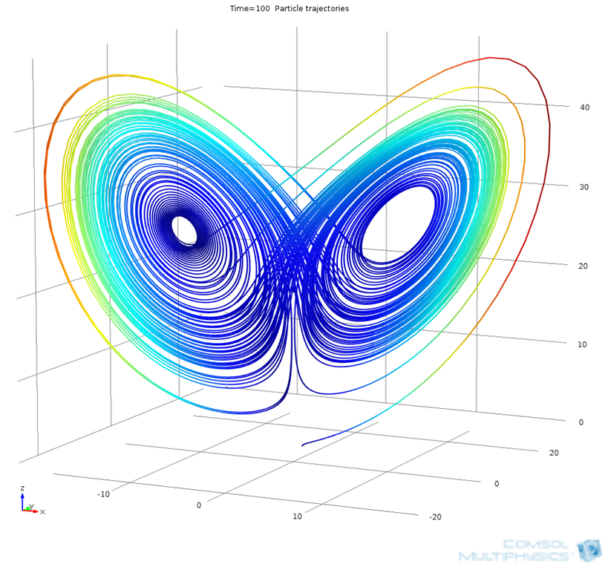
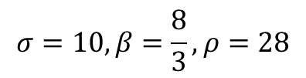
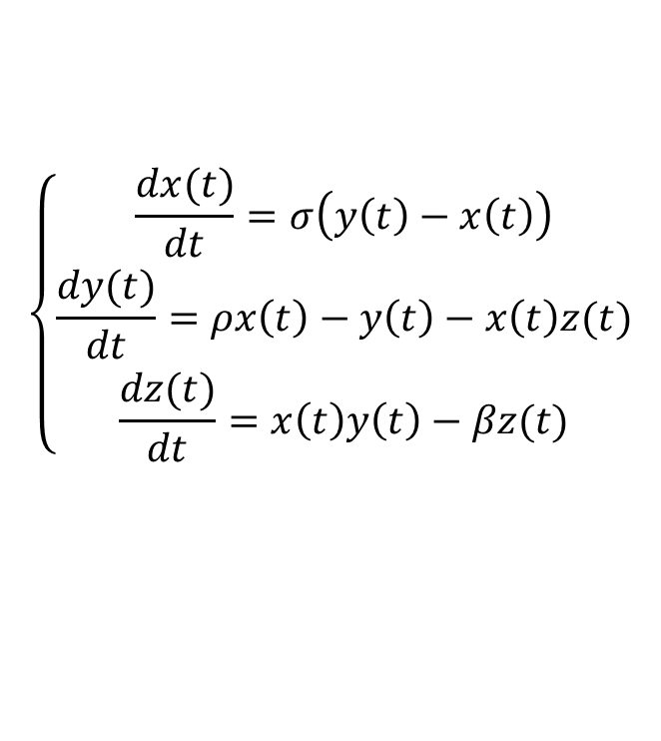
Lorenz Attractor with Particle Tracing Module
$$\left\{\begin{aligned}\frac{dx(t)}{dt}=σ\left(y\left(t\right)−x\left(t\right)\right) \\ \frac{dy(t)}{dt}=ρx\left(t\right)−y\left(t\right)−x\left(t\right)z(t) \\ \frac{dz(t)}{dt}=x\left(t\right)y\left(t\right)−βz(t)\end{aligned}\right.$$
$$σ=10, β=\frac{8}{3},ρ=28$$
See also ”Rossler attractor” model 10656.

