Slide 1
Modeling of a Lithium-air Battery
© 2014 COMSOL. All rights reserved.
Notes:
You can use the heading from the model documentation for the title.

Slide 2
Background and Motivation
Rechargeable lithium-air batteries have recently attracted great interest mainly due to their high energy density. The theoretical value is about 11400 Wh/kg which is around 10 times greater than the lithium-ion batteries.
In this work, discharge of a lithium-air battery is simulated using the ‘Lithium-ion Battery’ interface.
The transport of oxygen (from external air) in the porous carbon electrode is modeled using the ‘Transport of Diluted Species in Porous Media’ interface.
The electrochemical reaction (oxygen reduction) in the carbon electrode leads to changes in concentration of the reaction product and electrode porosity. This is modeled using ’Domain ODEs and DAEs’ interfaces.
The model can be used for studying the performance of lithium-air batteries and for providing insights towards cell design.
Additionally, the model provides motivation for a new interface specifically focussed at modeling of metal-air batteries.

Slide 3
Model
A 1D isothermal cell model for lithium-air battery is presented.
The unit cell comprises of a thin lithium sheet as the negative electrode, a porous carbon electrode filled with oxygen as the positive electrode, and a separator material between the electrodes. The organic electrolyte used comprises of a dissolved lithium salt in an aprotic solvent.
The porous carbon electrode provides a site for the electrochemical reduction of oxygen. During operation, the oxygen from the external air dissolves in the electrolyte, moves through the pores of cathode and reacts with lithium ions at the active site.
The reactions considered in the electrodes are as follows,
  Positive: 2Li⁺ + O₂ + 2e⁻ → Li₂O₂
  Negative: Li → Li⁺ + e⁻
  The reaction product in the positive electrode (Li₂O₂) is insoluble in the organic electrolyte and deposits on the active surface area in the porous cathode. This leads to porosity changes in the positive electrode.
The model is based on a study presented in J. Power Sources, 227, 243 2013

Slide 4
Model Equations
The Lithium-ion battery interface describes the following processes,
  Electronic current conduction in the electrodes
  Ionic charge transport in the electrodes and electrolyte/separator
  Material transport in the electrolyte
  Electrochemical reaction kinetics in the electrodes.
The kinetic expressions for the positive electrode reaction (described in the previous slides) is as follows,
For the negative electrode reaction, lithium metal kinetics expression is used.

Slide 5
Model Equations
The Transport of Diluted Species in Porous Media interface describes the mass transport of oxygen in the porous cathode by diffusion, along with the consumption of oxygen by the electrochemical reaction.
The change in the concentration of the reaction product in the positive electrode (Li₂O₂) is given as, ( is the solubility limit of Li₂O₂ dissolved in electrolyte)
The porosity change in the positive electrode is,

Slide 6
Model Equations
The specific area of the electrode/electrode interphase in the positive electrode is decreased by the morphology and dynamic change of porosity. The effective local surface area per unit volume of the electrode is given by
The volume fraction of solid Li₂O₂ formation is given by
The thickness of the Li₂O₂ film calculated from the volume fraction of the solid discharge products can be given as,

Slide 7
Model Setup
The ’Lithium-ion Battery’ interface is used with concentration dependent kinetics for the electrode kinetics at the positive electrode and lithium metal kinetics at the negative electrode. The thin lithium sheet (negative electrode) is represented using the Electrolyte-Electrode boundary interface.
The ‘Transport of Diluted Species in Porous Media’ interface is used to model diffusion of oxygen in the porous positive electrode.
’Domain ODEs and DAEs’ interfaces are used for modeling the porosity change and change in concentration of the reaction product in the positive electrode.
A parametric study is done for discharge current densities of 0.05, 0.1, 0.2 and 0.5mA/cm². A stop condition with a minimum voltage of 2.5V is imposed.
A comparison of the oxygen concentration, porosity and film thickness in the positive electrode at low and high discharge current densities is done to understand the effect on the cell voltage profiles.

Slide 8
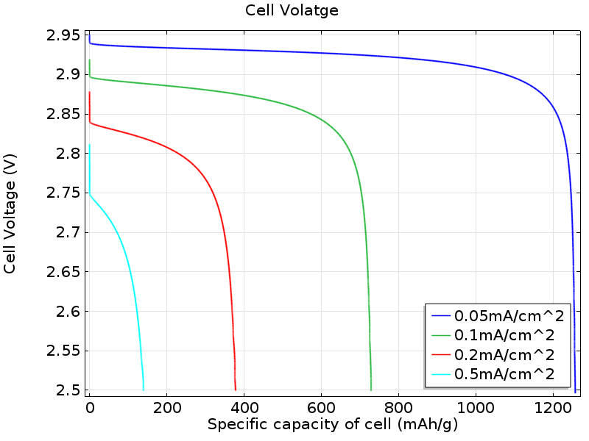
Results: Cell voltage profiles
The cell voltage profiles plotted as a function of capacity for different values of the discharge current density. At higher current densities, the discharge voltage profile and cell capacity are lower.

Slide 9
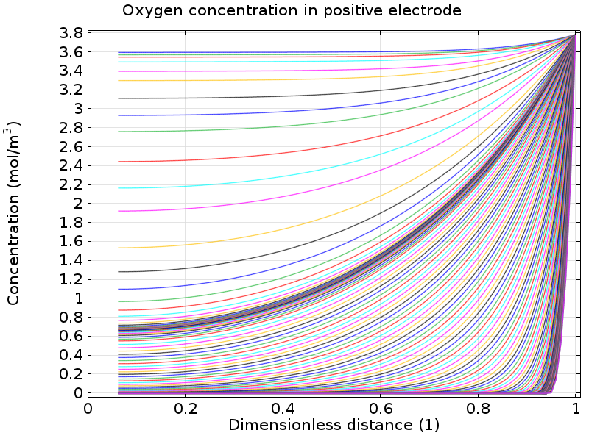
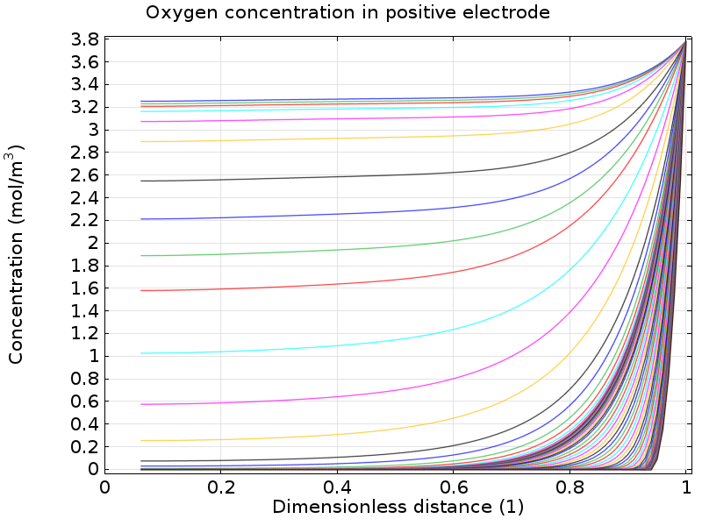
Results: Oxygen concentration in carbon electrode
i_{applied} = 0.1 mA/cm²
i_{applied} = 0.5 mA/cm²
The decreased transport of oxygen in the positive electrode at high discharge currents leads to the loss in capacity at high discharge rates.
Subsequently, the oxygen reduction reaction would be limited to regions close to the cathode-current collector edge as the discharge rate increases.

Slide 10
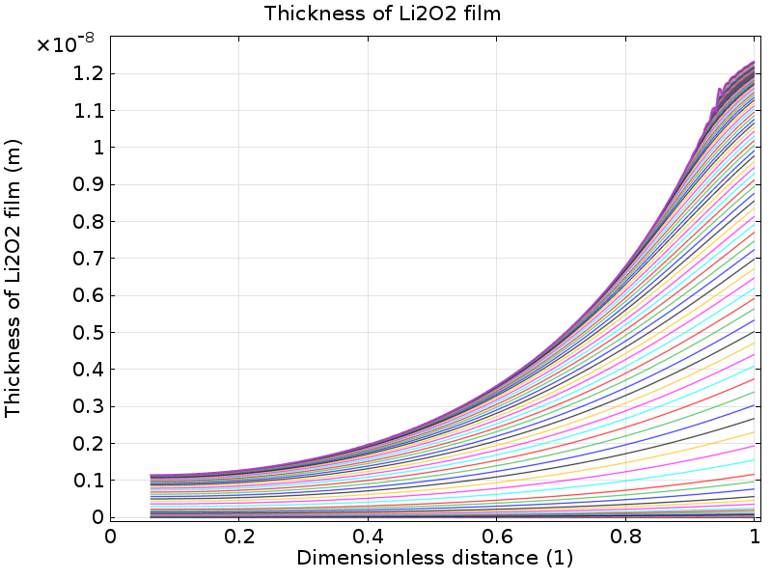
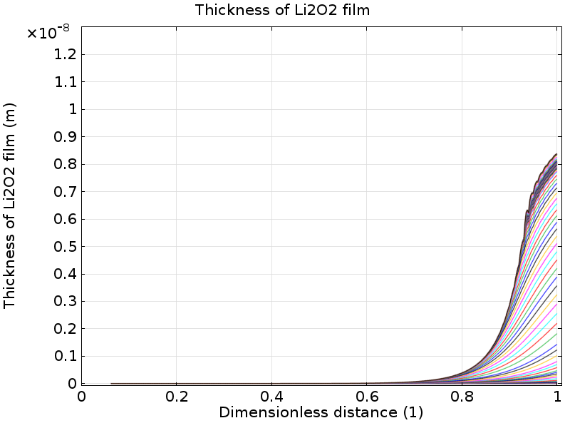
Results: Thickness of Li₂O₂ film in carbon electrode
i_{applied} = 0.1 mA/cm²
i_{applied} = 0.5 mA/cm²
At high discharge rates, the Li₂O₂ film deposition on the active surface area of the carbon electrode is predominantly limited to regions close to the cathode-current collector edge.

Slide 11
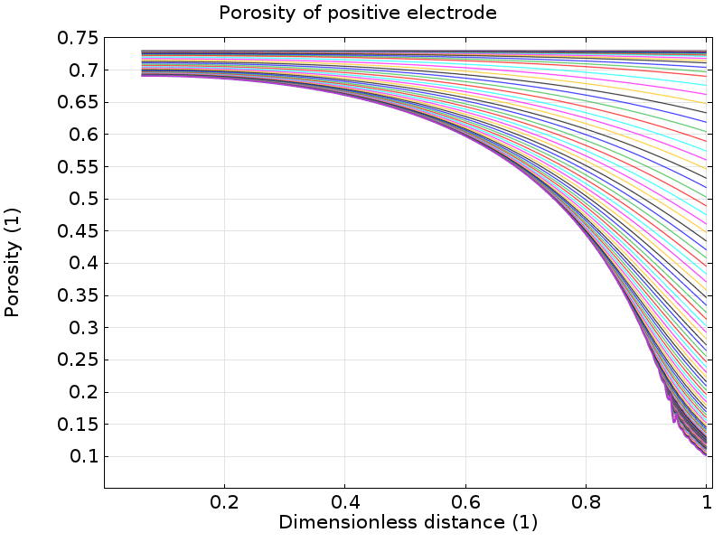
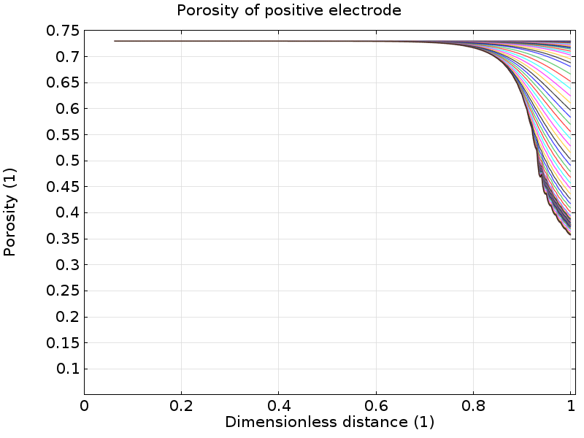
Results: Porosity of carbon electrode
i_{applied} = 0.1 mA/cm²
i_{applied} = 0.5 mA/cm²
The porosity of the carbon electrode decreases rapidly at regions closer to the cathode-current collector surface, as the discharge current increases.
This limits oxygen transport into the cell at higher discharge currents, thereby leading to incomplete utilization of the electrode and lower cell capacities.

