Slide 1
Example:
Protein Adsorption

Slide 2
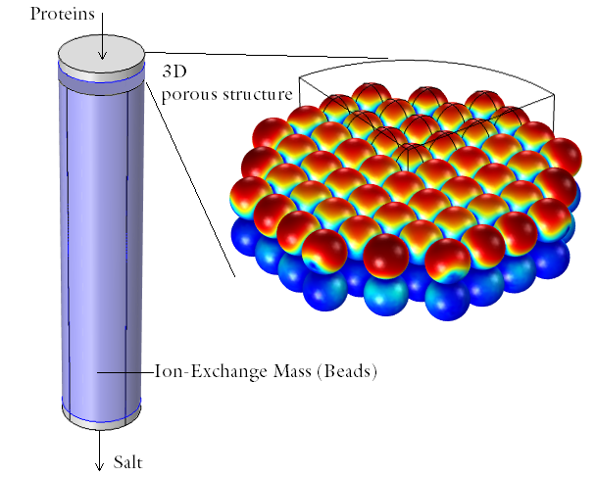
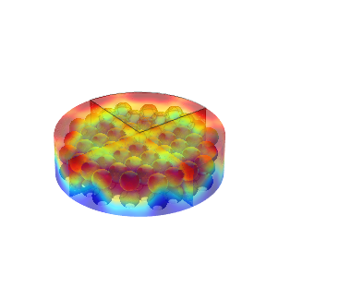
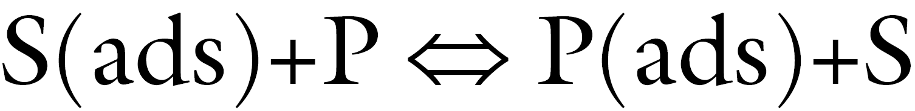
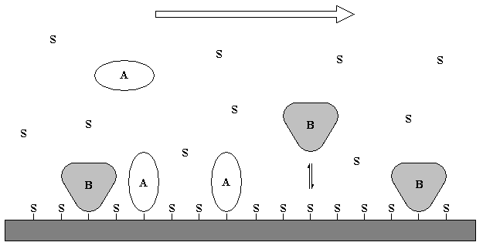
Ion-Exchange
Column packed with ion-exchange mass consisting of beads.
Equilibrium surface reactions describing the adsorption / desorption of protein, P, and salt, S:
Proteins A and B
3D
porous
structure
Ion-exchange mass (beads)
Salt

Slide 3
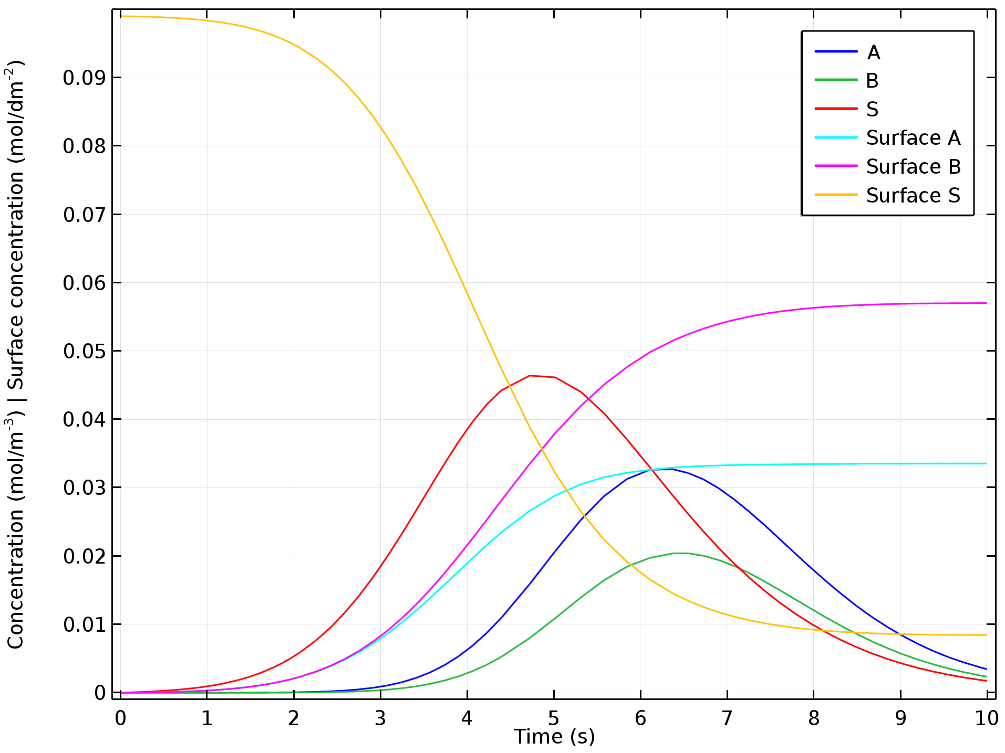
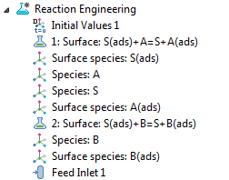
0D Study
Solved for in-built ideal reactor type CSTR, constant volume, in Reaction Engineering interface.
Proteins A and B fed through an inlet. Concentrations added in a pulse.

Slide 4
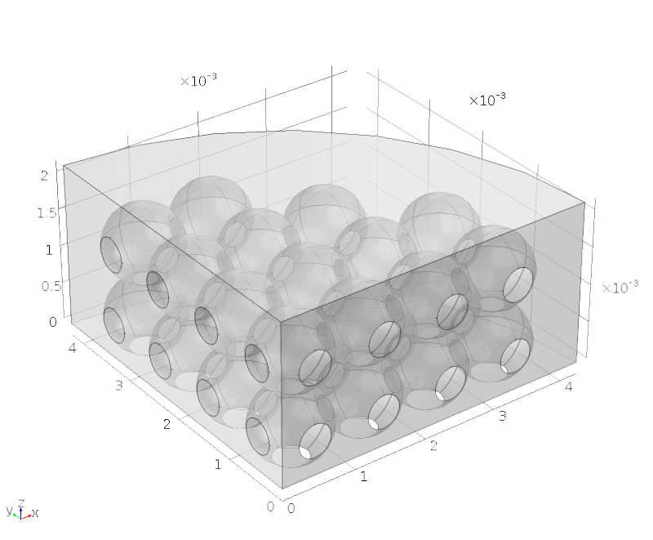
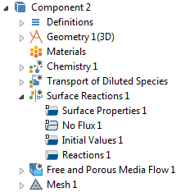
3D Study
3D model geometry of the top section of the column.
4 interphases to simulate the mass transport and reactions.

Slide 5
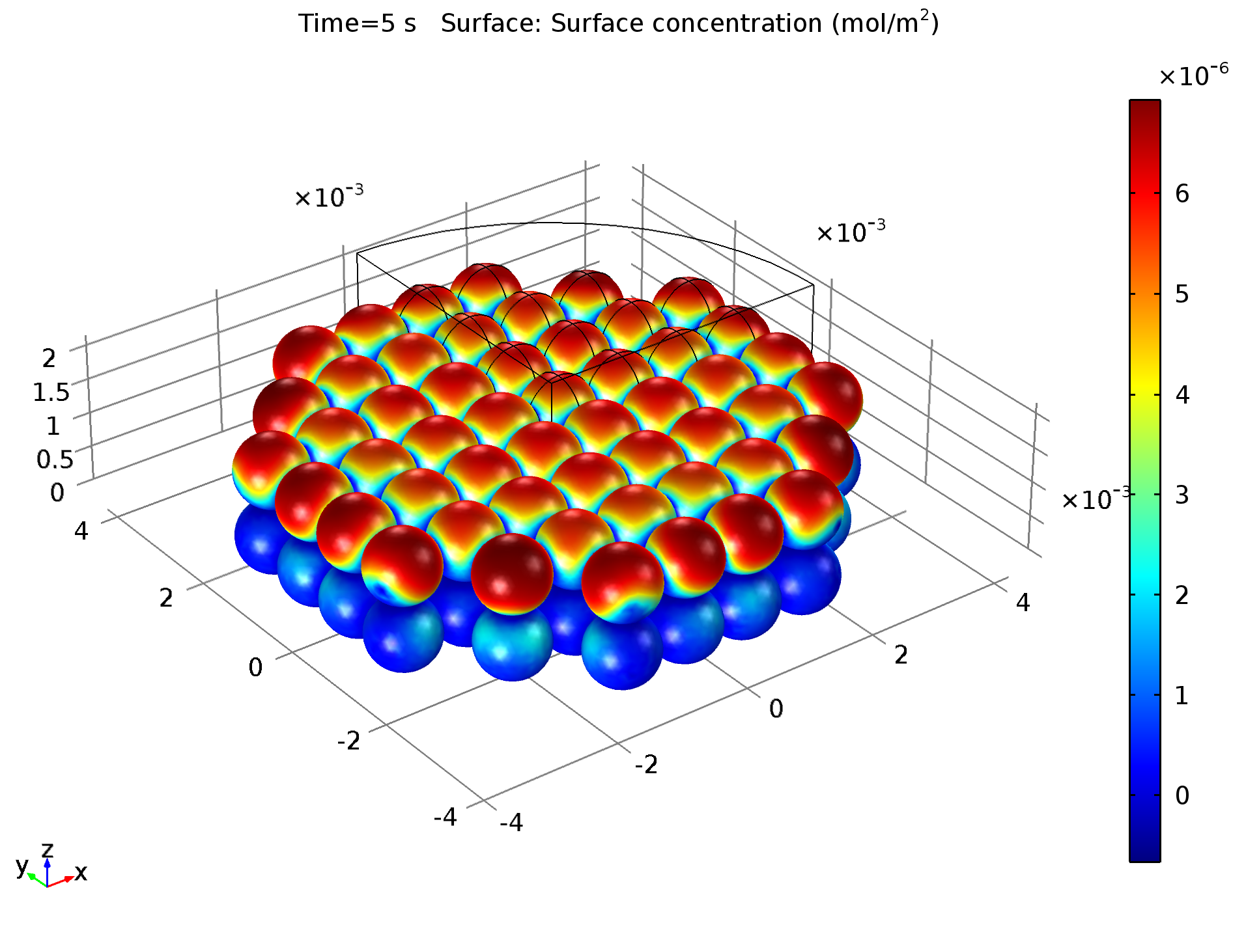
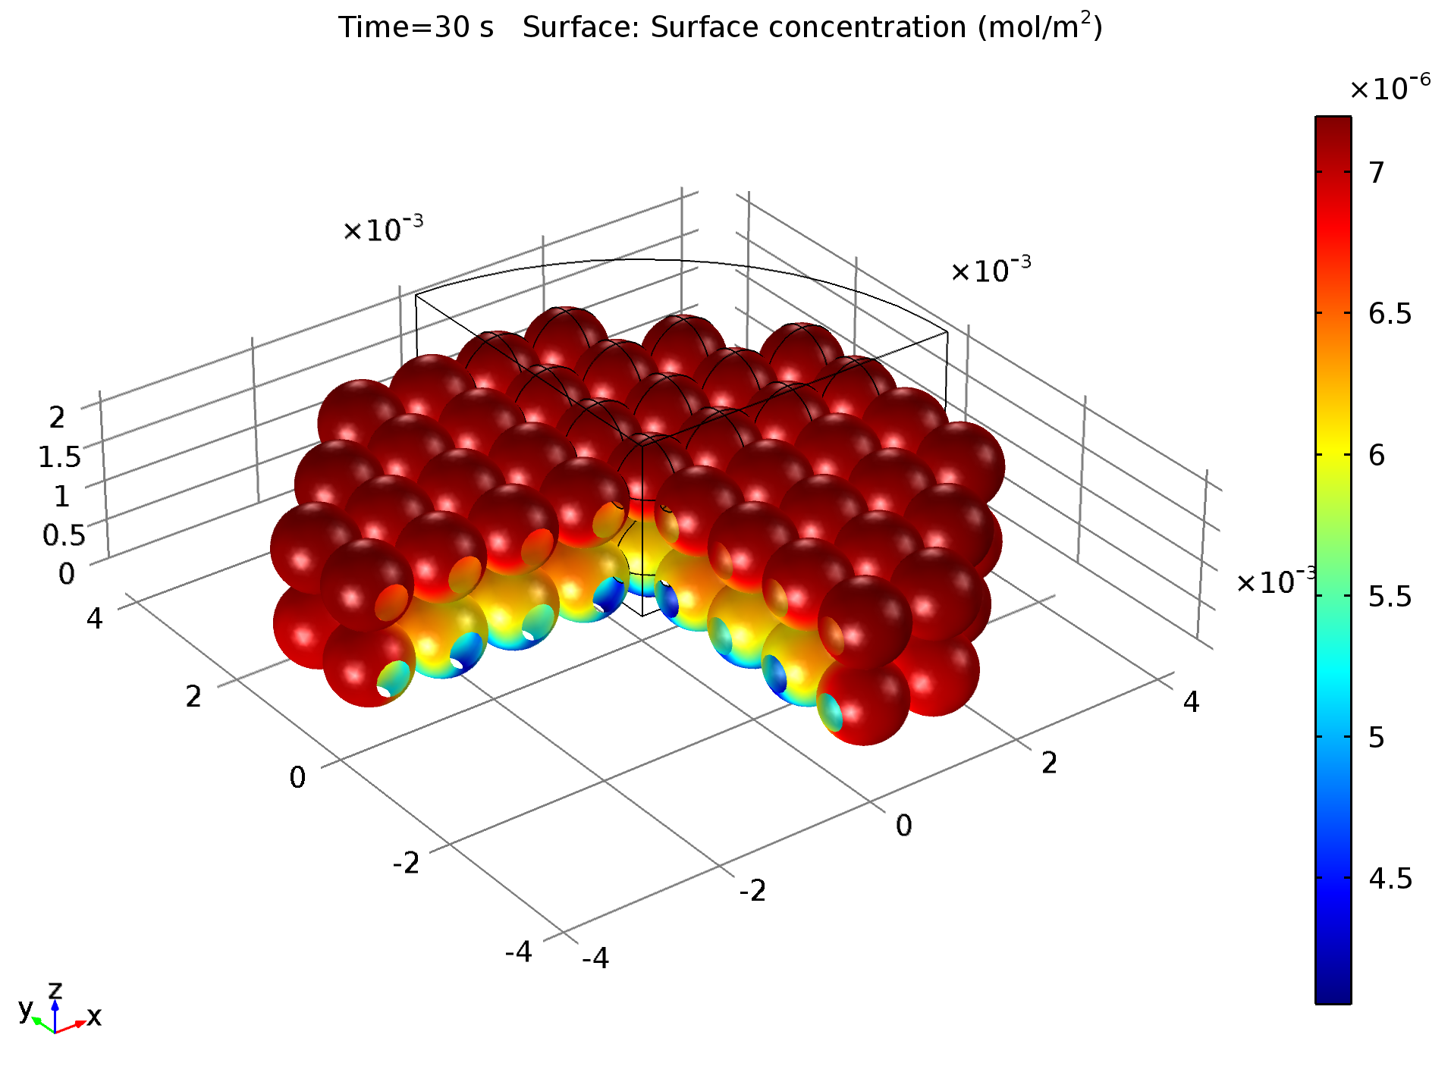
3D Study
Surface concentrations of the proteins show mass transport obstructions within the porous ion-exchange mass and the adsorption affinity.
t

