Slide 1
Ideal Stirred Tank Reactor System
Tank system with Inlet and Outlet Control
Notes:
You can use the heading from the model documentation for the title.

Slide 2
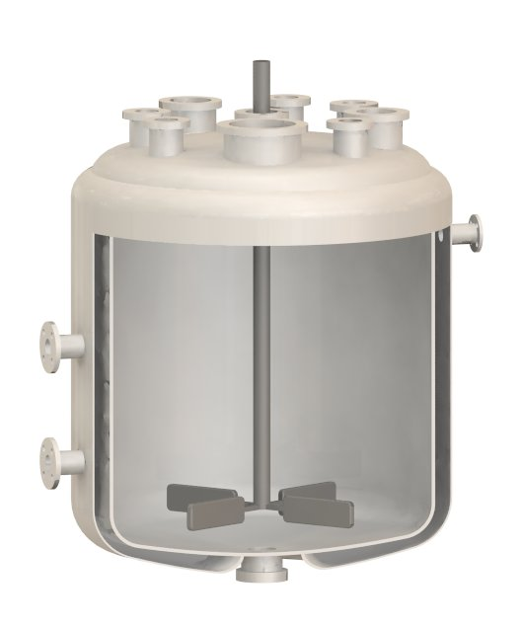
Background and Motivation
Liquid level and flow control at inlets and outlets are a important parameters for controlling the operating conditions in a tank reactor system
This model demonstrates a system of tanks with variable fill levels
Stirred tank reactor
Image courtesy of Robert Ashe under the GNU Free Documentation License

Slide 3
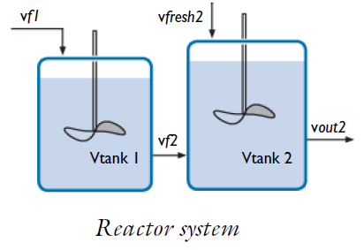
Model Definition
0 D ̶ Both tanks are perfectly mixed reactors;
Multiple inlets and outlets
Liquid phase 1st order
reaction
A→B
Non-continuous operation:
Fill levels vary in time.

Slide 4
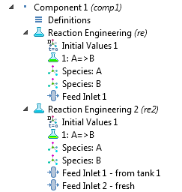
Modeling Interfaces
ReactionEngineering interface used for mass balance in tanks
CSTR (constant mass/generic)
reactor and Volumetric
Outlet Rate in Mass Balance
property for outputs
Each tank is modeled
with a separate interface

Slide 5
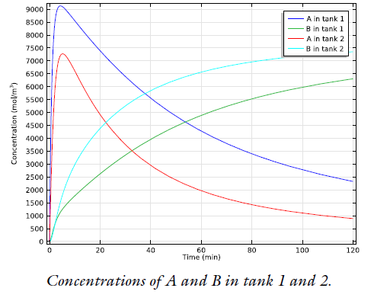
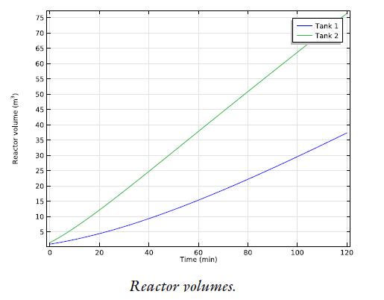
Results
The change of concentrations with time
Liquid volume in tanks

