Slide 1
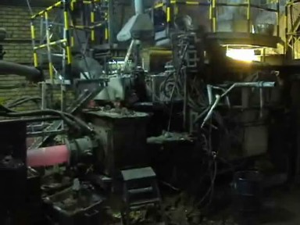
Modeling of a Continous Casting Process

Slide 2
Introduction
The purpose of this model is to describe the transition from melt to solid in the flow in the continous casting process.
The COMSOL Multiphysics model results show the temperature distribution, the position of the solidification regime and the glow field in the melt within the process at steady state.
The model is a replica, with altered dimensions and material properties, of a real customer case. It was origially used to optimise the process.

Slide 3
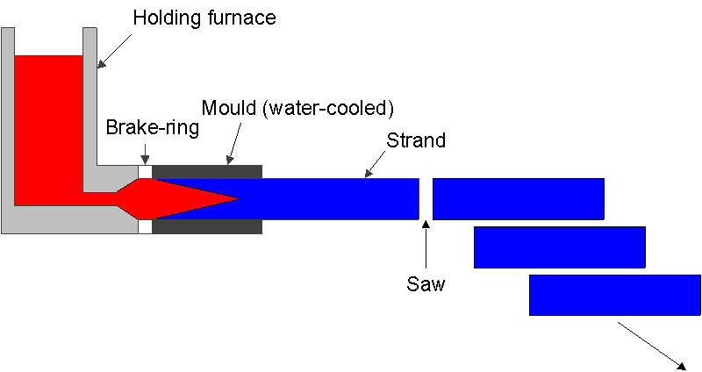
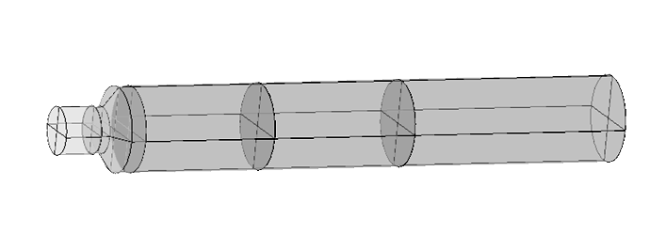
Process Geometry
z

Slide 4
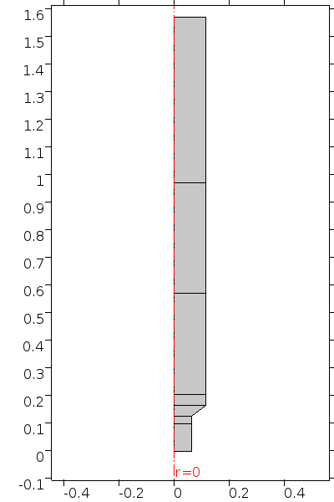
Problem Definition
3D cylinder → 2D axisymmetric model
Steady state model
Heat transfer including latent heat (solidification)
Flow field of melt with phase transition to solid including the ”mushy” region (i.e. where solid and liqud co-exist)
Temperature (and phase) dependent material properties
Outlet
z
Air cooling
Water cooled
mould
Casting die
r
Melt inlet

Slide 5
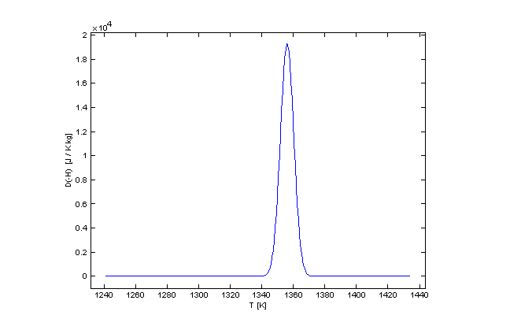
Heat Transfer With Latent Heat
Modified Heat equation:
Phase transition interval around the melting temperature:
Smoothed phase indicator α
  equal to 0 before transition interval
  equal to 1 after transition interval
Latent Heat as a pulse around the melting temperature
with

Slide 6
Fluid Flow With Phase Transition
Reynolds number about 25 → Laminar flow
Navier-Stokes:
Damping at the solid/liquid interface:
Fraction solid phase:

Slide 7



Results, Length of Melted Zone
Evaluating different casting rates (u) → Process optimization
u=1 m/s
u=1.4 m/s
u= 2.3 m/s
Phase change

Slide 8
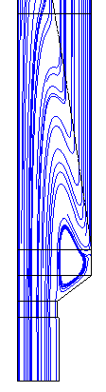
Results, Melt Flow
A vortex is present at the inlet, possibly explaining observed surface defects in the real process
→ Optimization of the design
Recirculation Zone

Slide 9
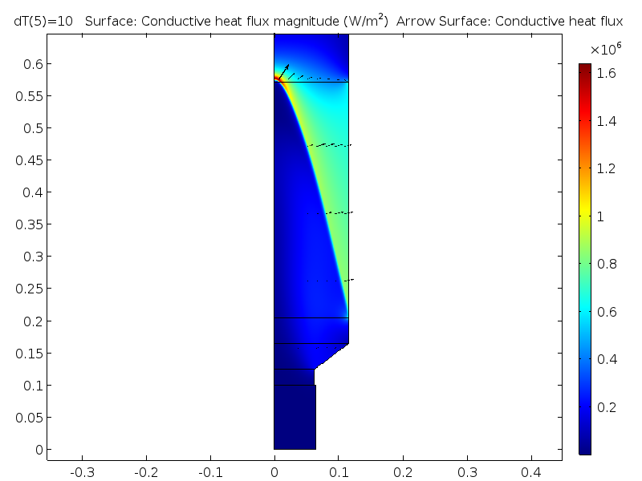
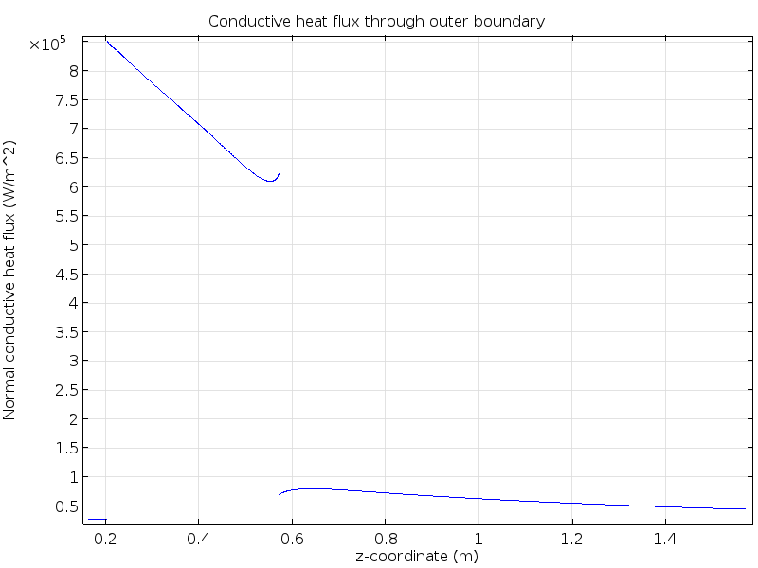
Results, Heat Flux
A majority of the heat is related to the phase transition
The surface normal heat flux at the radial boundary shows how the cooling occurs → Optimization of the cooling process
Conductive heat flux
Normal heat flux at boudary

Slide 10
Conclusions
The model describes the casting process in terms of temperature, flow field and phase transition.
There is a significantly nonlinear coupling between temperature and flow field.
The model is relatively easy to set up and solve in COMSOL Multiphysics.

