Slide 1
Fatigue Analysis of a Non-Proportionally Loaded Shaft with a Fillet

Slide 2
Model Background
The model shows how to perform a high-cycle fatigue in a non-proportionally loaded structure
Fatigue is predicted based on three stress-based models: Findley, Matake, and Dang Van.
Model documentation explains how to calculate model parameters from standard fatigue tests.

Slide 3
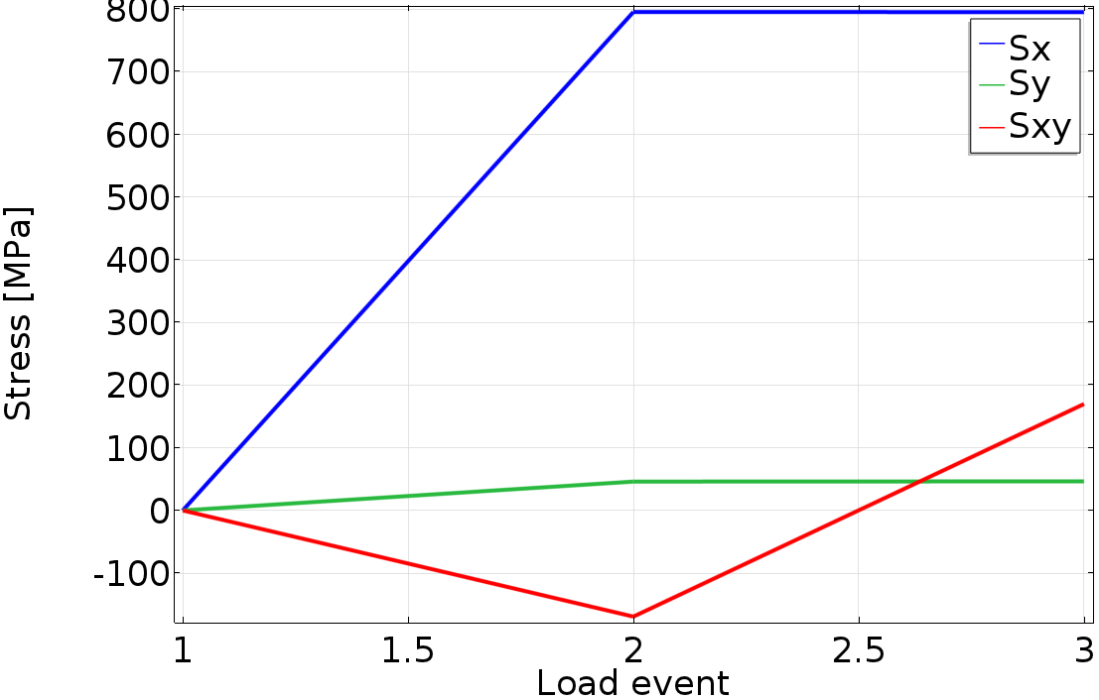
Non-Proportional Loading
Non-proportional loading is a description of a load situation when several loads affect a structure in a non synchronized way meaning they work out of phase.
The resulting stress response is also non-proportional, as shown in picture.

Slide 4
Fatigue Evaluation
The selection of the fatigue model is based on several factors such as for example: load type, expected lifetime and material.
In current application high-cycle fatigue is expected and the loading is non-proportional. Moreover material is metallic. The stress-based model family is suitable these type of conditions.

Slide 5
Fatigue Model Parameters
The material parameters of Findley, Matake, and Dang Van models are computed from two standard fatigue tests
  Reversed axial tension
  Pure tension
The relations are provided in the documentation

