Slide 1
Copper Electrodeposition in a Trench Using the Level Set Method
© Copyright 2017 COMSOL. COMSOL, COMSOL Multiphysics, Capture the Concept, COMSOL Desktop, COMSOL Server, and LiveLink are either registered trademarks or trademarks of COMSOL AB. All other trademarks are the property of their respective owners, and COMSOL AB and its subsidiaries and products are not affiliated with, endorsed by, sponsored by, or supported by those trademark owners. For a list of such trademark owners, see www.comsol.com/trademarks

Slide 2
Background and Motivation
The present model example is based on the Copper Deposition in a Trench model available in Electrodeposition Application Library.
The original The Copper Deposition in a Trench model features
  nonuniform deposition along the trench surface, leading to formation of a cavity/void.
  the Deformed Geometry interface cannot handle topological changes, the simulation cannot continue once the cavity is formed (at around 14 s).
The model presented here features
  Usage of the Level Set interface instead of the Deformed Geometry interface to also support cavity formations and allow longer simulated times (>25 s).
The electrode kinetics at the deposition boundary is defined as a domain term, making use of the delta function from the Level Set interface.

Slide 3
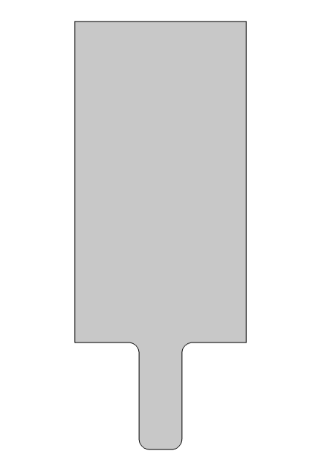
Model Geometry and Setup
Anode
The model geometry consists of an anode surface at the top and a cathode surface at the bottom which are exposed to the electrolyte solution.
The Tertiary Current Distribution, Nernst-Planck interface is used to solve for mass and charge transports of copper and sulfate ions in the electrolyte solution.
The Level Set interface is used to keep track of depositing boundary at the cathode surface.
Electrolyte
Cathode
(Depositing boundary)

Slide 4

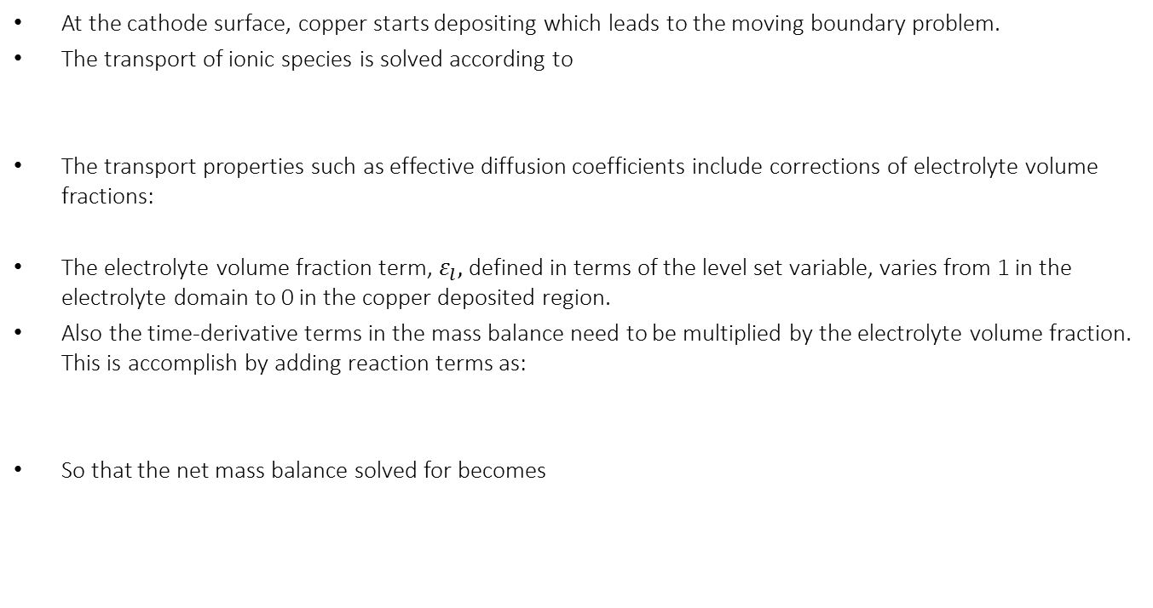



Model Setup
At the cathode surface, copper starts depositing which leads to the moving boundary problem.
The transport of ionic species is solved according to
The transport properties such as effective diffusion coefficients include corrections of electrolyte volume fractions:
The electrolyte volume fraction term, $ε_{l},$defined in terms of the level set variable, varies from 1 in the electrolyte domain to 0 in the copper deposited region.
Also the time-derivative terms in the mass balance need to be multiplied by the electrolyte volume fraction. This is accomplish by adding reaction terms as:
So that the net mass balance solved for becomes
$$\frac{∂c_{i}}{∂t}+∇∙\left(−D_{i,eff}∇c_{i}−z_{i}u_{m,i,eff}Fc_{i}∇φ_{l}\right)=R_{i}−\frac{ν_{i}i_{v} }{nF}$$
$$D_{i,eff}={ε_{l}D}_{i}$$
$$R_{i}=(1−ε_{l})\frac{∂c_{i}}{∂t}$$
$$ε_{l}\frac{∂c_{i}}{∂t}+∇∙\left(−{ε_{l}D}_{i}∇c_{i}−z_{i}u_{m,i}Fc_{i}∇φ_{l}\right)=−\frac{ν_{i}i_{v} }{nF}$$

Slide 5

Model Setup
The copper deposition reaction current density is added as a source term in the domain, using the level set delta function to represent the deposition reaction along the deforming boundary
The initial value of level set variable is assumed to be 1 in the electrolyte domain.
The level set variable of value 0.5 represents the depositing cathode boundary.
The Inlet node with level set variable of value 0 is prescribed at the cathode boundary while the rest of boundaries of the computational domain are prescribed with the Outlet node.
The level set variable is advected by the velocity field, which is estimated from the local current density.
$$i_{v}=i_{loc}δ$$

Slide 6
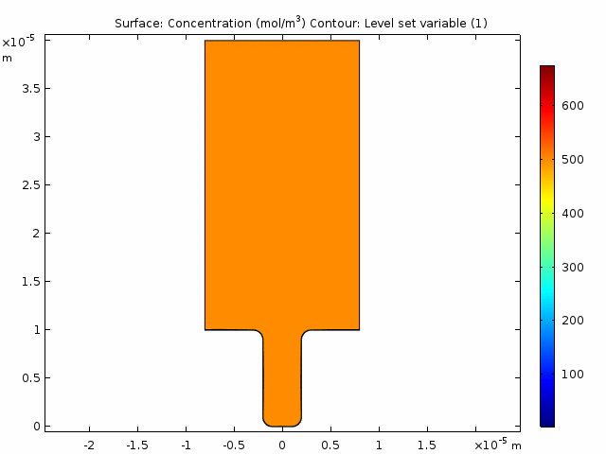
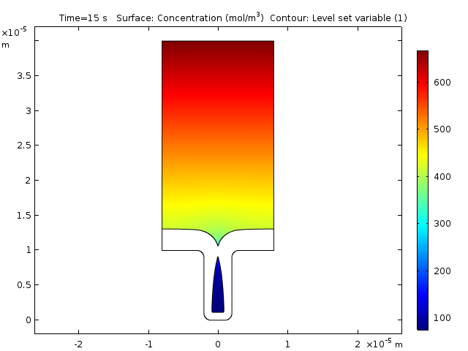
Model Results

Slide 7
Model Results
The model results demonstrate the evolution of the boundary (level set variable = 0.5) and ionic concentration of copper ions with time.
It can be seen that the copper deposition rate is considerably higher at the mouth of a trench than that at the bottom of the trench which results in the cavity formation.
Nonuniform deposition rate is attributed to nonuniform electrolyte current density distribution which is accentuated by depletion of copper ions at the bottom of the trench.
The model demonstrates how the topological changes such as cavity formation can be simulated using the level set method.
The electrodeposition models developed using the level set method can thus be useful in identifying the cavity or void regions developed during electrodeposition process in complex geometries.
The model results obtained from the level set formulation match well with the application library example of Copper Deposition in a Trench that uses the deformed geometry formulation, until cavity formation.

Slide 8
Reference
Copper Deposition in a Trench, Application Library of Electrodeposition Module, COMSOL Multiphysics.

