Slide 1
Heat and Moisture in Building Materials
Benchmark from EN15026:2007

Slide 2
Background and Motivation
The model is defined as a benchmark case in norm 15026:2007 annex A
This model also shows how to use the Heat and Moisture Transport interface.
The purpose of the model is to calculate the temperature and moisture profiles at different times after a change in the external conditions (temperature and relative humidity) inside a wall material (kind of concrete).

Slide 3
Geometry and Operating Conditions
1D geometry
Transient analysis during one year
Thick single homogeneous material
Water losses due to vapor only (no liquid water loss)
At the initial condition the relative humidity and the temperature are homogeneous in all the model. When the simulation starts the external temperature and the relative humidity changes.
  Initial condition: ϕ = 50 % , T = 20 °C
  External conditions change : ϕ = 95 %, Ts = 30 °C

Slide 4
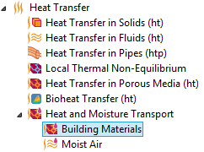
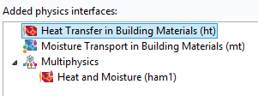
Modeling Interfaces
Multiphysics interface:
  Heat and Moisture Transport
  (Building Materials version)
Constituent interfaces:
  Heat Transfer in Building Materials (ht)
  Moisture transport in Building Materials (mt)
Multiphysics coupling node:
  Heat and Moisture (ham)

Slide 5
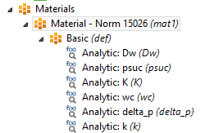
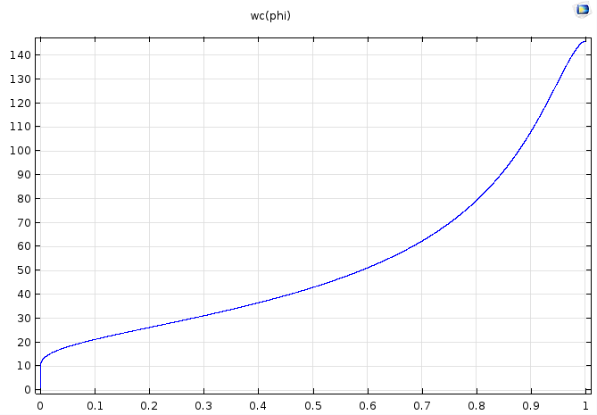
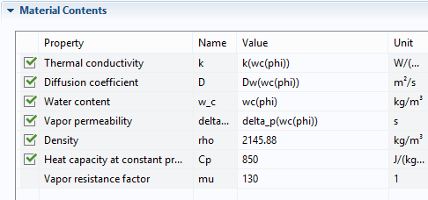
  Material properties from EN15026:2007
Moisture storage function wc as a function of the relative humidity, ϕ.

Slide 6
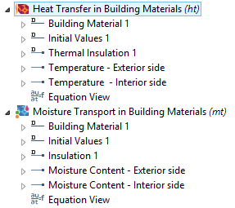
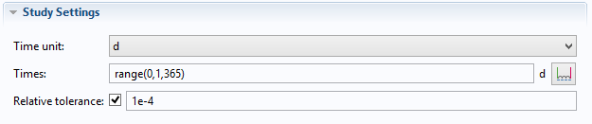
Model definition
Temperature and moisture content for exterior and interior sides
Initial temperature and relative humidity provided by Ambient settings in the Heat Transfer in Building Materials.
Simulation over one year

Slide 7
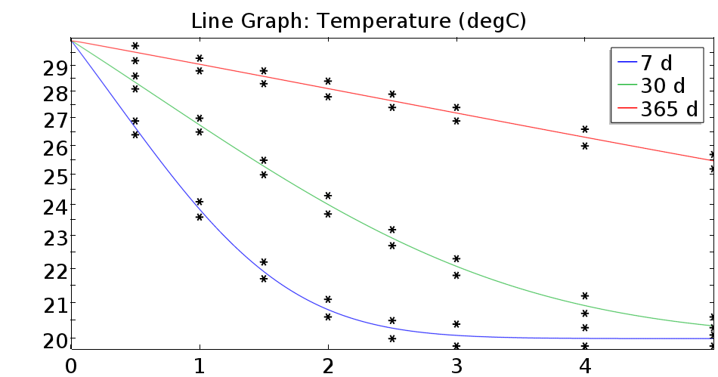
Temperature profile at d=7, 30, 365
* Represents the norm reference intervals

Slide 8
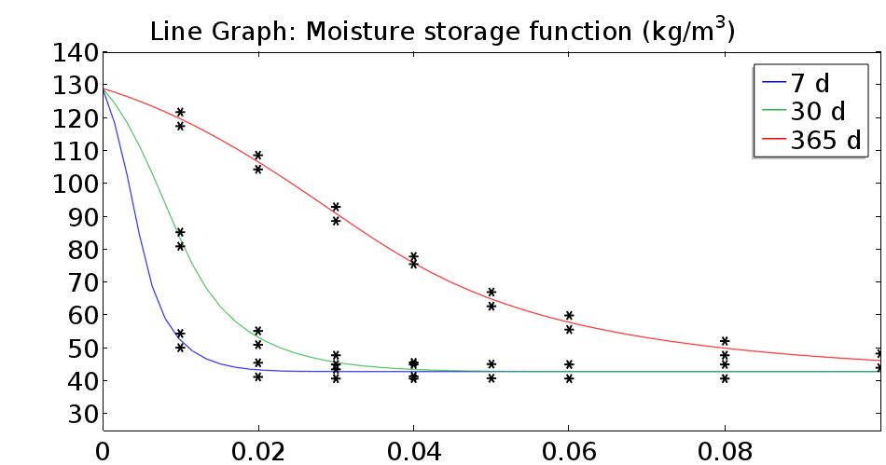
Water content profile at d=7, 30, 365
* Represents the norm reference intervals

