Slide 1
Shape Memory Alloy examples
Notes:
You can use the heading from the application documentation for the title.

Slide 2
Background and Motivation
Shape memory alloys properties are based on transformations between austenite and martensite phases.
Transformations can be induced thermally or mechanically.
The main phenomena in shape memory alloys are pseudoelasticity and shape memory effect.

Slide 3
Thermal Transformation
The phase transformation is described by the martensite volume fraction variable ξ.
When the material in its austenite phase is cooled, the martensite transformation starts at M_{s} temperature and ends at M_{f}.
When the martensite is heated the austenite transformation starts at A_{s} and end at A_{f}.
ξ
1
Martensite
Austenite
0
M_{f}
M_{s}
A_{s}
A_{f}
T

Slide 4
Pseudoelasticity
At high temperature the austenite transforms to martensite under mechanical loading. The (σ,ε) graph shows inelastic behavior.
Once transformation is completed the material behaves linearly in martensite phase.
When the loading is decreased the material transforms back to austenite and recovers its
initial shape.
σ
Austenite
Martensite
ε

Slide 5
Shape Memory Effect
At lower temperature the austenite transforms to martensite under mechanical loading as well.
When the loading is decreased the material stays in its martensite phase and residual
deformation remains.
The austenite phase is retrieved by heating the material. The material then recovers its initial shape.
σ
Austenite
Martensite
heating
ε

Slide 6
Pseudoelasticity: Parametric model
The model used for pseudoelasticity is a cylinder submitted to uniaxial loading.
2D axisymmetric geometry
is used.
A parametric study is performed to study the material at several temperatures: 328 K, 308 K, 276K, and 260 K.
 | Austenite | Martensite
Young’s modulus | 55 GPa | 46 GPa
Poisson’s ratio | 0.33 | 0.33
Heat capacity at constant pressure | 400 J/(kg.K) | 400 J/(kg.K)
Clausius-Clapeyron coefficient | 7.4 Mpa/K | 7.4 Mpa/K
Transformation start temperature | 270 K | 245 K
Transformation finish temperature | 280 K | 230 K
Maximum transformation strain | 0.056
data taken from D.C. Lagoudas, Shape Memory Alloys, Modelling and Engineering Applications, Springer 2008

Slide 7
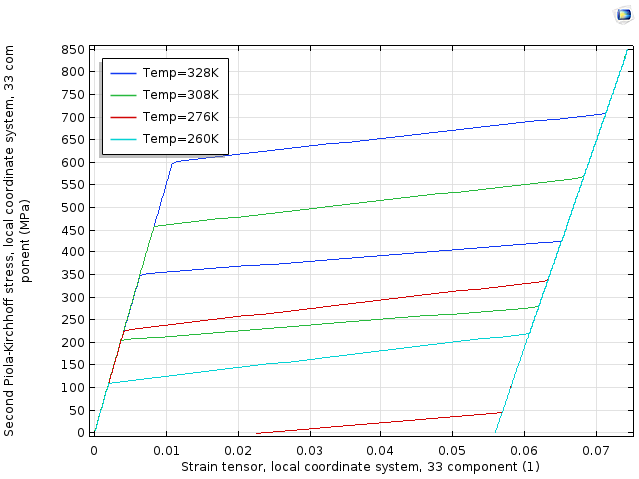
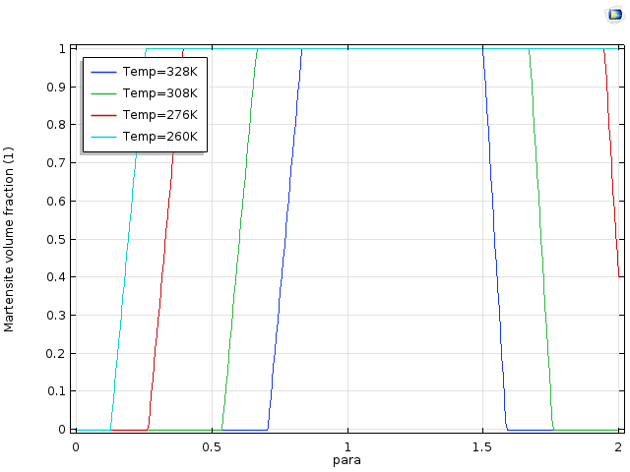
Pseudoelasticity: Results
For high temperatures (328 K, 308 K) a pseudoelastic behavior is seen, with return to initial state
At 276 K (As<T<Af) the reverse transformation is not complete at zero stress, so residual deformations remain.
At 260 K (T<As) the reverse transformation has not started. The material is purely martensite and the residual strain is maximal.
Stress-strain curves for parametric temperature
Martensite volume fraction vs pseudo-time parameter

Slide 8
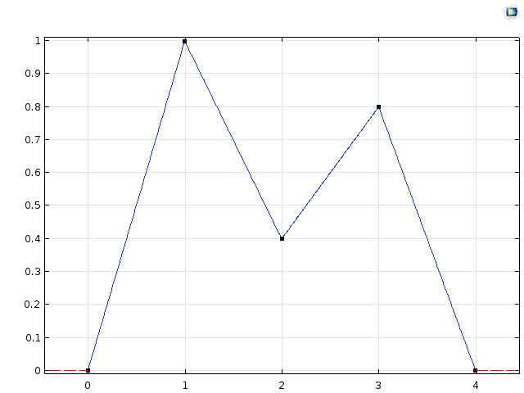
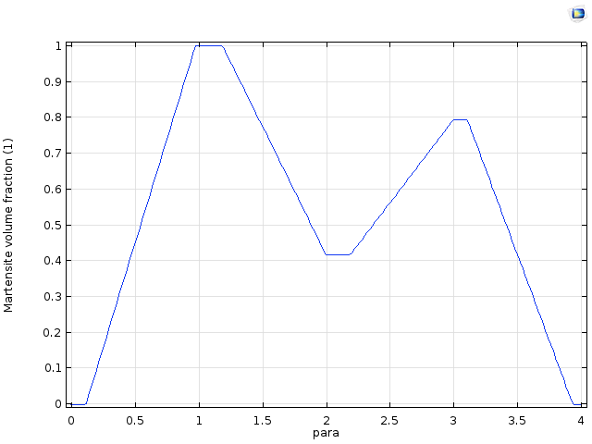
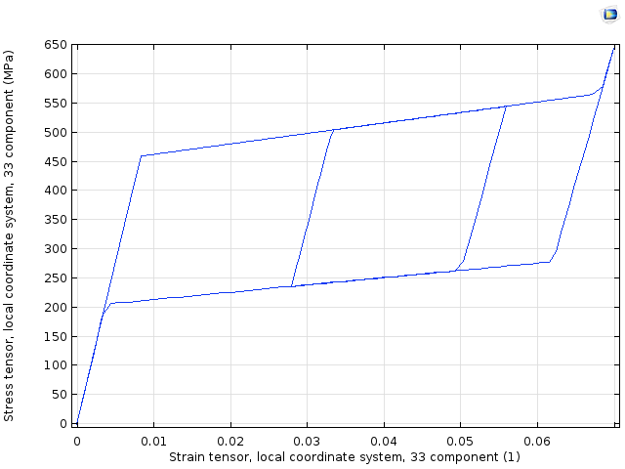
Pseudoelasticity: partial transformation
On this model a prescribed displacement is applied.
The material is loaded to a fixed maximal displacement, then decreased to 40%, increased to 80%, and finally decreased to 0.
It induces an “internal loop” in the stress-strain graph.
Prescribed displacement
Martensite volume fraction
Stress-strain graph

Slide 9
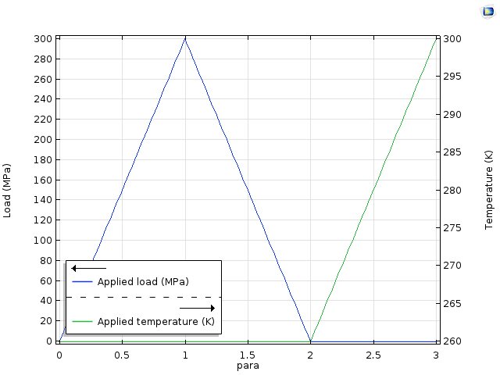
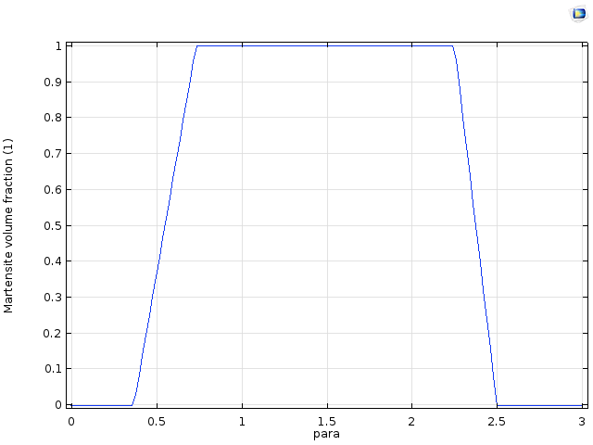
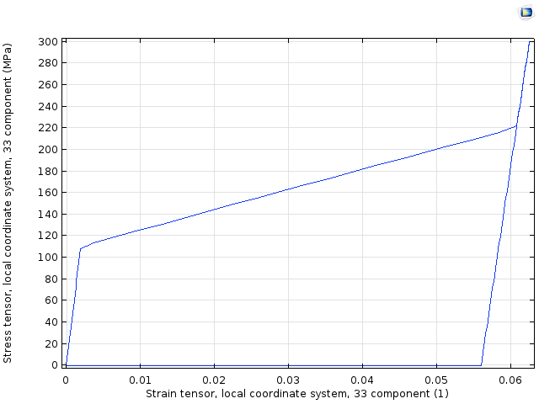
Shape Memory Effect
In this model the temperature is initially lower than the austenite start temperature. A stress cycle is applied and then the temperature is increased.
The unloading does not induce reverse transformation. It occurs only when the temperature is increased. At the same time the residual strain are decreased and the material recovers its
initial shape.
Loading: stress and temperature
Martensite volume fraction
Stress-strain graph

