Slide 1
Cavity Eigenfrequency Modeling Using the Electromagnetic Waves, Beam Envelopes Interface

Slide 2
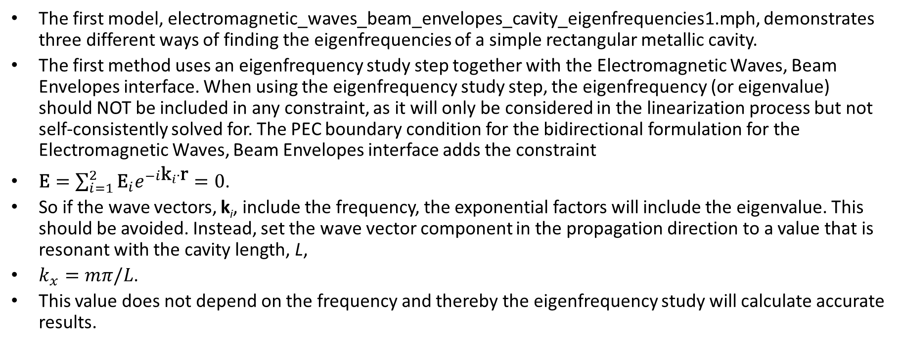
Description of Simulation
The first model, electromagnetic_waves_beam_envelopes_cavity_eigenfrequencies1.mph, demonstrates three different ways of finding the eigenfrequencies of a simple rectangular metallic cavity.
The first method uses an eigenfrequency study step together with the Electromagnetic Waves, Beam Envelopes interface. When using the eigenfrequency study step, the eigenfrequency (or eigenvalue) should NOT be included in any constraint, as it will only be considered in the linearization process but not self-consistently solved for. The PEC boundary condition for the bidirectional formulation for the Electromagnetic Waves, Beam Envelopes interface adds the constraint
$\text{E}=\sum_{i=1}^{2}{{\text{E}}_{i}e^{−i{\text{k}}_{i}∙\text{r}}=0}$.
So if the wave vectors, k_{i}, include the frequency, the exponential factors will include the eigenvalue. This should be avoided. Instead, set the wave vector component in the propagation direction to a value that is resonant with the cavity length, L,
$k_{x}=mπ/L$.
This value does not depend on the frequency and thereby the eigenfrequency study will calculate accurate results.

Slide 3
Description of Simulation (cont’d)
The second method uses a nonlinear eigenfrequency setup, together with the Electromagnetic Waves, Beam Envelopes interface. This method is also used in the Wave Optics Module Application Library model Transverse Modes for a Symmetric Laser Cavity and is included for comparison with the first method. Since this method does is not using the Eigenvalue solver, it doesn’t matter that the wave vector in the propagation direction depends on the frequency.
The third method uses an eigenfrequency study step together with the Electromagnetic Waves, Frequency Domain physics interface. It is demonstrated that a much finer mesh and cubic discretization order is required for this physics interface to obtain the expected eigenfrequencies.
A second model is also included, where the simple rectangular cavity has been slightly modified using two central metallic protrusions. This perturbs the modes and requires finer meshes, but all three methods produce similar results.

Slide 4
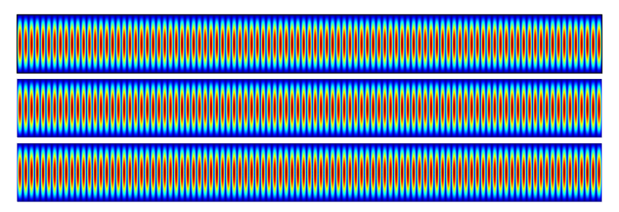
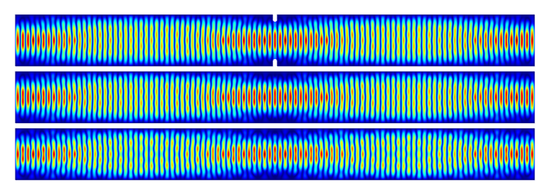
Results
Simple rectangular cavity
Cavity with protrusions (aperture)
The protrusions (aperture) are indicated in the top plot.
Top: Eigenfrequency solution, Electromagnetic Waves, Beam Envelopes
Middle: Nonlinear eigenfrequency solution, Electromagnetic Waves, Beam Envelopes
Bottom: Eigenfrequency solution, Electromagnetic Waves, Frequency Domain

Slide 5
Simulation Details
electromagnetic_waves_beam_envelopes_cavity_eigenfrequencies1.mph
  Method 1: Set the Wave vector, first wave parameter in the Wave Vectors section for the physics to kxm, which is a global parameter defined to be resonant with a longitudinal mode and independent of the frequency.
  Method 2:
    Define the Global Equations 1 node with the frequency, fmode, solved for and the normalization condition. The variable nEz is defined in Variables 1 under Component 1>Definitions.
    In the Equation section for the physics settings, set the Frequency to fmode.
    Define Initial Values 1, using the variable Emode.
    Note that the Wave vector, first wave parameter in the Wave Vectors section for the physics can be set to any suitable value, including frequency-dependent expressions.
    In the solver sequence enable the Split complex variables in real and imaginary parts check box in the Compile Equations: Stationary node.
  Method 3:
    Note that Step 3: Eigenfrequency 2 uses the finer Mesh 2, when solving with the Electromagnetic Waves, Frequency Domain interface. Furthermore, to get good accuracy compared to the analytic eigenfrequencies, Cubic discretization order is defined for in the Discretization section for the physics.
  The longitudinal and transverse modes can be changed by modifying the mLong and nTransv global parameters.

Slide 6
Simulation Details (cont’d)
electromagnetic_waves_beam_envelopes_cavity_eigenfrequencies2.mph
  The Polygon 1 and Mirror 1 nodes have been added to the geometry sequence.
  All three physics interfaces has a Perfect Electric Conductor 2 node, selecting the small polygons (protrusions)
  Both Mesh 1 and Mesh 2 are finer than in the previous model and also the Electromagnetic Waves, Beam Envelopes interfaces use cubic discretization order to achieve similar results as for the Electromagnetic Waves, Frequency Domain interface.

Slide 7
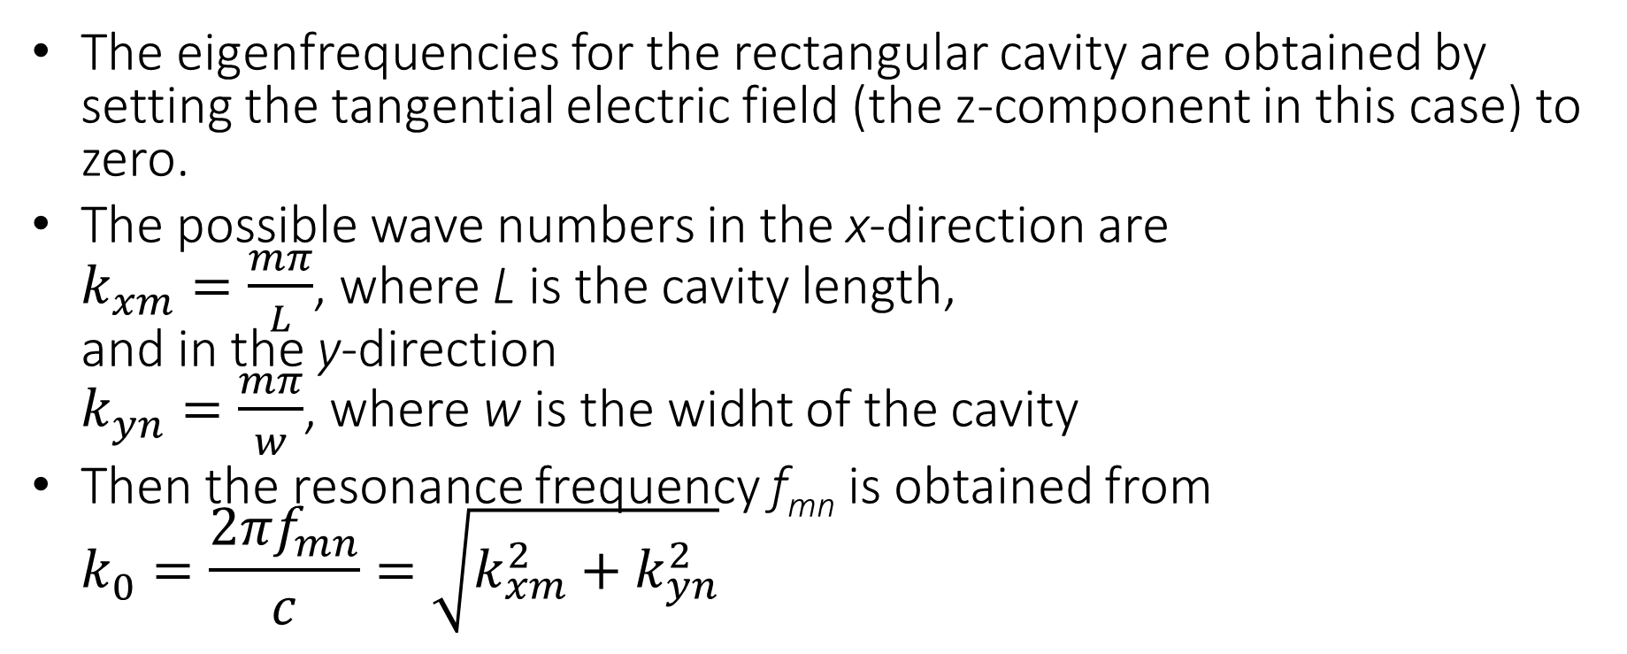
Analytical Comparison
The eigenfrequencies for the rectangular cavity are obtained by setting the tangential electric field (the z-component in this case) to zero.
The possible wave numbers in the x-direction are
$k_{xm}=\frac{mπ}{L}$, where L is the cavity length,
and in the y-direction
$k_{yn}=\frac{mπ}{w}$, where w is the widht of the cavity
Then the resonance frequency f_{mn} is obtained from
$k_{0}^{}=\frac{2πf_{mn}}{c}=\sqrt{k_{xm}^{2}+k_{yn}^{2}}$

