Slide 1
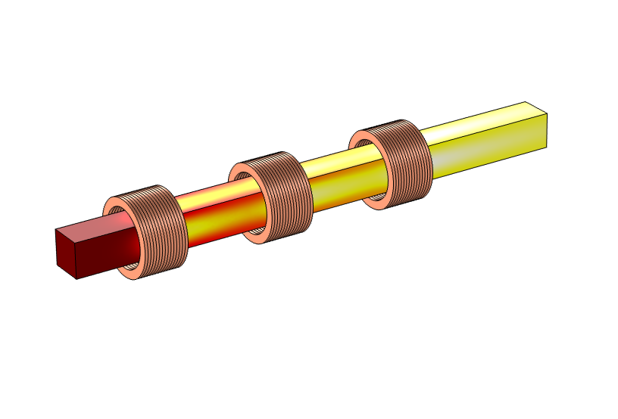
Demo: Induction Heating
A steel billet travels through three 10.000-turn coils
AC current through the coils creates alternating
magnetic fields
The magnetic fields induce eddy currents in the billet, heating it up
Compute power consumption, temperature distribution
I₃ = 30 A
I₂ = 30 A
I₁ = 40 A
T_{out} = ?
v = 0.04 m/s
T_{in} = 20°C
Notes:
Heating of a steel billet. Conveyed at 4 cm/s through 3 coils. The billet should be heated up so that it can be worked and deformed to a required thickness. This is accomplished by feeding the coils with an alternating current. The currents in the coils produce an alternating magnetic field, which in turn induces eddy currents in the steel billet. The eddy currents heat upp the billets due to losses in the material. In the application you usually want a high temperature, but also an evenly distributed heating. The model shows how high the temoerature gets and also the required electrical power.

