Slide 1
Example:
Porous Reactor

Slide 2
Introduction
This model shows the flow field in an experimental reactor for studies of heterogeneous catalysis.
The model couples the free fluid and porous media flow through the Navier-Stokes equations and Brinkman’s extension of Darcy’s law.
The mass transport of three species in the reactor is modeled through the diffusion and convection equation.

Slide 3
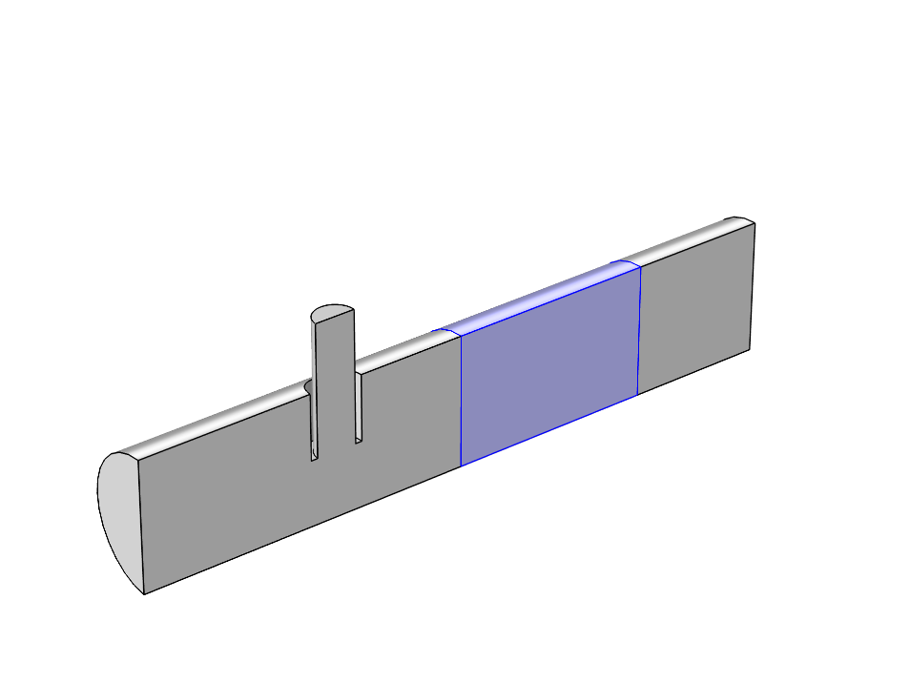
Geometry
The reactor consists of a tubular structure with an injection tube that has its main axis perpendicular to the axis of
the reactor.
The incoming species in the main and injection tubes reacts in a fixed porous catalyst bed.
Outlet A, B, C
Inlet species A
Production of C in pourous bed
Inlet species B

Slide 4
Domain Equations – Fluid Flow
The fluid flow in the free flow regions are described by the stationary
Navier-Stokes equations.
The fluid flow in the porous bed is described with Brinkman equations.
In the above equations h denotes the viscosity, r the density, and k
the permeability.

Slide 5
Domain Equations – Mass Transport
The mass transport is given by the diffusion and convection equation:
where c_{i} denotes the concentration of species i, u the velocity vector and R_{i} the reaction rate for species i.

Slide 6

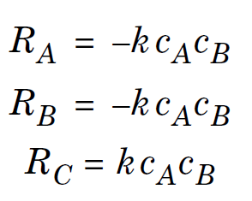
Reaction in Porous Material
Irreversible reaction gives according to mass action law the rates (mol/m3, s).

Slide 7
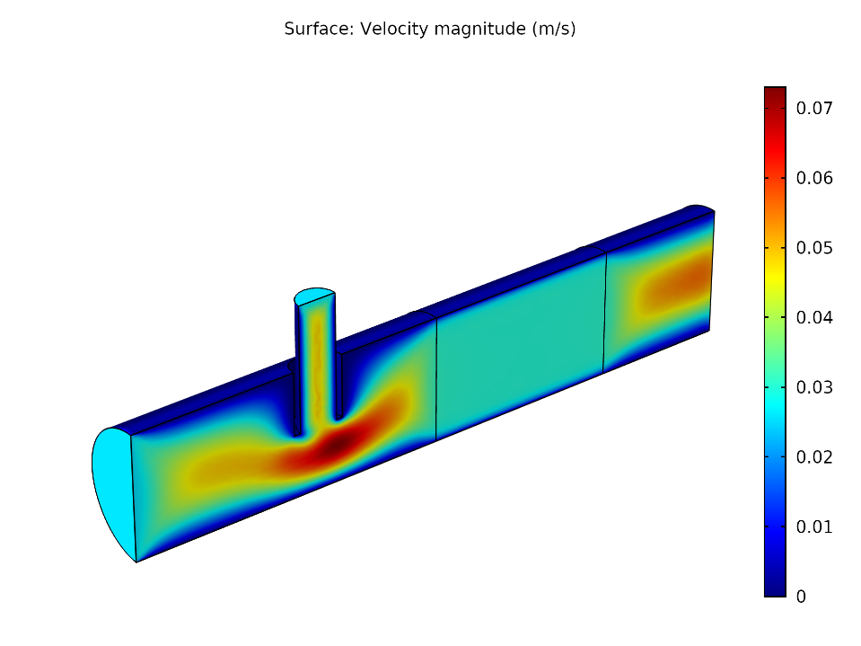
Results – Velocity Magnitude
The figure shows the flowlines of the velocity field and slices of the norm of the velocity field.
The flow is almost homogenized in the porous part of the reactor.

Slide 8
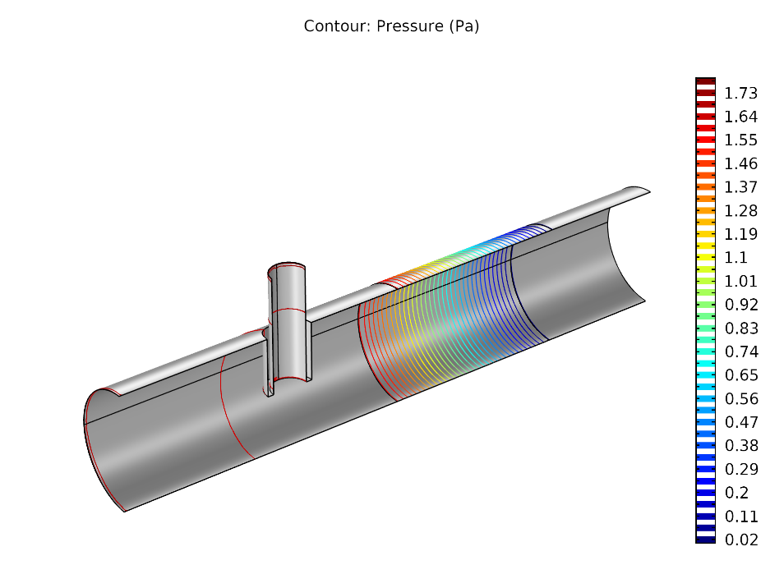
Results – Pressure
The figure shows the pressure in
the reactor.
The pressure dropp is mainly in the
porous bed.

Slide 9
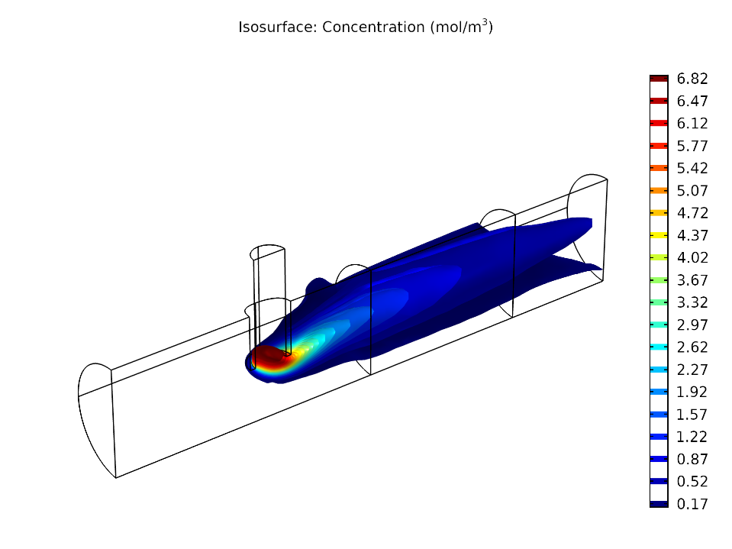
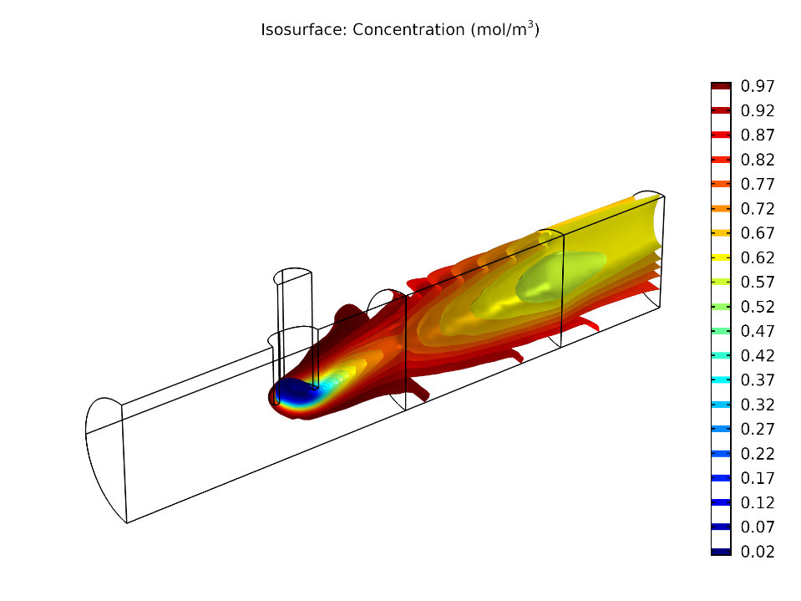
Results – Concentration
Concentration species A (mol/m³)
Concentration species B (mol/m³)

Slide 10
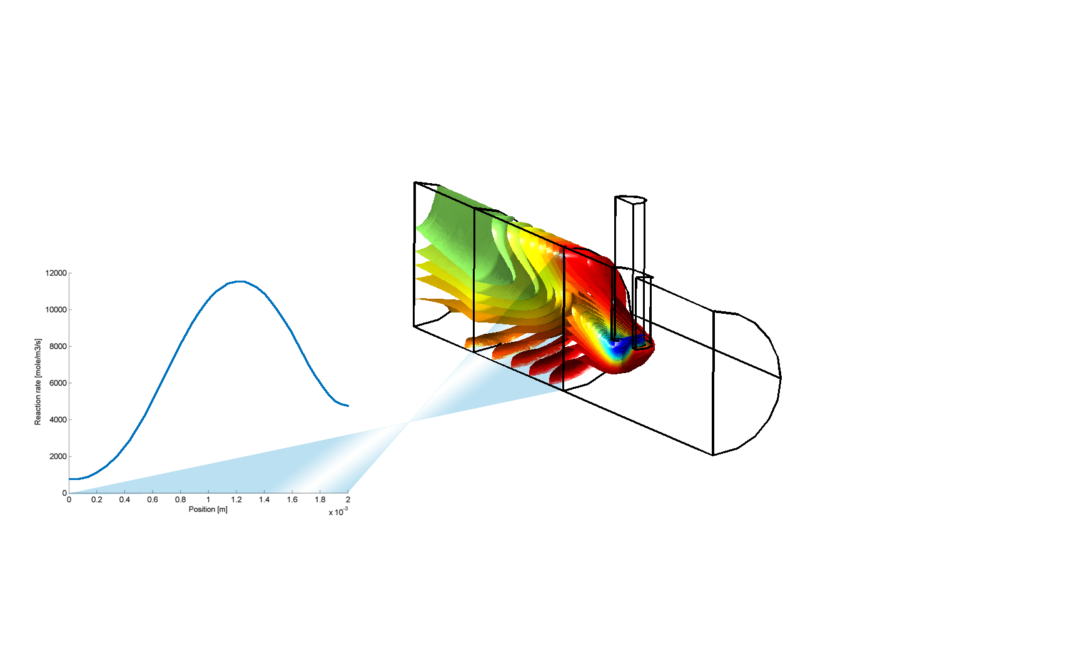
Results – Concentration
The figure shows the
iso-concentration surfaces of a species injected through the main channel into the core of the reactor.
This species is consumed in the porous bed and the reaction distribution at the inlet of the bed is shown in a cross-section plot.
The reaction is not uniformly distributed in the catalytic bed and has its maximum close to the radial position of the injection pipe.

