Slide 1
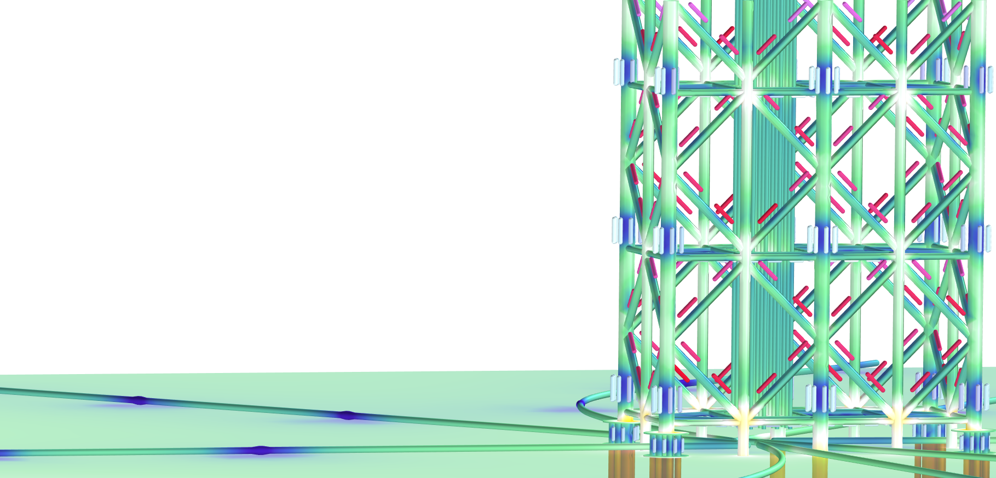
Cathodic Protection of an
Oil Platform Jacket

Slide 2
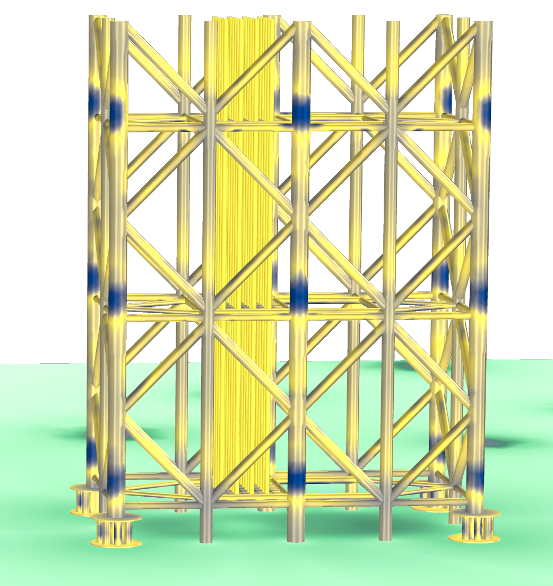
Purpose: Model of a Corrosion Protection System
Full scale oil rig geometry
Oil rig metal structure cathodically protected using sacrificial anodes
No external power source
The model can be used for:
  Positioning the anodes to protect the metal structure
  Estimate buildup of calcareous deposits that affect the cathodic current density over time
  Estimate the life of the sacrificial anodes
Calcareous deposits on a jacket structure. Note the location with the thickest deposit close to the sacrificial anodes (blue) and the more uniform layer (yellow) throughout the structure.

Slide 3
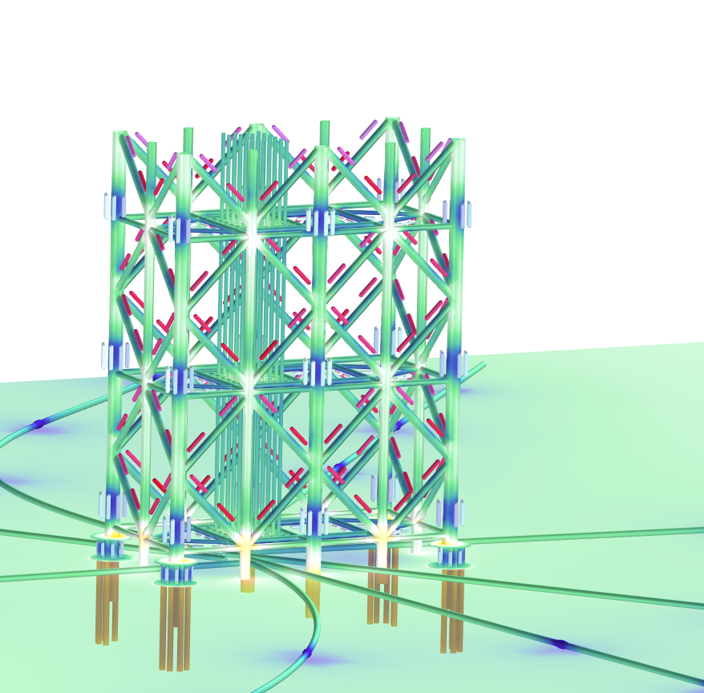
Problem Definition
Time-dependent analysis
Uniform composition and temperature in seawater
Linearized Butler–Volmer kinetics on anode and cathode
Current density at the cathode, accounting for calcareous deposit thickness
Equations at the cathodes keep track of the calcareous layer thickness.
Sacrificial anodes that deplete over time

Slide 4
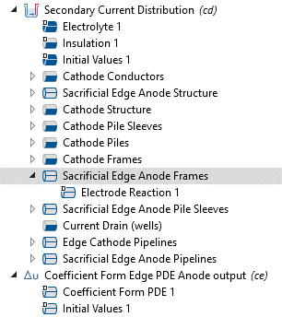
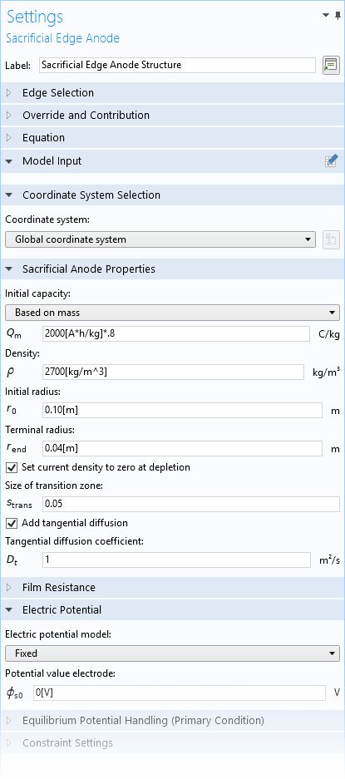
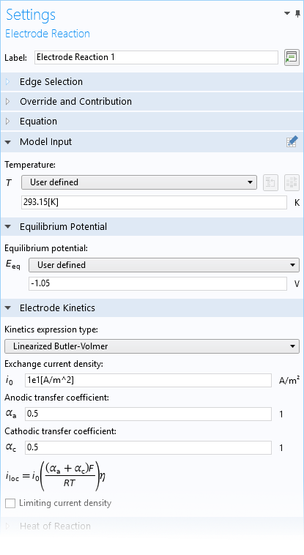
Sacrificial Anodes
Geometrical description:
  Cylinders modeled as edges with a time-dependent radius
Initial anode capacity:
  Based on mass of the Al anodes
  20% of the mass remains when the anodes are exchanged.
Kinetics at the anode:
  Linearized Butler–Volmer for anodic Al dissolution
Anode capacity with 80% utilization factor
Tangential diffusivity set to 1 for increased speed: Capacity is equal along length of anode
Linearized Butler–Volmer kinetics expression

Slide 5
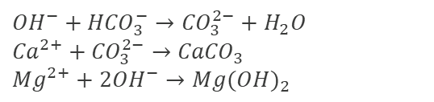
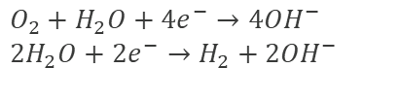
Background on Deposited Species
Reaction mechanism at the cathode:
Increased pH leads to precipitation. Most important reactions being:
Deposits lead to a slower diffusion rate of oxygen towards the surface which limits the oxygen reduction current density.
$$O_{2}+H_{2}O+4e^{−}→4{OH}^{−}$$
$$2H_{2}O+2e^{−}→H_{2}+2{OH}^{−}$$
$${OH}^{−}+{HCO}_{3}^{−}→{CO}_{3}^{2−}+H_{2}O$$
$${Ca}^{2+}+{CO}_{3}^{2−}→{CaCO}_{3}$$
$$Mg^{2+}+2{OH}^{−}→{Mg(OH)}_{2}$$
Reference: Yang et al., A Study of Calcareous Deposits on Cathodically Protected Mild Steel in Artificial Seawater Metals 2015, 5, 439-456

Slide 6
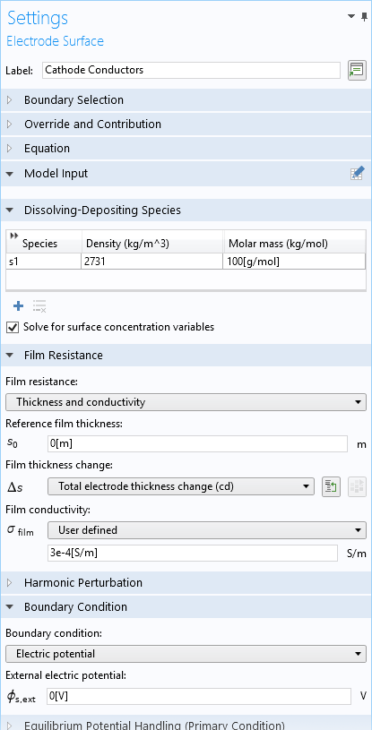
Electrode Surface, Deposited Species
Specify density and molar mass.
Check “Solve for surface concentration variables”.
Select film thickness and film conductivity.

Slide 7
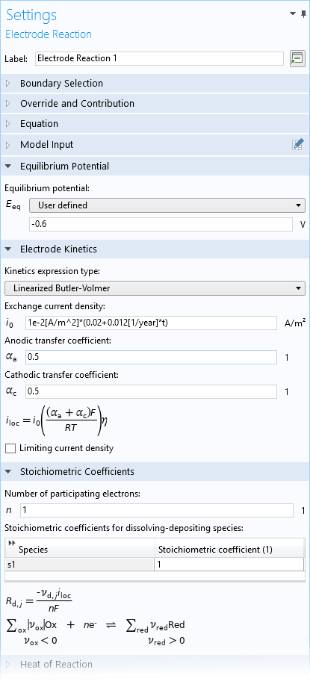
Electrode Reaction and Stoichiometry
Common mixed cathode equilibrium potential for
steel in seawater
Calibrate exchange current density to achieve desired current density over time.
Stoichiometric coefficients for precipitated species

Slide 8
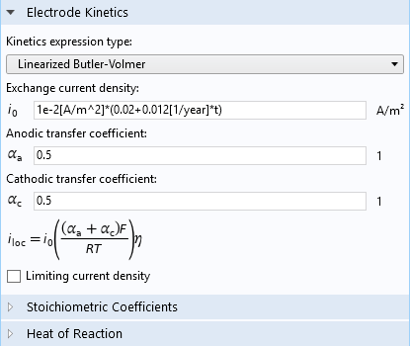
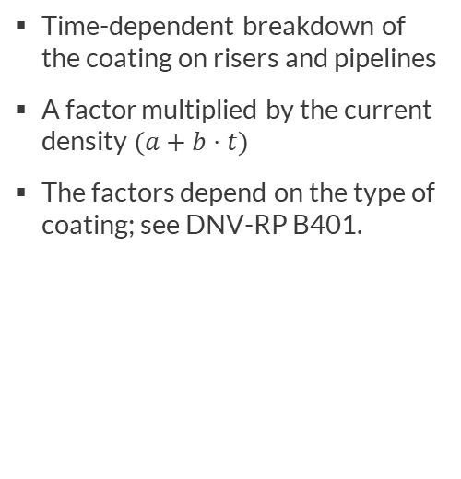
Coating Breakdown
Time-dependent breakdown of the coating on risers and pipelines
A factor multiplied by the current density $(a+b⋅t)$
The factors depend on the type of coating; see DNV-RP B401.

Slide 9
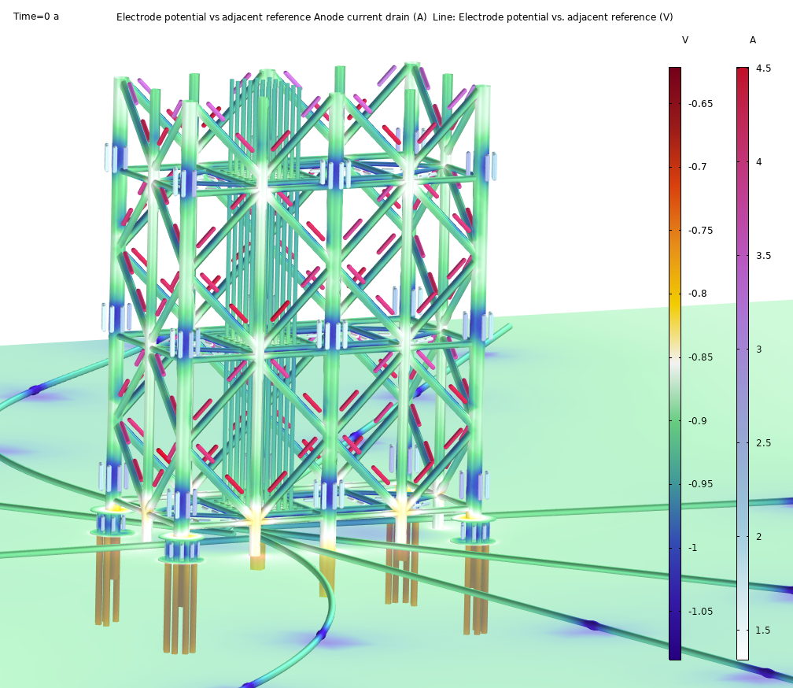
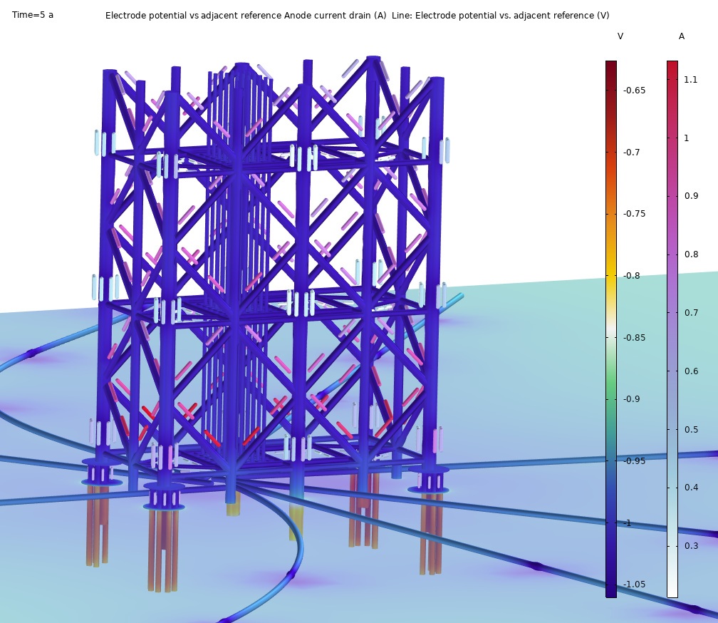
Surface Potential and Anode Output
Potential and anode output at t=0 years, before “polarization” of the structure.
Potential and anode output at t=5 years, a well “polarized” structure.
Notes:
Polarization is a term that is used by the community when they are talking about how calcareous deposits form and thus limits the oxygen diffusion towards the surface. This puts a moving limit on the oxygen dissolution-reaction current as function of time. May start at 400-500 mA/m^2 and move towards 20mA/m^2, or even lower, within 10-20 years.

Slide 10
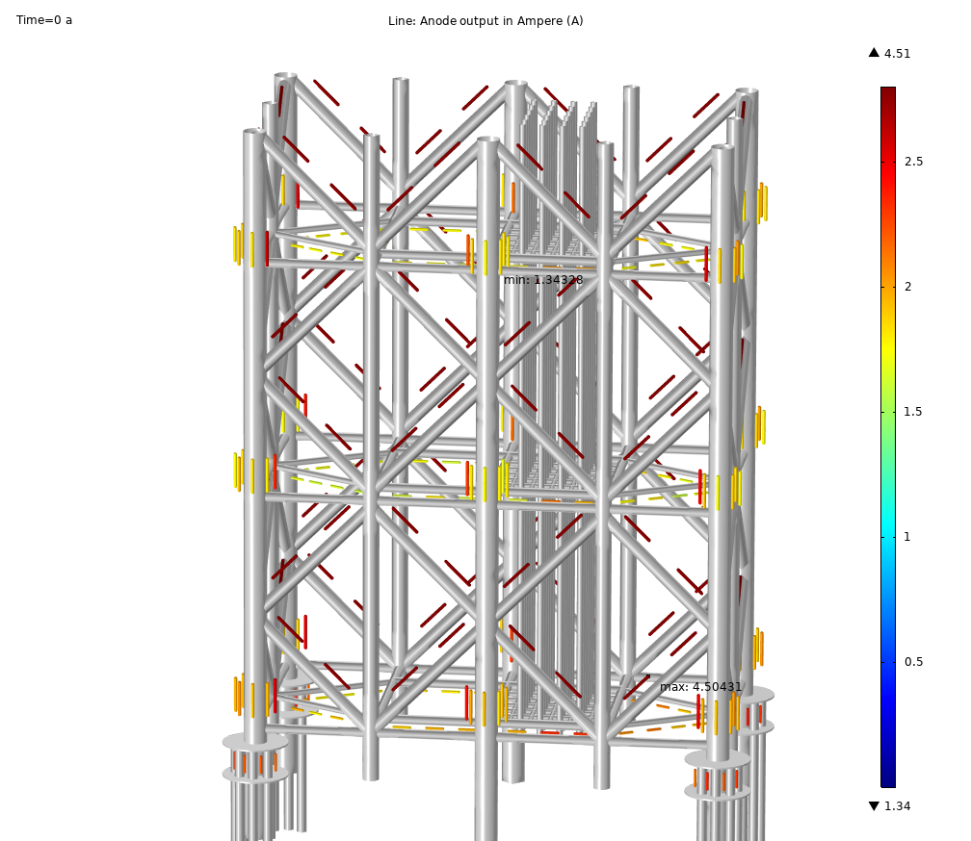
Anode output
Initial anode output in ampere for each anode, t=0 years

Slide 11
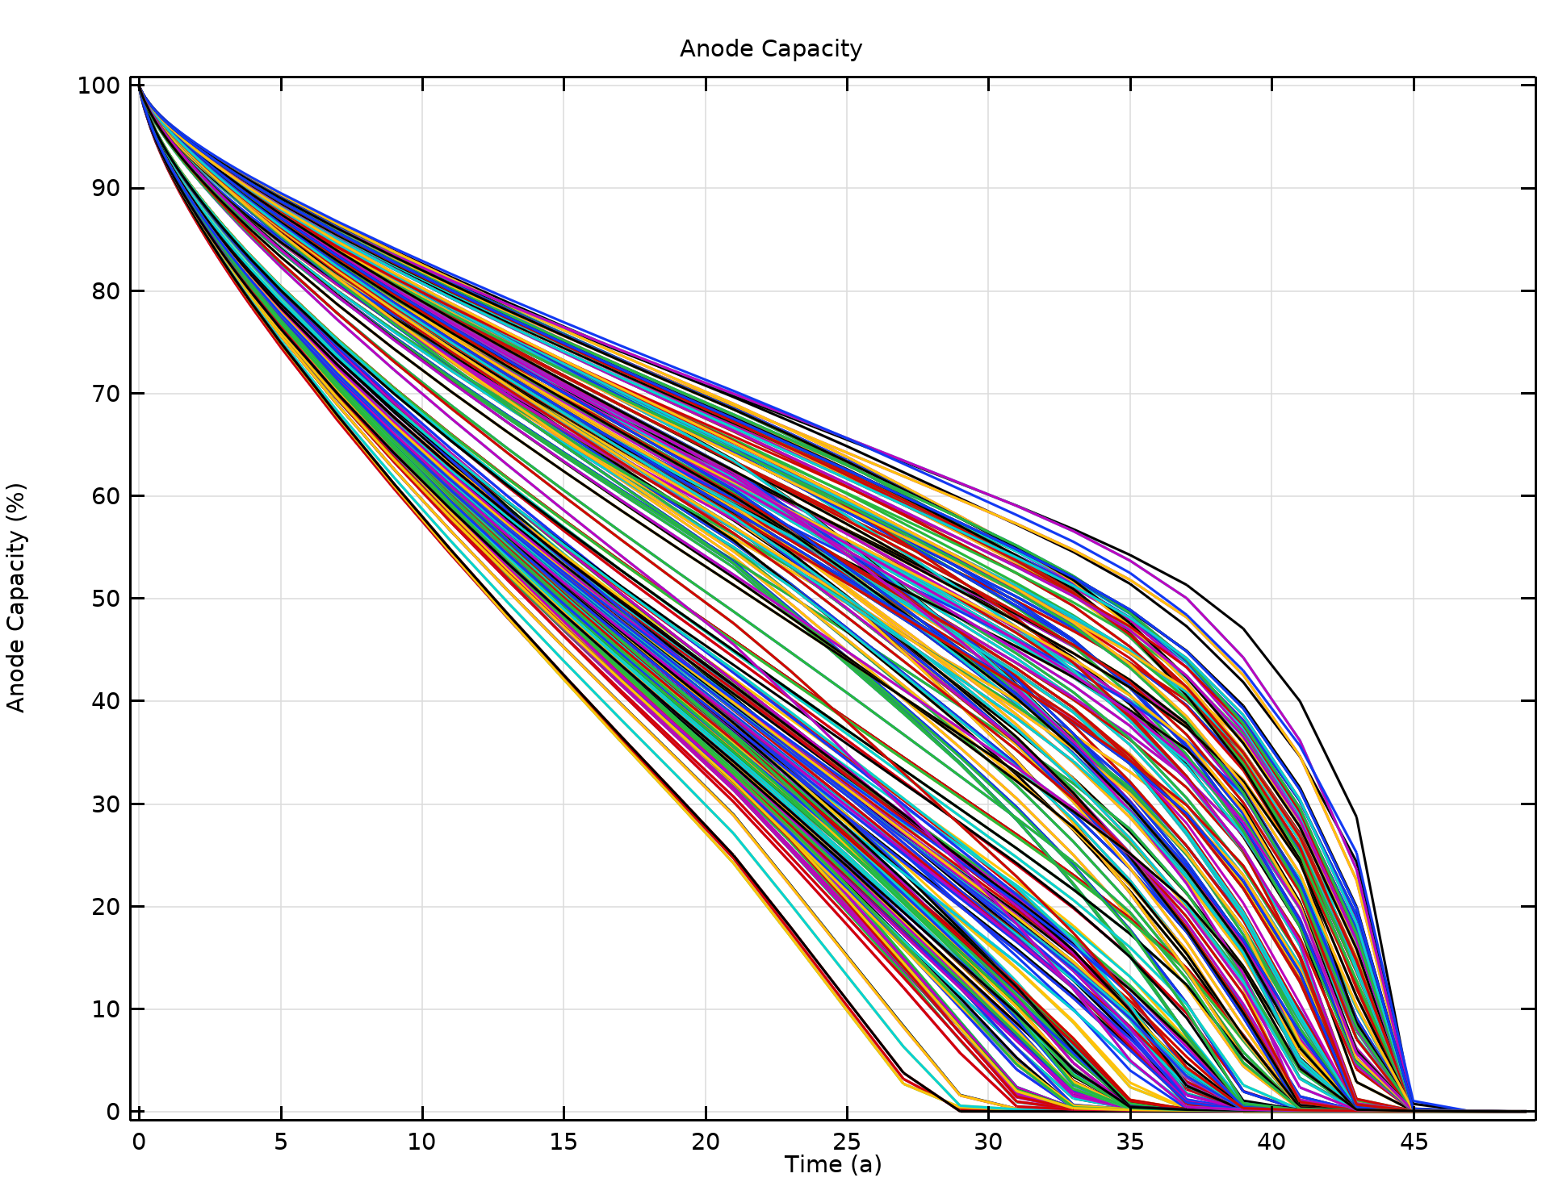
Anode Capacity
Anode capacity for all anodes as function of time. Note that all the anodes are consumed at approximately 45 years.

Slide 12
Extra slides

Slide 13
Using Diffusion for Integrating Over an Entity
Increasing diffusion coefficient
Input along line
Average of input along line

Slide 14
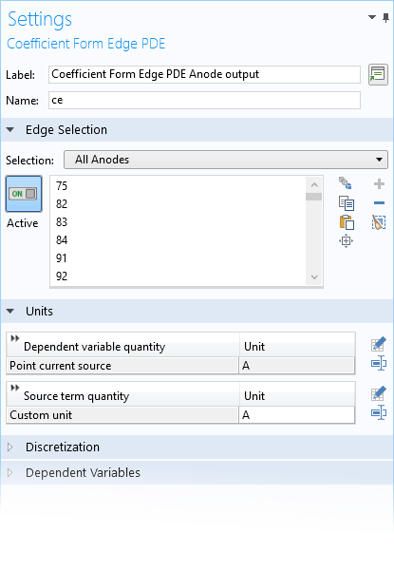
Computing Anode Output
For postprocessing purposes
Add a diffusion equation on the anode edges to smooth out the current density.
Current output will become a uniform quantity along the anodes for each time step.

Slide 15
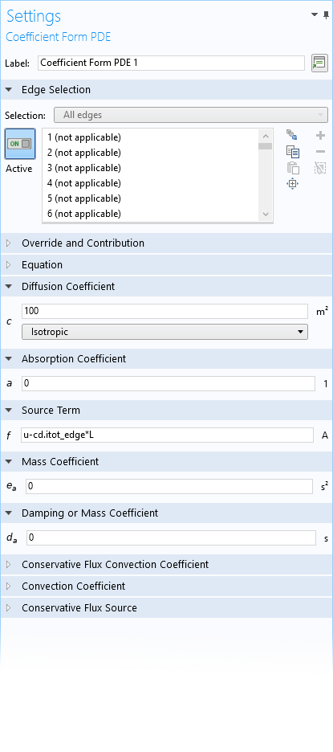
Computing Anode Output
Large diffusion coefficient
Set source term.
Set all other coefficients to 0.
Multiply with length, L, of anode to get total output.

