Slide 1
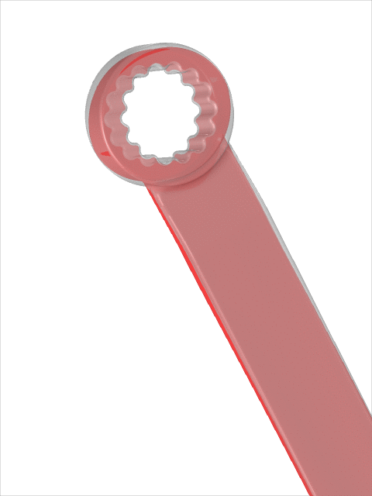
Shape Optimization of a Wrench

Slide 2
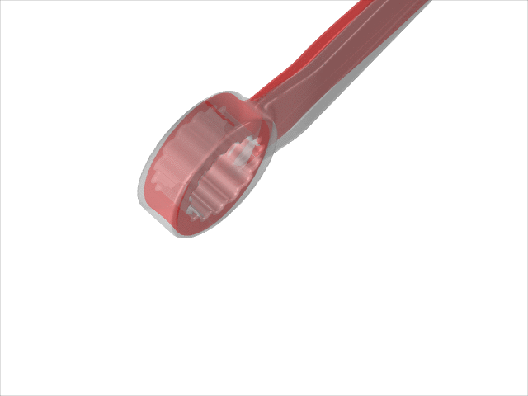
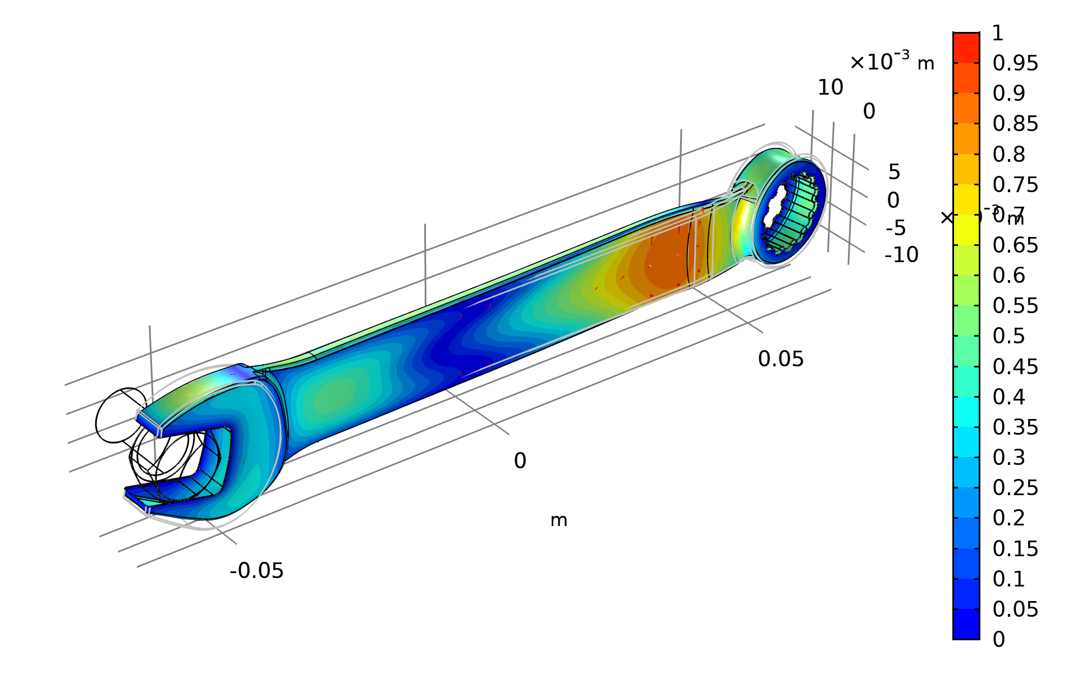
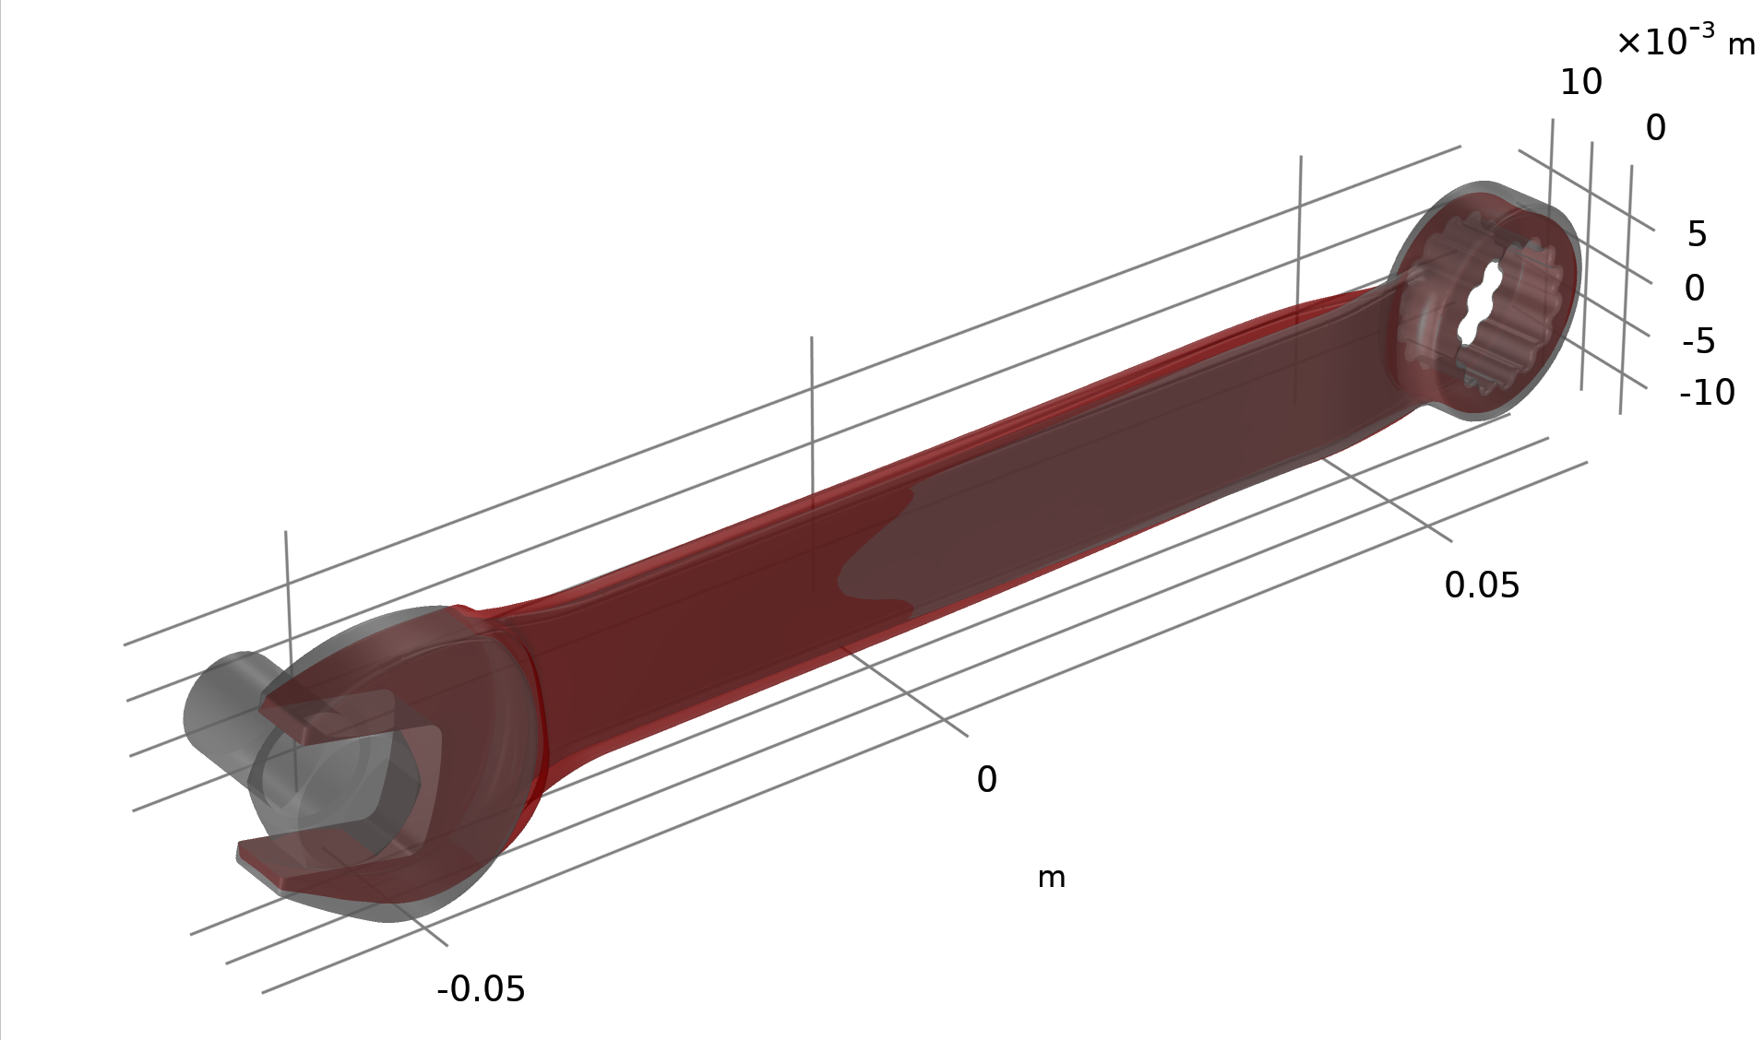
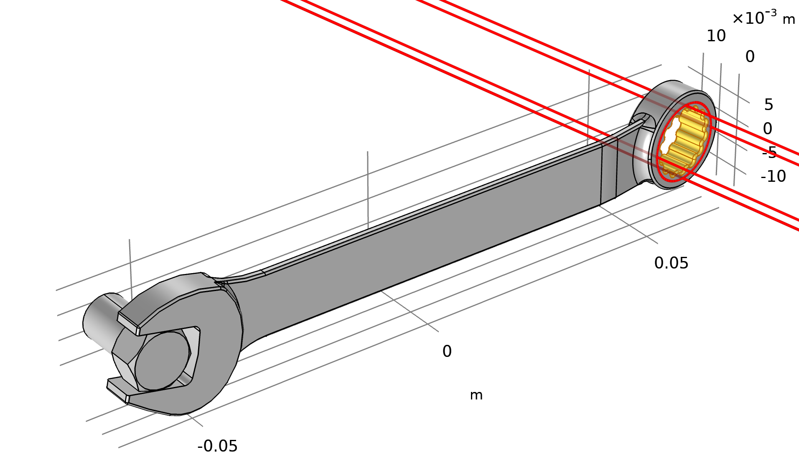


Shape Optimization of a Wrench
Introduction
Shape optimization can be used to improve the performance of a product by changing its shape.
This model optimizes the stiffness of a wrench, without increasing the mass.
The Free Shape Boundary feature is used to regularize the shape deformation.
The optimization removes material around head and the handle. It also straightens out the kink near the handle.
Visualization of the 3D deformation can be more clear with transparency enabled.
$$d={R_{min}^{2}∇_{∥}}^{2}d+c$$
$, −d_{max}≤c_{i}≤$ $d_{max}$
Shape Optimization of a Wrench
Notes:
Shape optimization can be used to improve the performance of product by changing its shape.
This model optimized the stiffness of a wrench, without increasing the mass. The figure shows on of the cylinder selection used to define the fixed boundaries.
The Free Shape Boundary feature is used to regularize the shape deformation. The control displacement field (c) is put through a filter to prevent large slopes in the deformation. The control displacement filter is a vector variable, so each point the boundary cannot move outside a box with a side length twice the maximum displacement. The maximum slope is related to the maximum displacement (d_max) divded by the filter radius (R_min), so if one encounters NaN/Inf error messages due to inverted elements, it is a good idea to decrease the maximum displacement or increase the filter radius.
The optimization removes material around head and the handle. It also straightens out the kink near the handle. The plot shows the relative normal boundary displacement, which is the displacement in the normal direction relative to the maximum displacement in that direction. The actual displacement field is plotted in red arrows, but they can be small and inside the structure.
Therefore visualization of the 3D deformation can be easier with transparency enabled.
The zoom up more clearly show the deformation of the kink near the handle. The original geometry is plotted in gray together with the optimized geometry in red.

