Slide 1
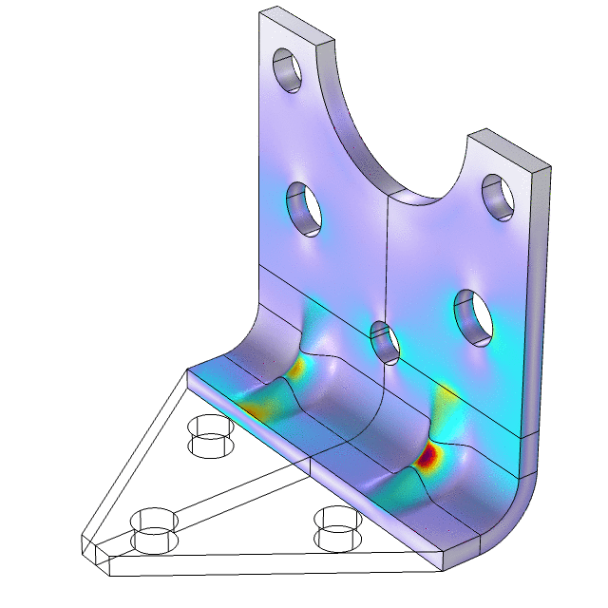
Multistudy Optimization of a Bracket

Slide 2
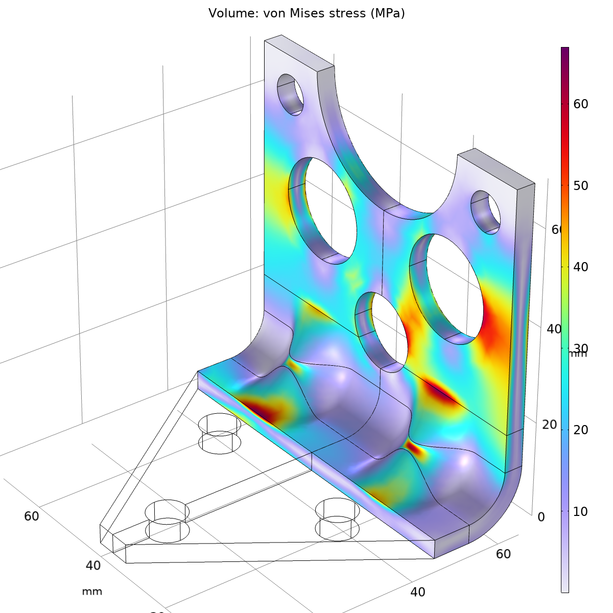
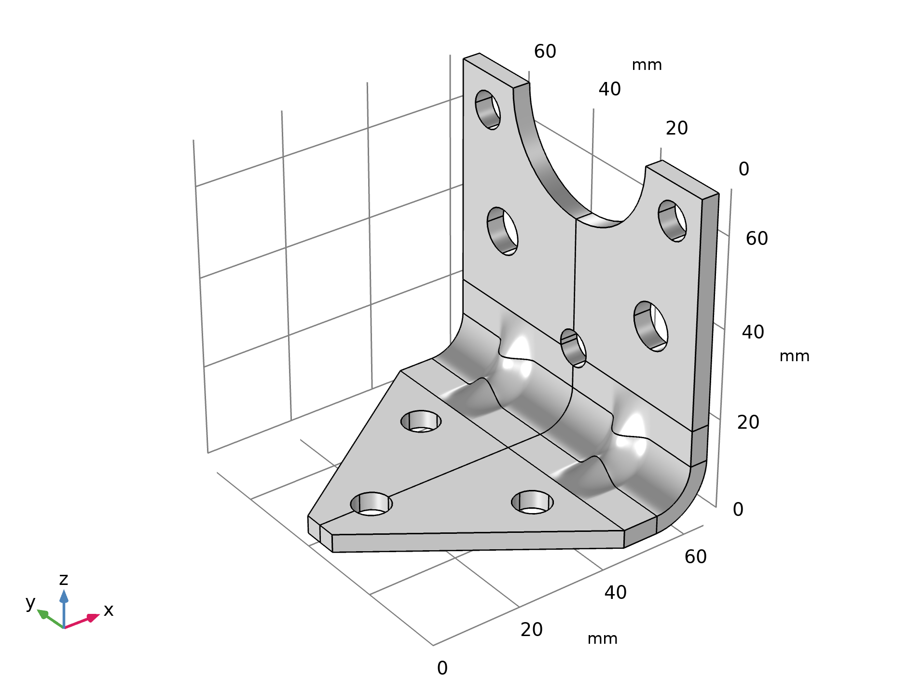
Multistudy Optimization of a Bracket
Problem definition
Vary 6 geometrical parameters
Minimize mass
Constrain
  Maximum stress
  Lowest eigenfrequency
  Topology
comsol.com/model/19761

