Slide 1
Three Different Configurations of 1D Photonic Crystal

Slide 2
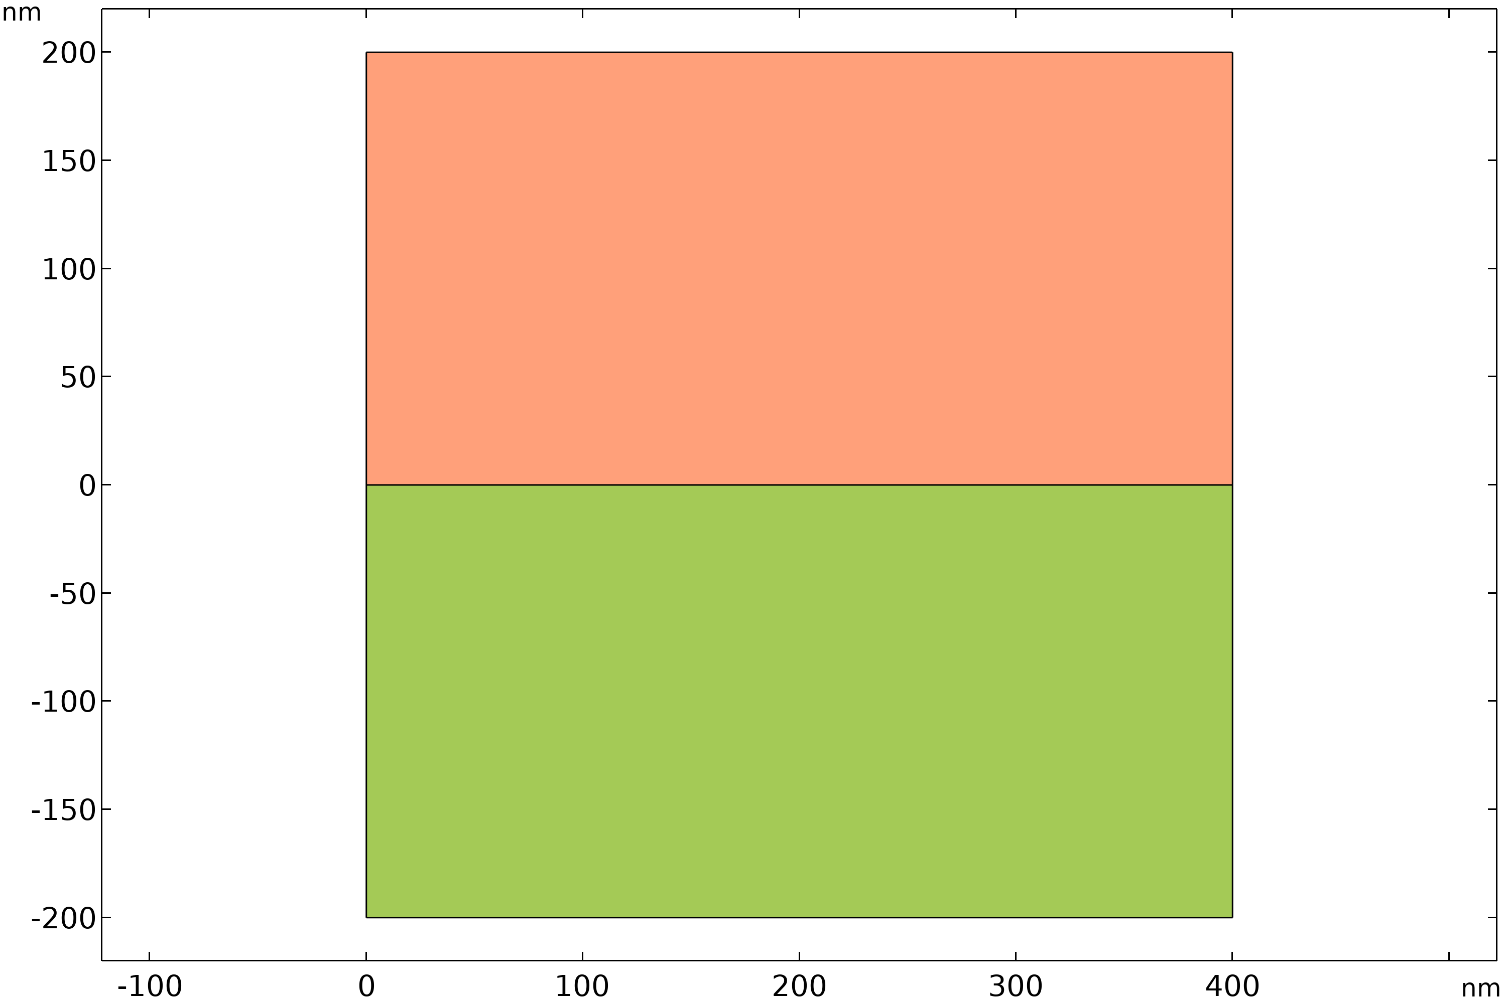
Model setup
Three different configurations of 1D photonic crystal are modeled as following:
Configuration 1:
  eps1 = 13
  eps2 = 13
Configuration 2:
  eps1 = 13
  eps2 = 12
Configuration 3:
  eps1 = 13
  eps 2= 1
The Floquet periodic condition is applied to the outer boundaries in y-direction to model a 1D photonic crystal repeating in y-direction.
The continuity periodic condition is applied to the outer boundaries in x-direction to model the material till infinity in ± x-direction.
Material 1 (eps1)
Material 2 (eps1)
Reference:
[1] J.D. Joannopoulus, R.D. Meade, and J.N. Winn, Photonic Crystals (Modeling the Flow of Light), Princeton University Press, 2008.

Slide 3
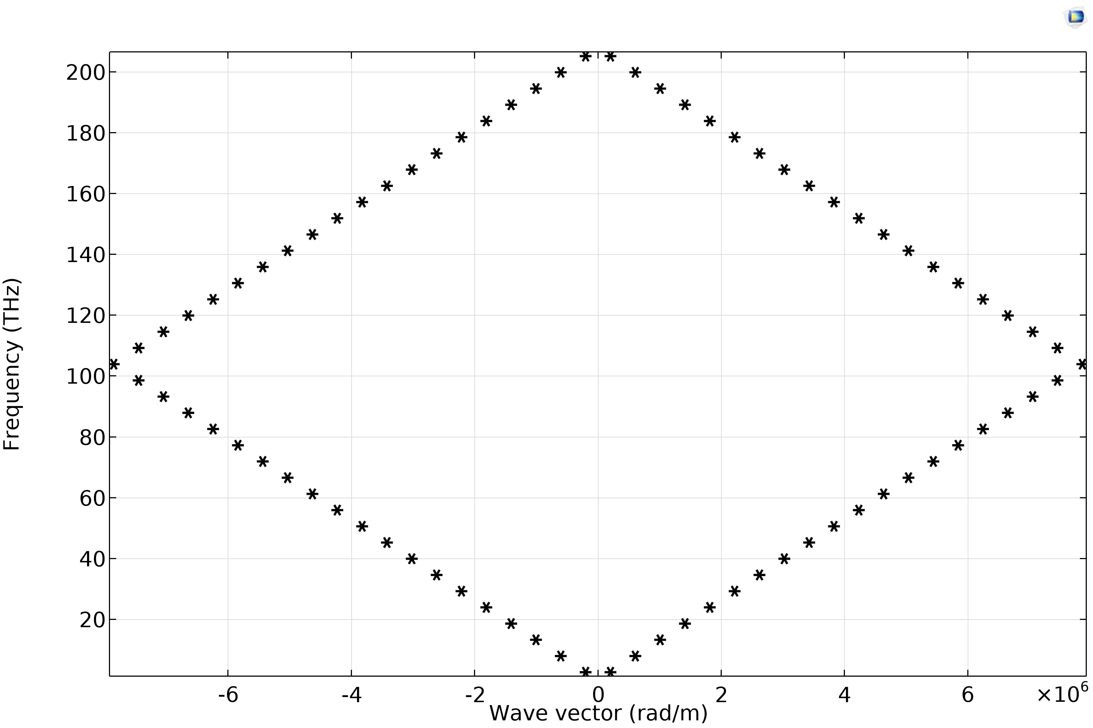
Configuration 1
Dispersion relation for configuration 1

Slide 4
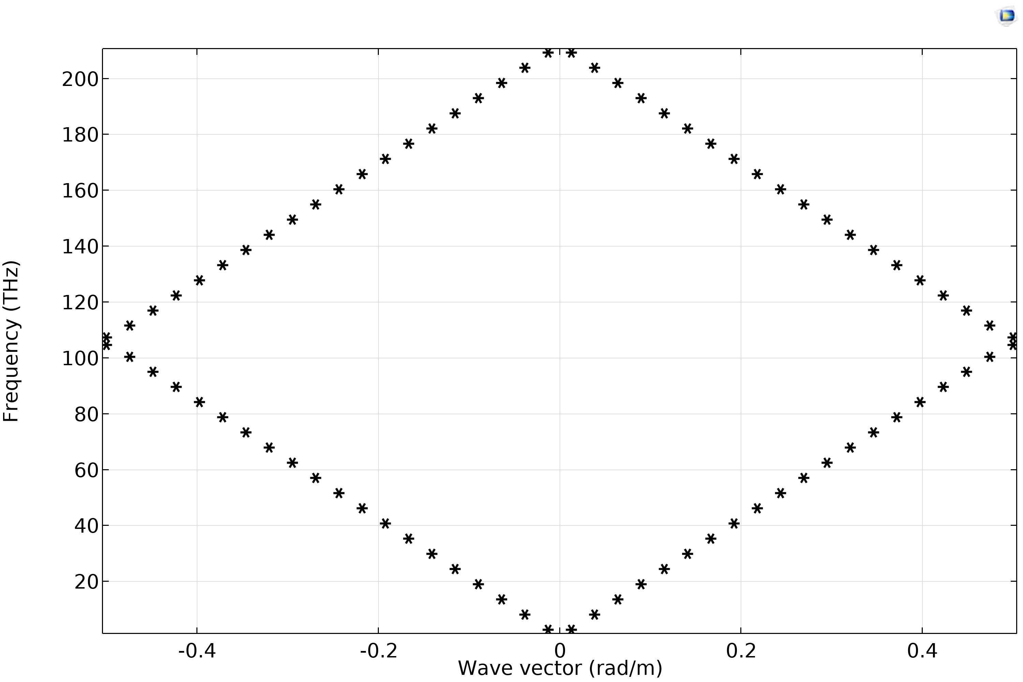
Configuration 2
Dispersion relation for configuration 2

Slide 5
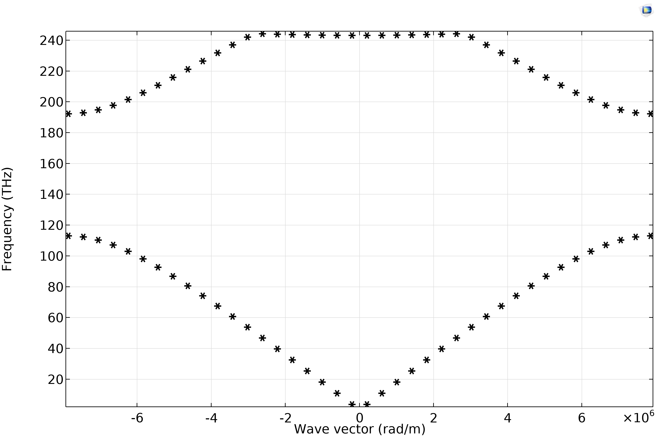
Configuration 3
Dispersion relation for configuration 3

